Slide 1
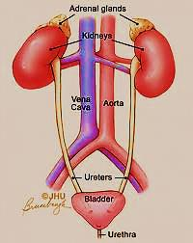
The Urinary System The Third Year

Slide 2
The urinary system consists of:
2 kidneys (Filtrate blood )
2 ureters
Urinary bladder
Urethra
Function:
Removing waste & water from body
Reabsorption of vital nutrients
Maintain acid /base balance
Help in control blood pressure
Help in produce red blood cells (EPO Hormone)
Produce Calcitriol (Vit. D) regulate Ca⁺ → healthy bones

Slide 3
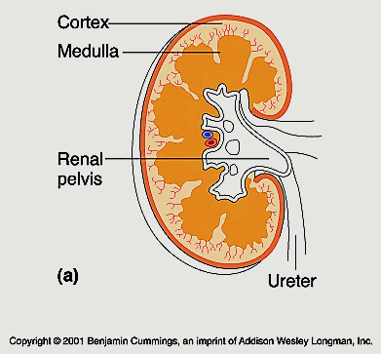
Kidneys
structure of the Kidney:
Stroma : capsule
Parenchyma:
Cortex ( outer part)
Medulla (inner part)
capsule

Slide 4
Nephron
is the microscopic structural and functional unit of the kidney that perform filtration of blood

Slide 5
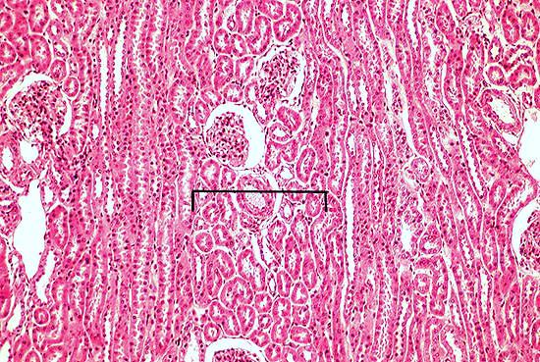
Renal corpuscles
Medullary rays
Medullary rays
Cortical labyrinth

Slide 6
Cortex: contains
Cortical labyrinth + medullary rays + renal columns
Cortical labyrinth: contains renal corpuscles and convoluted tubules.
Medullary rays: are regions where parallel arrays of straight potions of loop of Henle’s + collecting ducts travel perpendicular with the capsule (extend from the cortex to the medulla).
A band of cortical labyrinth separates the medullary rays. Each medullary ray with 1/2 of the adjacent cortical labyrinth on either side is a lobule.

Slide 7
Renal lobule defined within cortex
The tissue between 2 interlobular arteries is defined as lobule.
Interlobular arteries bisect Labyrinth.
Thus a lobule consists of ½ of labyrinth on one side of medullary ray & ½ of labyrinth on the other side . Nephrons of that lobule drain in a single collecting duct

Slide 8
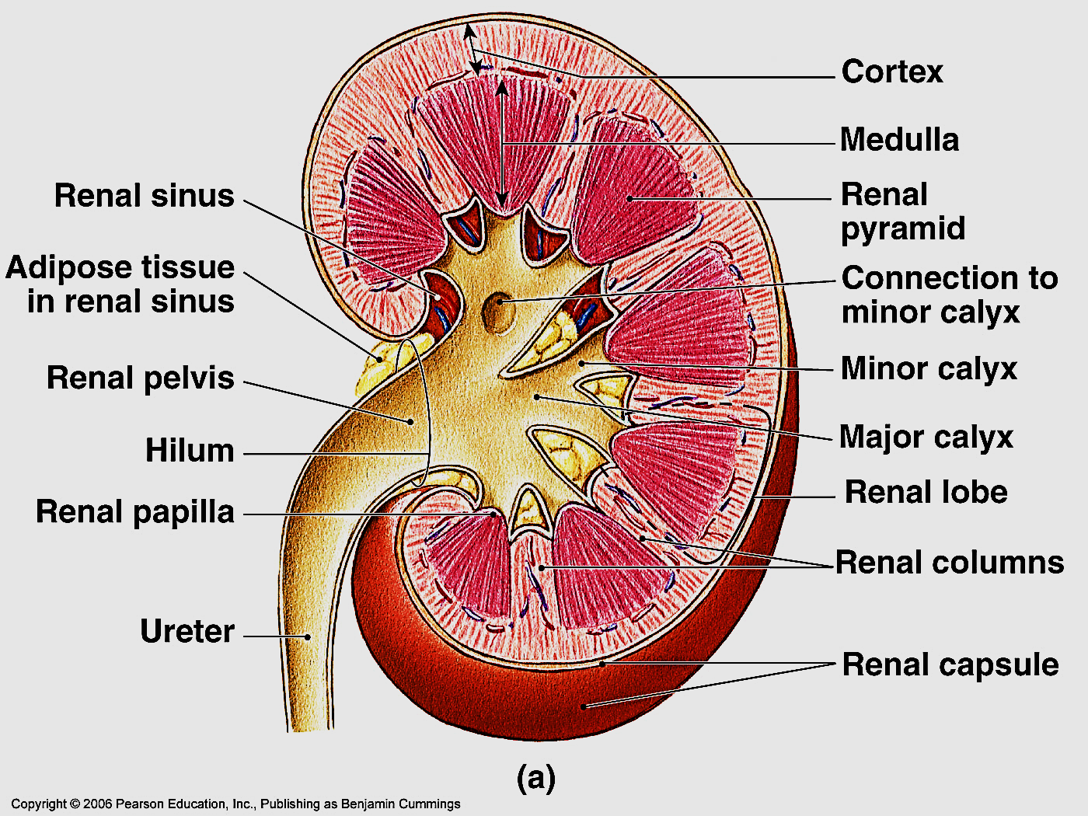
The medulla : consists of 8- 15
conical structures called
renal pyramids
The renal pyramids separated
by cortical C.T. extensions called
renal columns (Bertin columns)
contain BV & renal tubules
Each medullary pyramid +
the cortical tissue at its base &
along its sides form a renal lobe

Slide 9
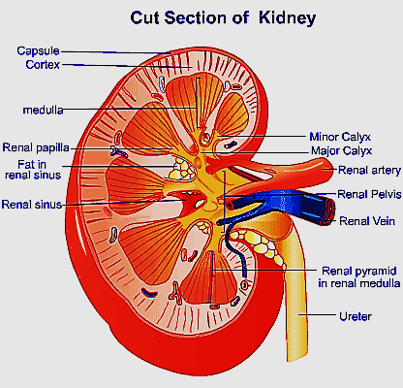
The apex of each pyramid is called renal papillae
The renal papillae
projects into a minor calyx
3-4 minor calyces join to
form a major calyx, which
empty into renal pelvis

Slide 11
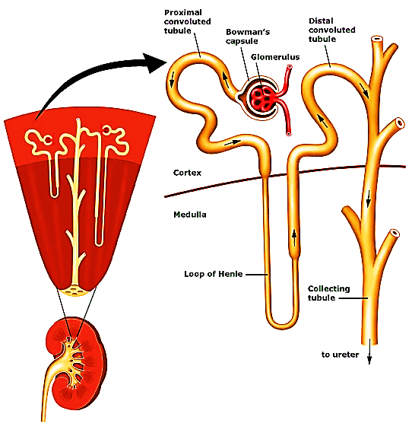
The uriniferous tubule
Consists of 2 parts: nephron + collecting duct
1- Nephron : the structural & functional unit of the
kidney that filter blood → which produce urine
2- Collecting duct: concentrate
& carries urine → to minor calyx
Nephron
Collecting duct

Slide 12
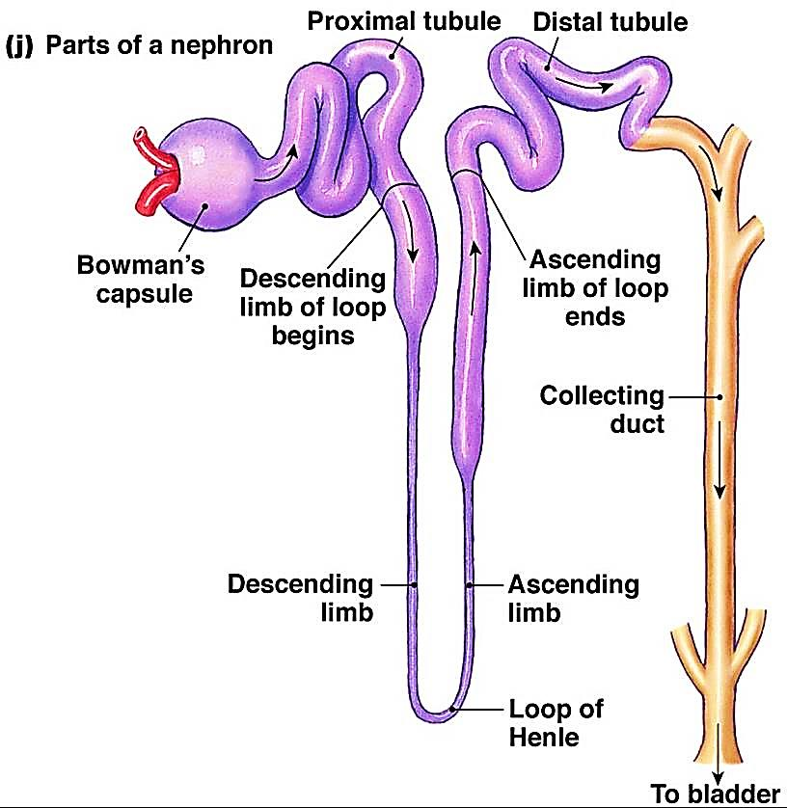
A- The nephron
Each kidney contains 1- 1.4 million nephrons
Each nephron consists of:
1- Renal ( malpigian) corpuscle
2- Proximal convoluted tubule (PCT)
3- Loop of Henle
4- Distal convoluted tubule (DCT)

Slide 13
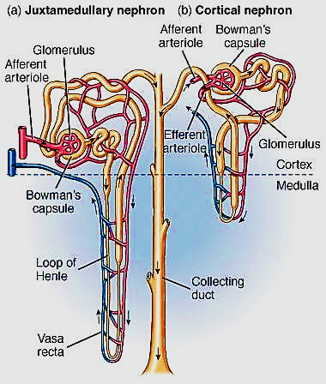
Classification of nephrons:
Cortical nephrons: 85%, short loop of Henle, extend close to cortico-medullary junction
Juxta-medullary nephron: has long Loop of Henle, extend
deep in the medulla
They are responsible for setting
up medullary osmotic gradient
→ production of concentrated
hypertonic urine

Slide 14
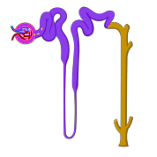
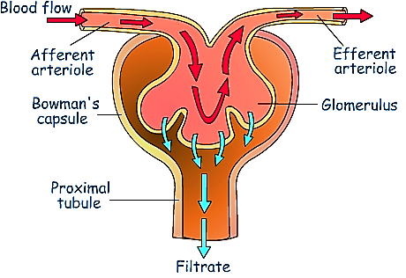
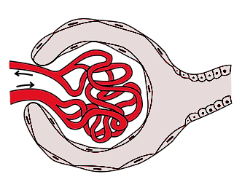
Renal (Malpigian) corpuscle
Renal corpuscle is where blood filtration occurs
it has 2 parts:
urinary & vascular parts
1 - Bowman’s capsule
Double walled chamber has:
Inner/ visceral layer (podocytes)
Outer /parietal layer (simple squamous epithelium)
2- Glomerulus :
Tuft of capillaries, inside the capsule, supplied by afferent arteriole & drained by efferent arteriole
1
2

Slide 15
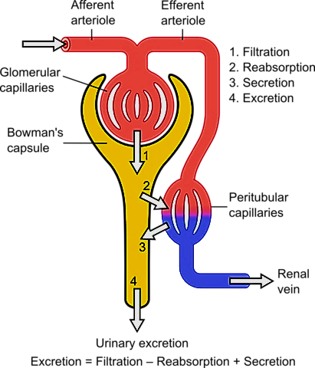
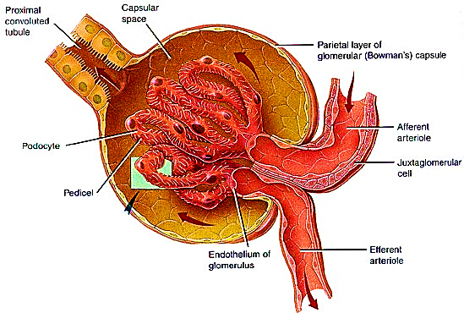
Glomerulus
The prefiltered blood enter the glomerulus through afferent a & filtered blood exit through efferent a.
The afferent arteriole has a thicker media, and larger diameter than the efferent one to create a high glomerular pressure → large quantities of filtrate

Slide 16
The wall of the glomerular capillaries is lined with fenestrated endothelial cells (70 – 100 nm), restrict the passage of blood cells & proteins
with continuous basement membrane formed of type IV collagen (-ve charged) which repel portions (-ve charged) from escaping through ( if Abs attack BM cause damage → glomerulonephritis
Bowman’s capsule visceral layer is lined with special cells called Podocytes
Outer layer lined e simple squamous epithelium

Slide 17
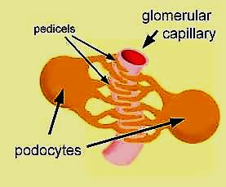
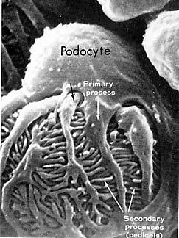
Podocytes
They are flattened cells with several
primary processes
Each 1ry process send numerous
2ry process (pedicles)
Encircle the underlying bl. capillary
2ry process interdigitate with each
other
Forming minute spaces in-between called filtration slits closed by semipermeable diaphragm (10- 40 nm)
they comprise the main filtration barrier in the glomerulus they also express vit D receptors

Slide 18
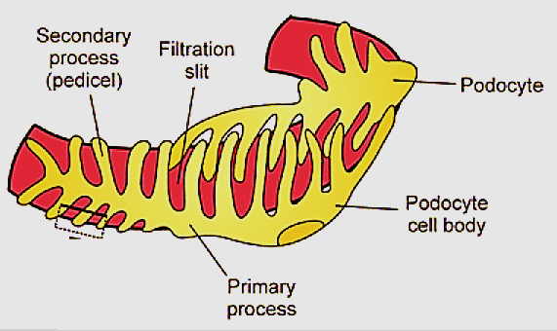
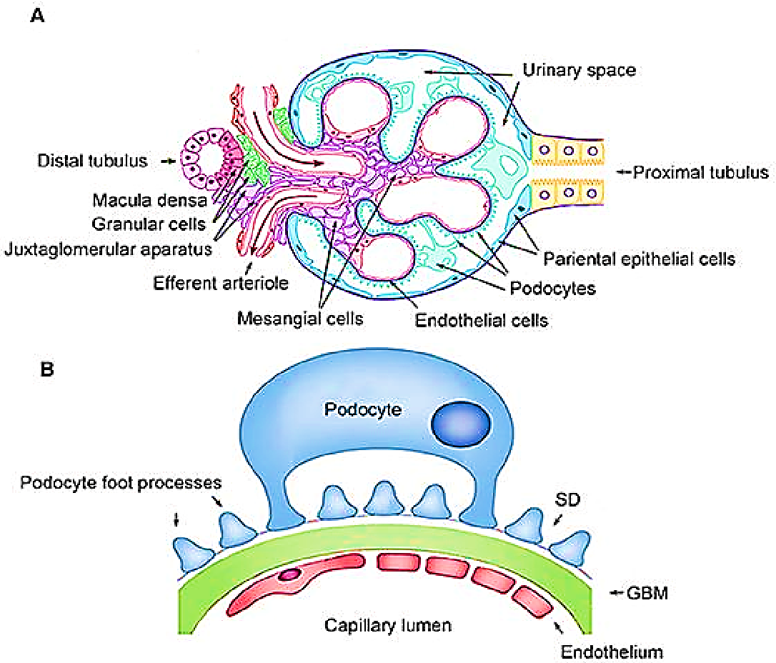
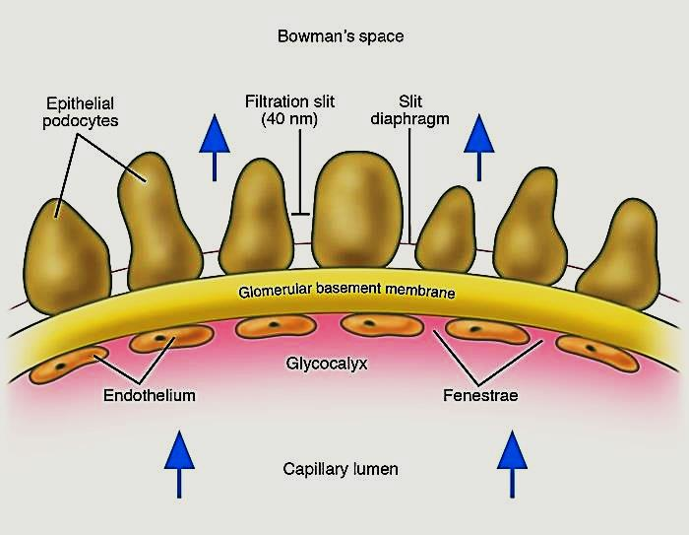
Filtration slits & slit diaphragm

Slide 19
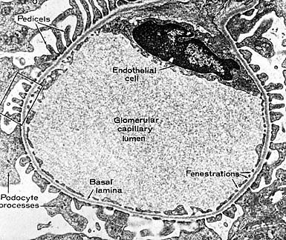
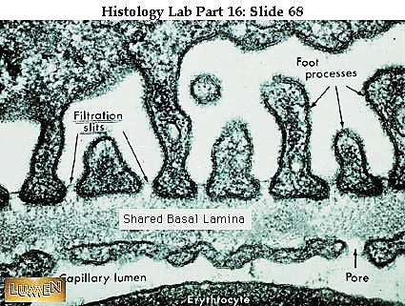
Capillary lumen

Slide 20
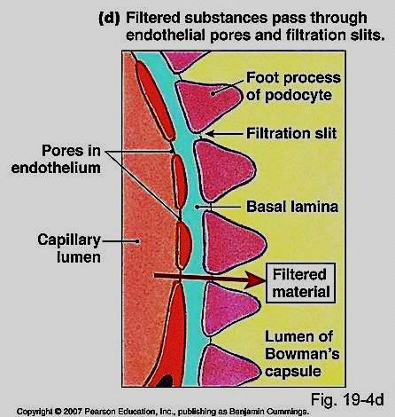
The cytoplasm of Podocytes
contains ↑free ribosomes, rER,
Mitochondria , Golgi, actin
microfilaments (contractility).
Function of podocyte:
1- formation of blood renal barrier
2- Renewal of glomerular basement
membrane (GBM)
???

Slide 21
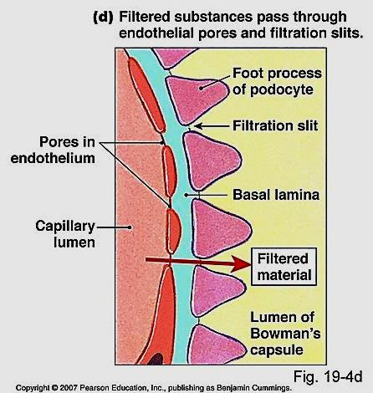
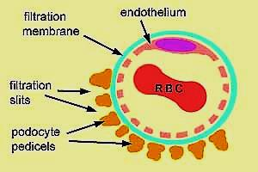
Blood Renal Barrier
Barrier that separate blood inside glomerular capillaries from glomerular filtrate inside Bowman’s space & through which filtration of blood occur
Formed of 3 layers:
1- Glomerular endothelium (fenestrated)
2- Basement m. (continuous & -ve charged )
3- Filtration slit diaphragms

Slide 22
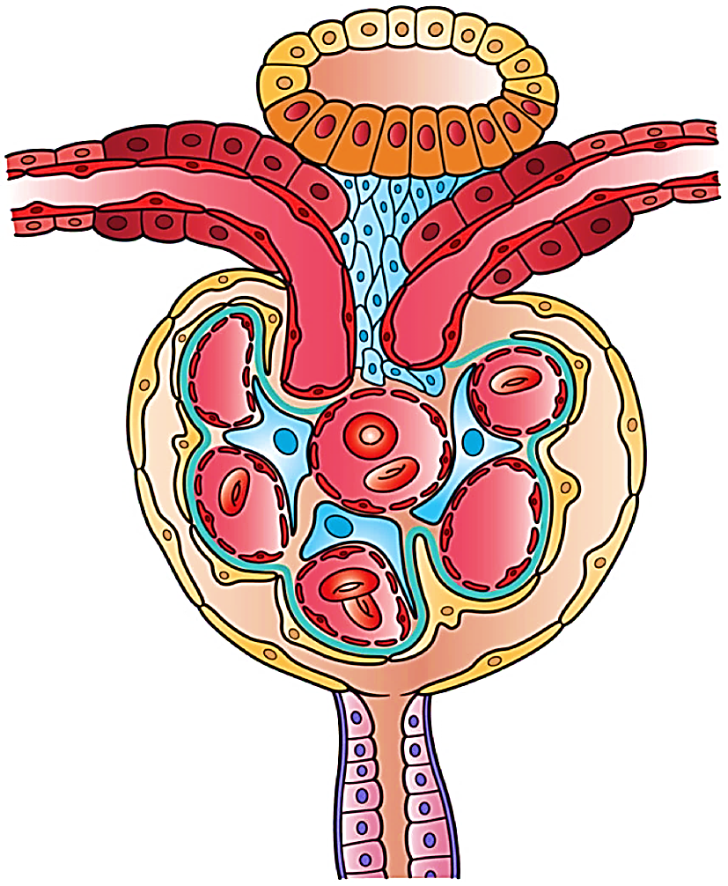
Mesangial cells
Specialized cells found around glomerular capillaries of the kidney
They are 2 types:
1- Intra -glomerular :
located along glomerular capillaries
within renal corpuscle
2- Extra-glomerular (Lacis cells) :
located at the vascular pole
Extra-glomerular mesangial cells
Intra-glomerular
mesangial cells

Slide 23
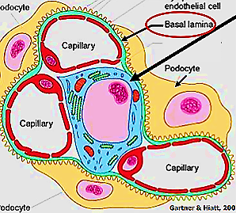
Intra-glomerular mesangial cells:
Specialized pericytes located between the endothelial cells & the basement membrane of glomerular capillaries form mesangium
Function:
1- Filtration: regulate bl. flow of glomerular
capillaries by their contractile activity →
control GFR
2- Structural support to glomerulus
3- Phagocytosis & renewal of BM

Slide 24
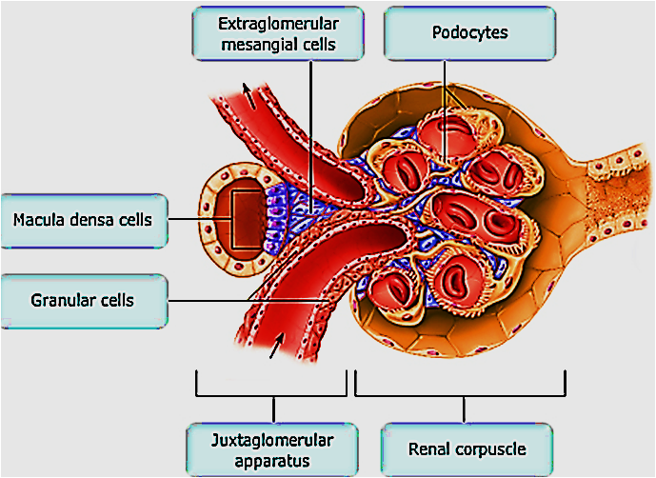
Extra-glomerular mesangial cells (Lacis cells):
Specialized smooth ms cells found outside the glomerulus , at the vascular end
Function:
1- Role in regulation of bl flow to
kidney & systemic bl. pressure via
Renin-Angiotensin-Aldosterone
system
2- Part of Juxta-glomerular apparatus, together with
macula densa & granular cells
3- may play role in secretion of erythropoietin Hormone.

Slide 25
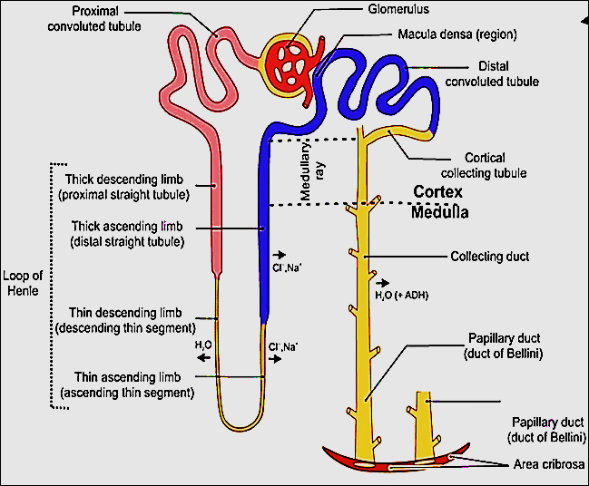
Juxtaglomerular apparatus
Located at the vascular end of renal corpuscle
Consists of 3 components:
1- Macula densa
(lining of distal convoluted T. )
2- Granular (juxtaglomerular)cells
(wall of afferent arteriole)
3- Lacis cells
(Extra-glomerular mesangial cells)

Slide 26
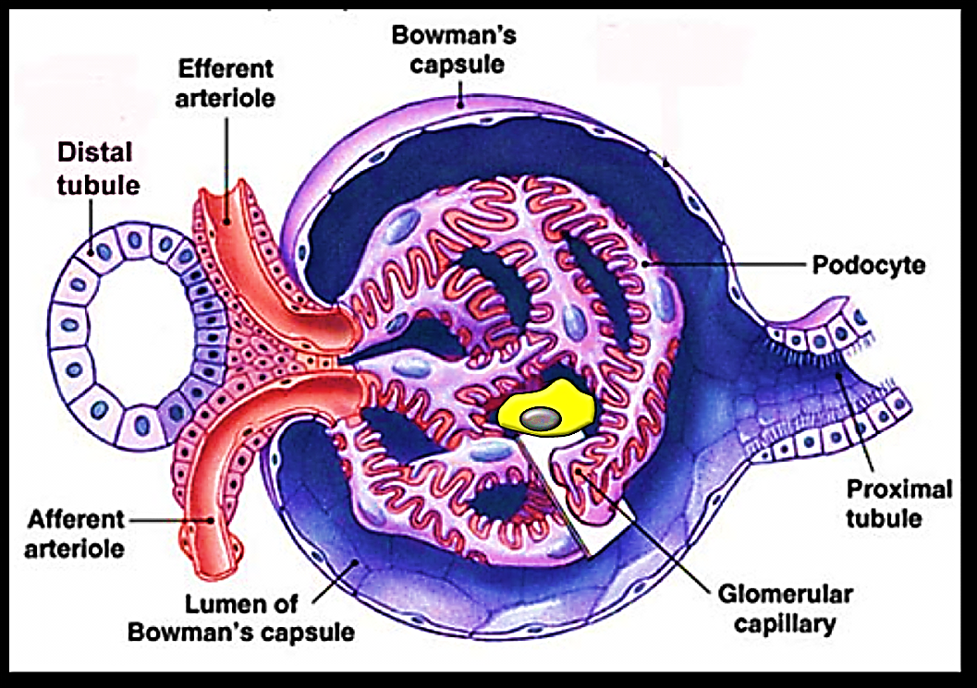
1- Macula densa (Nacl):
The part of DCT the fits between the aff. & eff. Arterioles Cells↑ in length→ become columnar
The nuclei of cells become apical, deeply stained & closely packed appear as dark spots
Golgi complex is infra-nuclear ( basal)
Basement membrane is lost, so these cells are in contact e granular cells
Function:
Act as osmoreceptors that
monitor the level of Na⁺ ions
of the filtrate in
the lumen of DCT
Na

Slide 27
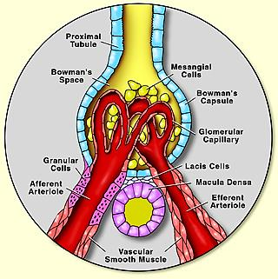
2- Juxtaglomerular cells ( granular) cells:
Modified smooth muscle cells present in the tunica media of the afferent arteriole
Nuclei of cells become rounded instead of being elongated
Cytoplasm contain secretory granules contain Renin H
Function:
Secrete Renin H

Slide 28
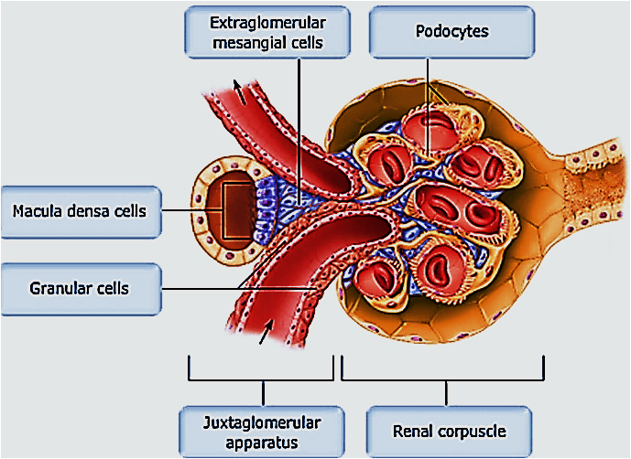
3- Extraglomerular mesangial cells (Lacis cells):
Small pale stained cells occupy the space between the afferent arteriole, eff. arteriole & macula densa
Function:
Supportive
Transmit signals from macula densa → glomerulus → vasoconstriction of blood vessels

Slide 29
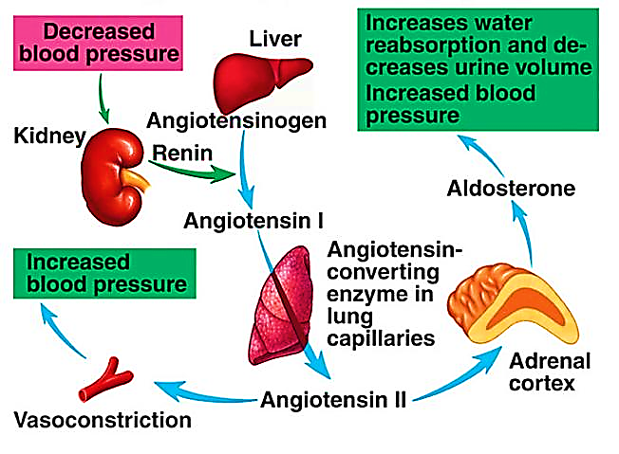
Function of Juxtaglomerular apparatus:
Regulation of glomerular filtrate rate & blood pressure through the Renin- angiotensin – Aldosterone system

Slide 30
Mechanism of Renin- angiotensin – aldosterone
Drop in blood pressure or blood volume
→ ↓ volume of glomerular filtrate
→ ↓ Na & Cl concentration In DCT.
→ Macula densa monitor these changes
→ ++ JG cells → Renin
→ changes angiotensinogen in blood ( formed by liver)→ angiotensin I → lung (has ACE) → angiotensin II

Slide 31
Angiotensin II is:
potent vasoconstrictor
++ release of Aldosterone from adrenal cortex & ADH from posterior pituitary
Aldosterone promotes reabsorption of Nacl by DCT
ADH promotes water reabsorption from collecting tubules
Both will cause ↑ blood pressure

Slide 32
Proximal & distal convoluted tubules
PCT
DCT
Longer+ narrow lumen
Lined e 3-5 cells
Ill-defined cell borders
apical brush border
Reabsorption of water (Na⁺ pump), sugar , amino acids
Secrtion of some metabolites
( penicillin , dyes, ammonia)
Shorter + wide lumen
Lined e 5-8 cells
clear cell borders
No brush border
Reabsorption of water under effect of Aldosterone

Slide 33
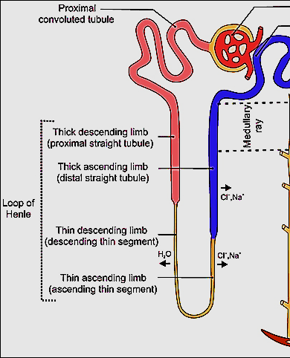
Loop of Henle
Variable in length
Thin segment: lined by simple squamous
Thick segment: lined by simple cubical
It descend from cortex to medulla
Function:
Create concentration gradient in the
medulla of kidney → produce hypertonic urine
The descending limb has ↑permeability to water,
↓ permeability to ions
The ascending limb is permeable to ions.
impermeable to water.

Slide 34
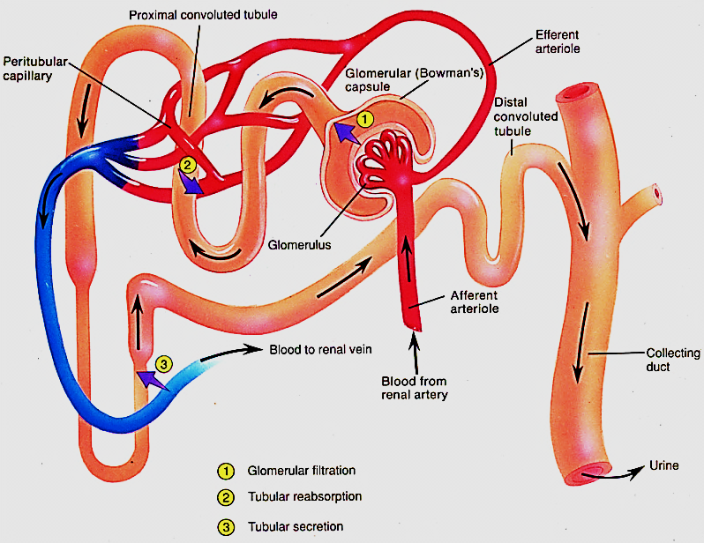
The collecting ducts
The excretory portion of renal tubules, under ADH
Lined with simple cuboidal epithelium. Each 6-8 collecting ducts drain into →tips of medullary pyramid
2 types of cells line
collecting tubules
Principle cells
Intercalated cells

Slide 35
Principle cells
Intercalate cells
Numerous
Very sensitive to ADH →
Responsible for the ability of collecting tubules to concentrate urine
Reabsorb Na & secrete K
Few, have apical microfolds
2 types alpha & Beta
Regulate acid- base balance
Alpha → H⁺ ion → acid urine
Beta → HCO₃⁻ → alkaline urine

Slide 36
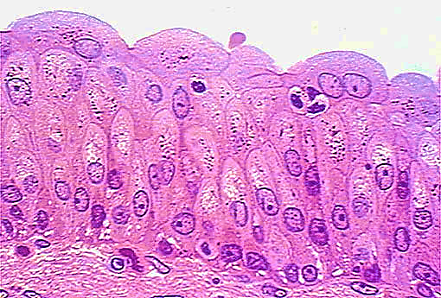
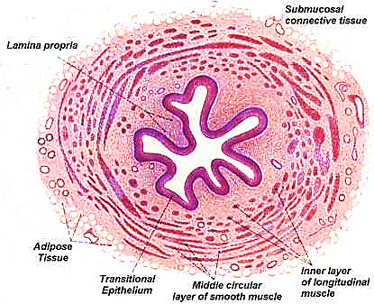
ureters
Muscular tube formed wall is formed of :
Mucosa - Musculosa – adventitia
Mucosa:
Transitional epithelium + CT lamina propria
Musculosa:
Upper 2/3 of ureter: inner longitudinal & outer circular
Lower 1/3 of ureter: additional outer longitudinal
Adventitia
Loose areolar CT

Slide 37
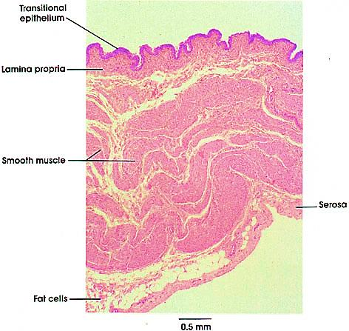
Urinary bladder
Mucosa:
Transitional epith. + lamina propria
Musculosa:
IL , MC & OL (detrusor ms.)
At the neck of bladder ,
the middle circular form→
internal urethral sphincter
serosa:
Loose areolar CT

Slide 38
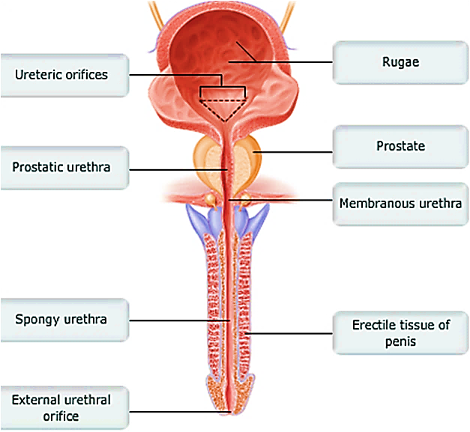
urethra
A-Male urethra
Prostatic – membranous – penile
Prostatic urethra:
Lined e transitional epithelium
Membranous urethra:
Lined e stratified columnar epithe
Penile urethra:
Lined e stratified columnar epith which → stratified squamous in its distal part ( fossa navicularis)

Slide 39
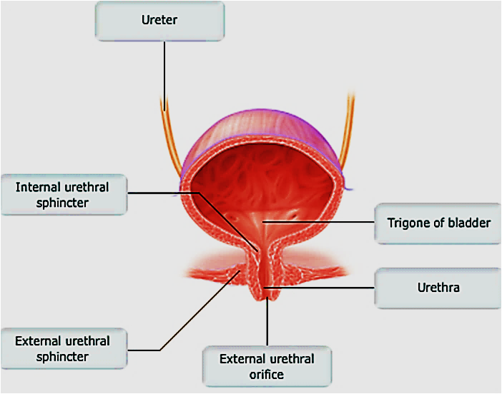
B- Female urethra
Short straight tube
Lined with transitional epithelium, then stratified squamous at its distal part

Slide 40
Thank you

