Slide 1
Vaginal birth after caesarean section
DONE BY :
Sara Al qaisi
Forat Majali
Shaden Qudah

Slide 2
Caesarean section
Definition:
is a surgical procedure in which incisions are made through a woman’s
abdomen (laparotomy) and uterus (hysterotomy) to deliver one or more babies.
Classification:
Elective: CSs are planned in ahead time.
Emergency: When the cesarean section is done because of sudden deterioration in maternal or fetal condition during labor or due to non-progress, failed induction or failed trial.
Maternal mortality rate for all Caesarean sections is 5 times that for vaginal delivery, especially with emergency cesareans performed in labor.
Maternal mortality is largely anesthetic related.
Risks are those from any major procedure:
hemorrhage, infection, visceral injury (injury of the bladder or bowel), thrombosis.
Classification according to the urgency:
immediate threat to life of woman or fetus (requiring immediate
delivery)
maternal or fetal compromise which is not immediately life- threatening (requiring urgent delivery)
(needing early delivery) but no maternal or fetal compromise
at a time to suit the patient and maternity team (elective delivery)

Slide 3
Indication:
Fetal:
maternal:
Cord prolapse
fetal distress
Fetal macrosomia > 4500 gm
Multiple pregnancy
Transverse lie and Malpresentation brow, mentoposterior, shoulder & compound presentations, breech
Failed induction, obstructed labor and Failure to progress in labor (Dystocia) (CPD)
Severe PET-relative contraindication
Repeat cesarean delivery
Abnormal placentation (eg. placenta Previa, placenta accrete).
Obstructive lesions in the lower genital tract, including leiomyomas of the lower uterine segment that interfere with engagement of the fetal head
Pelvic abnormalities that preclude engagement or interfere with descent of the fetal presentation in labor.
5- Active genital herpes infection or maternal HIV infection
If there is a previous CS can we try with vaginal delivery?
Yess (trial of labor)
Successful vaginal delivery rate is up to 80% in carefully selected
patients.
Criteria for trial of labor include:
patient consent
non-repetitive cesarean indication (e.g., breech, placenta Previa),
previous low segment transverse uterine incision
clinically adequate pelvis.

Slide 4
Unless there are maternal or fetal indications for cesarean delivery, vaginal delivery should be recommended
should not be performed before 39 weeks gestation without verifying fetal lung maturity (due to a potential risk of respiratory problems for the baby)
it is not recommended for women who want more children??
(due to the increased risk for placenta Previa/accreta and gravid hysterectomy with each cesarean delivery)
What should we do
Nursing:
preoperatively?
consent
Usually she is asked to be fasting 12 hours preoperative
I.V line.
Fluids.
Foley catheter.
External fetal and maternal monitors.
Antibiotic prophylaxis.
Antacids.
Lab tests:
CBC.
Blood type and cross match.
Coagulation study.
Ultrasound (document fetal position and estimated fetal weight and site of placenta)

Slide 5
Anesthesia options:
Spinal
general
epidural
How?
injection of a
Through systemic sedation and NO
injection of a local sedation into
local sedation into the
inhalation
the epidural space
subarachnoid space,
through a fine needle, 9 cm
long.
+ves
Simple and rapid onset
Can be given quickly (suitable for
Less incidence of hypotension
Minimal fetal exposure to
emergency CS)
because of slow onset of
drug
Blood pressure and breathing are
sympathetic block
Allow time for careful
easily controlled
Less incidence of spinal headache
abdominal wall incision and
Better in patient with psychological
Allow repeated administration
good hemostasis
problems
through epidural catheter if the
Avoidance of complication
of general anesthesia
(uterine atony and
pulmonary aspiration)
surgery is prolonged
Epidural catheter allow
administration of post-operative
analgesia
-ves
Hypotension
Extraction of the fetus should be
intrapartum nausea and
within 15 min. Nitrous oxide can
vomiting
cross placental blood barrier
→cardiacrespiratory depressant
spinal headache
effect on the fetus
Post-operative shivering
Acid aspiration syndrome
High incidence of uterine atony (Effect of halothane)
After anesthesia now the surgical incision started!!!

Slide 6
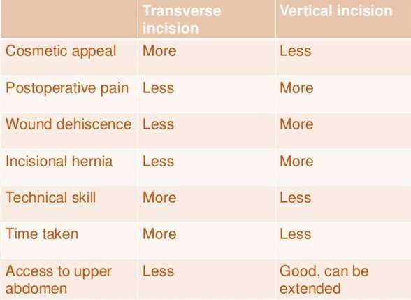
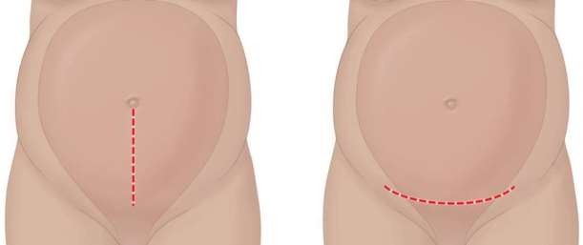
Firstly: abdominal wall incision Two types:
Vertical –in the midline extends from below the umbilicus to 2cm above the symphysis pubis indicated in cases of extreme maternal obesity and in significant intra-abdominal adhesion (emergent incision).
Transverse(pfannenstiel)-extends transversely for 15cm above symphysis pubis nearly 2cm..the incision is cephalad at the level of the pubic hair decreased analgesic requirements. (other names: maylard, Joel Cohen ...)

Slide 7
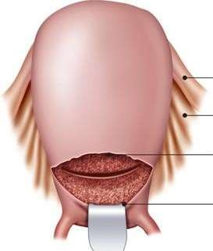
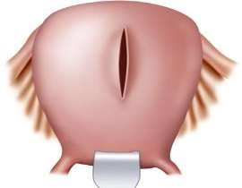
Uterine incision:( according to the GA, fetal presentation, placental location and the presence of well-developed uterine segment.)
Low segment transverse
incision(Monroe-Kerr)
Classical upper segment
incision(Kronig or Delee)
general
Most common uterine incision 90% Low transverse incision is smaller, horizontal and made near the bikini line made in the noncontractile portion of the uterus.
The bladder must be dissected inferiorly to expose the lower segment, and the bladder blade has been placed.
less commonly performed. Larger vertical incision made in the contractile fundus of the uterus and
(when the lower segment not developed, if an anterior placenta Previa is present, or if the fetus is in a transverse lie or in a preterm nonvertex presentation)
Again, the bladder has been dissected inferiorly to expose the lower segment, and the bladder blade has been placed.
1. any fetus(es) regardless of
+ves
trial of labor in subsequent pregnancy is safe
Less likely to rupture in next
pregnancy (.5-1.5%)
Less risk of bleeding
Less adhesions
less uterine infection
Easy to repair
1.fetus must be longitudinal lie
intrauterine orientation can be delivered
2. lower segment varicosities or myomas can be bypassed
-ves
trial of labor in a subsequent pregnancy is unsafe?? Higher risk of rupture in subsequent pregnancies 1.5% - 5%
More bleeding
Difficult to repair
High risk for adhesion
lower segment must be developed
varicosities or myomas in the lower
segment.
4.because of smaller incision the
obstetricians may need vacuum or forceps for delivery

Slide 8
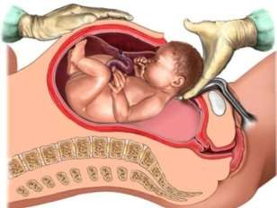
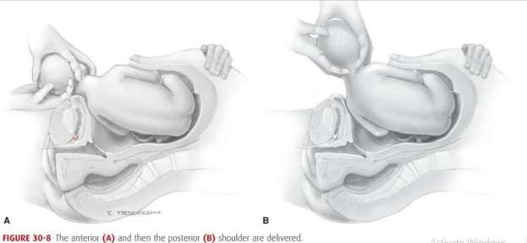
Delivery of the Fetus:
In a cephalic presentation, a hand is slipped into the uterine cavity between the symphysis and fetal head.
The head is elevated gently with the fingers and palm through the incision.
Once the head enters the incision, delivery may be aided by modest transabdominal fundal pressure
After head delivery, a finger should be passed across the fetal neck.
The head is rotated to an occiput transverse position,
The sides of the head are grasped with two hands, and gentle downward
traction is applied until the anterior shoulder enters the hysterotomy incision
Next, by upward movement, the posterior shoulder is delivered.

Slide 9
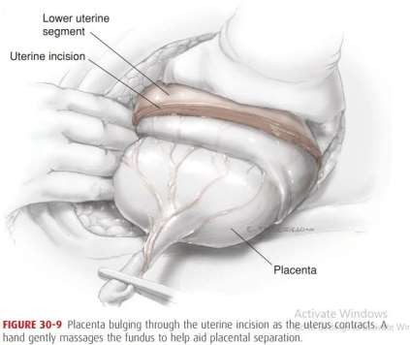
Two important aspects of the delivery are
the incision to delivery time (especially in previously compromised fetuses): Longer incision to delivery times are associated with worsening neonatal outcomes
delivery of the impacted fetal head: can be delivered either through pushing the head up from the vagina and elevating it up through the incision or by pulling it up as if it were a breech delivery.
After the fetus is delivered, the umbilical cord is doubly clamped and cut
Placental Delivery:
After delivery, oxytocin (20 U) is placed in the intravenous (IV) fluid to increase
contractions of the uterus.
The placenta is then delivered spontaneously, or manually along with some cord traction may reduce the risk of operative blood loss and infection
Fundal massage may begin as soon as the fetus is delivered to hasten placental separation and delivery.
Immediately after delivery and gross inspection of the placenta, the uterine cavity is suctioned and wiped out to remove avulsed membranes, vernix, and clots.
The average blood loss in CS is approximately 1000ml

Slide 10
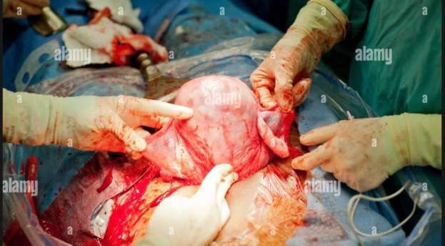
Repair of Uterus
Repair of the uterus can be facilitated by manual delivery of the uterine fundus through the abdominal incision (Externalizing): facilitates uterine massage, the ability to assess whether the uterus is atonic, and the examination of the adnexa.
Inspection of:
The incision is inspected for other bleeding vessels
any extensions of the incision
the bladder and lower segment inferior to the incision.
The principal disadvantage is discomfort and vomiting caused by traction in cesarean deliveries performed under regional analgesia.

Slide 11
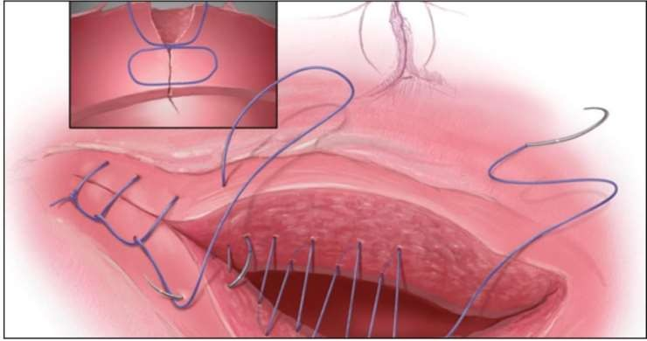
Repair of a low transverse uterine incision should be performed in either a 1-layer or 2-layer fashion with 0 or 2-0 chromic or polyglactin suture (absorbable sutures).
The first layer should include stitches placed lateral to each angle, with prior palpation of the location of the lateral uterine vessels. Most physicians use a continuous locking stitch.
If the first layer is hemostatic, the second layer (Lembert stitch) (continuous or interrupted)
Single-layer closure is typically faster and is not associated with higher rates of infection or transfusion

Slide 12
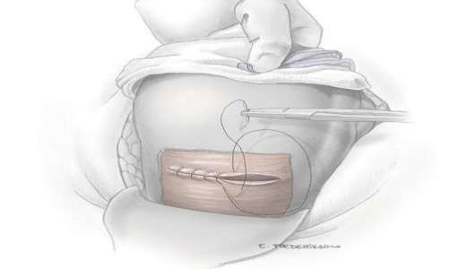
Postoperative care:
Maternal monitoring in the immediate postoperative period:
vital signs, uterine tone, vaginal and incisional bleeding, and urine output
are monitored closely.
pain relieving:
analgesia followed by oral nonsteroidal anti-inflammatory drugs.
Bladder catheter:
Removing the catheter as soon as possible minimizes the risk of infection.
Diet and activity:
Early ambulation (when the effects of anesthesia have abated) and oral intake (within six hours of delivery) are encouraged
Breastfeeding:
can be initiated in the delivery room.
Wound care:
Dressings can be removed, and patients may shower within 48 hours of
surgery.

Slide 13
Complications of CS:
short term
Long term risks to future pregnancies
risks to the newborn
Hemorrhage:
Blood loss during a cesarean delivery may be greater than during a vaginal
delivery, however, the transfusion rate remains low at 1% to 2% of patients undergoing cesarean section.
Causes:
laceration of uterine vessels that occurs with extension of the uterine incision.
Additional lacerations may extend into the vagina
The mean estimated blood loss at cesarean delivery is approximately 1000 mL.
Infection:
Infection is one of the most common complications of cesarean delivery. In the absence of prophylactic antibiotics, the rates of postpartum endomyometritis can be as high as 35% to 40%.
Another common complication of cesarean delivery is wound infection. may
occur in 2.5% to 16% of cesareans.
Risk for Infection increase with:
the presence of ruptured membranes [ most important] from genital tract.
obesity particularly important role in the occurrence of wound infection
blood transfusion.
Atelectasis.
Pneumonia (Aspiration).
Bacteremia.
Urinary tract infection.
Deep Abscesses.

Slide 14
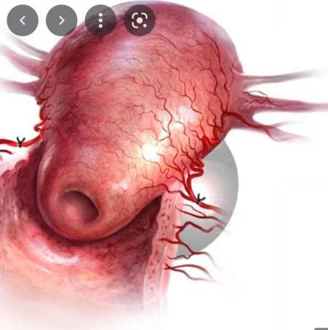
Incidental Surgical Injuries:
Bladder injuries are the most common injuries
bowel or ureters less common surgical injuries.
Risk factors:
prior pelvic surgery (including prior cesarean deliveries), emergency cesarean
delivery.
Early recognition and prompt management of these injuries are key to
preventing the development of further complications, such as sepsis, renal failure, and fistula formation.
Emergent Hysterectomy:
The risk of the need for hysterectomy after or during a cesarean delivery is
greater than after a vaginal delivery.
The most important risk factor :
is a previous Caesarean section especially when placenta overlies the old scar , increasing the risk of placenta accreta.
The most common indication: uncontrollable maternal hemorrhage,
other: atony, uterine rupture, extension of transverse uterine incision & fibroids preventing uterine closure & hemostasis.

Slide 15
Pain:
More in CS
narcotic pain medications can
have a significant impact on initial bonding between the mother and the newborn
on breastfeeding success rates
maternal functioning postpartum
the risk for postpartum depression may be greater.
Thromboembolism:
One of the leading causes of maternal mortality related to cesarean delivery is deep vein thrombosis resulting in pulmonary embolism.
The incidence of such complication can be reduced by adequate hydration, early embolization & administration of prophylactic heparin.
Paralytic ileus:
Expected in the first few days.
Bowel sound are absent or hypoactive and there is no passage of gas.
Anesthesia complication:
Abscess / meningitis
epidural hematoma
Failed intubation
High neuroaxial block
neurologic injury
Respiratory arrest

Slide 16
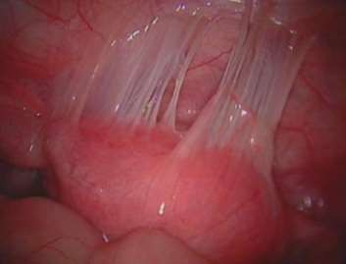
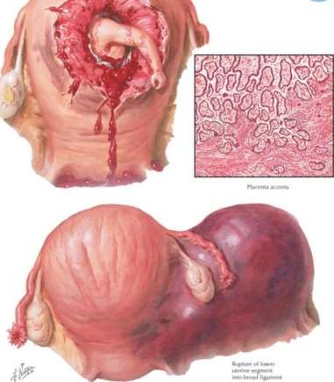
Long term and risks to future pregnancies
Adhesion formation:
So→ (Ectopic pregnancy risk will increase).
can cause significant morbidity and mortality related to bowel obstruction,
subinfertility, or organ injury during repeat abdominal surgery.
Uterine Rupture:
The incidence of uterine rupture is higher in women who undergo a trial of labor
after cesarean delivery.

Slide 17
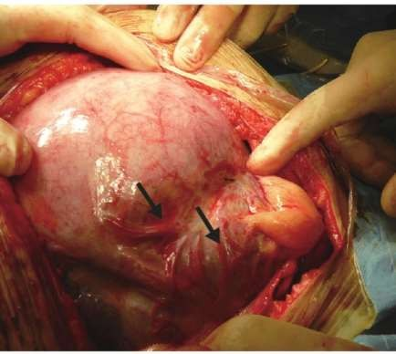
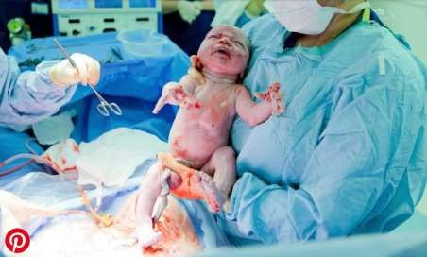
3. Abnormal placentation: placenta Previa, accrete, Abruptio.
Scar complications:
Long-term abdominal scar complications include numbness, pain [
Branches of the ilioinguinal nerve and the iliohypogastric nerve are severed by transverse abdominal incisions].
Uterine scar complications include cesarean scar pregnancy and postmenstrual spotting (an indentation on the endometrial side of the
cesarean scar).
risks to the newborn
Respiratory Difficulties.
Iatrogenic injury.
Failure to Breastfeed.

Slide 18
Vaginal birth after cesarean section (VBAC) describes a vaginal delivery in a women who has given birth via cesarean section in a former pregnancy.
Patients desiring VBAC delivery undergo a trial of labor (TOL), also called trial of labor after cesarean section (TOLAC)
the success rate for women in the U.S. who attempted a trial of labor after one previous cesarean was 70% , Some hospitals don't
offer VBAC because they don't have the staff or resources to handle emergency C-sections.
Decision making regarding mode of delivery must take into consideration the patient's personal preferences, obstetric history, data on the risks and benefits of TOLAC versus PRCD( planned repetitive cesarian delivery) , and availability of TOLAC in the selected birth setting.

Slide 19
Why it's done
Common reasons for choosing a trial of labor after cesarean
include:
Impact on future pregnancies
Lower risk of surgical complications. Successful VBAC is associated with lower rates of excessive bleeding, infection and blood clotting in one or more of the deep veins in the body (deep vein thrombosis).
VBAC also might decrease the risk of surgical removal of the uterus (hysterectomy) and injury to abdominal organs, such as the bladder or bowel.
Shorter recovery time.
Opportunity for an individualized birth plan. For some women, it's important to experience a vaginal delivery.

Slide 20
RISKS/BENEFITS OF TOLAC VERSUS PRCD
Maternal outcomes
Uterine rupture: The incidence of uterine rupture is low , but when it occurs, it is often associated with TOLAC more than PRCD and is potentially life threatening.
Risk if failed VBAC , which associated with higher risk of chorioamnionitis , PPH , Blood transfusion , hysterectomy
The risk factor which predicts failure was :
Younger age
Lack of previous vaginal delivery
Induction of labor
Fetal weight more than 4 kg
Perinatal mortality and neonatal mortality
– Perinatal mortality and neonatal mortality rates were higher for TOLAC than for PRCD

Slide 21
CANDIDATES FOR TOLAC
Optimal candidates:
The ideal candidates for TOLAC are women with a high likelihood of VBAC and a very low likelihood of intrapartum uterine rupture.
1-only One prior low transverse uterine incision .
2- Non repetitive cesarean indication ( breech , previa)
3- periods of 18 months between pregnancy
4- clinically adequate pelvis (no CPD)

Slide 22
Inappropriate candidates
Prior transfundal uterine incision
Previous delivery within 18 months
Transmyometrial incisions for open fetal surgery
Transmyometrial incisions to resect leiomyomas
Prior uterine rupture or dehiscence

Slide 23
Intrapartum management in settings of TOLAC
Intrapartum management of patients undergoing a trial of labor after cesarean (TOLAC) is similar to that in patients with an unscarred uterus, with some unique considerations, such as choice of cervical ripening/induction agent, intensity of cardiotocography, and required resources. The additional considerations derive from the increased risk for uterine rupture in these patients.
Facilities in which women attempt a trial of labor after cesarean (TOLAC) should have the resources (personnel and equipment) necessary to perform emergency cesarean birth given the increased risk of uterine rupture in this setting.
Upon admission for anticipated TOLAC, women should be consented for both TOLAC and repeat cesarean birth. Informed consent for TOLAC should include a discussion of the risk of uterine rupture as well as the success rate of TOLAC.
We obtain a baseline hemoglobin or hematocrit and blood type and screen. We recommend placement of intravenous access at admission in case cesarean birth and/or blood product administration become necessary.

Slide 24
assessment of labor progress
clinicians generally have a lower threshold for diagnosing failure to progress in women undergoing TOLAC than in women with an unscarred uterus
Prolonged latent phase — Women with a prolonged latent phase can be offered therapeutic rest, oxytocin, and/or amniotomy to assist with transition to active phase, similar to the management of women without a scarred uterus
Prolonged second stage — An observational study that included over 4500 women
undergoing TOLAC who reached the second stage of labor noted that 7.8 percent had a
second stage ≥3 hours .
Likelihood of vaginal delivery decreased with an increasing duration
of the second stage: from 91 to 97 percent within the first 2 hours to 46 percent at ≥4 hours. In addition, the frequency of uterine rupture or dehiscence significantly increased over time: from 0.7 percent at <1 hour to 3 percent at ≥3 hours. In contrast to other studies, the risk of adverse neonatal outcomes did not differ significantly by second-stage length.
•
However, there should be a low threshold for operative delivery if maternal vital signs or
symptoms or if fetal heart rate monitoring suggest uterine rupture
.

Slide 25
Monitoring for evidence of uterine rupture is a critical component of intrapartum management of TOLAC.
Signs and symptoms of uterine rupture may include :
fetal heart rate abnormalities (observed in 70 percent of cases),
weakening contractions
loss of fetal station
abdominal pain, suprapubic pain at the level of the hysterotomy,
need for frequent epidural dosing,
vaginal bleeding,
maternal hemodynamic instability, and hematuria.
Clinical vigilance and careful evaluation are especially warranted in women with persistent complaints of pain despite neuraxial anesthesia or need for frequent anesthetic redosing to achieve adequate pain control.

Slide 26
Induction of labor
The benefits and harms of planned repeat cesarean birth versus induction of labor have not been evaluated by randomized trials
However, factors that attenuate the risk of rupture in these women should also be considered. Women with a prior vaginal delivery and/or a favorable cervix do not appear to be at increased risk of uterine rupture with induction ; Avoidance of a prostaglandin for cervical ripening is also important.
Transcervical catheters, oxytocin, and amniotomy are reasonable options for cervical
ripening and labor induction in TOLAC.
Labor pattern during induction — Compared with inductions in women without a previous cesarean birth, induced labor in women undergoing TOLAC appears to be associated with slower progression in the latent phase but an equivalent labor course in the active phase.

Slide 27
Thank you

