Slide 1
Spinal tumors
Asem Darab’a & Rola Khlifat

Slide 2
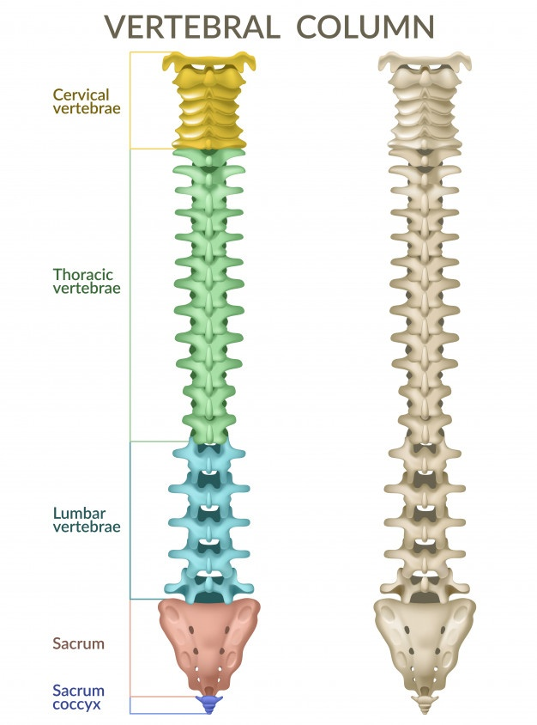
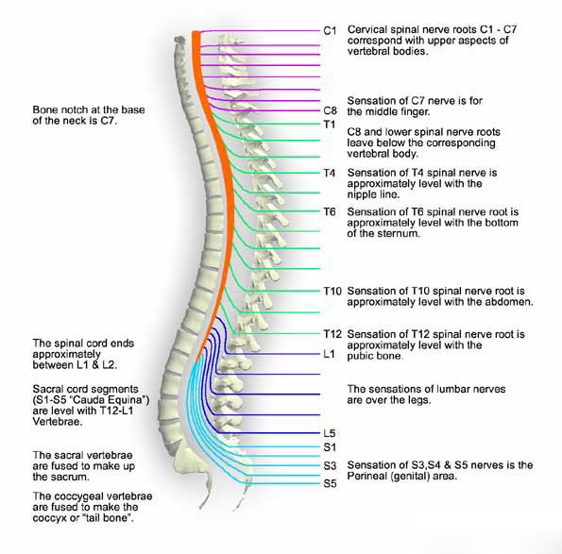

Slide 3
Overview
Spinal tumor is an abnormal growth arising from any of the tissues that make up the spine.
It might be Primary or secondary (Metastatic).
Primary spinal tumors are relatively rare, typically benign.
Lung, prostate, and breast cancers are the three most common cancers that tend to spread to the spine.

Slide 4
Clinical presentation
Non-mechanical back pain
In the middle or lower back.
Not related to injury, stress or physical activity.
The pain may increase with activity. With spinal tumors the pain is nocturnal and worse in recumbent position due to :
1. Venous congestion when pt is lying down
2. Dural stretching
Loss of sensation or muscle weakness in the legs, arms or chest
Stiff neck or back
Decreased sensitivity to pain, heat and cold.
Loss of bowel or bladder function.
Paralysis that may occur in varying degrees and in different parts of the body, depending on which nerves are compressed
Scoliosis or other spinal deformity resulting from a large and/or destructive tumor.

Slide 5
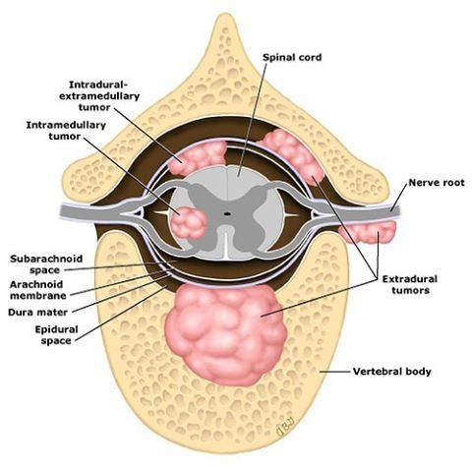
Notes:
In prostate the lesion is Osteocytic lesion

Slide 6
Extradural tumors
form inside the spinal column and may involve the vertebrae.
typically don’t affect the spinal cord.
They are often located in the epidural space.
Benign: Hemangioma, Osteoid osteoma, Osteoblastoma, Osteochondroma, bone cyst.
Malignant: Osteosarcoma, Chondrosarcoma, Multiple myeloma, Chordoma, Lymphoma, Mets.

Slide 7
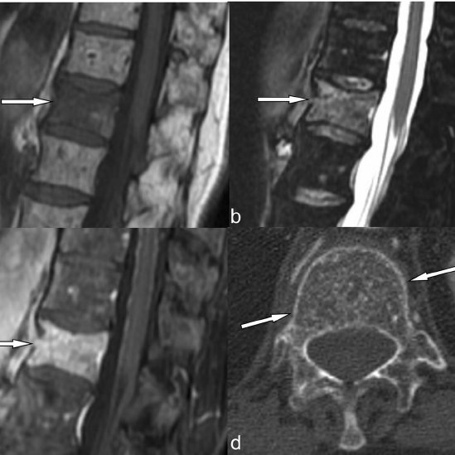
Hemangioma
a growth that forms from the tissues of blood vessels inside the spinal column.
These tumors are more common on the surface of the skin, especially in infants, but may also affect internal organs.
affect the vertebral body of a spinal segment.
frequently during mid-life.
Women more than men.
Notes:
Atypical MR imaging features of vertebral hemangioma involving the T12 vertebral body in a 51-year-old female. a Sagittal T1-weighted MR image shows a lesion with low signal intensity due to low adipocyte content ( arrow ). b Sagittal fat-saturated T2-weighted and c corresponding contrast-enhanced fat-saturated T1-weighted MR images show high signal intensity ( arrow in b ) and marked and homogeneous enhancement of the lesion ( arrow in c ) due to the prevalent vascular components. d Axial CT scan reveals the typical polka-dot sign ( arrows ), which supports the correct diagnosis

Slide 8
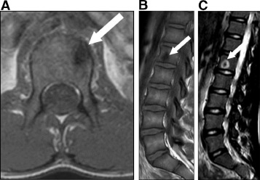
Osteoid osteoma:
a small tumor in the bone that is more common in children and younger adults.
the most common of the benign tumours.
Osteoblastoma:
similar to osteoid osteoma but typically larger and more aggressive.

Slide 9
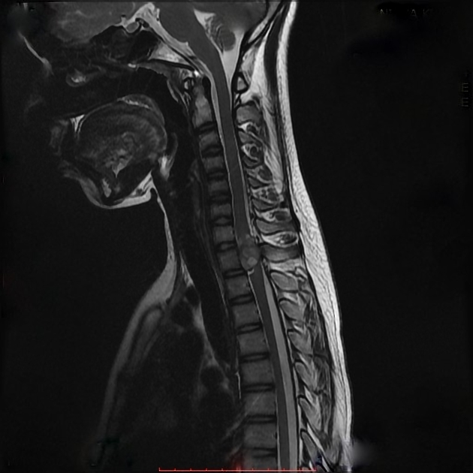
Osteochondroma
an overgrowth of cartilage and bone that usually occurs at the end of the bone near the growth plate.
Notes:
A pedunculated bony outgrowth is seen arising from the right superior articular process of the T2 vertebra. This lesion shows a hypointense stalk on T2WIs, and the cap of the lesion shows T2 hyperintense signal. The lesion shows heterogeneous post-contrast enhancement and encroaches into the spinal canal and causing myelopathic changes of the underlying dorsal spinal cord. The lesion is also causing posterior scalloping of T2 vertebra due to pressure effect.

Slide 10
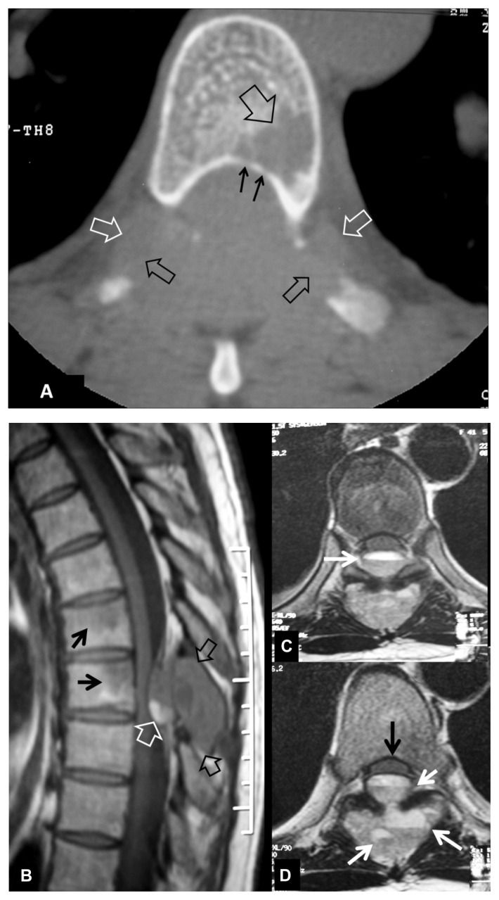
Osteosarcoma
a type of bone cancer that may originate in the spine but is more common in the thigh and shin bones.
most often in children, adolescents, and young adults.
Males more than females.
Notes:
A 41-year-old female with a proven telangiectatic osteosarcoma involving the 7th and 8th thoracic vertebrae, presenting with progressive myelopathy resulting from cord compression. (A) The axial CT image shows osseous destruction in the posterior elemens (black open arrows), soft tissue mass extending in the paraspinal space bilaterally (open white arrows) and marrow replacement in the vertebral body (large open black arrow). There is also cortical disruption of the posterior rim of the vertebral body (thin black arrows). (B) The sagittal T1-w MR image, shows the lesions causing destruction of the spinous process (open black arrows), extending into the spinal canal and displacing the spinal cord. The high signal intensity corresponds to hemorrhagic component (white open arrow). The low signal intensity areas in the vertebral bodies (thin black arrows) correspond to invasion of the trabecular bone. The axial T2-w TSE MR images (C,D), show the fluid-fluid levels (white arrows) both in the original location of the lesions and intracanalicularly. The spinal cord is displaced anteriorly (black thin arrow in D).

Slide 11
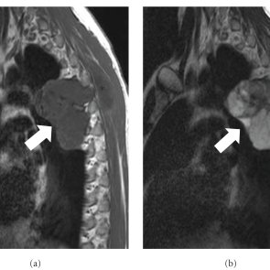
Chondrosarcoma
a tumor that arises from cartilage cells around the bone. Although uncommon in the spine, it can sometimes develop as a primary cancer in the bones that form the spinal column.
Notes:
MR imaging of the same patient. The sagittal T1-w (a) MR image shows a hypointense lobulated lesion (arrow). (b) The sagittal T2-w MR image shows the lesion with heterogeneous but predominantly high signal intensity (arrow). Note the superficial palpable component of the tumor (asterisks).

Slide 12
Multiple myeloma:
the most common primary malignant tumor of bone. ( osteolytic lesion )
adults greater than 40 years of age.
It tends to be generalized, involving multiple bones.
back pain and involvement of the spine is the most common presenting complaint.
Lymphoma:
A group of cancers that affect the cells of the immune system called lymphocytes.
It may develop in the spine as a primary tumor, but more often it arises elsewhere and spreads to the spine.
Extended from paravertebral LN Into vertebral body or through foramena to epidural space

Slide 13
Chordoma:
A malignant bone tumor that can develop inside the spinal column anywhere along its length
It is most commonly seen in the sacrum.

Slide 14
Spinal Cysts and Tumorlike Masses
Eosinophilic granuloma: benign lesions, rare in adults, that affect bones and may cause a collapse of the vertebrae; they are more common in the mid-back.
Epidural lipomatosis: excessive growth of fat inside the epidural space.
Synovial cyst: a fluid-filled sac that typically forms in the lumbar spine (lower back) around the vertebral joints, usually from a degenerative process, and is benign.
Arachnoid cyst: a fluid-filled sac that may cause separation in the membranes enveloping the spinal cord and may protrude into the epidural space.

Slide 15
Classification: Intradural
Extramedullary: ~90%
in subarachnoid space
Intramedullary: ~10%
within spinal cord
Schwannoma
Neurofibroma
Meningioma
Subarachnoid mets (only 4% of spinal mets) or “drop mets”
Ependymoma
Astrocytoma
Hemangioblastoma
Mets (only 2% of spinal mets)

Slide 16
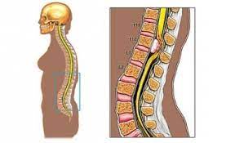
Benign Spinal tumors-Spinal meningioma
is the most common spinal cord tumor. predominate
after the fourth decade
more in female
They arise from meningothelial cells that are clustered around the spinal nerve roots.
80% in T-spine (15% C-spine)

Slide 17
Spinal Meningioma
Middle-aged women (80% women)
Spinal meningioma symptoms may include:
Difficulty walking or maintaining balance
Weakness
Pain at the tumor site
Loss of bowel or bladder control
Loss of sensation

Slide 18
Benign Spinal tumors-Schwannomas
A schwannoma is a spinal tumor that arises from the lining of the nerve cells of the spine.
The nerves of the spine are insulated by a protective sheath called myelin, which transmits nerve impulses throughout the body.
Schwann cells create the myelin sheath of the nerves.
When a schwannoma tumor develops, it forms around the tissue of the myelin sheath

Slide 19
Benign Spinal tumors-Schwannomas
encapsulated, solitary tumors that derive from Schwann cells .
They arise adjacent to, and displace the involved nerve root.
Schwannomas and neurofibromas typically involve the dorsal sensory nerve roots. Depending upon their site of origin, they can be intradural, extradural, or both,
forming a “dumbbell” or hour-glass shaped mass.

Slide 20
Spinal Neurofibromas
Noncancerous (benign) tumors that grow inside the sheath are called nuerofibromas.
the tumors are often a result of neurofibromatosis, can either be an inherited disorder or the product of a gene mutation. NF1 a genetic condition that causes abnormal growths within your nerve tissue.
Surgery is the most common treatment for spinal neurofibromas that are causing symptoms
(a) Neurofibromas (arrows) affecting all spinal nerve roots shown in frontal section. (b) This is confirmed by the normal image of the thoracic and the entire midsagittal section.

Slide 21
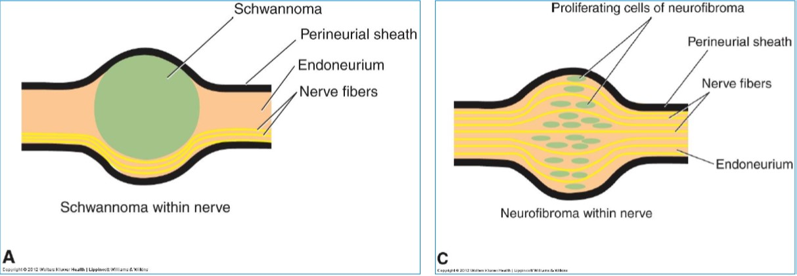
Nerve Sheath Tumors
Schwannomas
Slightly more common
Dorsal root
Encapsulated
Schwann cells
Malignancy v. rare
Neurofibromas
Slightly less common
Dorsal root
Unencapsulated
Schwann cells & fibroblasts
5-10% of pts w/ NF
malignant (≤ 1 yr survival)

Slide 22
Nerve Sheath Tumors
Majority arise from dorsal nerve root, but Ventral root tumors are more common in Neurofibromas.
10% of nerve sheath tumors are epidural or paraspinal.
1% of nerve sheath tumors are intramedullary
Symptoms :
Pain and radiculopathies
Paresthesias
Weakness

Slide 23
NERVE SHEATH TUMORS TREATMENT
1) Gross total excision:
– Recurrence is rare
2) Gross subtotal excision

Slide 24
Intramedullary tumor
These tumors usually arise from glia (supporting cells) within the spinal cord.
Astrocytomas and ependymomas account for the majority and occur with about equal frequency
although astrocytomas are more common in children and ependymomas more common in adults.
Hemangioblastomas, tumors of blood vessels, are less common

Slide 25
Malignant spinal-Astrocytomas
Astrocytomas are tumors that involve nerve cell within the spinal cord.
Neurological symptoms such as weakness and/or sensory changes may be the cause for seeking treatment.
They tend to spread throughout the spinal cord and brain.
Most common pediatric
90% of I.M .S.C.T in patient younger than l0 years of age.
60% in cervical and cervico-thoracic spinal cord segments.

Slide 26
Benign Spinal tumors-Ependymoma
Ependymoma is the most common primary spinal cord tumor involving the cells lining the canal in the center of the spinal cord.
mostly ccervical .
Distinguished an ependymoma from an astrocytoma preoperatively as the neurosurgeon will complete extirpation of ependymoma, whereas the infiltrative astrocytoma will not be completely resectable.

Slide 27
Eependymomas
Most common I.M.T in adults.
Middle age adult (most frequent)
Men = women
Mostly in filium terminale and lower thoracic spine
Variety of histological subtypes.
Cellular ependymoma (most common)
Epithelial
Tanycytic (fibrillary)
Sub ependymomas
myxopapillary
mixed
almost All are histologically benign
Unencapsulated and well circumscribed glial derived tumor.

Slide 28
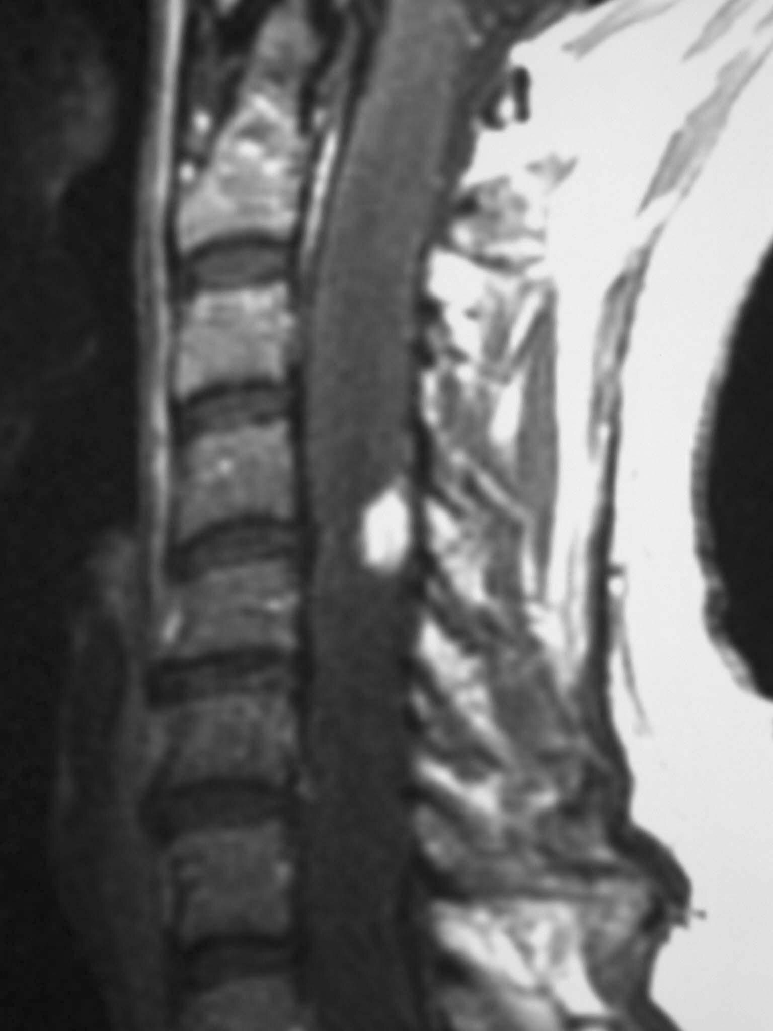
Hemangioblastomas
3-8% of I.M. S.C.T
15-25% occur in association with von hippel- lindau Syndrome.
Rare in childhood.
Benign tumor of vascular origin.
Sharply circumscribed not encapsulated.
Most are dorsally or dorsolaterally located.
Notes:
Sagittal T1-weighted image demonstrates the dorsal location of the tumor, which enhances homogeneously. This tumor does not show any flow voids that may be seen with larger tumors. Note that the spinal cord rostral and caudal to the tumor is quite swollen from edema.

Slide 29
Radiology & imaging
plain x Ray: obsolete
C.T Scan:Nonspecific
Myelography :Not optimal
MRI : modality of choice for diagnosis and pre operative evaluation
Most I.M. S.C.T are isointense
or slightly hypointense on T₁-weighted images.
Often there is only ill-defined Spinal cord enlargment on T₁ weighted images.
Bone scan
Spinal arteriography: in hemangioblastoma

Slide 30
Treatment
Pharmacological treatment→limited benefit.
Chemotherapeutic regimens → Limited success in the treatment of spinal cord neoplasms.
This may be partly due to the inability of the chemotactic agents to cross the blood-brain barrier.

Slide 31
Surgical Therapy
gross total resection.
The neoplasm is identified and then biopsy is performed.
Surgery then proceeds based on the histology from the frozen specimen.
Then you’ll receive a laminectomy, in which part of your vertebrae is removed to access the tumor
If the lesion is an astrocytoma, then the goal is debulking the tumor while not injuring the normal neural tracts.
Ependymomas are attempted to be resected completely as long as a viable plane can be established and normal neural tracts are not disturbed.

