Slide 1
Endocrine glands histology lecture 2
Dr AMAL ALBTOOSH

Slide 2
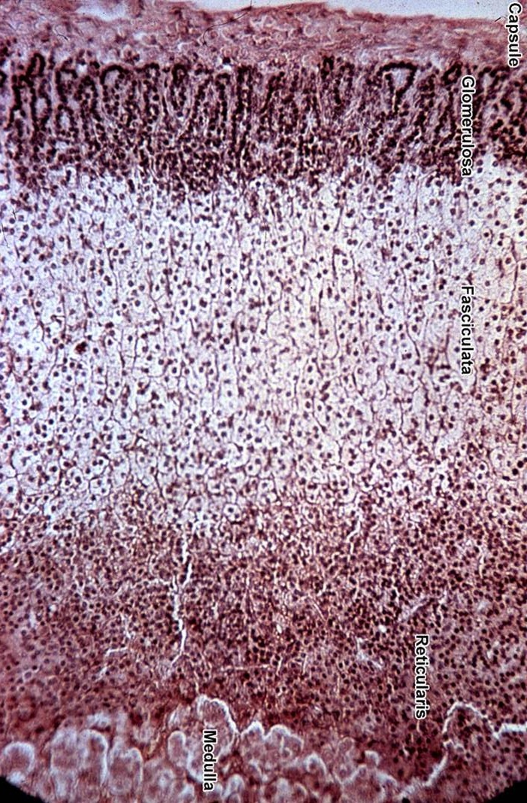
ADRENAL GLANDS or suprarenal gland
Stroma : The gland is surrounded by a thick connective tissue capsule.
Parenchyma : consist of
outer cortex (the main part)
inner medulla 10%

Slide 3
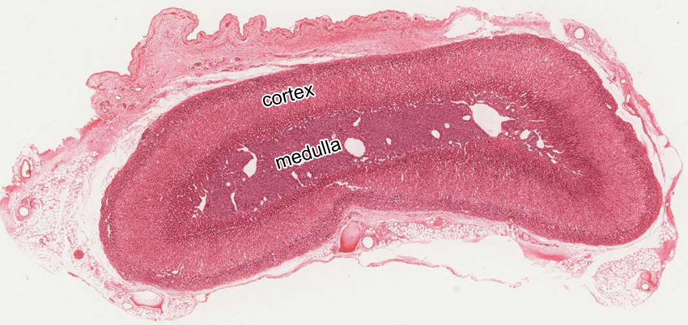
 | Cortex | Medulla
Colour | Yellow | Reddish-brown
Position | Peripheral | Central
Origin | (mesodermal) | Neural crest (ectodermal)

Slide 4
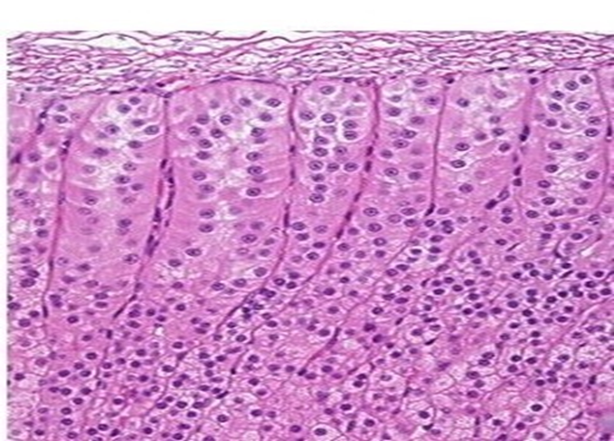
Zones of the cortex
Cortex | Z. Glomerulosa
% of volume | 15%
Shape of cells Arrangement | Columnar or pyramidal cells Closely packed rounded or arched clusters
Cytoplasm (Acidophilic) | Slightly vacuolated
Lipid droplets | few
Function | mineralocorticoids
Notes:
4

Slide 5
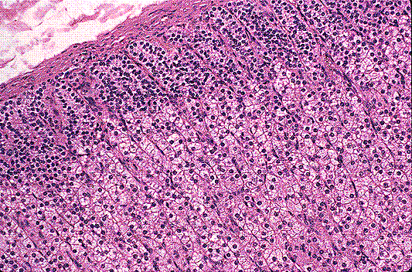
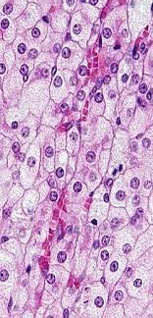
Zones of the cortex
Cortex | Z. Fasciculata Spongiocytes
% of volume | 65%
Shape of cells Arrangement | Polyhedral Cords 1 or 2 cell thick
Cytoplasm (Acidophilic) | Numerous vacuoles (spongiocytes)
Lipid droplets | numerous
Function | glucocorticoids
F
Notes:
5

Slide 6
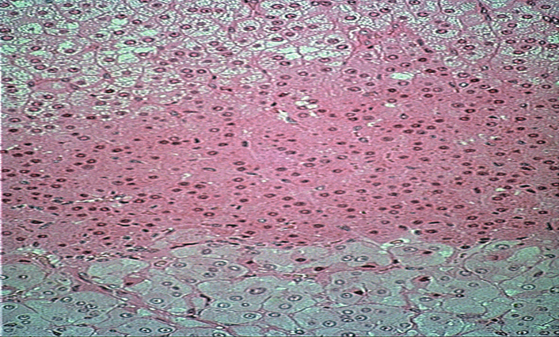
Zones of the cortex
Cortex | Z. Reticularis
% of volume | 7%
Shape of cells Arrangement | Polyhedral Anastmosing Irregular cords
Cytoplasm (Acidophilic) | less
Lipid droplets | less
Function | Sex hormones
R
Notes:
6

Slide 7
Cells in adrenal cortex are steroid secreting cells
Extensive smooth ER
Mitochondria with tubular cristae
Golgi apparatus
Lipid droplets
Spongiocytes in zona fasiculata (highly vacuolated cells due to lipid droplets)

Slide 8
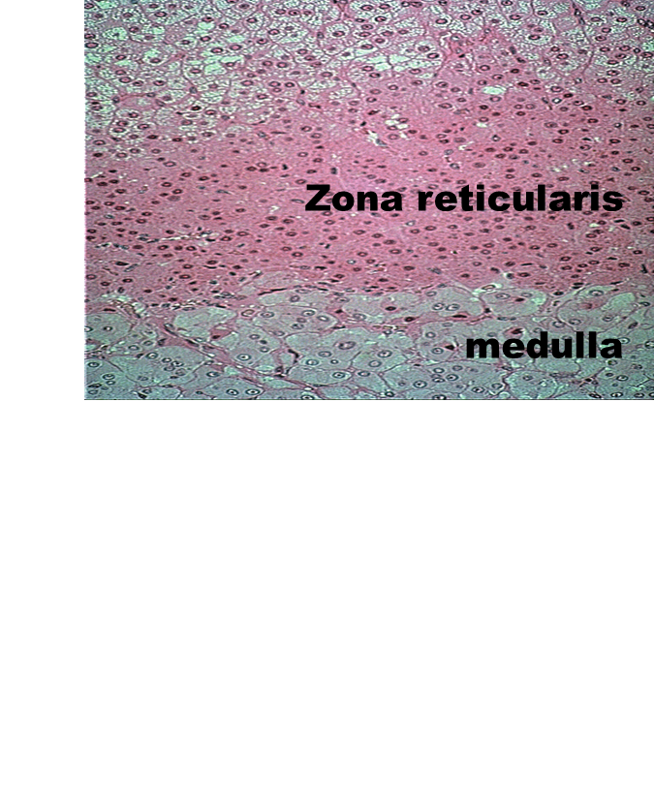
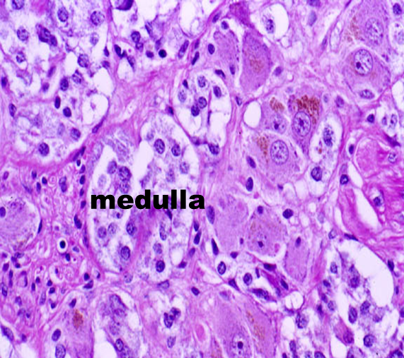
Adrenal medulla
Highly vascular
-Cells are arranged in strands or small clusters with capillaries and venules, weakly basophilic.
It includes Chromaffin cells:
granules of these cells can be stained with potassium bichromate.
Chromaffin cells are, like ganglion cells of the PNS, derived from neural crest cells.

Slide 9
Chromaffin cells epinephrine cells & nor epinephrine cells
LM: large ovoid cells
large spherical nuclei
pale basophilic cytoplasm
arranged in rounded groups
or short cords intimately
related to BVs
Chromaffin reaction

Slide 10
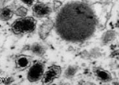
Granules of epinephrine & norepinephrine
Granules in: | Epinephrine-secreting cells | Norepinephrine-secreting cells
Size | Small | larger
Contents | Fill the granule | Do not
 | E M protein synthesizing cells: rER mitochondria prominent Golgi membrane-limited electron-dense granules of either epinephrine or norepinephrine
Notes:
10

Slide 11
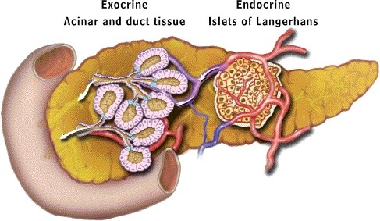
PANCREAS

Slide 12
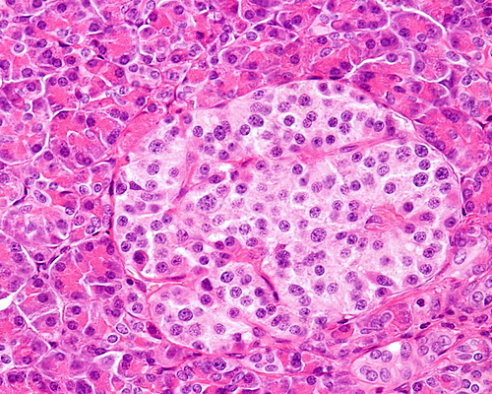
PANCREAS
Exocrine and endocrine gland.
The exocrine part produces pancreatic juice.
The endocrine part, ~1% , consists of the cells of the islands of Langerhans.
Endocrine part: Islets of Langerhans
Masses of pale staining cells scattered between the pancreatic acini
They are more in the tail than head of pancreas
The cells are separated by fenestrated
capillaries (highly vascularized)
Cells of islets of Langerhans are
Alpha, Beta, Delta, F (PP) cells

Slide 13
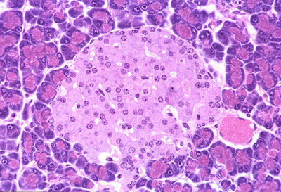
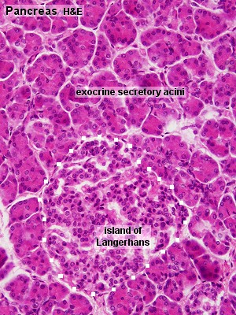
Structure :of the islands of Langerhans.
Stroma:
Surrounded by thin capsule
Parenchyma
cellular composition of the islands
70% beta-cells, insulin. Insulin stimulates
20% alpha-cells, glucagon.
5- 10 % delta-cells which secrete somatostatin,
F- cells (PP)

Slide 14
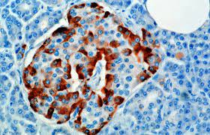
Beta (B) cells (70%):
Produce insulin which lower blood sugar
Cells are small in size, most numerous cell type, central in location in islets
Stain blue
EM: appear in two functional stages active & resting
When active synthesize insulin. When resting packed with granules storing insulin
Cells divide at very slow rate
Alpha (A) cells (20%):
Produce glucagon which increase blood sugar
Cells larger in size, fewer in number, peripheral location in Islets
Stain pink
Beta cells
Alpha cells

Slide 15
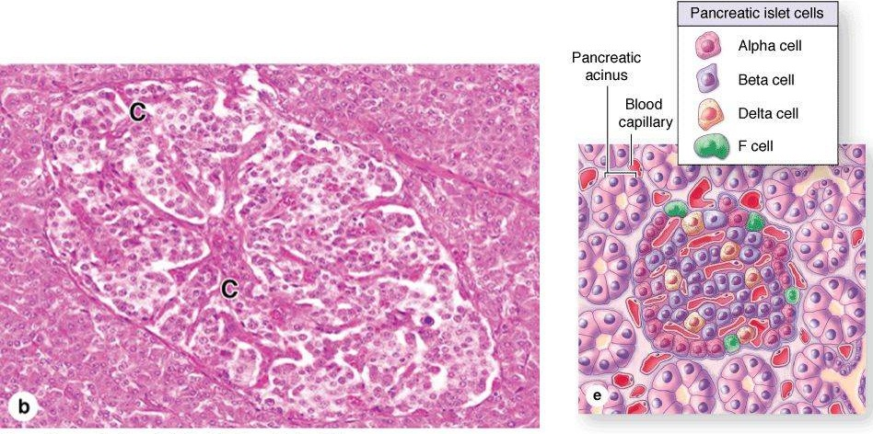
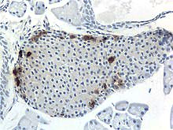
Delta cells:
Secret somatostatin ( growth inhibiting factor)
Cells scattered at periphery and less abundant
F (PP) cells:
Very few
Secrete pancreatic polypeptide h.
Regulate exocrine pancreas
secretions
Delta cells
PP cells

Slide 16
DIFFUSE NEUROENDOCRINE SYSTEM
most of these cells are derived from endodermal cells of the embryonic gut or bronchial buds.
These secretory cells are considered neuroendocrine because they produce many of the same polypeptides and neurotransmitter-like molecules
GIT (enteroendocrine cells) :
G cells EC cells
ECL cells D cells
S cells
Respiratory system
Bronchial Kulchitsky cells
Small granule cells
Neuroepithelial bodies
among tracheobronchial epithelium.
Other sites
Myocardium: → cardiodilatins and atrial naturetic polypeptides
Hypothalamus: supraoptic and paraventricular nuclei → oxytocin and vasopressin
Endocrine system: pinealocytes,parafollicular cells, chief cells, cells of islets of Langerhans and some adenohypophyseal and adrenal medullary chromaffin cells

Slide 17
Diffuse neuroendocrine system
Mode of action
Endocrine → target organ
Paracrine → surrounding tissue
Autocrine → themselves
Neuroendocrine → neurosecretion
Apudocytes or APUD cells
Classification according to staining activity
Argentaffin cells: ppt silver in absence of reducing agent
Argyrophilic cells: ppt silver in presence of reducing agent
Chromaffin like cells: bind K dichromate

Slide 18
Microscopic features
Two types:
Open type
Closed type
Electrolucent cytoplasm
Few small secretory granules at the base or vascular pole
Small infranuclear Golgi
Sparse rER
Apical part
APUD of small intestine

Slide 19
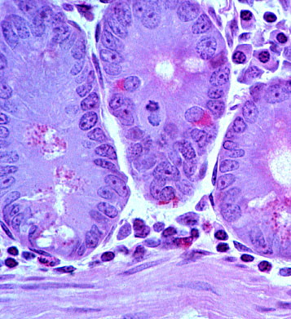
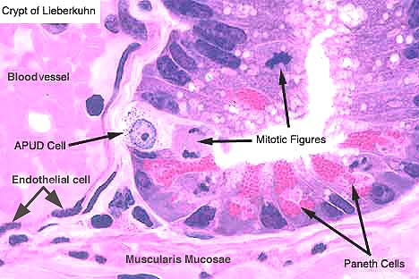
Enteroendocrine cells
Notes:
19

