Slide 1
وسهلا
أهلا
الأستاذ الدكتور يوسف حسين
أستاذ التشريح وعلم الأجنة - كلية الطب – جامعة الزقازيق – مصر
رئيس قسم التشريح و الأنسجة و الأجنة - كلية الطب - جامعة مؤتة - الأردن
دكتوراة من جامعة كولونيا المانيا
اليوتيوب Dr. Youssef Hussein Anatomy
جروب الفيس د. يوسف حسين (استاذ التشريح)

Slide 2
Functional areas of the Superolateral surface

Slide 3
Motor area 4
Primary motor area corresponds to the precentral gyrus (area 4), anterior part of the paracentral lobule Controls motor functions

Slide 4
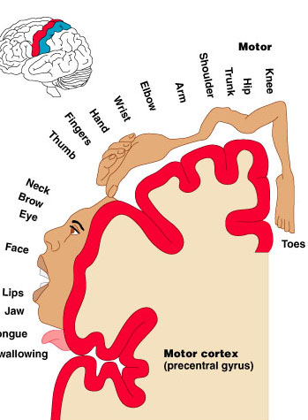
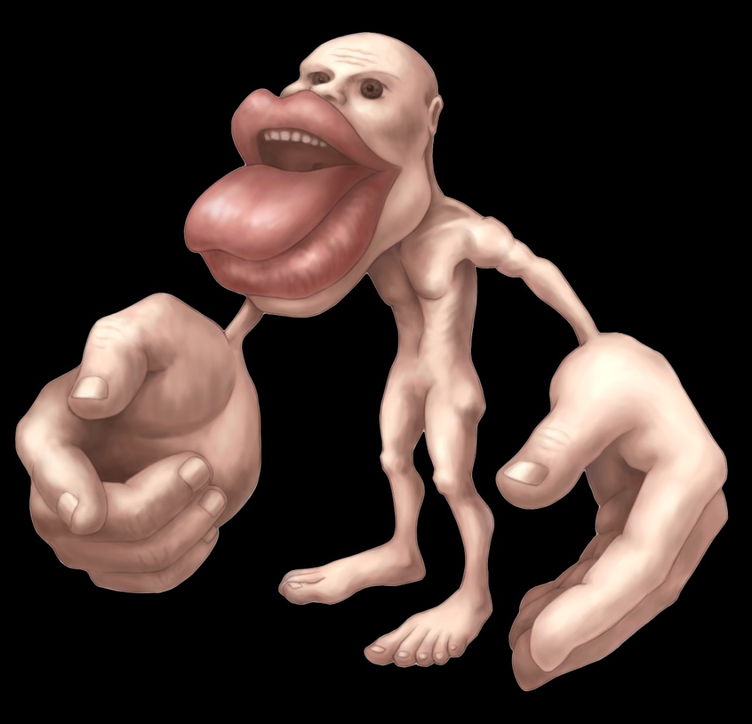
A body represented in upside down.
Head represented in lower part of precentral gyrus, leg and foot, represented on medial surface of hemisphere in paracentral lobule, size depends on skill
Lesion of the area 4 results in contra-lateral hemiplegia (UMNL).

Slide 5
Premotor area 6
Located anterior to the precentral gyrus
It is the origin of extrapyramidal fibers
Controls more complex movements
Involved in the planning of movements and storage of the learned movements to bring them later on.

Slide 6
Frontal eye field area 8
Fontal eye field (Brodmann area 8):
It lies anterior to the premotor cortex in the superior frontal gyrus
It controls movements of the eyes when eyes follow a moving target.
Notes:
- It lies anterior to the premotor cortex.
It controls movements of the eyes when eyes follow a moving target.

Slide 7
(Broca’s area)
44, 45
Motor speech (Broca's) area (areas 44, 45) is located in inferior frontal gyrus between the anterior and ascending rami (triangular area) of the lateral sulcus of the dominant hemisphere (95%).
It brings about the formation of words by its connections with the adjacent primary motor areas; the muscles of the speech.
Lesion in this area produces motor aphasia (loss of speech).
Notes:
يؤدي إلى تكوين الكلمات من خلال صلاته بالمناطق الحركية الأولية المجاورة ؛ عضلات الكلام.

Slide 8
(Writing area)
Writing area (Exner's area);
- It lies in the middle frontal gyrus.
The person able to express himself in written words
Lesion leading to Agraphia (loss of ability to write)

Slide 9
Prefrontal areas
9
10
11
12
Prefrontal area (areas 9,10,11,& 12)
- It lies in the most anterior part of the frontal lobe.
It is responsible for:
A- Planning, thinking, remember and problem solving
B- Motivating, emotions, good & sinful behavior, mood, psychological activities.
C- Telling of lies and truth
Notes:
أ- التخطيط والتفكير والتذكر وحل المشكلات ب- التحفيز ، الانفعالات ، السلوك الحسن والخاطئ ، المزاج ، الأنشطة النفسية. ج- قول الكذب والحقيقة

Slide 10
Somatosensory area 1,2,3
1
2
3
Somatosensory (Primary sensory) cortex corresponds to postcentral gyrus (areas 1,2,3), posterior part of paracentral lobule
It receives sensations from opposite side of body.
The body represented upside down
Lesion in this area leads to loss of sensation in opposite side of the body.

Slide 11
8
1
6
2
9
6
4
10
W
3
11
W
44
45
12
Secondary sensory 5&7
Secondary (Association) sensory area (area 5, 7);
- It occupies the superior parietal gyrus.
Function, stereognosis (ability to identify the familiar objective manually in the absence of visual and auditory information) shape, roughness, size of objects
Lesion results in asteriognosis

Slide 12
Supramarginal gyrus
Angular gyrus
40
39
Wernicke's area
Superior temporal sulcus
Sensory speech area (Wernicke’s- area 39, 40).
- It lies in inferior parietal gyrus extending to superior temporal gyrus, angular and marginal gyri.
- It is connected to motor speech area, auditory area and visual area.
- It is responsible for understanding spoken and written words.
- Lesion in this area produces sensory aphasia (can not understanding spoken and written words.).

Slide 13
Second auditory area 22
Pry auditory area
41&42
Primary auditory area (areas 41, 42)
It is present in the floor of the posterior ramus of the lateral sulcus and the middle part of the superior temporal gyrus (Heschl's gyrus).
It receives auditory radiation from the medial geniculate body (MGB).
- Lesion of this area leads to diminished hearing.
Auditory association area (Secondary) ( area 22): behind the primary auditory area.
- It is responsible for recognition and interpretation of the sounds.

Slide 14
the lips of the lateral sulcus are separated
Gustatory area 43
Insula
Gustatory area (area 43): lies in the insula .
It is concerned with the recognition of the taste sensation.
Insula lies at the bottom of the deep lateral sulcus and cannot be seen from the surface unless the lips of the sulcus are separated.

Slide 15
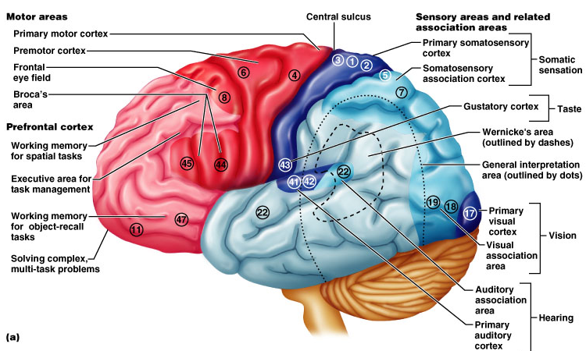
Functional and Structural Areas of the Cerebral Cortex
Notes:
Three kinds of functional areas
somatomotor areas, Somatosensory areas and Association areas
Brodmann areas – 52 structurally distinct areas

Slide 16
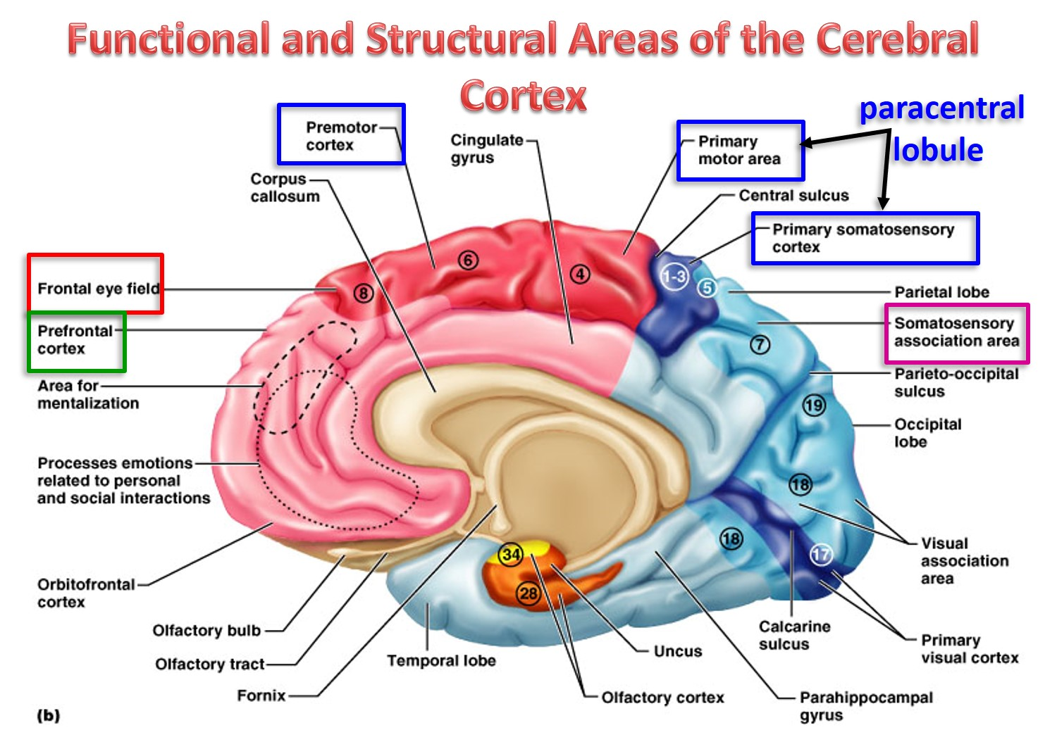

Slide 17
Thank you
Questions
I/Azzam - 2004

