Slide 1
Foreign Bodies in ear, nose and throat
Presented by :
Dina Awwad
Mohammed Btoush

Slide 2
Nasal foreign body:

Slide 3
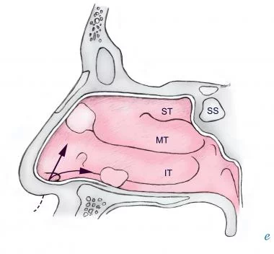
1-Nasal Foreign Bodies
Nasal foreign bodies (NFBs) are commonly encountered in emergency departments.
May present with signs and symptoms of unilateral nasal obstruction and unilateral rhinorrhea or sinusitis.
Unilateral rhinorrhea is a foreign body until proven otherwise.
Unilateral foreign bodies affect the right side more than left , this may be due to a preference of right-handed individuals to insert objects into their right naris.
The most common locations for NFBs to lodge are just anterior to the middle turbinate or below the inferior turbinate.

Slide 4
Nasal Foreign Bodies (Inanimate)
More frequently seen in the pediatric (2-5) years who have the highest incidence (Children's interests in exploring their bodies), they can also affect adults, especially those with mental retardation or psychiatric illness (may also insert foreign bodies to relieve preexisting nasal mucosal irritation or epistaxis).
Foreign bodies may be :
Retrograde lodgment of food particles into the nasal cavity may occur with vomiting.
Items commonly found in the nose, jewelry, paper products erasers, crayons, buttons, rocks, small toys, and hardware items.
Food items also are common, especially peas, beans, nuts, and candies.
Small disc batteries deserve special mention because they may produce extensive tissue damage. :
This type of battery is found in electronic games, watches, calculators, and hearing aids. They cause destruction via low-voltage electrical currents, and even liquefactive necrosis if their alkaline contents leak out.
Major complications of this particular foreign body include septal perforation, nasal synechiae (Adhesions in the nose -scar ), and stenosis of the nasal cavity.

Slide 5
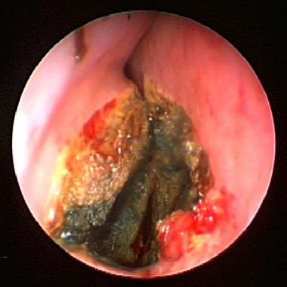
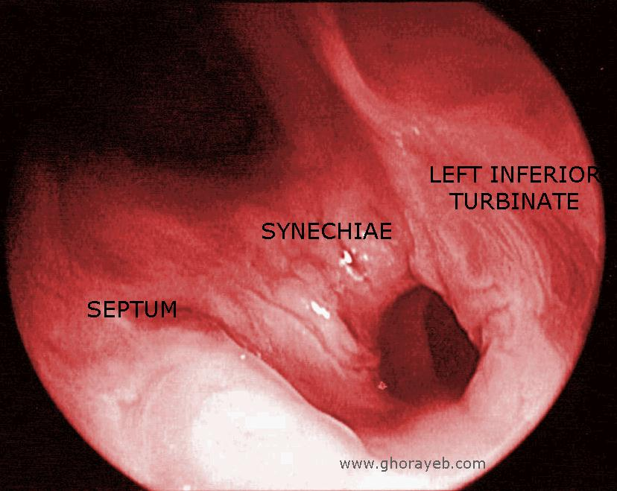

Slide 6
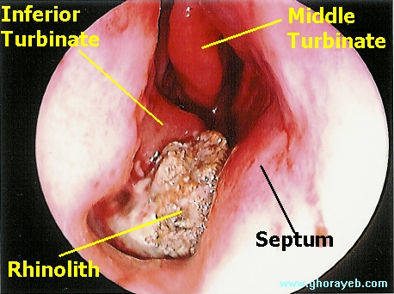
Iatrogenic nasal foreign bodies include nasal packs, splints (post septoplasty), cotton, needles, and pieces of instruments. Fragments of bone and cartilage may be left in the nasal cavity postoperatively.
Trauma may cause nasal foreign bodies such as bone, cartilage fragments, or teeth. An exogenous foreign body may lodge in the nasal cavity.
Firmly impacted and unrecognized foreign bodies can in time become coated with calcium, magnesium, phosphate, or carbonate and become a rhinolith. Rhinoliths are radio-opaque and typically are found on the floor of the nasal cavity.

Slide 7
Clinical manifestations
The onset of symptoms varies with the size and type of foreign body and the degree of obstruction and inflammation it produces.
Inorganic materials are often asymptomatic and may be discovered incidentally (unwitnessed).
Organic foreign bodies tend to be more irritating to the nasal mucosa and thus may produce earlier symptoms.
The most common sign of a nasal foreign body is unilateral purulent rhinorrhea.
Unilateral nasal obstruction and epistaxis may occur ,foul odor, sneezing, snoring, or pain.
Unilateral sinusitis and otitis media may develop as a result of a nasal foreign body.

Slide 8
Diagnosis
The physical examination is the main diagnostic tool.
Diagnosis of a nasal foreign body may be straightforward, particularly in the cooperative patient.
The diagnosis becomes more difficult when the foreign body has caused an inflammatory reaction. Visualization of the object then is limited because of edema and bleeding of the nasal mucosa.
Initial evaluation should include examination of the nose by Anterior Rhinoscopy , to see anterior 1/3 (nasal speculum and headlight). FB , local trauma may exist with erythema, edema, bleeding.
Looking for additional foreign bodies, whether they are in the nose or other body cavities is important.
Visualize the tympanic membranes for signs of acute otitis media, assess for sinusitis, and auscultate the chest and neck for wheezing or stridor, which may be a clue of foreign body aspiration.
Topical vasoconstriction and anesthesia are helpful for examination and Removal.
Radiographic assessment may be helpful if the object is radiopaque and also to evaluate for secondary sinusitis.
Flexible or rigid endoscopy ( posterior rhinoscope ) may be helpful in diagnosis when there is no object visualized on anterior rhinoscopy.

Slide 9
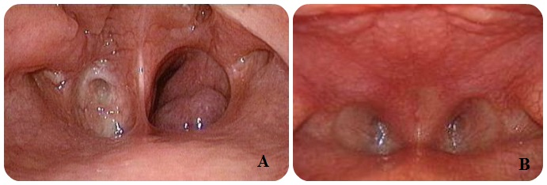
Differential diagnosis
Differentials to consider in the diagnosis of NFB include the following :
Sinusitis.
Nasal Polyps.
Tumor.
Upper respiratory infection (URI).
Unilateral choanal atresia (congenital anomaly in which the posterior nasal cavity is obstructed by either a cartilage or membrane).
Choanal atresia

Slide 10
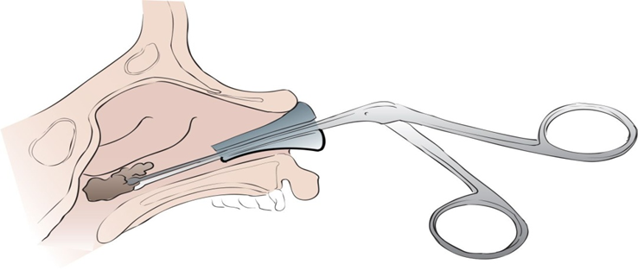
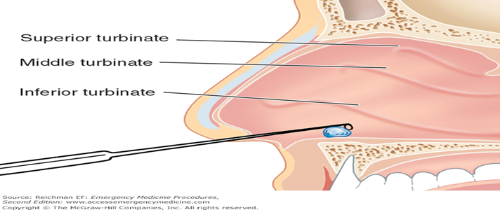
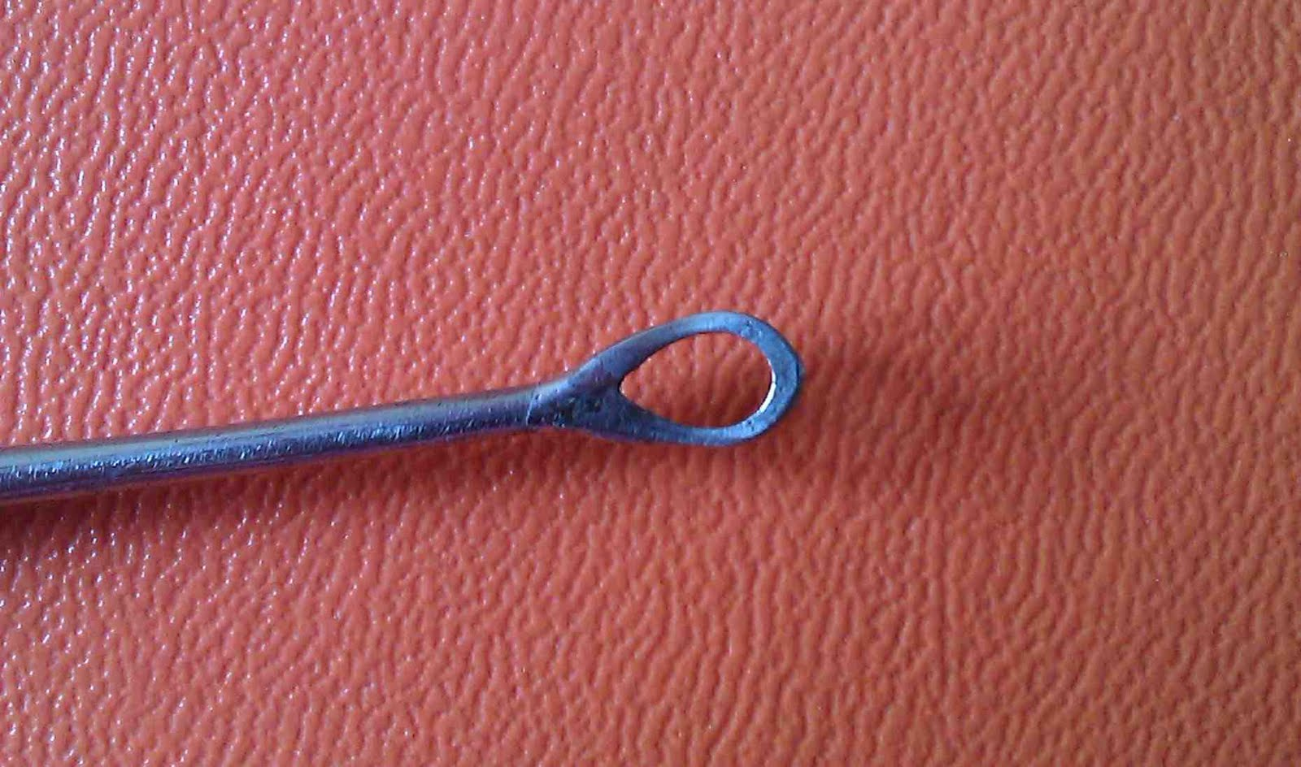
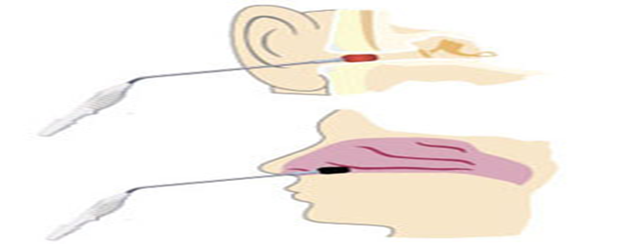
Management of nasal FB
Direct instrumentation :
For easily visualized, nonspherical, nonfriable foreign bodies. Previously described instruments include hemostats, alligator forceps, Hooked probes, hook-scope and bayonet forceps.
Ring probe :
Used for spherical & friable foreign bodies.
Suction :
For easily visualized, smooth or spherical foreign bodies.

Slide 11
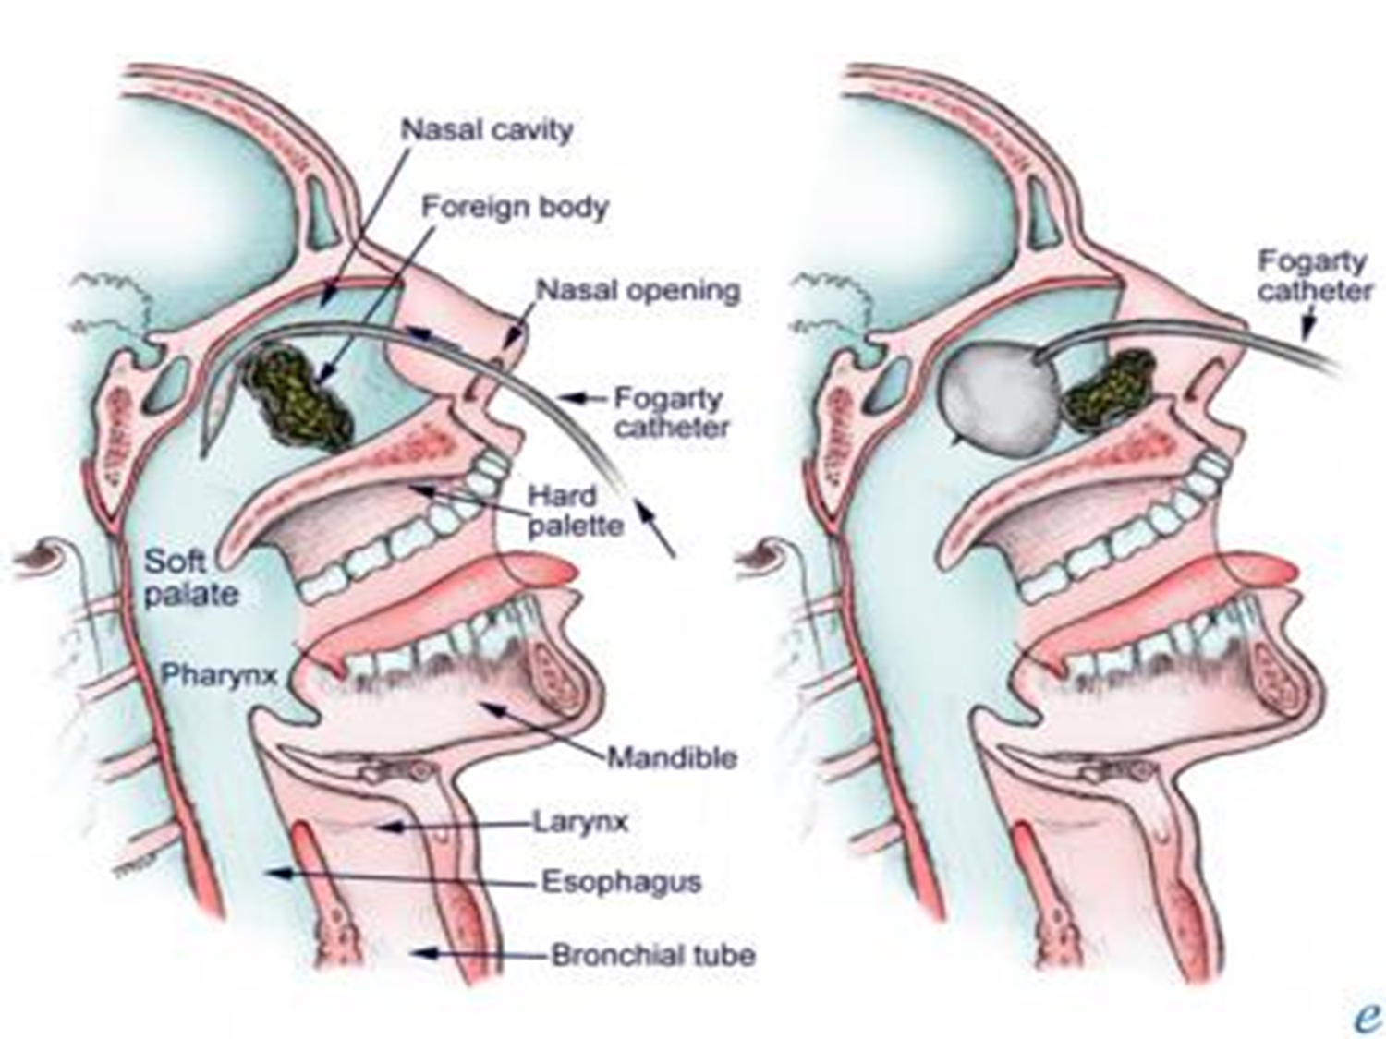
Management of nasal FB
Balloon catheters :
Small, round objects that are not easily grasped by direct instrumentation.
Regardless of catheter type(Foley catheters or Fogarty catheters), the technique is similar. First, the balloon is inspected, and the catheter is coated with 2% lidocaine gel. Then, when the patient lying supine, it is inserted past the foreign body and inflated with air or water (2mL in small children and 3mL in larger children). After inflation, the catheter is withdrawn, pulling the foreign body with it.
lidocaine : local anesthetics.

Slide 12
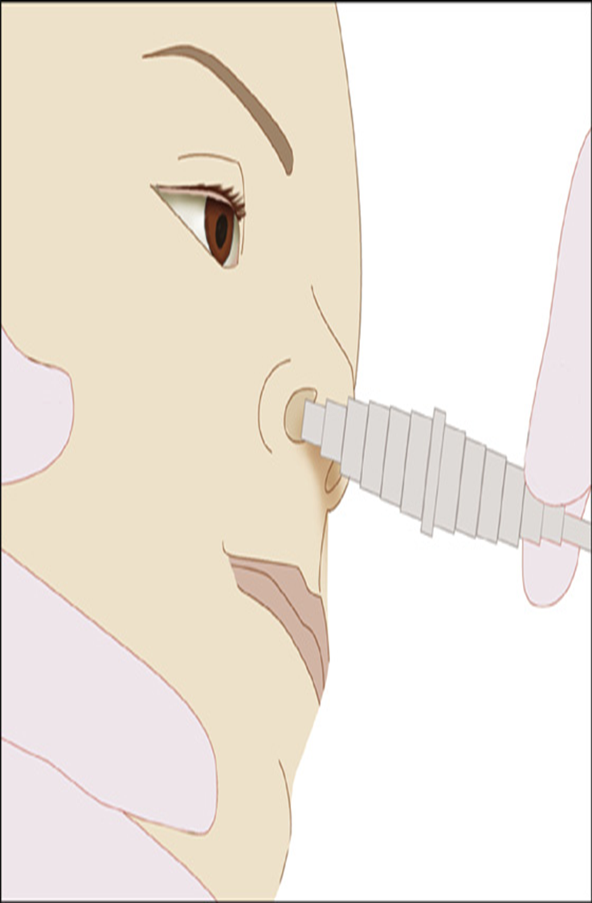
Management of nasal FB
Positive pressure :
Large, occlusive foreign bodies.
The least invasive form, "forced exhalation" can be accomplished by occluding the unaffected nostril and asking the child to blow hard out of his or her nose.
Another positive-pressure technique delivers air into the unaffected naris with the patient's mouth closed. In this method, the patient is placed on his or her side (foreign-body-side down), and the delivery device (known as a Beamsley Blaster) provides high-flow oxygen (10-15L/min) into the unaffected naris.

Slide 13
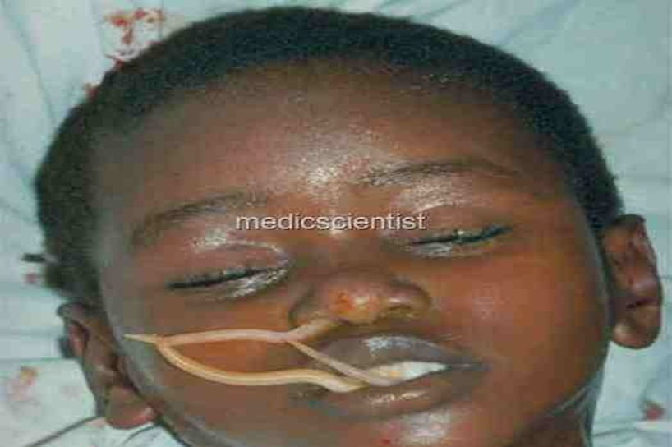
Management of nasal FB
If the object is metallic may be magnetized to assist in gently pulling the object from the nose.
All attempts at removal can be complicated by mucosal damage and bleeding. In addition, all failed attempts can result in posterior displacement of the NFB.
Animate foreign bodies ☹ ☹ ☹ :
Larvae and worms occasionally inhabit the nasal cavities of persons living in tropical and unhygienic environments. They can lead to the destruction of the nasal mucosa and subsequent necrosis of septal cartilage and turbinates. Patients with unhealthy noses, such as with ozena, are more susceptible to these problems than healthy patients.
Ozena : is a disease of the nose , called also”atrophic rhinitis” in which the bony ridges and mucous membranes of the nose waste away.
Nasal crusting, discharge, and a very bad smell.
Ascaris lumbricoides :
Severe congestion and purulent rhinorrhea occurs.
The parasitic infestation is treated systemically with mebendazole.
The worms should be removed from the nasal cavity.

Slide 14
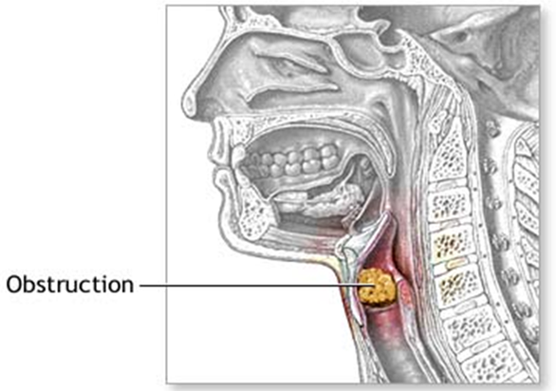

Slide 15
2-Throat Foreign Bodies
All pharyngeal foreign bodies are medical emergencies that require airway protection.
Because of complete airway obstruction usually occurs at the time of aspiration and results in immediate respiratory distress.
Seeds ,nuts , bones & coins.
Symptoms :
Patients with non obstructing or partially obstructing foreign bodies in the throat often present with a history of choking, dysphagia, odynophagia, or dysphonia.
Pharyngeal foreign bodies should also be suspected in patients with undiagnosed coughing, stridor, or hoarseness.
The sudden onset of stridor in a formerly normal child must always be regarded as being due to a foreign body until proved otherwise.

Slide 16
Examination :
Examine the pharynx and the larynx.
A foreign body in the cervical esophagus will cause pain on pressing the larynx against the spine.
Imaging :
Radiography can be helpful in localizing coins, button batteries, and other radiopaque objects, but most laryngeal foreign bodies, are radiolucent.
Esophagoscopy.
Laryngoscopy.
If the obstruction is Complete ,need more investigation

Slide 17
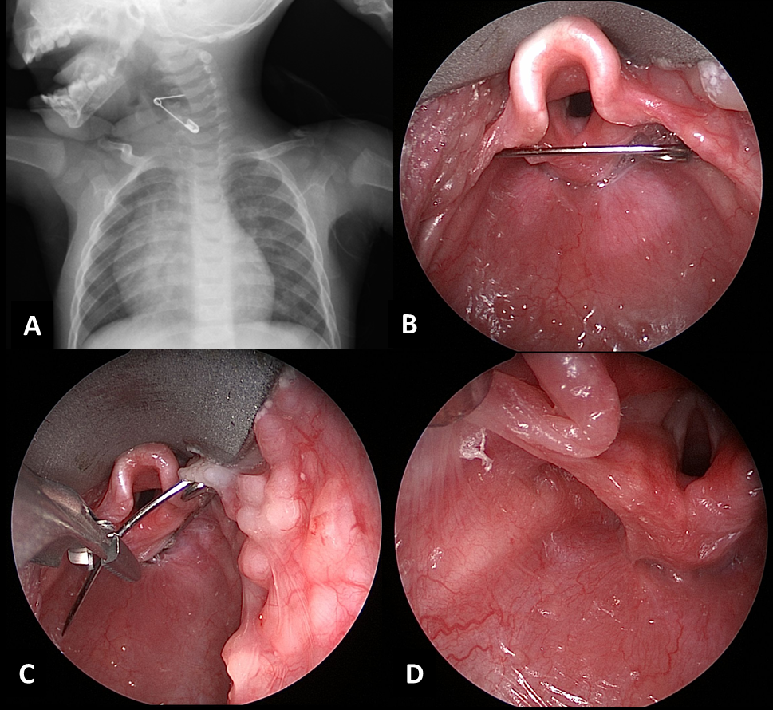
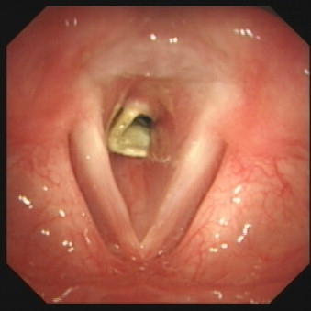

Slide 18
Management of throat foreign body
Heimlich's maneuver. Stand behind the person, and place your arms around his lower chest and give four abdominal thrusts. The residual air in the lungs may dislodge the foreign body providing some airway.
2. Cricothyrotomy or emergency tracheostomy should be done if Heimlich's maneuver fails.
Once acute respiratory emergency is over, foreign body can be removed by direct laryngoscopy.
Complications :
Airway obstruction.
Laryngeal edema.
Injury of esophagus by the FB.
Pushing the foreign body into the subglottic space, esophagus, or trachea.

Slide 19
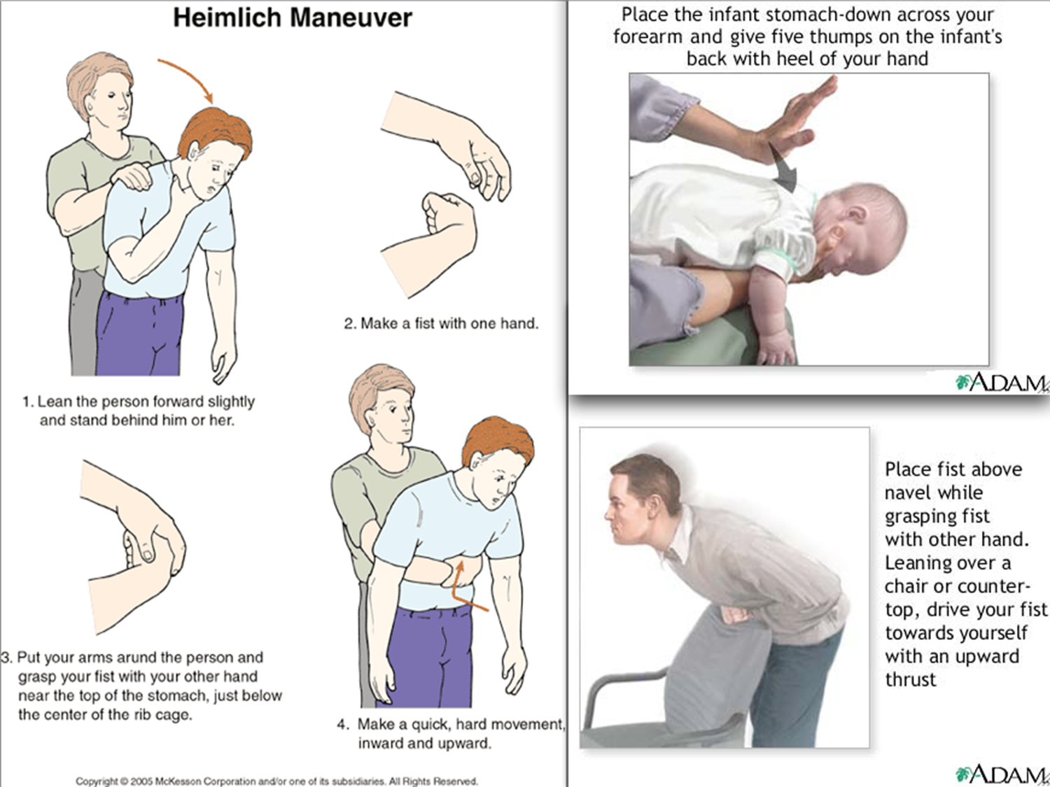

Slide 20
Ear Foreign Body

Slide 21
3-Ear Foreign Bodies
Foreign bodies of the ear are relatively common in emergency medicine. They are seen most often but not exclusively in children.
Various objects may be found, including toys, beads, stones, folded paper, and biologic materials such as insects or seeds.
History :
Most adults are able to tell the examiner that there is something in their ear, but this is not always true!!!!. For example, an older adult with a hearing aid may lose a button battery or hearing aid in their canal and not realize it.
Children, depending on age, may be able to indicate that they have a foreign body, or they may present with complaints of ear pain or discharge.
Patients may be in significant discomfort .
Patients may present with hearing loss.
Pain or bleeding may occur with objects that abrade the ear canal or rupture the tympanic membrane or from the patient's attempts to remove the object.

Slide 23
Ear Foreign Bodies
Physical examination :
The physical examination is the main diagnostic tool.
Physical findings vary according to object and length of time it has been in the ear.
An inanimate object that has been in the ear a very short time typically presents with no abnormal finding other than the object itself seen on direct visualization or Otoscopic examination.
Hearing loss may be noted.
With delayed presentation, erythema and swelling of the canal and a foul-smelling discharge may be present.
Insects may injure the canal or tympanic membrane by scratching or stinging.

Slide 24
Ear Foreign Bodies
Causes :
A patient, caretaker, or sibling intentionally places an object in the ear canal and is unable to remove it.
Insects may crawl or fly into the ear.
Differential diagnosis :
Cerumen impaction.
Hematoma.
Otitis externa.
Tumor.
Tympanic membrane perforation.

Slide 25
Ear Foreign Bodies
Diagnosis :
No specific laboratory or radiologic studies are recommended. The physical examination is the main diagnostic tool.
Use an otoscope while retracting the pinna in a posterosuperior direction.
Treatment & Management :
No specific prehospital treatment exists other than transport to a hospital ☺ ☺ . Occasionally, treating significant pain or nausea may be necessary.

Slide 26
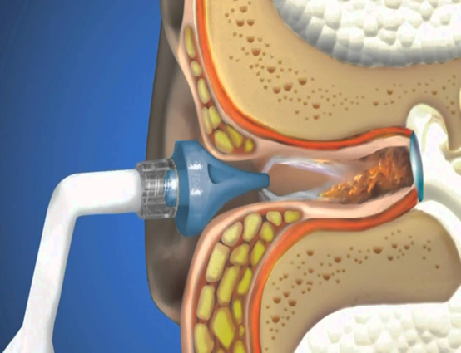
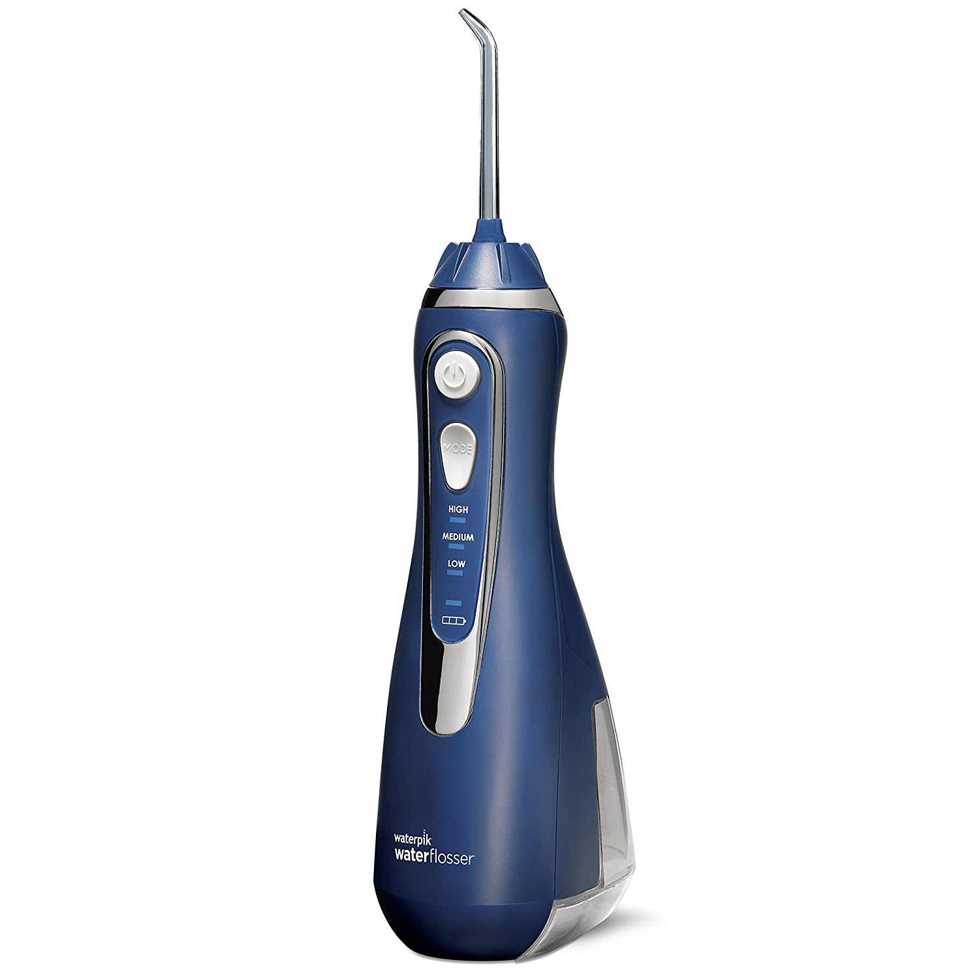
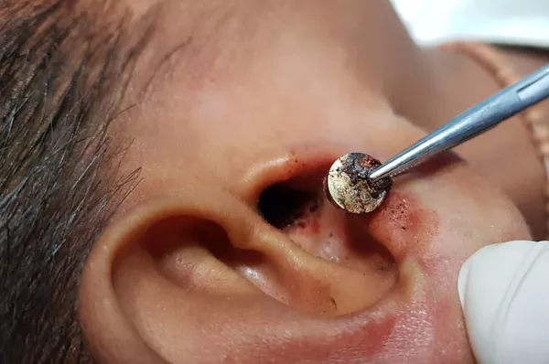
Methods of removal
Irrigation is the simplest method of foreign body removal.
The direction of water is PS.
The water’s temperature should be near the core temperature (37.5) , if more , this can lead to Nystagmus and Vertigo.
An electric ear syringe, available in some areas, may be very helpful for irrigation.
Use of the commercial product Waterpik is not recommended because the high pressure it generates may perforate the tympanic membrane.
Contraindications :
Tympanic membrane perforation.
Irrigation with water is contraindicated for soft objects, organic matter, or seeds, which may swell if exposed to water.
If there are AOM, OME or Otitis Externa.
Irrigation should be avoided in patients with button batteries in the ear because the electrical current and/or battery contents can cause a liquefaction tissue necrosis.

Slide 27
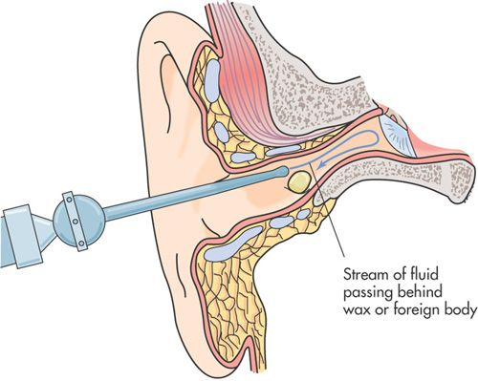
Complications of Irrigation
Perforation of tympanic membrane.
Otitis externa.
Damage to external auditory meatus.
Pain.
Deafness.
Vertigo.
Tinnitus.

Slide 28
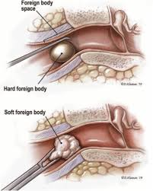
Methods of removal
1- Suction.
2- Grasp the object with forceps.
3- Place a right-angled hook behind the object and pull it out.
Live insects can be killed rapidly by instilling alcohol, 2% lidocaine (Xylocaine), or mineral oil into the ear canal. This should be done before removal is attempted but should not be used when the tympanic membrane is perforated.

Slide 29
Medications
After the foreign body is removed, inspect the external canal.
For most foreign bodies, no medications are needed.
However, if infection or abrasion is evident, fill the ear canal 5 times/day for 5-7 days with a combination antibiotic and steroid otic suspension (Cortisporin (Neumycin + polymyxin B sulphate + Hydrocortisone) or Cipro HC).
For Otitis Externa only (Swimmer’s ear) !!!!:
Avoid any interventions that push the object in deeper.
We might need to sedate the patient to attempt removal of the object.
Consult an ENT specialist if the object cannot be removed or if tympanic membrane perforation is suspected.
Notes:
Cortisporin Otic Suspension (neomycin and polymyxin B sulfates and hydrocortisone) is a combination of two antibiotics and an anti-inflammatory corticosteroid used to treat outer ear infections caused by bacteria (also known as swimmer's ear).

