Slide 1
FLEXOR RETINACULUM & HAND
By
Dr Abulmaaty Mohamed Assistant professor Anatomy & Embryology Mutah University

Slide 2
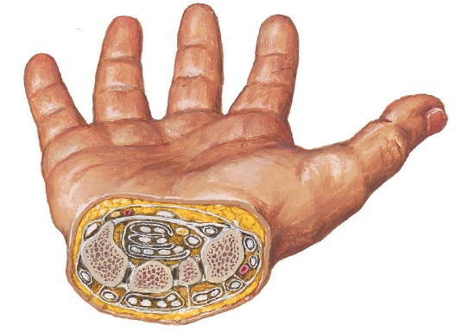
FLEXOR RETINACULUM & HAND

Slide 3
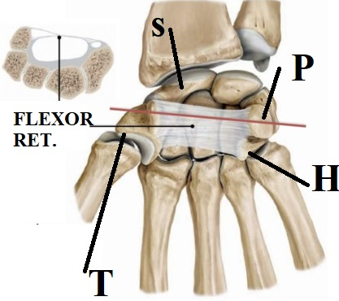
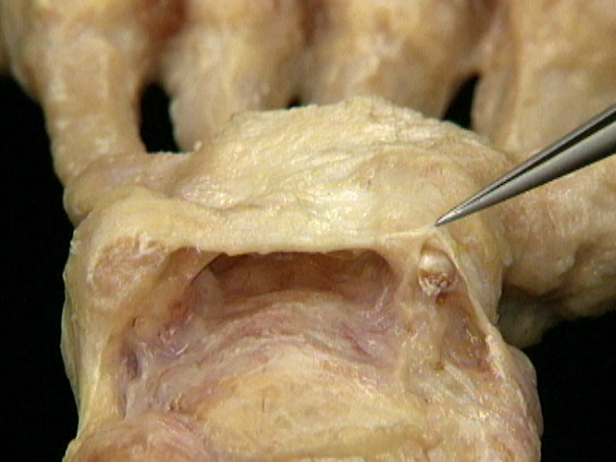
FLEXOR RETINACULUM
Def.: thick band of deep fascia in front of carpal bones converting
their concavity into tunnel called carpal tunnel
Function: keep long flexor tendons in place during contraction.
Attachments:
medially: attached to pisiform & hamate
laterally: splitted into 2 layers then attached to scaphoid & trapezium.

Slide 4
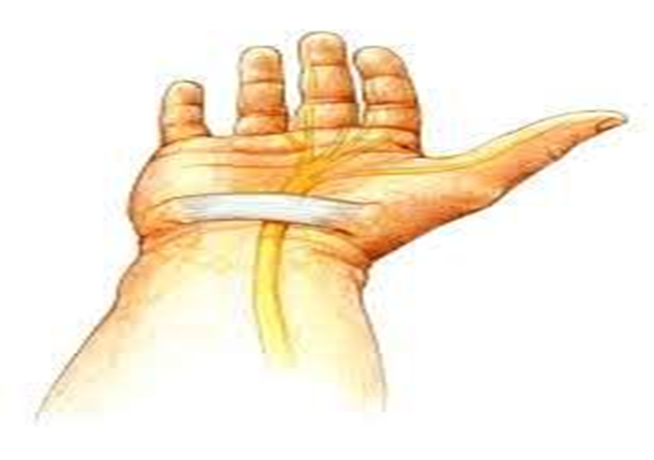
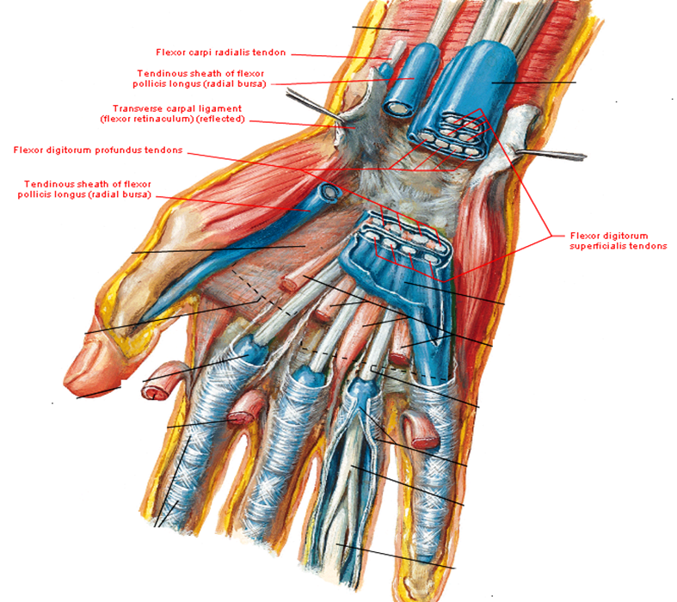
FLEXOR RETINACULUM
Relations:
Deep (structures in carpal tunnel):
1-median nerve( directly under retinaculum)
2-tendon of FPL( lateral to other tendons)
3-synovial sheath for tendon of FPL (radial bursa)
4-tendons of FDS & FDP
5-common synovial sheath for tendons of FDS& FDP (ulnar bursa) Between the 2 lateral laminae:
tendon of flex. carpi radialis & its synovial sheath

Slide 5
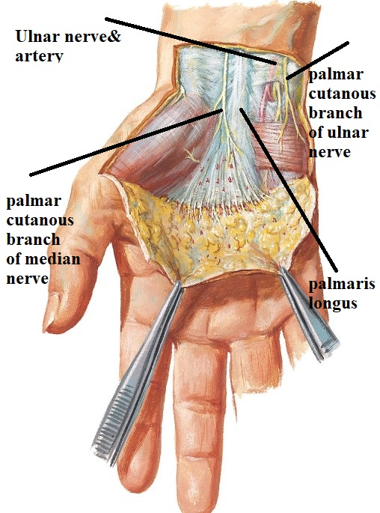
FLEXOR RETINACULUM
Relations:
Superficial: 1-ulnar n.
2-ulnar vessels.
3-palmar cutaneous br. of ulnar n.
4-tendon of palmaris longus.
5-palmar cutaneous br. of median n.

Slide 6
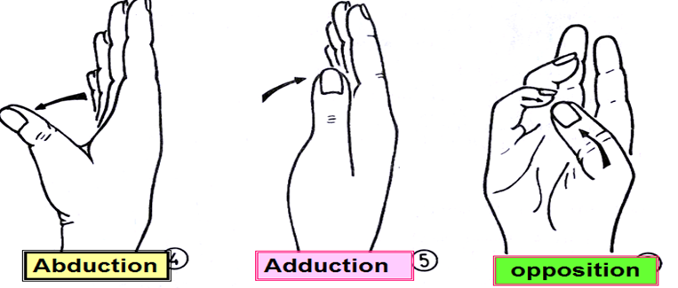
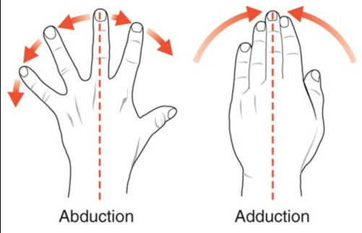
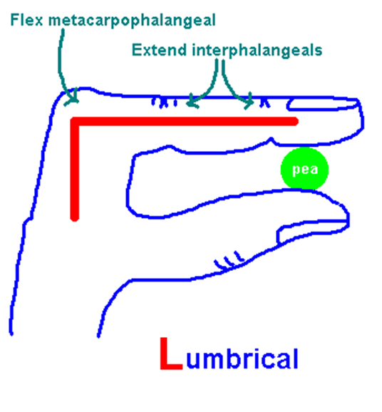
MUSCLES OF THE HAND

Slide 7
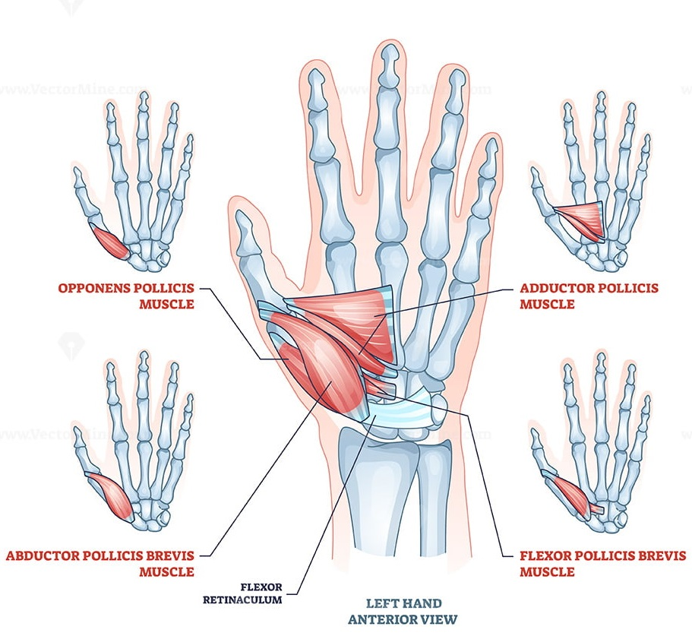
MUSCLES OF THE HAND
Short muscles of thumb
1-Abductor pollicis brevis :-
abduction of thumb
2-Flexor Pollicis brevis:-
flexion of thumb
3-Opponens pollicis:-
opposition of thumb by
flexion & medial rotation
of 1st metacarpal bone
4-Adductor pollicis:-
adduction of thumb
N.B.:- 1,2,3= thenar eminence

Slide 8
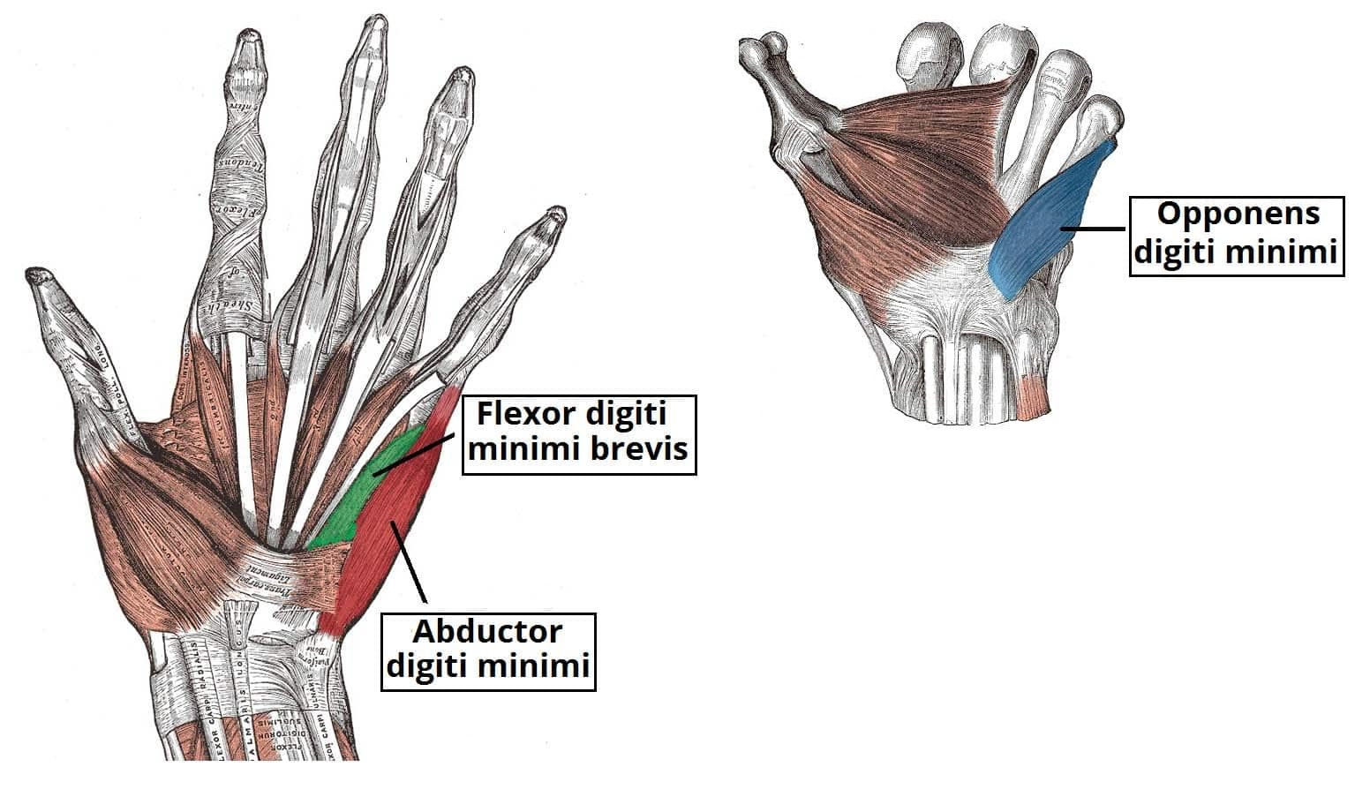
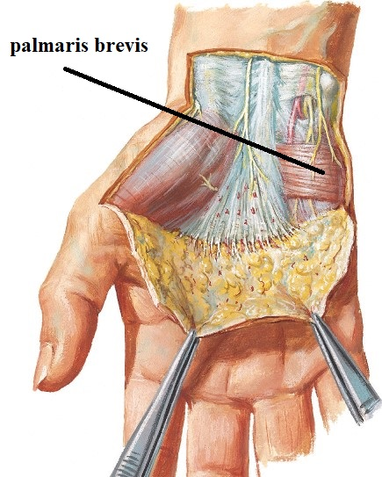
MUSCLES OF THE HAND
Short muscles of little finger
1-Abductor digiti minimi :-
abduction of little finger
2-Flexor digiti minimi:-
flexion of little finger
3-Opponens digiti minimi:-
lateral rotation of 5th metacarpal bone
4-palmaris brevis:-
to corrugate the skin at the base of the hypothenar eminence and So improve the grip of the palm in holding a rounded object
1,2,3= hypothenar eminence

Slide 9
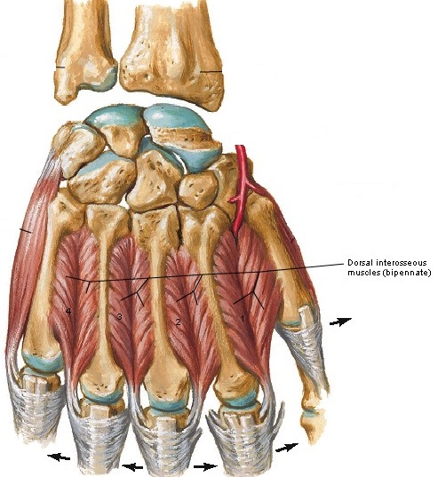
MUSCLES OF THE HAND
The intermediate group
Dorsal interossei:-
bipennate
4 muscles for all fingers except 1st & 5th
abduct the middle 3 fingers (away from axis of middle finger) DAB

Slide 10
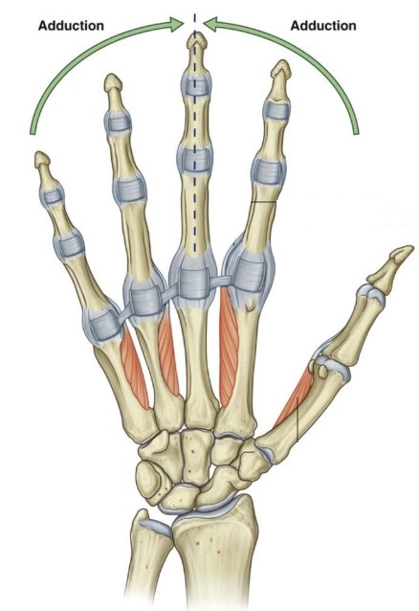
MUSCLES OF THE HAND
The intermediate group
Palmar interossei
unipennate
4 muscles for all fingers except 3rd
adduct the corresponding finger (towards axis of middle finger) PAD

Slide 11
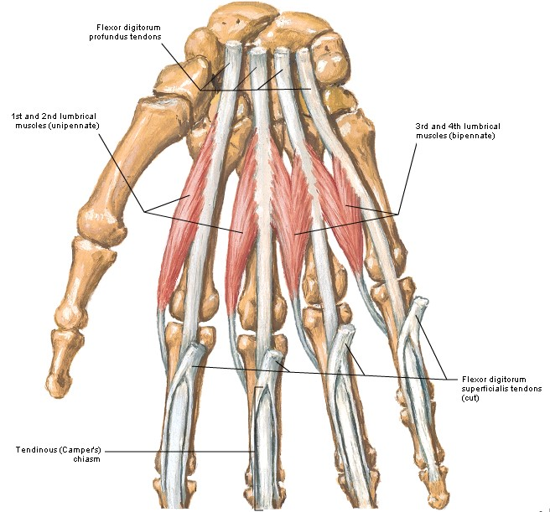
MUSCLES OF THE HAND
The intermediate group
Lumbrical muscles
4 muscles for all fingers except 1st
put the hand in writing position (flexion of M/P& extension of I/P)

Slide 12
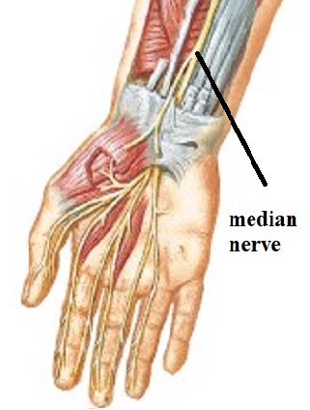
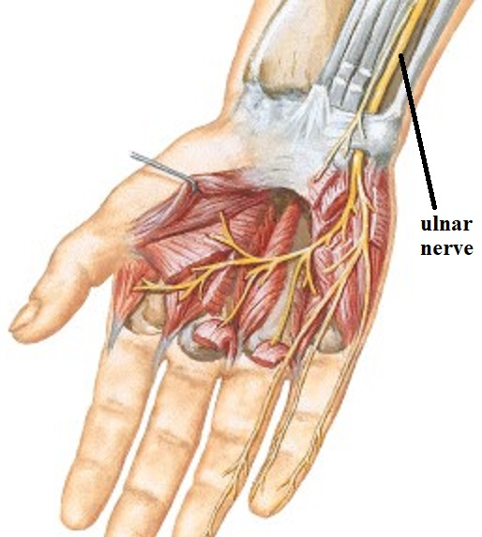
MUSCLES OF THE HAND
Nerve supply of muscles of the hand:-
All muscles of the hand are supplied by the ulnar nerve
except muscles of the thenar eminence and 1st & 2nd lumbricals which are supplied by median nerve

Slide 13
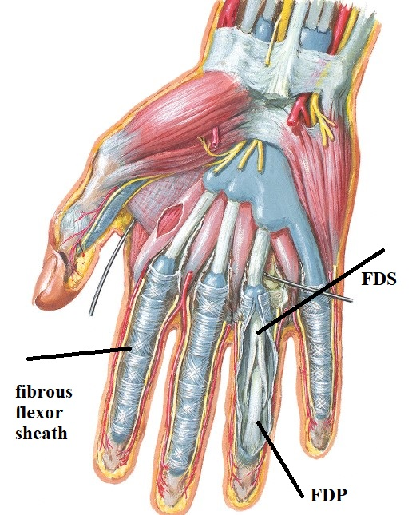
fascia OF THE HAND
Fibrous flexor sheath:
Def: thick deep fascia in front phalanges of medial 4 fingers
contents: 2 tendons FDS & FDP.

Slide 14
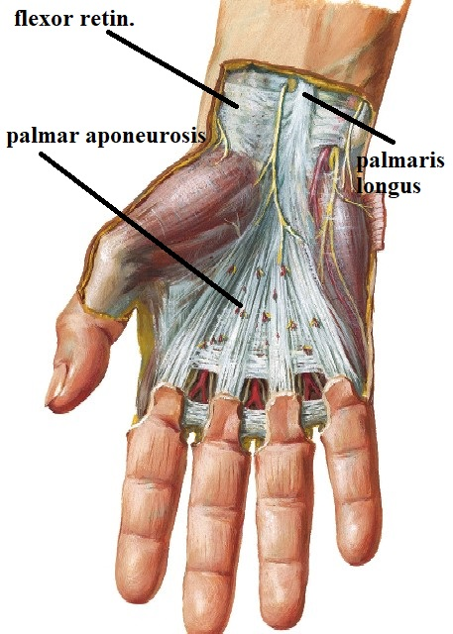
fascia OF THE HAND
PALMAR APONEUROSIS
Def: thick deep fascia in front of middle part of hand.
shape & attachment: triangle with
apex: attach to flexor retinaculum & palmaris longus
base: give 4 slips to medial 4 fingers each attach to skin & fibrous flexor sheath & proximal phalanx

Slide 15
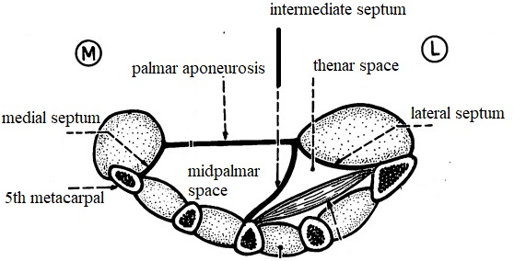
fascia OF THE HAND
PALMAR APONEUROSIS
extensions:
lateral palmar septum
attach to 1st metacarpal bone
medial palmar septum
attach to 5th metacarpal bone .
intermediate palmar septum
attach to 3rd metacarpal bone
N.B: the medial & lateral septa divide hand into: 3 compartments lateral: thenar eminence.
medial: hypothenar eminence
intermediate compartment that is divided by intermediate palmar septum Into1-thenar space: lateral to intermediate septum
2-midpalmar space: medial to intermediate septum

Slide 16
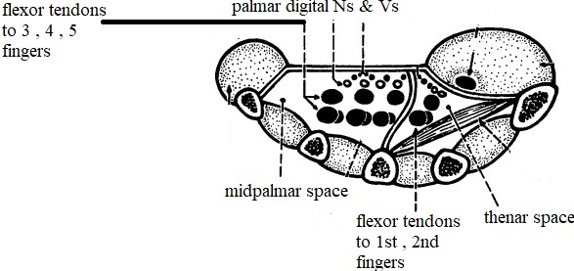
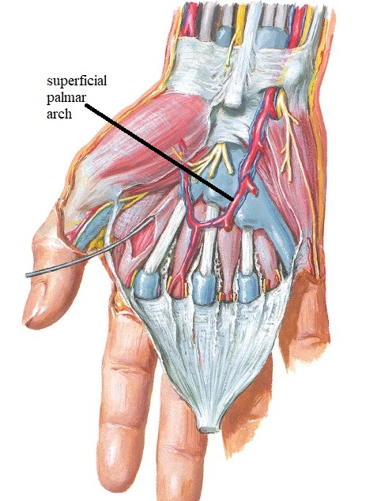
fascial SPACES OF THE HAND
Thenar space
Contents
1-Tendon of FPL TO thumb.
2- Tendons of FDS & FDP TO index
3-digital nerves TO thumb & index
Midpalmar space:
contents
1- Tendons of FDS & FDP TO 3rd , 4th , 5th fingers
2-digital nerves & vessels TO 3rd , 4th , 5th fingers
3-superficial palmar arch
4-deep palmar arch & deep br. of ulnar nerve

Slide 17
THANQ

