Slide 1
Rickets
Mona AbuZaid
Raya Al-shakhanbeh
Eman Hawatmah
Lama Rabe’e
Supervised by : Dr Aseel AlDmour

Slide 2
Definition , pathophysiology &risk factors Mona Abuzaid

Slide 3
Definition
A disease of growing bone at the growth plates and occurs in children only before fusion of the epiphyses , caused by deficient or impaired metabolism of vitamin D , calcium or phosphate -> failure of bone mineralization -> bone softening .
What is bone mineralization ?
Building of bones needs osteoblasts which secrete osteoid ( an organic matrix made of type 1 collagen ) and deposit calcium and phosphate aiming to confer strength to the growing bones .

Slide 4
Normally :-
Bone & blood calcium & phosphate are regulated by
→ vitamin D *through two main steps*
1- adequate intake from food or sun exposure
2- active form of vitamin D (calcitriol)
→ PTH which is secreted in response to low blood calcium levels .

Slide 5
Pathophysiology
Inadequate mineralization caused by deficiency in active vitamin D , phosphate or calcium
Epiphyseal plates are not closed yet in children this leads to softening , impaired growth and malformations

Slide 6
In rickets growth plate cartilage and osteoid continue to expand but mineralization is inadequate, the growth plate thickens. There is also an increase in the circumference of the growth plate and the metaphysis, increasing bone width at the location of the growth plates and causing widening of the wrists and ankles.
There is a general softening of the bones that causes them to bend easily which leads to a variety of bone deformities

Slide 8
Vitamin D deficiency
Causes :
1- intestinal malabsorption
2- decreased UV light exposure
3- medications e.g : phenytoin on long term use
4- liver and kidney diseases

Slide 9
Calcium deficiency
Causes :
1- Low intake
Diet
Premature infants (rickets of prematurity)
2- Malabsorption
Dietary inhibitors of calcium absorption

Slide 10
Phosphorus deficiency
Causes :
1- Inadequate intake
Premature infants (rickets of prematurity)
2- Medications
Aluminum containing antacids

Slide 11
Risk factors :
Age
Most commonly seen at 6-24 months old ( rapid growth and high needs for calcium and phosphate )
Diet
*Breast milk doesn’t contain enough vitamin D to prevent rickets .
*Vitamin D-deficient mothers

Slide 12
Skin color
Dark skin doesn’t react as strongly to sunlight as lighter skin does, so it produces less vitamin D . ( African and middle eastern children are at higher risk for rickets )
Geographic location
Higher risk for rickets in areas with little sunlight

Slide 13
Types of Rickets
Raya Al-shakhanbeh

Slide 14
1. NUTRITIONAL RICKETS
Nutritional rickets caused by inadequate intake of vitamin D and/or calcium

Slide 15
A-Vitamin D deficiency
An infant's vitamin D status depends upon the amount of vitamin D transferred from the mother prenatally and upon the amount of vitamin D ingested or produced by the skin during exposure to ultraviolet light postnatally.
Materno-fetal transfer of vitamin D is mostly in the form of 25-hydroxyvitamin D (25OHD), which crosses the placenta, half-life of 25OHD in an infant is approximately two to three weeks, thus, the serum concentration of vitamin D falls rapidly after birth unless additional sources are available.
Vitamin D-deficiency rickets typically presents between three months and three years of age, when growth rates are high, and exposure to sunlight may be limited.
Notes:
Vitamin D acts on the kidney, intestine, bone in order to resorb both calcium and phosphate
Osteoblasts lay down osteod then it is mineralized meaning there is deposition of minerals (calcium and phosphate) into the osteod matrix
Defective mineralization occurs in rickets and osteomalacia

Slide 16
B-Calcium deficiency
Rickets can occur if calcium intake is very low. This problem generally does not occur unless calcium intake is very low because vitamin D increases intestinal calcium absorption. Most children with calcium deficiency rickets have normal serum 25OHD and high serum 1,25(OH)₂D concentrations, indicating adequate intake of vitamin D. Indeed, the turnover of vitamin D is accelerated in the setting of calcium deficiency.
mutations in CYP2R1, which encodes the principal vitamin D 25-hydroxylase.
rickets does not occur in hypoparathyroidism .
Notes:
The CYP2R1 gene provides instructions for making an enzyme called 25-hydroxylase. This enzyme carries out the first of two reactions to convert vitamin D to its active form, 1,25-dihydroxyvitamin D3, also known as calcitriol.

Slide 17
2. CONGENITAL RICKETS
- Occurs when there is severe maternal vitamin d deficiency .
- These newborns can have symptomatic hypocalcemia , intauterine growth retradation , and decreased bone ossification , along with classic rachitic change.
Notes:
Congenital خلقي منذ الولادة
Signs and symptoms of hypocalcemia in newborn :
Vomit
Floppy in appearance
Jittery
Seizures
Not feed well
Rachitic change is osteod deposition at the costochondral junction like little beads

Slide 18
3. SECONDARY RICKETS
Along with inadequate intake , vitamin d deficiency can develop due :
1- inadequate absorption .
2- decrease hydroxylation in the liver.
3- increase degradation .
Notes:
Decreased production (liver injury and cirrhosis for example)
and increased degradation (hepatic catabolism)

Slide 19
4. VITAMIN D "DEPENDENT" RICKETS
1-alpha-hydroxylase deficiency and hereditary resistance to vitamin D (HRVD) are distinct disorders characterized by hypocalcemia, hypophosphatemia, elevated alkaline phosphatase levels, and rickets.
Vitamin D Dependent Rickets subdivided into two types:
(VDDR) Type I
(VDDR) Type II
Notes:
Vitamin D acts on the kidney, intestine, bone in order to resorb both calcium and phosphate
No activation of vit d no proper calcium and phosphate absorption from intestines and kidneys
Osteoblast activation = high alk phosphate
Alkaline environment that allows to calcify the unmineralized osteods

Slide 20
(VDDR) Type I
Autosomal recessive disorder, is characterized by 1-alpha-hydroxylase deficiency which leads to defective conversion of 25-hydroxyvitamin D (25OHD) to 1,25-dihydroxyvitamin D (1,25[OH]₂D).
The characteristic biochemical findings of 1-alpha-hydroxylase deficiency are normal serum levels of 25OHD and low levels of 1,25(OH)₂D.
Patients with VDDR1 have inactivating mutations in the CYP27B1 gene, which encodes the enzyme.
Blood level of 25(OH)D3 are normal but those of 1,25(OH)2D3 are markedly decreased despite hypocalcaemia.
Notes:
low dietary calcium and phosphate result in enhanced activity of 1α(OH)ase
And in VDDR 1 the enzyme is deficient

Slide 21
Clinical features of VDDR:
type I are similar to common vitamin D deficiency but clinical features occur in early infancy mostly in 2nd trimester of life.
FTT is an important clinical feature,
Convulsion .
Poor activity, laying supine position mostly occur due to severe muscle and bone pain
Notes:
2nd trimester of life = after 3 months,
Ftt = failure to thrive
& stunted growth
From HYPOCALCEMIA : muscle cramps, twitching, tingling in the hands and feet, and fits.

Slide 22
(VDDR) Type II
autosomal recessive disorder. It is associated with end–organ resistance to 1,25-dihydroxyvitamin D (1,25[OH]₂D), usually caused by mutations in the gene encoding the vitamin D receptor.
The defect in the receptor interferes with the function of the hormone-receptor complex, thereby preventing 1,25(OH)₂D action.
It is a very rare form of rickets that has been reported in about 100 cases.

Slide 23
Clinical features of rickets occur at early age.
Other characteristics features:-
Seizure and developmental delay particularly motor developmental delay.
Alopecia persists in older age, although skeletal problem may improve with age.
elevated serum alkaline phosphatase and elevated circulating level of 1,25(OH)D3.
Notes:
alopecia resulting from the lack of vitamin D receptor activity within keratinocytes develops in approximately two-thirds of cases and is a marker of disease severity
Hypocalcemia → increased hydroxylation of vit d but there is end organ resistance so the hypocalcemia is not corrected by the compensatory mechanism

Slide 24
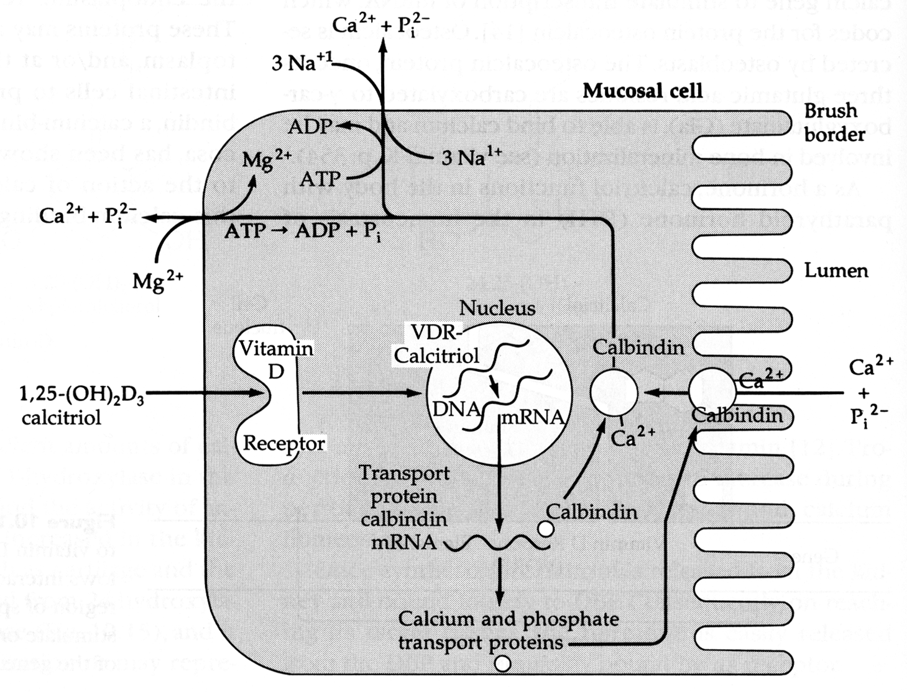

Slide 25
FGF-23
The main function of FGF23 seems to be regulation of phosphate concentration in plasma. FGF23 is secreted by osteocytes in response to elevated calcitriol. FGF23 acts on the kidneys, where it decreases the expression of NPT2, a sodium-phosphate cotransporter in the proximal tubule.
Thus, FGF23 decreases the reabsorption and increases excretion of phosphate. FGF23 may also suppress 1-alpha-hydroxylase, reducing its ability to activate vitamin D and subsequently impairing calcium absorption
Notes:
Fibroblast growth factor 23
There is a host of defects that ultimately lead to excess FGF23 levels and thereby cause renal phosphate wasting and hypophosphatemic rickets.

Slide 26
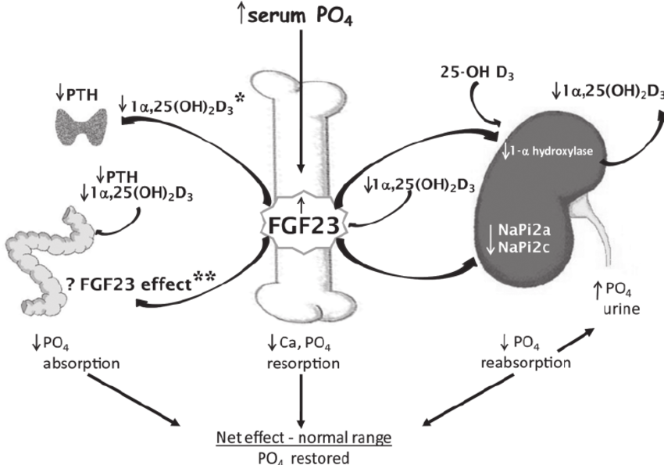
Notes:
FGF23 acts on the receptor complex in the parathyroid glands to decrease parathyroid hormone (PTH) gene expression and PTH secretion through activation of the MAPK pathway.
PTH being a major stimulator of vitamin D synthesis in the kidney while vitamin D exerts negative feedback on PTH secretion. The major function of PTH and major physiologic regulator is circulating ionized calcium

Slide 27
Chronic Kidney Disease
Vitamin D Deficiency Rickets due to Chronic Kidney Disease
Refractory rickets may occasionally be present with chronic kidney disease (GFR <30–35 mL/min/1.72 m2)
Rickets occur due to defective production of 1,25(OH)2 D3 in the kidney.
The clinical features of osteodystrophy depend on patients chronic renal parenchymal pathology and duration of the disease.
Biochemical features are characterized by decreased calcium, increased serum phosphate, in addition to increased BUN and increased serum creatinine.

Slide 28
Phosphate Deficiency Rickets
Increased phosphate loss (renal tubular phosphate loss):
Familial (X-linked dominant) hypophosphatemic rickets
Renal tubular acidosis
Fanconi’s syndrome
Decreased store of phosphate
Extremely preterm infant with dietary deficiency of phosphorus together with ↓ store of calcium and phosphorus.
Decreased intestinal absorption of phosphate
Ingestion of phosphate binders ( Aluminum Hydroxide )
Notes:
Fanconi syndrome is a rare disorder of kidney tubule function that results in excess amounts of glucose, bicarbonate, phosphates (phosphorus salts), uric acid, potassium, and certain amino acids being excreted in the urine.
Urinary phosphate wasting
Hypophosphatemia is caused by inadequate intake, decreased intestinal absorption, excessive urinary excretion, or a shift of phosphate from the extracellular to the intracellular compartments. Renal phosphate wasting can result from genetic or acquired renal disorders.
Rickets in RTA is multifactorial. Systemic acidosis is associated with defective mineralization of the cartilages and bones due to increased solubility of the mineral phase. During acidosis, calcium and phosphate are mobilized from bones for the purpose of buffering by enhanced osteoclastic resorption.
Cell phosphate deficiency may contribute to the adverse effects of renal tubular acidosis on bone

Slide 29
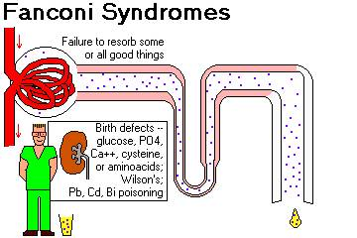

Slide 30
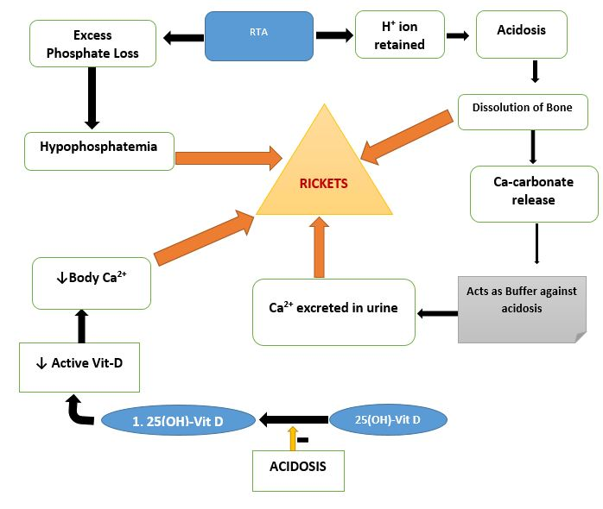

Slide 31
Eman Hawatmah

Slide 32
Head
1-Skeletal manifestation:
-Anterior fontanel…..Delayed closure.
-Bossing of the skull…….square vault(caput quadratum)
-Craniotabes (behind the ear).
-Head Circumference…….Enlargement.
-Delayed Dentition.

Slide 33
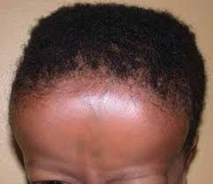
Caput quadratum

Slide 35
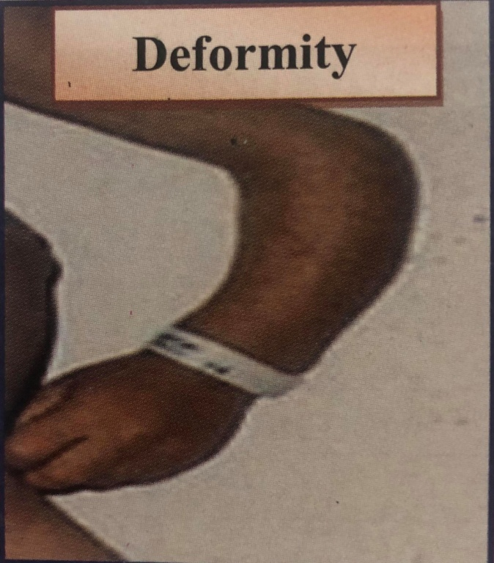
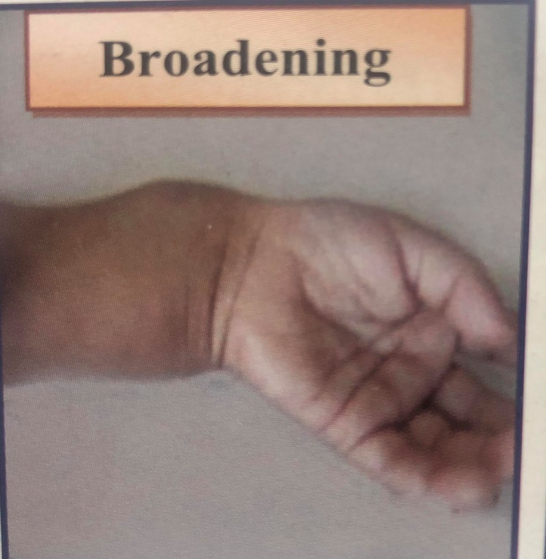
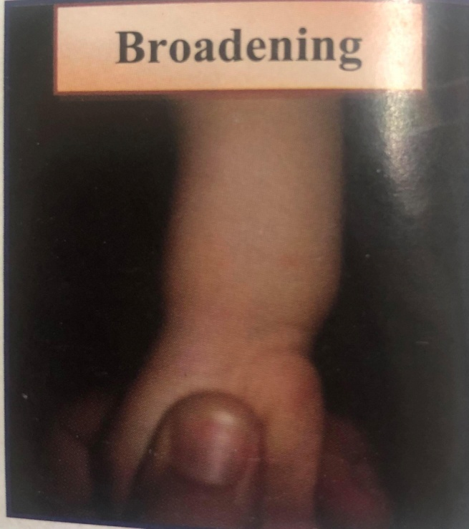
Extremities
Upper limb
-convex deformity of radius & ulna(in crawling baby)
-Broad lower end of radius & ulna.

Slide 36
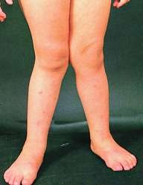

Slide 37
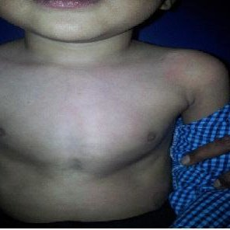
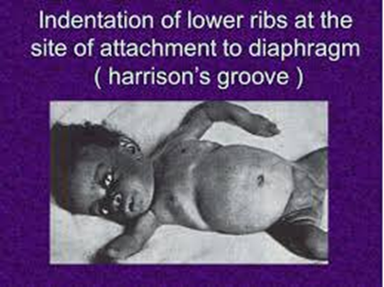
Thorax
Harrison sulcus : Horizontal groove along the lower part of the chest(costal insertion of the diaphragm).
Flaring of the lower ribs.
Longitudinal sulcus: Longitudinal groove
at the sides of the thorax behind rosary.
chest deformities: Pigeon chest.
Rosary beads: broadening
at the costochondral junction.

Slide 38
Flaring of the lower ribs

Slide 39
Pigeon chest

Slide 41
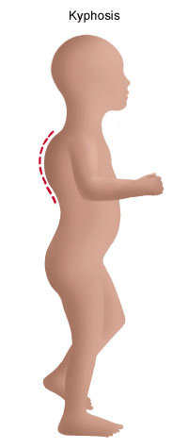
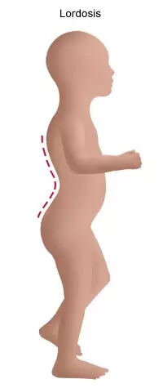
Spine
-Dorsolumber kyphosis when sitting.
-Dorsolumber lordasis when standing.

Slide 42
2-Muscles and ligament:
Genarlized hypotonia and laxity of ligaments due to hypophosphatemia.
-Delay milestones(sitting,standing,walking)
-Deformities>>> kyphosis.
-Distention>>>> displacement of liver and spleen downwards(lax ligament).
Restlessness & increased Sweating

Slide 43
Mnemonic

Slide 44
Findings
Lama Rabe’e

Slide 45
METAPHYSIS
fraying: indistinct margins of the metaphysis
splaying: widening of metaphysial ends
cupping: concavity of metaphysis
EPIPHYSEAL
WIDENING
RIBS RICHET ROSARY (BEEDED APPEARANCE ON POSTERIOR RIB )
GENERAL BONE :
DEMINERALISATION
BOWING OF WEIGHT BEARING BONES.
PROTRUSIO ACETABULI

Slide 46
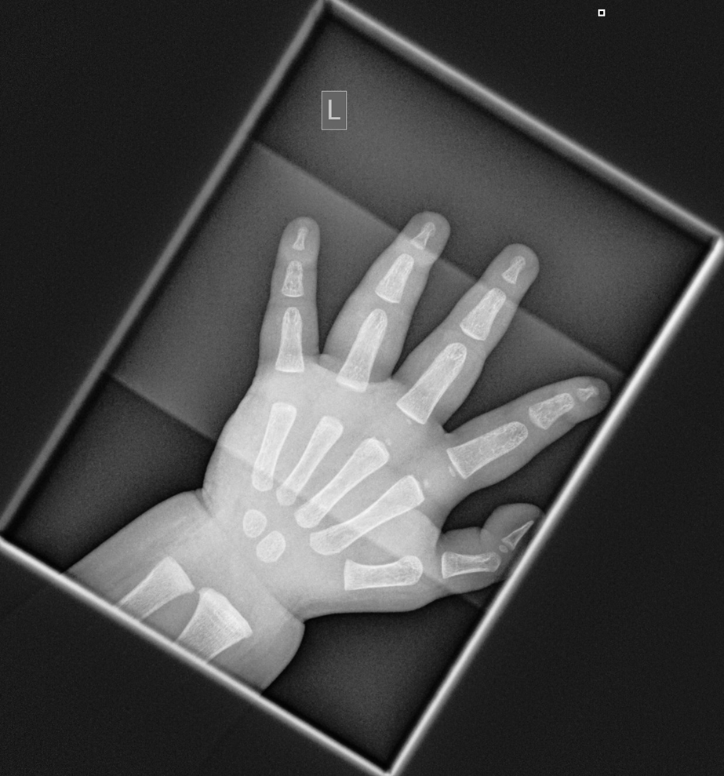
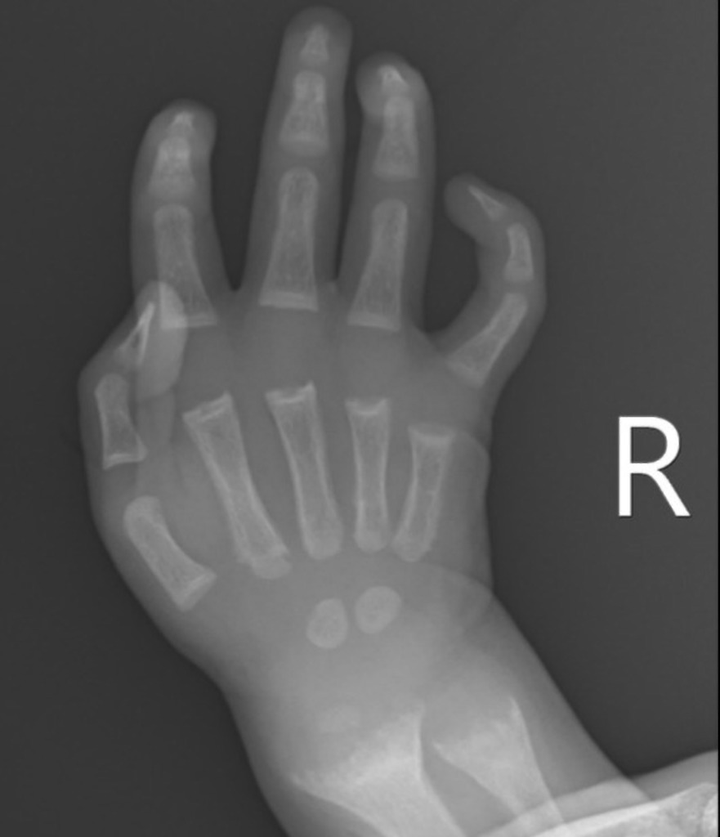
normal hand X-RAY
FRAYING ,SPLAYING AND CUPPING
OF METAPHYSIS

Slide 47
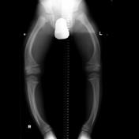
Bowing
Rachitic rosary

Slide 49
Complications
1- Respiratory infections and atelectasis due to:
- chest deformities that interfere with proper expansion.
- Hypotonia of respiratory muscles ,weak cough reflex. 2- Neurological: Tetany and Convulsions.
3- Iron deficiency anemia.
4- Pathological fractures: green stick fractures.
5- Constipation.
6- If the rickets is severe and prolonged there may be permanent bone deformities.
7- Severely low blood calcium levels can lead to cramps, seizures and breathing problems.
8-Heart muscle weakness - this complication is rare

Slide 50
Investigation
Labs:
✓ serum calcium: normal ( N:9-1 1mg%)
✓ serum phosphorus: markedly decreased (N:4.5-6.5mg%)
✓ serum alkaline phosphatase: high

Slide 51
Treatment
There is no simple regimen for treatment for such a varied entity and even within each category the treatment must be carefully tailored to meet the needs of individual pt
Generally treatment include combination of vit D , Ca and phosphate
Orthopedic measures my be required to correct deformities that cannot be expected to improve with growth

Slide 52
Nutritional Vit.D Deficiency
Children with nutritional Vit.D deficiency should receive Vit.D and adequate nutritional intake of calcium and phosphorus .
Strategies for administration :
1. single day dose .300k-600k IU of Vit.D are administered orally or IM as 2-4 Doses over 1 day .
2.administered gradually .Vit.D 2000-5000 IU/day over 4-6wk.
- Either strategy should be followed by daily Vit.D intake of 400-600 IU/day and it’s important to ensure that the child receive adequate dietary calcium and phosphorus .

Slide 53
Congenital Vit.D Deficiency
- Since the cause is sever maternal Vit.D deficiency the treatment includes Vit.D supplementation and
adequate intake of calcium and phosphorus.
- Nowadays the Use of prenatal vitamins containing Vit.D prevents this entity.

Slide 54
Calcium deficiency
- Treatment focuses on providing adequate calcium typically as a dietary supplement .
- Vit.D supplement is necessary if there is concurrent Vit.D deficiency.
- Prevention strategies include → discouraging early cessation of breastfeeding and increasing dietary sources of calcium.

Slide 55
Vit.D-Dependent Rickets Type 1
- Since these children can’t convert 25-D into 1,25-D they respond to long-term treatment with 1,25-OHD ( calcitriol ) with initial high dose and lower doses once the rickets has healed .
- The dose of calcitriol is adjusted to maintain a low-normal serum calcium level , normal serum Phosphorus level and a high-normal PTH level . Targeting to avoids excessive dosing of calcitriol. Which can cause hypercalciuria and Nephrocalciuria .

Slide 56
Vit.D-Dependent Rickets Type 2
- Some of these patient respond to extremely high doses(supraphysiological dose of 1,25 dih vit D ) of Vit.D2 , 25-D , 1,25-D especially patients without alopecia .
- This response is due to a partially functional Vit.D receptors and all patients should be given a 3-6 month trial of high-dose Vit.D and high dose of oral or IV calcium.
- Treatment of patients who don’t respond to Vit.D is difficult and prognosis is poor .

Slide 57
Chronic kidney disease
- Therapy requires the use of a form of Vit.D that can act without 1α-hydroxylation by the kidney which is calcitriol , which both permits adequate absorption of calcium and directly suppresses the parathyroid gland .
- Because hyperphosphatemia is a stimulus for PTH secretion , normalization of serum phosphorus level via restriction and use of oral binders is as important as the use of activated Vit.D .

Slide 58
X-Linked hypophosphatemia Rickets
- Patients respond well to a combination of oral phosphorus and Calcitriol .
- The daily need for phosphorus is 1-3 g of elemental phosphorus divided into 4-5 doses .
- Frequent dosing helps to prevent decrements in serum phosphorus because there is a rapid decline after each dose also it decreases diarrhea which is a complication of high dose oral phosphorus .

Slide 59
Prevention
1. sun Exposure to mothers
2. weaned and put on to cows milk, eggs , fish, and dairy products
3. Daily intake of 400 iu vitD by supplemention
4. Lactatting mothers should receive supplemention with milk or vit D to ensure prevention of rickets in their babies

Slide 60
Prognosis
-Most children have an excellent response with
radiologic healing occurring within a few months
-Laboratory results should also normalize rapidly.
-Many of the bone malformations improve dramatically But children with sever disease can have permanent deformities and short stature .

