Slide 1
Elimination Disorders
Done by:
Ahmad maaitah
Mohammed nawafleh
Supervised by : Dr. Najeeb Alqsous
Notes:
This talk has been prepared to provide important clinical information regarding the diagnosis and treatment of elimination disorders.
We will spend this time discussing two types of elimination disorders which include enuresis and encopresis
Appropriate diagnosis and treatment of elimination disorders is a central part of the practice of child and adolescent psychiatry

Slide 2
Elimination Disorders: disorders characterized by developmentally inappropriate elimination of urine or feces
Though typically involuntary, this may be intentional.
includes:
Enuresis
Encopresis

Slide 3
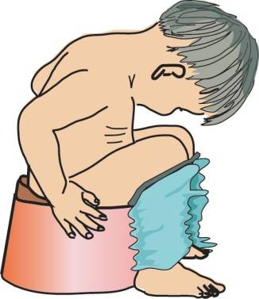
Normal Development
Toddler Phase (18 months- 5 years): During toddler phase a child usually becomes interested in mastering elimination
Bowel Continence
Bladder Continence
Most children have achieved bowel and bladder continence by age 4 & 5
females achieve continence earlier than males
Notes:
1. During toddler phase a child usually becomes interested in mastering elimination
2. Most children have achieved bowel and bladder continence by age 4 & 5
3. Acquiring continence usually proceeds in the following order
nighttime bowel
day time bowel
daytime bladder
nighttime bladder
4.1/3 of children in the US are completely toilet trained by age 24 months
5. Females achieve continence earlier than males

Slide 4
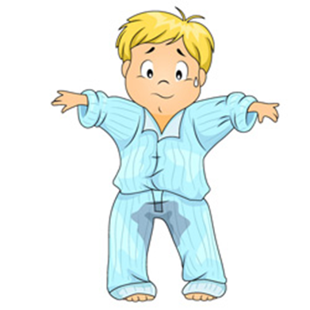
Enuresis
Enuresis :The act of Involuntary urination; either during the day (diurnal) or at night (nocturnal).
Nocturnal enuresis is 2-3 times more common than diurnal enuresis

Slide 5
Enuresis
Nocturnal Enuresis ; more common in boys
Diurnal Enuresis ; more common in girls.
A child may also have both
Primary Enuresis
Secondary Enuresis , This type may be caused by psychological factors or an underlying medical condition
Notes:
1. When a child fails to successfully achieve toilet training by the age of five and has repeated voiding of urine into the bed or clothes at least twice per week for at least three consecutive months he/she meets DSM IV-TR diagnostic criteria for enuresis.
2. There are different types of enuresis and a diagnosis should be specific because treatment options may differ.
a. Nocturnal Enuresis- voiding while asleep; This is the most common type
b. Diurnal enuresis- voiding while awake
c. A child may also have both
3. Further classification of enuresis identifies whether enuresis is primary or secondary
a. Primary enuresis indicates that a child has never accomplished continence through the night. This type is usually due to maturational and /or physiological delays
b. Secondary enuresis is when a child achieved continence for at least 6 consecutive months but began wetting again- This type may be caused by psychological factors or an underlying medical condition

Slide 6
Sub-types Of Enuresis:
Mono-
symptomatic
Mainly Nocturnal enuresis
Non Mono-
symptomatic
Diurnal enuresis mainly BUT possible nocturnal
NO bladder dysfunction
NO *daytime
symptoms
Bladder dysfunction
daytime
symptoms
*Daytime symptoms:
Urgency
Hesitancy
Frequency
Leakage
Sensation of incomplete avoiding

Slide 7
Risk Factors
Genetic predisposition
Increased urine volume (polyuria)
Inhibition of the pontine micturition center of the brainstem
Psychosocial factors
local bladder dysfunction (UTI, neurogenic bladder, Cystitis)

Slide 8
Prevalence
30% of US children achieve continence by age 2
5-10% of 5 year olds meet criteria for nocturnal enuresis
15% of enuretic children have spontaneous resolution of symptoms each year
2-3% of 12 year olds meet criteria for nocturnal enuresis
1% of 18 year olds still have enuretic symptoms
Notes:
Even though only 5-10% of 5 year-olds meet criteria for enuresis; as many as 20% of 5 year-olds have bedwetting problems
2. Overall 5-7 million US children have primary nocturnal enuresis
3. Enuresis has been found to be more common in African-Americans and Asian immigrants in the US
4. When both parents have had enuresis there is a 77% incidence of enuresis in their offspring
5. If one parent has had enuresis there is a 44% incidence. There is a 15 % incidence in children without an enuretic parents
6. Twin studies have shown 68% concordance with monozygotes and 36% with dizygotes
7. In regards to inheritance patterns, studies have revealed that chromosomes 13,4,8,22,and 5 are associated with enuresis. The transmission may include autosomal dominant, autosomal recessive, and sporadic

Slide 9
Diagnostic Criteria
Recurrent urination into clothes or bed-wetting.
Occurs two times per week for at least 3 consecutive months OR result in clinical distress or marked impairment in social.
At least 5 years old developmentally.
Not due to a substance (e.g., diuretic) or another medical condition (e.g., UTI, neurogenic bladder, diabetes,spina bifida, seizure disorder).

Slide 10
Assessment:
History : The most important step
Child’s Age
Onset of Symptoms (Primary/Secondary)
Timing (Nocturnal/Diurnal/Both)
Frequency
Family History
Developmental History

Slide 11
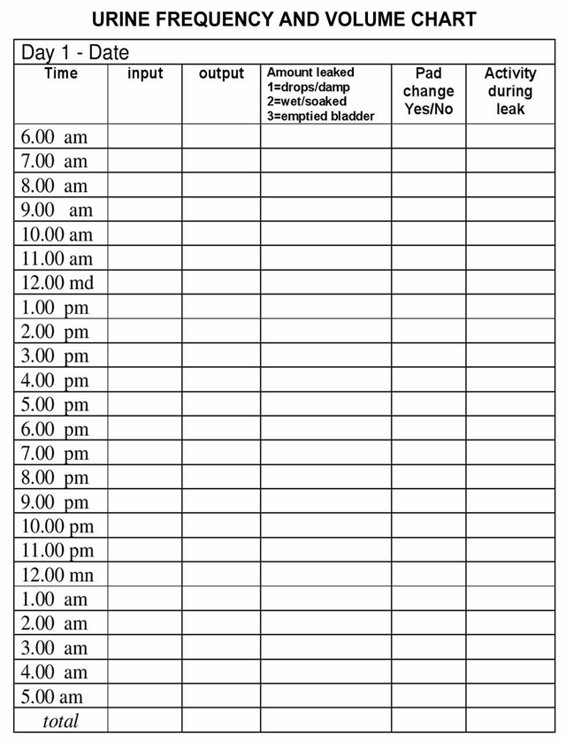
48-hour frequency/ volume chart : when and how much their child voids and drinks, as well as associated symptoms such as incontinence, holding manoeuvres …ect)

Slide 12
physical examination: It is essential that organic causes of incontinence are ruled out . A full pediatric and neurological exam is recommended.
Psychiatric assessment: a routine assessment regarding comorbid emotional and behavioral disorders is recommended. A validated and standardized parental questionnaire is recommended because of the high frequency of comorbid disorders.

Slide 13
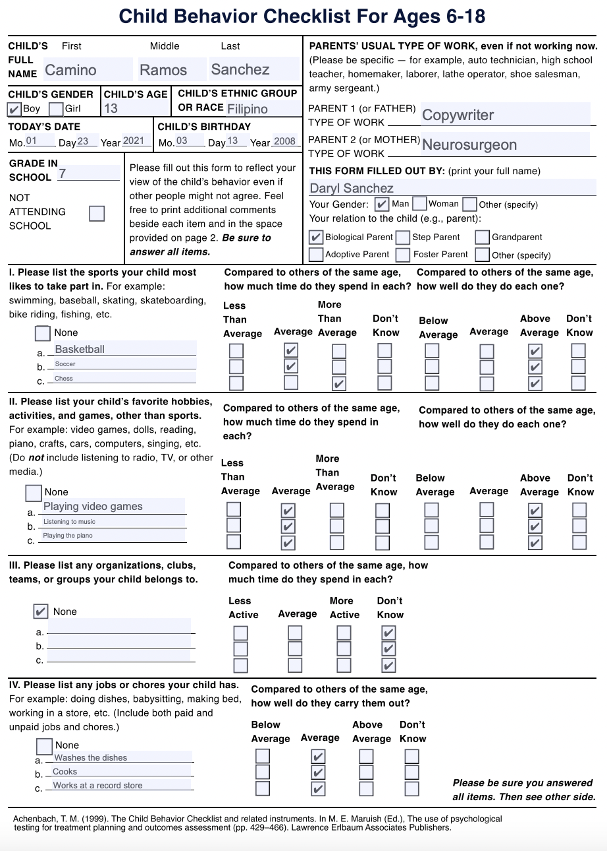
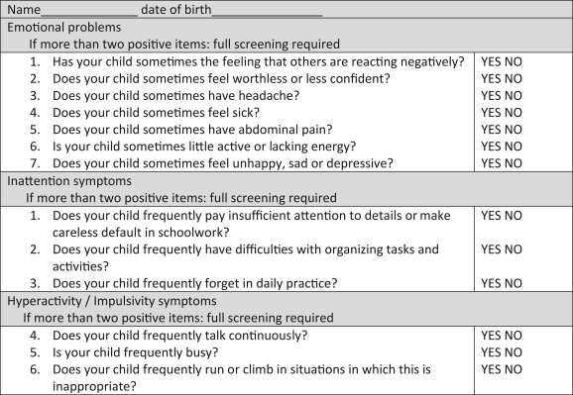
This can be done by:
using a short screening questionnaire such as the SSIPPE first
and a long questionnaire next such as the CBCL

Slide 14
Consults
Pediatric Urology
-Ultrasound of Genitourinary system
-Voiding Cystourethrogram ) These modalities may help reveal underlying abnormalities such as detrusor hypertrophy and over activity and they may also demonstrate bladder are flexia and urinary retention(
Pediatric Neurology
EEG; underlying seizur
Sleep Study
Obstructive Sleep Apnea
Notes:
1. Consider consultation if a child presents with repeated UTI or diurnal enuresis
2. Ultrasounds and Voiding Cystourethrograms
These modalities may help reveal underlying abnormalities such as detrusor hypertrophy and over activity
They may also demonstrate bladder areflexia and urinary retention
3. Peds Neuro- EEG; underlying seizure
4. Sleep Study- Obstructive Sleep Apnea

Slide 15
Treatment
Education
Watchful Waiting
Non-pharmacological Management
Pharmacological Management
Therapeutic Interventions
Notes:
There are five major categories of treatment options that are available to children and families
Education
Watchful Waiting
Nonpharmacological Management
Medication management
Therapeutic Interventions
1. Educational Points are important regardless of which treatment option a family chooses. These are some of the educational points that a family should be made aware of.
a. 15 % annual spontaneous remission rate
b. Review and correct parental expectation
c. Waiting until the child is ready for potty training
d. Ensuring there is no teasing/shame given for failures
e. Limiting caffeine and dairy products in evening hours
f. Limiting nighttime and not daytime fluids
g. Remind children that it isn’t their fault
h. Teaching parents patience
i. Educating parents to not punish their child
j. Warning parents about potential relapse
2. When parents decide to pursue watchful waiting it is important to educate the family about the natural history, available treatments, and prognosis of enuresis
3. For those families that wish to pursue treatment an analysis of the underlying etiology/etiologies will help determine the most successful modality
a. If the underlying etiology is Diabetes, sleep apnea, hyperthyroidism- treat the disorder
b. Surgery may be indicated for ectopic ureter, neurogenic bladder, bladder calculus, and possibly T&A for OSA

Slide 16
Non-Pharmacological Interventions
First line treatment
Behavioral Modification:
Scheduled voiding times
Nighttime fluids restriction
Using waterproof bed covers
Notes:
Education/Advice
Achieving continence takes time
Do not limit fluids during the day
Involving teachers who may discretely remind a child to take bathroom breaks
Limit Nighttime fluid intake- all fluid should be withheld within 1 hour of before bed
Dairy products should be stopped 4 hours before bed- potential to cause osmotic diuresis
Caffeine should be limited to morning use only provided its long half-life
Urinate before bed
Hallway night light
If bathroom is far place a potty chair in the child’s room
Help the child clean soiled linen
Girls- can benefit from being reminded to wipe from front to back to prevent UTIs
Overweight females often have daytime post-void incontinence- instructing the child to urinate with knees apart instead of together can prevent vaginal reflux and be curative if this is the etiology
Bell and Pad
-This is the most common and successful non-pharamcological intervention
-Relies upon classical and operant conditioning
-The child sleeps on the pad or it is affixed to their clothing
-When the child begins to urinate a sensor within the pad triggers an alarm (typically an auditory alarm but it may be vibratory)
Classical Conditioning
-After repeated use of the bell and pad, the distention of the bladder and the sense to urinate become associated with the auditory signal. This leads to waking (the conditioned response)
Operant Conditioning
-The child views the alarm as a punishment (which may awaken others in the house as well) and therefore seeks to avoid triggering the alarm.
Efficacy
-Typically takes months for the bell and pad to work
-One month of dry nights is considered a success
-Success rates of up to 80-90% if families continue to use it however 48% prematurely terminate use
-When success is achieved relapse rates can be up to 40% and in these cases the bell and pad can be reintroduced
Drawbacks
-expensive
-time consuming
-requires motivation
-children may find it embarrassing

Slide 17
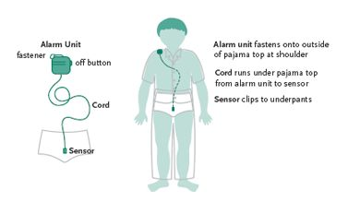
Non-Pharmacological Interventions
4- Bladder-Volume Alarm
5- Star Chart System
6- Nightlifting
7- Timed Night Awakening
8- Bladder Training Exercises/Overlearning
Notes:
Bladder-Volume Alarm-Senses the bladder when it is nearing capacity. This has added advantage of alerting the child before they wet.
Star Chart System- Reward system
Nightlifting- Taking child to the toilet to the toilet in a semi-sleep state-does not have good efficacy
Timed Night Awakening- every two hours- takes a huge investment on the part of the parents
Bladder Training Exercises and Overlearning- Drink a large amount of fluid and hold it for as long as possible- can be effective yet also unpleasant

Slide 18
Pharmacological Interventions
Indications:
Lack of motivation in the children
Family overwhelmed by demands such as a work situation, cramped housing,
Short-term dryness is required , e.g., for school outings
Desmopressin
imipramine
Oxybutynin (antispasmodics)
TCAs
NSAIDs(Indomethacin)
Notes:
Medications
Medications can work very quickly
Beneficial for sleep overs and camp
Only Desmopressin and Imipramine have US FDA indications for the treatment of nocturnal enuresis
Desmopressin and Impiramine are relatively ineffective in the treatment of diurnal enuresis
Oxybutynin which has FDA approval for overreactive bladder in children can be effective in the treatment of diurnal enuresis.
Desmopressin
This is the first line agent for treatment of nocturnal enuresis
More favorable side effect profile that TCAs
This medication is a long acting form of arginine vasopressin also known as antidiuretic hormone or ADH
Success rates from 10%-65% with a relapse rate as high as 80%
Takes about an hour after administration to reach efficacy
The child should take the medication two hours before bed
The child should stop drinking one hour before administration
The child should not drink at least eight hours following its administration
Its duration of action is 10-12 hours
Compensatory polyuria the day after may occur after its effects have worn off
Can be crushed for easy administration
In children older than six years of age the starting dose if 0.2 mg by mouth at night
Maximum dose is 0.6 mg by mouth at night
Monitor sodium because may have risk for hyponatremia
B. Imipramine
This was the main treatment prior to approval of Desmopressin
It has many effects which is why it may have an overall greater success rate than Imipramine
Helps to treat comorbid anxiety and depression
Anticholinergic properties allow it to mediate the relaxation of the bladder detrusor muscle
Increases sphincter tone
Increases release of ADH which results in free water retention
Increases brain arousal by suppressing rapid eye movement sleep making it easier for the child awaken
Also has benefit in the treatment of ADHD. There is a high comorbidity between nocturnal enuresis and ADHD
Starting dose between 6-12 yr old- 10mg by mouth at bedtime
Maximum dose is 50 mg po qhs
12 yr older start at 10 and max dose 75 mg po qhs
Side-effects
Potential lethality in overdose
Suicide black box warning- increased risk in children, adolescents, and young adults with MDD or other psychiatric disorders
Cardiac dysrhythmias, convulsions, coma
10% of patients will have side-effects which can include drowsiness, dry mouth, dizziness, constipation, difficulty starting urine stream, blurred vision, palpitation
Baseline ECG before starting
SSRIs
Lack FDA indication for enuresis
Case reports that it improves and causes nocturnal enuresis
Methylphenidates and Dextroamphetamines
Best when used in combination with bell and pad
May reduce the depth of sleep thereby allowing a child to awaken more easily to the sense of a full bladder
Indomethacin
Enhances the effects of ADH
Diurnal Enuresis/Oxybutynin
Has indication for overactive bladder
Anticholinergic agent that relaxes bladder smooth muscle
Inhibits involuntary detrusor muscle contractions
Start in ages over 5 years old 5mg BID
Ages 1-5 – starting dose 0.2 mg/kg BID
Maximum dose is a total of 15 mg per day
Extended release for children older than 6 at 5mg po daily
Maximum is 20 mg po daily

Slide 19
Desmopressin
One starts with the low dosage of one pill 0.2mg in the evening for two weeks. If the child is dry or a marked reduction of wet nights is documented one stays with this dosage .
Otherwise, medication is increased up to
0.4mg.
A reduction of wet nights or even
dryness can be achieved in 70% of cases
S.E: rare; like head, stomach aches and lack of appetite. The most dramatic, though rare side effect is hyponatremia and water intoxication.

Slide 20
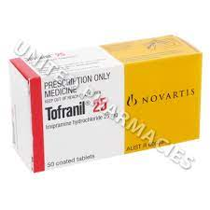
Tricyclic antidepressants:
such as imipramine have a proven anti-enuretic effect.
A low dose of 10mg to 25mg in the evening is often sufficient.
NOTE: Due to high risk for cardiac arrhythmias even with therapeutic doses, a detailed family history, ECG before and during treatment and blood tests are recommended.
Side-effects
Potential lethality in overdose
convulsions, coma
10% of patients will have side-effects which can include drowsiness, dry mouth, dizziness, constipation, difficulty starting urine stream, blurred vision, palpitation

Slide 21
Additional Treatments
This type of intervention can significantly address secondary enuresis which may be triggered by a psychological stressor
Cognitive Behavioral Therapy
Psychodynamic Psychotherapy
Biofeedback: This is a form of pelvic floor physical therapy
Notes:
Therapy
CBT may help a child address cognitive distortions
Biofeedback- This is a form of pelvic floor physical therapy. Kegel exercises may strengthen the pelvic floor musculature

Slide 22
ASK
As a Healthcare provider you should ask about :
1- If other family members have had enuresis
2- How often your child urinates during the day
3- How much your child drinks in the evening
4- If your childs have had recent stress in their life

Slide 23
Encopresis
defined as the repeated passage of feces in inappropriate places. The voiding is typically regarded as involuntary although it may be volitional. The term is derived from the Greek Word Kopros meaning dung or feces.

Slide 25
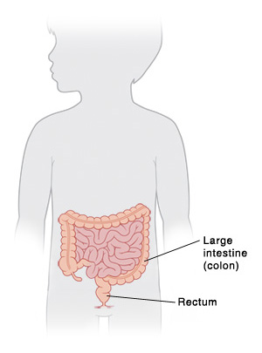
Encopresis
Primary Encopresis
Secondary Encopresis
Retentive Encopresis
Nonretentive encopresis
Notes:
-Encopresis is less common than enuresis
-This elimination disorder may be more impairing and have more consequences
-When bowel continence is not achieved by age 4 a diagnosis of encopresis can be made
-Etiology may be physiological and/or psychological
Encopresis- defined as the repeated passage of feces in inappropriate places (usually undergarments). The voiding is typically regarded as involuntary although it may be volitional. The term is derived from the Greek Word Kopros meaning dung or feces
Primary Encopresis- soiling in a child who has never gained bowel continence for six months or more
Secondary Encopresis- soiling in a child who hag previously acquired bowel control. When secondary encopresis is due to psychological stress it may be referred to as regressive enuresis
Retentive Encopresis- Encopresis with Constipation and Overflow Incontinence
Nonretentive Encopresis- Encopresis without Constipation and Overflow Incontinence
Encopresis unlike enuresis rarely occurs during sleep and when this occurs it is a poor prognostic indicator

Slide 26
Prevalence
Secondary encopresis is more common
Between ages 7-8 prevalence is 1.5%
3:1 male to female ratio
Retentive type is 80-95% of cases
Notes:
-By the age of 4, 95% of children have achieved bowel continence
-Boys tend to lag behind girls
-Secondary encopresis is slightly more common (50-60%)
-Some children don’t meet full criteria; even still isolated incidents have significant consequences (embarrassment and anxiety) and may led to teasing and bullying

Slide 27
Etiology
Delay in maturation
Underlying medical condition
Psychological/Behavioral
constipation

Slide 28
DSM-v Diagnostic Criteria
■ Recurrent defecation into inappropriate places (e.g., clothes, floor).
■ Occurs at least one time per month for at least 3 months.
■ At least 4 years old developmentally.
■ Not due to a substance (e.g., laxatives) or another medical condition (e.g., hypothyroidism, anal fissure, spina bifida) except via a constipationrelatedmechanism.

Slide 29
Primary Encopresis
Delayed Physical Maturation
Inappropriate Toilet Training
Notes:
Delayed physical maturation is often a common cause of primary retentive encoporesis
It is also caused often by harsh toilet training
Examples of harsh toilet training include
A. Starting training too early
B. Forcing the child to sit on the toilet for very extended periods of time
C. Physical punishment/ridicule for failures
Parents at times feel pressure to rush toilet training for the following reasons:
A. Diapers are expensive
B. Continence may be required for child care
Parents at time feel no need to potty train or neglect to do so. The child may develop toilet phobia in these cases
When a child’s parents train inappropriately this can create a power struggle between the parent and child about using the bathroom
Parental reactions can determine if the child becomes successful with continence

Slide 30
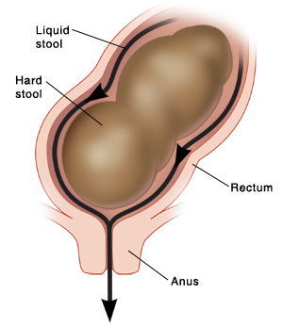
Retentive Encopresis
Represents 80-95% of cases
Infrequent Bowel Movements
Large Stools
Painful Defecation
Notes:
Retentive Encopresis with overflow incontinence represents 80-95% of cases with encopresis
Children with constipation have infrequent bowel movements, large stools, and difficult painful bowel movements
When stooling is painful a child may avoid stooling and withhold their feces. This will become a repeated behavior and lead to more hardening of the stool and retention.
The stool may eventually become too hard to pass through the anus. The bowel may also distend as stool accumulates. With time this may result in the child losing the ability to sense a full bowel.
As the stool continues to accumulate liquid stool may leak around the blockage and cause soiling (encopresis with constipation and overflow incontinence).
Breaking this cycle is key in the treatment of retentive encopresis
Addressing the cause of constipation is essential and there can be different causes including poor fluid intake, poor nutrition as in insufficient fiber in the diet. Achild may also have anxiety related to using public restrooms. Another cause may include medications the child is taking.

Slide 31
Secondary Encopresis
Birth of sibling
Parental Divorce
Abuse
Autism / Psychosis
Notes:
-Secondary encopresis may arise due to new stressors
-Bowel incontinence in response to birth of a sibling or other stressors is regressive
-Children with ODD and CD may use soiling as a form of retaliation and anger against parents and authorities
-Some children find their feces interesting enough to smear it. Older children who engage in this behavior may suffer from MR/Autism/Psychosis/RAD

Slide 32
Diagnisis
• Child's age.
• Onset (primary/secondary).
• Timing (day/night).
• Frequency.
• Bowel Habits (frequency, stool size, consistency).
• Melena/Hematochezia.
• Pain with Defecation/Fluid and Dietary Habits.
• Location of soiling.

Slide 33
The history should focus on these items:
Developmental history.
Recent Stressors.
Mental Health -anxiety, depression, MR, Autism, ODD,CD
Current Medications.
Previous Surgeries.
Past Medical History.
Family History.
Previous Treatment for encopresis.

Slide 34
Physical Examination
Abdominal pain/distention
Height/Weight
Neurological Examination
Skin Examination
Rectal Examination
Stool Collection: parasites
Blood Testing: TSH hypothyroidism
Rectal Biopsy/Barium Enema
Abdominal XRAY

Slide 35
Treatment
Advice/Education
Nonpharmacological
Pharmacological Intervention
Notes:
It is essential to treat any underlying disorder that is suspected. When an identifiable organic cause can be determined this should be treated appropriately.

Slide 36
Advice/Education
Dietary Changes (foods high in fiber)
Increase Fluid Intake
Make Toilet Training Non-Threatening
Make Toilet Accessible
Regular Bathroom Times
Notes:
Increase fluid intake and fiber
Reduce dairy intake
Older children should be encouraged to exercise more frequently
Fiber supplements
Improve access to the toilet
Star charts/small rewards
Timed sitting
Assist in cleaning soiled clothing
Regular bathroom times/ best times are after meals for up to fifteen minutes

Slide 37
Nonpharmacological
CBT
Psychodynamic Psychotherapy
Notes:
CBT and psychodynamic therapy can be used to help decrease symptoms of anxiety and depression associated with encopresis
Biofeedback can be beneficial in the treatment of pelvic floor dysfunction. It can also teach the child sphincter control

Slide 38
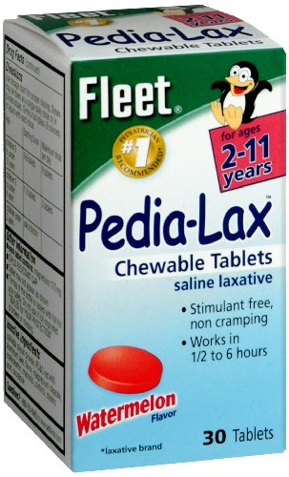
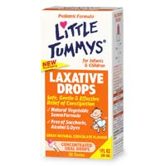
Pharmacological
Laxatives
Mineral Oil
Stool Softeners
Notes:
When the cause of encopresis is retentive type it is important to provide the child with interventions that will allow emptying of the bowel and interrupt the cycle of constipation and painful defecation
-increase fluid intake
-osmotic laxatives- polyethylene glycol, lactulose, and glycerine
-stimulant laxatives-senna
-stool softeners-docusate and mineral oil
Mineral oil may be provided after meals
Impaction- when the child is impacted oral medications is the first line treatment. Rectal medications may work faster but they are more invasive. Rectal treatments may worsen a child’s anxiety. After fecal disimpaction maintenance use of laxatives may be required for months to years to prevent relapse
TCAs- Have been used in the cases of nonretentive encopresis. There have been some benefits in the use of imipramine in th past however one must consider the anticholinergic effects
Loperamide- also used in treatment of non retentive type encopresis. It can increase anal sphincter pressure thereby reducing bowel incontinence
Rarely extends into adulthood; spontaneous resolution does occur
Watchful waiting is not an option

