Slide 1
Pericardial Effusion
Nada Mahasneh

Slide 2
introduction
Pericardial effusion: an accumulation of fluid in the pericardial space between the parietal and visceral pericardium. May be acute or chronic.
In chronic effusions the pericardium stretches to a certain degree to accommodate more fluid. In acute effusions, however, the added volume quickly exceeds the maximum capacity of the pericardial space and they are more likely to result in tamponade.
The fluid can be either bloody (following aortic dissection) or serous (usually idiopathic)

Slide 3
etiology
Hemopericardium:
Cardiac wall rupture
Chest trauma
Aortic Dissection
Cardiac surgery (heart valve surgery, coronary bypass surgery)
Serous pericardial effusion
Idiopathic
Acute pericarditis (especially viral)
Postpericardiotomy syndrome
Uremia
Hypothyroidism
Right Heart Failure

Slide 4
Clinical features
Initially asymptomatic in most cases
Shortness of breath, especially when lying down (orthopnea)
Retrosternal chest pain
Can cause compressive symptoms
(Hoarseness, Nausea, Dysphagia, Hiccups)
Apical impulse is difficult to locate or nonpalpable.
Ewart sign: dullness to percussion at the base of the left lung with increased vocal fremitus and bronchial breathing due the compression of lung parenchyma by the pericardial effusion

Slide 5
diagnosis
Echocardiography
- Indication: diagnosis and monitoring of all patients with suspected pericardial effusion
- TTE (gold standard)
- Allows for the detection of:
- Small effusions of 25–50 mL during ventricular systole
- Effusions of > 50 mL throughout the cardiac cycle

Slide 6
diagnosis
ECG
Findings in pericardial effusion
Normal in smaller effusions
Low voltage complexes and electrical alternans in larger effusions

Slide 7
The combination of tachycardia, low QRS voltage, and electrical alternans is highly suggestive of a large pericardial effusion.

Slide 8
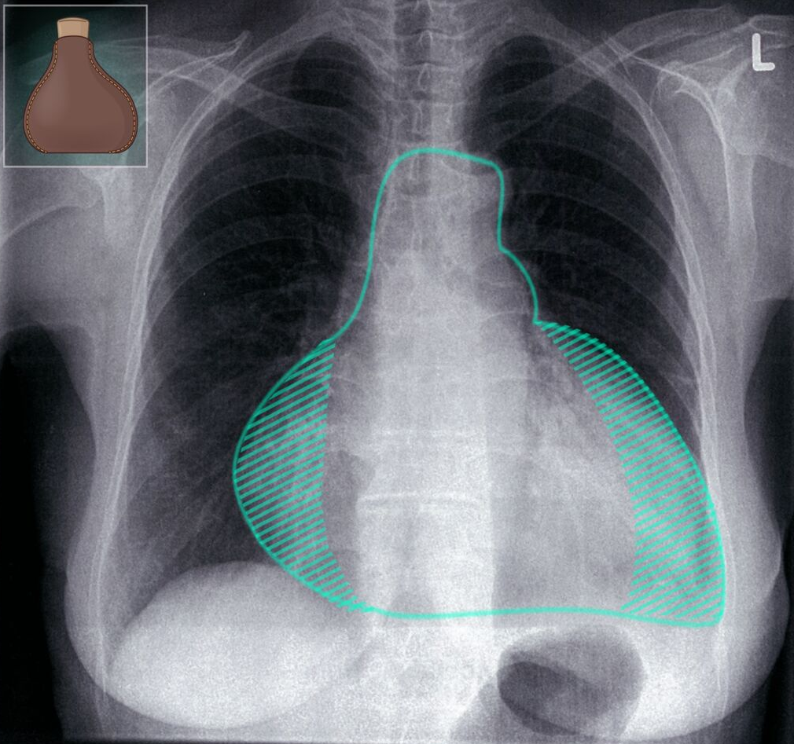
diagnosis
CXR
Not required to diagnose pericardial effusion but often performed to exclude other causes of dyspnea PA view findings:
Enlarged cardiac silhouette
Water bottle sign: the radiographic sign of a large pericardial effusion
250 ml of fluid must be present before an effusion is visible on CXR

Slide 9
diagnosis
Pericardial fluid analysis
Indication: pericardial effusion of unclear etiology
Procedure: diagnostic pericardiocentesis
Analysis :
Cell count: ↑ WBC in infection ↑ RBC in hemorrhagic effusions
Gram stain and culture (infectious cause)
Cytology (malignancy)
Acid-fast bacilli (tuberculous infection)
Glucose level: < 60–80 mg/dL suggestive of malignant, parapneumonic, or tuberculous effusions, or connective tissue disease
Protein level: > 6.0 g/dL is associated with purulent , parapneumonic, and tuberculous effusions.
LDH: Isolated pericardial fluid LDH elevation of > 300 units/dL suggests malignant

Slide 11
treatment
Small pericardial effusion: Conservative management focusing on treating the underlying cause is usually sufficient , repeat echocardiogram in 1 to 2 weeks is appropriate.
Large pericardial effusion causing symptoms or of uncertain etiology: Consider pericardial fluid drainage
Provide supportive care, e.g., pain management

Slide 12
Thank You

