Slide 1
4- O2-Hb dissociation curve, shift & significance By Prof. Sherif W. Mansour Physiology dpt., Mutah school of Medicine . 2023/2024

Slide 2
Oxygen Transport by Blood
* O₂ is carried by blood in two forms:
1) O₂ in physical solution: Nature: O₂ molecules dissolved in blood.
• Volume: it depends on O₂ tension according to Henery’s law: (dissolved O₂ = PO₂ x 0.003). So,
In arterial blood (with tension of 100 mmHg) = 0.3 ml/100 ml. and in venous blood (with tension 40 mmHg) = 0.13 ml/100 ml
• Importance: 1) It determines O₂ tension in the blood. 2) It is easy to be used by the tissue.
3) It determines the rate and direction of O₂ diffusion. 4)It determines the percentage saturation of haemoglobin with O₂.
2) O₂ chemical form:
• Nature: O₂ combines with the iron of haemoglobin while still in the ferrous state (It is called oxygenation not oxidation of Hb). - Hb combines with O₂ in steps HbO₂, HbO₄, HbO₆, and HbO₈
• Volume: 19 ml O₂/100 ml arterial blood. 14 ml O₂/100 ml venous blood (at rest)
• Importance: it is the main O₂ supply to tissues (however, the tissue utilize physical O₂ at first then chemical form)

Slide 3
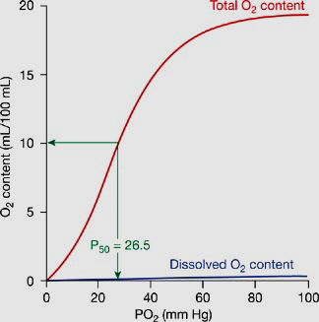

Slide 4
O₂ -Dissociation Curve of Hemoglobin
• Definition: O₂ dissociation curve shows relationship between O₂ tension and percentage saturation of Hb at different O₂ tensions (Because the percentage saturation is not varied according to Hb. content in different persons).
• Method: 3 ml of blood in Tonometer are allowed to form thin layer on the wall and then exposed to different O₂ tensions and % saturation is calculated and plotted against the O₂ tensions in a cu
Physiological significance of the curve:
(a) At the lung and arterial blood: If the blood is exposed to:
- O₂ tension of 100 mmHg (normal alveolar O₂ tension) → 95% saturation .
- O₂ tension of 70 mmHg (alveolar tension at high altitude or diseased lung ) → 90% saturation.
- So change of O₂ tension from 100 to 70 mmHg → mild change of % saturation. So the curve is nearly horizontal and saturation is easy and complete even with low O₂ tension at the lung to bind with more oxygen and carry it to tissue indicating that Hb has high affinity to O₂ at lungs.

Slide 5
(b) At the tissue and venous blood : If the blood is exposed to:
- O₂ tension of 40 mmHg (resting muscle& venous blood tension) → 70% saturation.
- O₂ tension of 25 mmHg (during exercise) → 40% saturation.
So, mild change in O_{­2} tension from 40 to 25 mmHg → large decrease in saturation from 70 to 40% to give oxygen to tissue, so the curve is nearly vertical (steep) at tissue & venous side due to low affinity of Hb to O₂ at lower O₂ tension.
- Also pressure difference between arterial and tissue O₂ is high (100-40 = 60 mmHg) → loss of 25% (95-70 = 25%) of O₂ carried by Hb at rest.

Slide 6
(c) The curve is sigmoid or “S” shaped: because Hb contains 4 ferrous atoms and each one is saturated at certain O₂ tension & saturation of each one facilitates of the following one and so on .As there are 2 states of Hb: (1) Tense or “T” state when Hb gives O_{2,} the “β” chains moves a part with decrease O₂ binding. (2) Relaxed or “R” state when Hb take O₂ the β chains move closer and favors more O₂ binding.
- Bohr Effect: it is the decrease in O₂ affinity to hemoglobin when pH of the blood falls(Acidic) . It can be attributed to the fact that reduced HB binds H⁺ more actively than does oxyhemoglobin which causes unloading of O2 more easily.
i.e at lung level (↓ Co₂ & H⁺) →↑ Hb affinity to O₂, and at tissue level (↑ Co₂ & H) →↓ Hb O₂ affinity to give it to tissue.
O₂-Hb curve isn’t between O₂ tension and O₂ content as this content is variable from person to other according to amount of hemoglobin. However, the percentage saturation isn’t varied from one to another.

Slide 7
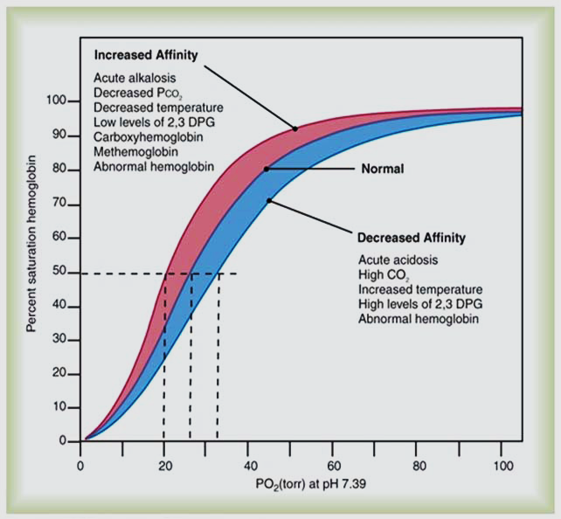

Slide 8
Shift of the O₂ dissociation curve
Shift to right | Shift to left
Meanings: It means that at any O₂ tension the Hb is less saturated with O₂ and give O₂ to tissue (↓ affinity or unloading) | It means that at any O₂ tension the Hb is more saturated with O₂ so give less O₂ to tissue (↑ affinity or loading)
Causes: decrease O₂ increase Co₂ (Bohr’s effect) increase H⁺ (acidosis or ↓pH) increase temperature (fever) increase 2,3 DPG . Pregnancy Exercise Anemia. | increase O₂ decrease Co₂ decrease H⁺ (alkalosis ) decrease temperature decrease 2,3 DPG Fetal Hemoglobin CO poisoning. Polycythemia.
Significance: This increase O₂ supply to active muscle during exercise. | This increases O₂ loading on Hb at the lung .

Slide 9
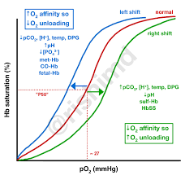

Slide 10
(1) Effect of 2,3 DPG:
- 2,3 Diphosphoglycerate is formed in RBCs by anaerobic glycolysis, and combines to the reduced Hb leading to ↓ Hb affinity to O₂. 2,3 DPG increased in anemia, muscular exercise, high altitude, increase in thyroid hormone(hyperthyroidism), growth hormones and androgens and in chronic hypoxia → ↑O₂ supply to tissue
- but in a stored blood →↓ 2,3 DPG →↓ O₂ supply to tissue of recipient. Also acidosis depress glycolysis and decrease 2,3DPG.
(2) Effect of fetal Hb in newly born:
-Adult Hb contains pair of (α) and pair of beta (B) polypeptides which combine with 2,3 DPG → ↓ Hb affinity to O₂.
-Fetal Hb contains pair of alpha (α) and pair of gamma (γ) which can’t combine with 2,3 DPG so → ↑ Hb affinity to O₂. This facilitates movement of O₂ from mother to fetus and keeps high O₂ in fetal Hb to be used under need.
(3) Effect of muscular exercise:
- Muscular exercise increases O₂ supply to tissue (muscles) by 50 times by the followings:
1- ↑ cardiac output by 6 times (from 5 to 30 L/min).
2- VD of blood vessels of skeletal muscles (sympathetic and metabolic) →↑O_{­2} supply by 3 times.
3- ↑ coefficient of O₂ utilization by muscles, the muscle take 15 ml O₂ from total 19 ml O₂/100 ml of arterial blood due to (↓ O₂ in tissue & shift of O₂ dissociation curve to Rt. as before) →↑O₂ supply by 3 times.
* In untreated diabetes and renal failure there are shift to right due to associated acidosis.

Slide 11
P50 of Hemoglobin & factors influencing
The P50 is the oxygen tension at which hemoglobin is 50% saturated. The normal P50 is 26.7 mm Hg.
Shifting the curve to the left or right has little effect on the SO2 in the normal range where the curve is fairly horizontal; a much greater effect is seen for values on the steeper part of the curve.
Shifting of the Oxy-hemoglobin dissociation curve:
A right-ward shift increases P50 and lowers hemoglobin’s affinity for oxygen, thus displacing oxygen from hemoglobin and releasing it to the tissues.
A left-ward shift decreases P50 and increases hemoglobin’s affinity for oxygen, thus reducing its availability to the tissues.
N.B: Met-hemoglobinemia causes a left-ward shift in the curve.

Slide 12
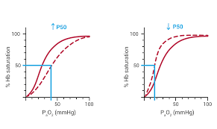
Shift to right
Shift to Left

Slide 13
Thank You

