Slide 1
Burns
Dr. Ashour Mohammed
Cons. Plastic Surgeon

Slide 2
BASIC PRINCIPLES
■ Burn management can be broken down to the 5R principles to guide the most
suitable therapy for each individual patient:
• Resuscitation: The modified Brooke formula is now preferred by most burn
centers (over the Parkland formula) to minimize over-resuscitation after burn
injury. The time of injury, not the time of presentation, is used to figure the
infusion rate
• Resurfacing: Involves tangential excision of partial-thickness burns and
suprafascial excision of full-thickness burns followed by coverage with
temporary dressings, biologic matrices, xenograft, allograft, autograft, or
vascularized tissues
• Reconstruction: Involves restoration of form and function and can be divided
into acute, intermediate, and late reconstruction
• Rehabilitation: Involves early mobilization, splinting, scar management,
sensory re-education, strengthening, and conditioning
• Recovery: True recovery involves the return of self-esteem and self-worth,
coupled with the confidence to move toward independence, enabling patients
to return to school, work, and social functions

Slide 3
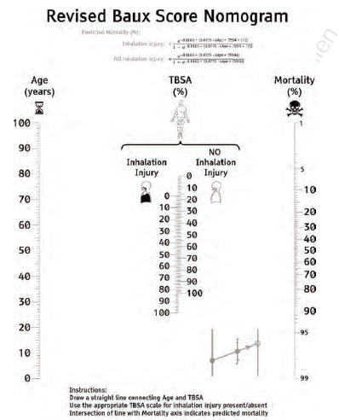
DEMOGRAPHICS
INCIDENCE IN THE US
■ 486,000 burn injuries receive medical treatment per year
• 3,275 deaths per year
■ High-risk groups: Pediatric, geriatric, military personnel, and disabled
populations
PROGNOSIS
■ Major predictor of mortality: Age, total body surf ace area (TBSA), inhalation
injury
• Baux score: 50% mortality if age + %TBSA = 110 (Baux score)
• However, if there is associated inhalation injury, then 50% mortality associated with age + %TBSA = 100 (revised Baux score)
■ Nomogram for the revised Baux score for mortality following burns

Slide 4
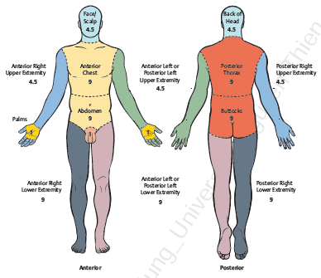
“Rule of 9s” for adults: To calculate TBSA, assign the following percentages per
area burned :
• Head and neck, 9%
• Anterior torso, 18%
Posterior torso, 18%
• Each upper extremity, 9%
• Each lower extremity, 18%
• Genitals, 1%
• Palm (without digits) represents a unit of 1% TBSA

Slide 5
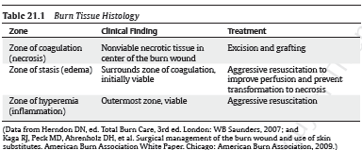
PATHOPHYSIOLOGY
BURN WOUNDS CLASSIFIED BASED ON DEPTH OF PENETRATION
■ Depth depends on: Mechanism, temperature, duration of contact, thickness of the
dermis, and blood supply
■ Progression of TBSA and depth depends on such patient factors as diabetes,
smoking, previous XRT, autoimmune disease, pre-existing hepatic or renal
dysfunction, use of vasopressors, hypothermia, difficult resuscitation, and
development of infection

Slide 6
■ First degree (superficial burns)
• Epidermis only
• Skin erythema, painful
• Blanches with pressure
• No blistering
• Symptoms subside over 3–4 days, the dead epidermis sloughs and is replaced
by regenerating keratinocytes at about day 4
■ Second degree (partial-thickness burns)
• Superficial: Papillary dermis sparing skin appendages
▶ Painful
▶ Blanches with pressure
▶ Blistering may be delayed for 12–24 hours after burn
▶ With appropriate wound care, most superficial partial-thickness burns will
heal within 2 weeks without risk of hypertrophic scarring
• Deep: Reticular dermis involving loss of skin appendages
▶ Decreased sensation
▶ Capillary refill slow or not at all
▶ Blistering
▶ Generally, takes longer than 3 weeks to heal, hypertrophic scarring
common, usually treated with excision and grafting
• Indeterminate: Mixed-depth partial-thickness burns
▶ Evaluated with serial clinical assessments over several days post injury to
determine healing potential
▶ May use laser Doppler imaging
■ Third degree (full-thickness burns)
• Entire dermis and adnexal structures
• Blistering absent
• Insensate, charred, leathery consistency
• Color varies with mechanism of burn
• If there is no intervention, it will demarcate and separate over days to weeks.
However, this delays healing and risks infection
• Circumferential third-degree burns of extremities may lead to compartment
syndrome if muscles become edematous; likewise circumferential chest wall
burns may inhibit expansion and breathing

Slide 7
CRITERIA FOR TRANSFER TO A BURN CENTER
■ Burn Center Transfer Criteria has been established by the American Burn
Association (ABA) to provide safety and proper care for the burn patients
INDICATIONS/PATIENT SELECTION
■ Partial-thickness burns >10% of TBSA
■ Third-degree burns
■ Burns involving face, hands, feet, genitalia, perineum, or major joints
■ Chemical burns
■ Electrical burns
■ Any burn with concomitant trauma in which burn poses greatest risk to patient
■ Inhalation injury
■ Preexisting medical disorders that could affect mortality
■ Hospitals without qualified personnel or equipment for care of burned children
■ Patients who will require special social, emotional, or rehabilitative intervention
TIP: The criteria for transfer to a burn center are frequently asked on
examinations, including boards.

Slide 8
PREOPERATIVE DIAGNOSIS AND TREATMENT
FACIAL BURNS
■ Airway evaluation
• Extensive edema formation (blood supply and loose connective tissue): Head
elevation
■ Full-thickness burns should be excised and grafted within 7–10 days post injury to
promote early wound closure and minimize scar contracture deformities
■ Eye examination and fluorescein staining for corneal injury before extensive
edema
■ Ophthalmology consult
INHALATION INJURY
■ Clinical significance
• Increased mortality
• Airway closure secondary to oropharyngeal edema
• Increased resuscitation fluid requirements
• Impaired pulmonary gas exchange
• Pneumonia
• Risk of systemic inflammatory response syndrome and multiorgan failure
▶ Chronic pulmonary dysfunction
▶ Laryngeal edema
■ Supraglottic injury (thermal/chemical): Hoarseness, pharyngeal erythema, and
edema
■ Infraglottic injury (chemical): Mental status changes because of hypoxia
■ Carboxyhemoglobin (≥10% in CO poisoning)
■ Chest radiographic examination (typically normal initially)
■ Bronchoscopy may assist in determining severity

Slide 9
■ Cyanide toxicity
▶ Hydrogen cyanide (HCN), the gaseous form of cyanide, is generated by the
combustion of nitrogen and carbon containing substances, such as wool,
silk, cotton, and paper
▶ Cytotoxicity is due to its reversible inhibition of cytochrome c oxidase,
suppressing cellular respiration and causing tissue anoxia and metabolic
acidosis
▶ Elevated HCN concentrations are directly related to the probability of
death as it causes severe central nervous system (CNS), respiratory, and
cardiovascular dysfunction
▶ Toxicity occurs at a level of 0.1 μg/mL, and at 1.0 μg/mL, death is likely
▶ Consider using Cyanokit: Hydroxocobalamin 5–10 g intravenous injection
for adults or 70 mg/kg for children
♦ If clinical suspicion of cyanide poisoning is high, Cyanokit should be
administered immediately
■ Treatment: Goal is to maintain oxygenation while facilitating adequate ventilation
• Strategies include use of 100% oxygen to disassociate CO from hemoglobin
(Hgb), prevention of barotrauma with low tidal volumes, permissive
hypercapnia, high frequency percussive ventilation, and extracorporeal
membranous oxygenation (ECMO)
COMPARTMENT SYNDROME
■ May occur in burn or unburned limbs due to massive fluid resuscitation
■ High voltage electrical injury
■ Crush injury
■ Occult fracture
■ Delay in escharotomy (ischemic–reperfusion syndrome)
■ Clinically:
• Pain on passive stretch
• Tense compartments on palpation
• Paresthesia
• Doppler flowmeter
• Compartment pressures > 30 mm Hg is indication for escharotomy or fasciotomy
However, decision to operate is usually made based on clinical factors
CAUTION: Compartment syndrome may also occur when pressures are < 30 mm Hg, in the presence of a fracture or with significant crush injury.

Slide 10
ELECTRICAL INJURIES
■ Approximately 5% of burn admissions
■ Can produce significant morbidity despite relatively small burn sizes
■ Three types: Current, arcing, and flash
• True electrical injury by current flow
• Arc injury from the electrical arc as it passes from the source to an object
• Flame injury from ignition of clothing or surroundings
■ Most sequelae from high-voltage injury (>1000 volts)
■ Find contact points
■ Electrocardiogram (EKG) and troponins
■ Continuous cardiac monitoring, for at least 24 hours
• Arrhythmias common
■ Renal function panel including creatine kinase above 1000 IU
■ Tea-colored urine indicates myoglobinuria
• Maintain urine output at 75–100 mL/hour to minimize myoglobin precipitation.
Bicarbonate or mannitol may be needed
■ Risk of compartment syndrome in involved extremity

Slide 11
CHEMICAL BURNS
■ Alkali: Penetrates deeply because of liquefactive necrosis and protein denaturation
• Commonly found in oven cleaners, drain cleaners, fertilizers, and heavy
industrial cleansers
• Copious water irrigation for at least 15–20 minutes
• Avoid neutralization with weak acids, which causes an exothermic reaction
■ Acids: Coagulative necrosis and protein precipitation limit the depth of tissue damage
• Copious water irrigation for at least 15–20 minutes
■ Hydrofluoric acid: Fluoride ion binds calcium causing severe systemic
hypocalcemia and tissue necrosis leading to death
• Treat topically with calcium gel, intradermal calcium gluconate, or intra arterial
calcium gluconate based on severity
• Cardiac monitoring
■ Phenol: Coagulative necrosis can cause systemic derangement (e.g., liver, kidney)
• Irrigate and treat with polyethylene glycol or ethyl alcohol
■ Phosphorus: Stain particles with 0.5% copper sulfate or detect with UV light and surgically remove
• Can cause hypocalcemia, hyperphosphatemia, and cardiac arrhythmias
■ Anhydrous ammonia: Exposure causes blistering of the skin and injury to the
lungs if the fumes are inhaled
• Copious irrigation with water
TIP: These chemical injuries and their treatments are frequently on written
board exams.

Slide 12
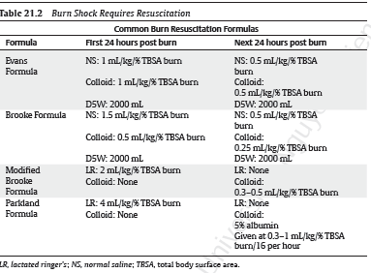
RESUSCITATION: PARKLAND VERSUS MODIFIED BROOKE FORMULA
■ Burn shock with systemic response typically occurs with >20% TBSA (>15% in
pediatric and geriatric patients) and may be exacerbated by hypovolemia (from
alcohol or hyperglycemia-induced diuresis) or cardiogenic failure
■ Burn shock requires resuscitation; otherwise, maintenance fluids may
be adequate
■ Colloids and pressors are indicated if crystalloid resuscitation is inadequate
■ Both Parkland and modified Brooke formulas recommend crystalloids during the first 24 hours
• Administration of colloids (5% albumin) is normally reserved for the second
24 hours, but is often used earlier for oliguria when calculated crystalloid
requirements are met
• Parkland Formula: 4 mL × Weight (kg) × % TBSA burned
• Modified Brooke Formula: 2 mL × Weight (kg) × % TBSA burned
• Half of the total amount in lactated Ringer’s solution given over the first 8 hours from the time of injury and the second half over the next 16 hours, with rate adjusted based on hourly urine output (UO; target UO is 0.5 mL/kg per hour)
• Additional fluid is typically required in concurrent trauma, electrical injury,
inhalation injury
• Maintenance fluid with D5W ½ NS in addition to resuscitation fluid is required
in infants and children
TIP: Adequate volume resuscitation is paramount because this can preserve the
zone of stasis (edema) and prevent further tissue loss

Slide 13
OPERATIVE TREATMENT
ACUTE-PHASE BURN RECONSTRUCTION
■ Excision
• Fascial excision results in less blood loss than tangential excision but creates a
more severe deformity
• The decision on how much to excise during a single setting is determined by
the patient’s comorbid conditions, blood availability, and the ability to cover
the wound
■ Wound coverage
■ Eyelid and oral commissure contractures surgically treated in the acute burn
period to prevent exposure keratitis and irreversible damage to dentition
■ Aggressive occupational therapy including splinting
TIP: Plan for surgical blood loss of 0.5 mL/cm2 (area of burn excision; Total size of burn wound excision that can safely be performed at each operative setting ranges from 10 to 20% TBSA but depends on depth of excision, blood available for intraoperative transfusion, and critical care resources available in the postoperative setting
.

Slide 15
INTERMEDIATE-PHASE BURN RECONSTRUCTION
■ Hypertrophic burn scars mature over months to years. In this period, the goal is
favorable scar maturation
• Depth of initial injury and wound tension determine final scar appearance
• Techniques to relieve tension include Z-plasty, releases with grafting, laser
treatment, intralesional and laser assisted steroid delivery (used sparingly),
and fat grafting
• Aggressive occupational therapy including splinting

Slide 16
LATE-PHASE BURN RECONSTRUCTION
■ Mature burn scars blend into surrounding normal tissue as they become more
pliable, less hypertrophic, and less hyperemic
■ Goals of therapy after scar maturation are definitive treatment of remaining
functional and aesthetic deformity. Postoperative therapy is critical to outcome in
some regions
■ Scars that remain hypertrophic and hyperemic are typically under persistent
tension and may be treated with release and laser treatment
■ Each body region presents unique problems that may be best approached at
various levels of the reconstructive ladder
• Head and neck: Eyebrows, eyelids, ears, nose, perioral, and scalp reconstruction
should be based on an overall strategy and a clear understanding of the
fundamental problems. Tissue expanders are helpful
• Extremities: Larger joints of the extremity are important for hand and
foot positioning. Assess the entire extremity during operative planning to
maximize functional restoration
• Breasts: Release with grafting, flaps, tissue expansion, and implant exchange.
Obtain symmetry in unilateral burn injury because a burned breast may not
become ptotic over time

Slide 17
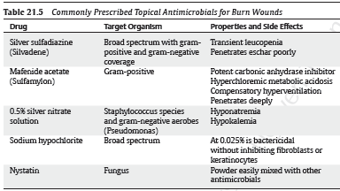
POSTOPERATIVE TREATMENT
■ Systemic antibiotics for suspected infections
■ Culture guided: Sputum, blood, tissue, urine
■ Topical antimicrobials
■ Nutrition
• Burns involving more than 20% of the TBSA represent a massive metabolic injury
• Malnutrition results in delayed wound healing, organ failure, and compromised
immune system
• Enteral nutritional (EN) feeding is preferred to total parenteral nutrition
(TPN) because it stimulates enteric blood flow, maintains barrier function by
preserving tight-junction integrity, and induces production and release of
mucosal immunoglobulin and critical endogenous growth factor
• Curreri formula is used to calculate caloric needs:
▶ Age, 16–59 years = 25 kcal/kg/day + 40 kcal/%TBSA/day
▶ Age, > 60 years = 20 kcal/kg/day + 65 kcal/%TBSA/day
• Dedicate 1.5–2 g/kg/day and 2.5–4 g/kg/day of protein in burned adults and burned children, respectively, with additional glutamine supplementation, providing a calorie/nitrogen ratio of 100:1

Slide 18
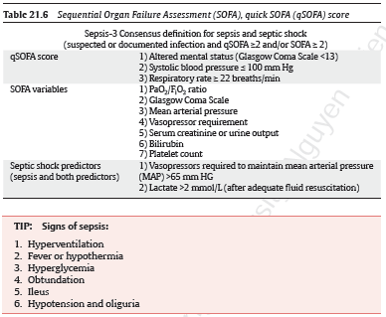
COMPLICATIONS
■ Care related
• Hospital acquired infections: Most common cause of death in burn patients
▶ Hospital associated pneumonia and ventilator associated pneumonia
▶ Central line associated blood stream infections
▶ Catheter associated urinary tract infections
▶ Skin and soft tissue infections
• Sepsis (new definition—Sepsis-3 based on Sequential Organ Failure Assessment
[SOFA]
▶ Biomarkers predictor of sepsis include C-reactive protein (CRP),
procalcitonin (PCT), and cytokines including IL-6, IL-10, and IL-120
■ Shock: Inadequate end-organ perfusion, based on inability to meet the metabolic
demands of the tissue
■ Gastrointestinal complications: Ileus, stress gastritis, gastroduodenal perforation, bowel perforation from ischemia, abdominal compartment syndrome, Clostridium difficile infection, pancreatitis, acalculous cholecystitis
■ Renal failure: Acute tubular necrosis (ATN) from hypoperfusion, nephrotoxicity
from antibiotics such as aminoglycosides and vancomycin

Slide 19
■ Hospital acquired pressure injuries:
• Device related: Endotracheal tube, nasogastric tube, splint, dressing
• Sacral, trochanteric, ischial, calcaneal, malleolar, occipital
■ Surgical
• Graft loss
• Burn scar contracture
• Delayed healing with chronic wounds
■ Heterotopic ossification: Pathologic formation of ectopic osseous lesions causing severe pain, nonhealing wounds, and restricted range of motion
• Can result from severe trauma, burns, musculoskeletal injury, spinal cord
injury (SCI), traumatic brain injury (TBI), and genetic mutation in bone
morphogenetic signaling protein
• Nonsteroidal anti-inflammatory drugs (NSAIDs), bisphosphonates, and
radiation therapy have been used as preventive prophylaxis
■ Wound breakdown
■ Hypertrophic scar formation with chronic neuropathic pain, manifested by
paresthesias, dysesthesias, pruritis

Slide 20
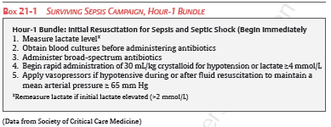
KEY SAFETY MEASURES
■ Pneumonia
• Obtain sputum cultures and start broad spectrum antibiotics for recurrent
fevers post excision. Aggressive pulmonary toilet
• Early tracheostomy for severe inhalation injury to promote ventilation wean
and easy suctioning
■ Sepsis
• Hour-1 Bundle
▶ Excise all deep burns, serial re-evaluations of indeterminate burns, may use
laser Doppler imaging to help determine depth
▶ Clinical suspicion for necrotizing soft tissue infections (NSTI); need radical
Debridement
■ Bleeding
• Intraoperative bleeding—calculate expected blood loss
• Transfusion ratio 1:1:1 (packed red cells/fresh frozen plasma/platelets)
• Check labs including prothrombin time, partial thromboplastin time, bleeding
time
• Viscoelastic tests, such as thromboelastography (TEG) and rotation
thromboelastometry (ROTEM), are efficient, fast, and sensitive at detecting
early coagulation abnormalities and help guide blood product therapy
• Rule out disseminated intravascular coagulation (DIC), check D-Dimer and fibrinogen levels
■ Venous thromboembolism (VTE)
• Overall incidence in the burn population is low (0.61%), including deep venous
thrombosis (DVT, 0.48%) and pulmonary embolism (PE, 0.18%)
• Routine chemoprophylaxis with unfractionated heparin or low molecular
weight heparin
• Complex DVT/PE treatment depends on the cause (spontaneous versus induced)

Slide 21
KEY POINTS
☑ Decreased sensation occurs with deep second-degree and deeper burns.
☑ Know the criteria for admission for burn injuries—they are frequently
asked on tests.
☑ The traditional Parkland formula is still used to calculate initial resuscitation for the first 24 hours after burn injury. The time of injury, not the time of presentation, is used to figure the rate.
☑ Silver sulfadiazine can cause leukopenia.
☑ Mafenide acetate can cause metabolic acidosis secondary to its inhibition
of carbonic anhydrase.
☑ Silver nitrate can cause hyponatremia.

Slide 22
THANK YOU

