Slide 1
Inherited Gynecological Malignancies
presented by :
Ahmad harazneh
Ahmad aldahamsha
Sara alkhatib
Ghaith suheimat

Slide 2
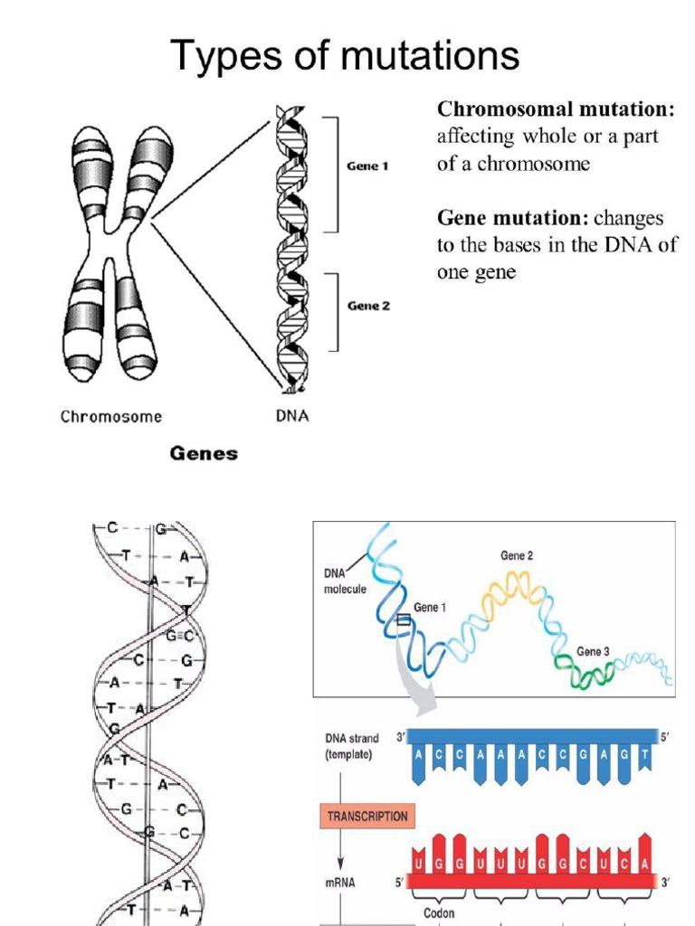

Slide 3
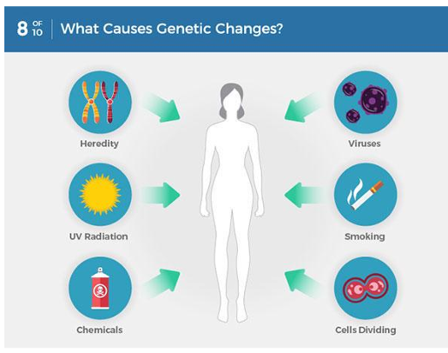
MUTATIONS:
Are sudden and abrupt changes in genetic materials of an organism.
Two types of mutations:
1)Genetic mutations :alteration in the sequence of neuclotides in DNA which results in change in a gene coded a protein.
2) Chromosomal mutations : disruption in chromosomal structure or number called:(aneuploidy)

Slide 4
Introduction
Background and Importance of Genetic Testing in Women’s Cancer:
- Over 20 years since the discovery of BRCA1 and BRCA2 genes.
- Revolutionized germ-line genetic analysis and genetic risk assessment.
- Routine care now includes assessing breast cancer (BC) and ovarian cancer (OC) risk.
Expansion of Genetic Testing:
- Initially limited to high-risk patients, now more accessible to specialists and primary care physicians (OB/GYN, oncologists).
Recommendations guided by NCCN, USPSTF, and other organizations.
Key Genetic Discoveries and Risks:
- Research has clarified cancer risks from BRCA1/2 mutations and mismatch repair (MMR) genes linked to Lynch syndrome (LS) (MLH1, MSH2, MSH6, PMS2).
- Genetic advancements led to evidence-based practices in cancer prevention (surgery, screening, chemoprevention).
- Understanding of how cancer risk perceptions influence health behaviors, communication, and family dynamics.

Slide 5
Introduction
Genetic testing for hereditary cancer risk makes feasible cancer prevention through intensive screening, surgical prophylaxis, and chemoprevention.
Identifying causative genetic mutations allows women to get an estimate of their lifetime risks for OC and EC in an effort to support informed decisions aboutmanaging cancer risks and subsequent lifestyle decisions such as childbearing.
Another advantage of risk assessment is the decrease in the anxiety for those women in a family with a known genetic predisposition to a gynecologic cancer but who are, upon testing, found to be “true negative” or non-carriers of a familial gene.

Slide 6
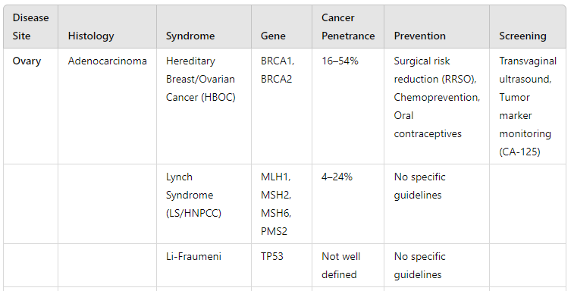
Gynecologic Cancers, Associated Genes, and Prevention

Slide 7
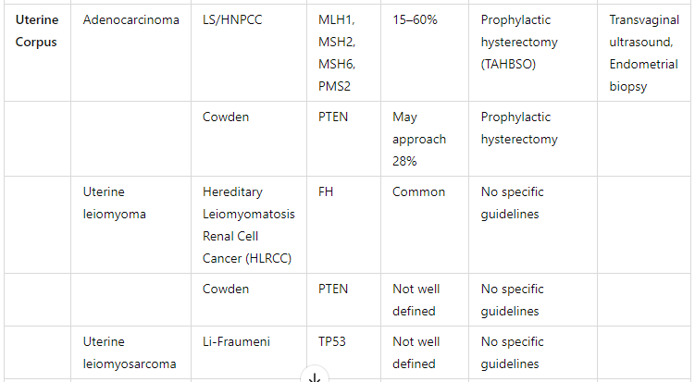
Gynecologic Cancers, Associated Genes, and Prevention 2

Slide 8
Common cancer syndromes with gynecologic cancer risks: Hereditary Breast–Ovarian Cancer (HBOC) and Lynch syndrome (LS)
Overview of Cancer Syndromes:
Hereditary Breast-Ovarian Cancer (HBOC) and Lynch Syndrome (LS):
Autosomal-dominant inherited conditions.
HBOC: Predisposes to breast cancer (BC) and ovarian cancer (OC).
LS (also known as Hereditary Non-Polyposis Colorectal Cancer, HNPCC): Predisposes to colorectal cancer (CRC), endometrial cancer (EC), and OC, as well as other cancers.

Slide 9
Genetic Mutations:
HBOC:
BRCA1 and BRCA2 gene mutations are key drivers.
BRCA1 is associated with a higher risk of early-onset BC, particularly triple-negative breast cancer (TNBC).
Both BRCA1 and BRCA2 mutations increase the risk of second breast cancer, male breast cancer (especially BRCA2), pancreatic cancer, prostate cancer, and melanoma.

Slide 10
Lynch Syndrome (LS):
Linked to mutations in mismatch repair (MMR) genes: MLH1, MSH2, MSH6, and PMS2.
Variability in cancer risk depending on the specific gene:
MLH1 and MSH2: Strong association with early-onset CRC and EC.
MSH2: More extracolonic cancers (e.g., stomach, small bowel, genitourinary tumors, brain cancer, and skin manifestations).
MSH6: Higher risk of EC and later onset CRC.
PMS2: Potentially lower penetrance and cancer risk compared to other LS genes.

Slide 11
Cancer Risk Statistics:
HBOC Risks:
BRCA1/2 mutations occur in approximately 1 in 500 individuals.
Lifetime risk of ovarian cancer (OC):
BRCA1 carriers: 44–63% risk by age 70.
BRCA2 carriers: 27–31% risk by age 70.
BRCA1-associated OC tends to occur 5–10 years earlier than sporadic cases, while BRCA2-associated OC occurs around the same age as sporadic OC.
Lynch Syndrome Risks:
1 in 300 individuals have mutations in the LS genes.
Lifetime risk of ovarian cancer in women with LS: 5–15%, compared to 1.4% in the general population.
LS increases the risk of CRC, EC, OC, as well as stomach cancer, small bowel cancer, and brain cancer (e.g., Turcot syndrome), along with skin manifestations (Muir-Torre syndrome).
Endometrial cancer (EC) risk is high and may even exceed CRC risk in some cases of LS.
2–6% of EC cases can be attributed to LS alone.

Slide 12
Prevalence and Genetic Contribution:
Previous estimates suggested that 10–15% of unselected OC cases were due to a genetic predisposition.
More recent data indicate that HBOC and LS together may account for at least 20% of OC cases.BRCA1/2 mutations are responsible for the majority of epithelial OC associated with HBOC.
An additional 5% of OC cases (totaling 25% of all OC) are due to pathogenic mutations in other genes beyond BRCA1/2 and LS-associated genes.
Clinical Presentation and Index Cancers:
In Lynch Syndrome:
More than 50% of affected women may present with gynecologic malignancy (most commonly EC) as their first cancer.
This makes endometrial cancer a common index cancer in women with LS.

Slide 13
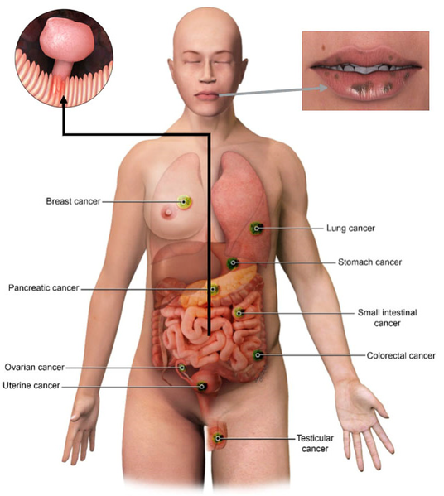
Rare syndromes with gynecologic manifestations
1. Peutz–Jeghers syndrome (PJS):
Caused by mutations in the STK11 tumor suppressor gene.
- Rare autosomal dominant disease (1:20,000 prevalence).
- Key features: mucocutaneous pigmentation, gastrointestinal hamartomas, increased risk of breast, ovarian, and cervical cancers.
- Associated ovarian tumors: benign sex cord tumors with annular tubules (SCTATs), dysgerminomas, granulosa cell tumors, Brenner tumors, and Sertoli cell tumors.
- SCTATs in PJS patients are often multifocal, bilateral, and small.
- PJS also associated with minimal deviation adenocarcinoma (MDA) of the cervix, with a 15–30% lifetime risk and earlier onset (mean age 33 vs 55 years in non-PJS patients).

Slide 14
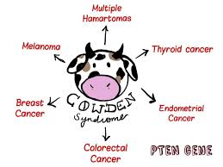
2. Cowden syndrome (CS):
- Caused by mutations in the PTEN gene.
- Increases the risk of endometrial cancer (28% lifetime risk), as well as breast and thyroid cancers.
- Patients may also have uterine fibroids and thyroid disorders.
.

Slide 15
Rare syndromes with gynecologic manifestations 2
3. Hereditary Leiomyomatosis and Renal Cell Cancer (HLRCC):
- Caused by mutations in the fumarate hydratase (FH) gene.
- Increased risk of uterine leiomyomas (fibroids) and leiomyosarcoma.
- Associated with type 2 papillary renal cell carcinoma
4. Li–Fraumeni syndrome (LFS):
- Caused by mutations in the TP53 gene.
- High risk of multiple cancers, including ovarian cancer and endometrial cancer, as well as breast cancer and sarcomas.
- Earlier onset of ovarian cancer (median age 39.5 years).
5. Polymerase Proofreading Associated Polyposis (PPAP):
- Caused by mutations in POLE and POLD1 genes.
- Associated with an increased risk of endometrial cancer and early-onset colorectal cancer.

Slide 16
Fanconi Anemia pathway
FA Pathway Function: It plays a crucial role in repairing double-strand DNA breaks through homologous recombination.Connection to Cancer: Mutations in FA pathway genes disrupt DNA repair, increasing the risk of cancers, particularly breast cancer (BC) and ovarian cancer (OC).
Genes Associated with Moderate Risk of Breast Cancer (BC):
CHEK2, BARD1, MRE11A, NBN (NBS1), RAD50, RAD51C, RAD51D, BRIP1 (FANCJ).
Gene Associated with High Risk of Breast Cancer (BC):
PALB2 (FANCN).
RAD51C Mutations:
Present in 1.3% of families with both BC and OC.
Lifetime risk of ovarian cancer (OC) is elevated up to 9%.
RAD51D Mutations:
Relative risk of OC estimated at 6.3 (95% confidence interval: 2.9–13.9).

Slide 17
OVARIAN CANCER :
1: screening
2:surgical prophylaxis
3:chemoprevention

Slide 18
INTRODUCTION
The second most common gynecologic malignancy in developed countries.
The most common cause of gynecologic cancer death and the fifth leading cause of cancer death in women
The majority of ovarian malignancies (95 %) are derived from epithelial cells; the remainder arise from other ovarian cell types (germ cell tumors, sex cord- stromal tumors).
Serous carcinoma, the most common histologic subtype of epithelial ovarian carcinoma (75 percent of epithelial carcinomas).

Slide 19
RISK FACTOR
1_ Age:
The incidence increases with increasing age
- The average age at diagnosis of ovarian cancer is 63 years old.
The age at diagnosis of ovarian cancer is younger among women with a hereditary ovarian cancer syndrome. The risk of ovarian cancer reaches 2-3% in women with a BRCA1 gene mutation at age 40 and for those with a BRCA2 mutation at age 50.The typical age at diagnosis of ovarian cancer in women with Lynch syndrome (hereditary nopolyposis colon cancer) is 43 to 50 years

Slide 20
2_Reproductive and hormonal factors :
1- Early menarche (< 12 years ). (ovaries work foe longer time )
2- late menopause (> 52 years ).
3- Nulliparity .
4- Infertility.

Slide 21
3- Genetic factors:
Several ovarian cancer susceptibility genes have been identified, primarily BRCA1and 2 and the mismatch repair genes (associated with Lynch syndrome);other genesinclude RAD51C, RAD51D, and BRIP1
The estimated lifetime risk of ovarian cancer is 35-46 % for BRCA1 mutation carriers and 13-23 %for BRCA2 mutation carriers
the lifetime risk of ovarian cancer in women with Lynch syndrome is 3-14 % compared with 1.5 %in the general population
4_Family history of ovarian cancer
5_Environmental Factors

Slide 22
OVARIAN CA SCREEING
OC is one part of a spectrum of pelvic high grade serous cancers which also include fallopian tube and primary peritoneal cancer.
There is no proven effective screening for OC, which is often discovered at an advanced stage (57% Stage 4) when the survival rate is poor (75% at one year, 44% at 5 years
Many studies have investigated methods, including trans-vaginal ultrasound and/or serum CA125 testing, to screen high risk women , but these studies have failed to identify OC at lower stages or show an improvement in overall survival
In fact, harm was demonstrated in the form of increased surgical complication rates in women undergoing surgery after a false positive screening test

Slide 23
Limitations And Challenges Of Screening:
Potential benefits:To reduce ovarian cancer mortality_: a screening program would need to detect ovarian cancer at an early stage, because with current treatment methods, ovarian cancer mortality is closely related to stage at diagnosis, The poor overall survival rate is in large part because 75 percent of patients have spread of cancer beyond the ovary at the time of clinical detection.
Potential harms:The potential harms associated with screening for ovarian cancer include risks of false-positive results, psychological stress, and surgical risks.

Slide 24
Cancer antigen 125 (CA 125)
The CA 125 antigen is a large transmembrane glycoprotein derived from bothcoelomic (pericardium, pleura, peritoneum) and müllerian (fallopian tubal,endometrial, endocervical)
Normal value : CA 125: ≤35 U/Ml.
CA 125 testing alone has a low sensitivity, particularly for early stage ovarian cancer.only raised in 50% of early stage disease.
Specificity is limited because a variety of benign and malignant gynecologic and non-gynecologic conditions elevate CA 125, leading to false-positive results.

Slide 25
Transvaginal ultrasound (TVUS)
In the aggregate, studies do not suggest that screening with TVUS reduces ovarian cancer mortality
The sensitivity of TVUS is in part observer-dependent
In women at high risk of ovarian cancer, ultrasonography for screening has performed poorly in detecting early-stage epithelial ovarian cancer
No screening strategy (cancer antigen [CA] 125, transvaginal ultrasound [TVUS], or multimodal testing) has been shown to reduce mortality And all screening strategies are associated with a high rate of false-positive tests and a risk of harms from invasive testing

Slide 26
Surgical Prophylaxis
One of the clear benefits of knowing a patient's mutation status is the option to use risk-reducing surgical prevention in the form of prophylaxis
Expert guidelines including the National Comprehensive Cancer Network (NCCN) support the option for prophylactic surgery, including risk reducing salpingo–oophorectomy (RRSO) and/or total abdominal hysterectomy (TAH), after childbearing in BRCA1/2 and LS mutation carriers
For women with BRCA1/2 mutations, RRSO is recommended between ages 35–40 when childbearing is complete.
the recommended age is due to early age of onset of OC in BRCA1/2 carriers; without intervention,3% of women with BRCA1 mutations are diagnosed with OC by age 40 and 21% by age 50

Slide 27
RRSO reduces the risk of OC by ~75–96%; however BRCA1/2 mutation carriers still carry a persistent risk (3–4%) of primary peritoneal cancer after RRSO
Approximately 2–17% of women having RRSO for prophylaxis may have an occult cancer at the time of surgery
Serous tubal in situ carcinoma (sTIC), a precancerous tubal lesion, has also been identified in this population and is frequently located in fimbriated end of the fallopian tube adjacent to the ovary
The existence of tubal precancerous lesions has further led to the theory of the fallopian tube as the origin for pelvic serous cancers, which may impact preventive options for BRCA1/2 carriers
If ongoing studies can demonstrate that prophylactic salpingo– oophorectomy with delayed bilateral oophorectomy (PSDO) is as effective as RRSO prior to age 40, this option would permit high risk women to avoid surgical menopause and its negative impact on quality of life.However, this option would notably offer no benefit for reduction of BC or OC risk
prophylactic salpingectomy alone is discouraged by NCCN guidelines

Slide 28
Chemoprevention
Oral contraceptive pills (OCPs) have been shown to decrease the risk of OC
OCPs have a duration dependent benefit ,, 50% reduction in OC with long-term use of OCP (i.e. the longer the use, the greater duration of risk reduction)
Among the potential limitations of OCPs for OC prevention is a concern for increased BC risk, although studies to date have shown somewhat conflicting results
several retrospective analyses have associated an increased risk of BC with ever using OCPs and longer duration of use

Slide 29
Endometrial Cancer:
1:screening
2:surgical prophylaxis
3:chemoprevention

Slide 30
Introduction
Endometrial carcinoma is the fifth leading cancer in the women worldwide.
In developed countries it’s the most common gynaecological cancer but in developing countries it’s surpassed by cervical cancer.
Mean age of presentation is 56 years

Slide 31
Risk Factors
Obesity
Late menopause
Diabetes mellitus
Another cancer; ovary, endometrium, colon
Unopposed estrogen
Tamoxifen prolonged use

Slide 32
Screening
Women with hereditary risk for EC have the option of surveillance with trans-vaginal ultrasound and endometrial biopsy, though these options, per NCCN guidelines, are not supported by data
screening can be considered if a patient has not completed childbearing, or is not ready or able to have prophylactic surgery
Irregular or postmenopausal bleeding is an early, identifiable symptom for EC
Women at risk for EC should be counseled to report any abnormal uterine bleeding

Slide 33
Surgical Prophlaxis:
Prophylactic hysterectomy and RRSO is 100% protective against EC and OC in patients with LS and should be considered by women who have completed childbearing
Chemoprevention:
A recent metaanalysis of 36 studies including 27,000 women with EC demonstrated that OCPs have a long-term benefit for reducing risk for EC in average risk women. For every 5 years of OCP use, EC risk is reduced by 24%, and 10–15 years of use decreases risk by ~50%

Slide 34
Reproductive and sexual health considerations
Sara Alkhatib

Slide 35
Outlines:
Fertility Considerations
2. Pre-implantation Genetic Diagnosis (PGD)
3. Menopause, Sexual Considerations, and Quality of Life After RRSO

Slide 36
1. Fertility Considerations:
Women considering prophylactic surgeries have important issues to consider regarding timing of pregnancy, increased cancer risks with advancing age, and fertility issues. The wider availability of reproductive technologies, such as pre-implantation genetic diagnosis (PGD), may add further complexity to reproductive decisions.

Slide 37
Impact of BRCA1/2 Mutations on Fertility:
Some evidence suggests that fertility may be compromised in BRCA1/2 mutation carriers through a negative effect on ovarian reserve caused by early accelerated oocyte apoptosis and depletion , leading to premature menopause. Population studies have found an earlier age of menopause in BRCA1/2 carriers compared to the general population, though not all studies have identified an impact on fertility or parity.

Slide 38
Childbearing Decisions:
These studies are important to share with women with BRCA1/2 mutations, as this information may impact childbearing decisions. Fertility Preservation Options: Fertility preservation is an option for women at risk for GYN cancers considering definitive surgery and may necessitate reproductive endocrinology and infertility (REI) referral. For mutation carriers considering RRSO, embryo or oocyte cryopreservation is an option to preserve fertility prior to RRSO. A clear association of fertility drugs to OC has to date not been definitively established. Women considering prophylactic hysterectomy can also consider 3rd party reproduction (surrogate).

Slide 40
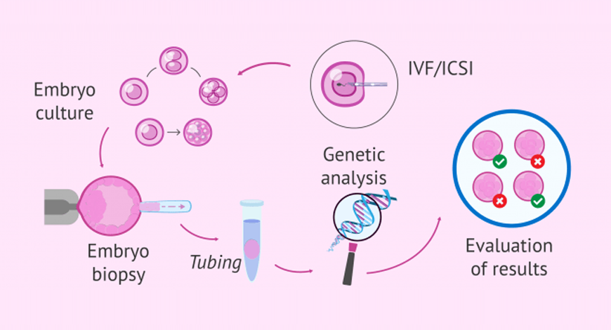

Slide 41
2. Pre-implantation Genetic Diagnosis (PGD) Purpose:
Another reason for mutation carriers to consider REI referral is for the purpose of PGD. REI specialists are able to test an embryo for the known genetic mutation and select an unaffected embryo.
Considerations:
However, some healthcare providers and patients may not consider PGD due to personal or religious belief

Slide 42
Patient Attitudes:
Patient attitudes regarding PGD have been studied by a national advocacy group for BRCA1/2 carriers (FORCE). While an overall low level of awareness (20–32%) of the option for PGD was noted among conference participants, approximately one-third thought PGD was an acceptable option to reduce risks of a child inheriting a known mutation. Positive attitudes toward PGD were associated with greater awareness of PGD, desire for more children, and previous pre-natal genetic testing .

Slide 43
3. Menopause, Sexual Considerations, and Quality of Life After RRSO Prevalence of RRSO:
Approximately 60–70% of women with a BRCA1/2 mutation elect to have RRSO between the ages of 35–70 . Those with OC in their family are more likely to opt for RRSO.

Slide 44
Short- and Long-term Effects of Surgical Menopause:
Once a mutation carrier decides to move forward with oophorectomy, she faces myriad short- and long-term effects of surgical menopause. These include hot flashes and mood changes in the short-term and long-term effects of vaginal dryness and sexual dysfunction, in addition to increased risk of bone loss and cardiac disease. The major side effects of surgical menopause following salpingo–oophorectomy are summarized in Table 3.

Slide 45
Quality of Life (QOL) After RRSO:
QOL after RRSO has been extensively studied. Common themes include fewer cancer-related worries in RRSO patients but also more menopausal symptoms and sexual dysfunction. Prospective studies have shown that RRSO (vs. screening) may decrease sexual frequency up to one year after surgery and lead to sexual dysfunction for up to 5 years.
Finch et al. found that BRCA1/2 mutation carriers who elected for RRSO but took hormone replacement therapy post-operatively had less hot flashes and vaginal dryness, but still experienced decreased sexual satisfaction .

Slide 46
patient Information Needs:
Patients have reported the need for more information regarding the impact of surgery on their sexual health and the availability of sex therapy .

Slide 47
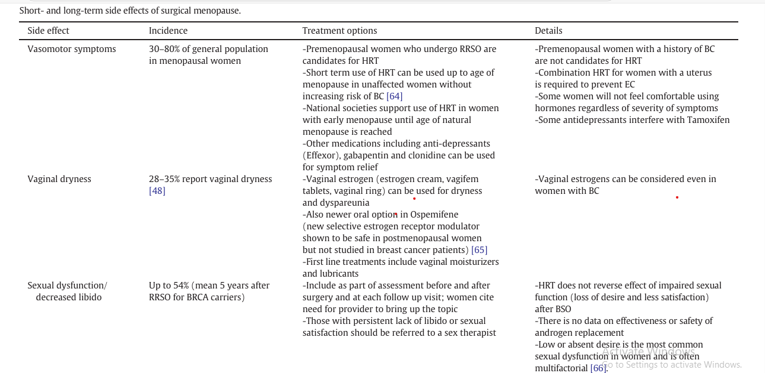

Slide 48
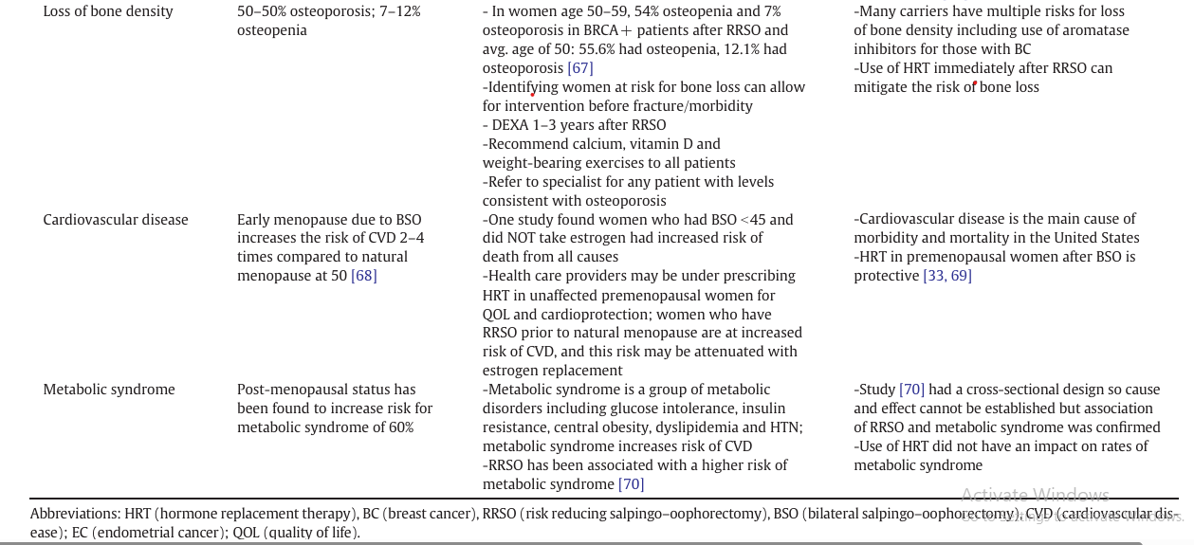

Slide 49
Summary :
Women with BRCA1/2 mutations face complex considerations in reproductive and sexual health. Fertility decisions may be impacted by ovarian reserve and early menopause. PGD offers options for reducing genetic risks, though awareness and acceptance vary. RRSO affects quality of life, especially regarding menopausal symptoms and sexual health.

Slide 50
5. Evolution of cancer risk assessment: universal Lynch syndrome screening and multi-gene panel testing

Slide 51
Family history and predictors of
genetic risk of cancer
- The cornerstone of cancer risk assessment remains the review of family history, the appreciation of physical findings related to genetic syndromes (e.g. café-au-lait spots), and the construction of a detailed pedigree that includes ages of cancer diagnosis, ages and causes o. f death, and documentation of complex familial relationships (e.g. consanguinity).
-. muliple factors are known to predict genetic risk of cancer, an abbreviated list of high-risk characteristics that may be useful in the routine care of women are provided in the next slides

Slide 52
personal and family history and clinical characteristics associated with an increased risk of cancer syndromes, particularly those including a gynecologic malignacy.
1- Historical Characteristics:These are personal or family history details that
may indicate a higher cancer risk:
.Early-age cancer onset: Example—Breast cancer diagnosis before 40 or other
cancers before 50.
.Multiple cancer diagnoses: Diagnosis of more than one type of cancer, such as
colon and endometrial cancer.
•Recurrent cancer diagnoses: Same cancer diagnosed more than once, such as
right breast cancer at 45 and left breast cancer at 55.
•Bilateral cancer: Cancer present in both breasts or other paired organs (e.g.,
associated with Cowden syndrome).
•Rare cancers: Small bowel cancer, bile duct cancer, or cancers of the renal pelvis
(often associated with Lynch syndrome).

Slide 53
2. Tumor Histologic Characteristics: Certain
pathologies of tumors are associated with specific
genetic mutations or cancer syndromes :
- Breast cancer: Triple-negative breast cancer, often linked
to BRCA1 mutations.
- Ovarian cancer: More commonly serous or endometrioid cell types, usually of high grade, with a strong association with TP53 mutations. \
- BRCA1/2 associated cancers: Increased likelihood of
endometrioid or clear cell histology.
- Lynch syndrome-associated cancers: Often include
endometrial cancer with microsatellite instability.
- Endometrial cancer: Lower uterine segment tumors
approximately 30% are linked to Lynch syndrome.

Slide 54
3. Non-cancer History/Exam Finding
- Certain skin findings or benign growths may suggest an underlying cancer syndrome:
- Sebeceous skin cancers: Linked to Lynch
syndrome and Muir-Torre variant.
- Trichilemmomas and papillomatous
papules: Features of Cowden syndrome.

Slide 55
4. Other Features:
- Fibroid uterus: A potential feature of Cowden syndrome or Hereditary Leiomyomatosis and Renal Cell Cancer (HLRCC).

Slide 56
Universal Lynch syndrome
screening
- in 2008, investigators from Ohio State University established the feasibility of screening incident CRC tumors for LS using immunohisto chemical (IHC) staining and microsatellite instability (MSI) testing.They found ~3% of CRC were associated with a germ-line LS mutation,and demonstrated the low sensitivity of the Revised Bethesda Guide lines (RBG) for detecting germ-line mutations (RBG missed 25% of mutations).
- A companion analysis showed cost-effectiveness of their
screening approach.
- Since then, universal LS screening employing IHC, MSI or both tests has been adopted at the majority of NCI- designated cancer centers nationwide as well as many community hospitals.

Slide 57
.Universal Lynch Syndrome (LS) Screening for
Endometrial Cancer (EC):
- Many centers now screen all incident endometrial cancers (prevalence ~2%) for Lynch Syndrome (LS).
- 2014 Society of Gynecologic Oncology
recommends that all women with EC receive:
-Personal/family history review.
-Molecular screening for LS.

Slide 58
- Both IHC and MSI are accepted screening methods:
.Advantages of IHC and MSI Testing
•IHC is more accessible for labs without molecular expertise.
•IHC helps determine which proteins or genes may be affected.
- Reflex Screening Protocol at Our Center:
- Universal screening starts with reflex IHC of all EC and CRC
cases (no age limits).
- Reflex MSI testing for equivocal IHC results (e.g., unclear
expression).
- MLH1 methylation testing is sent out only when required by the
genetics team.
- Protocol has been in place since 2011.

Slide 59
- Benefits of Universal Lynch Syndrome (LS) Screening ensures high-
risk patients are accurately referred for risk assessment.
- Nonetheless, weaknesses with the univeral screening approach include:
-High False Positive Rate: Requires careful management of screening
accuracy.
-Challenges in Follow-Up: Patient follow-up after positive results can
be difficult to manage.

Slide 60
NGS-Based Panel Testing for Cancer Risk
Overview of NGS Testing:
Replaced traditional single-gene tests (e.g., APC or BRCA1/2)
with testing of multiple genes simultaneously.
Allows for examination of both common and rare cancer risk
genes at once, reducing the need for multiple counseling visits.
Advantages:
-Comprehensive Testing: Multiple genes tested in one panel, saving time and reducing the need for repeat visits. Example: A patient with ovarian cancer can now be tested for BRCA1/2, MMR genes, and rare OC genes (e.g., TP53) in one test.
Limitations:
-Indeterminate Results:
May yield results with
unclear clinical significance, frustrating patients
and providers as risks remain unquantified.

