Slide 1
Abdominal incisions
Adnan Khanji
Rajih Nazzal
Mohammad Torman

Slide 2
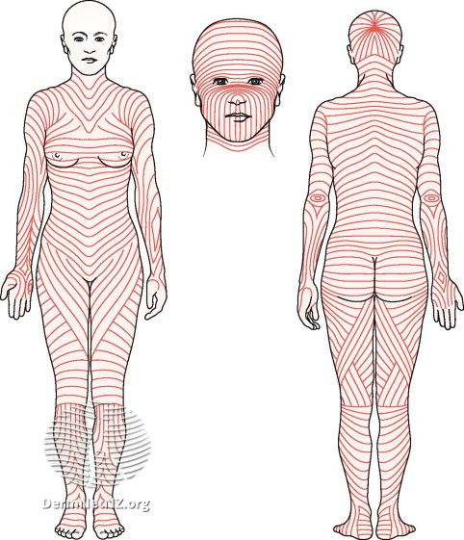
The ideal incision
The ideal incision should allow for consistently good access, following the langer lines for maximal wound strength and minimal scaring,
muscle should be split not cut, and being easily
opened and closed.
The langer lines:- lines of skin tension parallel
to the neutral orientation of the collagen fibers
in the dermis and underlying muscle fibers

Slide 3
MCburney’s point
This point corresponds to the base of the appendix where it is attached to the
cecum (beginning of the large intestines)

Slide 4
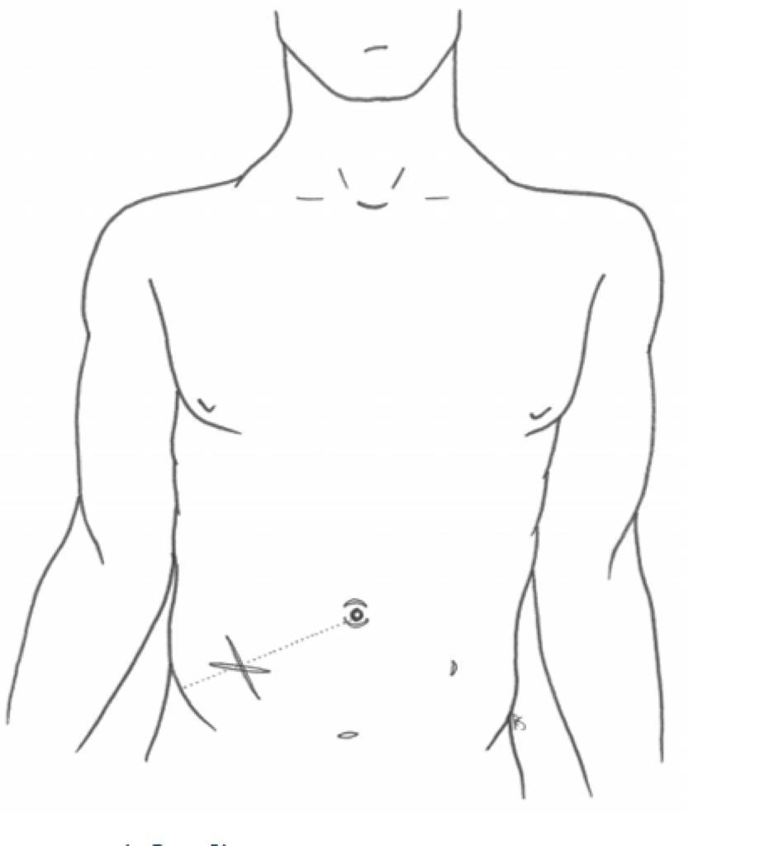
Gridiron and lanz incisions
The gridiron and lanz incisions are both incisions that can be used to access the appendix predominantly for appendectomy
The lanz incision is a transverse incision while
The gridiron is oblique
While the gridiron incision is oriented along
the langer Lines
the lanz incision produces much more
Aesthetically pleasing results as the scar is hidden
beneath the bikini lines

Slide 5
Gridiron and lanz incisions
Disadvantages include:-
the risk of injury to the
ilioinguinal and iliohypogastric nerves
The incisions cut through:-
Skin
subcutaneous fat and fascia
external and internal obliques
transversus abdominis
transversalis fascia.
Both incisions are indicated for appendectomy

Slide 6
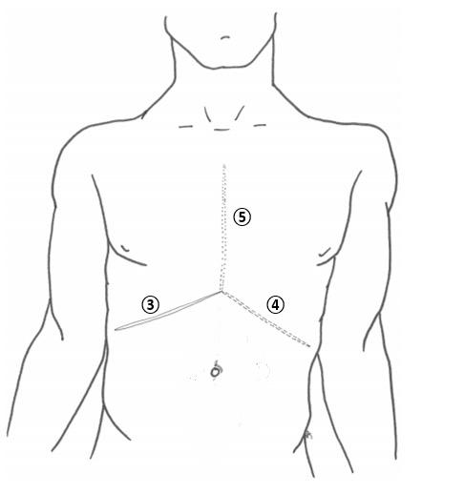
Kocher incision
An incision made parallel to the right subcostal margin to access the underlying liver and biliary tree (3 on its own)
Mercedes Benz incision the Chevron incision with
a vertical incision and break through
the xiphisternum (3+4+5)
It may be mirrored on the contralateral side
to provide access to the spleen or
performed bilaterally
as a Rooftop (chevron) incision to provide
efficient access to organs such as
the pancreas and biliary tree within the
transpyloric plane (3+4)

Slide 7
Kocher incision
Disadvantages include:-
the risk of injuring the superior epigastric
vessels, and lateral extension of the incision
risks disruption of intercostal nerves.
Skin
Superficial fascia:
I. Camper's fascia (fatty layer)2. Scarpa's fascia (membranous layer)*
Lateral half : External oblique / Internal oblique / Transversis abdominis*
Medial half: anterior rectus sheath /Rectus abdominis / posterior rectus sheath *
Transversalis fascia*
Extraperitoneal fat*
peritoneum
Indications of the kocher incision: gall bladder and biliary tract operation (usually open cholecystectomy)
Cheveron incisions may be used for oesophagectomy, gastrectomy, bilateral adrenalectomy,
hepatic resections, or liver transplantation
Mercedes benz may be used for the same indications as the Chevron incision, and diaphragmatic hernia,
however classically seen in liver transplantation

Slide 9
Midline laprotomy
commonly used for procedures requiring emergency laparotomy, such as:-
--faecal peritonitis secondary
to malignant intestinal perforation
--ischaemic bowel
--trauma
Incision down the middle of abdomen
along and through the linea alba:
It will encounter the following layers of tissue
Skin
Subcutaneous fatty layer (Camper’s fascia)
Membranous fascia (Scarpa’s)
Linea alba* Transversalis fascia
Preperitoneal fat
Parietal peritoneum
Disadvantages include patients experiencing more pain
than they would from a transverse incision, particularly
during deep breathing postoperatively, and the incision
is perpendicular to the Langer’s skin tension
lines resulting in poorer cosmesis.

Slide 11
This incision generally provides the best visualization and intra-abdominal access
Immediate complications of a midline laparotomy incision may include
anaesthetic difficulties,
haemodynamic instability,
primary haemorrhage from cut vessels and
iatrogenic injury to surrounding tissues and viscera

Slide 12
Pfannnestiel

Slide 13
hernia
Inguinal hernia repair

Slide 14
Complications of abdominal surgical incisions
Generic early complications declare themselves in the hours and days following the operation and may include:
atelectasis, postoperative pneumonia, urinary tract infection, oliguria, bedsores and deep vein thrombosis
Specific early complications include:
reactionary haemorrhage where small vessels ooze and intra-operative haemostasis fails once the blood pressure normalises, intra-abdominal collection, postoperative ileus and wound infection.
Late complications include the development of an incisional hernia,

