Slide 1
Postoperative Fever
By:
Sara Azaizeh Aya Irtaimat
Supervised by : Dr . Ali Jad

Slide 2
Pyrexia / Fever
Refers to a raised body temperature, typically greater than 37.5 C.
It is common in surgical patients, either due to the underlying disease process or as a post-operative complication.
Represent 40-50% of post op complication whatever the underlining cause.
Infection is regularly the suspected cause, other conditions must be considered when approaching the surgical patient with pyrexia .
It may also be an indicator of a severe and life threatening underlying pathology.

Slide 3
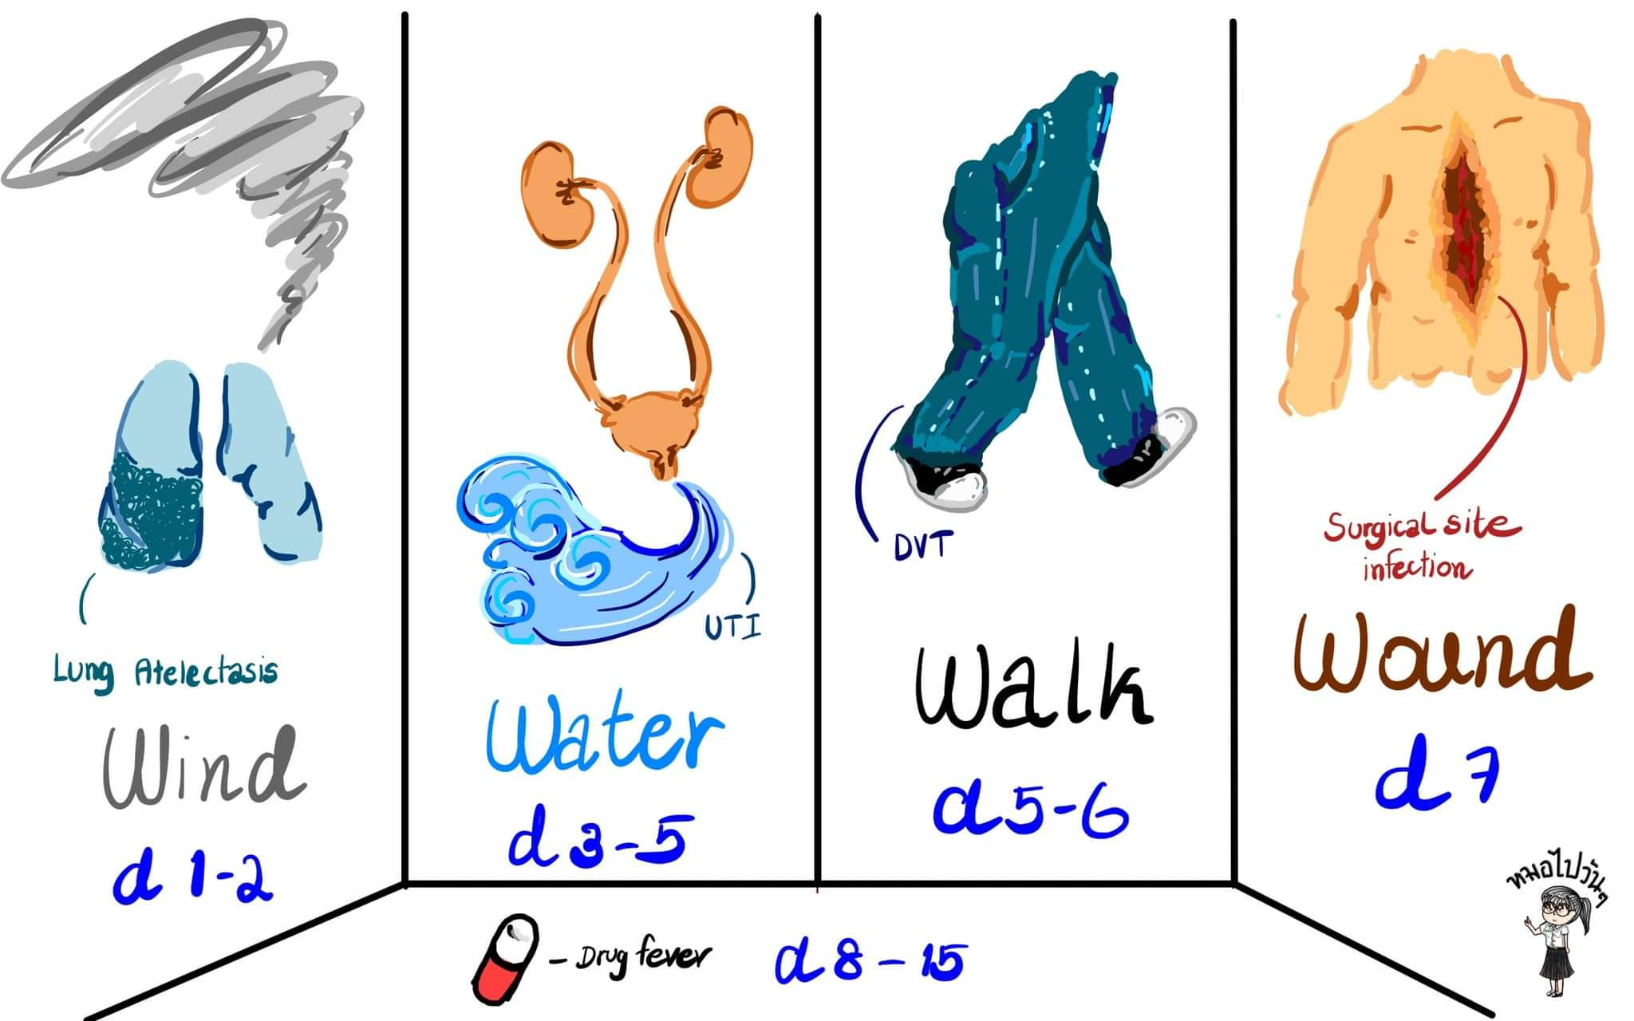
Causes of Postoperative Fever
“ WALKING in WONDER in the WIND with rain WATER falling on the WOUNDED heart ” .

Slide 4
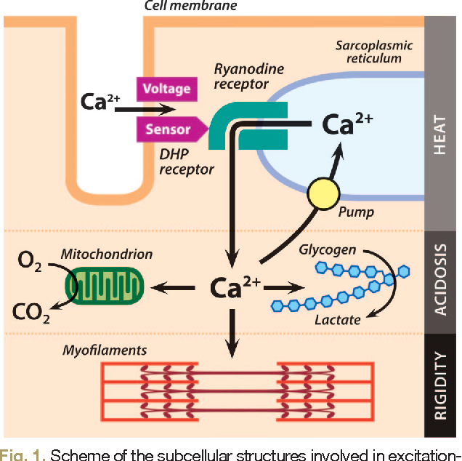
Malignant Hyperthermia
Is a life threatening inherited disorder due to reaction to certain drugs used for anesthesia (halothane) or muscle relaxent
(succinylcoline ) .

Slide 5
Malignant Hyperthermia
Signs and Symptoms :
Temperature>40C (104F ).
Tachycardia and tachypnea.
Hypercalcemia and hyperkalemia.
Acidosis.
Muscle rigidity.
Myoglobinuria and multible organ failure.
Management :
Prevent it by a family history prior operation
IV DENTROLENE : antidote decreases the loss of ca from SR in the skeletal muscle and restore the metabolism to the normal.
1oo% oxygen
Cooling blankets

Slide 6
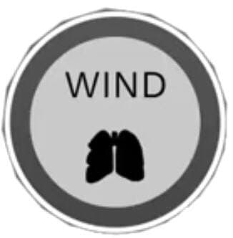
Atelectasis
Is a complete or partial collapse of the entire lung or area (lobe) of the lung , resulting in reduced or absent gas exchange .
MOST COMMON cause of po fever in 24-48h period.
Complications :
Low blood oxygen (hypoxemia).
Pneumonia. (esp. if fever persist)
Respiratory failure.
Clinical Manifestations
Low-grade fever
Dyspnea, tachycardia and Tachypnea
Pleural pain, and central cyanosis

Slide 7
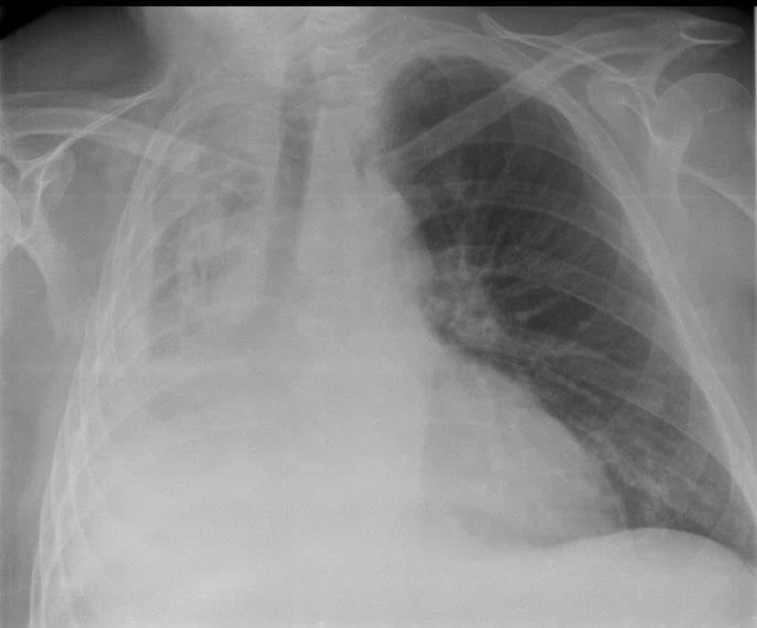
Atelectasis
CXR :
Opacity of the affected area.
Ipsilateral hemidiaphragmatic elevation.
Mediastinal &tracheal deviation.
Physical examination :
Dullness
Decreased breath sound
Management :
Pre op :
1-no smoking 2- treatment of pulmonary disease
Post op
1- control pain 1-physiotherapy 2-incentive spirometry
Brochoscopy

Slide 8
Pneumonia
HOSPITAL-ACQUIRED PNEUMONIA : pneumonia developing 48 - 72 h after operation.
VENTILATOR-ASSOCIATED PNEUMONIA (VAP), pneumonia developing 48 - 72 h after endotracheal intubation.
Postoperative pneumonia is the third most common complication for all surgical procedures
Gram-negative, aerobic bacteria including: Pseudomonas, Klebsiella, and Enterobacter species, With regard to Gram-positive bacteria, Methicillin-Resistant Staphyloccocus aureus is the most common cause.
COMPLICATION :
Pleural effusion
Empyema
Respiratory failure
Sepsis

Slide 9
Pneumonia
Risk Factors :
Age(more than 50) .
Duration of surgery (more than 3h).
Glasgow coma scale (less than 15).
Endotracheal intubation ( more than 2 days).
Tracheostomy .
Mechanical ventilation.
ICU (more than 5 days).
Clinical manifestations :
1- Fever.
2-Cough and sputum production.
2- Dyspnea, tachycardia and tachypnea.
3- Chest pain and central cyanosis.

Slide 10
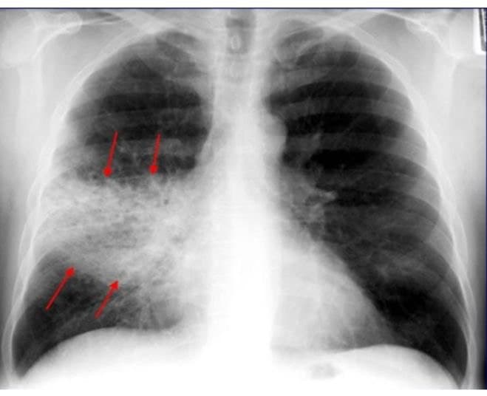
Pneumonia
Physical examination :
Dullness
Decreased breath sound and bronchial breathing
CXR :
OPACITY of affected area
Air Bronchogram
Lab test :
CBC/CRP/ABG
SPUTUM culture and sensitivity
Management :
EMPIRIC TX:
1-Antipseudomonas:ceftazidime or cefipime
2-AntiMRSA:Vancomycin or linezolid
3-Then give antibiotic according to culture and sensitivity results

Slide 11
Aspiration
Due to aspiration of GI content
Most common organism : anaerobic bacteria
Most common Location: Right middle & lower lobe
Risk factors :
Reduced GCS (e.g. secondary to anaesthesia)
Iatrogenic interventions (e.g. misplaced NG tube)
Prolonged vomiting without NG tube insertion
Underlying neurological disease
Oesophageal strictures or fistula
Post-abdominal surgery
Treatment :
Clindamycin

Slide 12
Urinary Tract Infection
Urinary tract infection ( UTI) : is an infection in any part in urinary system which include (kidney ,bladder ,ureters , and urethra).
UTIs are the most common hospital-acquired infection and are associated with indwelling catheters 80%to 90% of cases.
Fever associated with UTI tend to emerge 3 to 5 days after surgery .

Slide 13
Urinary Tract Infection
Risk factors :
Age more than 60 years.
History of previous UTI .
Significant comorbidities (renal failure, diabetes mellitus).
Those with prostatic disease.
Those who received spinal anesthesia .
Those undergone anorectal surgery .
Duration of catheterization.
The most Common infectious causes is Escherichia coli but there are other microorganisms such as (klebsiella,enterobacter ,pseudomonas, and serratia )

Slide 14
Urinary Tract Infection
How can I prevent post operative UTI?
Multiple strategies have been demonstrated to reduce the incidence of UTI including :
Reduce catheter use and duration ,Sterile catheter insertion technique and early postoperative removal of catheter.
Patient may present with
Dysuria.
Abdominal and supra pubic tenderness.
Post operative urinary retention is extremely common after surgery in lower abdomen , pelvis , perineum or groin.

Slide 15
Urinary Tract Infection
Investigation :
Urine analysis:
WBC indicate inflammation/infection
Nitrites refer to presence gram negative bacteria (Escherichia Coli)
Urine culture
Treatment involves:
Adequate hydration (either po or iv)
Antipyretics
Start with empircial antibiotic (wide spectrum antibiotics) then specific antibiotic after result in sensitivity.

Slide 16
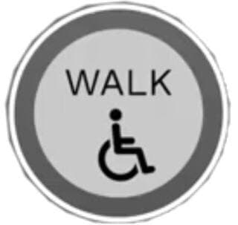
Venous Thromboembolism(VTE):
VTE is an overall disease process that can occur as Deep vein thrombosis(DVT) only, pulmonary embolism(PE) only, or PE with DVT.
Suspect VTE pyrexia if it occurs more than 4 days after the surgery (it may persist for months post operatively)
Post operative VTE occurs as a result of either a major surgery, an orthopedic surgery, or a neurosurgery.
Deep vein thrombosis(DVT):
It is the formation of a blood clot in a deep vein most commonly in the legs or the pelvis.
Symptoms:
1. Redness 2. Swelling
3. Pain 4. Enlarged veins
5. Cyanosis fever.
Some cases may present asymptomatic.

Slide 17
Deep Vein Thrombosis(DVT):
The detachment of a clot (or multiple clots) from the veins and travelling to the right side of the heart onto the pulmonary arteries, forming a pulmonary embolism, proposes the most fatal complication of DVT.
Physical examination :
Unilateral calf or thigh tenderness
Unilateral calf or thigh erythema
Unilateral calf or thigh pitting edema
Unilateral calf or thigh swelling (difference between two legs should be more than 3cm)
Palpable cord (a thickened palpable vein)

Slide 18
Deep Vein Thrombosis(DVT):
Diagnosis :
Duplex ultrasonography is the standard imaging test to diagnose DVT
A positive D-dimer test indicates DVT
Contrast venography is the most accurate test for DVT but it is invasive therefore largely replaced by duplex ultrasonography.
MRI and CT, both can show blood veins and clots.

Slide 19
Deep Vein Thrombosis(DVT):
Treatment :
Anticoagulants
IV :
Unfractionated heparin
LMWH
Fondaparinux
Orally :
Warfarin
Dabigatran, rivaroxaban, apixaban, edoxaban
Thrombolytics: which are only given in severe cases because of high risk of causing bleeding rather than anticoagulation.
Inferior vena cava filter: when anticoagulants can’t be used or don’t work well, a filter can be introduced into the IVC to capture the embolus before it reaches the lung.
Thrombectomy: a procedure to remove the blood clot itself.

Slide 20
Pulmonary Embolism
The partial or full blockage of a pulmonary artery by clot that is moved from a preexisting thrombus elsewhere in the body. Most likely of DVT in the legs.
Symptoms :
a. Shortness of breath
b. Chest pain(particularly on breathing)
c. Coughing blood.
Signs :
a.Low blood oxygen levels b.Tachypnea c.Tachycardia
Severe cases may present comatose, or severely low blood pressure, or even sudden death.

Slide 21
Pulmonary Embolism
It is challenging to examine a PE patient because they rarely display the classic presentation, which is the sudden onset of pleuritic chest pain, SOB, and hypoxia.
Risk factors :
DVT
Hypercoagulable state
Immobilization
Surgery
Trauma
Pregnancy
Usage of OCP and estrogen replacement therapy
Malignancy

Slide 22
Pulmonary Embolism
Diagnosis :
D-dimer test.
Computerized tomography pulmonary test (CTPA).
Ventilation perfusion scan also called V/Q scan.
Leg vein ultra sound.
Treatment :
Anticoagulants .
Thrombolytics.
IVC filter for prevention or further complication of PE.
Clot removal.

Slide 23
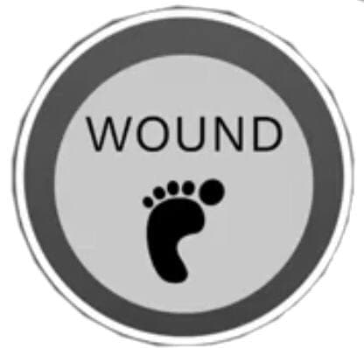
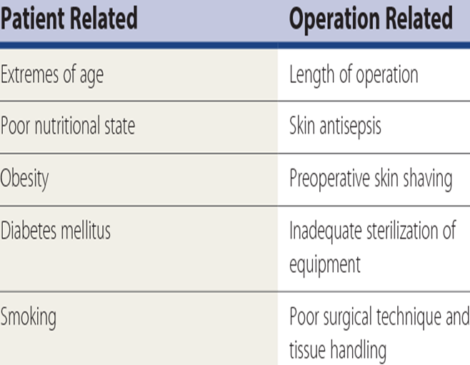
Wound Infection (SSI)
Surgical Site Infection : is an infection that occurs after surgery in the part of the body where the surgery took place .
Typically begins to produce fever around postoperative day 7 .
Physical exam will reveal erythema, warmth, tenderness and fluctuance .
There are several factors that increase the risk of a SSI :

Slide 24
Wound Infection (SSI)
Investigation: Any suspected wound surgical site infection should have wound swabs taken for culture .
Management: Any sutures or clips present should be removed , allowing for the drainage of any pus. Empirical antibiotic should be started ; different wounds are often caused by different oragnisms , tailoring antibiotic therapy following culture results.
Prevention: The prevention of surgical site infections can be achieved in the pre-operative , intra-operative and post-operative settings.

Slide 25
Wound Infection (SSI)
Pre-operative phase: - Give prophylactic antibiotics if indicated (clean surgery involving a prosthesis , clean-contaminated surgery or contaminated surgery). -Do not remove hair routinely-if necessary do this immediately prior to surgery with an electric clipper. -Patient advice-shower prior to surgey, encourage weight loss , optimised nutrition (to promote wound healing), good diabetic control and smoking cessation.
Intra-operative phase: -Prepare the skin at the surgical site immediately before the incision using an antiseptic preparation , ( Povidone-iodine or Chlorhexidine are most suitable). -Change gloves or gowns if contaminated . -Use an appropriate interactive dressing at the end of the operation to cover all surgical incisions .

Slide 26
Wound Infection (SSI)
Post-operative phase: Monitor wounds closely-dressing changes , thus minimising the chance of bacterial contamination .
Ensure that wounds in difficult areas such as skin creases and underneath skin folds (such as groin) are closely observed . Topical antibiotics are used in some cases post-operatively as well; they shown that they probably do prevent SSI rates when compared with no topical antibiotic or antiseptic therapy .

Slide 27
Wonder Drugs
Anytime .
Antimicrobial & Heparin account for almost one third of cases of drug-related fever in hospitalized patients.
Any drug can cause fever.
Review medication list .
Stop suspected drugs.

Slide 28
Thank You!
Any Questions ?!

