Slide 1
7- Microcirculation By Prof. Sherif W. Mansour Physiology dpt., Mutah school of Medicine .

Slide 2
Microcirculation unit
The microcirculation is a complex system. It can be simplified to a microcirculation unit. The blood does not flow directly from arterioles into the venules but rather into a thoroughfare vessels which connects the arterioles to the venules. This vessel, like arteriole and venule, has sparse smooth muscle layer mainly located at the arteriolar end.
The true capillaries open from the proximal end of thoroughfare vessel. The entrances of these capillaries are controlled by rings of smooth muscle (pre-capillary sphincters).
The precapillary sphincters have a rich sympathetic innervation causing continuous contraction (tone). The sympathetic tone may be increased or decreased reflexly. On contraction of those sphincters, blood rapidly passed through the thoroughfare vessel to the venules, while when they are relaxed, blood passes out into the true capillaries.

Slide 3
Active and inactive capillaries:
In resting tissues : only 10% of the capillaries are opened and 90% are completely closed. After a few seconds, the opened capillaries become closed spontaneously while a similar number of the previously closed capillaries are opened (Alternation Phenomenon).
Alternation phenomenon can be explained as follows:
- Gradual ↓ in O₂ and ↑ CO₂ and H⁺ around the closed capillaries succeed to open them.
- Blood flow in this area provides O₂ and removes waste products (CO₂ + H⁺) → abolishing their vasodilator effect → capillaries are closed again.
In active. tissues : The vasodilator metabolites formed in these tissues → dilatation of precapillary sphincters → blood flow through the closed capillaries.
Structure of capillary wall:
It is composed of a unicellular layer of endothelial cells with flattened nuclei and is surrounded by a basement membrane. There is no muscle layer. Pores or fenestration are present inbetween the cells. The total thickness of the wall is about 0.5 u and the diameter of the capillary is 4 - 9 U.
The pores in capillaries of some organs have special character according to each organ.

Slide 4
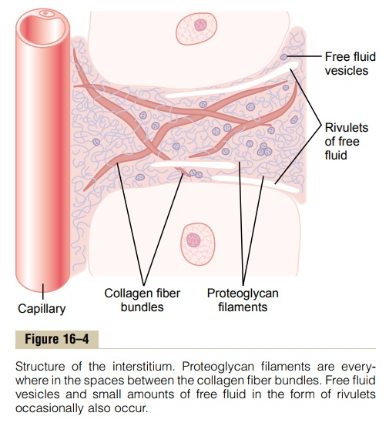
Structure of the interstitium:
1. Collagen fiber bundles : They extend long distances. They are extremely strong, so they provide most of the strength of the tissues.
2. Proteoglycan filaments (Muco-polysaccharides) : They are extremely thin, coiled molecules composed of 98% hyaluronic acid and 2% protein. They fill all the spaces between the collagen fibers.
3. Tissue gel : The combination of the proteoglycan filaments and the fluid entrapped within them is called tissue gel.
4. Free fluid : There is a small amount of free fluid that is free of proteoglycan molecules → can flow freely. In edema, free fluid expands tremendously.
Importance of gel matrix:
a-It acts as a "filler" to hold the cells apart → large enough spaces for fluids and nutrients to diffuse to distant cells.
b-It prevents fluid from flowing through the tissue spaces from the upper part of the body to into the lower part.
c-It immobilizes bacteria and keeps them from spreading through the tissues.

Slide 5
*Factors determine filtration and interstitial fluid formation (Transcapillary exchange):
The interstitial (tissue) fluid formation is determined by four primary forces (Starling forces):
(1) Capillary blood pressure:
- At arteriolar end = 30-40 mmHg
- At venular end = 10-15 mmHg
- This pressure moves fluid out from the capillary.
(2) Interstitial fluid colloid osmotic pressure:
- Some of plasma proteins leak into the tissue spaces → osmotic pressure which absorb fluids to outside the capillary.
- This pressure is about 8 mmHg.
(3) Colloidal osmotic pressure of plasma proteins:
Since the plasma proteins with high molecular weight do not penetrate the capillary membrane and by Donnan effect it attracts Na⁺ to inside the cells → colloid osmotic (oncotic) pressure which absorb fluid to inside the capillary by force of 28 mmHg (mainly by albumin).
(4) Interstitial (tissue fluid pressure):
- Interstitial free fluid pressure is sub-atmospheric about – 3 mmHg. So it causes suction of fluid out of the capillary (It is positive in the liver and spleen).

Slide 7
* The net result:
• At arteriolar end • At venular end
1- Capillary pr. 30 10
2- Tissue O.P. 8 8
3- Tissue fluid p. 3 3
Out ward forces 41 mmHg 21 mmHg
4- O.P of plasma prot. 28 28 mmHg
• The net result = 41-28 • The net result = 28-21
= 13 mmHg = 7 mmHg
- At arteriolar end filtration by 13 mmHg
- At venular end reabsorption by 7 mmHg
As the venular end the capillaries are more permeable (more branched, more and wide pores) so the most of filtration is reabsorbed and small amount removed from the interstitial fluid by the lymph vessels.

Slide 8
FACTORS AFFECTING CAPILLARY CIRCULATION
A. Nervous factors:
Some capillaries are supplied by vasodilator or vasoconstrictor fibers.
B. Chemical factors
• Vasopressin → vasoconstriction.
• Adrenaline and noradrenaline → capillary constriction.
• Acetyl choline → capillary dilatation all over the body including coronary capillaries.
• Metabolites e.g C0₂, lactic acid, 0₂ lack → capillary dilatation.
• Histamine → powerful capillary dilatation.
Injection of histamine → sudden increase in the vascular bed capacity → decrease venous return and COP → histamine shock.
C. Mechanical factors
• Dilatation of arterioles →↑ blood flow →↑ capillary pressure → capillary dilatation.
• Venous pressure : ↑ venous pressure by compression of veins →↑ capillary pressure → capillary dilatation.
Gentle stroking of the skin → direct constriction of the underlying capillaries → pallor of the stroked area (white line) which appears within 15 seconds and lasts for 2 minutes. It is called white line response.

Slide 9
Heavy stroking of the skin → triple response:
1. Red Line : appears after a latent period of few seconds. It is due to dilatation of the capillaries produced by the release of histamine or other vasodilator substances as a result of tissue injury.
2. Red flare : An irregular area of redness around the red line: Mechanism : local axon reflex.
Stimulus : tissue injury.
Receptors : pain receptors.
Afferent : afferent pain fibers in the normal ortho-dromic direction.
Efferent : side branch of the nerve in the anti-dromic direction.
Effector organ : arterioles where vasodilator substance (P substance, kinin and histamine) is released.
Response : arteriolar dilatation. It is not a true reflex because its axon do not reach the central nervous system So, called local axon reflex or antidromic fibres..
3. Wheal : It is an area of localized edema. Vasodilator substances released from the injured tissue → capillary permeability to increase fluid in tissue spaces (edema).

Slide 10
D. Physical factors
• Warming → capillary dilatation.
• Cooling → capillary constriction → blood flows directly through the arteriovenous anastomosis. If excessive cooling is prolonged with poor arteriovenous anastomosis, accumulation of metabolites in tissues will occur → capillary dilatation in spite of cooling. So, nose tip ears and fingers can be seen red in spite of cold in winter.
*Capillary fragility
Capillary walls are extremely fragile. However, when a person stands erect, the pressure in capillaries may rise to 100 mmHg and the capillary do not rupture. This can be explained by low of Laplace : T = P x r whore T is the wall tension, P is the distending pressure and r is the diameter. The wall tension of the capillary is very low due to their extremely small diameter.
Capillary fragility test (Hess Test);
A sphygmomanometer cuff is applied to the upper arm and inflated to a pressure of 80 mmHg. and kept at this level for 5 minutes. The cuff is then deflated and the skin over the forearm examined. The number of peticheal hemorrhages in a circular area 5 cm in diameter is counted. If it is more than 2 or 3, the capillaries are considered fragile.
Increased capillary fragility: may result from
•Defect in the wall : old age; vitamin C deficiency and certain toxic and allergic states.
•Defect in the blood : as deficiency of blood platelets.

Slide 11
Thank You

