Slide 1
Juvenile Idiopathic Arthritis
Suleiman dmor
Ahmad al-jafary
Samah rezeq

Slide 2
Juvenile idiopathic arthritis (JIA)
formerly called juvenile rheumatoid arthritis(JIA)
is a broad term used to describe several different forms of chronic arthritis in children
the most common chronic rheumatological disease of childhood
Without appropriate and early aggressive treatment, JIA may result in significant morbidity, such as leg-length discrepancy, joint contractures, permanent joint destruction, or blindness from chronic uveitis.

Slide 3
Definition
Arthritis is defined as joint effusion with the presence of : limitation of range of motion, tenderness, and hotness
JIA is defined as arthritis of one or more joints occurring for at least 6 weeks in a child younger than 16 years of age
JIA is a diagnosis of exclusion. A number of conditions, such as infections, malignancy, trauma, reactive arthritis, and connective tissue diseases such (SLE), must be excluded before a diagnosis of JIA can be made

Slide 4
etiology
The etiology is not completely understood
multifactorial, (genetic and environmental factors)
siblings of those affected by JIA have a prevalence that is 15- to 30-fold higher than the general population.
Other factors : psychological stress, trauma, hormonal abnormalities, and infectious triggers

Slide 5
Epidemiology
JIA is one of the more frequent chronic diseases of childhood
prevalence of 1 : 1,000 children.
has two peaks, one at 1-3 years and one at 8-12 years, but it can occur at any age
Girls are affected more commonly than boys

Slide 6
Pathology
Cell-mediated and humoral immunity play a role in the pathogenesis of JIA
The common underlying manifestation is the presence of chronic synovitis.
The synovium becomes thickened and hyper vascular with infiltration by lymphocytes, along with inflammatory cytokines such as: (TNF-a), (IL-6), IL-1 and IL-17.
The role of humoral immunity in is supported by the increased level of autoantibodies, such as antinuclear antibodies (ANAs), and by the presence of circulating immune complexes

Slide 7
Clinical Features
All subtypes of JIA, share common symptoms:
Joint swelling
morning stiffness .
pain, and limited movement of a joint.
Limping or problems using a limb.
Spiking fevers
Rash
Eye involvement : uveitits , iritis . (Red eyes )
Unspecific symptoms like : lethargy, reduced physical activity, and poor appetite .

Slide 8
Systemic onset JIA
Or also called juvenile form of Still's disease
In this type ( 10% ) patients do not present with onset of arthritis but rather with preceding systemic inflammation.
A definite diagnosis of systemic-onset JIA must await the development of arthritis.
The arthritis of JIA follows the systemic inflammation by 6 weeks to 6 months. The arthritis is typically polyarticular in nature and can be extensive and resistant to treatment

Slide 9
Systemic onset JIA
Typical, spiking fever ( up to 39 ), once or twice per day, of at least 2 weeks’ duration.
salmon-pink macules of different sizes accompanies febrile periods seen on trunk and proximal extremities or over pressure areas.
Constitutional symptoms : malaise , arthralgia , myalgia and sometimes FTT .
Hepatosplenomegaly occurs in 70% of children.
Generalized lymphadenopathy .
Serositis, such as pleuritis and pericarditis , occurs in 50% of children

Slide 10
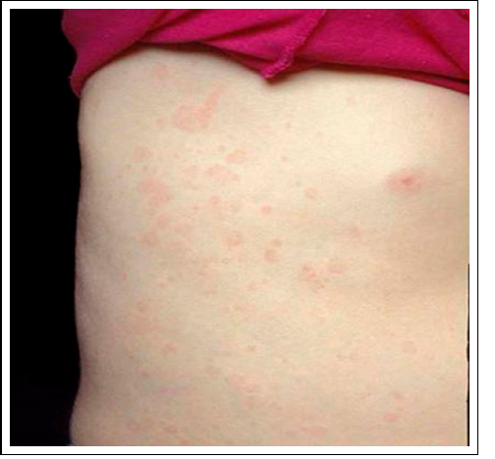

Slide 11
Diagnosis & prognosis
Diagnosed by exclusion
lab findings: anemia of chronic disease, neutrophilia, thrombocytosis, elevated acute phase reactants(ESR, CRP, ferritin )
The prognosis of systemic JIA depends on the severity of the arthritis
Most systemic symptoms resolve over months to years,
and mortality, which is < 0.3% in North America, is associated mainly with MAS and infections secondary to immune suppression

Slide 12
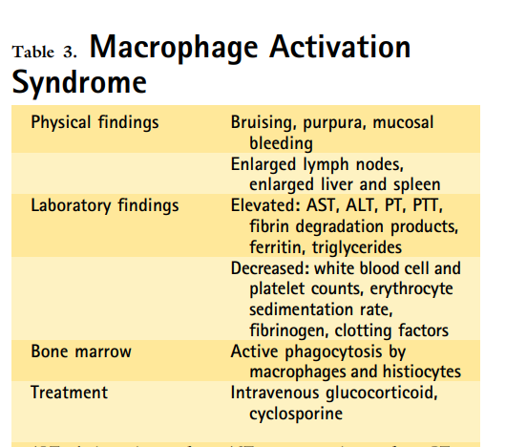
Macrophage Activation Syndrome
Occurring in more than 10% of sJIA patients,
MAS can be seen in the context of overwhelming inflammation
which leads to activation of proliferation of T lymphocytes and macrophages
resulting in overwhelming release of proinflammatory cytokines.
The patient develops high fevers, liver insufficiency hepatosplenomegaly, neurological abnormalities, and bleeding diathesis.
. There is evidence of disseminated intravascular coagulation,
.

Slide 13
MAs
Bone marrow sampling may identify mature macrophages displaying hemophagocytic activity
Laboratory abnormalities include pancytopenia, prolongation of the PT and PPT and elevated levels of D-dimer, and ferritin
Because MAS carries a significant mortality early recognition and treatment of MAS with corticosteroids or cyclosporine is important to prevent multisystem organ failure

Slide 14
There are five types of juvenile arthritis:
1- Oligoarthritis
2- Polyarthritis
3- Systemic-onset JIA
4- Psoriatic arthritis
5- enthesitis artharitis
Notes:
JIA can be divided into several subtypes, depending on the number of joints involved (less than five versus five or more), the presence of sacroiliac involvement, and the presence of systemic features, each with particular disease characteristics

Slide 15
Oligoarthritis
also called pauciarticular juvenile rheumatoid arthritis
The most common type
presents in young children, with a peak at
1 to 3 years and another peak at 8 to 12 years.
It's often mild.

Slide 16
Oligoarthritis
Arthritis affecting 1-4 joints during 1st 6 mo of disease; 2 subcategories are recognized:
1. Persistent oligoarthritis—affecting ≤4 joints
throughout the disease course
2. Extended oligoarthritis—affecting >4 joints after 1st 6 mo of disease .
The arthritis is found in medium-sized to large joints
The joints most commonly affected are the knee, ankle, and wrist.

Slide 17
Oligoarthritis
This type of arthritis is more common in girls than in boys, and many children will outgrow this disease by the time they become adults.
Children with oligoarticular JIA may be otherwise well without any evidence of systemic inflammation (fever, weight loss, or failure to thrive) or any laboratory evidence of systemic inflammation (elevated white blood cell count or erythrocyte sedimentation rate)

Slide 18
Oligoarthritis
Most likely type to cause eye inflammation (chronic anterior uveitis).
The presence of a positive antinuclear antibody (ANA) identifies children with arthritis who are at higher risk for chronic uveitis.
Although all children with JIA are at increased risk, the subgroup of children, particularly young girls, with oligoarticular (less than five affected joints) JIA and a positive antinuclear antibody are at highest risk, with an incidence of uveitis of 80%.

Slide 19
Oligoarthritis
The uveitis associated with JIA can be asymptomatic until the point of visual loss, making it a primary treatable cause of blindness in children. It is crucial for children with JIA to undergo regular ophthalmologic screening with a slit-lamp examination to identify anterior chamber inflammation and to initiate prompt treatment of any active disease.

Slide 20
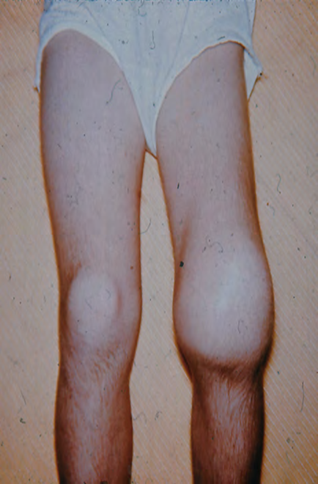
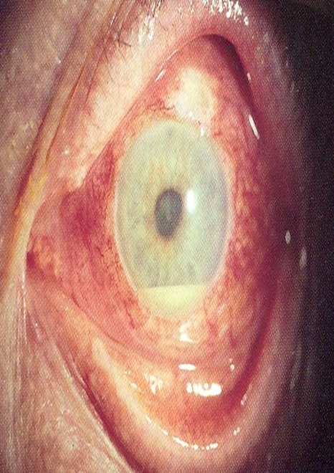

Slide 21
Polyarthritis
also called polyarticular juvenile idiopathic arthritis (pJIA)
The second most common type of JIA.
It may come on suddenly or can steadily involve more joints over a period of months.
In this type (40%), children present with arthritis in five or more joints within the first 6 months of diagnosis.

Slide 22
Polyarthritis
The child tends to have symmetrical arthritis, which can affect any joint but typically involves the small joints of the hands.
Painful swelling in fingers, toes, wrists, ankles, hips, knees, the neck and jaw.
There also may be malaise, low-grade fever, growth retardation .

Slide 23
Polyarthritis
Long-term complications :
- The cervical spine may also be involved through subluxations and fusion with loss of lordosis and limited extension .
- It may be associated with erosions, finger deformities such as Boutonniere finger.

Slide 24
Polyarthritis
-ve : Symmetric or asymmetric; small and large joints; cervical spine ; temporomandibular joint leads to Micrognathia .
+ve : Aggressive symmetric polyarthritis

Slide 25
Polyarthritis
In polyarticular JIA, there are 2 peaks : one in early childhood and the other one is in adolescence.
The latter is usually associated with +RF and anti CCP AB and represents an early onset of adult RA.

Slide 26
Polyarthritis

Slide 27
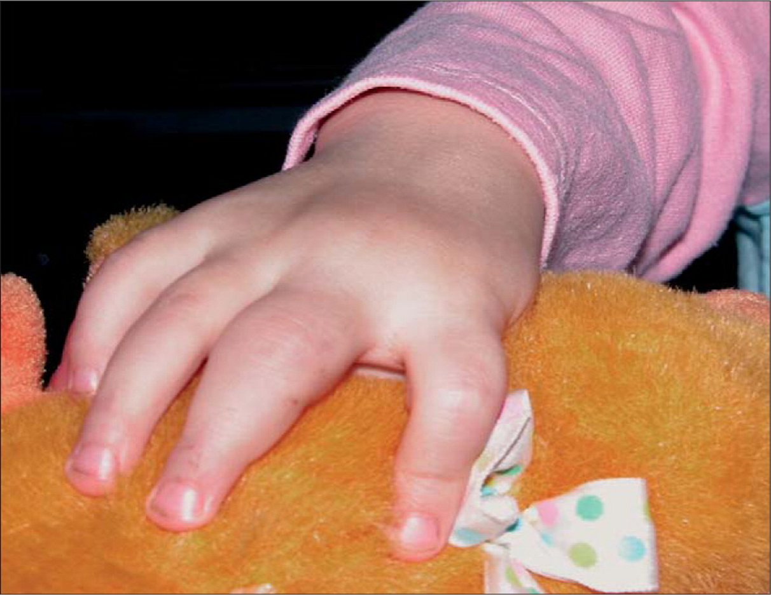

Slide 28
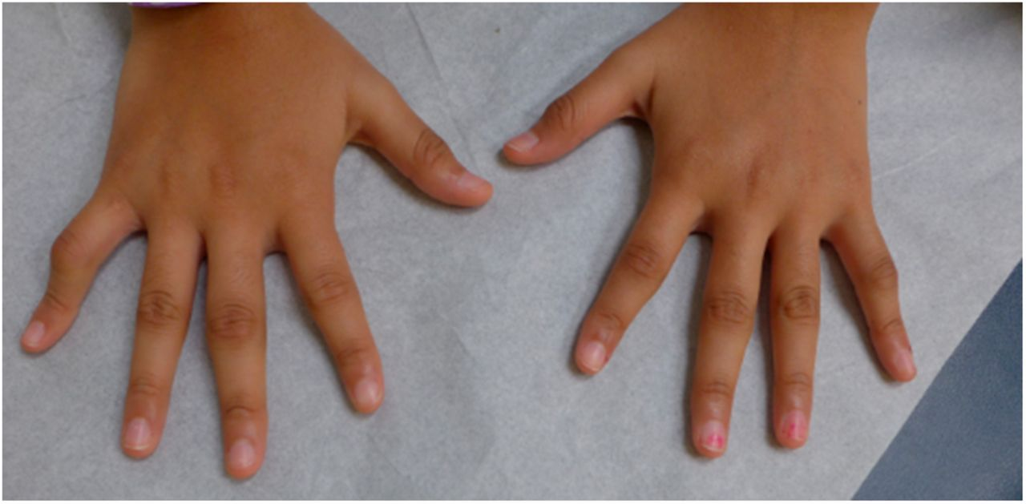
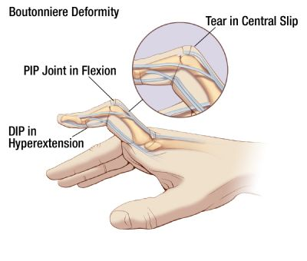

Slide 29
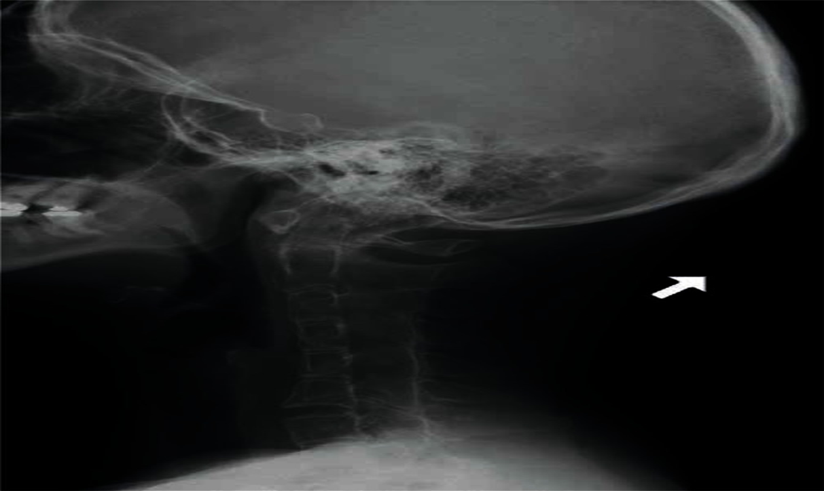
Cervical spine involvement manifesting as decreased neck extension, occurs with a risk of atlantoaxial subluxation and neurologic sequelae.

Slide 30
Systemic onset JIA
Or also called juvenile form of Still's disease
In this type ( 10% ) patients do not present with onset of arthritis but rather with preceding systemic inflammation.
A definite diagnosis of systemic-onset JIA must await the development of arthritis.
The arthritis of JIA follows the systemic inflammation by 6 weeks to 6 months. The arthritis is typically polyarticular in nature and can be extensive and resistant to treatment

Slide 31
Systemic onset JIA
The child appears systemically ill with characteristics of :
Typical recurring, spiking fever ( up to 39 ), usually once or twice per day, which can occur for several weeks to months.
salmon-pink macules of different sizes. It migrates to different locations on skin, rarely persisting in one location more than one hour. The rash is commonly seen on trunk and proximal extremities or over pressure areas.
Constitutional symptoms : malaise , arthralgia , myalgia and sometimes FTT .
Hepatosplenomegaly occurs in 70% of children.
Generalized lymphadenopathy .
Serositis, such as pleuritis and pericarditis , occurs in 50% of children.

Slide 32
Diagnosis
Rheumatoid factor and ANA tests are generally negative in systemic JIA
lab findings: anemia of chronic disease, neutrophilia, thrombocytosis, elevated acute phase reactants(ESR, CRP, ferritin)

Slide 33
Evanescent (non-fixed) erythematous rash - (salmon-pink macules )-
Notes:
The rash of systemic juvenile idiopathic arthritis is salmoncolored,
macular, and nonpruritic. Individual lesions are transient and occur
in crops over the trunk and extremities. (Reprinted from the American
College of Rheumatology: Clinical slide collection on the rheumatic
diseases, Atlanta, copyright 1991, 1995, 1997, ACR. Used with permission
of the American College of Rheumatology.)

Slide 34
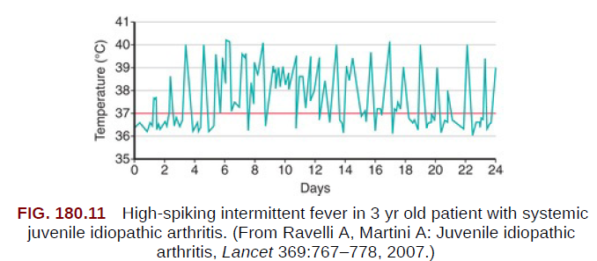
Quotidian fever
The characteristic fever, defined as spiking temperatures to ≥39°C (102.2°F), occurs on a daily or twice-daily basis for at least 2 wk, with a rapid return to normal or subnormal temperatures

Slide 35
Psoriatic arthritis
defined by arthritis together with either a
psoriatic rash or two of the following:
dactylitis (sausage-like fingers)
nail pitting
onycholysis (painless detachment of the nail from the nail bed)
psoriasis in a first-degree relative
Notes:
Dactylitis is swelling of ≥1 digit(s), usually in an asymmetric distribution, that extends beyond the
joint margin.
A minimum of 2 pits on any 1 or more nails at any time.

Slide 36
-
JPsA most often appears between the ages of 11 and 12 . Girls are more likely to develop it when they are younger and boys when they are older
Typically, psoriatic plaques are seen on the extensor sides of joints, haired skin, the umbilicus and the perineum

Slide 38
Dactylitis

Slide 39
Enthesitis Related Arthritis
Enthesitis is an inflammation of the insertion points of the tendons
this form occurs most often in boys older than 6 years
and is linked to ankylosing spondylitis and inflammatory bowel disease.

Slide 40
Nelsons’ definition
Enthesitis is defined as tenderness at the insertion of a tendon, ligament, joint capsule, or fascia to bone.

Slide 41
-
The main characteristics of the patients include
RF and ANA negativity
HLA B27 positivity is reported in 65-80 % of patients
asymmetric arthritis of the lower extremities
The Achilles tendon is the most commonly affected site
Notes:
1. Presence of or history of sacroiliac joint
tenderness or inflammatory lumbosacral pain,
or both ¶
2. Presence of HLA-B27 antigen
3. Onset of arthritis in a male >6 yr old
4. Acute (symptomatic) anterior uveitis
5. History of ankylosing spondylitis, enthesitisrelated
arthritis, sacroiliitis with IBD, Reiter
syndrome, or acute anterior uveitis in firstdegree
relative

Slide 42
Characteristics
1. Presence of or history of sacroiliac joint tenderness or inflammatory lumbosacral pain, or both
2. Presence of HLA-B27 antigen
3. Onset of arthritis in a male >6 yr old
4. Acute (symptomatic) anterior uveitis
5. History of ankylosing spondylitis, enthesitis related arthritis, sacroiliitis with IBD, Reiter syndrome, or acute anterior uveitis in first degree relative

Slide 43
Undifferentiated arthritis
Arthritis that fulfills criteria in no category or in ≥2 of the above categories.

Slide 44
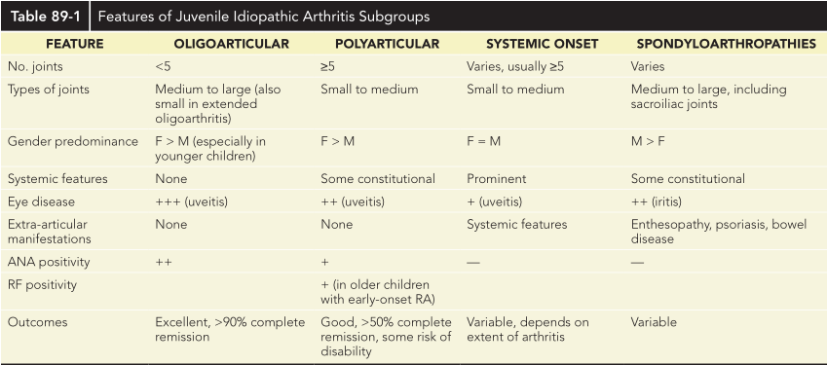

Slide 45
COMPLICATIONS
Complications with JIA result primarily from :
the loss of function of an involved joint secondary to contractures, bony fusion, or loss of joint space.
More serious complications stem from associated uveitis; if left untreated, it can lead to serious visual loss or blindness.

Slide 46
Long-term Complications
Anemia
Permanent joint damage
Decreased Growth
Disproportionate limbs

Slide 47
LABORATORY AND IMAGING STUDIES

Slide 48
Important notes
The diagnosis of (JIA) is based on the history and physical examination findings.
No laboratory studies are diagnostic for JIA, and indeed, all laboratory study findings may be normal in children with this disorder.
Testing can be used to monitor the condition, its potential complications, response to treatment, and to monitor for potential side effects associated with some treatments

Slide 49
Usual Lab Test workup
CBC
ESR & CRP
ANA
RF
HLA-B27
Synovial fluid analysis

Slide 50
CBC
Children with polyarticular and systemic disease commonly show anemia of chronic disease.
Leukocytosis and thrombocytosis
Most children with oligoarticular JIA have no laboratory abnormalities.
In all pediatric patients with joint or
bone pain, a complete blood count should be performed to exclude leukemia,
which also can present with limb pain

Slide 51
ESR & CRP
(ESR) or (CRP) level is usually elevated in children with systemic-onset JIA .
May be elevated in those with polyarticular disease.
It is often within the reference range in those with oligoarticular disease.
When elevated, inflammatory markers can be used to monitor disease activity

Slide 52
ANA & RF
70% of children with oligoarticular JIA have positive ANA.
Positive ANA should also raise suspicion of (SLE).
A positive ANA is a marker for increased risk of anterior uveitis.
Children younger than 6 years at arthritis onset with a positive ANA finding are in the highest risk category for development of uveitis and need slit lamp screening every 3-4 months. Titers do not correlate with disease activity.

Slide 53
Older children and adolescents with polyarticular disease should have a rheumatoid factor(RF) and anti-CCP antibody performed to identify children with early onset adult rheumatoid arthritis.
Approximately 5-15% of patients with polyarticular JIA are seropositive for RF .

Slide 54
Synovial fluid analysis
Diagnostic arthrocentesis may be necessary to exclude suppurative arthritis in children who present with acute onset of monarticular symptoms.
The synovial fluid white blood cell count is typically less than 50,000 to 100,000/mm3 and should be predominantly lymphocytes, rather than neutrophils seen with suppurative arthritis. Gram stain, PCR, and culture should be negative.

Slide 55
Radiology
Early radiographic changes include:
soft tissue swelling
periarticular osteopenia
and periosteal new-bone apposition around affected joints
Erosions of bony articular surfaces may be a late finding.

Slide 56
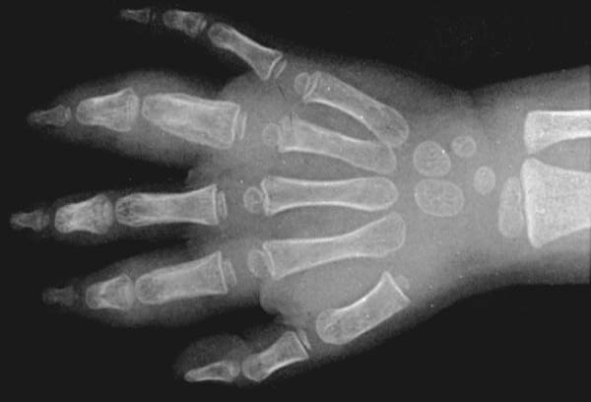
Early(6mo duration) radiographic changes of JIA. Soft-tissue swelling and periosteal new bone formation appear adjacent to the 2nd and 4th proximal interphalangeal joints.

Slide 57
Continued active disease may lead to :
subchondral erosions
loss of cartilage
with varying degrees of bony destruction, and fusion.

Slide 58
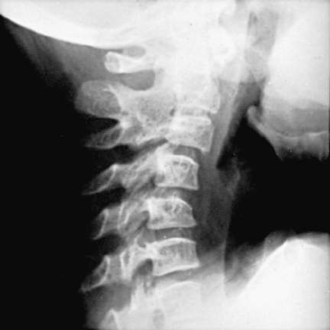
Radiograph of the cervical spine of a patient with active JIA, showing:
1- fusion of the neural arch between joints C2 and C3,
2- narrowing and erosion of the remaining neural arch joints,
3- obliteration of the apophyseal space, and loss of the normal lordosis

Slide 59
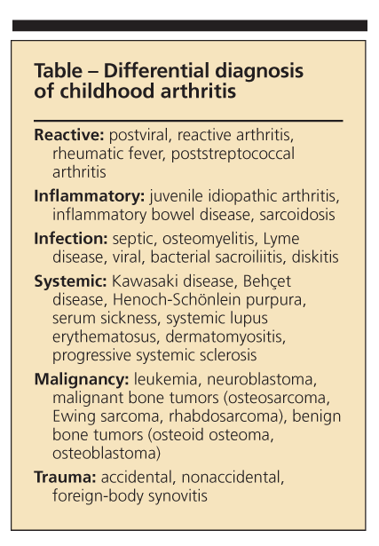
Differential diagnosis
The diagnosis of JIA is established by the presence of arthritis, the duration of the disease for at least 6 weeks, and exclusion of other possible diagnoses.

Slide 60
TREATMENT
The treatment of JIA focuses on suppressing inflammation, preserving and maximizing function, preventing deformity, and preventing blindness.
Nonsteroidal anti-inflammatory drugs :(NSAIDs) are the first choice in the treatment of JIA. Naproxen, sulindac, ibuprofen, indomethacin, and others have been used successfully.

Slide 61
Second-line medications : DMARDs such as :
Hydroxychloroquine and sulfasalazine have been used in patients whose arthritis is not completely controlled with NSAIDs alone.
Methotrexate, has become the drug of choice for polyarticular and systemic-onset JIA, which may not respond to baseline agents alone.
Methotrexate can cause bone marrow suppression and hepatotoxicity; regular monitoring can minimize these risks.

Slide 62
Biologic agents that inhibit TNF-α and block the inflammatory cascade, including etanercept, infliximab, and adalimumab, are effective in the treatment of JIA.
The risks of these agents are greater, include serious infection and, possibly, increased risk of malignancy.
Anakinra, an interleukin-1receptor antagonist, is very beneficial in the treatment of the systemic features of systemic-onset JIA.

Slide 63
Systemic corticosteroid medications, such as prednisone and prednisolone, should be avoided in all but the most extreme circumstances, such as for severe systemic-onset JIA with internal organ involvement or for significant active arthritis leading to the inability to ambulate.
In this circumstance, the corticosteroids are used as bridging therapy until other medications take effect. For patients with a few isolated inflamed joints, intra-articular corticosteroids may be helpful.

Slide 64
- American College of Rheumatology (ACR) criteria for complete remission are as follows :
No inflammatory joint pain
No morning stiffness
No fatigue
No synovitis
No progression of damage, as determined in sequential radiographic examinations
No elevation of the erythrocyte sedimentation rate (ESR) and C-reactive protein (CRP) levels

Slide 65
Thank you

