Slide 1
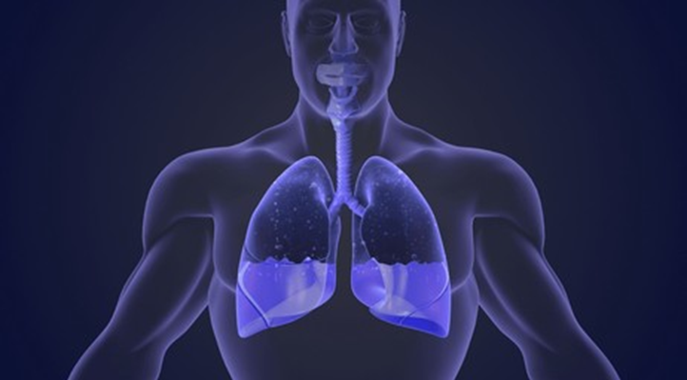
Plural effusion

Slide 2
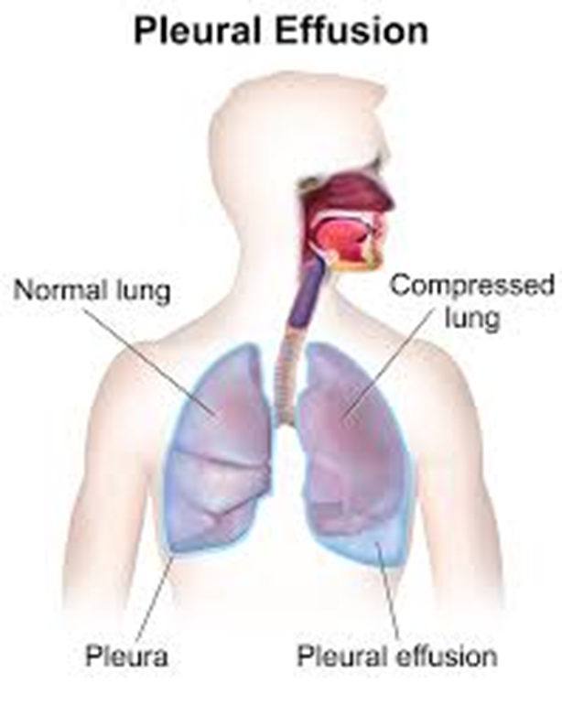
Definition
Is the accumulation of fluid in the pleural cavity
The nature of fluid:
Serous fluid (hydrothorax)
Pus (empyema)
Blood (hemothorax)
Chyle (chylothorax)

Slide 3
Classification
By involvement
Unilateral
Bilateral
By mechanism
Transudative
Exudative

Slide 4
Transudative vs Exudative pleural effusion
 |  | Transudative pleural effusion | Exudative pleural effusion
Pathophysiology |  | ↑ Capillary hydrostatic pressure (increased capillary wedge pressure) ↓ Capillary oncotic pressure | ↑ Capillary permeability (e.g., due to inflammation)
Common Causes |  | Congestive heart failure Low protein states, e.g., chronic kidney and liver disease Pulmonary embolism **Because these diseases are systemic, they usually cause bilateral and equal effusion | Pulmonary infections Malignancy of pulmonary or metastatic origin Inflammatory conditions: e.g., pancreatitis, autoimmune diseases Injury: e.g., hemothorax, chylothorax Pulmonary embolism Collagen vascular diseases (RA, SLE) Drug induced
Light criteria | Pleural fluid protein/serum protein ratio | ≤ 0.5 | > 0.5
 | Pleural fluid LDH/serum LDH ratio | ≤ 0.6 | > 0.6
 | Pleural fluid LDH | < ⅔ the upper limit of normal serum LDH | > ⅔ the upper limit of normal serum LDH
 | Interpretation: It is an exudative effusion if met at least ≥1 criteria. | If at least 1 criterion is not met for trasudate, then this is an exudative effusion
Specific gravity |  | ≤ 1.016 | > 1.016
Glucose |  | ≥ 60 mg/dL | <60 mg/dL

Slide 5
Transudative vs exudative pleural effusion
A transudative effusion needs no further evaluation. It resolves by adequate treatment of the disease.
An exudative effusion will cause unilateral effusions. This type of effusion needs further investigation.
In some cases, it can be a combination of both it can also be caused by lymphatic obstruction (lymphatic effusion)
One of the few conditions that can cause a transudate or exudate is pulmonary embolism (PE). If a patient has a transudative effusion but no apparent cause, consider PE
How do we make the distinction between these two?
Thoracentesis should be performed for new and unexplained pleural effusion.

Slide 6
Parapneumonic effusion
Pleural effusion adjacent to pneumonia, lung abscess & bronchiectasis.
It’s classified into 3 categories depending on the bacterial count ;)
 | Uncomplicated | Complicated | Empyema
General | Sterile exudate | Bacterial invasion | Frank pus
Pleural fluid | WBC < 50K pH > 7.2 Glucose: normal/low ↑ LDH | WBC > 50k pH < 7.2 Glucose: <60 ↑ LDH | Pus pH < 7.2 Glucose: <60 ↑ LDH
Gram stain/Culture | Negative | Positive/Negative* | Positive
Management | Antibiotics | Antibiotics + Drainage | Antibiotics + Drainage

Slide 7
Clinical presentation
If the patient has minimal effusion with minimal lung compression, he might not have any symptoms
When the effusion is moderate to large in size or caused by inflammation symptoms are present.
It may also lead to respiratory failure in some cases.
Note that symptoms are related to the underlying cause of effusion.

Slide 8
Signs and symptoms
Dyspnea
Dry nonproductive Cough
Peripheral edema
Pleuritic chest pain
Analysis of pain:
Pain may be mild or severe.
Described as sharp or stabbing.
Exacerbated with deep inspiration.
Pain may be localized to the chest wall or referred to the ipsilateral shoulder or upper abdomen.

Slide 9
Physical examination
Palpation:
Asymmetric expansion
Reduced tactile fremitus
Mediastinal shift and tracheal deviation away from the effusion (effusion of >1000ml)
Percussion:
Dullness over the area of effusion
Auscultation:
Faint or absent breath sounds
Pleural friction rub
There may be signs of pneumonia ( bronchial breathing, crackles)
Physical findings accrue at effusion >300 ml.

Slide 10
investigations
Total and differential leucocyte count
CRP and ESR
Radiological examination
CXR
CT SCAN
Ultrasonogram
Thoracentesis

Slide 11
Chest x-ray
Findings:
Blunting of the costophrenic angle
Meniscus-shaped margin
Notes:
In PA VIEW a total of 300 ml is needed to diagnose pleural effusion
In lateral decubitus even 50 ml can be detected, it can also determine whether fluid is free flowing or loculated.

Slide 12
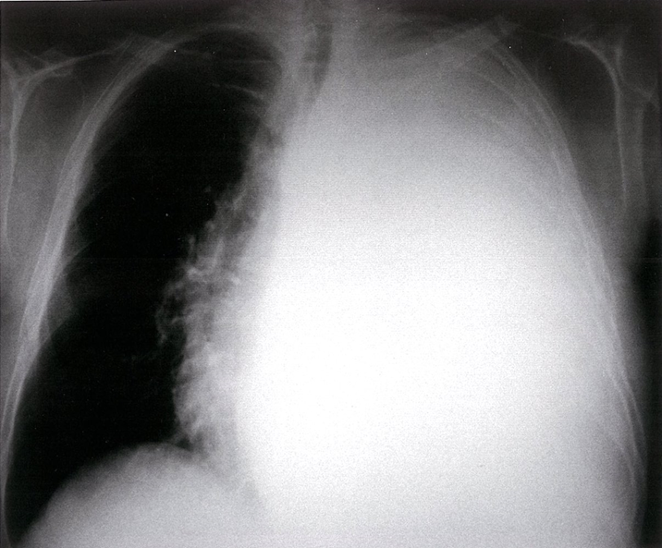
Chest x-ray
Findings:
Large effusion
Complete opacification of the lung
Mediastinal shift
Tracheal deviation away from the effusion (space-occupying lesion)

Slide 13
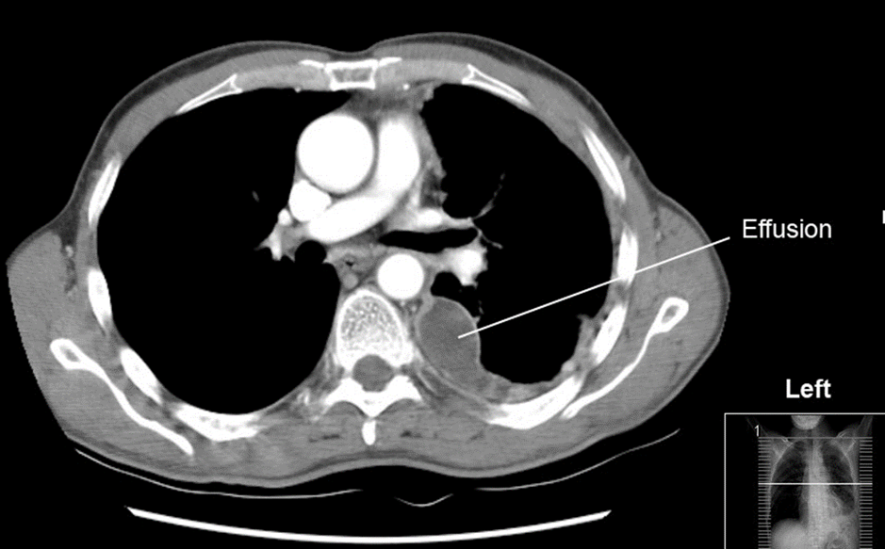
Ct scan
Gold standard; but use is limited because of radiation and contrast exposure
More reliable than CXR for detecting effusion, it can display pleural abnormalities, and determine the volume of the pleural fluid
Notes:
Can detect > 3–5 mL of fluid
Fluid density measurement can help differentiate pleural effusion from empyema and hemothorax [

Slide 14
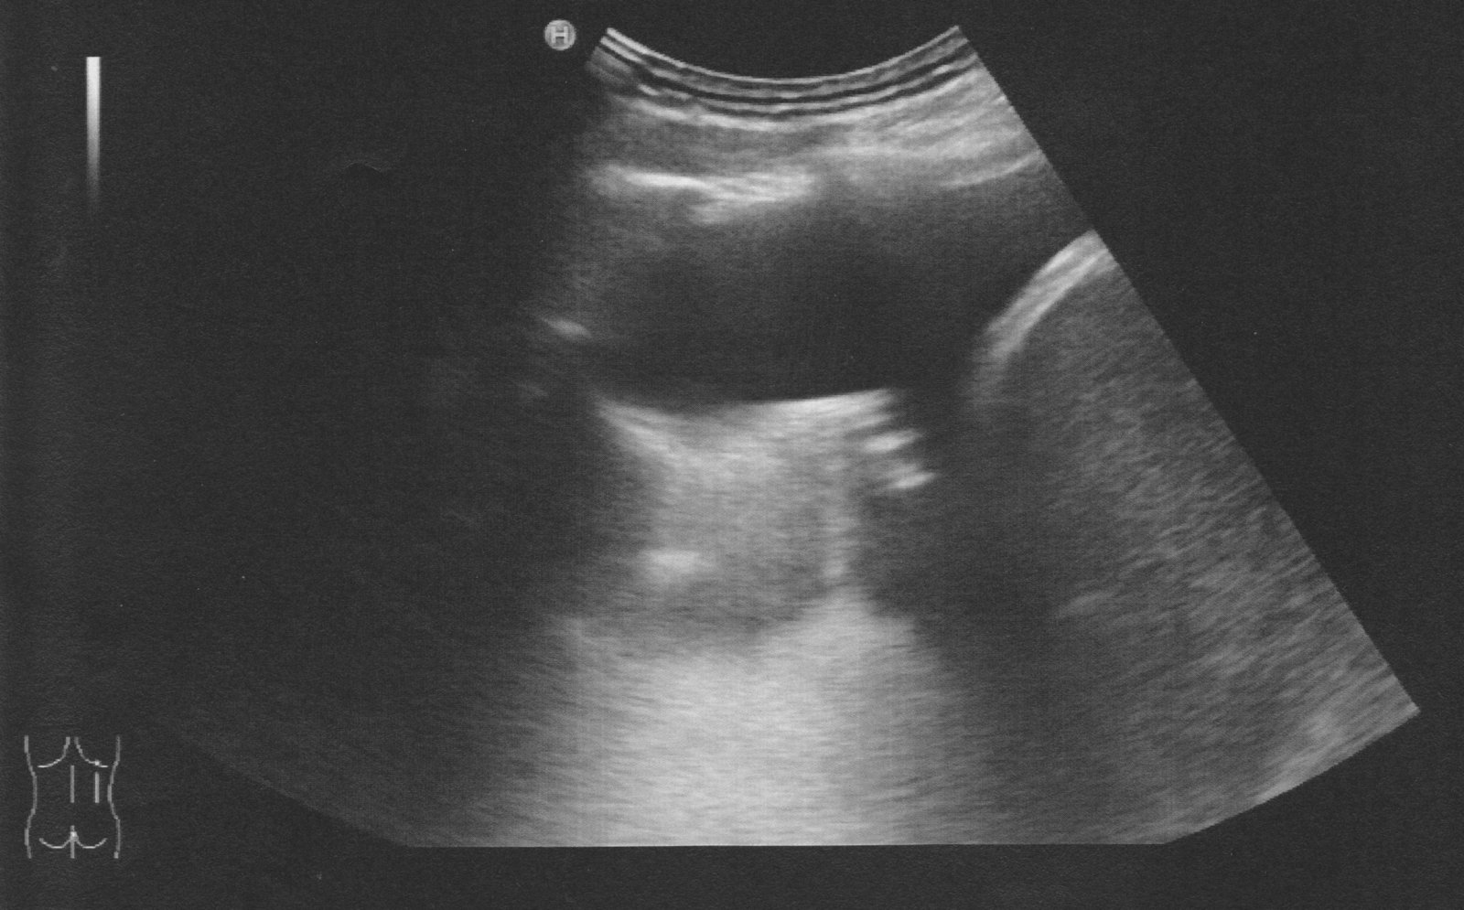
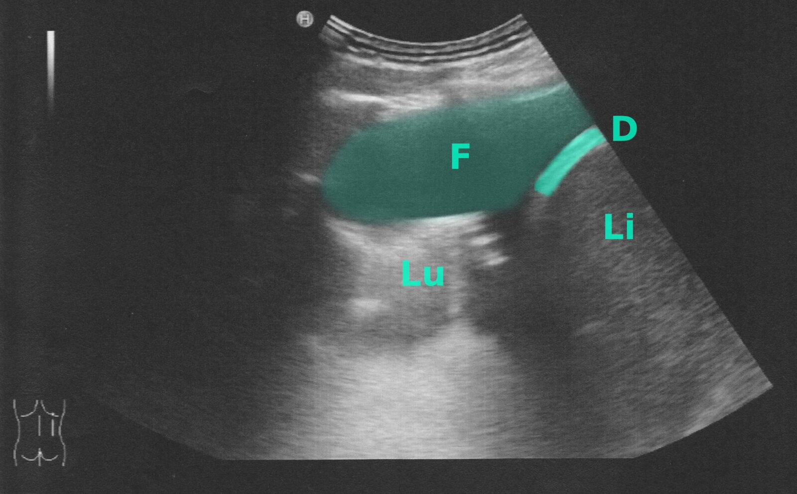
Thoracic US
Ultrasound chest (posterior right hemithorax)
Anechoic fluid (green overlay; F) is visible in the costodiaphragmatic recess between the right hemidiaphragm (D) and atelectatic lung (Lu).
Li: liver

Slide 15
Thoracentesis - Differential diagnosis of exudative effusions
Pleural fluid parameter |  | Associated conditions
Appearance | Cloudy, milky | Chylothorax (TAG: >110 & Cholesterol: <200 mg/dL) Pseudochylothorax (TAG: <110 & Cholesterol: >200 mg/dL)
 | Purulent | Parapneumonic effusion Empyema (Frank Pus)
 | Bloody | Hemothorax Malignant effusion Pulmonary embolism/infarct
Hematocrit > 0.5 × peripheral hematocrit |  | Hemothorax
pH < 7.2 |  | Complicated parapneumonic effusion Empyema Malignant effusion Esophageal perforation Collagen vascular disease
NOTE: Transudate is usually clear, has a decreased cell count, and has low levels of protein, albumin, and LDH. Exudate typically appears cloudy, has an increased cell count, and has high levels of protein, albumin, and LDH.
Mnemonic: MEAT has low glucose (<60ml/dL): Malignancy, Empyema, Arthritis (rheumatoid pleurisy), and Tuberculosis are causes of pulmonary effusion associated with low glucose levels.
Pleural fluid with a bloody appearance suggests a malignant etiology or hemothorax!
Notes:
Grossly bloody fluid may result from trauma, malignancy, post pericardiotomy syndrome, or asbestos-related effusion
Elevated pleural fluid amylase : esophageal rupture , pancreatitis ,malignancy.

Slide 16
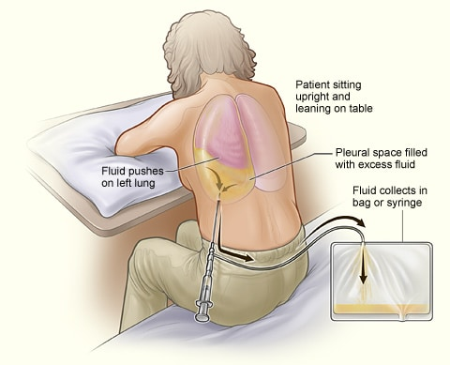
Notes:
is a procedure that drains fluid or air from the space between the lungs and the wall of the chest (the pleural space). It is done using a hollow needle or a plastic tube inserted through the chest wall. Normally only a small amount of fluid is in the pleural space and is done in the most dependent part.
Landmarks and positioning
Place the patient in the sitting position with their arms resting on the bedside table.
Determine the puncture site using ultrasound and mark the skin.
1–2 intercostal spaces beneath the upper margin of the effusion
Midscapular or posterior axillary line.

Slide 17
management
Treat the underlying cause:
Acute congestive heart failure: loop diuretics
Collagen vascular diseases: steroids
Pneumonia: antibiotics And so on…

Slide 18
management
Therapeutic thoracentesis:
Goals:
Removal of pleural fluid that compromises cardiac and/or respiratory function and/or carries a risk of infection
Indications:
Massive collection or rapid collection of pleural fluid
Severe respiratory distress
Suspected empyema
Massive mediastinal shift
Complicated parapneumonic effusions should be drained due to a high risk of progression to empyema
.

Slide 19
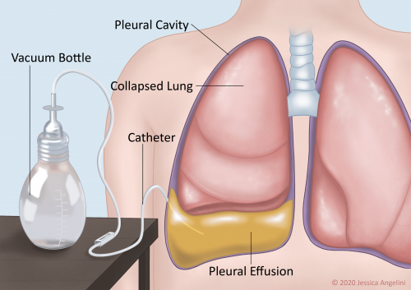
management
Indwelling pleural catheter
Can remain in situ for months.
Goal:
Recurrent pleural fluid removal without repeated puncture
Indication:
Rapidly reaccumulating pleural effusions (e.g., malignant effusions)

Slide 20
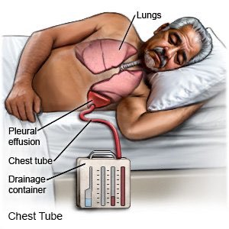
management
Surgical procedures
Tube thoracostomy (Chest tube)
Can remain in situ for a few days.
Indications
Pleural effusion in combination with significant cardiac and/or respiratory decompensation
For recurrent pleural effusion or urgent drainage of infected and/or loculated effusions
Drainage of high-viscosity fluid that is likely to clog: Empyema & Hemothorax

Slide 21
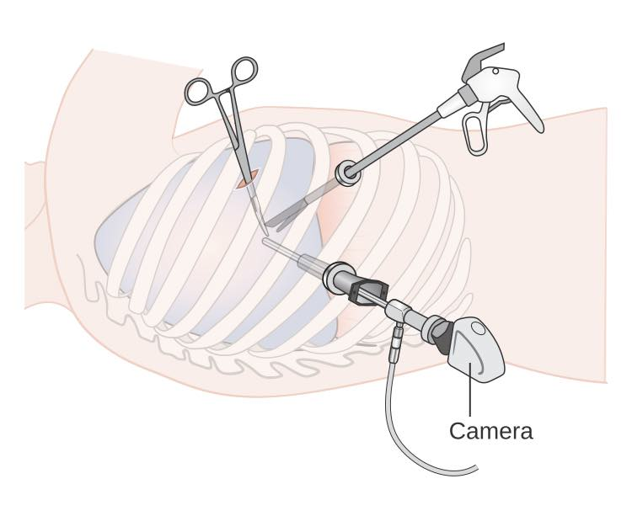
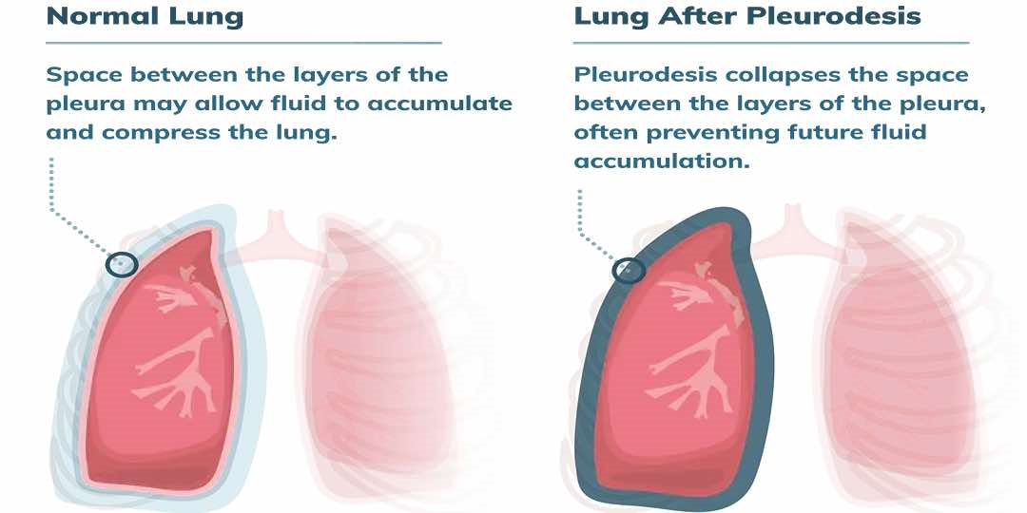
management
Video-assisted thoracoscopic surgery (VATS)
Pleurodesis:
Definition: chemical (e.g., talc) or surgical obliteration of the pleural space
Indication: Recurrent malignant effusions

Slide 22
Thank you!
{رَبَّنَا أَفْرِغْ عَلَيْنَا صَبْرًا وَثَبِّتْ أَقْدَامَنَا وَانصُرْنَا عَلَى الْقَوْمِ الْكَافِرِينَ}
-البقرة

