Slide 1
UROGENITAL SYSTEM
THE PERINEUM & ISCHIORECTAL FOSSA
Dr. Aiman Qais Afar
Surgical Anatomist
College of Medicine /University Of Mutah

Slide 2
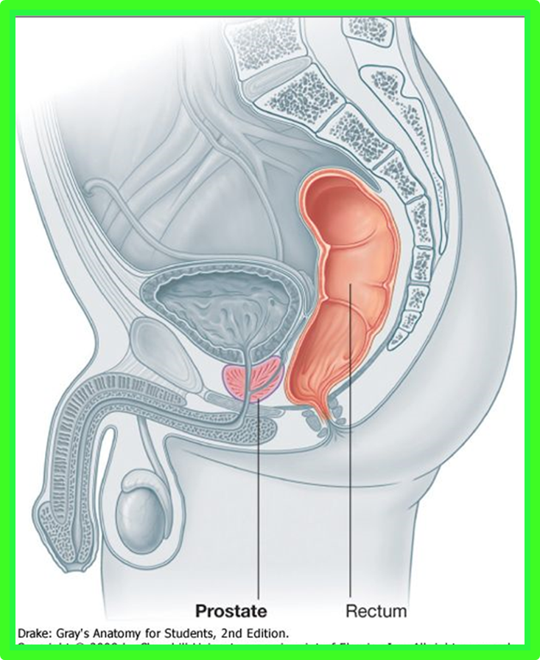
The Perineum
The cavity of the pelvis is divided by the pelvic diaphragm into the main pelvic cavity above and the perineum below .

Slide 3
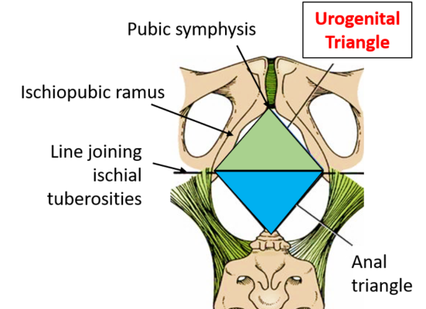
The Perineum
The perinium is diamond shaped and is bounded:
Anteriorly: The symphysis pubis
Posteriorly: the tip of the coccyx
Laterally: The ischial tuberosities
Diamond-shaped perineum divided by a broken line into the:
Urogenital triangle
Anal triangle.
The Urogenital triangle is bounded in front by the pubic arch and laterally by the ischial tuberosities

Slide 4
Urogenital Triangle
Superficial Fascia
Can be divided into a fatty layer and a membranous layer.
The fatty layer (fascia of Camper) is continuous with the fat of the ischiorectal fossa and the superficial fascia of the thighs
In the scrotum, the fat is replaced by smooth muscle the dartos muscle.
The dartos muscle contracts in response to cold and reduces the surface area of the scrotal skin

Slide 5
Urogenital Triangle
Superficial Fascia
The membranous layer (Colles' fascia) is attached:
Posteriorly to the posterior border of the urogenital diaphragm
Laterally to the margins of the pubic arch
Anteriorly it is continuous with the membranous layer of superficial fascia of the anterior abdominal wall (Scarpa's fascia).
The fascia is continued over the penis (or clitoris) as a tubular sheath (Buck's fascia) and Colle's Fascia in the scrotum

Slide 6
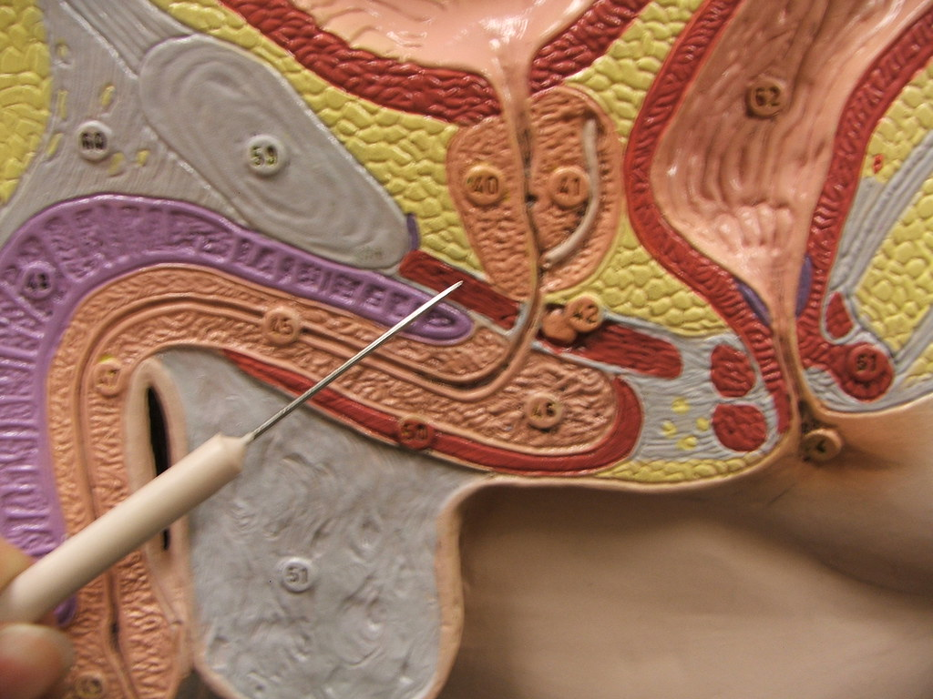
Urogenital Diaphragm
Is a triangular musculofascial diaphragm situated in the anterior part of the perineum
filling in the gap of the pubic arch

Slide 7
Urogenital Diaphragm
It is formed by the sphincter urethrae and the deep transverse perineal muscles, which are enclosed between a superior and an inferior layer of fascia of the Urogenital diaphragm.
The inferior layer of fascia is often referred to as the perineal membrane.

Slide 8
Urogenital Diaphragm
Anteriorly: the two layers of fascia fuse, leaving a small gap beneath the symphysis pubis.
Posteriorly: the two layers of fascia fuse with the membranous layer of the superficial fascia and the perineal body
Laterally, the layers of fascia are attached to the pubic arch.
The closed space that is contained between the superficial and deep layers of fascia is known as:
The deep perineal pouch.

Slide 9
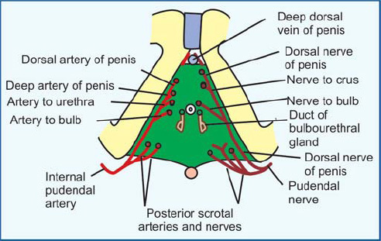
** The structures piercing the perineal membrane.
In male
1- Membranous Urethra.
2- Ducts of the bulbo-urethral glands
3- Artery of the urethra.
4- Artery of the bulb.
5- Deep artery of the penis.
6- Dorsal artery of the penis.
7- Dorsal nerve of the penis

Slide 10
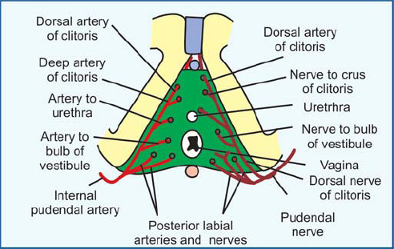
** The structures piercing the perineal membrane.
In female
1- Urethra.
2- Vagina behind the urethra.
3- Artery of the urethra.
4- Artery of the bulb.
5- Deep artery of the clitoris.
6- Dorsal artery of the clitoris.
7- Dorsal nerve of the clitoris.

Slide 11
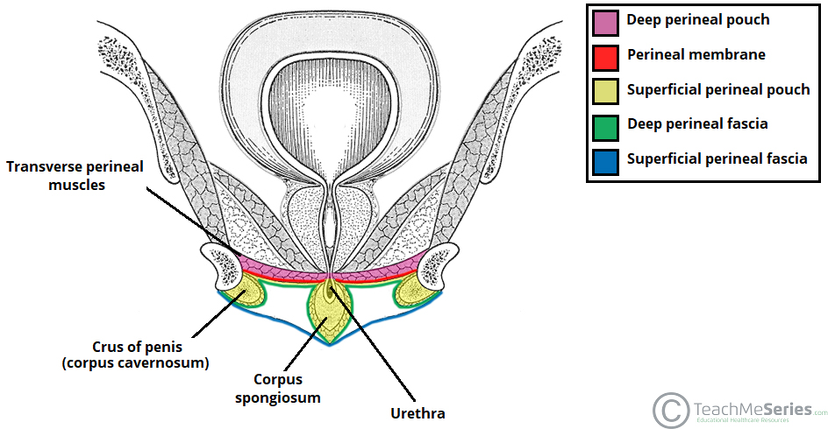
Superficial Perineal Pouch
** Boundaries
1- Floor: membranous layer of superficial fascia (Colle's fascia).
2- Roof: perineal membrane.
3- On each side: pubic arch.
4- Posteriorly: closed by the attachment of the roof and floor.
5- Anteriorly: opened.

Slide 12
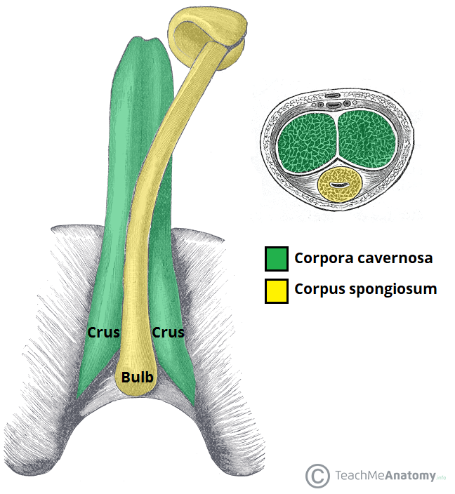
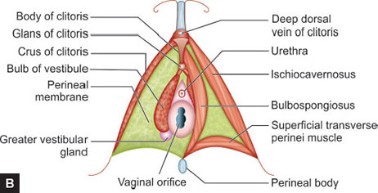
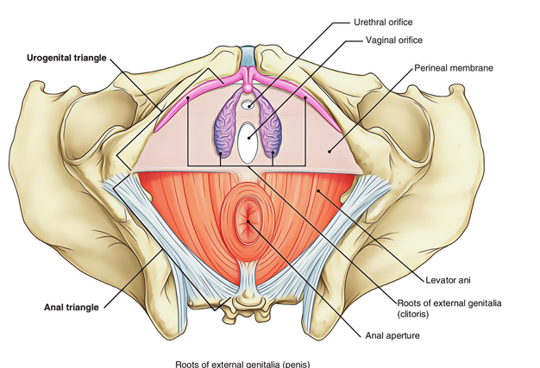
Contents of Superficial Perineal Pouch
A- Root of the penis
1- Bulb of the penis: is the posterior part of the corpus spongiosum.
2- 2 Crura of the penis: is the posterior part of the corporus cavernosum.
3- Penile urethra inside the bulb of the penis.
N.B- In Female
1- Root of the clitoris.
2- Vestibule of the vagina and greater vestibular glands

Slide 13
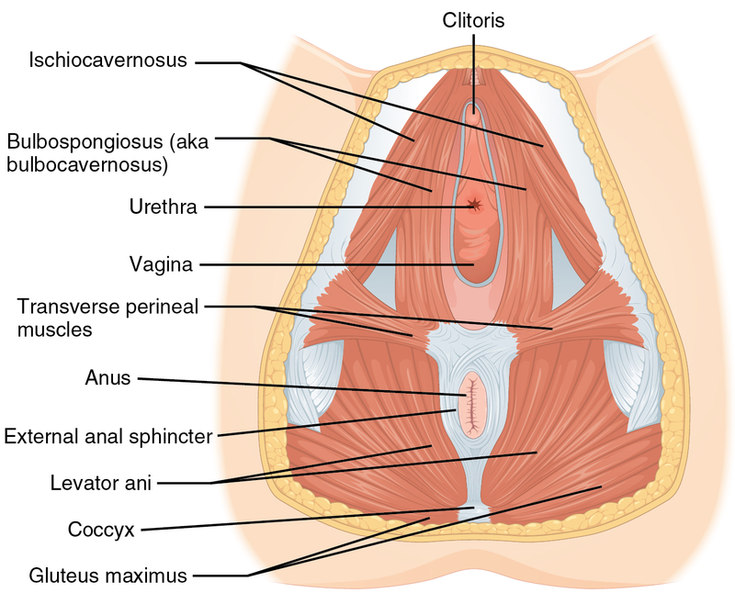
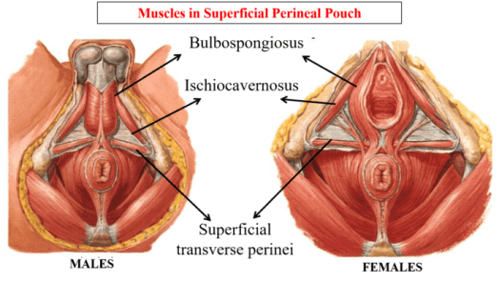
Contents of Superficial Perineal Pouch
B- Superficial perineal muscles (right and left)
1- Superficial transversus perinei muscles. (** Action: fixation of the perineal body.)
2- Bulbospongiosus muscles. ** Action; Empty the urethra (contract at the end of micturition or ejaculation).
3- Ischiocavernosus muscles. ** Action, maintain erection of the penis and clitoris

Slide 14
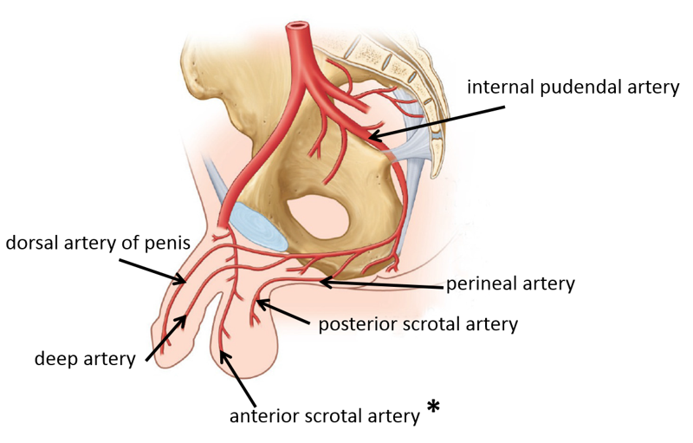
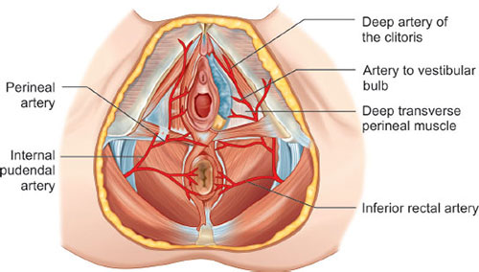
Contents of Superficial Perineal Pouch
C- Nerves and vessels
1- Posterior scrotal (male) or labial (female) arteries, from the perineal branch of the internal pudenal artery.
2- Deep artery of the penis or clitoris (one of the two terminal branch of internal pudendal artery).

Slide 15
Contents of Superficial Perineal Pouch
C- Nerves and vessels
3- Dorsal artery of the penis or clitoris (one of the two terminal branch of internal pudendal artery).
4- Artery of the bulb of the penis (male) or vestibule of the vagina (female).

Slide 16
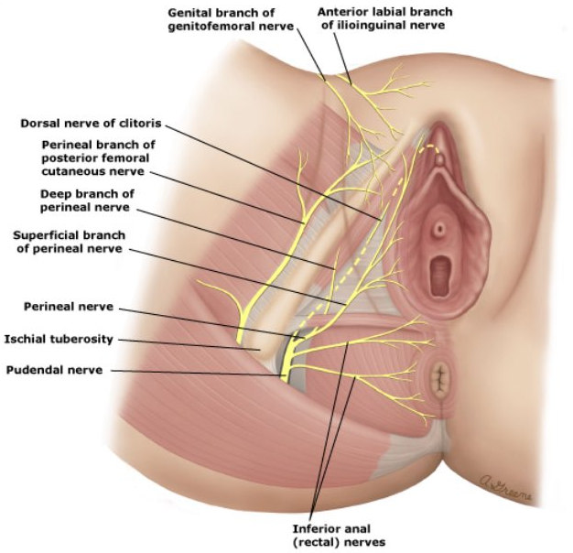
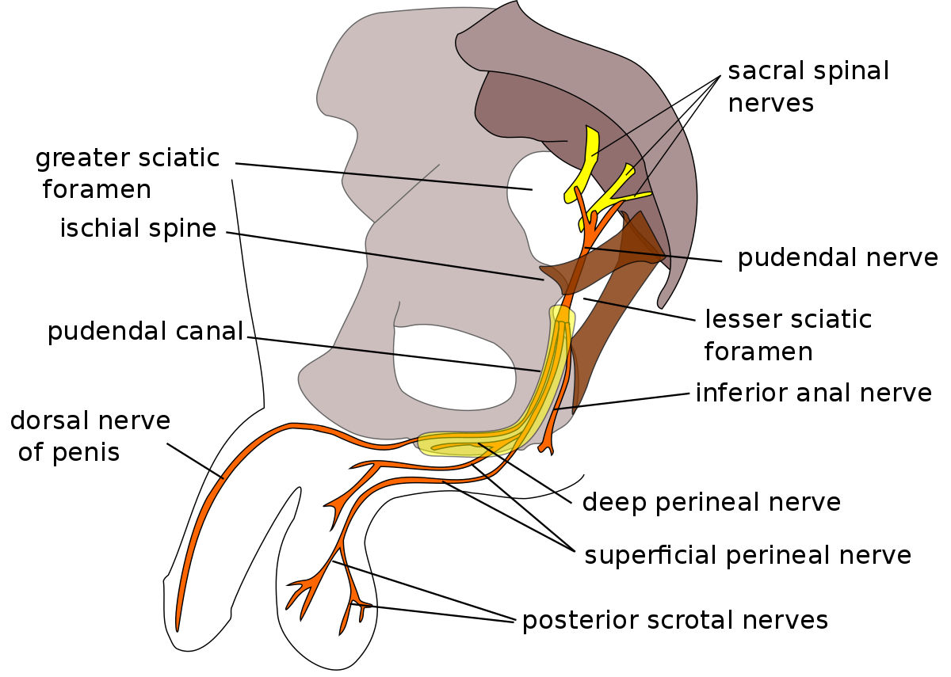
Contents of Superficial Perineal Pouch
C- Nerves and vessels
1- Posterior scrotal (male) or labial (female) nerves: They arise from the perineal branch of pudendal nerve to the scrotum or labia majora
2- Dorsal nerve of the penis or clitoris: (one of the two terminal branch of pudendal nerve).

Slide 17
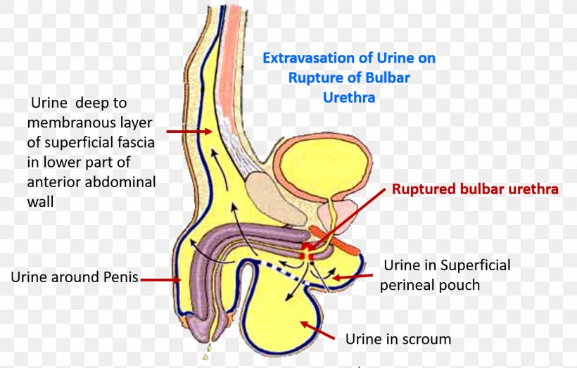
Superficial Perineal Pouch
- Superficial perineal pouch is opened anteriorly where it is continuous with the space deep to the membranous layer of the superficial fascia of the anterior abdominal wall.
Rupture of the urethra leading to extravasations of urine into the superficial perineal pouch → to the anterior abdominal wall.
The urine also deseeds to the front of the thigh till the fusion of membranous layer of superficial fascia with the deep fascia.

Slide 18
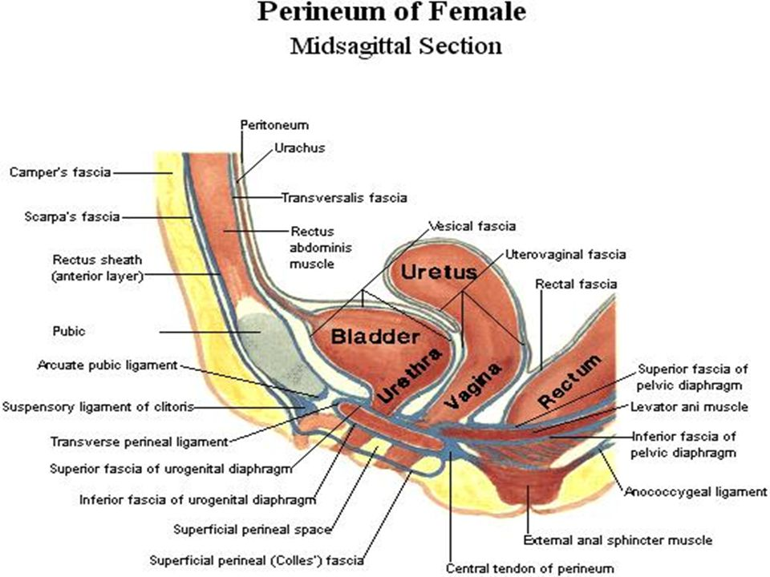
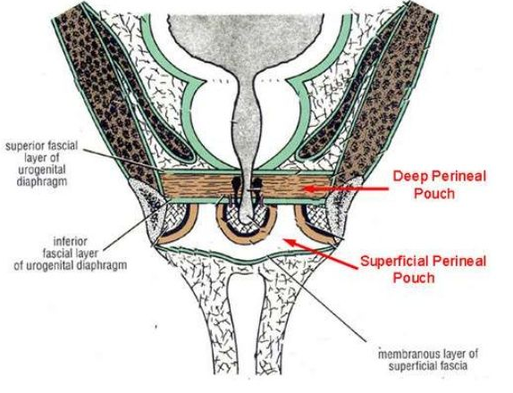
Deep Perineal pouch
** Boundaries
1- Roof: superior fascia of the pelvic diaphragm.
2- Floor: perineal membrane (inferior fascia of the pelvic diaphragm).
3- On each side: pubic arch.
4- Anteriorly and posteriorly: closed by the fusion of the roof and floor.

Slide 19
** Contents of the deep perineal pouch
A- Contents in male
I- Membranous urethra.
2- Bulbourethral glands and their ducts open into the spongy urethra.
B- Contents in female
1- Urethra: In the median plane closely anterior to the vagina.
2- Vagina: in the median plane.

Slide 20
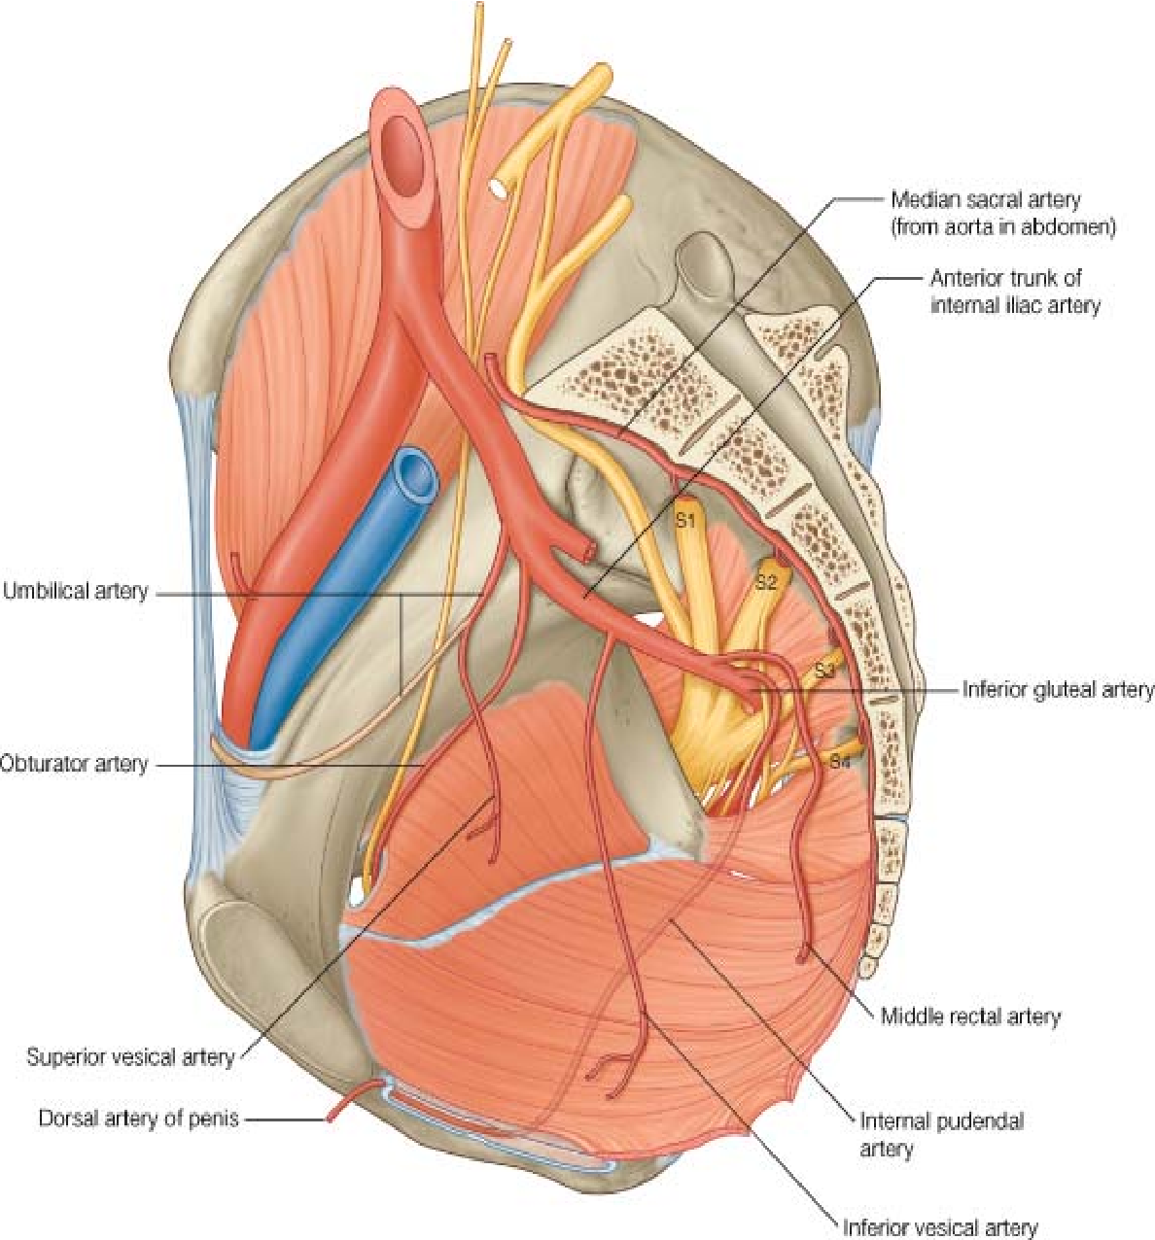
** Contents of the deep perineal pouch
C- Contents in both male and female
1- Sphincter urethrae.
2- Deep transversus perinei muscles: one on each side.
D- Nerves and vessels;
- Dorsal nerve of the penis or clitoris.
- Internal pudendal artery.

Slide 21
Sphincter Urethrae Muscle
Surrounds the urethra in the deep perineal pouch. It arises from the pubic arch on the two sides and passes medially to encircle the urethra
Action
The muscle compresses the membranous part of the urethra and relaxes during micturition.
It is the means by which micturition can be voluntarily stopped

Slide 22
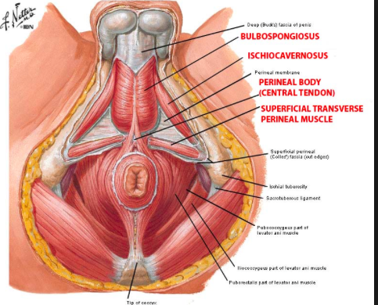
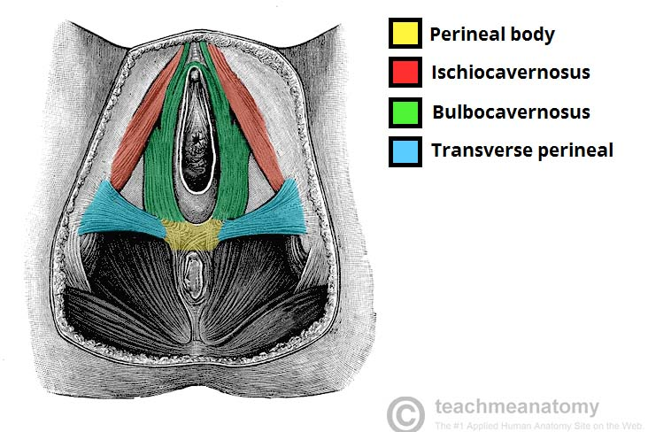
Perineal Body
- The perineal body is a median fibromuscular pyramidal mass.
** Site:
1) In male: between the anal canal and bulb of the penis.
2) In female: between the anal canal and lower part of the vagina.

Slide 23
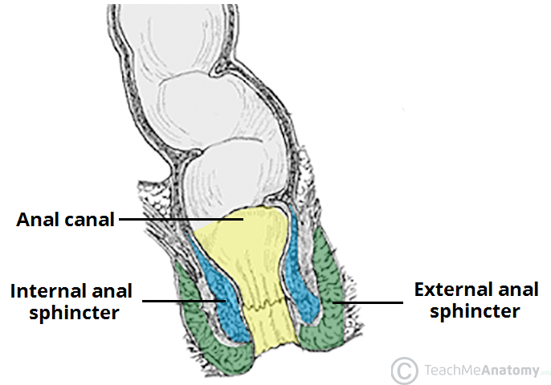
Perineal Body
** Muscles attached to the perineal body:
1- External anal sphincter.
2- Sphincter of the urethra.
3- Superficial transversus perinei muscles (of both sides).
4- Deep transversus perinei muscles (of both sides).
5- Anterior parts of the levator ani (of both sides).
6- Bulbospongiosus.

Slide 24
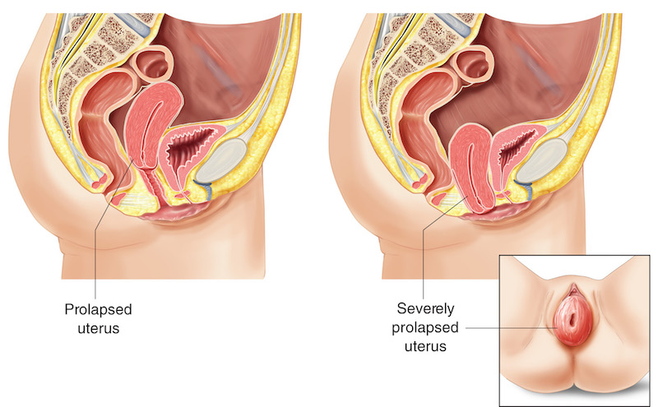
Perineal Body
** Applied anatomy:
- The perineal body is essential to the integrity of the pelvic floor.
- Rupture of the perineal body leads to widening of the gap between the anterior borders of the levator ani muscles. This predisposes to the prolapse of the uterus.

Slide 25
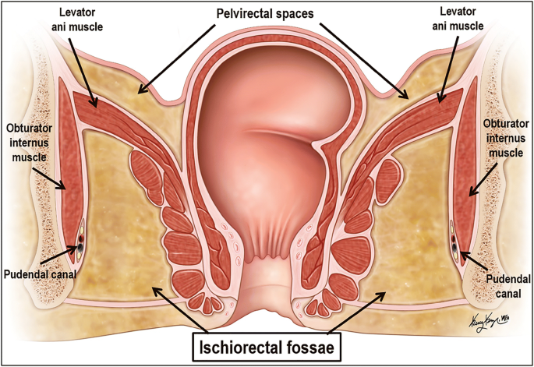
Ischiorectal Fossa
** Shape: a wedge-shaped
** Position: space on each side of the anal canal.
** Boundaries (walls):
Lateral wall: vertical.
It is formed by the obturator internus, obturator fascia and ischial tuberosity.
The obturator fascia is split to form the pudendal canal (its contents pudendal nerve and internal pudendal vessels).

Slide 26
Ischiorectal Fossa
2- Medial wall: sloping
Upper part: the levator ani muscle.
Lower part: the external anal sphincter.
3- The base: is directed downward and is formed by the peri-anal skin and fascia.
4- The apex: is directed upward and is formed by the meeting obturator internus and levator ani muscles.

Slide 27
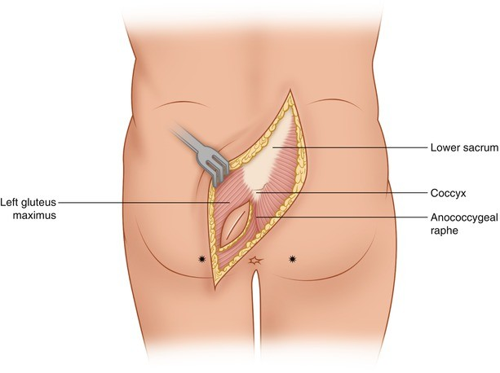
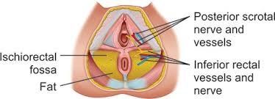
Ischiorectal Fossa
5- Anterior boundary: superficial and deep perineal pouches and their contents.
6- Posterior boundary: sacrotuberous ligament and gluteus maximus muscle.

Slide 28
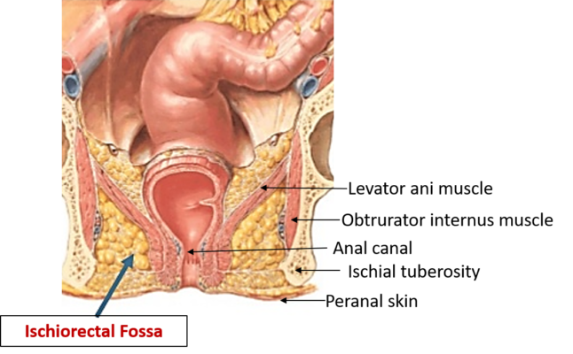
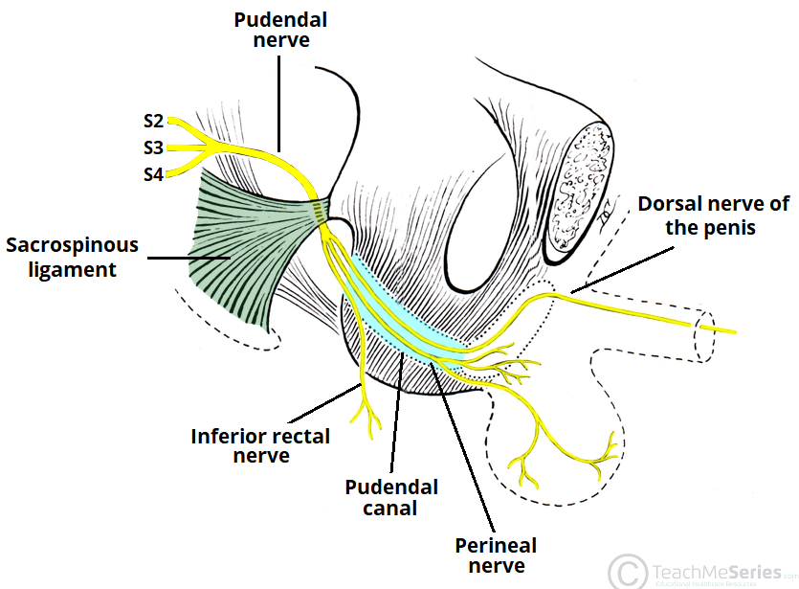
Ischiorectal Fossa
** Contents:
1- lschiorectal pad of fat: allows distension of the anal canal during defecation.
2- Pudendal canal and its contents (pudendal nerve and internal pudendal vessels).

Slide 29
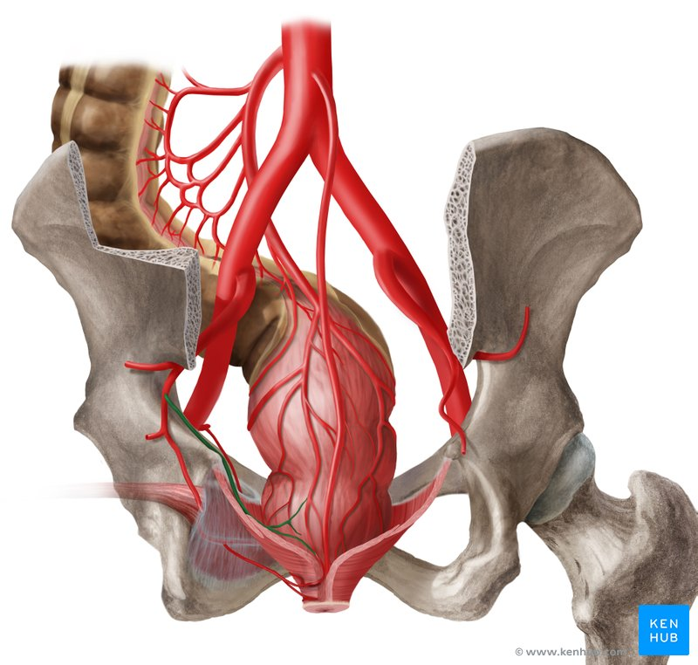
Ischiorectal Fossa
** Contents:
3- Inferior rectal vessels:
The artery arises from the internal pudendal artery in the pudendal canal.
It crosses the fossa to reach the anal canal.
Inferior rectal A

Slide 30
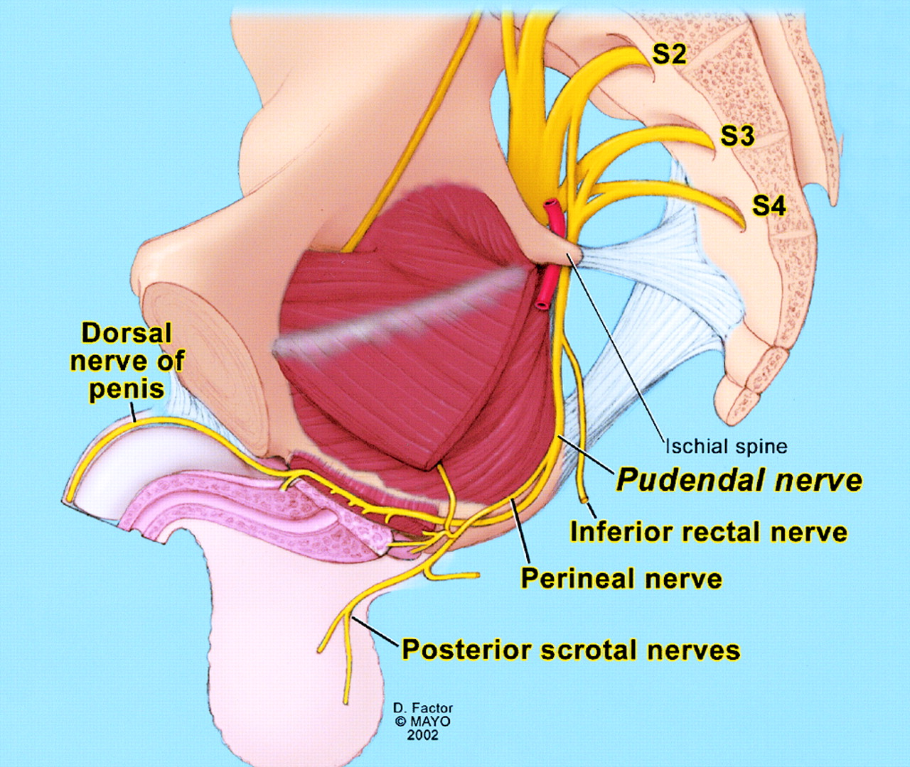
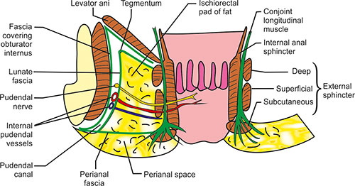
Ischiorectal Fossa
** Contents:
4- Inferior rectal nerve:
- It is a branch of the pudendal nerve in the pudendal canal.
- It crosses the fossa to supply the levator ani, and external anal sphincter.

Slide 31
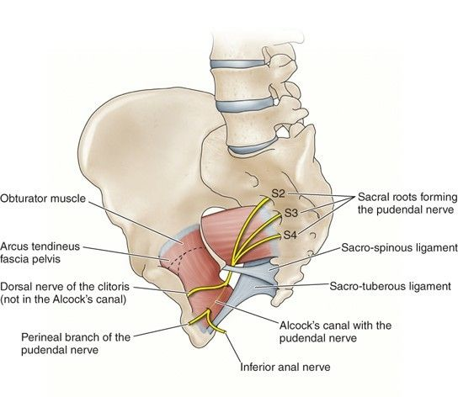
Ischiorectal Fossa
** Contents:
5- Perineal branch of the 4th sacral nerve.
6- Posterior scrotal nerves and vessels: to the scrotum (in male)
7- Posterior labial nerves and vessels: to the labia majora (in female).

Slide 32
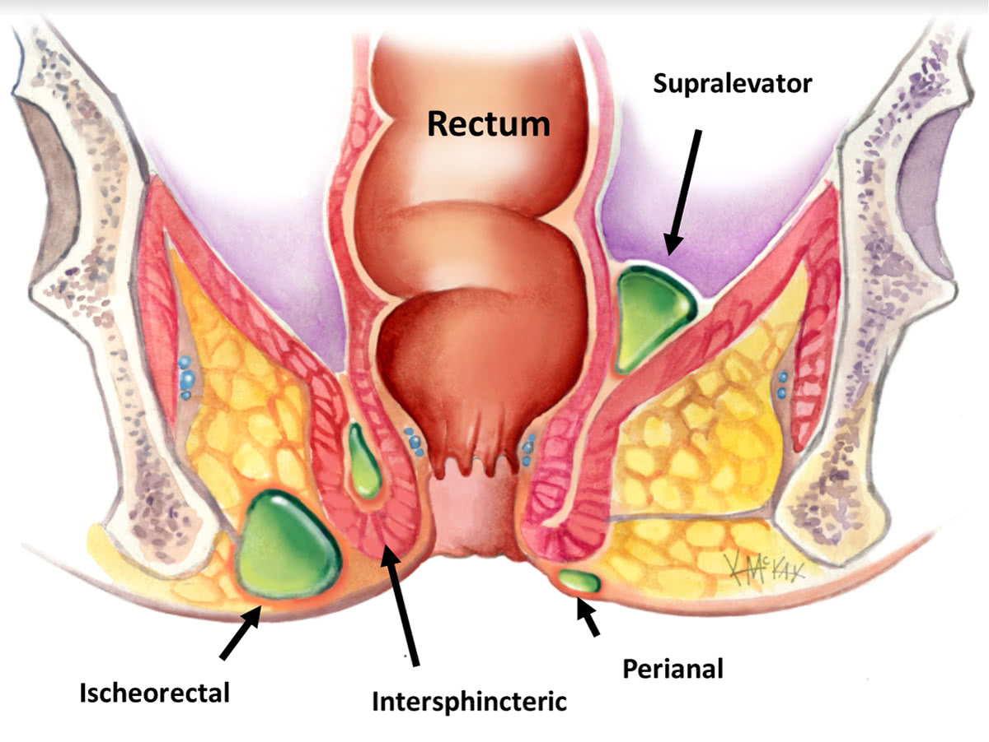
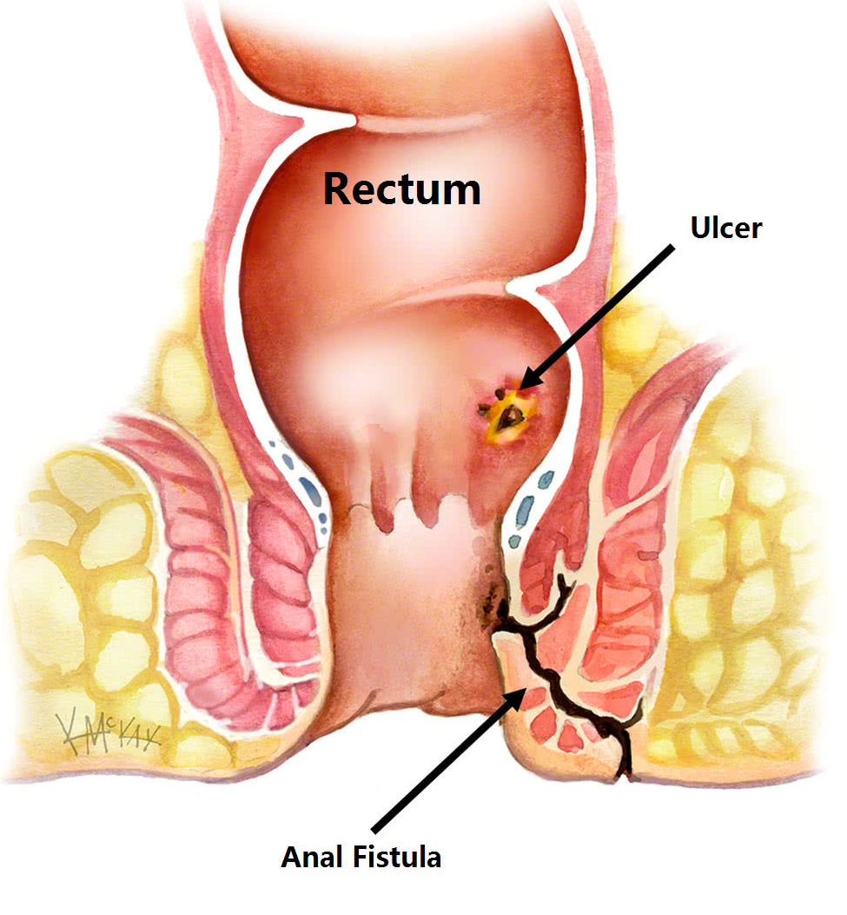
Ischiorectal Fossa
** Applied anatomy:
1- Infection of the ischiorectal fossa leading to an ischiorectal abscess.
2- If the abscess opens into the anal canal, it produces anal fistula.
3- If the abscess opens into the skin, it produces an external sinus.

Slide 33
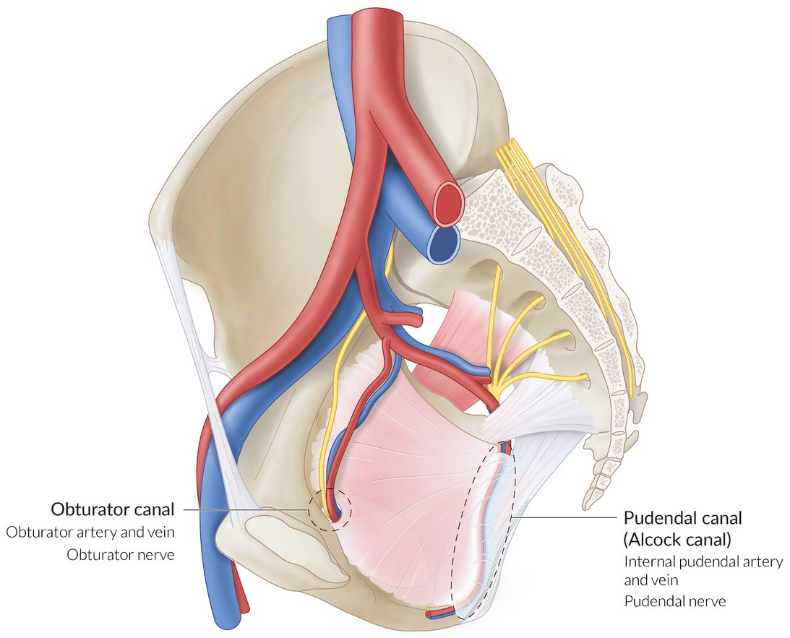
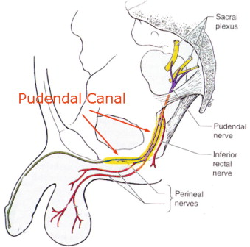
Ischiorectal Fossa
Pudendal canal
** Definition: It is a tunnel in the lateral wall of the ischiorectal fossa.
** Formation: It is formed by splitting of the obturator fascia.
** Begins: at the lesser sciatic foramen.
** Ends into the deep perineal pouch.
** Contents: Pudendal nerve and internal pudendal vessels.

Slide 34
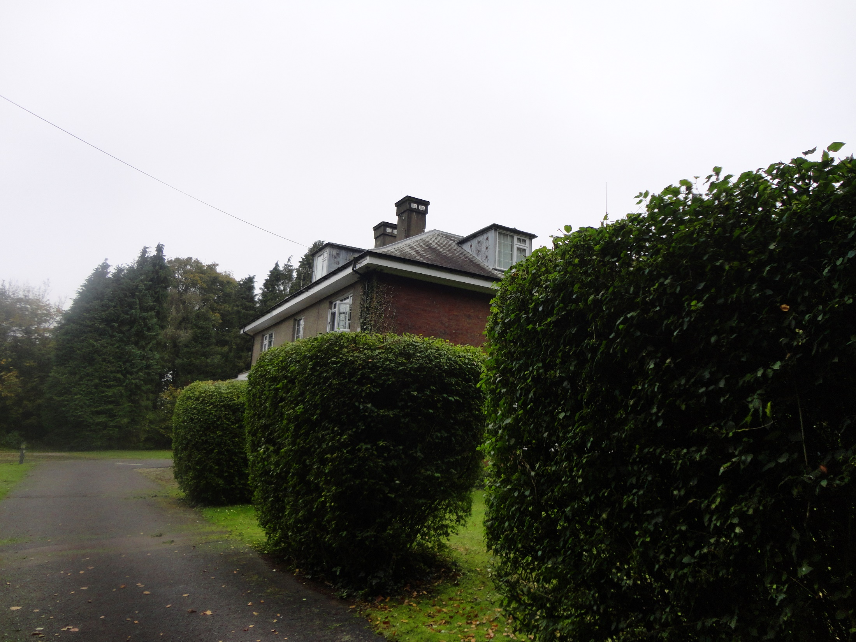
Dr. Aiman Qais Al-Maathidy
Tuesday 8 May 2023

