Slide 1
Endoscopy in Gynecology
Supervised by:
Dr Alaa Owais
Presented by:
Neama Abed
Momen Ibrahim
Abdulsalam Al btoosh

Slide 2
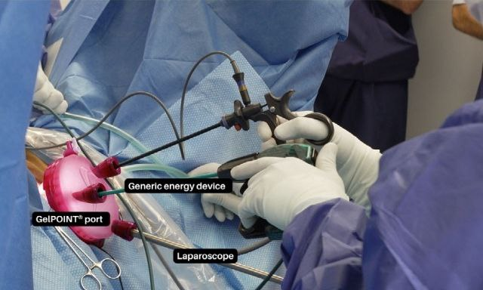
Introduction:
Natural Orifice Transluminal Endoscopic Surgery (NOTES):
is an emerging minimally invasive surgical technique that employs natural orifices, such as the rectum and vagina, for surgical access thus obviating the need for any external skin incisions.
The transvaginal route, known as vaginal Natural Orifice Transluminal Endoscopic Surgery (vNOTES), is the most accessible and most commonly used.
It utilises a colpotomy entry, followed by carbon dioxide insufflation (to create pneumoperitoneum) and insertion of endoscopic instruments
(including laparoscope and energy devices) through the vagina

Slide 3
Gynaecological vNOTES procedures include:
adnexal surgery,
ovarian cystectomy,
myomectomy
hysterectomy
And is associated with 1-reduced morbidity,2-improved cosmesis
and 3-decreased length of hospital stay compared with laparoscopic surgery
as this route combines the conventional vaginal approach and single port endoscopy and is derived from surgical skills gained from both vaginal and endoscopic surgery.

Slide 4
Indications:
Contraindications:
severe endometriosis obliterating the cul de sac
dense pelvic adhesions where there is risk of bladder or bowel injury
(ICS) classification Stage III or IV uterovaginal prolapse,
previous rectal surgery
gynaecological malignancy
pelvic radiotherapy
history of a previous total hysterectomy
previous mesh sacrocolpopexy
virginity.
benign uterine and adnexal pathology such as (ectopic pregnancy)
ovarian cyst
patients with high body mass index
(when conventional laparoscopy becomes challenging.)

Slide 5
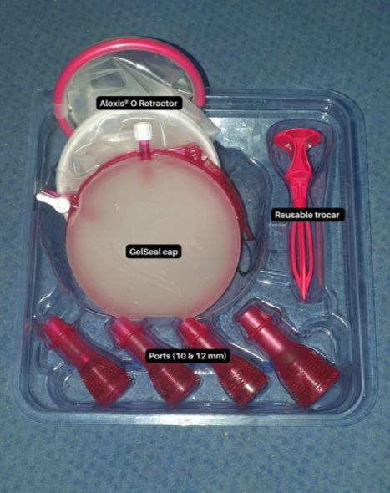
Technique In brief:
1.vNOTES procedures are typically performed under general anaesthesia with the patient placed in the Trendelenburg position.
2.The vaginal mucosa is initially circumscribed around the cervix and mobilised from the uterus
( similar to the first steps of a vagina hysterectomy.)
3. An Alexis O-Retractor introduced behind the colpotomy incision
4.pneumoperitoneum then created with an insufflation
pressure of 10mm Hg, allowing good visual and operative access.
5. specimens are retrieved through the vagina and the colpotomy incision closed with absorbable sutures.

Slide 6
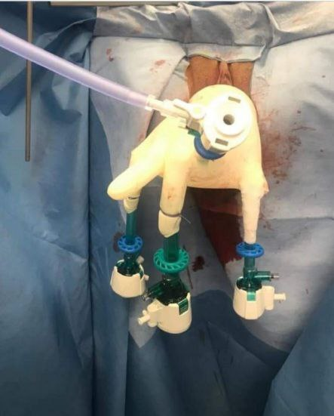
As it’s important to keep the CO2 insufflation , some surgeons earlier on used to attach a surgical glove onto the rim of the Retractor and incising the ends to admit a standard 10-mm trocar (which is used for CO2 insufflation and laparoscope insertion)
However current practice is to use specially designed airtight access platforms such as GelPOINT V-Path in order to provide a seal around the vaginal cuff to maintain insufflation pressure and allow introduction of instruments.

Slide 7
Comparisons with conventional procedures:
Compared with traditional laparoscopy:
the low pressure maintenance pneumoperitoneum used in vNOTES
(6–10 mmHg versus 12–16 mmHg, respectively)
means that less anaesthetic ventilation is required, and there is a lower risk of insufflation-induced bradycardia and less severe postoperative pain scores,
so most patients are comfortable with only paracetamol and NSAIDS.
*based on systematic review of cohort retrospective studies

Slide 8
Shorter operation time
Shorter length of stay
Efficacy
Complications
Readmission rates
Post op pain scores
Less blood loss
Compared with
Laparoscopic assisted vaginal hysterectomy or total laparoscopic hysterectomy revealed:
similar
BETTER

Slide 9
Cost-effectiveness:
According to Two studies discussed financial costs comparing vNOTES with LAVH and TLH:
vNOTES is more expensive due to the cost of the retractor and energy devices
Training and learning curve :
Despite the clear advantages reported, there is little data available to assess the learning curve for vNOTES skill acquisition.
The current shortage of experienced operators providing exposure to vNOTES training may deter interested gynaecologists from applying this technique in daily practice.

Slide 10
Robotic vaginal Natural Orifice Transluminal Endoscopic Surgery (RvNOTES)
Initial data from case series are promising with low conversion to open or laparoscopy salvage and minimalblood loss and post-operative pain.
However, the extra cost, setup time and learning curve of RvNOTES requires further validation.
While the authors are optimistic about the adoption of vNOTES in the future, it should be considered, at the moment, as a technique under evaluation for use in gynaecological surgery.

Slide 11
molecular testing and maintenance targeted therapies in ovarian cancer

Slide 12
Introduction
Epithelial ovarian cancers is the seventh commonest malignancy in women worldwide.
Ovarian cancer accounts for 5% of cancer-related mortality in the UK, with a 42.6% overall five year survival rate.

Slide 13
High-grade serous carcinoma
HGSC comprises 70% of epithelial ovarian carcinomas.
It is commoner in women of Caucasian ethnicity, with a mean age of 65 years.
Owing to its nonspecific symptoms and insidious course, approximately 80% of cases present with advanced disease (FIGO stage III/IV).
Recent evidence reveals that more than 70% of HGSC originate from the fimbrial epithelium of the fallopian tube .
TP53 mutations are the most common (96%) , with BRCA1/2 mutations the next commonest (20%).

Slide 14
Continue
Until the recent introduction of maintenance therapies, the standard of care was surgical cytoreduction to achieve no macroscopic residual disease (NMRD) ,together with platinum based chemotherapy , followed by routine surveillance.
Despite optimal treatment, 70% of patients will relapse.
This prompted the drive to develop maintenance therapies for these cancers after response to chemotherapy to reduce the risk of disease progression or recurrence.

Slide 15
Continue
Recent molecular analyses of ovarian cancers provided a better understanding of their evolution and progression dynamics on a genomic level, which in turn guided the development of new targeted therapies.

Slide 16
PolyADP-ribose polymerase (PARP) enzymes
enzymes that are critical in DNA repair. PARP-1 supports DNA repair via the BER pathway ; it replaces missed bases by directing DNA polymerase b to the site of DNA damage
Homologous recombination is a DNA repair mechanism that helps maintain cellular viability through rectifying DNA damage.
This is particularly critical to the survival of highly proliferating cells such as malignant cells.
PolyADP-ribose polymerase (PARP) enzymes are crucial in single-strand DNA repair pathways.

Slide 17
PARP inhibitors
PARP inhibitors (PARPi) are a useful new therapeutic modality for HGSC .
The main mechanism of action is ‘PARP trapping’, where PARP enzymes get ‘stuck’ to DNA break sites creating an irreversible complex that locks and obstructs the DNA replication fork.
Olaparib, niraparib and rucaparib are the currently approved PARPi for treatment of ovarian cancer
Best for HGSC WITH BRCA1/2

Slide 18
PARP inhibitors
At first-line, after response to chemotherapy ,olaparib maintenance therapy continues for up to 2years , either as mono therapy or incombination with bevacizumab
Niraparib is given for up to 3 years

Slide 19
PARP inhibitors side effects
haematological deficiencies
fatigue
abdominal pain
gastrointestinal upset
diarrhoea
Thrombocytopenia more frequently occurs with niraparibuse
rucaparib has been associated with deranged liver function.

Slide 20
Homologous recombination repair
DNA damage response (DDR) is an umbrella term comprising several DNA repair mechanisms, including:
Mismatch repair (MMR)
Nucleotide excision repair (NER)
Base excision repair (BER)
Nonhomologous end-joining (NHEJ) …. Faster with a higher susceptibility to errors
Homologous recombination repair (HRR).

Slide 21
Continue
HRR pathway is controlled by several key proteins
encoded by genes including (BRCA1/2, ATM, BARD1, BRIP1,
CHEK1/2, FAM175A, MRE11A, NBN, PALB2 and RAD51C/D)
HRD can occur through either a loss-of-function mutation or by silencing epigenetic events to genes encoding HRR pathway proteins.

Slide 22
Homologous recombination deficiency assays
We need to identify patients with tumors characterized by HRD to identify the cohort of patients who will derive the greatest benefit from PARPi.
There are three main ways to detect HRD:
identifying a specific genomic alteration in an HRR pathway gene
using a genomic scar assay
With functional assays

Slide 23
Homologous recombination repair genetic assays
abnormality in an HRR pathway gene , either through a (loss of function mutation) or an (epigenomic silencing event such as hypermethylation), results in HRD .
Ex :-
BRCA1/2 gene mutations … (can either be detetcted in the germline or in tumor tissue)
Non-BRCA1/2 HRR gene mutations (approximately 30% of ovarian HGSC)
Epigenomic silencing (methylation of gene) …. [ TCGA detected BRCA1 hypermethylation in 11% of HGSC cases ]

Slide 24
Genomic scars
Available genomic scarring assays include
mutational signature : are characteristic genomic patterns reflecting historic mutational events that are possibly implicted in disease development and progression
functional assays : identify HRR status
copy number variation
Notes:
HRR phenotype can be inferred through quantifying genomic scars in malignant cells. The unstable genome in HRD cancers exhibits a profile comprising various somatic mutations including single-base substitutions (SBSs) and structural variants (SVs). These assays reflect the resultant phenotype, not the causative effect.

Slide 25
copy number variation
structural abnormality in which genomic changes including deletions and duplications result in distinct variations among individuals , ex: (large scale transitions (LST), loss of heterozygosity (LOH) and telomeric allelic imbalance (TAI))
Genomic scarring quantification is regarded as the base for
the HRD tests used in several PARPi clinical trials (e.g.,
PAOLA1 and PRIMA). Here, assessment of HRD relies on
the combination of two features: BRCA1/2mut and genomic
scarring
Notes:
Quantifying these variations can indicate ‘genomic scarring’ reflecting abberations that might have instigated a malfunction in certain DNA repair pathways, rendering the cells’ susceptability to malignant changes

Slide 26
Molecular testing pathways
The initial sampling event could either take place in interventional radiology or during primary cytoreductive surgery
In radiologically guided biopsies, obtaining at least five cores is recommended for a sufficient sample for HRD testing
Notes:
A reliable molecular tissue-based assessment depends on proper sampling and careful handling. This can only be achieved by the coordinated efforts of the gynaecological oncologists, interventional radiologists and pathologists
HRD testing is currently available in England through Myriad MyChoice for newly diagnosed stage III/IV of any high-grade nonmucinous epithelial histology eligible for first-line treatment

Slide 27
Significant trials
PARPi maintenance treatment for platinum-sensitive relapsed ovarian cancer
Olaparib, niraparib and rucaparib have been approved for use as maintenance therapy for platinum-sensitive relapsed ovarian cancer (PSROC) following enhanced progressionfree survival (PFS) in treated cohorts (versus placebo) in clinical trials
(Study-19, SOLO2, NOVA and ARIEL3 )
are among the pivotal clinical trials that investigated PARPi as second-line (or beyond) maintenance therapy in PSROC

Slide 28
First-line PARPi maintenance treatment
Olaparib: maintenance treatment in patients with BRCA1/2mut and newly diagnosed advanced stage (III/IV) high-grade serous or endometrioid ovarian cancer
41 months of follow-up, olaparib maintenance therapy had a70% lower risk of disease progression or mortality than theplacebo group, with a Kaplan–Meier estimate of 60% forolaparib cohort for freedom of disease progression and fromdeath at 3 years, compared with 27% with placebo
Notes:
Following the observation of consistent clinical benefit seen using different PARPi in recurrent ovarian cancer, the role of maintenance therapy postchemotherapy in the first-line setting was investigated. Significant trials studying PARPi as a first-line monotherapy following platinum-based chemotherapy in advanced ovarian HGSC

Slide 29
Niraparib : EMA/FDA approval was given for all cases with advanced ovarian HGSC who have responded to first-line chemotherapy
Veliparib : was studied in newly diagnosed stage (III/IV) high-grade serous ovarian cancer when added to induction chemotherapy then continued as maintenance treatment after chemotherapy. Adding veliparib extended the PFS ; but it has not yet been licensed by NICE, EMA or FDA for use in ovarian cancer.

Slide 30
Long-term impact
PFS was enhanced in newly diagnosed epithelial ovarian cancer (EOC) when PARPi was used with chemotherapy then as maintenance (compared with chemotherapy alone) and when PARPi was used as a maintenance monotherapy (compared with placebo)
PFS also improved in recurrent platinum-sensitive EOC when PARPi was used as a maintenance therapy (compared with placebo) after chemotherapy and when PARPi was used with chemotherapy then followed as maintenance compared with chemotherapy alone.
Notes:
PFS showed little or no improvement when PARPi was used with chemotherapy (compared with chemotherapy alone) in both newly diagnosed and recurrent platinumsensitive EOC. Similarly, little or no effect on PFS was encountered in recurrent platinum-sensitive EOC when PARPi was used as monotherapy compared with chemotherapy alone. In recurrent platinum-resistant EOC, PFS data were not reported

Slide 31
Challenges and limitatiaons
1. optimal HRD assay that can precisely reflect the dynamic real-time HRR status, rather than historic molecular events, remains one of the biggest challenges
2. assessment of the validity of HRD assays on fresh-frozen samples is needed, as most studies so far have used formalin-fixed paraffin embedded specimens

Slide 32
Conclusion
PARPi have proved to be a therapy for high grade ovarian cancer, particularly HGSC, with an improvement in enhanced progression free survival (PFS) consistently observed across multiple randomised controlled trials.
HRD appear to have better sensitivity to PARPi, although the effects of PARPi on HRD negative malignancies require further assessment.
Continuing trials should inform further about the long-term effects of PARPis in terms of impact on QoL, in addition to potential novel therapeutic combinations.

