Slide 1
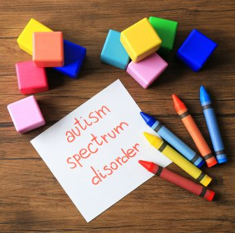
Autistic spectrum disorder
Rama bitoni
Doaa jarajrh

Slide 2
Autism spectrum disorder :
Autism
Asperger’s disorder
Childhood disintegrative disorder
Pervasive developmental disorder – not otherwise specified
Rett’s syndrome

Slide 3
A s d :
Deficit in social interaction and communication
Restricted and repetitive behaviors
ASD

Slide 4
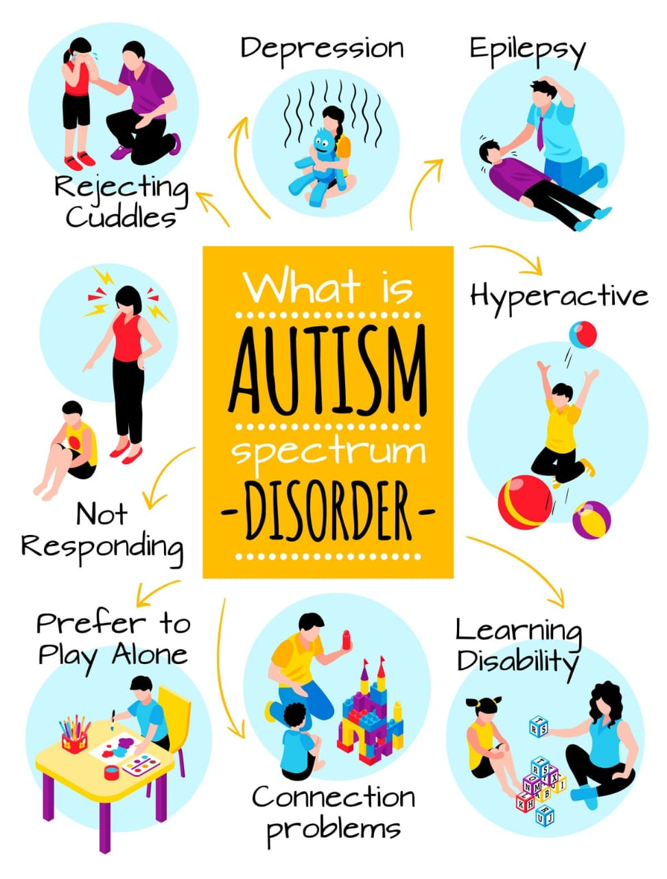
Epidemiology
● The 4:1 ratio of diagnosis in males: females.
● Symptoms typically recognized between 12 and 24 months old, but varies based on severity.

Slide 5
etiology
Etiology of ASD is multifactorial :
Prenatal neurological insults (e.g., infections, drugs)
advanced paternal age, and low birth weight.
Association with epilepsy.

Slide 6
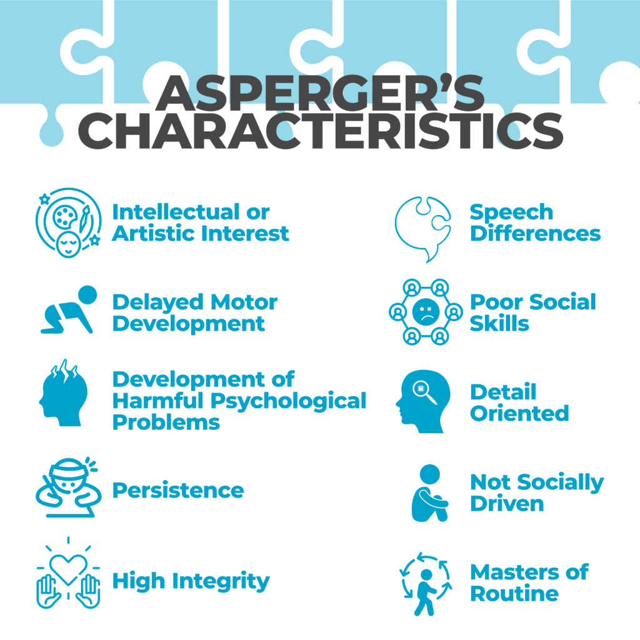
Asperger syndrome ( AS)
Also known : schizoid disorder of childhood , level 1 autism spectrum disorder .
Usual onset : before two years old with long term duration
Causes : poorly understood .
Has high heritability , environmental factors play a role .
It is neurodevelopmental disorder characterized by significant difficulties in social interaction and non-verbal communication , along with restricted and repetitive patterns of behavior and interest .
Differs ftom other forms of ASD by relatively unimpaired language and intelligence

Slide 7
Rett syndrome
Rare , non – inherited , postnatal neurological disorder that occurs mainly in girls ( in contrast with autism which primarily happens in males ) .
Slow onset of symptoms , starts around 1-2 years of age ( similar to autism )
Hallmark : regression of cognitive or motor skills .
Clinical manifestations : * deceleration of head growth * loss of purposeful hand skills * gait and motor abnormalities * loss of spoken language * sterotypic hand movement ( hand to mouth licking , grabbing , clothing , hair)

Slide 8
Childhood Disintegrative Disorder ( CDD)
Also known as HELLERS SYNDROME and DISINTEGRATIVE PSYCHOSIS .
Rare condition characterized by late onset of developmental delays or sever and sudden reversals in language , social function and motor skills .
Usual onset 3 – 4 years of age .
Causes of CDD is unknown CDD has some similarity to autism and considered low functioning form of it
Treatment involves both behavior , environmental therapy and medication .
S and S : between the ages of two and ten skills acquired are lost almost completely in at least two of the follwing six functional areas : * expressive language skills * social skills and self care skills * control over bowel and bladder * motor skills * plays skills lack of normal function also occurs in two of the folowing areas : * social interaction * communication * repattive behavior and interest patterns

Slide 9
Pervasive developmental disorder

Slide 13
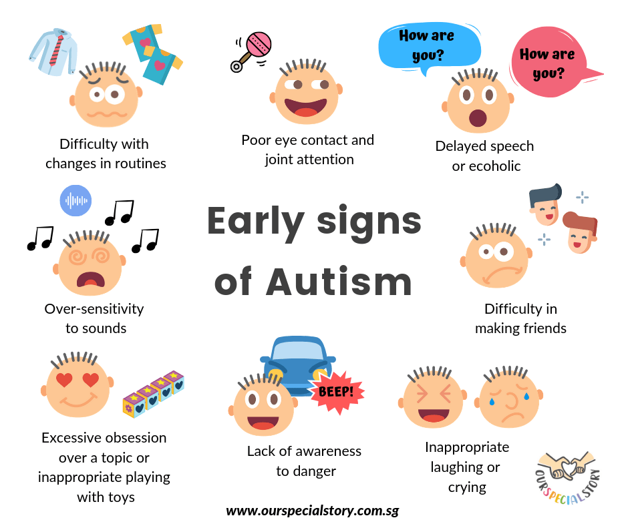
Dsm 5
A . Problems with social interaction and communication:
1)Impaired social/emotional reciprocity (e.g., inability to hold conversations).
2)Deficits in nonverbal communication skills (e.g., decreased eye contact).
3)Interpersonal/relational challenges (e.g., lack of interest in peers).
B. Restricted, repetitive patterns of behavior, interests, and activities:
4)Intense, peculiar interests (e.g., preoccupation with unusual objects).
5)Inflexible adherence to rituals (e.g., rigid thought patterns).
6)Stereotyped, repetitive motor mannerisms (e.g., hand flapping).
7)Hyperreactivity/hyporeactivity to sensory input (e.g., hypersensitive to particular textures).

Slide 14
C. Symptoms must be present in the early developmental period (but may not become
fully manifest until social demands exceed limited capacities, or may be masked by
learned strategies in later life).
D. Symptoms cause clinically significant impairment in social, occupational, or other
important areas of current functioning.
E. These disturbances are not better explained by intellectual disability (intellectual
developmental disorder) or global developmental delay. Intellectual disability and
autism spectrum disorder frequently co-occur; to

Slide 15
Associated Behavioral Symptoms that May Occur in Autism Spectrum Disorder
Disturbances in Language Development and Usage : no longer considered a core feature of autism spectrum disorder , Language deviance, as much as language delay , difficulty putting meaningful sentences together, even when they have extensive vocabularies.
intellectual Disability.
Irritability.
Instability of Mood and Affect.
Response to Sensory Stimuli.
Hyperactivity and Inattention.
Precocious Skills.
Insomnia.
Minor Infections and Gastrointestinal Symptoms.

Slide 17
prognosis
ASD is a chronic condition . The prognosis is variable,
but the two most important predictors of adult outcome
are level of intellectual functioning and language impairment.
Only a minority of patients can live and work independently
in adulthood.

Slide 18
Treatment
There is no cure for autism, but various treatments are used to help manage symptoms and improve basic social, communicative, and cognitive skills:
1) Early and Intensive Behavioral Intervention (EIBI)
2) Social Skills Training.
3) Behavioral therapy.
4) Cognitive-Behavioral Therapy
5)Low-dose atypical antipsychotic medications (e.g., risperidone, aripiprazole) may help reduce disruptive behavior, aggression, and irritability.

