Slide 1
Neuro Reporting
2022-2023

Slide 2
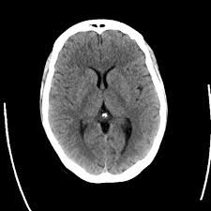
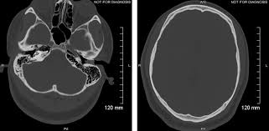
NORMAL BRAIN CT SCAN REPORT
NO FOCAL BRAIN LESION
CENTRAL MIDLINE STRUCTURES ( NO MIDLINE SHIFT),
NO MASS EFFECT
NORMAL VENTRICULAR SYSTEM
( NO HYDROCEPHALUS)
NO FRACTURE OR BONY LESION

Slide 3
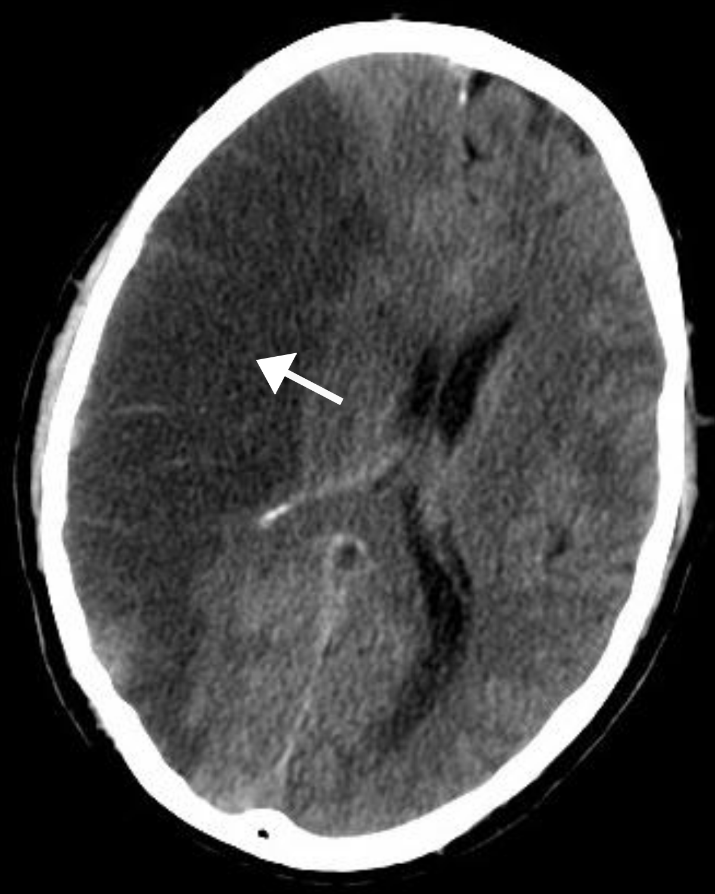
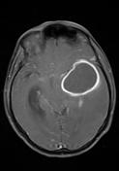
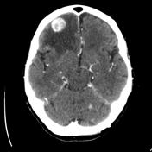
FOCAL BRAIN LESION
ANY FOCAL PATHOLOGY IN THE BRAIN IS CONSIDERED FOCAL LESION
ISCHEMIA , HEMORRHAGE, TUMOUR, ABCESS,…….
ISCHEMIA
ABCESS
HEMORRHAGIC METS

Slide 4
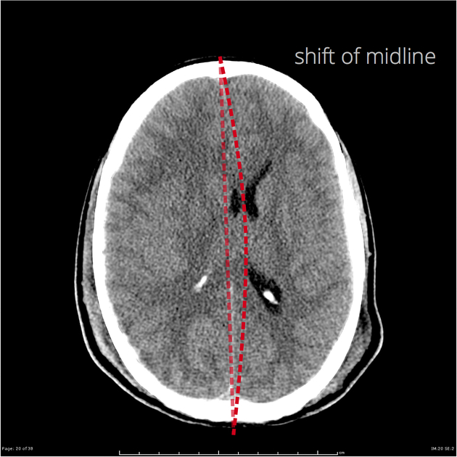
MIDLINE SHIFT midline structures should be in the midline if they are not, pathology may be causing displacement
midline structures
falx cerebri
septum pellucidum
3rd ventricle
interpeduncular cistern
4th ventricle

Slide 5
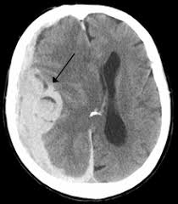
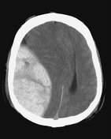
MASS EFECT
Intracranial mass effect describes what happens around a focal lesion like tumor in the brain. It is important to make the distinction between an abnormality that causes mass effect and compresses adjacent structures, and one that does not. Most tumors will cause mass effect on surrounding structures and in turn cause midline shift or hydrocephalus

Slide 6
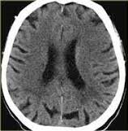
NORMAL VENTRICULAR SYSTEM
NORMAL VENTRICLE
DILATED VENTRICULAR SYSTEM (HYDROCEPHALUS)

