Slide 1
Restriction enzymes

Slide 3
Restriction enzymes have the following important characteristics :
1-Most restriction enzymes recognize a single restriction site:
4-8 Bp
palindromic
2- The restriction site is recognized without regard to the source of the DNA.
3- Mapping of DNA molecules .

Slide 4
blunt end
sticky end

Slide 6
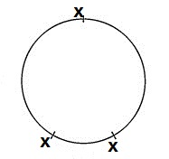
number of fragments produced by restriction enzymes (n) :
Restriction site (x) :
-circular : ( n = x )
Linear : (n = x + 1 )

Slide 7
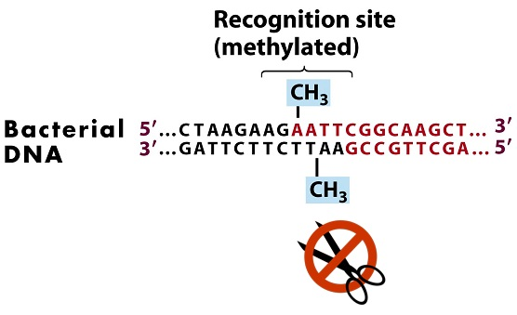
Restriction modification system
What prevents these enzymes from cutting up the host DNA ?

Slide 8
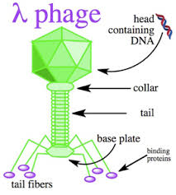
What is lambda phage ?
-It is a bacterial virus or bacteriophage ,that infects the bacterial species Escherichia coli .
-The size of lambda DNA is 48502 bp.
-PstI
- EcoRI
- HindIII

Slide 9
