Slide 1
IV Fluids
Anas shwawreh
Mahdi abu aloush
Ahmad Aboud
Mohammad AL-Qudah

Slide 2
IV Fluids

Slide 3
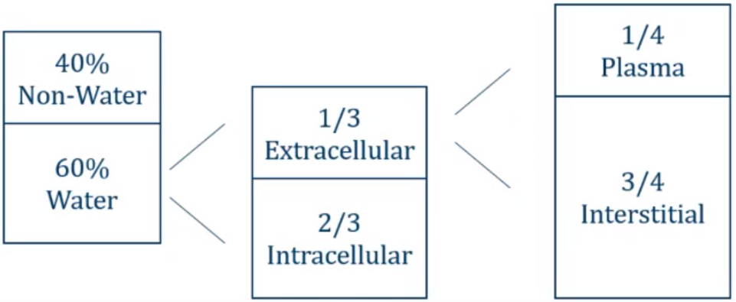
Fluid compartments

Slide 4
Fluid Intake and Output
• Normal oral intake ~2 L/day • Output: • Urine: 1.0 L/day • Insensible losses: • Stool: 0.25 L/day • respiration, sweating: 0.75 L/day •Insensible losses: pathologic states • Fever • Burns
Notes:
Insensible fluid loss is the amount of body fluid lost daily that is not easily measured, from the respiratory system, skin, and water in the excreted stool.

Slide 5
IV fluid therapy indications
• IV fluid therapy is used to maintain homeostasis when: • intake is insufficient • to replace any additional losses.
• These losses may occur from: GIT (due to severe vomiting, diarrhoea), urinary tract (eg, diabetes insipidus), blood loss from trauma or surgery. In addition, insensible losses can increase during fever or after suffering from burns because the barrier function of the skin is impaired.

Slide 6
Types of IV fluids
Crystalloid solutions
Colloid solutions
• Contain water and salts
• Examples: • Normal saline • Lactated ringers • half normal saline • D5W • Hypertonic saline.
•infusion : fluid loss ratio = 1:1
•infusion : blood loss ratio = 4:1 5:1
• Contain water and large molecules
• Mainly remains in the intravascular compartment.
• used for resuscitation in severe hypovolemia , blood loss and burns.
• Examples: albumin, gelatin, dextran solutions, hydroxyethyl starches
• Expensive
• infusion : blood loss ratio = 1:1
Notes:
Fluid losses (urine and insensible perspiration) are replaced in a 1:1 ratio with a balanced crystalloid infusion solution. Additionally, intravascular blood loss must be replaced in a 4–5:1 ratio.

Slide 7
osmolarity
Osmosis: simple diffusion of water from high conc of water to low conc of water across semi permeable membrane.
Osmolarity of solution is equal to number of osmoles per liter of solution.
Normal range of osmolarity in plasma is about 280-295 milli-osmoles per liter.
Tonicity is the total conc. of solutes which make an osmotic force across a membrane.
The term tonicity is used to describe the osmolarity of a solution relative to plasma. • Isotonic (osmolarity of a solution ~ to plasma) • hypertonic (osmolarity of a solution > to plasma) • hypotonic (osmolarity of a solution < to plasma)
ECF
ICF
Notes:
the osmolality of the extracellular fluid (ECF) is approximately equal to that of the intracellular fluid (ICF).
Osmole: the osmosis caused by a mole.

Slide 8
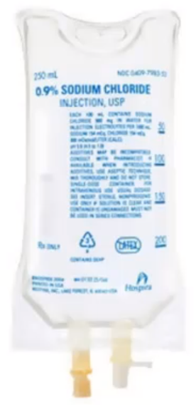
Normal Saline
0.9% Normal Saline
• Approximately same osmolarity as plasma • [Na] = [Cl] = 154 mmol/liter • total osmolarity = 308 mOsmol/liter vs. 285 m0sm/L plasma
• Normal saline is isotonic
• 25% remains in intravascular space
•Used for volume replacement • Hypovolemic shock • Septic shock

Slide 9
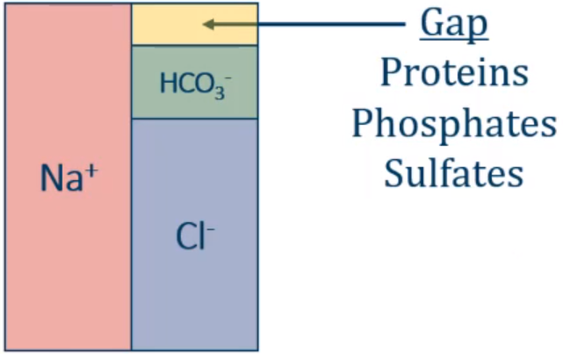
Normal Saline
cell
H+
K+
0.9% Normal Saline
• Normal Saline Results in influx of chloride ions (Cl)
• Causes shift of bicarbonate ions (HCO3) into cells
• Causes acidosis ( pH)
• Acidosis → potassium shift out of cells
• ↑ serum potassium
• “Hyperchloremic metabolic acidosis”
• C/O: CHF, CKD, Liver cirrhosis
Notes:
Hyperchloremic metabolic acidosis

Slide 10
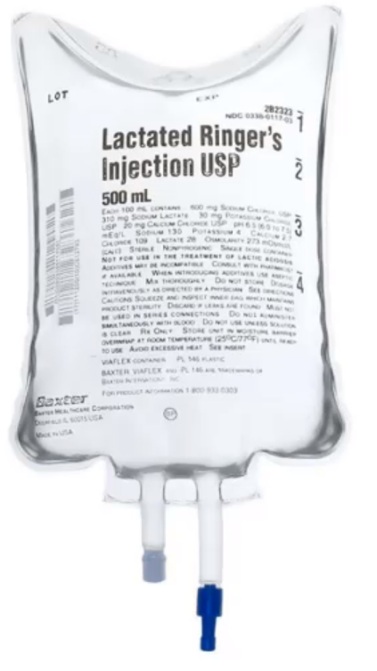
Lactated Ringers
• Sodium, chloride, potassium, calcium, and lactate.
• "Balanced fluid"
• Isotonic: osmolarity 286 mOsm/L
• 25% remains in intravascular space
• Lactate metabolized to bicarbonate
• Acts as buffer in acidotic states
• Most common use: trauma resuscitation

Slide 11
Indications & Contraindications
First-line replacement therapy in the perioperative period.
Fluid resuscitation after a blood loss due to trauma, surgery, or a burn injury.
Replace GI tract fluid losses.
Metabolic acidosis.
Poor liver function. (affect lactate metabolism → Lactic acidosis )
Hyperalkalosis
Citrated blood transfusions (Clumping of red cells if it is co-administered with blood products)
Notes:
Citrate is the anticoagulant used in blood products. It is usually rapidly metabolised by the liver.

Slide 12
Half Normal Saline
0.45% Normal Saline
• [Na] = [Cl] = 77 mmol/liter
• total osmolarity = 154 mOsmol/liter vs. 285 m0sm/L plasma
• Hypotonic solution concentration of sodium chloride
• Does not remain intravascular
• Used as "maintenance fluids"
• Replaces daily losses of sodium and water
• 5% dextrose often added: D5 half NS
• Potassium can be added: D5 half NS with 20mEq K
• Often used when oral intake is low

Slide 13
D5W
5% Dextrose
• IV fluid that contains Dextrose and free water.
• Dextrose is metabolized leaving only free water
• Used to correct hypernatremia to dilute sodium.
Notes:
Dextrose is not considered to have an osmotic effect because it is rapidly metabolized in blood

Slide 14
Hypertonic Saline
3% Saline
• Hypertonic: ~900 mOsm/liter
• Draws fluid out of tissues into vascular space
• ICF ECF
• Used in two circumstances: • Elevated intracerebral pressure • Severe hyponatremia

Slide 15
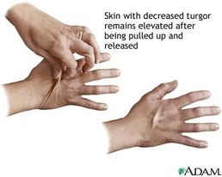
Hypovolemia
• Many causes: • Vomiting/diarrhea • Poor oral intake • Third spacing/fluid leak: sepsis, trauma
• Clinical features: • Decreased urine output • Dry mucous membranes • Poor skin turgor Hypotension
• Treatment: oral intake, IV fluids

Slide 16
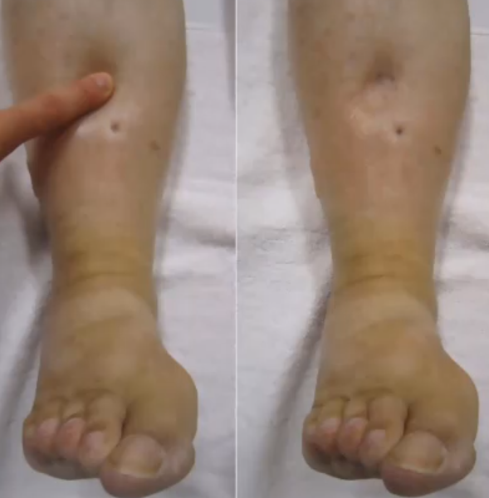
Hypervolemia
• Classic causes • Heart failure • Cirrhosis • Nephrotic syndrome
• Clinical features: • Weight gain • Pitting edema • Elevated jugular venous pressure • Pulmonary edema
• Treatment: diuretics

Slide 17
Maintenance of Fluids
(4-2-1 rule)
(4ml/kg for the first 10kg) + (2ml/kg for kg 11-20) + (1ml/kg for every kg above 20) = hourly rate
* Example: Calculate the hourly maintenance fluid rate for a child who weighs 25kg
(4ml x 10kg) + (2ml x 10kg) + (1ml x 5kg) = hourly rate
40ml + 20ml + 5ml = 65ml/hr
Maintenance of electrolytes
Na+: 3 mEq/kg/day, K+ : 1 mEq/kg/day
e.g. 50 kg patient maintenance requirements
• fluid = 40 + 20 + 30 = 90 mL/hour = 2160 mL/day
• Na+ = 150 mEq/day
• K+ = 50 mEq/day

Slide 18
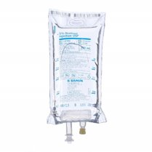
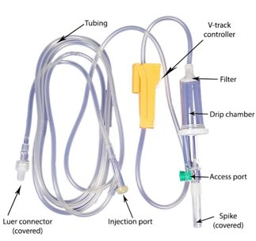
Equipment of I.V. therapy
I. Solution containers.
II. I.V. administration sets.

Slide 19
IV CANNULA
Present day IV cannula are available from sizes 14 gauge to 26 gauge with universal color coding for easy recognition of IV cannula. Smaller the gauge, wider is the cannula and has higher flow rate.
Normal adult size: 18-20 G
Situations requiring rapid fluid transfusion like trauma: 14-16 G
Preferred pediatric size: 22 G
Infants and neonates: 24-26 G
+pink is most commonly used

Slide 20
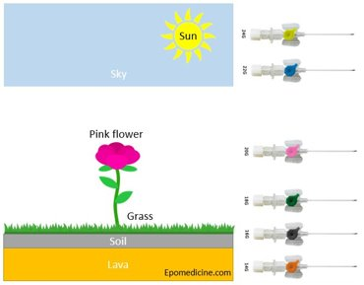
The earth has magma inside (orange color) – 14 G
There is soil on surface (grey color) – 16 G
Grass has grown on the soil (green color) – 18 G
Pink flower has grown above the grass (pink color) – 20 G
Above is the blue sky (blue color) – 22 G
The sun is in the sky (yellow color) – 24 G

Slide 21
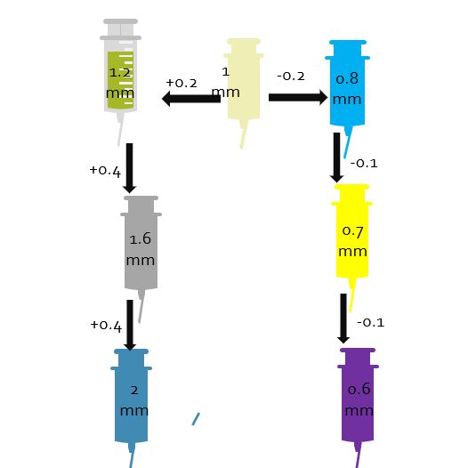
External diameter of cannula :
Remember the pink (20 G) cannula is 1 mm in diameter. For cannula next to pink: 1 +/- 0.2 mm
18 G (green): 1.2 mm
22 G (blue): 0.8 mm
For cannula smaller “gauze” than 18 G:
16 G (grey): 1.2 + 0.4 = 1.6 mm
14 G (orange):1.6 + 0.4 = 2 mm
For cannula larger than 22 G:
24 G (yellow): 0.8 – 0.1 = 0.7 mm
26 G (purple): 0.7 – 0.1 = 0.6 mm

Slide 22
