Slide 1
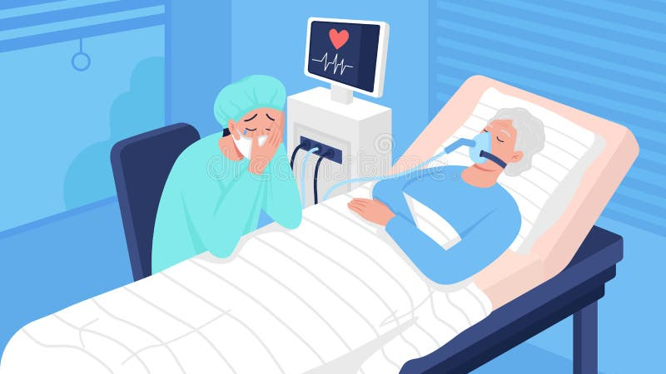
Coma, vegetative state, locked in syndrome, stupor
Presented by: Raghad Amr

Slide 2
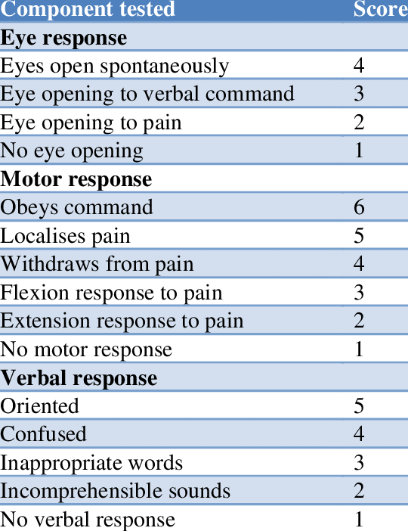
GCS is a reliable objective way for recording the conscious state of the patient.
• Severe injury, GCS ≤8 (Patient most likely comatose. In this case we may consider airway protection)
• Moderate injury, GCS 9–12
• Minor injury, GCS 13–15

Slide 3
Definition
Coma is defined as a persisting state of deep unconsciousness, it results from sustained impairment of awareness of self and of the environment (Unarousable unresponsiveness).
It is estimated as a sustained GCS of 8 or less.
Causes are classified into two categories:
1. Neurologic vs. Non-Neurologic
2. Focal Lesions vs. Diffused

Slide 4
Causes
Metabolic (non-neurologic) :
• Drugs, poisoning, e.g., carbon monoxide, alcohol, tricyclics.
• Hypoglycaemia, hyperglycaemia (ketoacidotic, or HONK).
• Hypoxia, CO2 narcosis (COPD).
• Septicaemia.
• Hypothermia.
• Myxoedema, Addisonian crisis.
• Hepatic/uraemic encephalopathy.

Slide 5
Causes cont.
Neurological:
• Trauma.
• Infection: meningitis, encephalitis, malaria, typhoid, typhus, rabies, trypanosomiasis.
• Tumour: primary or secondary.
• Vascular: stroke, subdural, subarachnoid, hypertensive encephalopathy.
• Epilepsy: non-convulsive status or post-ictal state.

Slide 6
Focal structural lesions
Infratentorial (directly involving the brainstem) (e.g., trauma, infarction, haemorrhage, tumour, demyelination).
Supratentorial (compressing the brainstem) (similar causes, but particularly affecting the right cerebral hemisphere).

Slide 7
Diffused
Decreased availability of substances required for normal brain metabolism (hypoxia, hypoglycaemia),
Metabolic disorders (e.g., renal and liver failure, hypothermia, vitamin deficiencies),
Epilepsy (interfering with the normal electrical activity of the brainstem)
Inflammation of the brain or its coverings (encephalitis, meningitis),
Drugs and toxins (opiates, antidepressants, hypnotics, alcohol).

Slide 8
This is aimed at locating the pathology, as it implies either:
1) Damage to the ascending reticular activating system (ARAS) located throughout the brainstem from the medulla to the thalami (usually producing loss of arousal with unassessable awareness). The brainstem can be affected directly (e.g., pontine haemorrhage) or indirectly (e.g., compression from transtentorial or cerebellar herniation secondary to a mass or oedema).
2) Diffuse, bilateral, cortical dysfunction (usually producing loss of awareness with normal arousal).

Slide 9
Approach
Examination:
• Vital signs (HR, RR, BP, Temperature).
• Signs of trauma.
• Stigmata of other illnesses: liver disease, alcoholism, diabetes, myxoedema.
• Skin: needle marks, cyanosis, pallor, rash (meningitis; typhus), poor turgor.
• Smell the breath (alcohol, hepatic fetor, ketosis, uraemia).
• Opisthotonus ≈meningitis or tetanus. Decerebrate/decorticate.
• Meningism; but do not move neck unless cervical spine is cleared.
• Pupils: size, reactivity, gaze.
• Heart/lung exam: BP, murmurs, rubs, wheeze, consolidation, collapse.
• Abdomen/rectal for organomegaly, ascites, bruising, peritonism, melaena.
• Foci of infection (abscesses, bites, middle ear infection).
• Features of meningitis: neck stiffness, rash, focal neurology, etc.
• Note the absence of signs, (e.g., no pin-point pupils in a known heroin addict).

Slide 10
Approach cont.
Quick history From family, ambulance staff, bystanders:
- abrupt or gradual onset?
- How is the patient found; suicide note, seizure?
- If injured, suspect cervical spinal injury and do not move spine.
- Recent complaints; headache, fever, vertigo, depression?
- Recent medical history; sinusitis, otitis, neurosurgery, ENT procedure?
- Past medical history; diabetes, asthma, hypertension, cancer, epilepsy, psychiatric illness?
- Drug or toxin exposure (especially alcohol or other recreational drugs)?
- Any travel?

Slide 11
Investigation
Head CT
CXR
Cervical Spine X-Ray
EEG
Lumbar Puncture (LP)
ECG
Blood chemistry (CBC, TFT, LFT, U&E, creatinine, urinalysis, glucose, toxicology screening)

Slide 12
Management
Immediate management:
• Assess Airway, Breathing, and Circulation.
• Consider intubation if GCS <8 or initiate artificial airway when necessary .
• Support the circulation if required (I.e., IV fl uids).
• Give O2 and treat any seizures.
• Protect the cervical spine, unless trauma is known not to be the cause.
• Treat Hypoglycemia if present, with glucose IV.
• IV thiamine if any suggestion of Wernicke’s encephalopathy.
• IV naloxone for opiate intoxication (may also be given IM or via ET tube);
• IV flumazenil for benzodiazepine intoxication, only if airway compromised.

Slide 13
If the diagnosis is unclear
• Treat the treatable: O2, naloxone, glucose, Pabrinex® IV (contains Thiamine) for Wernicke’s encephalopathy.
• Septic specifics: cefotaxime for meningitis, artemether/quinine for malaria, aciclovir for encephalitis.
• Do routine biochemistry, haematology, thick films, blood cultures, blood ethanol, drug screening, etc.
• Arrange urgent CT head scan; if normal, proceed to LP if no Contra-indications.
N.B.
Detailed neurological examination of the eyes and limbs may help localize the site of brain damage; as it is usually in the cerebral cortex bilaterally, the thalamus, or the brain stem.
High BP and low HR may indicate elevated ICP.

Slide 15
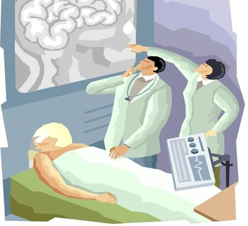
Vegetative state
A vegetative state, or unaware and unresponsive state, is a specific neurological diagnosis in which a person has a functioning brain stem but no consciousness or cognitive function.

Slide 16
What are the symptoms?
A person in an unaware and unresponsive state has experienced injury to the brain. They have no cognitive function, or ability to think. But since their brain stem is still functioning, the person may:
regulate breathing and heart rate without assistance
open their eyes
have a sleep-wake cycle
have basic reflexes
move their eyes, blink, or tear up
moan, grunt, or appear to smile
They’re not able to:
follow objects with their eyes
respond to voices or verbal commands
speak or communicate through blinking or gesturing
move with purpose
interact with their surroundings
show signs of emotion
show signs of awareness

Slide 17
Difference between vegetative state and other conditions
Minimally conscious state. The person alternates between awareness and lack of awareness.
Coma. The person is not awake or aware.
Brain death. Damage to the brain and brain stem are categorically irreversible.
Locked-in syndrome. The person is conscious and fully aware but fully paralyzed and unable to speak.

Slide 18
How is this state diagnosed?
Diagnosis of an unaware and unresponsive state requires:
presence of a sleep-wake cycle
no language expression or comprehension
no evidence of sustained, reproducible, purposeful, or voluntary response to stimulation of sight, sound, smell, or touch
a functioning brain stem
Some of this information will come from direct observation by a neurologist.
A neurologist may also use diagnostic testing to confirm the diagnosis. These tests may include:
EEG (electroencephalogram) to evaluate electrical activity in the brain
CT or MRI scan to help assess damage to the brain and brain stem
PET scan to help assess cerebral function

Slide 19
Is there a treatment?
There’s no real treatment. Rather, the focus is supportive care so the brain can heal. The person will be carefully monitored for changes or signs of improvement.
In addition, doctors will take steps to prevent potential complications, such as:
infection
pneumonia
respiratory failure
Supportive care may involve:
a feeding tube to provide nutrients
changing positions on a regular basis to avoid pressure sores
physical therapy to gently exercise the joints
skin care
oral care
management of bowel and bladder functions

Slide 20
Locked-in Syndrome
Locked-in syndrome is a state of wakefulness and awareness with quadriplegia and paralysis of the lower cranial nerves, resulting in inability to show facial expression, move, speak, or communicate, except by coded eye movements.
Locked-in syndrome typically results from a stroke (pontine hemorrhage or infarct) that causes quadriplegia and disrupts and damages the lower cranial nerves and the centers that control horizontal gaze. Other disorders that result in severe widespread motor paralysis (eg, Guillain-Barré syndrome) and cancers that involve the posterior fossa and the pons are less common causes.
Locked-in syndrome can also result from infection, tumors, toxins, trauma, arteriovenous malformations, and opioid use

Slide 21
What are the symptoms?
Patients with locked-in syndrome have
intact cognitive function
awake, with eye opening and normal sleep-wake cycles.
can hear and see.
However:
cannot move their lower face, chew, swallow, speak, breathe, move their limbs, or move their eyes laterally.
Vertical eye movement is possible.
patients can open and close their eyes or blink a specific number of times to answer questions.

Slide 22
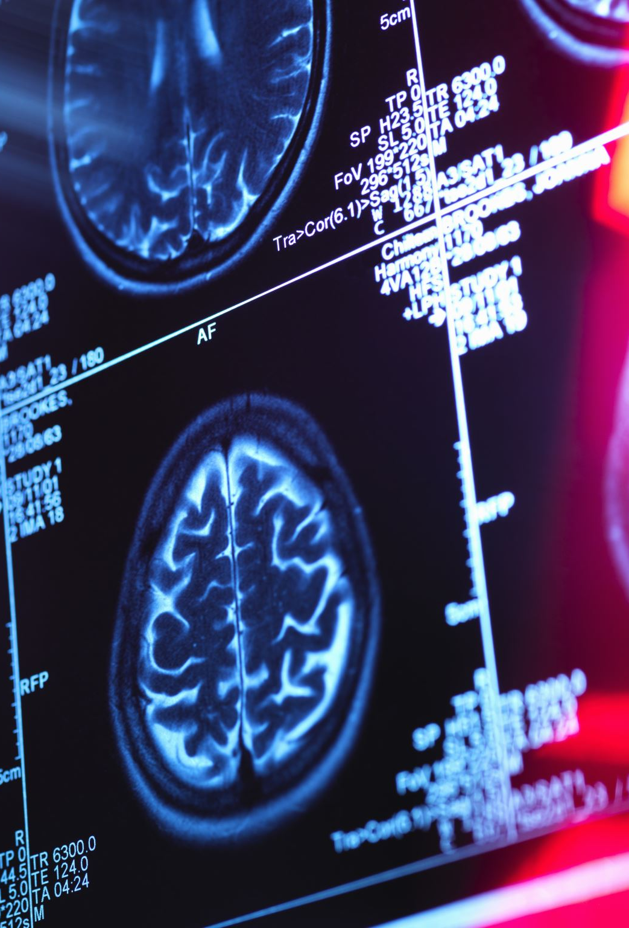
How is this state diagnosed?
Clinical evaluation
Diagnosis of locked-in syndrome is primarily clinical. Because patients lack the motor responses (eg, withdrawal from painful stimuli) usually used to measure responsiveness, they may be mistakenly thought to be unconscious. Thus, all patients who cannot move should have their comprehension tested by requesting eye blinking or vertical eye movements.
As in vegetative state , neuroimaging is indicated to rule out treatable disorders. Brain imaging with CT or MRI is done and helps identify the pontine abnormality. Positron emission tomography (PET), single-photon emission computed tomography (SPECT), or functional MRI may be done to further assess cerebral function if the diagnosis is in doubt.
In patients with locked-in syndrome, electroencephalography (EEG) shows normal sleep-wake patterns.

Slide 23
Is there a treatment?
Supportive care
Communication training
Supportive care is the mainstay of treatment for patients with locked-in syndrome and should include the following:
Preventing systemic complications due to immobilization (eg, pneumonia, urinary tract infection, thromboembolic disease)
Providing good nutrition
Preventing pressure ulcers
Providing physical therapy to prevent limb contractures
There is no specific treatment for locked-in syndrome.

Slide 24
Stupor
Stupor can be a serious mental state where people don’t respond to normal conversation. Instead, they respond only to physical stimulation, such as to pain or rubbing on their chest, which is known as a sternal rub.

Slide 25
What Are the Symptoms of Stupor?
Someone experiencing stupor can be aroused or woken up with vigorous stimulation. They may be considered unconscious but may respond somewhat to stimuli. This is different from someone in a coma because people in a coma can’t be woken up or aroused at all.
Stupor can cause the following physical symptoms in addition to mental symptoms:
abnormal breathing, such as breathing too slow or fast
muscles contracted in abnormal ways
pupils that are wider or smaller than normal
pupils that don’t react or change with exposure to light
There can be other, disease-specific symptoms associated with stupor as well.

Slide 26
What Are the Causes of Stupor?
There are many causes of stupor, most of which are severe diseases. Examples of possible causes of stupor include:
alcohol intoxication
brain aneurysm
brain tumor
carbon monoxide poisoning
cardiac arrest
delirium
dementia
drug overdose
encephalitis (brain infection)
head injury
hyperglycemia
hypernatremia
hyperthermia
hyperthyroidism
hypoglycemia
hyponatremia
hypothermia
hypothyroidism
hypoxia or lack of oxygen
kidney failure
liver failure
meningitis
respiratory arrest
seizure
sepsis, a serious bloodstream infection
stroke

Slide 27
How Is Stupor Diagnosed?
Someone with stupor is unable to provide a medical history. If an eyewitness is available, a doctor may ask about their symptoms or any relevant medical history, if available.
The next step is to do a physical examination of the person. This includes taking vital signs, such as:
heart rate
respirations
blood pressure
temperature
oxygen saturation
Each of these can provide important information if the problem is related to the lungs or heart.
The doctor will evaluate how the person is breathing and any visible injuries that could be causing stupor. This includes head injuries as well as signs of bleeding on the body. The person’s posture or body positioning could also indicate stroke.
A neurological or brain examination is next. This can include testing the person’s reflexes, include pupil reflexes and light movements. The doctor may provide stimuli, including noise, pressure on the fingernails, or a sternal rub, to test their response.

Slide 28
How Is Stupor Treated?
How someone is treated for stupor depends on the underlying cause or causes.

