Slide 1
ENDEMIC DISEASES
Ansam Alzubaidi Mona Alzoubi Raghad Wasfi
Amal Abdallah Aseel Jamal Mai Bani atta

Slide 2
What is the endemic diseases ?
A disease outbreak is endemic when it is consistently present but limited to a particular region. This makes the disease spread and rates predictable
“constant rate of infection”

Slide 3
WHAT’S THE DIFFERENCE?

Slide 4
The disease is a presets in a community at all times but in relatedly low frequency
The sudden and rapid spread of an infectious disease within a short period of time affecting a large number of people within a region or a group .
The phenomenon when an epidemic becomes very widespread and affects the entire world.

Slide 5
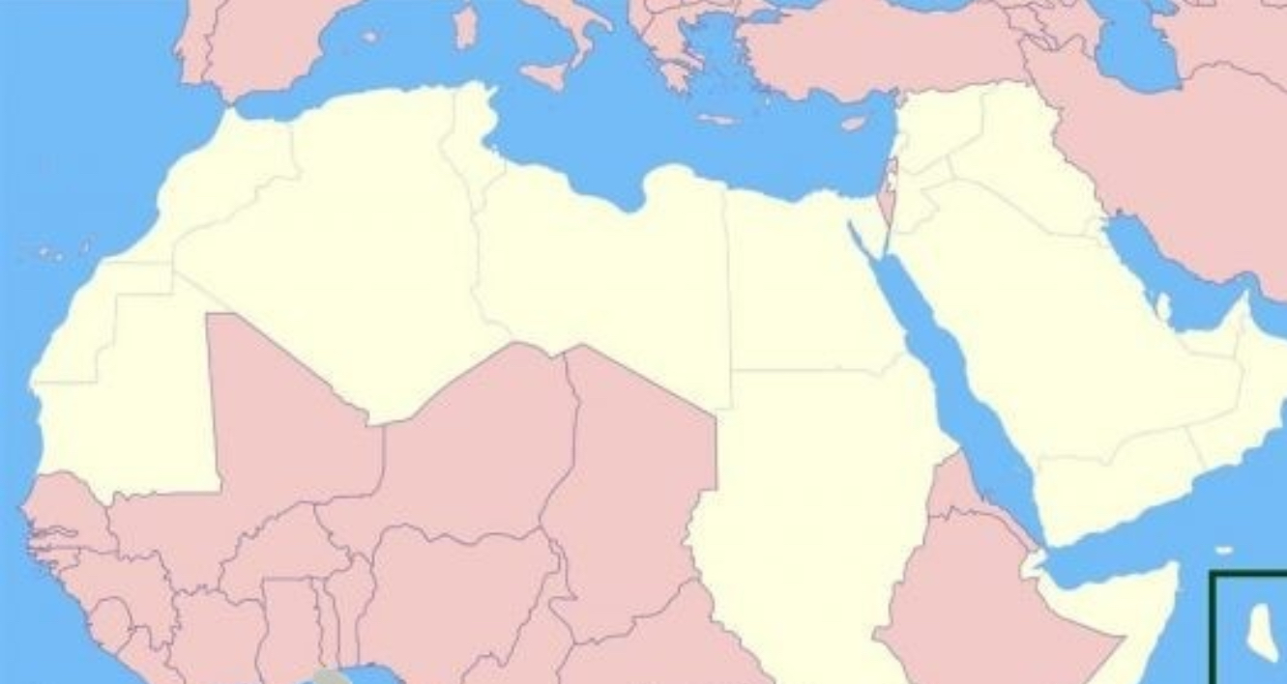
WHAT ABOUT OUR COUNTRIES?

Slide 6
Brucellosis | Bacterial
Typhoid fever | Bacterial
INFECTIOUS MONONUCLEOSIS | Viral
leishmaniasis | parasitic

Slide 7
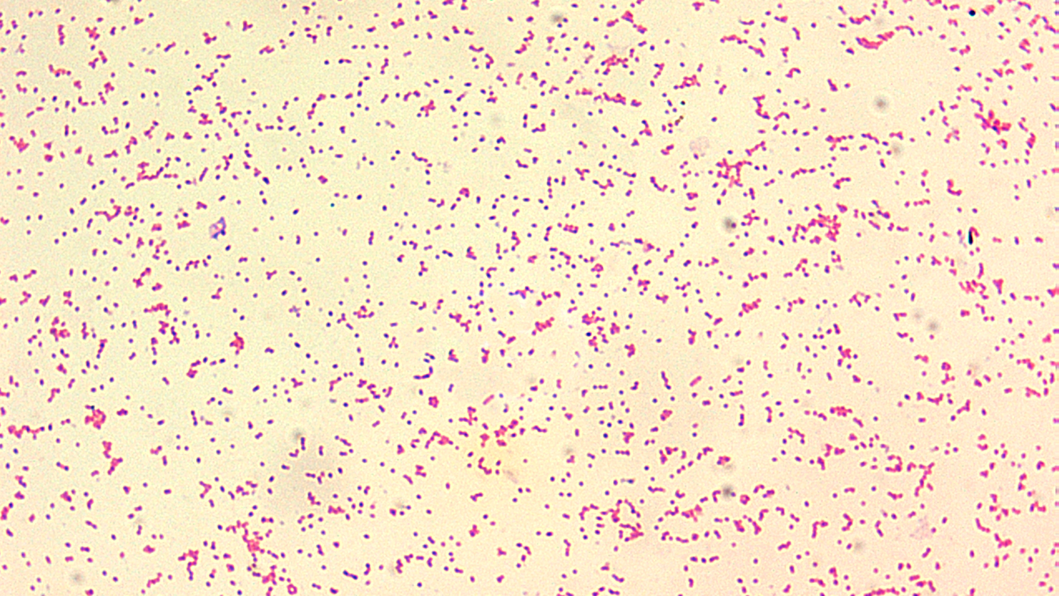
BRUCELLOSIS
Gibraltar or rock fever, Mediterranean fever, Maltese or Malta fever, undulant fever or Cyprus fever

Slide 8
What’s brucellosis?
Bacterial disease, infectious
• Highly contagious zoonotic
• Caused by ingestion of unpasteurized milk
• Undercooked meat from infected animals
• Or also with close contact with infected animal
“Human is a dead end host (accidental)”
“Much of the brucellosis in children is food-borne and is associated with consumption of unpasteurized milk”

Slide 9
EPIDEMIOLOGY
Brucellosis is endemic in many parts of the world
Because of improved sanitation and animal vaccination, brucellosis has become rare in industrialized countries.
• All age-groups can be infected by Brucella, and infections are more common in males, likely because of more frequent occupational and environmental exposures.
•CHILDHOOD BRUCELLOSIS ACCOUNTS FOR 10–30% OF CASE!

Slide 10
MICROBIOLOGY
Species
Gram negative aerobic coccobacillus Facultative, intracellular organism
•non motile , non spores forming , urease and catalase positive
Multiple species Associated with certain hosts • Environmental persistence Withstands drying Temperature, pH, humidity Frozen and dust, soil

Slide 11
Populations at Risk
Occupational disease
• Cattle ranchers/dairy farmers
• Veterinarians
• Abattoir workers
• Meat inspectors
• Lab workers
• Hunters
• Travelers
• Consumers
• Unpasteurized dairy products

Slide 12
Transmission
Ingestion :
Raw milk, unpasteurized dairy products • Rarely through undercooked meat •
Mucous membrane or abraded skin contact with infected tissues •
Animal abortion products:
Vaginal discharge, aborted fetuses, placentas

Slide 13
PATHOPHYSIOLOGY

Slide 15
CLINICAL MANIFESTATIONS

Slide 16
Brucellosis is a systemic illness that can be very difficult to diagnose in children without a history of animal or food exposure.
Symptoms can be acute or insidious in nature and are usually nonspecific, beginning 2–4 wk.
Although the clinical manifestations do vary, the classic triad of fever, arthralgia/arthritis, and hepatosplenomegaly can be demonstrated in most patients.
Fever is present in >75% of cases , The fever pattern can vary widely (38-40 ) comes in wave
A common symptoms in children are:
•Refusal to eat •Lassitude. •Failure to thrive.

Slide 17
Bones and joints frequently are involved, with the sacroiliac joint as well as the hips, knees, and ankles being the most common in children.
•Although headache, mental inattention, and depression may be demonstrated in patients with brucellosis, invasion of the nervous system occurs in only about 1% of cases.

Slide 19
Diagnosis
History: history of unpasteurized milk or diary products ingestion.
PE: classic triad ✔️
Routinely tests as CBC may show low or normal WBCs but are not helpful!
A definitive diagnosis is established by Culture: recovering the organisms in the blood, bone marrow, or other tissues

Slide 20
5. In the absence of +ve culture go for Serology:
A- serum agglutination test, B- PCR,
C- Enzyme immunoassay
Serology:
A- Serum agglutination test
•This method does not detect antibodies against B. canis because this organism lacks the smooth lipopolysaccharide.
•Low titers may be found early in the course of the illness, requiring the use of acute and convalescent sera testing to confirm the diagnosis.

Slide 21
False-positive results due to cross-reacting antibodies to other gram-negative organisms such as Yersinia enterocolitica, Francisella tularensis, and Vibrio cholerae can occur.
In addition, the prozone effect can give false-negative results in the presence of high titers of antibody.
-To avoid this issue, serum that is being tested should be diluted to =1:320.
We may also use PCR , enzyme immunoassay (most sensitive method that detect brucella AB)

Slide 22
Congenital brucellosis
Congenital brucellosis occurs using trans-placental transmission due to maternal infection during pregnancy or ingestion of the contaminated maternal secretions during birth and breastfeeding. The diagnosis of brucellosis is made by culture or serology.
It may lead to spontaneous abortion, intrauterine fetal death, or delivery of an infected neonate.

Slide 24
Treatment
IN children above 8 years: Doxycycline is used for 6 weeks (in combination with rifampin)
IN children below 8 years: TMP- SMX for 6 weeks (in combination with rifampin)

Slide 25
How to prevent
Prevention of brucellosis is dependent on effective eradication of the organism from cattle, goats, and swineherds as well as from other animals.
•Pasteurization of milk and diary products for human consumption is an important element of disease prevention in children.
•In endemic areas, immunization and testing are needed in all animals. Public awareness and education play major roles in prevention of the disease.
•Live attenuated vaccine strains are available for B abortus and B melitensis but can cause infection in humans and are not recommended

Slide 26
TYPHOID FEVER
Enteric fever

Slide 27
INTRODUCTION
Typhoid fever is an acute illness associated with fever caused by the Salmonella typhi bacteria. It can also be caused by Salmonella paratyphi, a related bacterium that usually causes a less severe illness.
•Major cause morbidity and mortality.
•Food water borne disease.
The bacteria are deposited in water or food by a human carrier and then spread to other people

Slide 28
Microbiology

Slide 30
EPIDEMIOLOGY
More common in regions where sanitary conditions are poor particularly in Southeast Asia, Africa and Latin America. WHO estimates globally 16 million and 33 million cases annually, with 500 000 to 700 000 deaths • About 70% of all typhoid fever fatalities occur in Southeast Asia • In South Africa, an outbreak occurred in September 2005 in the town of Delmas leading to 3 346 cases of diarrhea, of which 596 were laboratory confirmed as being typhoid cases The last major outbreak of typhoid in South Africa before this one was in 1994 in the same town. There were 5 reported deaths
Population-based studies from South Asia also indicate that the age-specific incidence of typhoid may be highest in children <5 yrs. of age, in association with comparatively higher rates of complications and
hospitalization.

Slide 31
What about the transmission?
Typhoid fever is highly infectious. Transmitted through faeco-oral route.
How Do People Get Typhoid Fever?
•Work in or travel to area where typhoid fever is endemic
•Work as a clinical microbiologist handling Salmonella typhi
bacteria
•Have close contact with someone who is infected or has recently been infected with typhoid fever
•Drink water contaminated by sewage that contains S. typhi

Slide 32
What’s a long-term carrier of typhoid fever?
Some people continue to be contagious with typhoid fever even after they’ve recovered (long-term carrier). You can spread typhoid for a year or more with no symptoms. It’s important to get tested for S. Typhi after you feel better to make sure you can’t spread it to other people.

Slide 33
PATHOPHYSIOLOGY

Slide 36
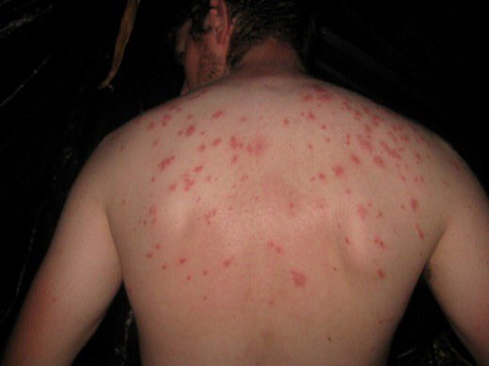
ROSE SPOTS

Slide 37
Paratyphoid fever
The course tends to be shorter and milder than that of typhoid fever and the onset is often more abrupt with acute enteritis. The rash may be more abundant and the intestinal complications less frequent.

Slide 40
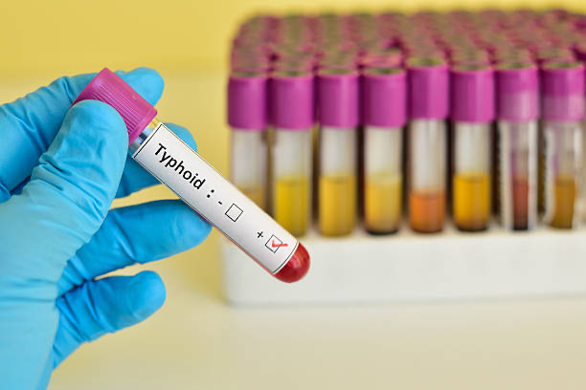
DIAGNOSIS & INVESTIGATION
Blood culture
•Specific serologic test
- Identify Salmonella antibodies / antigens
[ Fluorescent antibody study to look for
substances that are specific to Typhoid bacteria ]
- Widal Test and ELISA
•Urine and Stool Culture (2nd & 3rd week)
•Marrow Culture *
-90% sensitive unless until after 5 days commencement of antibiotic
•Punch-biopsy samples of rose spots Culture
-63% sensitive
•Clot culture

Slide 41
CULTURE MAY BE OBTAINED FROM CSF, PERITONEAL FLUID, MESENTERIC LNS, RESECTED INTESTINE, GALLBLADDER, PHARYNX, TONSILS, ABSCESS, BONE

Slide 43
OTHER NON- SPECIFIC LAB STUDIES
Moderate anemic, increased ESR, thrombocytopenia, lymphopenia
•Slightly elevated PT and aPTT, decreased fibrinogen level
•Liver transaminases & bilirubin – increased 2x normal
•Mild hyponatremia & hypokalemia
•Serum ALT: LDH > 9:1 = viral hepatitis
< 9:1 = typhoid hepatitis

Slide 44
TREATMENT
Activity – rest is helpful
•Medical care
o Antibiotic
o Corticosteroids ( for severe typhoid fever)
o Antipyretics
•Diet - fluid and electrolytes should be monitored. Soft digestible diet is preferable in absence of abdominal distension and ileus
•Surgical care – in cases of intestinal perforation

Slide 45
ANTIBIOTIC
Fluoroquinolone (Drug of choice) – ciprofloxacin (500mg bds)
3rd generation cephalosporin – ceftriaxone, cefotaxime (alternative)
Azithromycin ( 500mg once daily) alternative when fluoroquinolone
resistant is present
Treatment should be continued for 14 days
Chronic carriers were formerly treated for 4 weeks with ciprofloxacin but may require an alternative agent and duration, as guided by antimicrobial sensitivity testing.
•Cholecystectomy may be necessary.

Slide 46
Prognosis
Appearance of complications.
● Infants and children with underlying malnutrition and those infected with multi drug-resistant isolates are at higher risk for adverse outcomes.
●Despite appropriate therapy, 2–4% of infected children may relapse after initial clinical response to treatment.
●Individuals who excrete S. Typhi for ≥3 mo after infection are regarded as chronic carriers.
The prognosis for a patient with enteric fever depends on :
- The rapidity of diagnosis
- Institution of appropriate antibiotic therapy.
- General state of health and nutrition,
- Causative Salmonella serotype,

Slide 47
INFECTIOUS MONONUCLEOSIS (GLANDULAR FEVER) (KISSING DISEASE)

Slide 48
OVERVIEW
Mononucleosis is an illness that commonly affects teenagers and young adults, but can affect children as well. Viruses, most commonly Epstein-Barr Virus (EBV), and certain infections cause the illness. Mono is sometimes called “the kissing disease” because it spreads easily through bodily fluids like saliva.
The EBV virus, a DNA virus of the herpes virus family, is transmitted in oral secretions by close intimate contact
For most people, mono isn’t serious, and it improves without treatment. Still, extreme fatigue, body aches and other symptoms can interfere with school, work and daily life. With mono, you might feel sick for about a month.
Originally described as glandular fever, it derives its name from the mononuclear lymphocytosis with atypical-appearing lymphocytes that accompany the illness.

Slide 49
Epidemiology and transmission
EBV infects >95% of the world's population.
The epidemiology is related to the age of primary acquisition of EBV infection. In developing countries, most of EBV infection occurs in infancy and early childhood, when it is either asymptomatic or similar to other childhood infections. In developed countries, the age of acquisition of EBV infection shifts upwards and thus the illness is seen more commonly.
Mono is contagious. It spreads from person to person through contact with saliva (spit). It's nicknamed "the kissing disease" because it can spread through kissing. It also spreads through coughing and sneezing, or when people share something with spit on it (like a straw, drinking glass, eating utensil, or toothbrush).
Mono can also spread through sex or blood transfusions, but this is much less common. Among children, transmission occur by exchange of saliva from child to child

Slide 50
Primary infection with EBV during childhood is usually asymptomatic or mild and indistinguishable from other childhood infections.
Primary EBV infection in adolescents and adults manifests in 30–50% of cases as the classic triad of fatigue, pharyngitis, and generalized lymphadenopathy , which constitute the major clinical manifestations of infectious mononucleosis.
So this syndrome may be seen at all ages but is rarely apparent in children younger than 4 yr of age, when most EBV infections are asymptomatic, or in adults older than 40 yr of age, when most individuals have already been infected by EBV .
People who've been infected carry the virus for life, even after symptoms stop and even if they had no symptoms. The virus is then "dormant," or inactive. Sometimes the dormant virus "wakes up" and finds its way into a person's saliva. This means that they can be contagious from time to time, even when they have no symptoms.

Slide 51
PATHOPHYSIOLOGY

Slide 52
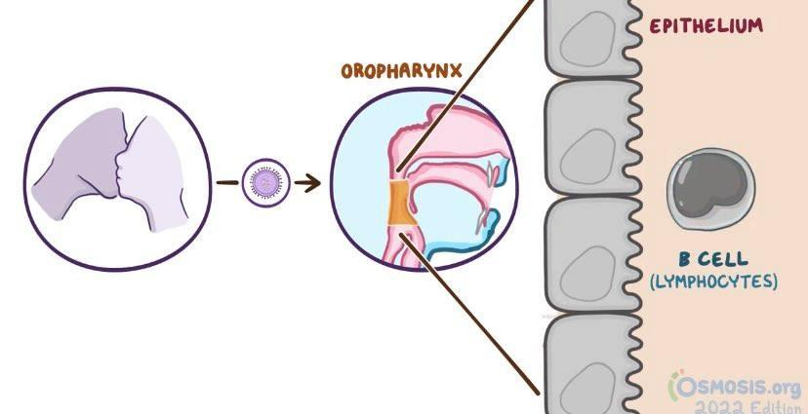
●After transmission by saliva to the oral cavity, EBV infects both oral epithelial cells and tonsillar B- lymphocytes
●The virus has an incubation period 2-6 weeks.
●The virus starts its replication at the IP and continue, and sheds in the pharyngeal secretions.
●Ongoing viral replication leads to viremia and dissemination of infected B-lymphocyte into the blood and lymphoreticular system.
●The infected B-cells produce antibodies called heterophile which can be used in diagnosis.
●The infected B-cells will also stimulate CD8+ cytotoxic T-cell, which have the major role in supression of the primary EBV infection.

Slide 53
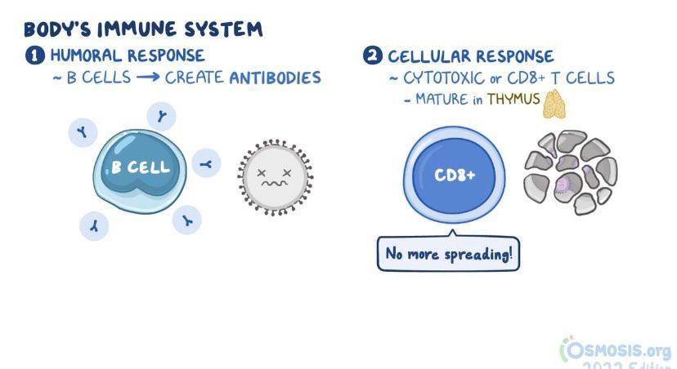
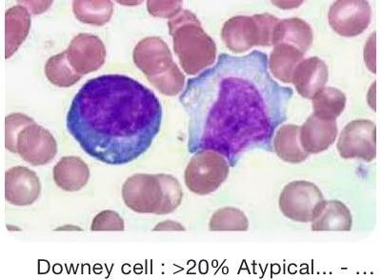
The CD8 lymphocytes proliferate to check this replication of virus in the B lymphocytes and represent the atypical lymphocytes seen in EBV infection. Like other herpes viruses, EBV establishes lifelong latent infection after the primary infection with frequent asymptomatic reactivations.
The infected B-cells will also stimulate CD8+ cytotoxic T-cell, which have the major role in supression of the primary EBV infection.

Slide 54
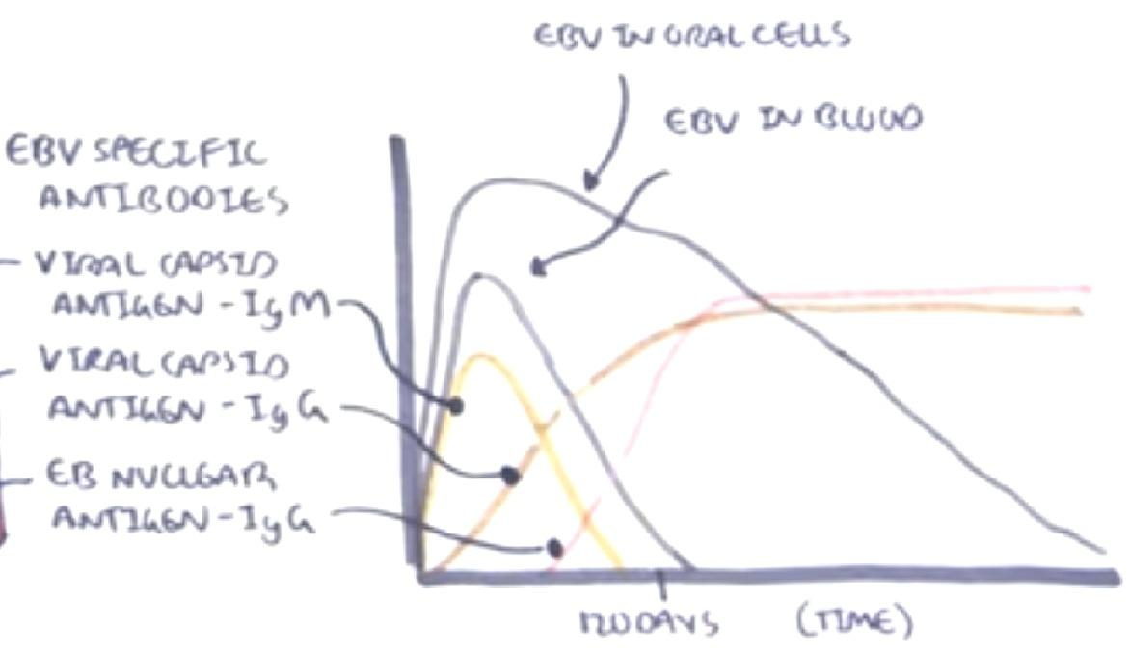
Polyclonal CD8 T activation occurs early during the incubation period following infection, while expansion of EBV-specific CD8 T lymphocytes is detected closer to the time of symptom onset.
●It will also stimulate CD4+ Helper T-cells, which in turn will introduce the virus and stimulate normal B-cell transformation to plasma cell, and so making long term memory for the virus.
●CD4+ will initially secrete viral capsid IgM which remains in the blood for 4 months. Then the viral capsid IgG will appear, after that the nuclear igG will appear and will indicate resolution of the disease.
●The primary infection can be asymptomatic and undistinguishable, but it can be with clinical manifestation which start after 6 weeks and induced by the host immune response .

Slide 55
●The host immune response is effective in rapidly reducing the EBV viral load, although persistent shedding of high levels of virus can be detected in the oropharynx for up to 6 mo. Intermittent shedding from the oropharynx occurs for many years following primary infection.
●The virus persists in lifelong latent infection primarily in memory B lymphocytes
●Only a few viral proteins, including the EBV-determined nuclear antigens (EBNAs), are produced during latency. These proteins are important in maintaining the viral episome during the latent state.
●Reactivation and new viral replication occurs at a low rate in populations of latently infected cells and is responsible for intermittent viral shedding in oropharyngeal secretions of infected individuals. Reactivation is unlikely to be accompanied by distinctive clinical symptoms.

Slide 56
Clinical features
●The incubation period of infectious mononucleosis in adolescents is 30-50 days. In children, it may be shorter. The majority of cases of primary EBV infection in infants and young children are clinically silent. In older patients, the onset of illness is usually insidious and vague.
●The disease usually include a triad of fatigue <acute or prolonged (>1 wk) >,, lymphoadenopathy, and pharyngitis.
●Additionally there’s fever, headache, nausea, and abdominal pain.
●The prodromal period may last 1-2 wk .
●Splenic enlargement may be rapid enough to cause left upper quadrant abdominal discomfort and tenderness, which may be the presenting complaint.

Slide 57
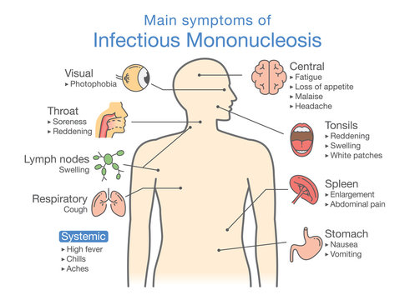
Clinical features
Symptomatic EBV infections in older children and adults are characterized by insidious onset of:(on the photo)
COMPLICATIONS:
airway obstruction due to enlargement of oropharyngeal lymphoid tissue, menin­gitis, seizures, ataxia, myocarditis, hemolytic anemia, thrombocytopenia, neutropenia, aplastic anemia, inter­stitial pneumonitis and pancreatitis.

Slide 58
ON PHYSICAL EXAMINATION
●The classic physical examination findings are generalized lymphadenopathy(90% of cases), splenomegaly (50% of cases), and hepatomegaly (10% of cases).
●Lymphadenopathy occurs most commonly in the anterior and posterior cervical nodes and the submandibular lymph nodes and less commonly in the axillary and inguinal lymph nodes.
●Although liver enzymes are often elevated, symptomatic hepatitis or jaundice is uncommon.
● Splenomegaly to 2-3 cm below the costal margin is typical (15–65% of cases); massive enlargement is uncommon.
●The sore throat is often accompanied by moderate to severe pharyngitis with marked tonsillar enlargement, occasionally with exudates.
●Other clinical findings may include rashes and edema of the eyelids.
● Patients with infectious mononucleosis who are treated with ampicillin or amoxicillin may experience an ampicillin rash, which may also occur with other β-lactam antibiotics.

Slide 59
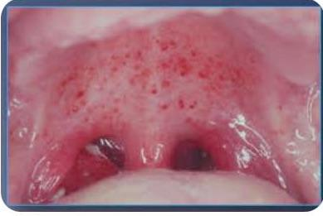
Examination shows pharyngeal inflammation with exudates and petechiae at the junction of soft and hard palate

Slide 60
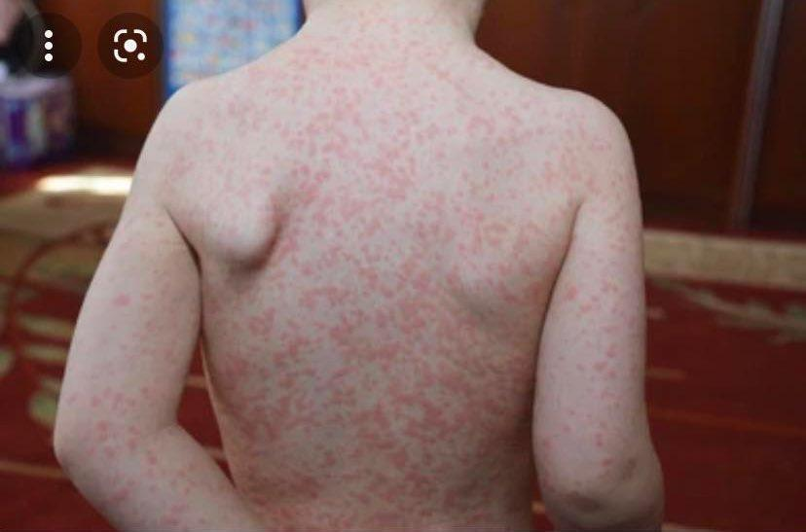
MACULOPAPULAR RASHES ARE SEEN IN 3-15% CASES AND IN 80% OF THOSE WHO HAVE RECEIVED AMPICILLIN OR AMOXICILLIN.
Amoxicillin-induced rash in Epstein-Barr virus infection. Morbilliform maculopapular rash on the leg.

Slide 61
DIAGNOSIS AND INVESTIGATIONS
Diagnosis can be made by the presence of classical clinical symptoms with atypical lymphocytosis in the peripheral blood. The diagnosis is usually confirmed by serologic testing.
●Clinical manifestation as mentioned.
●CBC: *Heterophile antibodies or specific EBV antibodies*viral capsid IgM *viral capsid IgG (monospot test),,,,
*leukocytosis of 10,000–20,000 cells/mm3, of which at least ⅔ are lymphocytes; atypical lymphocytes usually account for 20–40% of the total number.
The atypical cells are mature T lymphocytes(CD8+) that have been antigenically activated When compared with regular lymphocytes *microscopically, the cells are larger overall, with larger, eccentrically placed indented and folded nuclei with a lower nucleus-to-cytoplasm ratio.
●Mild elevation of hepatic transaminases occurs in approximately 50% of uncomplicated cases but is usually asymptomatic without jaundice.
● PCR for DNA detection , and CSF lumbar puncture.
●Throat swab culture to rue out bacterial cause(Group A streptococcus)

Slide 62
DIFFERENTIAL DIAGNOSIS
Infectious mononucleosis-like illnesses may be caused by primary infection with cytomegalovirus, T. gondii, adenovirus, viral hepatitis, HIV, or possibly rubella virus.
•CMV infection is a particularly common cause in adults.
•Streptococcal pharyngitis may cause sore throat and cervical lymphadenopathy indistinguishable from that of infectious mononucleosis but is not associated with hepatosplenomegaly

Slide 63
COMPLICATIONS
Severe complications are unusual in patients with infectious mononucleosis
●The most feared complication is:
•subcapsular splenic hemorrhage
•splenic rupture, commonly related to trauma
•Airway obstruction >Swelling of the tonsils and oropharyngeal lymphoid tissue.
•variety of neurologic manifestations, such as headache, more severly seizures and ataxia.
•Guillain-Barré syndrome or Reye syndrome may follow acute illness.
•Myocarditis, Interstitial pneumonia, Hemolytic anemia
• Perceptual distortions of sizes, shapes, and spatial relationships, known as the Alice in Wonderland syndrome (metamorphopsia), may be a presenting symptom.

Slide 64
Treatment
There is no specific treatment for infectious mononucleosis.
●The mainstays of management are rest, adequate fluid and nutrition . symptomatic treatment to manage fever, throat discomfort, and malaise
● As soon as there is definite symptomatic improvement, the patient should be encouraged to resume normal activities.
● Because blunt abdominal trauma may predispose patients to splenic rupture, it is customary to advise against participation in contact sports and strenuous athletic activities during the first 2-3 wk of illness or while splenomegaly is present.
●Treatment with IV corticosteroid for airway obstruction ,thrombocytopenia and hemolytic anemia.
prednisone (1 mg/kg/ day for 7 days) is advised for tonsils enlargement

Slide 65
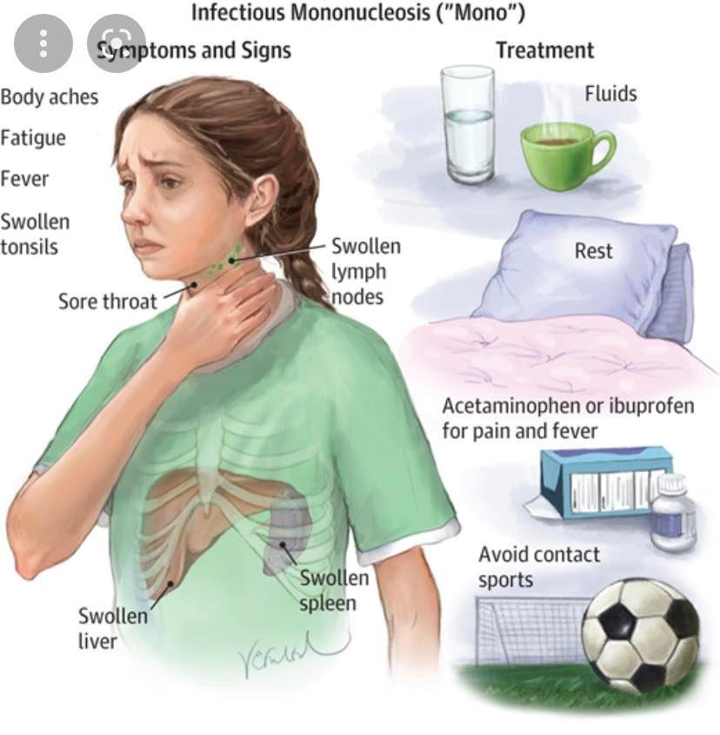

Slide 66
PROGNOSIS
The prognosis for complete recovery is excellent. The major symptoms typically last 2-4 wk, followed by gradual recovery within 2 mo of symptom onset.
●Prolonged and debilitating fatigue and malaise may wax and wane for several weeks to 6 mo and are common complaints even in otherwise unremarkable cases. Occasional persistence of fatigue for a few years after infectious mononucleosis is well recognized.

