Slide 1
Anticoagulant Therapy
Presented By:
Anas Amjad
Othman Ali

Slide 2
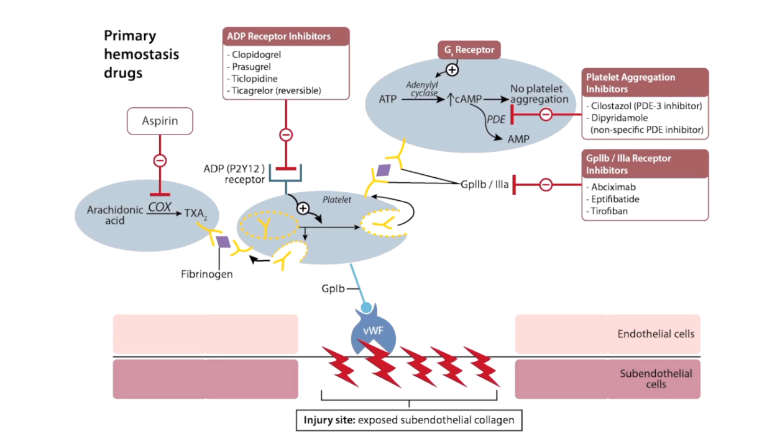
Antiplatelets

Slide 3
1-ADP inhibitors
ADP inhibitors irreversibly block ADP(P2Y12) receptors
Prevent platelets aggregation
Prevent the expression of glycoproteins Iib\Iia on platelets surface
Eg: Clopidogrel , prasugrel, Ticagrelor ,Ticlopidine
USES :
Use for unstable angina/NSTEMI usually in combination with aspirin
Use for acute coronary artery syndrome
Use for symptomatic PAD
Use as an alternative to aspirin
Used with coronary stents to prevent platelet clots forming around stent
Can decrease incidence and recurrence of thrombotic stroke

Slide 4
SIDE EFFECTS :
Ticlopidine can cause neutropenia and agranulocytosis
ADP inhibitors can cause TTP
ADP inhibitors can cause allergic reactions (eg, rash ,pruritis, anaphylaxis)
ADP inhibitors can cause hemorrhage

Slide 5
2-Platelets aggregation inhibitors
Antiplatelets PDE inhibitors
Cilostazol : is a PDE 3 inhibitors ,is a direct arterial vasodilator
Dipyridamole :is a nonspecific PDE inhibitor that inhibits platelets aggregation , increases adenosine (blocks adenosine reuptake into platelets).
Dipyridamole causes high adenosine leads to vasodilation
Use the previous two to alleviate intermittent claudication
Use the previous two with coronary stents to prevent platelets clot to form around stent

Slide 6
USES :
Used in ischemic stroke or TIA prevention (alongside aspirin)
Dipyridamole can be used in cardiac stress testing (due to coronary vasodilation)
Adverse effects:
Nausea and diarrhea
Abdominal pain
Hypotension
Facial flushing
Headaches
Tachycardia

Slide 7
SIDE EFFECTS:
Ventricular arrhythmia ( for PDE3 effects)
Dipyridamole can cause neurotoxicity at high levels so seizures
cliostazol Heart failure
CONTRAINDICATIONS:
Hypotension
Caffeine within 12 hours
Bronchospasm (asthma)

Slide 8
3-Gpiib/iiia receptors inhibitors
Mechanism of Action :Block fibrinogen binding to platelets. Prevents proper platelets aggregation and thrombus formation
1-Abciximab: is made from monoclonal antibody fab fragments
2-Eptifibatide,Tirofiban
Use for unstable angina,PCI
Can cause bleeding

Slide 9
Contraindications
Active bleeding
The patient has high risk of bleeding
If major surgery or severe trauma occurred within the past 30 days
Abciximab and tirofiban With platelet counts below 100,000/mm3

Slide 10
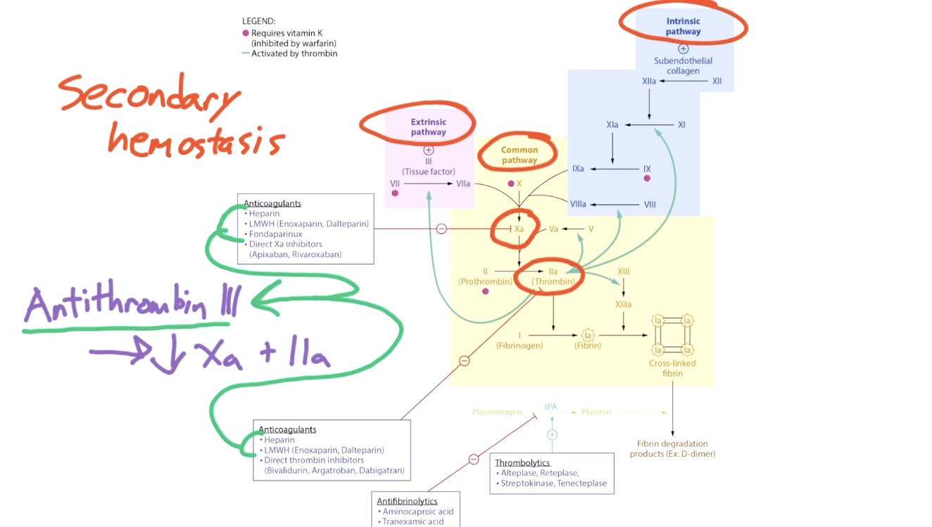
anticoagulants

Slide 11
1- Heparin
Activates antithrombin III so lower action of factor IIa (thrombin) and factor Xa
Short half-life
Monitor PTT
LMWHs (low molecular weight heparins)
Enoxpirin,daltapirin
LMWHs bind to antithrombin III in a way that cause inhibition of factor Xa (minimal factor IIa inhibition) so decreased fibrin meshwork

Slide 12
* FONDAPARINUX :
Is a synthetic heparin
Inhibits factor Xa only
Shared characteristics:
LMWHs and fondaparinux are Renally excreted
LMWHs and fondaparinux have better bioavailability than UFH
LMWHs and fondaparinux have longer half-life than UFH(2-4x UFH)

Slide 13
Uses:
Immediate anticoagulation for PE
Use heparins for acute coronary syndrome
Use heparins for DVT
Use heparins for MI
Use heparins during pregnancy since heparins do not cross
placenta

Slide 14
Adverse effect :
Cause bleeding
Can cause thrombocytopenia (HIT) (more common with UFH and less likely with LMWHs and fondaparinux)
Note: heparin treatment requires regular monitoring of platelet counts ,especially for UFH , even before start treatment

Slide 15
HIT (heparin induced thrombocytopenia)
Pathogenesis :
Heparin and platelet factor IV form a complex , the body responses by producing IGG antibodies against this complex.
When IGG binds to the heparin platelet complex forming IGG-heparin-platelet factor IV immunocomplex , which bind to the platelet surfaces leads to activation of platelet then form small platelet clots Consumption of platelet form blood which cause thrombocytopenia and arterial or venous thrombosis
Another adverse effects : Cause osteoporosis
Rapidly reverse heparin-induced bleeding using protamine sulfate

Slide 16
Contraindications:
Severe uncontrolled hypertension .
Uncontrolled active bleeding .
History of HIT.
LMWHs and fondaparinux are contraindicated in kidney disease because these are renally excreted.

Slide 17
2-Thrombolytic
Eg: Alteplase , retaplase , streptokinase and Tenecteplase
Direct or indirect aid in conversion of plasminogen to plasmin
Cleave fibrin clots
Increase pt and ptt
No change to platelet counts
Uses:
Early for an MI
Early for ischemic stroke
Direct thrombolysis of severe PE
As alternative to PTCA or PCI in STEMI if PTCA connot be performed within 90-120 minutes

Slide 18
Adverse effects : can cause hemorrhage
Contraindications:
In patients with history of hemorrhagic stroke
Also in nonhemorrhagic stroke within 3 months
Intracranial neoplasm
Recent surgery
A known bleeding disorder
Severe hypertension

Slide 19
Reverse thrombolytics with antifibrinolytics ( aminocaproic acid and tranexamic acid) or with platelet transfusion or by factor corrections (eg, cryoprecipitate , FFP , PCC)

Slide 20
3-Factor Xa inhibitor
Fondaparinux, Rivaroxaban (oral), Apixaban (oral).
4-Direct thrombin inhibitor Hirudin, Lepirudin, Bivalirudin, Desirudin, Argatroban and Dabigatran (oral).
synthetic heparin compound that inhibits factor Xa indirectly by antithrombin ,but does not inhibit thrombin
prolong PT and PTT (Xa in both pathways)
Thrombin time will not be affected.
can be given once a day at a fixed dose without monitoring
Less likely than UFH or LMWHs to trigger HIT(heparin induced thrombocytopenia)
* Used in atrial fibrillation as alternatives to warfarin.
rapid and potent direct binding to thrombin
DTIs are not associated with the development of thrombocytopenia
* Uses: - Patients with HIT: stop heparin and start DTI , PTT often monitored. - Acute coronary syndrome: Bivalirudin. - Atrial fibrillation: standard dose of Dabigatran (oral) , doesn’t require PT/INR monitoring.
MOA
advantage

Slide 21
5-Vitamin K antagonist coumarins (Warfarin)
competitively inhibits vitamin K epoxide reductase (decrease synthesis of active vit K reduced Form )🡪 Vitamin K-dependent factors II, VII, IX, & X(1972) (as well as anticoagulant proteins C & S).
This lead to decrease Carboxylation of clotting factors .
Long half-life (days) BUT Narrow therapeutic index(ratio between effective & toxic dose).
Does not have an effect on already-synthesized coagulation factors; therefore, the therapeutic effects are not seen until these factors are depleted (3-4 days )
effect depends on the amount of vitamin K in the body which varies with diet, antibiotics (inhibits GI bacteria) or drugs interfere with metabolism.
You have to check your PT/INR constantly monitoring (at least once a month).
Any Polymorphism in gene for VIT K epoxide reductase complex will affect efficiency & metabolism .
MOA
Protein C ,S are the first protein to decrease after start warfarin therapy .
Low protein C ,S can cause initial hypercoagulation & skin necrosis.
NOTE :
Notes:
*vitamin K epoxide reductase converts vitamin K to a reduced form
*Why the PT/INR is the preferred test for monitoring the effects of warfarin? * - Because factor VII, which is part of the extrinsic pathway, has the shortest half-life (4-6 Hours) of the four vitamin K dependent factors. - Means that factor VII will be the first level to fall after warfarin administration, therefore the extrinsic pathway in the PT test is much more sensitive to the effects of warfarin. (only PT test captures factor VII activity)

Slide 22
Heparin Bridging :
Administer heparin alongside with warfarin regimen .
Reduced risk of skin\tissue necrosis OR recurrent venous thrombosis .
NOTE :
-Used as prevention of ischemic stroke (e.g. from embolus)
- In patients with atrial fibrillation. - In patients with mechanical heart valve. - Patients who have DVT/PE. (for at least several months)
Should you use an IV immediate-acting drug like heparin to anti-coagulate the patient during their initial prothrombotic period on warfarin? * - Yes, for clot disorders (DVT/PE), heparin is used anyway because of its acute onset. This provides anti-coagulation during initial warfarin therapy. - One exception: patients with atrial fibrillation. They don’t have an active clot ; they are just at high risk of forming a clot. So we often start warfarin without heparin.
uses

Slide 23
Wide variation in drug response (non predictable)
Narrow therapeutic window.
Slow onset of action, so not given in emergency conditions.
Bleeding (haemorrhagic blisters & painful purpura).
Polymorphisms in CYT P450 (2C9) isoforms that metabolizes warfarin 🡪 toxicities or under use, Numerous food- & drug-drug interactions.
Contraindicated in pregnancy (fetal warfarin syndrome) teratogenic .
🡪 give heparin or LMWH instead , Warfarin is safe for lactating mothers
Protien C deficient (first few days)when warfarin is initiated, this briefly creates a prothrombotic state(increase tendency of blood the thrombose). This effect is limited because other factor levels will fall and that is antithrombotic.
Skin necrosis:
A rare complication of therapy presents as large dark, purple skin lesions within a few days after warfarin administration due to:
-protein C deficiency
-very high doses of Warfarin.
Limitation

Slide 24
Patients with active bleeding , high risk of bleeding Or ulcer related bleeding .
Patients with pericarditis Or endocarditis .
Patients with recent surgery
Pregnant female unless she has a mechanical heart valve .
Contraindication
Slow warfarin reversed achieved by VIT K administration .
Rapid warfarin reversed achieved by FFP or PCC (Prothrombin complex concentrate)
NOTE :

Slide 25
Inadequate diet; malnutrition, dieting, decreased absorption
Impaired synthesis of clotting factors: -hepatocellular disorders -hepatic congestion.
Increased catabolism of clotting factors: In hypermetabolic states-fever, thyrotoxicosis.
Decrease response:
Decreased plasma protein binding:
🡪elimination of free drug & shortening of its t1/2 as pts with nephrotic syndrome .
Decreased catabolism of clotting factors: Hypothyroidism.
Hereditary resistance to oral anticoagulant .
Gastric acid inhibition(because it is decrease the uptake of warfarrin) .
Foods rich In VIT K .
Cytochrome P450 inducers .
Increase response :
Cytochrome P450 inhibitors .
Acetaminophen .
Damage to gut flora .
Factors altering response

Slide 26
Inhibition of Vit K synthesis by intestinal flora: oral antibiotics
Inhibition of Vit K absorption: liquid paraffin
Decrease in drug metabolism by microsomal enzyme inhibitors(increase its t½): chloramphenicol, & cimetidine
Displacement of the drug from protein binding sites: phenylbutazone & salicylates
Co-administration of drugs that increase bleeding tendency by:
-inhibiting platelet function; NSAIDs
-inhibiting coagulation factors; heparin
Drugs modulating responsee

Slide 27
1- Fresh Frozen Plasma (FFP): 2- Vitamin K: - In the absence of serious bleeding: *INR 3-5: Hold warfarin. *INR 5-9: Hold warfarin and oral vitamin K. *INR >9: Consider IV vitamin K or FFP. - Severe bleeding with any increase in INR: Administer FFP.
Antidote
Notes:
1- Fresh Frozen Plasma (FFP): - It’s the plasma after removal of RBCs, WBCs and Platelets, frozen for storage. - Once thawed, must be used within 24 hours or the clotting factors degrade. - FFP can be used to reverse the effect of warfarin very quickly.
- It will correct deficiencies of any clotting factors. (other low vitamin K factor levels will be corrected by FFP) - PT/PTT levels will normalize after infusion.
2- Vitamin K: - Can also be given to reverse the effect of warfarin, used when INR is too high (>3) in the absence of serious bleeding. - Given orally or IV. (IV can cause anaphylaxis)

Slide 28
Thank you

