Slide 1
IMPULSE CONTROL DISORDERS
Done by:
Amen maaitah
Abdallah alshobak
Supervised by:
Dr.Najeeb Qsous

Slide 2
Impulse control disorders are characterized by problems in the self-regulation of emotions and behaviors.
The behaviors violate the rights of others and/or conflict with societal norms.
Impulse control disorders are not caused by another mental disorder, medical condition, or substance use.
OCD is a big differential diagnosis

Slide 3
Core qualities of the impulse control disorders are as follows:
1-Repetitive or compulsive engagement in behavior despite adverse consequences.
2-Little control over the negative behavior.
3-Anxiety or craving experienced prior to engagement in impulsive behavior.
4-Relief or satisfaction during or after completion of the behavior.

Slide 4
Process:
Impulse
They feel an impulse that driving them to do Sth
Tension :
They know they should not be doing it
Pleasure:
Relief:
Ok,I have done it
Guilt/no guilt:

Slide 5
TYPES OF IMPULSE CONTROL DISORDERS
1-Intermittent explosive disorder
2-Kleptomania
3-Pyromania
4-Gambling disorder
5-Trichotillomania

Slide 6
Intermittent Explosive Disorder
Recurrent behavioral outbursts resulting in verbal and/or physical aggression against people or property.

Slide 7
DSM-5 diagnosis and criteria
Either:
Frequent verbal/physical outbursts (that do not result in physical damage to people, animals, or property) twice weekly for 3 months
Or:
Rare (more than three times per year) outbursts resulting in physical damage to others, animals, or property.
Outbursts and aggression are grossly out of proportion to the triggering event or stressor.
Outbursts are not premeditated and not committed to obtain a desired reward.
Aggressive outbursts cause either marked distress or impairment in occupational/interpersonal functioning, or are associated with financial/legal consequences.
Aggression is not better explained by another mental disorder, medical condition, or due to the effects of a substance (drug or medication).

Slide 8
EPIDEMIOLOGY/ETIOLOGY
■More common in men than women.
■ Onset usually in late childhood or adolescence.
■ May be episodic, but course is generally chronic and persistent.
■ Genetic, perinatal, environmental, and neurobiological factors may play a role in etiology.
Low levels of serotonin in the CSF have been shown to be associated with impulsiveness and aggression.

Slide 9
DIFFERENTIAL DIAGNOSIS
Medical: Brain tumors, endocrine disorders, degenerative disorders
Psychatric : Antisocial personality disorder, Borderline presonality disorder, schizophrenia, substance intoxication

Slide 10
TREATMENT
■ Treatment involves use of SSRIs, anticonvulsants, or lithium.
■ CBT (cognitive behavioral therapy)has been shown to be effective and is often used in combination with medications.
■ Group therapy and/or family therapy may be useful to create behavior plans to help manage episodes

Slide 11
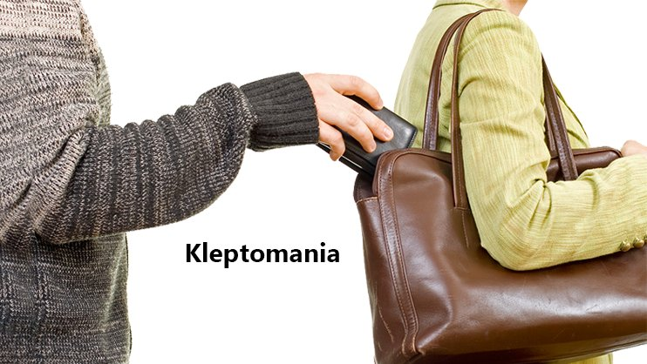
Kleptomania (an impulse to steal)

Slide 12
DIAGNOSIS AND DSM-5 CRITERIA
1- Failure to resist uncontrollable urges to steal objects that are not needed for personal use or monetary value.
2-Increasing internal tension immediately prior to the theft.
3-pleasure or relief is experienced while stealing; however, those with the disorder often report intense guilt and depression.
4-Stealing is not committed to express anger/vengeance and does not occur in response to a delusion or hallucination.
5-Objects stolen are typically given or thrown away, returned, or hoarded.

Slide 13
EPIDEMIOLOGY/ETIOLOGY
■ Three times more common in women than men, though rare in the general population.
■ Higher incidence of comorbid mood disorders, eating disorders (especially bulimia nervosa), anxiety disorders, substance use disorders, and personality disorders.
■ Higher risk of OCD and substance use disorders in family members.
■ Illness usually begins in adolescence and course is episodic.
65% of patients with kleptomania suﬀer from bulimia nervosa.

Slide 14
Treatment
Treatment may include CBT (including systematic desensitization and aversive conditioning) and SSRIs.
There is also some anecdotal evidence for the use of naltrexone, which blocks reward pathways mediated by endogenous opioids.

Slide 15
Pyromania

Slide 16
Pyromania is the impulse to start fires, typically with feelings of gratification or relief afterward.

Slide 17
DIAGNOSIS AND DSM-5 CRITERIA
■ At least two episodes of deliberate fire setting.
■ Tension or arousal experienced before the act; pleasure, gratification, or relief experienced when setting fires or witnessing/participating in their aftermath.
■ Fascination with, interest in, curiosity about, or attraction to fire and contexts.
■ Purpose of fire setting is not for monetary gain, for expression of anger or vengeance, to conceal criminal activity, or as an expression of sociopolitical ideology. It is not in response to a hallucination, delusion, or impaired judgment (intoxication, neurocognitive disorder).
■ Fire setting is not better explained by conduct disorder, a manic episode, or antisocial personality disorder.
Must rule out arson. ( criminal act/set fires with CRIMINAL intent )

Slide 18
EPIDEMIOLOGY/ETIOLOGY
■ Rare disorder but much more common in men.
■ Most begin to set fires in adolescence or early adulthood.
■ High comorbidity with mood disorders, substance use disorders, gambling disorder, and conduct disorder.
■ Episodes are episodic and wax and wane in frequency.

Slide 19
PHYSICAL AND PSYCHIATRIC PRESENTING SYMPTOMS
Many watch fires in their neighborhood and/or set off fires alarms.
Lack remorse for the consequences of their action, and show resentment toward authority figures.
May become sexually aroused by the fire.

Slide 20
TREATMENT
Most don’t go into treatment and symptoms will remain chronic.
While there is no standard treatment, CBT, SSRIs, mood stabilizers, and antipsychotics have all been used.
Because no treatment has been proven to be beneficial, incarceration may be indicated.

Slide 21
Gambling Disorder

Slide 22
A disorder characterized by persistent and recurrent gambling behavior that includes a preoccupation with gambling, a need to gamble with more money, attempts to stop gambling and/or to win back losses, illegal acts to finance the gambling, or loss of relationships due to gambling.
In DSM-5 this is now included under substance –related and addictive disorders

Slide 23
DIAGNOSIS AND DSM-5 CRITERIA
Persistent and recurrent problematic gambling behavior, as evidenced by four or more of the following in a 12-month period:
Preoccupation with gambling
2. Need to gamble with increasing amount of money to achieve pleasure
3. Repeated and unsuccessful attempts to cut down on or stop gambling
4. Restlessness or irritability when attempting to stop gambling
5. Gambling when feeling distressed (depressed, anxious, etc.)
6. Returning to reclaim losses after gambling (“get even”)
7. Lying to hide level of gambling
8. Jeopardizing relationships or job because of gambling
9. Relying on others to financially support gambling

Slide 24
EPIDEMIOLOGY/ETIOLOGY
■ Prevalence: 0.4–1.0% of adults in the United States.
■ Men represent most of the cases.
■ More common in young adults and middle-aged, and lower rates in older adults.
■ Similar to substance use disorders, the course is marked by periods of abstinence and relapse.
■ Increased incidence of mood disorders, anxiety disorders, substance use disorders, and personality disorders.
■ Etiology may involve genetic, temperamental, environmental, and neurochemical factors.
■ One-third may achieve recovery without treatment.

Slide 25
PHYSICAL AND PSYCHIATRIC PRESENTING SYMPTOMS
May engage in antisocial behavior to obtain money for gambling.
Appear overconfident.
Suicide attempts.
Multiple arrest and/or incarceration.

Slide 26
TREATMENT
■ Participation in Gamblers Anonymous (a 12-step program) is the most common treatment.
■ Cognitive behavioral therapy has been shown to be effective, particularly when combined with Gamblers Anonymous.
■ Important to treat comorbid mood disorders, anxiety disorders, and substance use disorders where appropriate.

Slide 27
Trichotillomania

Slide 28
A disorder characterized by pulling one’s own hair, resulting in hair loss.
There is anxiety before the act and a release of anxiety after the act.
In DSM-5 this is now included under obsessive compulsive and related disorder

Slide 29
DIAGNOSIS AND DSM-5 CRITERIA
■ Recurrent pulling out of one’s hair, resulting in hair loss.
■ Repeated attempts to decrease or stop hair pulling.
■ Causes significant distress or impairment in daily functioning.
■ Hair pulling or hair loss is not due to another medical condition or psychiatric disorder.
■ Usually involves the scalp, eyebrows, or eyelashes. May include facial, axillary, and pubic hair.

Slide 30
EPIDEMIOLOGY/ETIOLOGY
■ Lifetime prevalence: 1–2% of the adult population.
■ More common in women than in men (10:1 ratio).
■ Onset usually at puberty. Frequently associated with a stressful event.
■ Etiology may involve biological, genetic, and environmental factors.
■ Increased incidence of comorbid OCD, major depressive disorder, and excoriation (skin-picking) disorder.
■ Course may be chronic with waxing and waning periods. Adult onset is generally more difficult to treat.

Slide 31
PHYSICAL AND PSYCHIATRIC PRESENTING SYMPTOMS
Hair loss is significant over all areas of the body.
Area most affected is the scalp.
May eat the hair, resulting in bezoars, obstruction, and malnutrition.
Head-banging, nail-biting, and gnawing may be present.
Examination of the scalp reveals short, broken hairs along with long hairs.

Slide 32
TREATMENT
■ Treatment includes SSRIs, second-generation antipsychotics, lithium, or N-acetylcysteine.
■ Specialized types of cognitive-behavior therapy (e.g., habit reversal training).

Slide 33
THANK YOU

Slide 34
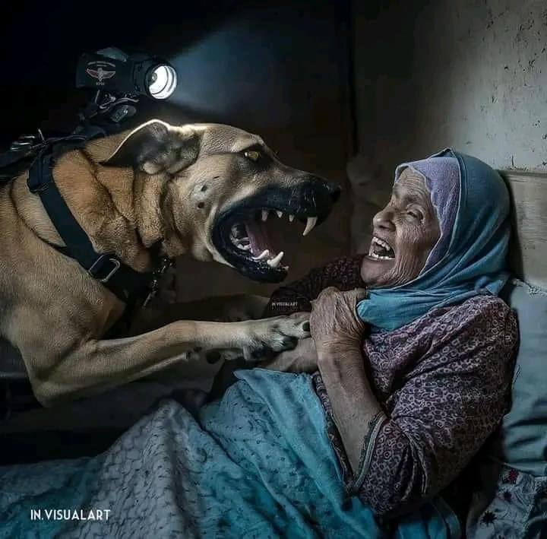
"وَلَا تَحْسَبَنَّ اللَّهَ غَافِلًا عَمَّا يَعْمَلُ الظَّالِمُونَ إِنَّمَا يُؤَخِّرُهُمْ لِيَوْمٍ تَشْخَصُ فِيهِ الْأَبْصَارُ"
من اعتاد خان ...!!!

