Slide 1
VIP
تم تفريغ كلام الدكتور بالأحمر طباعة وتنسيق : رائد علي
Constipation
Lamees Nayl Abuzaid

Slide 3
Introduction
Constipation definition is relative to stool frequency, consistency and the effort involved in passing the same. To expound on “abnormal,” we need to define “normal.
Constipation generally is defined as infrequent, hard , dry stool, difficulty in passing stool or painful bowel movements, Or two or less of defecation per week or passing hard (pellet-like) stool at least twice weekly.
Notes:
Physicians define it as: two or fewer stools per wk OR passage of hard stools for at least 2 wks

Slide 4
Epidemiology
Constipation is an extremely common problem in children and accounts for 25%-35% of all visits to pediatric gastrointerologists
Childhood constipation is most commonly seen in toddlers around the time of toilet training.
Before puberty, constipation appears to be equally common among girls and boys, After puberty and into young adulthood, females are more likely to develop constipation.
Notes:
3-5%
of all visits to pediatric outpatient clinics

Slide 5
Encopresis
Definition:
voluntary or involuntary Passage of feces in inappropriate situations after a chronological age of 4 years (or equivalent developmental level).
Notes:
Fecal incontinence (the preferred term over encopresis or soiling) is now included among the diagnostic criteria for functional constipation
Definition
voluntary or involuntary passage of feces into inappropriate places at least once a month for 3 consecutive months once a developmental age of 4 yr has been reached.
Encopresis (incontinence) : Voluntary or involuntary passage of stool in an appropriate place at least once
per month for three consecutive months.
- Developmental age should be more than 4 years

Slide 6
Encopresis is often classified variously as follows:
Type | Explanation
Retentive | With constipation and secondary overflow and leakage around obstruction; more common
Non-retentive | Without constipation
Type | Explanation
Primary | Seen in boys from infancy and often associated with global developmental delay and enuresis
Secondary | Seen in children after successful toilet training, often functional in nature, marked with a higher level of stressors and psychological disorders
Notes:
Subtypes :
1)Retentive encopresis : 65-95%
-w/ constipation & overflow incontinence
-often the result of chronic constipation and fecal impaction
2)Nonretentive encopresis
-w/o constipation & overflow incontinence
-no evidence of fecal impaction
-no evidence of anatomic, inflammatory, metabolic, endocrine, or neoplastic process that could explain the symptoms.
-It is more likely to have associated 1ry underlying psychological etiology

Slide 7
Normal stooling patterns
Infants:
The first bowel movement usually occurs within 36 hours after birth in term.
Breast fed infants usually have more frequent bowel movements than formula fed babies.
Children:
Most children have from 3 bowel movements per day to 3 per week.
Generally, Regular or normal bowel movements can vary significantly among children, especially among infants.
Notes:
-90 percent of normal newborns pass meconium within the first 24 hours of life.
-The gradual decrease in bowel movement frequency with advancing age correlates with changes in transit time and varying patterns of colonic motility
-start to decrease gradually with age due to :
1. change in the transient time
2. pattern of colonic motility
. In childhood :most of them will

Slide 8
Pathophysiology
Retention
vicious circle
Withholding
Hard stools
Painful stool
Notes:
Voluntarily constrict anal sphincter (no evacuation)>stretching of ampulla >water absorbed and become
hard stool > with time > overstretched ampulla > decrease urge to defecate > stool pushed to anal canal
leading to soiling.
In most cases, childhood constipation develops when the child begins to associate pain with defecation
Child voluntarily constricts anal sphincters and does not evacuate his bowel
↓
Rectal ampulla stretches and accommodates increasing amount of stool
↓
Water is mainly absorbed and stool becomes harder
↓
With passage of time rectal ampulla overstretches
↓
Overstretching reduces the urge to daefecate
↓
Stool is pushed into the anal canal also and starts collecting there leading to soiling

Slide 9
Clinical Signs and Symptoms of Pediatric Constipation:
Symptom | Explanation
Stool withholding maneuvers | the typical features of such mannerisms are: Infants: back-arching Older infants/toddlers: moving back and forth, straightening legs, tip-toeing. Older children: stand stiff or squat.
Blood in stools | Painful bleeding per rectum in older children is associated with fissures, fistulae, infection, and maybe a harbinger of Crohn’s disease. Children with rectal polyps present with painless bleeding. In infancy, this is classically associated with cow milk protein allergy.
Pain | In pediatric constipation, pain is segregated as per location, character and timing. Pain can be present in the abdomen or locally around the anus

Slide 10
Symptom | Explanation
Infrequent stools | Reduced bowel movement is often synonymous with constipation and is a defining criterion for the same. However, almost half of the pediatric population with constipation does not have a reduced frequency of passage of stools.
Soiling | Though paradoxical and often mistaken as diarrhea; meager, involuntary fecal soiling is associated with constipation in almost 90% of children.
Enuresis and other urinary disturbances | Compression of the bladder by impacted stools in the rectum can simulate enuresis. Chronic pelvic muscular contraction often culminates in incomplete relaxation during voiding and post void residues.
Associated issues | Obesity, is often associated with constipation.

Slide 11
Causes of Constipation
commonest
Non organic (functional).
organic

Slide 12
Functional constipation
Defined :
by the ROME III classification, requires two or more of the following features in a child with developmental age ≥ 4 years and occurring at least once per week for at least two months before diagnosis.
The symptoms must be present for one month in infants and toddlers, and two months in older children.
The diagnosis also requires exclusion of organic causes of the symptoms.
No evidence of a 1ry anatomic or biochemical cause.
Notes:
Functional constipation
It is responsible for more than 95% of cases of constipation in healthy children one year and older, and is particularly common among preschool-age children
1-functional: 95%
. At age of 1 year and older (especially in preschool age)
. No anatomical or biochemical causes

Slide 13
Rome III Criteria for Diagnosis of Functional Constipation:
1) Two or fewer defecations in the toilet per week.
2) At least one episode of fecal incontinence per week.
3) History of retentive posturing.
4) History of painful or hard bowel movements.
5) Presence of a large fecal mass in the rectum.
6) History of large diameter stools which may obstruct the toilet.
PACCT (The Paris Consensus on Childhood Constipation Terminology Group) define this pathology as “passage of stools in an inappropriate place, occurring in children with a mental age of 4 years and older, with no evidence of constipation on history or examination.”
Notes:
The features of the ROME classification are summarized as below:
History of agonizing or rigid bowel movements
Passing of stools so large that they obstruct the toilet
At least one episode of fecal incontinence per week
History of retentive posturing(standing or sitting with legs extended and stiff or crossed legs) or excessive voluntary stool retention
Two or fewer defecations in the toilet per week
Presence of a large fecal mass in the rectum
The latest in the terminology of pediatric constipation is “non-retentive fecal soiling.”
Originally coined for children soiling albeit no difficult infrequent defecation; PACCT (The Paris Consensus on Childhood Constipation Terminology Group) define this pathology as “passage of stools in an inappropriate place, occurring in children with a mental age of 4 years and older, with no evidence of constipation on history or examination.”

Slide 14
Regarding rome 3 criteria : 2 or more of them is sufficient to diagnose functional constipation
Thus, the presnce of normal frequency of bowel motion doesn’t rule out functional constipation if the pt has two other criteria ,
ex on functional constipation diagnosis : pt has retentive posture and painful bowel motion although he defecates daily
……………………………………………………..
Functinal constipation is 95% of constipation causes in pediatrics so its important to do good aproach to avoid too much investigations
In the hx and ex ; try to find the red flags (see next) to catch the remainig (5%) causes of constipation (organic causes) , if no red flag and the diagnosis go with functional constipation ; avoid too much tests and in general; reassure the parents , give laxative and follow up the pt ( see next for management )

Slide 15
Causes of functional constipation
Developmental: Cognitive handicaps, attention deficit disorder(ADHD)
Toilet training issues :
coercive toilet training toilet phobia school bathroom avoidance
sexual abuse.
Introducing solid food or cereal.
Depression .
Notes:
*here are three periods during which the infant and developing child are particularly prone to develop functional constipation. The first occurs after the introduction of cereals and solid food into the infant's diet, the second with toilet training, and the third during the start of school
Situational Coercive toilet training Toilet phobia Toilet training issues School bathroom avoidance Sexual abuse

Slide 16
Constipation
DONE BY : MOHANAD AL-HADDADIN
SUPERVISED BY : DR.HAYTHAM DMOUR

Slide 17
outlines
1-Red flags suggesting organic cause
2-Organic causes of constipation
3-Hirschsprung Disease
4-approach to constipation (history taking)

Slide 18
Causes of Constipation
Functional constipation 95%
Organic constipation 5%

Slide 19
Organic causes
responsible for fewer than 5 % of children with constipation.
-These usually can be distinguished from functional constipation by clinical features on the history or physical examination

Slide 20
Red Flags Suggesting an Organic Cause of Constipation in Children

Slide 21
1-Constipation starting extremely early in life (<1 month of age)
(Congenital malformation of anorectum or spine, Hirschsprung disease)
2-Delayed passage of meconium >48 hour
(Hirschsprung disease, cystic fibrosis, congenital malformation of anorectum or spine)
3- Failure to thrive / delayed growth
(malabsorption, cystic fibrosis, metabolic condition,HD)
4-Severe Abdominal distension (pseudo-obstruction,HD)
5-Explosive stool and air from rectum upon withdrawal of examining finger (Hirschsprung disease)
6- Blood in the stools in the absence of anal fissures (IBD,HD)

Slide 22
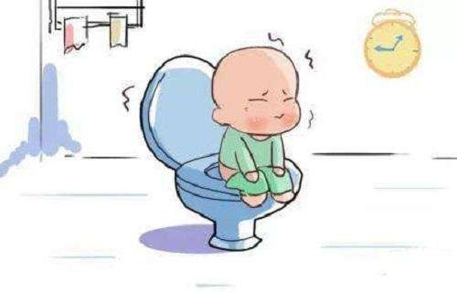
7-Fever,Bilious vomiting (HD)
8-Abnormal thyroid gland (hypothyroidism)
9-Perianal fistula
10-Abnormal position of anus
11-Absent anal or cremasteric reflex( Spinal cord anomalies, trauma)
12-Decreased lower extremity strength/tone/reflex( Spinal cord anomalies, trauma)
13-Tuft of hair on spine
14-Sacral dimple
15-Gluteal cleft deviation
16-Extreme fear during anal inspection/Anal scars(child abuse)

Slide 23
Red flags …
17-Ribbon” like stools (very narrow in diameter) (anal stenosis,HD)
18-Urinary incontinence or bladder disease
19-Congenital anomalies or syndromes associated with Hirschsprung disease ( Down syndrome)
20-Family history of Hirschsprung disease or other GI diseases
21-No response to conventional treatment

Slide 24
Organic causes
Structural
neuromuscular
Anal stenosis
Anal stricture
Rectal abscess or fissure
Imperforate anus
Anterior dislocation of the anus
Hirschprung disease
Pseudoobstruction
Spinal cord lesions ( tumors or spina bifida,tethered cord)

Slide 25
Organic causes
Metabolic
Intestinal
Cystic fibrosis
Hypothyroidism
Hypokalemia
Hypercalcemia
Hypermagnesemia
Diabetes mellitus
Multiple endocrine neoplasia type 2B
Dietary protein allergy
Celiac disease

Slide 26
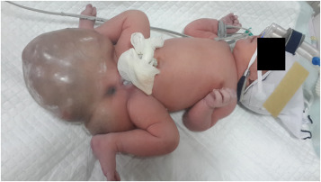
Organic causes
Drugs/toxics
Sacral teratoma
Lead
Narcotic
Anticholinergics
Antidepressants
Opiates
Chemotherapy
Vitamin D intoxication
Infant botulism

Slide 27
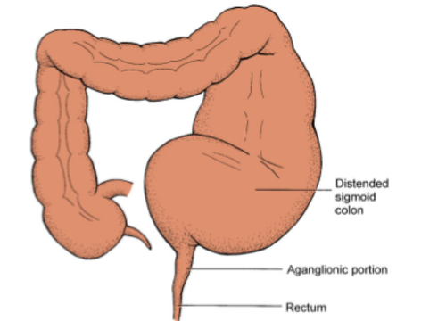
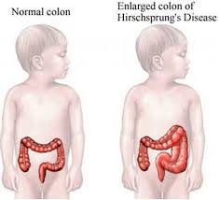
Hirsch-sprung disease

Slide 28
Hirschsprung disease
Is an important consideration in newborns and young infants presenting with constipation.
HD represents congenital aganglionosis of the colon that occurs secondary to failure of craniocaudal migration of neural crest-derived ganglion cells during fetal development, results in megacolon proximal to the aganglionic segment due to stasis of stool within the normal part of the colon.
Normally,neurocrest cells are in the esophagus by 6 weeks gestation,transverse colon by 8 weeks,and rectum by 12 weeks
As a result, the affected segment of the colon fails to relax.
Should be considered as a diagnosis in any newborn who fails to pass meconium within the first 24 hours of life and requires rectal stimulation to pass stool.

Slide 29
epidemiology
In the majority of cases ,the aganglionic segment involves only the rectosigmoid colon
In 3-5%of cases,there is total colonic aganglionosis
Incidence 1/5000
Male : female ( 3:1 )
Positive family history in nearly 10% of cases
Less than 10% of cases occur in infants born with a birth weight less than 3 kg
8-20% are diagnosed after 3 years of age
Occurs as an isolated trait in 70%,in other cases,may be associated with down syndrome,waardenburg syndrome,cartilage hair hypoplasia,neonatal appendicitis,or multiple endocrine neoplasia type II
Genetically seen with abnormalities in the RET and endothelium type b receptor pathway

Slide 30
Clinical Presentation
Symptoms typically begin during the newborn period
Failure to pass meconium within the first 24 hours of life
Constipation with infrequent stools
Failure to thrive or delayed growth
Toxic megacolon ( bilious vomiting , abdominal distention , fever , dehydration )

Slide 31
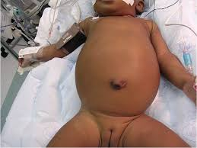
On abdominal examination :
multiple fecal masses
On rectal examination :
a tight anal canal with an empty rectum ,
or explosion of stool after withdrawing finger from rectal exam (squirt sign)
-Stool is typically not hard and formed
-Overflow encopresis is rare

Slide 32
Complication of constipation
Abdominal & rectal pain
Encopresis.
Rectal fissures .
Enuresis.(because of dilated colon)
UTI/ ureteral obstruction.
Rectal prolapse.
Stasis syndrome →
Bacterial overgrowth.
Steatorrhea.
Protein losing enteritis.

Slide 33
Approach to constipation
History
Physical examination
Investigation
Treatment

Slide 34
History
-age of onset of symptoms (<1month dx HD)
-frequency and consistency of stools
-pain/difficulty and/or bleeding when passing stools
- Coexistence of abdominal pain or fecal incontinence
-withholding behavior
-Changes in appetite, nausea and/or vomiting, and weight loss.
-Passage of hard stool
-Soiling / encopresis
- Failure to thrive (FTT)

Slide 35
History
Birth history→ complication ,BW, time of passage meconium
tolerance of early feeding.
Recent transition of breast to formula milk.
Toilet training history → attempt to accomplish toilet training at an inappropriately early age, coercive toilet training can lead to toilet aversion, prime time for withholding

Slide 36
History
Family hx→ Hirschsprung, CF, hypothyroidism, neurofibromatosis, myopathies…
Dietary hx→ milk & fiber intake.
Drug history should be collected, including the use of oral laxatives, enemas, suppositories, herbal treatments, behavioral treatment, and other medications

Slide 37
History
Sexual or rectal abuse should be considered especially if resistant to treatment.
Response of parents to soiling
Don’t forget to ask and examine about the red flags which were mentioned before.

Slide 38
Hirschsprung | Functional | History
At birth or <1mon | >2y | Onset of constipation
Very rare | Common | Encopresis
None | Usual | Forced bowel training
Small, ribbon-like | Very large | stool size
Possible | None | enterocolitis
Common | Common | Abdominal pain
Common | Uncommon | FTT
Yes, 10% | Variable | Family history

Slide 39
Constipation:
Physical examination &
Investigations
By: Michael K. Madani
Supervised by:
Dr. Haitham Dmour

Slide 40
Physical examination
General physical examination : general appearance, vital signs, and assessment of growth (Height and weight should be measured and plotted on growth charts)
Abdominal examination : abdominal distension, and abdominal or pelvic masses, bowel sound, tenderness .
Notes:
The physical examination begins with general assessment of growth
Height and weight should be measured and plotted on growth charts.
The abdomen is inspected for distention, auscultated for bowel sounds, and palpated for masses and tenderness

Slide 41
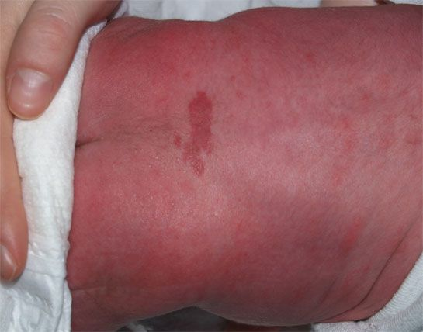
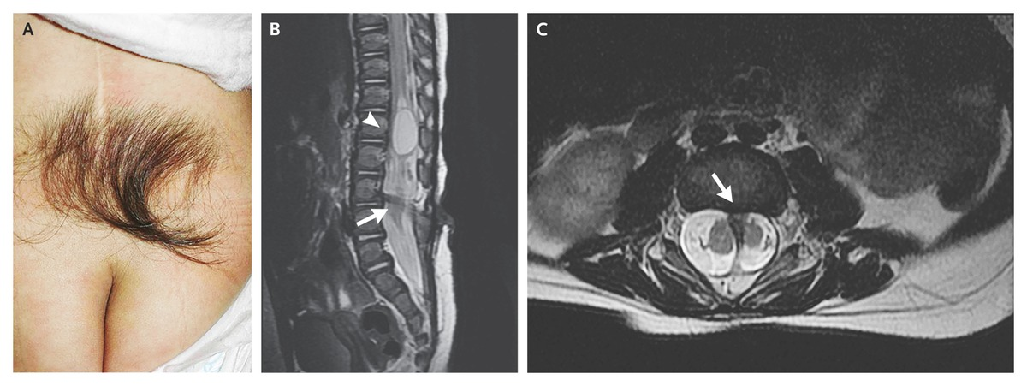
Cont’d / PE
Back examination : Findings suggestive of spinal dysraphism include sensory and motor deficits, a patulous anus, urinary incontinence, an absent cremasteric reflex, increased pigmentation, vascular nevi, or hair tufts or sinus or lipoma in the sacrococcygeal area
Notes:
sacral dimples or pits that might indicate an abnormality of the distal spinal cord.
n infants, neurologic examination focuses on tone and muscle strength. In older children, the focus is on gait, deep tendon reflexes, and signs of weakness in the lower extremities

Slide 42
Cont’d / PE
On neurologic examination: findings suggesting neurologic dysfunction (due to spinal dysraphism or other cause)
check anal and/or cremasteric reflex, and perform lower limb neuromuscular examination including tone, strength, and deep tendon reflexes:
Anal wink / cremasteric reflex absent
Decrease in lower extremity strength, tone or reflex
Abnormal deep tendon reflexes of lower extremity (Delay in the relaxation phase may be hypertonia)
Abnormal thyroid gland (Hypotonic and delayed reflexes)
Severe abdominal distention – consider organic cause of neurological origin
Asymmetry and flattening of gluteal muscles
In infants, neurologic examination focuses on tone and muscle strength. In older children, the focus is on gait, deep tendon reflexes, and signs of weakness in the lower extremities

Slide 43
Digital anorectal examination
A digital anorectal examination is not routinely necessary for the evaluation of patients with a typical history and symptoms of functional constipation if there is suspicion of organic cause we perform it. This is because the digital anorectal examination is unpleasant for the child and has only moderate sensitivity (77%) and specificity (35 %)n for detecting or confirming constipation in this group of patients.
Inspection: anal fissure , fistula , perianal inflammation, hemorrhoids, ulcers, strictures, skin tags
Other aspects accessed in DRE: Anterior displaced anus (halfway between the posterior fourchette and the tip of the coccyx), Anal sphincter tone , Size of rectal vault , Impacted stool (hard or soft)
Explosive expulsion of stool after the examination (squirt sign)
Notes:
Also note the location of the anus on the perineum. In most children, the anus is approximately halfway between the posterior fourchette (base of the scrotum in boys; where the labia minora meet in girls) and the tip of the coccyx.
Whether children with anterior displacement of the anus

Slide 44
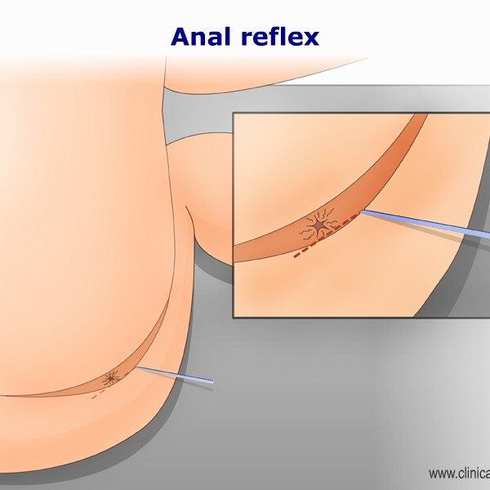
Root value: S2 – S4
Notes:
confirm the presence of an anal wink. To elicit an anal wink, stroke the perianal skin with a pin or probe. In response to the stroking, the subcutaneous portion of the external anal sphincter should contract and visibly pucker at the anal margin. Failure to elicit this reflex can indicate an abnormality with either peripheral sensory or motor nerves or central connections mediating the reflex.

Slide 45
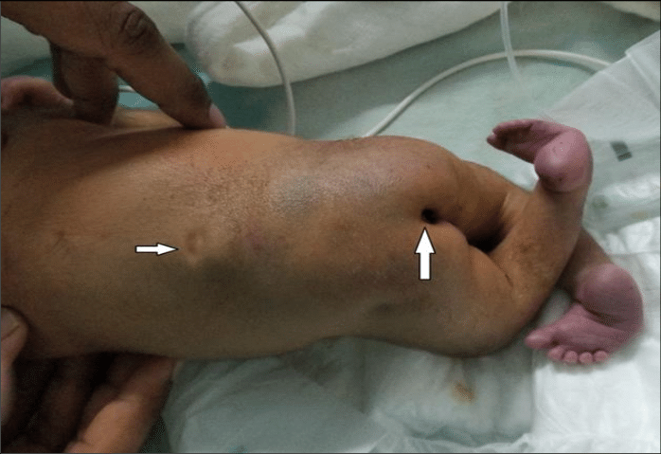
The anus is usually patulous, (loose, open) and has reduced resting and squeeze pressures. Sometimes it is necessary to observe the patient while they strain on a toilet to see the prolapse happen (the perineum can be seen with a mirror or by placing an endoscope in the bowl of the toilet).

Slide 46
(No transition zone)

Slide 47
Investigations
In most cases, organic causes of constipation can be excluded on the basis of a careful history and physical examination.
If warning signs of possible organic constipation are present, focused laboratory and radiographic testing should be performed.
In addition, these tests may be appropriate for patients who fail to respond to a well-conceived and carefully administered intervention program, including disimpaction, frequent and effective use of laxatives, and behavioral management.

Slide 51
Investigations
Imaging
Laboratory tests
Motility testing

Slide 52
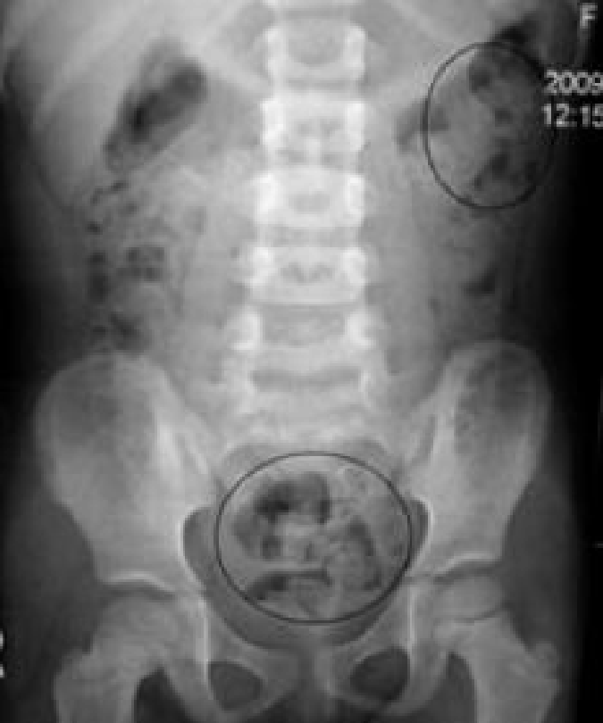
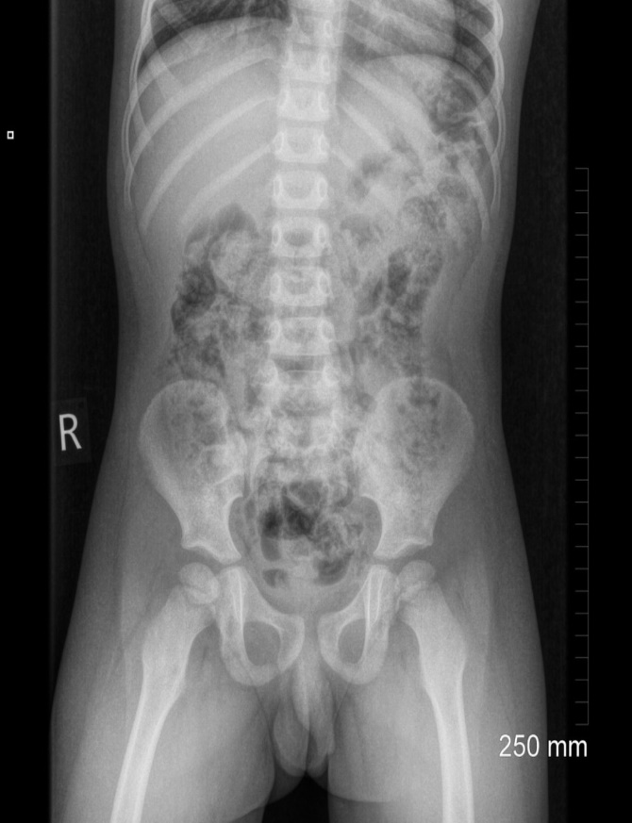
Imaging
Abdominal radiograph:
A plain abdominal radiograph is not indicated for the routine evaluation of functional constipation
Indications:
Inadequate historical information to determine if the patient has constipation
If the physical examination is limited by patient cooperation, obesity
Fecal impaction , acute constipation
Notes:
An abdominal radiograph can also be useful in assessing the colonic fecal burden among children who are obese or who refuse a rectal examination. It can also be helpful in assessing the efficacy of medical therapy when the child's history is unclear
for the presence of stools

Slide 53
Barium enema
A barium enema provides supportive evidence for Hirschsprung disease in children with features suggestive of this disorder, such as early onset constipation from the neonatal period, especially with delayed passage of meconium, or suggestive findings on anorectal examination (anorectal anomaly).
The study should be performed " unprepared ", i.e, without measures to remove stool from the rectum
Functional constipation  massive amounts of stool, no transition zone.
Hirschsprung disease transition zone, delayed evacuation (>24 hours).
Less reliable during the 1st months of life, as the proximal colon may require several months after birth to dilate sufficiently for a transition zone to be apparent.

Slide 54
Do not use an air-contrast enema; because radiographic evaluation for Hirschsprung disease (HD) depends on finding a change in colonic caliber between the normal and abnormal aganglionic segment.
With an air-contrast study, the colon is evacuated to identify mucosal abnormalities.
By evacuating the colon prior to study, any caliber change may be masked.
Moreover, do not perform any form of rectal manipulation on the child for 48 hours prior to the procedure
The radiologist is looking for a change in colonic diameter from the narrow aganglionic segment to more dilated ganglionic segment.
This transition zone is characteristic of Hirschsprung disease, & rectal manipulation may transiently dilate the narrowed distal segment, causing a false negative result.
In the case of HD, Some providers use anorectal manometry as the initial investigation or proceed directly to rectal biopsy. In very young infants, the barium enema may be normal and the diagnosis must be established by rectal biopsy.

Slide 55
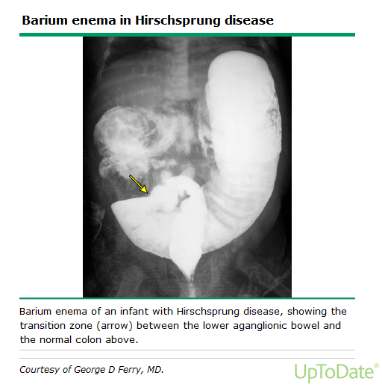

Slide 56
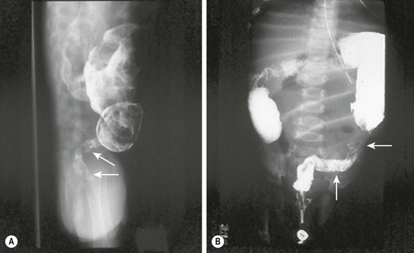

Slide 57
In Hirschsprung disease we order barium enema, Anorectal manometry first , but the definitive diagnosis is biopsy
barium enema findings suggestive for hirschsprung disease :
1- transition zone
2- delayed evacuation of enema (beyond 24h) – this revealed by doing abdominal x-ray after 24h of enemal procedure
Those findings are suggestive not definitive and –ve results don’t rule out the dx of hirschsprund dx

Slide 58
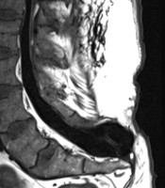
Spine radiographs
Just if the presence of suggestive Hx and PE
Plain films of the lumbosacral spine should be performed for children with evidence of spinal dysraphism or neurological impairment of the perianal area or lower extremities.
If there is a high suspicion of neurologic dysfunction, magnetic resonance imaging (MRI) should be considered to investigate the possibility of tethered cord and spinal cord tumors
Sacral spinal dysraphism with meningiocele

Slide 59
Laboratory tests
Its suggested at the time of the initial evaluation in patients with signs or symptoms of an organic cause of constipation
such as the following clinical situations:
Celiac screening: For children with failure to thrive or recurrent abdominal pain, because the symptoms of celiac disease may be subtle.
for suspected metabolic conditions including
thyroid disease - thyroxine (T4) or thyroid stimulating hormone (TSH)
hypercalcemia - serum calcium levels
hyperkalemia -serum potassium levels
diabetes mellitus - fasting glucose level
diabetes insipidus - serum and urine osmolarity (Dehydration leads to constipation)
suspected toxicity - obtain toxic screen and lead level
for other suspected systemic disorders such as
cystic fibrosis (CF) - perform sweat test
celiac disease - perform serologic testing with immunoglobulin A tissue transglutaminase antibody (tTG), consider endoscopy
suspected cow's milk allergy - consider elimination diet or allergy testing (specific IgE antibodies to cow’s milk)
psychiatric disorders - perform psychological and psychiatric evaluation

Slide 60
Thyroid stimulating hormone – For children with impaired linear growth and depressed reflexes, or those with a history of central nervous system disease,
measurement of free thyroxine (T4) as well as thyroid stimulating hormone (TSH).
Electrolytes and calcium – For children at risk for electrolyte disturbances (eg, those with metabolic abnormalities or inability to tolerate adequate fluids)
A growth velocity less than 5 cm/year (1.6 inches/year) suggests the possibility of growth failure in prepubertal children

Slide 61
Urine analysis and culture – For children with a history of rectosigmoid impaction, especially in association with encopresis.
There is relation btw UTI and constipation
UTI can cause constipation , and constipation is a risk factor for UTI development ,
So regardless to functional or organic ; any pt with chronic constipation develops fever and urinary symptoms >> you should rule out UTI
Notes:
Signs and symptoms of lead poisoning in children include:
Developmental delay
Learning difficulties
Irritability
Loss of appetite
Weight loss
Sluggishness and fatigue
Abdominal pain
Vomiting
Constipation
Hearing loss
Seizures
Eating things, such as paint chips, that aren't food (pica)

Slide 62
Motility testing
Motility testing is typically considered in patients who have no obvious organic cause of constipation and who fail to respond to vigorous treatment of functional constipation. So mainly used in patients with intractable constipation before considering surgical methods.
Colon transit studies
Anorectal manometry

Slide 63
Colon transit studies
A colonic transit study is not helpful for the routine evaluation of a child with constipation
may be used to discriminate between functional constipation and functional nonretentive fecal incontinence or in cases of unclear diagnosis
Using radio-opaque markers (Sitzmark capsules) or scintigraphy techniques, One of the easiest techniques is to have the child swallow a capsule containing 24 radiopaque markers once a day for three days. Plain radiographs are taken on the fourth day (and sometimes also on the seventh day), and analyzed for the number and location of retained markers
generally reserved for the secondary evaluation of selected patients in whom the diagnosis is unclear.
Ideally, any fecal impaction should be relieved, and laxatives should be discontinued several days prior to performing the study.

Slide 64
A CTT of >= 62 hrs constipation
A CTT <62 hrs rules out constipation

Slide 65
A seven-year-old boy with a delayed colonic transit time. The distribution of the markers, with a majority in the rectosigmoid region, is characteristic for anorectal retention.

Slide 66
Anorectal manometry
involves placement of a catheter containing pressure-transducing sensors into the rectum, thereby permitting measurement of neuromuscular function of the anorectum.
The procedure includes measurements of the rectoanal inhibitory reflex , rectal sensation and compliance, and squeeze pressures.

Slide 67
Notes:
Anorectal manometry can be useful in discriminating between functional constipation and Hirschsprung disease. A balloon catheter is inserted into the rectum during this test.
The procedure includes measurements of the rectoanal inhibitory reflex , rectal sensation and compliance, and squeeze pressures.
Normally, when the rectal balloon is inflated, the internal anal sphincter relaxes reflexively (anorectal reflex)
Among patients with Hirschsprung disease, the internal anal sphincter fails to relax in response to rectal distention.

Slide 68
Functional constipation  distension of the rectum causes relaxation of the internal sphincter.
Hirschsprung disease no sphincter relaxation
Anorectal manometry also can identify patients with dyssynergic defecation, which is a functional disorder characterized by the incomplete evacuation of fecal material from the rectum due to paradoxical contraction or failure to relax pelvic floor muscles when straining to defecate.

Slide 69
Rectal biopsy
The definitive means of establishing or excluding Hirschsprung disease.
The tissue is examined histologically for the presence or absence of ganglion cells in the submucosal plexus.

Slide 71
Management of chronic functional constipation
There are four general steps in bowel retraining:
Disimpaction.
Maintenance therapy :Prolonged laxative treatment and behavior therapy to achieve regular evacuation and avoid recurrent constipation.
Dietary changes (primarily increasing fiber content) to maintain soft stools.
Gradual tapering and withdrawal of laxatives as tolerated.

Slide 72
1) Disimpaction
“Fecal impaction” is a term used to describe markedly increased amounts of stool in the colon, which is a subjective judgment based on clinical findings.
- Clues suggest fecal impaction -
Constipation-associated fecal incontinence.
Significant stool mass palpable on digital rectal or abdominal examination, or on abdominal radiograph.
History of incomplete or infrequent evacuation.

Slide 73
Oral medications :
This method is noninvasive and may help the child feel in control. Oral medications also are particularly valuable for children with a history of painful defecation, perineal trauma, or difficulty tolerating enemas.
- Options -
Polyethylene glycol (PEG) without electrolytes, PEG-electrolyte solutions, or high-dose mineral oil have all been shown to be effective for initial disimpaction.
Notes:
The PEG without electrolytes is generally the most palatable of these options and better accepted by children

Slide 74
Polyethylene glycol 3350:
1 to 1.5 g/kg/day by mouth for up to six days. The daily dose is dissolved in approximately 10 mL/kg of water.
Polyethylene glycol-electrolyte solution (eg, GoLYTELY): 25 mL/kg per hour to a maximum of 1000 mL/hr by nasogastric tube until stool appears clear, or 20 mL/kg per hour for four hours per day.
Mineral oil:
3ml/kg per day by mouth. Mineral oil should not be used for infants, neurologically impaired children, and others at high risk for gastroesophageal reflux, because of risks of pneumonitis if the oil is aspirated.
Other oral agents:
Include magnesium hydroxide , magnesium citrate , lactulos, sorbitol, senna, and bisacodyl.
Notes:
The rate of the PEG-electrolyte infusion should be slowed if the child develops vomiting or abdominal distension. Bowel perforation has been reported in children undergoing bowel disimpaction with nasogastric PEG-electrolyte solutions, especially in patients with previous bowel surgeries, who may have unrecognized sub-acute bowel obstruction due to a stricture or an adhesion.

Slide 75
Rectal medications :
For patients with severe impaction, are more rapidly effective than oral medications for disimpaction and may be a powerful motivator for toilet sitting.
Enemas are invasive and may be difficult to administer to an uncooperative or fearful child.
Sodium phosphate enemas, or mineral oil enemas followed by a sodium phosphate enema may be used for rectal disimpaction.

Slide 76
Sodium phosphate enema :
(33 mL) enema for children 2 to <5 years; (66 mL) enema for children 5 to 12 years; and (133 mL) enema for children ≥12 years. This dose may be repeated once within 12 to 24 hours, if necessary.
Saline enema:
This can be administered using a dose of 10 to 15 mL per kg.
Mineral oil enema:
(66 mL) enema for children 2 to 12 years of age, and (133 mL) enema for children ≥12 years.
Bisacodyl suppositories:
May be used for older children, and glycerin suppositories for infants.
Notes:
several case reports of life-threatening hyperphosphatemia and hypocalcemic tetany, particularly in young children, those with colonic dysmotility, and/or with repeated administration of enemas [45-48]. Phosphate-based enemas should be avoided in children with renal insufficiency

Slide 77
Oral and rectal — Combination treatment with oral and rectal medications is often the most effective approach for moderate or severe fecal impaction
Notes:
the initial treatment is with oral medication to soften the stool, and rectal medication is added on day two to help evacuate the impacted stool. An alternative combination approach consists of three to four consecutive three-day cycles in which a phosphate sodium enema is administered on day one, a bisacodyl suppository on day two, and bisacodyl tablet (10 mg) on day three [5,24].

Slide 79
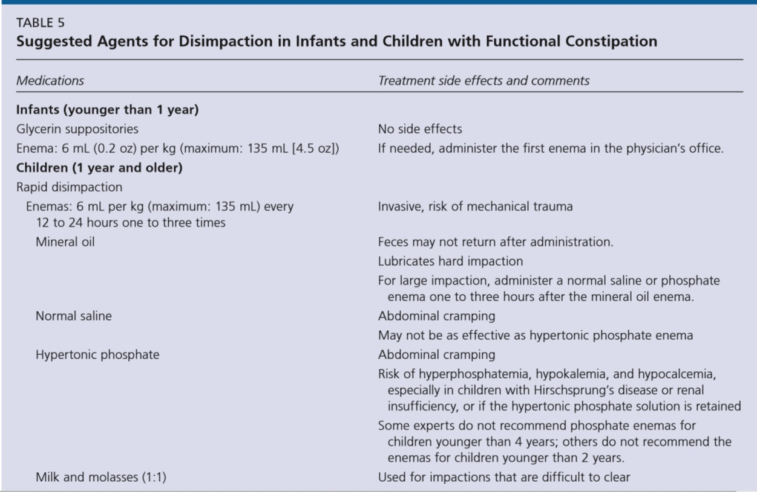

Slide 81
2) Maintenance
Laxatives:
After disimpaction, patients should be treated with a maintenance regimen of oral laxatives to “retrain” the bowel and avoid re-impaction.
Adequate doses of medication should be given to maintain a pattern of soft bowel movements once or twice a day.
Polyethylene glycol 3350, magnesium hydroxide (milk of magnesia), lactulose, and mineral oil.

Slide 82
Parents should be advised to adjust the laxative dose according to the response, and to increase the dose every two days until the child has one or two soft stools each day, or to decrease it if the patient develops diarrhea.
After starting the laxative treatment, parents should be advised to encourage the child to use the toilet for 5 to 10 minutes at the same time each day, preferably after breakfast or dinner.
Notes:
In young children, eliminating any pain associated with the passage of bowel movements is extremely important. Using very large doses of laxatives to produce very soft stools may be necessary.

Slide 84
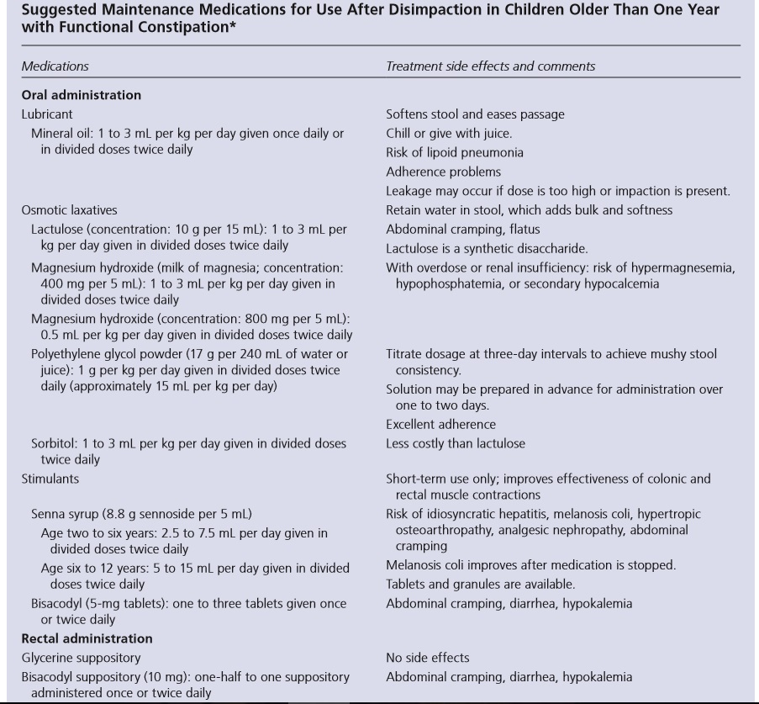

Slide 85
The choice of laxative is less important than using an adequate dose and assuring compliance.
The dose should be based upon age, body weight, and severity of constipation.

Slide 86
Behavior modification
Is used to recondition the child to normal bowel habits.
Toilet-sitting :The child should sit on the toilet shortly after a meal, for 5 to 10 minutes, two to three times per day Toilet sitting episodes should occur at the same time each day and be timed with a timer or stopwatch.

Slide 87
Reward system: for any effort (toilet training ) not necessary for success (pass stool) .
Monitoring :
The parents or caretaker should use a diary or log to record bowel movements, the use of medication, and episodes of fecal incontinence, abdominal pain, and wetting.

Slide 88
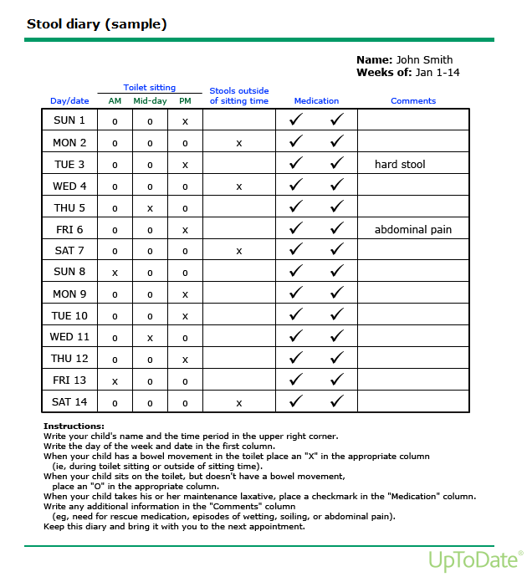

Slide 89
3) Dietary changes
Fiber:
Increasing the intake of fiber, through dietary changes or fiber supplements, is often recommended for acute and chronic constipation.
For children with acute or mild chronic constipation, a reasonable target for dietary fiber can be calculated as the child’s age plus 5 to 10 grams/day (ie, 11 to 16 grams/day for a six year old child).
Notes:
For children with acute or mild chronic constipation, a reasonable target for dietary fiber can be calculated as the child’s age plus 5 to 10 grams/day (ie, 11 to 16 grams/day for a six year old child).

Slide 90
Fluid intake:
There is no evidence that constipation can be successfully treated by increasing fluid intake unless the patient is clinically dehydrated.
Children with chronic constipation or fecal incontinence should be encouraged to consume at least (960 to 1920 mL) of water or other non-milk liquids per day, particularly if they are using fiber supplements.

Slide 91
Cow's milk:
In children whose constipation is unresponsive to other measures, and especially in those with atopic symptoms, we suggest a trial for at least two-weeks of eliminating all cow's milk protein from the diet.
Switching the patient to a low-iron formula is not necessary, as several studies have shown that ingestion of iron-supplemented formulas is not associated with an increased incidence of constipation.

Slide 92
Follow-up
After entering the maintenance phase, the child should have regular follow-up visits, initially on a monthly basis and then less frequently (eg, every three to four months). The clinician should review the child's stool records and repeat the abdominal and rectal examinations.

Slide 93
DISCONTINUATION OF LAXATIVES
The goal of therapy is passage of soft normal caliber stools every one to two days, without fecal incontinence.
Once the child has achieved regular bowel habits (and independently uses the toilet), the frequency of mandatory toilet sitting and the use of laxatives can be reduced.
The laxative dose is gradually decreased to a dose that will prevent soiling, and maintain one to two bowel movements per day.
Typically wait until optimal bowel habits are achieved and stable for at least six months before laxative use is further decreased.
Notes:
In many cases, laxatives need to be taken for months and sometimes years to induce daily soft stools

Slide 94
TREATMENT FAILURE
Failure of treatment, manifested by continued soiling and recurrent impaction.
Most treatment failures are caused by inadequate medication or premature discontinuation.
Repeated failure despite adequate compliance requires reconsideration of the diagnosis and the possibility of further testing.

Slide 95
SURGERY
Anal sphincter release:
Some children with constipation refractory to medical therapy may respond to an intervention to release the internal anal sphincter through myectomy or injection of botulinum toxin.

Slide 96
Acute episodes of constipation
Children:
Usually be treated with dietary changes, including increasing fiber and ensuring adequate fluid intake if the symptoms are mild.
For those with stool withholding behavior, pain while defecating, rectal bleeding or anal fissure, Suggestion for initial treatment with an osmotic or lubricant laxative, rather than dietary intervention alone.

Slide 97
Infants:
Treated by the addition of undigestible, osmotically active carbohydrates to the formula, such as sorbitol-containing juices (eg, apple, prune, or pear).
For infants who have begun solid foods, sorbitol-containing fruit can be used.
Glycerin suppositories or rectal stimulation with a lubricated rectal thermometer can be used occasionally if there is very hard stool in the rectum, but should not be used frequently.

Slide 98
In infants older than six months who have ongoing or recurrent constipation despite dietary interventions, osmotic laxatives such as lactulose or PEG3350 may be required. Infants with severe or recurrent constipation, especially those with constipation from birth, should be carefully evaluated for possible organic causes.

Slide 99
References:
Nelson Textbook of Pediatrics-2016.
Study from American Family Physician Web site.
Old seminar.
Thank You ☺

