Slide 1
Abdominal pain during pregnancy
التبييض باللون البرتقالي
Approach to diagnosis and management
Supervised by :
Dr. Omar Abu -Azzam
Students Names:
.Mohammad Al-Asasfeh .Mona AL-Zoubi .Hala yousef
.Sondus AL-Malahmeh

Slide 2
introduction
The approach to acute abdominal/pelvic pain in pregnancy is similar to that in the nonpregnant state, with some additional challenges.
The initial goal is to identify patients who have a serious or even life-threatening etiology for their symptoms and require urgent intervention.
Additional issues during pregnancy include consideration of the effects of anatomic and physiologic changes related to pregnancy, causes of acute abdominal/pelvic pain that may be more common due to the pregnant state or related to obstetric complications, and the effect of the disorder on the fetus.
Indicated diagnostic imaging and interventions should be performed since delay in diagnosis and treatment can increase maternal and fetal/newborn morbidity and mortality.
Signs and symptoms that suggest a possible serious disease process include moderate or severe abdominal or pelvic pain, vaginal bleeding, new onset hypertension, hypotension, vomiting, or fever.

Slide 3
History
Pain history - SOCRATES
Other abdominal symptoms - vaginal bleeding, bowel and urinary symptoms; pre-eclampsia symptoms (eg headache, visual change, nausea).
Fetal movements
Obstetric history ﻿﻿-last menstrual period (LMP) ﻿﻿-confirm whether the patient's last bleed was 'normal' for the patient (ectopic pregnancy may have some bleeding which can be mistaken for menstrual bleed) ﻿﻿-ask if there has been any difficult or assisted conception
-confirm use of any contraception (coil and progestogen-only pill (POP) increase ectopic risk).
Past medical and gynecological history, medication, allergies, last meal.

Slide 4
Physical examination
•Vital signs – Obtain vital signs: Hemodynamic instability is an indication for immediate evaluation of pregnant patients.
•Abdominal examination – Examine the abdomen: the examination is the same for pregnant and nonpregnant patients and includes inspection, auscultation, percussion, and palpation.
However, the anatomical changes due to enlarged gravid uterus need to be considered.
•Uterus – Determine uterine size (which correlates with gestational age) and evaluate tone, tenderness, and, in the second half of pregnancy, frequency of contractions.
The normal uterus is non-tender and soft, like any other relaxed muscle.
A rigid or tender uterus in the second half of pregnancy suggests placental abruption, intrauterine infection, uterine rupture, or possibly labor.

Slide 5
•Fetal heart rate – The fetal heart rate should be documented.
Continuous fetal heart rate monitoring is usually appropriate in pregnancies that have reached a gestational age with a reasonable chance of extrauterine survival (≥22 weeks of gestation).
An abnormal fetal heart rate may be the direct consequence of a pregnancy-related cause of abdominal/pelvic pain (eg, placental abruption) or it may be an indirect consequence of maternal compromise (eg, hypotension, infection). In either case, fetal resuscitation is usually indicated and urgent delivery may be appropriate.
•Fetal membranes – Whether the membranes have ruptured or remain intact should be determined via a sterile speculum examination. Rupture often leads to initiation of labor and may be associated with intrauterine infection or placental abruption.
•Cervix – Cervical dilation/effacement should be assessed by digital examination if the membranes are intact and ultrasound has confirmed the absence of placenta previa. Obstetric and nonobstetric disorders may lead to uterine contractions, which may result in cervical changes consistent with labor.

Slide 6
labs
In general, we suggest the following, unless a specific diagnosis is strongly suspected:
Complete blood count with differential
Urinalysis
Basic metabolic panel (electrolytes and renal function)
Liver and pancreatic biochemical and function tests (aminotransferases, bilirubin, amylase, lipase)
Pregnant patients with hemodynamic instability (hypotension or tachycardia) should have blood sent for coagulation studies and type and crossmatch.
In the presence of fever or unstable vital signs possibly related to sepsis, blood and urine cultures are performed and may be helpful subsequently to confirm suspected infection and guide choice of antibiotic therapy.

Slide 7
imaging
Ultrasound
It is widely available, portable, nonionizing, and its diagnostic performance is often adequate.
MRI
Use of MRI is preferable to CT because it avoids ionizing radiation, It is important to note that gadolinium crosses the placenta and may have potential harmful fetal effects. Therefore, the use of gadolinium generally should be avoided.

Slide 8
Abdominal pain in pregnancy
Obstetrical & Gynecological
Non-Obstetrical (Medical-Surgical)
Intestinal Obstruction
Cholecystitis
Appendicitis
Pancreatitis
First half of preg.
Second half
Any time in preg.
Miscarriage
Ectopic
Constipation
Round Ligament pain
Placental Abruption
Preg. Related Liver ds.(PET, HELLP, Acute Fatty Liver
Labor
Intra Amniotic Infection
Fibroid-Red degeneration
Bleeding Ovarian Cyst
Adnexal
Torsion
Uterine Rupture
PID
(Very rare)
GER
Diverticulitis
Lower Lobe Pneumonia
UTI
To choose your DDx Keep in mind GA+ commonest causes

Slide 9
First Half of pregnancy

Slide 10
1-Miscarraige
is defined as the loss of a pregnancy before 20 weeks of gestation.
Diagnosis
Speculum and pelvic examinations are the first steps in the diagnostic evaluation. If no products of conception are identified grossly in the cervix or vagina, then ultrasonography is the most useful follow-up test. The sonographic signs of a nonviable pregnancy vary with gestational age.
Signs and symptoms
mild to moderate midline crampy pelvic pain and mild to moderate vaginal bleeding.
Don’t forget to ask about passing tissues/ vesicles
8 weeks of amenorrhea+ abdominal pain+ vaginal spotting in the 2nd visit (the 1st one confirming an intrauterine sac)→ think of missed miscarriage

Slide 11
Miscarriage
FH present
Sever pain→ due to open cervix
No abdominal pain

Slide 12
Septic miscarriage
Sever abdominal pain+ sever tenderness+ febrile pt.+ foul smell discharge+ chills+ shivering
Mx: broad spectrum antibiotics then evacuation
Don’t do Immediate surgical management→ friable uterus

Slide 13
2-Ectopic pregnancy
Clinical manifestations
vary somewhat depending upon the location and status of the pregnancy.
Abdominal pain due to localized bleeding or rupture is a common symptom of all types of ectopic pregnancy.
Vaginal bleeding
Blood in the peritoneal cavity can be identified by ultrasound examination of the pelvis and abdomen.
Patients with rupture may also have tachycardia, hypotension, low grade fever, and a mild elevation in the white cell count.
8 weeks of amenorrhea+ abdominal pain+ vaginal spotting in the 1st visit → think of Ectopic miscarriage
Diagnosis
is usually based upon results from a combination of ultrasound examination and B-hCG level in the early first trimester.
Management :
Surgical.
Medical.
Expectant.

Slide 14
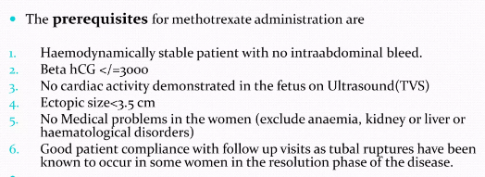
Ectopic miscarriage
Abdominal Exam: uterine size+ tenderness (ruptured ectopic causing hemoperitonium)
Pelvic exam: do speculum exam to search for local causes of bleeding (polyps, ectropion),
adnexal mass
US: Gold standard
(b-hCG not necessary to be done before the US esp. if we visualize the intrauterine sac//
b-hCG is crucial in cases of → 1- ectopic & 2- molar pregnancy
Mx:
Consider pt. hemodynamic stability+ b-hCG value+ free fluids
(if there is free fluid even if the pt. is stable don’t do medical Mx)
Surgical Mx: ectomy vs otomy→ health state of the 2nd ovary

Slide 15
3-constipation
Physiological changes in pregnancy result in the slowing of gut peristalsis.
Signs and Symptoms
Varied but colicky lower abdominal pain (L>R) is the most common
Management
• High-fibre diet (its enough in the majority of cases).
• Osmotic laxatives.
• Glycerin suppositories.
It is due to a combination of factors, including the effects of the hormonal changes of pregnancy on the gastrointestinal tract, mechanical effects of the enlarging uterus, reduced physical activity, intake of iron supplements or vitamins with iron, and changes in diet

Slide 16
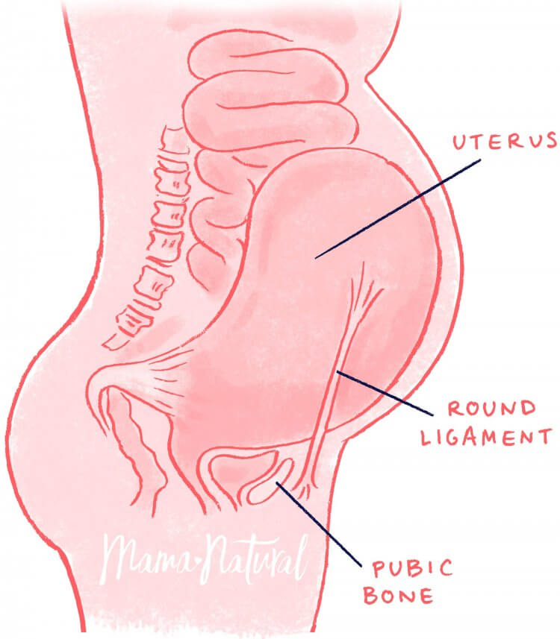
4- Round ligament pain
Pain is more common on the right (dextrorotation of the uterus) and may be bilateral. The pain may radiate to the groin and labia majora and Aggravated by movement. Vaginal bleeding is not present.
Early in pregnancy, unilateral mild sharp pelvic pain related to "stretching" of one of the round ligaments is a common benign process
Felt when the uterus become an abdominal organ→ 2^{nd+} 3rd trimester
There are no positive laboratory or imaging findings. Round ligament pain is a clinical diagnosis of exclusion.
Tx:
• Reassurance.
• Simple analgesia
• Support belts may help.

Slide 18
Second half of pregnancy

Slide 19
1- Placenta abruption
!
Classically presents with
Vaginal bleeding (except in concealed abruption)
Abdominal and/or back pain
Uterine tenderness
Uterine rigidity
Uterine contractions.
The severity determined according to maternal+ fetal state
The fetal heart rate pattern may be abnormal and is likely to be abnormal in pregnancies with substantial placental separation. In these cases, maternal DIC (the most serious complication) and/or fetal death commonly occur.
A retroplacental, preplacental, or subchorionic clot is the classic ultrasound finding of placental abruption but is not always present.
Diagnosis is based on clinical findings, and delivery is usually indicated.
Is decidual hemorrhage leading to the premature separation of the placenta prior to delivery
MANAGEMENT: The state of the mother and fetus is key.
If the bleeding is life threatening or fetal testing is non-reassuring then deliver.
Otherwise, stabilize, prepare for the possibility of a future bleed(Large bore IV cannulas, PRBCs, and FFP), Then Prepare for preterm delivery (dexamethasone).

Slide 20
2- Pregnancy related liver ds: preeclampsia
1
Preeclampsia is a syndrome characterized by the new onset of hypertension and usually proteinuria after 20 weeks of gestation in a previously normotensive patient.
Right upper quadrant or epigastric pain is a sign of liver involvement and signifies the severe spectrum of the disease.
The pain may be caused by stretching of Glisson's capsule due periportal or subcapsular bleeding or, rarely, hepatic rupture (use US).
The diagnosis is based on characteristic symptoms, findings on physical examination, and laboratory results
Management of severe preeclampsia: Delivery is the definitive treatment
Hospitalization until delivery
Antenatal corticosteroids
Deliver after 32 to 34 weeks of gestation
For acute therapy: labetalol, and hydralazine
Seizure prophylaxis with magnesium sulfate

Slide 22
Hellp syndrome
2
Hemolysis with a microangiopathic blood smear, elevated liver transaminases, and a low platelet count are the findings in HELLP syndrome
Clinical presentation:
The most common clinical presentation is abdominal pain and tenderness in the midepigastrium, right upper quadrant, or below the sternum. As with preeclampsia, the pain may be caused by stretching of Glisson's capsule due periportal or subcapsular bleeding or, rarely, hepatic rupture.
Many patients with HELLP also have nausea, vomiting, and malaise, which may be mistaken for a nonspecific viral illness or viral hepatitis, particularly if the serum AST and LDH are markedly elevated
Hemolysis markers: LDH, schistocytes in the blood film
Mx:
Immediate delivery regardless GA
Don’t wait until giving dexa
Hypertension and proteinuria are present in approximately 85% of cases, but it is important to remember that either or both may be absent in HELLP

Slide 23
Acute fatty liver
3
The diagnosis of acute fatty liver of pregnancy is usually made clinically
Laboratory test findings may show increased levels of aminotransferases, bilirubin, uric acid, ammonia, and creatinine; thrombocytopenia; prolonged prothrombin time; hypoglycemia; and leukocytosis.
Imaging tests of the liver are primarily used to exclude other diagnoses, such as a hepatic infarct or hematoma, although some authors have reported finding fat on ultrasound, CT, or MRI.
Acute fatty liver of pregnancy occurs after 20 weeks of gestation, usually in the third trimester.
The most frequent initial symptoms are nausea or vomiting (approximately 50% of patients), abdominal pain (particularly epigastric, 50%), anorexia, and jaundice (30%).
Approximately 70% of patients have signs of preeclampsia at presentation or at some time during the course of illness
Initial management of the patient with AFLP includes prompt delivery of the fetus, regardless of gestational age.
Medical treatment is provided to stabilize the mother while the liver recovers.

Slide 24
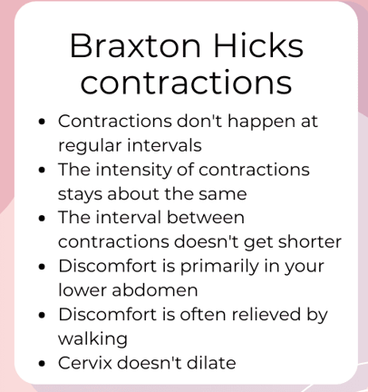
3- labor
Labor should always be considered in the differential diagnosis of abdominal pain in pregnant patients, especially when symptoms are increasing over time It is a clinical diagnosis defined by uterine contractions of increasing frequency, intensity, and duration that cause cervical dilation and/or effacement over time.
Differentiate btween labor pain and Braxton Hicks Contractions:
The presence of light vaginal bleeding and/or rupture of membranes increases diagnostic certainty in patients with minimal cervical dilation or effacement
• Preterm labour may present with a history of vague abdominal pain which the woman may not associate with uterine activity.
Consider a VE in pregnant women with abdominal pain.
Labor pain without cervical changes: threatened preterm
Mx: admission+ tocolysis

Slide 25
4- Intra Amniotic infection(chorioamnionitis)
Infection of the amniotic fluid, membranes, placenta, and/or umbilical cord. It may be subgrouped as clinical (overt) or subclinical infection, or as histologic chorioamnionitis (which may be noninfectious).
* IAI is typically polymicrobial and usually results from migration of cervicovaginal flora through the cervical canal in patients with ruptured membranes
Signs and symptoms of intra-amniotic infection include fever, abdominal pain, uterine tenderness, leukocytosis, maternal and fetal tachycardia, and uterine contractions. It is most common in the setting of preterm or term rupture of the fetal membranes, with or without labor.
Management:
IAI cannot be cured medically without delivery. We suggest prompt induction or augmentation of labor, as appropriate, with cesarean birth reserved for standard obstetric indications
Broad spectrum antibiotics should be started as soon as diagnosis is made and continued through delivery to minimize maternal and fetal morbidity
Our preference is ampicillin 2 g intravenously every six hours plus gentamicin 5 mg/kg once daily.

Slide 26
Any time in pregnancy

Slide 27
1- Fibroid (red degeneration)
Fibroid in pregnancy: 1/3 increase in size, 1/3 no change, 1/3 decrease in size
Red degeneration: in increasing fibroid (feeding artery not enough→ areas of hemorrhagic infarcts→ sever pain
The majority of fibroids remain asymptomatic in pregnancy.
Degeneration may occur and is more common with leiomyomas >5 cm in diameter
Pedunculated fibroids are at risk of torsion; symptoms are similar to those with degeneration
Red degeneration is a hemorrhagic infarction of the uterine leiomyoma.
Treatment
• Analgesia (pain should resolve in 4–7 days; however, it may be severe and prolonged, so advice from pain specialists should be sought).
Most cases improve with: Admission+ iv fluids+ strong analgesia
DON’T think of surgical Mx in pregnancy
Most patients have only localized pain, although mild leukocytosis, fever, peritoneal signs, and nausea and vomiting can occur.
Fibroids are readily identified on ultrasound examination.
Pain after ballottement by the abdominal ultrasound probe directly over the fibroid supports the diagnosis of degeneration or torsion.
NOTES
Placental abruption differs in that the fibroid uterus is soft except at the site of the fibroid and the FH is normal.
Myomectomy must not be performed in pregnancy as it will bleed ++ (the only exception being for a torted pedunculated fibroid).

Slide 28
2- Bleeding ovarian cyst
Rupture of an ovarian cyst into the peritoneal cavity or bleeding into an ovarian cyst may be associated with the sudden onset of unilateral lower abdominal pain.
Ultrasound is the first-line imaging study for identification and characterization of the ovarian neoplasm and to look for fluid in the cul-de-sac.
Although it can occur anytime in pregnancy, rupture is most likely to occur in the first or early second trimester. The pain often begins during strenuous physical activity, such as exercise or sexual intercourse. Rarely, bleeding is sufficiently severe to cause hemodynamic instability.
Mx: ovarian cystectomy (open vs laparoscopic→ depend on the GA// considering open in advanced GA

Slide 29
3- Adnexal torsion
the ovary,
A presumptive diagnosis of torsion can be made with reasonable confidence in patients with acute pelvic pain and an adnexal mass with the characteristic sonographic appearance (including Doppler studies) of torsion and after exclusion of other conditions. A definitive diagnosis requires direct visualization of a rotated ovary at the time of surgery. The preferred treatment for a viable appearing ovary is to attempt to conserve the ovary by untwisting the pedicle to allow for the return of blood flow to and from the ovary.
A salpingo-oophorectomy is required if the ovary is clearly nonviable (necrotic/gelatinous with loss of all normal anatomic structures) at surgery.
Adnexal torsion may involve
Ovarian torsion typically presents with right lateralized lower abdominal pain, frequently accompanied by nausea, vomiting, low-grade fever, and/or leukocytosis.
It occurs in all three trimesters but is most common in the first trimester and can occur postpartum.
Risk factors include an ovarian cyst or mass and induction of ovulation, which can cause enlarged multicystic ovaries
fallopian tube,
or both structures.

Slide 30
4- Uterine rupture
This usually occurs during labour but has been reported antenatally.
Rupture of an unscarred uterus in a laboring patient is rare; risk factors include grand multiparity, dystocia (malpresentation, macrosomia), obstetric procedures (breech extraction, uterine instrumentation, cephalic version), and prolonged or excessive use of uterotonic drugs
Signs and symptoms include nonreassuring fetal heart rate tracing or fetal death, uterine tenderness, abdominal pain, peritoneal irritation, bradycardia, vaginal bleeding, shock, and loss of fetal station.
Risk factors
• Previous CS or other uterine surgery.
• Congenital abnormalities of the uterus.
• Induction or use of oxytocin in labour.
• Failure to recognize obstructed labour.
Management
• Maternal resuscitation.
• Urgent laparotomy to deliver fetus and repair uterus.
If the pt. completed her family→ hysterectomy
If not→ repair (which may failed due to atony, so consider hysterectomy ☺
Investigations • FBC. • Cross-match blood.

Slide 31
Non-obstetric (surgical) causes
BY:
Sondus W. AL-Malahmeh

Slide 32
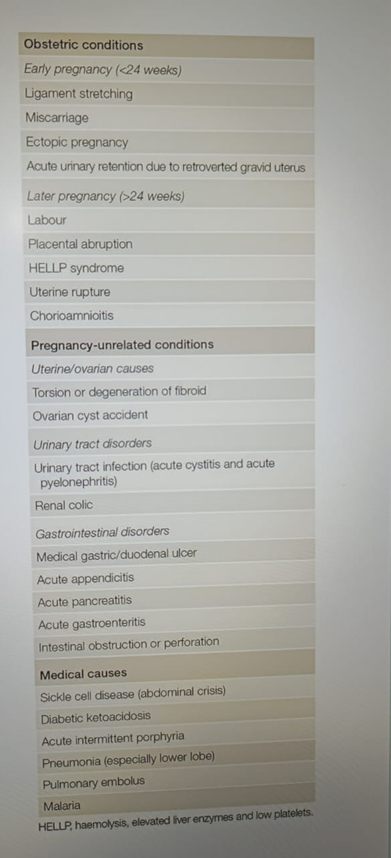

Slide 33
1- appendicitis low threshold dx in pregnancy
Acute appendicitis is inflammation of the appendix, which in its worst form can lead to rupture. It is the most common cause of an acute surgical abdomen in pregnancy
Its incidence is 1:1500–2000 pregnancies with equal frequency in each trimester. Pregnant women have the same risk of appendicitis as non-pregnant women.
Patients with appendicitis in pregnancy often present in a non classical way ). In the classic presentation, central abdominal pain localises to the right iliac fossa – at McBurney’s point which is 6 cm along a line from the anterior superior iliac spine toward the umbilicus.3 Pain is associated with anorexia, nausea and fever up to 39.3°C with raised white cell count. Underlying inflammation irritates the anterior abdominal wall causing signs of rebound and guarding; the ‘surgical’ abdomen. Rovsing’s sign of increased pain on withdrawing the examining hand from the abdomen demonstrates peritoneal irritation.
A pregnant patient may present with heartburn, constipation, diarrhoea, urinary symptoms or just general malaise. Pain may be felt in McBurney’s point or anywhere on the right side of the abdomen.4 This occurs because after 12 weeks the enlarged uterus stretches the anterior abdominal wall and omentum away from the area of inflammation (upward shifting) This prevents the classic signs of rebound tenderness or guarding.

Slide 34
Imaging is indicated where the diagnosis is uncertain. The primary goal of imaging is to reduce delays in surgical intervention. The secondary goal is to reduce the negative appendicectomy rate.
Investigations can be misleading in pregnancy. Nonpregnant patients with acute appendicitis usually have a mild leucocytosis, with white cell count over 10x109 /L. This is a common finding in normal pregnancy however, where the leucocyte count may reach 29 x109 /L without any underlying health problem. In pregnancy an elevated white cell count can be attributed to inflammation if the C reactive protein (CRP) level is also raised. In general however, elevated CRP is a very non-specific marker for inflammation.
Ultrasound MRI CT

Slide 35
Differential diagnoses
pre-eclampsia or HELLP syndrome (haemolysis, elevated liver enzymes, low platelets; a severe variant of pre-eclampsia) may present with abdominal pain and vomiting.
Ectopic pregnancy
Pyelonephritis
PID
Ovarian torsion
Rupture uterus
Abruptio
Threatened miscarriage
may present with abdominal pain though gastrointestional symptoms are rare. Examination of the cervix and correlation with ultrasound
. This can be done by ultrasound and correlation with blood human chorionic gonadotrophin levels

Slide 36
Management
Open Vs laparoscopic?!
According to the GA
The treatment for acute appendicitis is surgery.
Maternal and fetal morbidity increase dramaticall if the appendix perforates as high as 36%.16 Perforation of an infected appendix can cause widespread pus and faecal soiling of the intra-abdominal cavity. This can cause severe sepsis and a critically ill patient. In addition to the risk of fetal loss, a perforated appendix increases the risk of preterm delivery and future difficulties with pelvic adhesions and subfertility.
immediate laparotomy, appendicectomy and extensive irrigation of the abdomen.
Antibiotics should not be used alone in management without surgery as they are not sufficient for definitive treatment.20

Slide 37
2- Cholecystitis
This is the second most common surgical condition in pregnancy (progesterone diminishes smooth muscle tone and predisposes to cholestasis leading to gallstone formation). The incidence of gallstones is 7% in nulliparous and 19% in multiparous women. The incidence of acute cholecystitis is 1–8:10 000 pregnancies.
Cholelithiasis
Asymptomatic
cholelithiasis
Symptomatic
cholelithiasis
Chronic
calculous
cholecystitis
Acute
calculous
cholecystitis
increase in Progesterone.
bile is unable to exit the gallbladder
Cholestasis
Cholelithiasis

Slide 38
Biliary Colic Cholecystitis
biliary colic
The pain occurs due to a stone obstructing the cystic duct, causing wall tension; pain resolves when stone passes
Pain usually lasts 1-5 hrs, rarely > 24hrs
Ultrasound reveals gallstones
Exam, WBC, and LFT normal in this case
RUQ pain lasting hours to days
Pain usually unremitting more than 6h
Nausea, vomiting, anorexia & fevers common
Positive Murphy’s sign
Palpable/tender or even visible RUQ mass
Elevated WBC
Jaundice (indicating obstruction of the common bile duct).

Slide 39
The Problem in detecting the beginning of gallbladder disease during Pregnancy is that the symptoms may be confused with Morning Sickness.
Persist beyond the first trimester (Symptoms of Gallbladder disease are more common in the Third trimester or after delivery).
U/S early (most effective
Complication
The reason for the increased rate of Fetal demise is unclear. Most happen after 37 gestational weeks and may be secondary to Pathology induced by the elevated bile acids that can cross the placenta.
Perinatal Mortality rate is increased when the Mothers have severe disease with total bile acid levels ≥ 40 μmol/L.
Bile acids may cause Fetal cardiac arrest after entering Cardiomyocytes in high amounts.

Slide 40
Treatment
In general, the Goal of treatment during Pregnancy is to Reduce the symptoms and complications, and then treat the disease itself after Pregnancy.
The First step in treating change your diet and eat fewer fatty foods (the gallbladder will have to work less)
Regular exercise can also be Helpful.
Any Surgery during Pregnancy is generally avoided. But if the inflammation is severe, if there is an infection or if the colic is acute, (laparoscopic surgery with 2 small incisions).

Slide 41
3.Pancreatitis
This occurs more frequently in the 3rd trimester and immediate post-partum period. It can occur in early pregnancy associated with gallstones. Although rare, it is more common in pregnancy than in non-pregnant women of a similar age. Incidence 1:5000 pregnancies.
Management
-Conservative treatment is the mainstay:
• IV fluids.
• Electrolyte replacement.
• Parenteral analgesics, e.g. morphine (pethidine is contraindicated).
• Bowel rest with or without nasogastric suction.
-Early surgical intervention is recommended for gallstone pancreatitis in all trimesters as >70% of patients will relapse before delivery.
• Laparoscopic/open cholecystectomy.
Risk factors
• Gallstone disease.
• High alcohol intake.
• Hyperlipidaemia.
The diagnosis of acute pancreatitis is based on the fulfillment of two out of the three following criteria:
clinical picture with epigastric pain radiating to the back, pancreatic amylase activity > 3 times the upper limit of normal (blood amylase activity may normalize within 48–72 h from the onset of symptoms
features of acute pancreatitis in imaging
The indication for ERCP in pregnancy is symptomatic cholelithiasis manifested by jaundice, cholangitis, or biliary pancreatitis

Slide 42
complications
Acute pancreatitis in pregnancy carries an increased risk of preterm labor, prematurity, and death. The effects of the disease on the fetus are related
The consequence of the severe course of acute pancreatitis accompanied by SIRS may be the disruption of the functioning of the placenta, which may result in the death of the child

Slide 43
4- intestinal obstruction
It is the third most common non-obstetric reason for laparotomy during pregnancy. It complicates 1:1500–3000 pregnancies. Incidence increases as the pregnancy progresses. Adhesions are the commonest cause.
The leading causes are adhesions and volvulus. Ruling out a bowel obstruction is especially important if vomiting is not accompanied by nausea or if emesis is feculent in character.The delay from presentation to admission continues to be a significant cause of morbidity and mortality, and a high index of suspicion is mandated in pregnant patients with past history of abdominal surgery
Diagnosis
Erect abdominal X-ray (AXR) showing gas-filled bowel with little gas in large intestine.
Cbc,APGs,electrolyte
• USS (abdominal and pelvic).
Treatment
Signs and symptoms
• Acute abdominal pain.
• Vomiting.
• Constipation.
• Pyrexia.
Conservative treatment no improvement after 3 days: surgical operation

Slide 44
Thank you
Resources :
Up-To-Date: Approach to acute abdominal/pelvic pain in pregnant and postpartum patients
Oxford Handbook of Obstetrics and Gynaecology 3rd Edetion
Ten teachers book
Rcog guidlines

