Slide 1
The last Anatomy Lab 🥳🎉🎉

Slide 2
UROGENITAL SYSTEM THE KIDNEYS & URETER
Dr. Aiman Qais Afar Surgical Anatomist
College of Medicine / University of Mutah
Thursday 28 April 2022
1

Slide 3
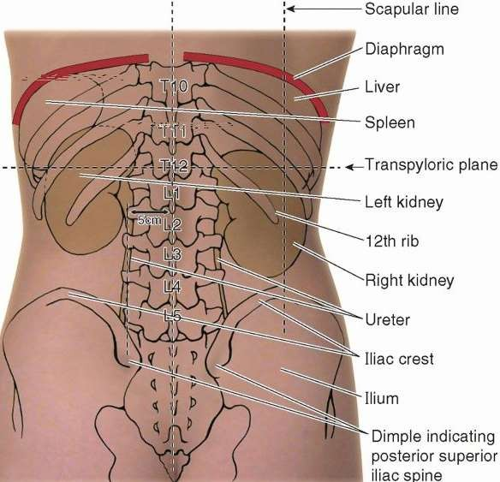
KIDNEYS
They lie retroperitoneally on the posterior abdominal wall, one on each side of the vertebral column at the level of the T11-L3 vertebrae
They are largely under cover of the costal margin
Thursday 28 April 2022
Dr. Aiman Qais Afar
3

Slide 4
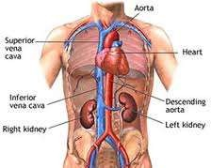
KIDNEYS
The right kidney lies slightly lower than the left kidney because of the large size of the right lobe of the liver.
With contraction of the diaphragm during respiration, both kidneys move downward in a vertical direction by as much as 1 in. (2.5 cm).
Thursday 28 April 2022
Dr. Aiman Qais Afar
4

Slide 5
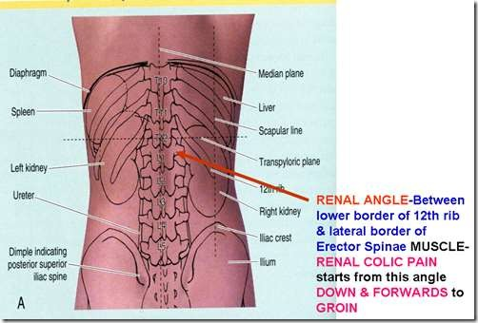
KIDNEYS
Thursday 28 April 2022
Dr. Aiman Qais Afar
5

Slide 6
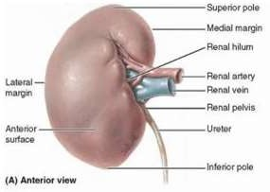
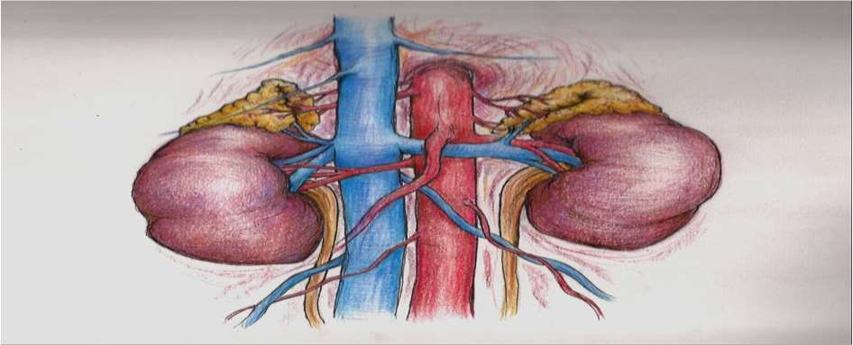
KIDNEYS
The hilum extends into a large cavity called the renal sinus.
Dr. Aiman Qais Afar Thursday 28 April 2022
5

Slide 7
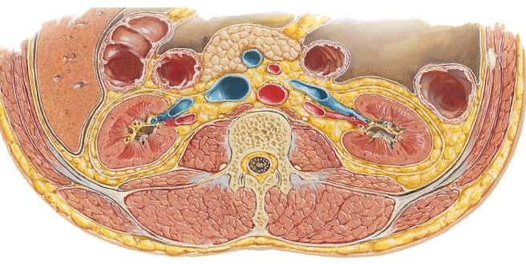
Kidneys
The kidneys have the following coverings:
Fibrous capsule : This is closely applied to its outer surface.
Perirenal fat: This is fat that covers the fibrous capsule
Renal fascia: This is a condensation of areolar tissue outside
the perirenal fat. It encloses the kidneys and the suprarenal glands.
Pararenal fat: This is external to the renal fascia and is often large in amount
Perirenal fat Fibrous capsule
Dr. Aiman Qais Afar Thursday 28 April 2022
Pararenal fat
Renal fascia
6

Slide 8
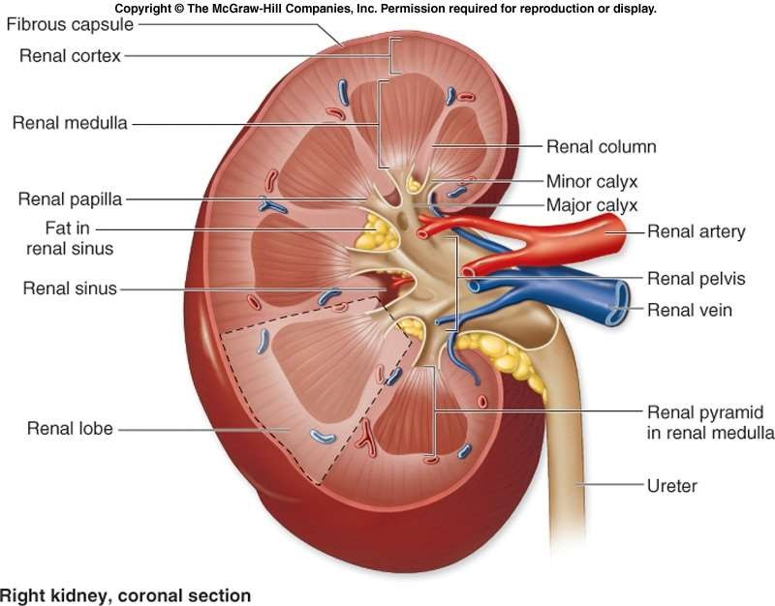
KIDNEYS
Renal Structure
Each kidney has a dark brown outer cortex and a light brown inner medulla.
The medulla is composed of about a dozen renal pyramids, each having its base oriented toward the cortex and its apex, (the renal papilla), projecting medially.
Dr. Aiman Qais Afar Thursday 28 April 2022
7

Slide 9
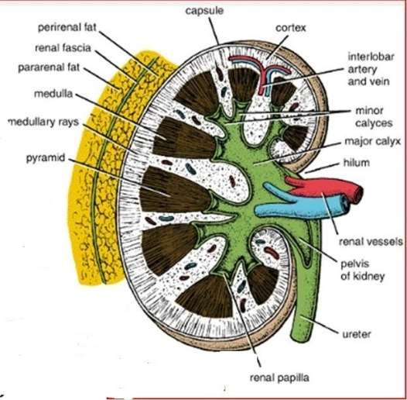
KIDNEYS
The cortex :
Extends into the medulla between adjacent pyramids as the renal columns.
Extending from the bases of the renal pyramids into the cortex are striations known as medullary rays
Thursday 28 April 2022
Dr. Aiman Qais Afar
8

Slide 10
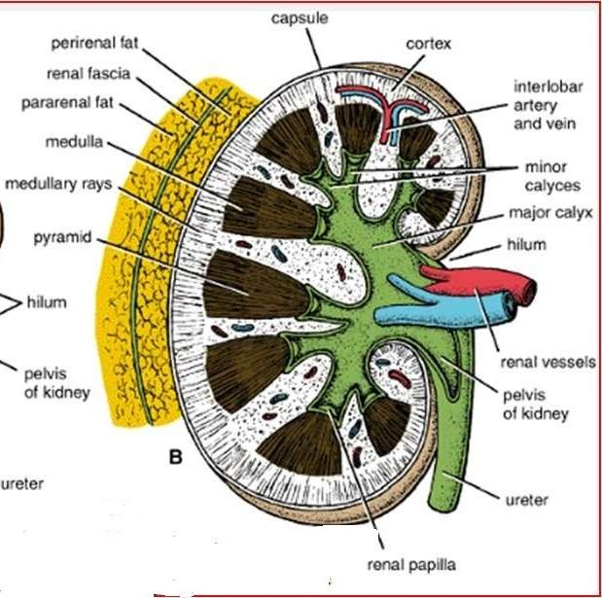
KIDNEYS
The renal sinus, which is the space within the hilum, contains the upper expanded end of the ureter, the renal pelvis.
This divides into two or three major calyces, each of which divides into two or three minor calyces
Each minor calyx is indented by the apex of the renal pyramid, the renal papilla.
Thursday 28 April 2022
Dr. Aiman Qais Afar
9

Slide 11
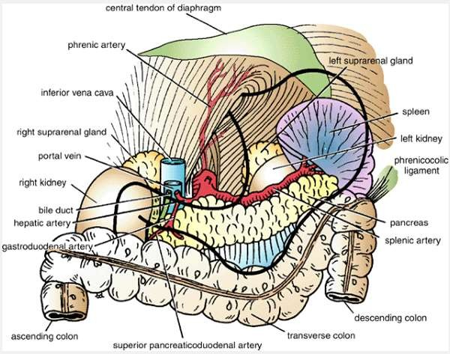
KIDNEYS
Important Relations, Right Kidney
Anteriorly: The suprarenal gland, the liver, the second part of the duodenum, and the right colic flexure
Thursday 28 April 2022
Dr. Aiman Qais Afar

Slide 12
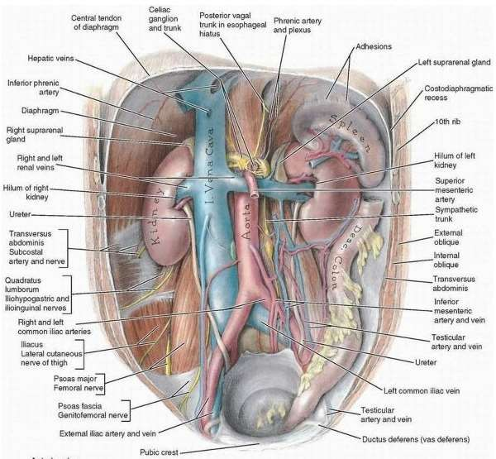
KIDNEYS
Posteriorly
The diaphragm;
The costodiaphragmatic recess of the pleura
The 12th rib مهم
The psoas
Quadratus lumborum
Transversus abdominis muscles.
The subcostal (T12), iliohypogastric, and ilioinguinal nerves (L1) run downward and laterally
Thursday 28 April 2022
Dr. Aiman Qais Afar

Slide 13
KIDNEYS
Thursday 28 April 2022
Dr. Aiman Qais Afar
Important Relations, Left Kidney
Anteriorly: The suprarenal gland, the spleen, the stomach, the pancreas, the left colic
flexure, and coils of jejunum
13

Slide 14
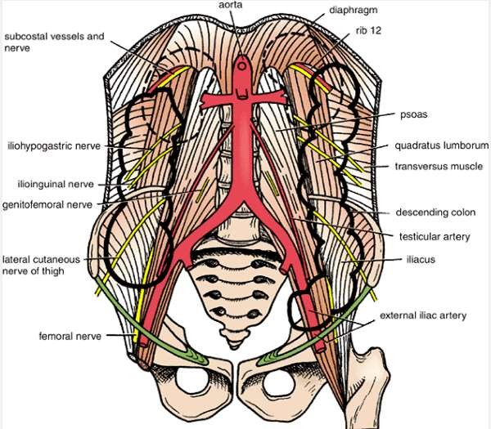
KIDNEYS
Posteriorly:
The diaphragm
The costodiaphragmatic recess of the pleura
The 11th (the left kidney is higher)
and 12th rib مهم
The psoas,
Quadratus lumborum
Transversus abdominis muscles.
The subcostal (T12), iliohypogastric, and ilioinguinal nerves (L1) run downward and laterally
Thursday 28 April 2022
Dr. Aiman Qais Afar
14

Slide 15
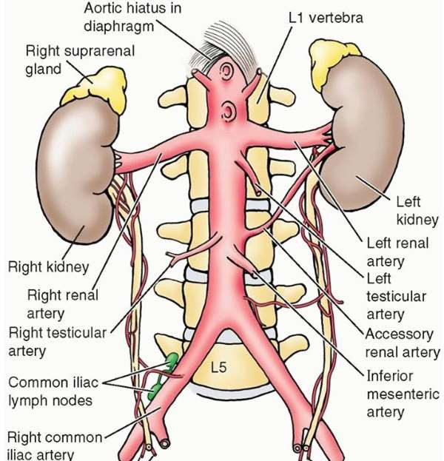
KIDNEYS
Blood Supply
Arteries
The renal arteries arise at the
level of the IV disc between the L1 and L2 vertebrae
The longer right renal artery passes posterior to the IVC.
Dr. Aiman Qais Afar
Thursday 28 April 2022
15

Slide 16
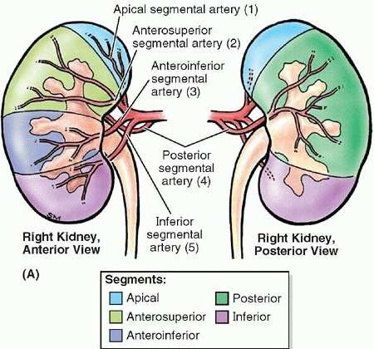
KIDNEYS
Dr. Aiman Qais Afar
Each renal artery usually divides into five segmental arteries that enter the hilum of
the kidney.
They are distributed to different segments or areas of the kidney.
Thursday 28 April 2022

Slide 17
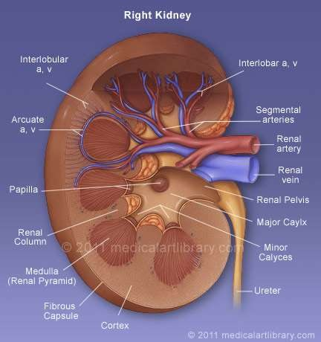
KIDNEYS
Lobar arteries arise from each segmental artery, one for each renal pyramid.
Before entering the renal substance, each lobar artery gives off two or three interlobar arteries
The interlobar arteries run toward the cortex on each side of the renal pyramid.
Thursday 28 April 2022
Dr. Aiman Qais Afar
16

Slide 18
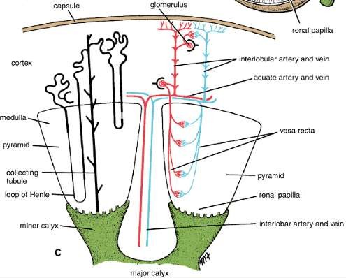
KIDNEYS
At the junction of the cortex and the medulla, the interlobar arteries give off the arcuate arteries, which arch over the bases of the pyramids
The arcuate arteries give off several interlobular arteries that ascend in the cortex.
The afferent glomerular arterioles arise as branches of the interlobular arteries
Abdominal aorta 🡪 Renal A. 🡪 Segmental A. 🡪 Lobar A. 🡪 Interlobar A. 🡪 Arcuate
A. 🡪 Interlobular A. 🡪 Afferent.
Thursday 28 April 2022
Dr. Aiman Qais Afar

Slide 19
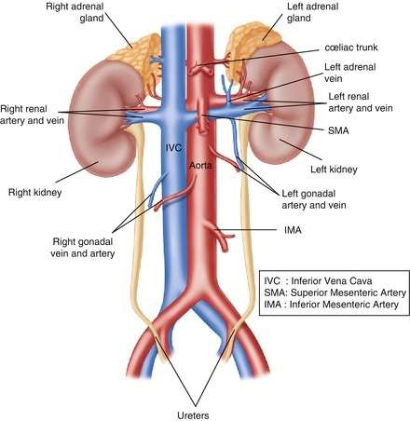
KIDNEYS
Veins
The renal vein emerges from the hilum in front of the renal artery and drains into the inferior vena cava.
Thursday 28 April 2022
Dr. Aiman Qais Afar

Slide 20
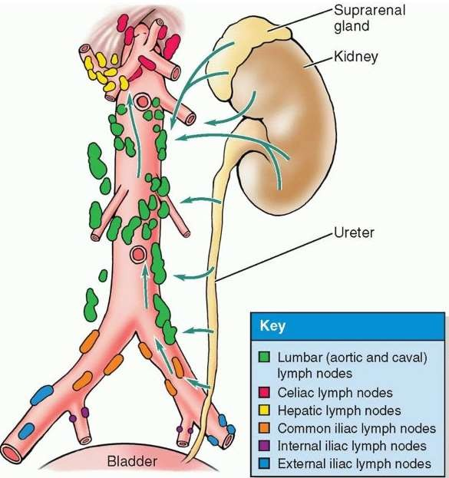
KIDNEYS
Lymph Drainage
Lymph drains to the lateral aortic lymph nodes around the origin of the renal artery
& Lumbar (aoratic and caval) lymph node
Renal pelvis 🡪 Renal sinus
🡪 Major calyx 🡪 Minor calyx 🡪 Renal papilla 🡪 Nephron (collecting duct
…)
Thursday 28 April 2022
Dr. Aiman Qais Afar

Slide 21
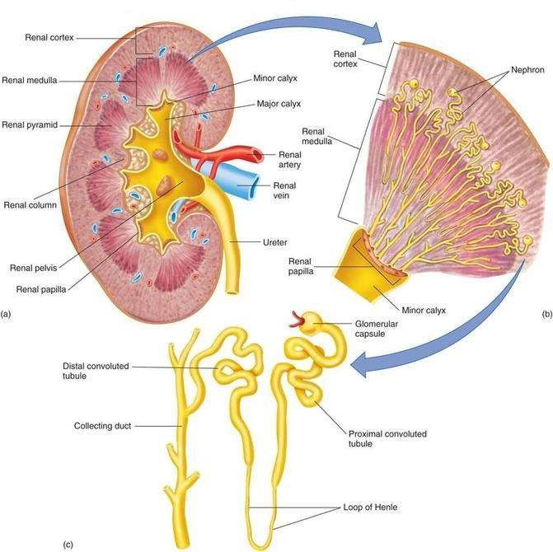
Renal pelvis 🡪 Renal sinus 🡪 Major calyx 🡪 Minor calyx 🡪 Renal papilla 🡪 Nephron (collecting duct …)
Thursday 28 April 2022
Dr. Aiman Qais Afar

Slide 22
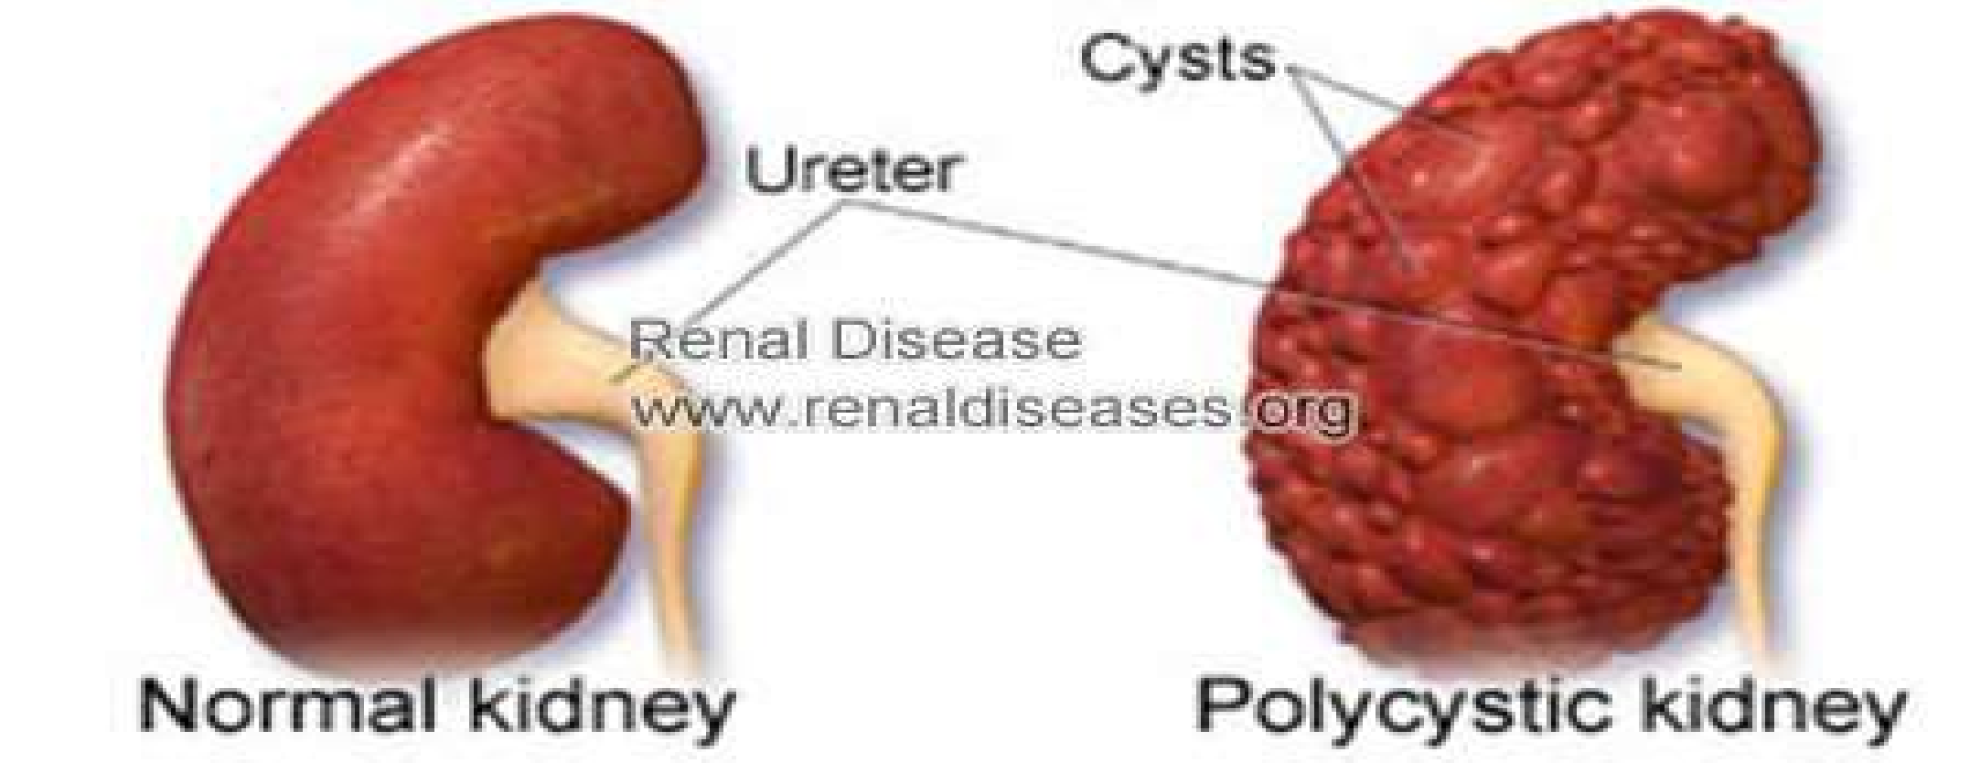
Renal Cysts
Dr. Aiman Qais Afar
Thursday 28 April 2022
21

Slide 23
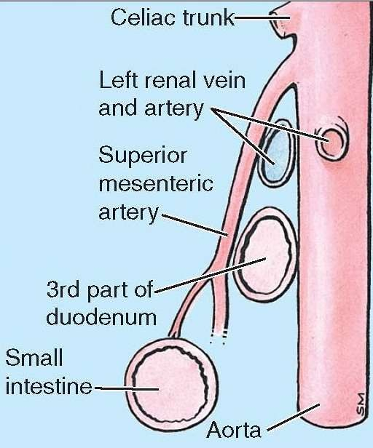
Renal Vein Entrapment Syndrome
In crossing the midline to reach the IVC, the longer left renal vein traverses an acute angle between the SMA anteriorly and the abdominal aorta posteriorly (and perhaps the third part of the duodenum) resulting in a renal vein entrapment syndrome also known as “nutcracker syndrome”.
left testicular pain in men (related to the left testicular vein draining into the left renal vein proximal to the compression).
Thursday 28 April 2022
Dr. Aiman Qais Afar

Slide 24
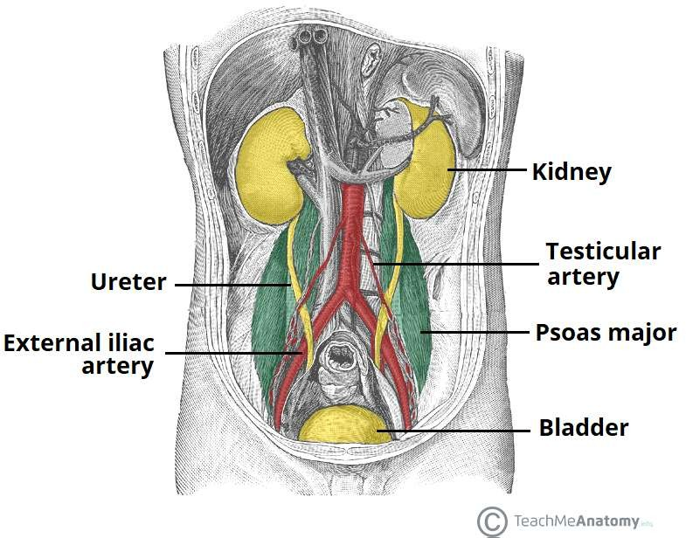
Ureter
The two ureters are muscular tubes that extend from the kidneys to the posterior surface of the urinary bladder
Thursday 28 April 2022
Dr. Aiman Qais Afar

Slide 25
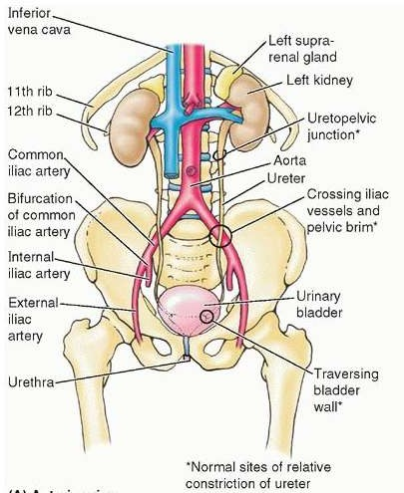
Ureter
Each ureter measures about 10 in. (25 cm) long and resembles the esophagus (also 10 in. long) in having three constrictions along its course:
where the renal pelvis joins the ureter in the abdomen,
where it is kinked as it crosses the
pelvic brim to enter the pelvis.
where it pierces the bladder wall.
Thursday 28 April 2022
Dr. Aiman Qais Afar

Slide 26
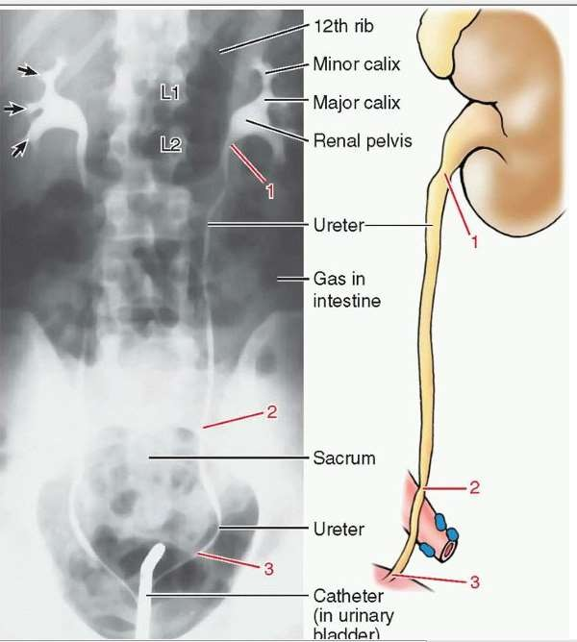
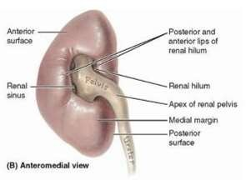
Ureter
Thursday 28 April 2022
The renal pelvis is the funnel-shaped expanded upper end of the ureter.
It lies within the hilum of the kidney and
receives the major calyces.
The ureter emerges from the hilum of the kidney and runs vertically downward behind the parietal peritoneum (adherent to it) on the psoas muscle, which separates it from the tips of the transverse processes of the lumbar vertebrae.
Dr. Aiman Qais Afar

Slide 27
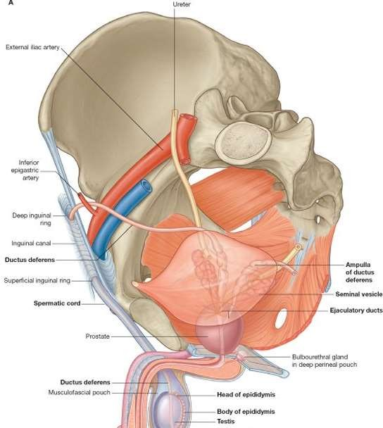
Ureter
It enters the pelvis by crossing the bifurcation of the common iliac artery in front of the sacroiliac joint
The ureter then runs down the lateral wall of the pelvis to the region of the ischial spine in front of the internal iliac artery and turns forward to enter the lateral angle of the bladder.
Thursday 28 April 2022
Dr. Aiman Qais Afar

Slide 28
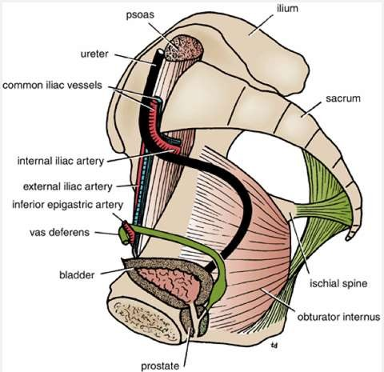
Ureter
The ureter passes obliquely through the wall of the bladder before opening into the bladder
Near its termination, it is crossed by the vas deferens.
Thursday 28 April 2022
Dr. Aiman Qais Afar

Slide 29
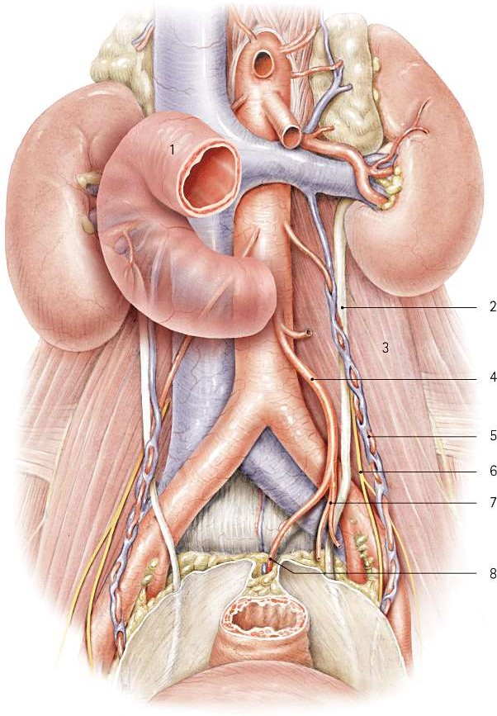
Ureter
Relations, Right Ureter
Dr. Aiman Qais Afar Thursday 28 April 2022
28
Anteriorly: The duodenum, the terminal part of the ileum, the right colic and ileocolic vessels, the right testicular or ovarian vessels, and the root of the mesentery of the small intestine
Posteriorly: The right psoas muscle, which separates it from the lumbar transverse processes, and the bifurcation of the right common iliac artery

Slide 30
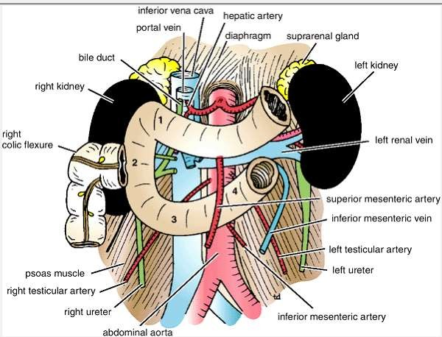
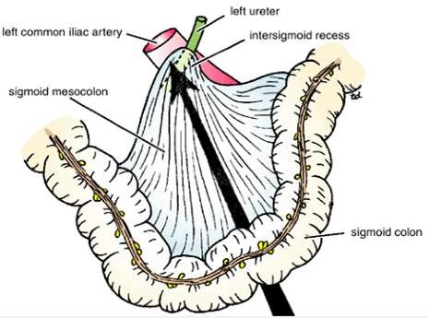
Ureter
Relations, Left Ureter
Anteriorly: The sigmoid colon and sigmoid mesocolon, the left colic vessels, and the left
testicular or ovarian vessels
Posteriorly: The left psoas muscle, which separates it from the lumbar transverse
processes, and the bifurcation of the left common iliac artery
Thursday 28 April 2022
Dr. Aiman Qais Afar
29

Slide 31
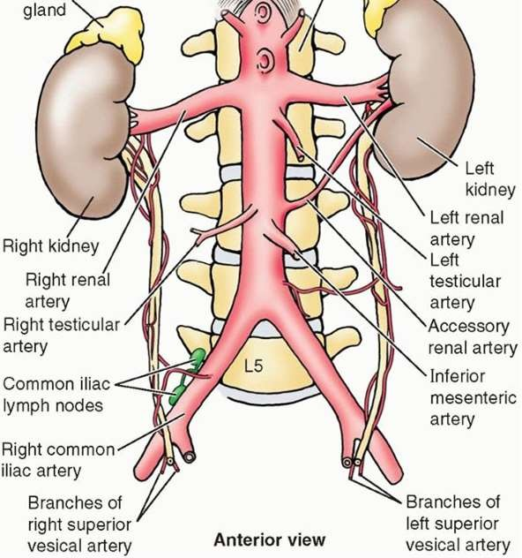
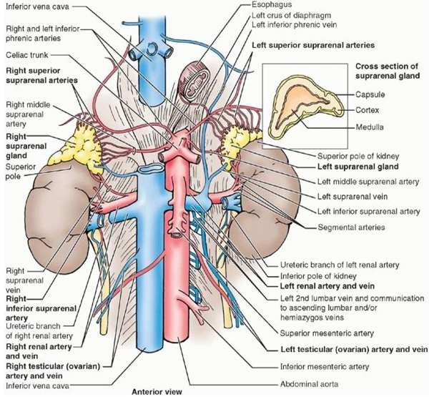
Ureter
Blood Supply ::: Arteries
Dr. Aiman Qais Afar
Thursday 28 April 2022
30
As follows: upper end, the renal artery
middle portion, the testicular or ovarian artery
in the pelvis, the superior vesical artery Veins
Venous blood drains into veins that correspond to the arteries.

Slide 32
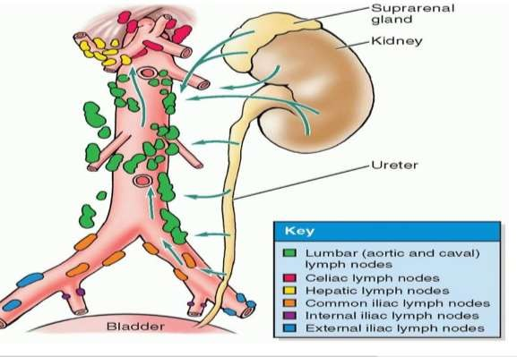
Ureter
Dr. Aiman Qais Afar
Thursday 28 April 2022
31
Lymph Drainage
The lymph drains to the lateral aortic nodes and the iliac nodes.

Slide 33
UROGENITAL SYSTEM
THE BONY PELVIS & PELVIC DIAPHRAGM
Dr. Aiman Qais Afar Surgical Anatomist
College of Medicine / University of Mutah
Sunday 8 April 2022
32

Slide 34
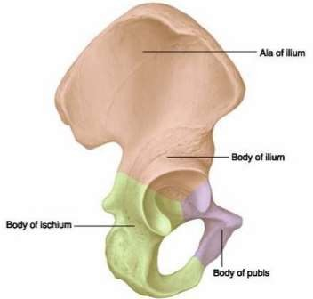
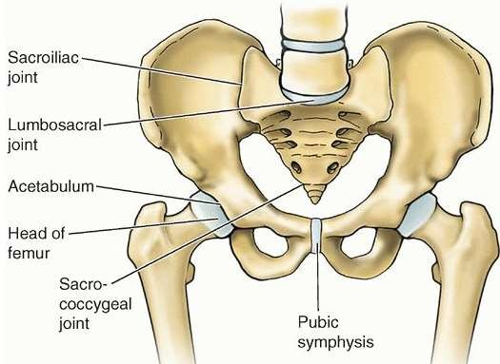
Pelvic bones
Hip Bone
In children, each hip bone consists of the ilium, which lies superiorly; the ischium, which lies posteriorly and inferiorly; and the pubis, which lies anteriorly and inferiorly .
The three separate bones are joined by cartilage at the acetabulum.
At puberty, these three bones fuse together
to form one large, irregular bone.
Dr. Aiman Al-Maathidy
Sunday 8 April 2022
33

Slide 35
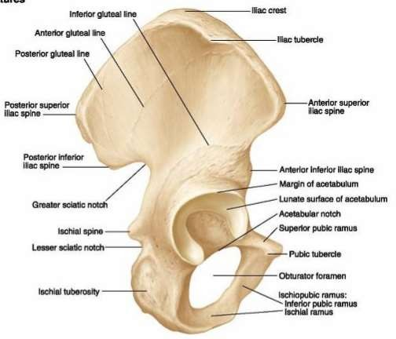
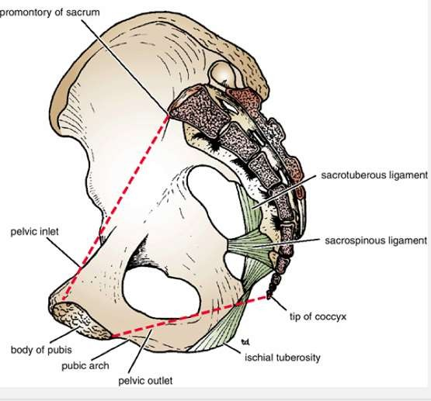
Pelvic bones
Hip Bone
On the outer surface of the hip bone is a deep depression, the acetabulum, which articulates with the hemispherical head of the femur
Behind the acetabulum is a large notch, the greater sciatic notch, which is separated from the lesser sciatic notch by the spine of the ischium.
The sciatic notches are converted into the greate and lesser sciatic foramina by the presence of the sacrotuberous and sacrospinous ligaments
r
Dr. Aiman Al-Maathidy Sunday 8 April 2022
34

Slide 36
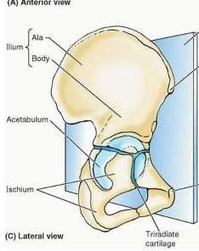
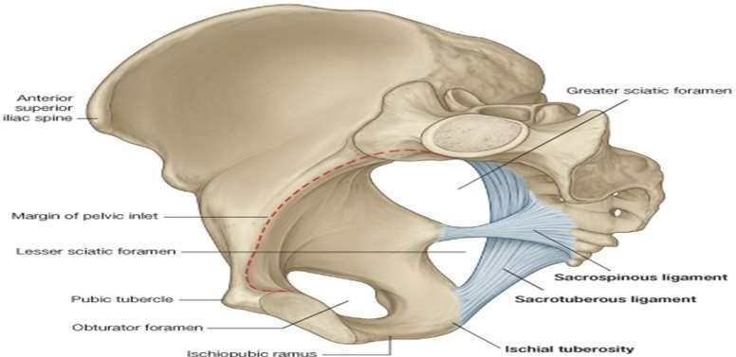
Hip Bone
Dr. Aiman Al-Maathidy
Sunday 8 April 2022
The ilium possesses the iliac crest which runs between the anterior and posterior superior iliac spines. Below these spines are the corresponding anterior and posterior inferior iliac spines. The ilium has a large auricular surface for articulation with the sacrum. The iliopectineal line runs downward and forward around the inner surface of the ilium and serves to divide the false from the true pelvis.
36

Slide 37
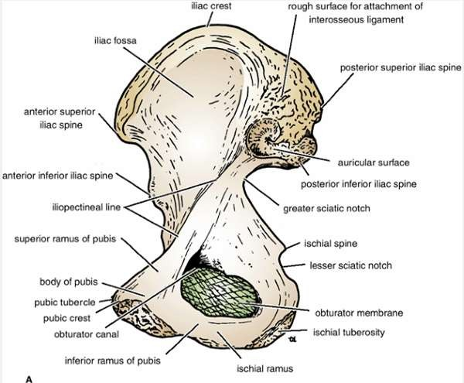
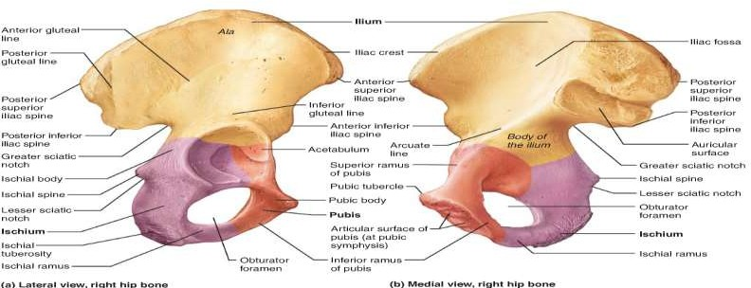
Hip Bone
Dr. Aiman Al-Maathidy
Sunday 8 April 2022
The ischium is the inferior and posterior part of the hip bone and possesses an ischial spine and an ischial tuberosity
The pubis has a body and superior and inferior pubic rami.
The body of the pubis bears the pubic crest and the pubic tubercle and articulates with the pubic bone of the opposite side at the symphysis pubis .
There is a large opening, the obturator foramen, which is bounded by the parts of the ischium and pubis is
filled in by the obturator membrane
37

Slide 38
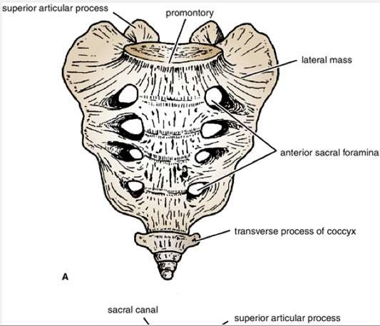
Sacrum
Consists of five rudimentary vertebrae fused
together.
The upper border or base of the bone articulates
with the fifth lumbar vertebra.
The narrow inferior border articulates with the
coccyx.
Laterally, the sacrum articulates with the two iliac bones to form the sacroiliac joints .
The sacral promontory which is an important obstetric landmark used when measuring the size of the pelvis.
Sunday 8 April 2022
Dr. Aiman Al-Maathidy
37

Slide 39
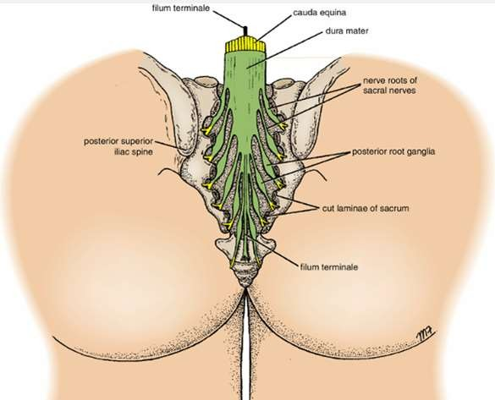
Pelvic bones
Sacrum
The vertebral foramina together form the
sacral canal.
Which contains the anterior and posterior roots of the lumbar, sacral, and coccygeal spinal nerves; the filum terminale; and fibrofatty material.
It also contains the lower part of the subarachnoid space down as far as the lowe border of the second sacral vertebra
r
Sunday 8 April 2022
Dr. Aiman Al-Maathidy
38

Slide 40
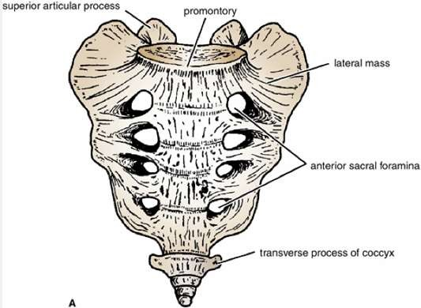
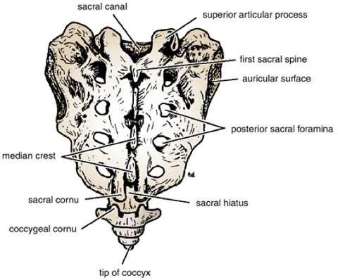
Sacrum
The anterior and posterior surfaces of the sacrum possess on each side four foramina for the passage of the anterior and posterior rami of the upper four sacral nerves
The sacrum is usually wider in proportion to its length in the female than in the male
Sunday 8 April 2022
Dr. Aiman Al-Maathidy
39

Slide 41
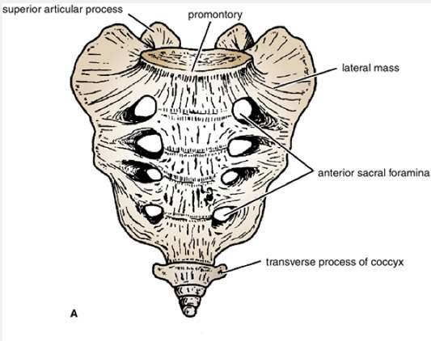
بنذلا بجع
Coccyx
Pelvic bones
The coccyx consists of four vertebrae fused together to form a small triangular bone, which articulates at its base with the lower end of the sacrum
The coccygeal vertebrae consist of bodies only, but the first vertebra possesses a rudimentary transverse process and cornua.
قلخ هنم ,بنذلا بجع لاإ بارتلا هلكأي مدآ نبا لك".1 “بكري هيفو
الله لوسر قدص
Sunday 8 April 2022 Dr. Aiman Al-Maathidy
40

Slide 42
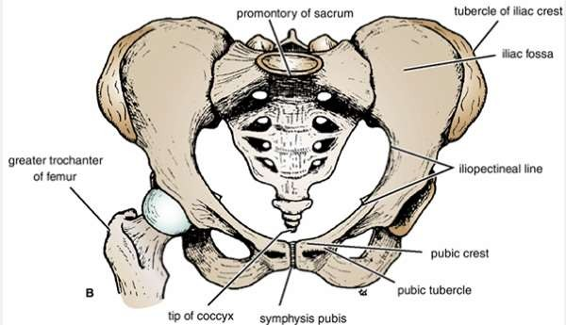
The Pelvis
Dr. Aiman Al-Maathidy
The bony pelvis is composed of four bones: the two hip bones, which form the lateral and anterior walls, and the sacrum and the coccyx, which are part of the vertebral column and form the back wall
Sunday 8 April 2022
41

Slide 43
The Pelvis
Dr. Aiman Al-Maathidy
The two hip bones articulate with each other anteriorly at the symphysis pubis and
posteriorly with the sacrum at the sacroiliac joints
The front of the symphysis pubis and the anterior superior iliac spines should lie in the same vertical plane. This means that the pelvic surface of the symphysis pubis faces upward and backward and the anterior surface of the sacrum is directed forward and downward.
Sunday 8 April 2022
42

Slide 44
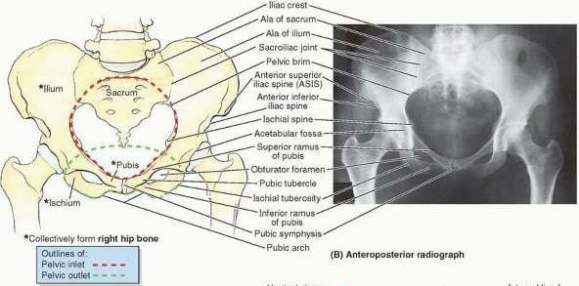
The Pelvis
Dr. Aiman Al-Maathidy
Sunday 8 April 2022
43
The pelvis is divided into two parts by the pelvic brim, which is formed by the sacral promontory behind, the iliopectineal lines laterally, and the symphysis pubis anteriorly.
Above the brim is the false pelvis, which forms part of the abdominal cavity.
Below the brim is the true pelvis

Slide 45
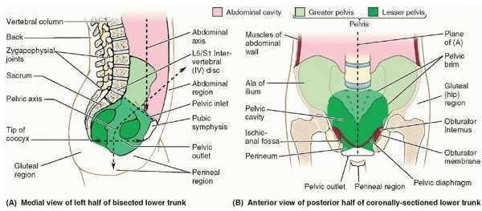
The Pelvis
Dr. Aiman Al-Maathidy
Sunday 8 April 2022
False Pelvis
It is bounded behind by the lumbar vertebrae, laterally by the iliac fossae and the iliacus muscles, and in front by the lower part of the anterior abdominal wall. It considered as part of the abdominal cavity.
44

Slide 46
The Pelvis
Sunday 8 April 2022
45
Dr. Aiman Al-Maathidy
True Pelvis
The true pelvis has an inlet, an outlet, and a cavity.
The pelvic inlet, or pelvic brim , is bounded posteriorly by the sacral promontory, laterally by the iliopectineal lines, and anteriorly by the symphysis pubis
The pelvic cavity lies between the inlet and the outlet.
It is a short, curved canal, with a shallow anterior wall and a much deeper posterior wall.

Slide 47
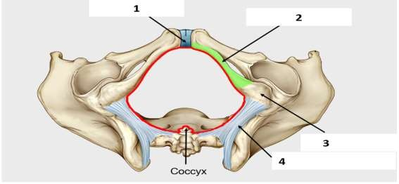
The Pelvis
Dr. Aiman Al-Maathidy
Sunday 8 April 2022
The pelvic outlet is bounded posteriorly by the coccyx, laterally by the ischial tuberosities, and anteriorly by the pubic arch ...
The pelvic outlet has three wide notches.
The pubic arch is Anteriorly, between the ischiopubic rami, and laterally are the sciatic notches.
The sciatic notches are divided by the sacrotuberous and sacrospinous ligaments into the greater and lesser sciatic foramina
46

Slide 48
The Pelvis
From an obstetric standpoint, because the sacrotuberous ligaments are strong and relatively inflexible, they should be considered to form part of the perimeter of the pelvic outlet.
Thus, the outlet is diamond shaped, with the ischiopubic rami and the symphysis pubis forming the boundaries in front and the sacrotuberous ligaments and the coccyx forming the boundaries behind
Dr. Aiman Al-Maathidy Sunday 8 April 2022
47

Slide 49
Pelvic Muscles
Piriformis Muscle
Arises from the front of the lateral mass of the sacrum and leaves the pelvis to enter the gluteal region by passing laterally through the greater sciatic foramen . It is inserted into the upper border of the greater trochanter of the femur
Action: It is a lateral rotator of the femur at the hip joint.
Sunday 8 April 2022
Dr. Aiman Al-Maathidy
48

Slide 50
Pelvic Muscles
Dr. Aiman Al-Maathidy
Sunday 8 April 2022
Obturator Internus Muscle
Arises from the pelvic surface of the obturator membrane and the adjoining part of the hip bone . The muscle fibers converge to a tendon, which leaves the pelvis through the lesser sciatic foramen and is inserted into the greater trochanter of the femur.
Action: It laterally rotates the femur at the hip joint.
49

Slide 51
Pelvic Muscles
Dr. Aiman Al-Maathidy ^{Sunday 8 April 2022 50}
Coccygeus Muscle
This small triangular muscle arises from the spine of the ischium and is inserted into the lower end of the sacrum and into the coccyx .
Action: The two muscles assist the levatores ani in supporting the pelvic viscera.

Slide 52
Pelvic Muscles
Levator Ani Muscle
Is a wide thin sheet that has a linear origin from the back of the body of the pubis, a tendinous arch formed by a thickening of the fascia covering the obturator internus, and the spine of the ischium . From this extensive origin, groups of fibers sweep downward and medially to their insertion , as follows:
Sunday 8 April 2022
Dr. Aiman Al-Maathidy
51

Slide 53
Pelvic Muscles
Dr. Aiman Al-Maathidy
Anterior fibers: The levator prostatae or sphincter vaginae form a sling around the prostate or vagina and are inserted into a mass of fibrous tissue, called the perineal body, in front of the anal canal.
The levator prostatae support the prostate and stabilize the perineal body
The sphincter vaginae constrict the vagina and stabilize the perineal body
Sunday 8 April 2022
52

Slide 54
Pelvic Muscles
Dr. Aiman Al-Maathidy
53
Intermediate fibers: The puborectalis forms a sling around the junction of the rectum and anal canal.
The pubococcygeus passes posteriorly to be inserted into a small fibrous mass, called the anococcygeal body, between the tip of the coccyx and the anal canal
Posterior fibers: The iliococcygeus is inserted into the anococcygeal body and the coccyx.
Sunday 8 April 2022

Slide 55
Pelvic Muscles
Action: The levatores ani muscles of the two sides form an efficient muscular sling that supports and maintains the pelvic viscera in position. They resist the rise in intrapelvic pressure during the straining and expulsive efforts of the abdominal muscles (as occurs in coughing). They also have an important sphincter action on the anorectal junction, and in the female they serve also as a sphincter of the vagina.
Dr. Aiman Al-Maathidy
Sunday 8 April 2022
54

Slide 56
Structure of the Pelvic Walls
The pelvis has anterior, posterior, and lateral walls and an inferior wall or floor.
Anterior Pelvic Wall
The anterior pelvic wall is the shallowest wall and is formed by the bodies of the pubic bones, the pubic rami, and the symphysis pubis
Sunday 8 April 2022
Dr. Aiman Al-Maathidy
55

Slide 57
Structure of the Pelvic Walls
Posterior Pelvic Wall
The posterior pelvic wall is extensive and is formed by the sacrum and coccyx and by the
piriformis muscles and their covering of parietal pelvic fascia
Sunday 8 April 2022
Dr. Aiman Al-Maathidy
56

Slide 58
Structure of the Pelvic Walls
The lateral pelvic wall is formed by part of the hip bone below the pelvic inlet, the obturator membrane, the sacrotuberous and sacrospinous ligaments, and the obturator internus muscle and its covering fascia
Dr. Aiman Al-Maathidy Sunday 8 April 2022
57

Slide 59
Lateral Pelvic Wall
Dr. Aiman Al-Maathidy
Sunday 8 April 2022
58
Obturator Membrane
is a fibrous sheet that almost completely closes the obturator foramen, leaving a small gap, the obturator
canal, for the passage of the obturator nerve and vessels as they leave the pelvis to enter the thigh .
Sacrotuberous Ligament
is strong and extends from the lateral part of the sacrum and coccyx and the posterior inferior iliac spine to
the ischial tuberosity .

Slide 60
Lateral Pelvic Wall
Sacrospinous Ligament
is strong and triangle shaped.
It is attached by its base to the lateral part of the sacrum and coccyx and by its apex to the spine of the ischium
The sacrotuberous and sacrospinous ligaments prevent the lower end of the sacrum and the coccyx from being rotated upward at the sacroiliac joint by the weight of the body
59
Dr. Aiman Al-Maathidy Sunday 8 April 2022

Slide 61
Inferior Pelvic Wall, or Pelvic Floor
Sunday 8 April 2022
60
The floor of the pelvis supports the pelvic viscera and is formed by the pelvic diaphragm
The pelvic diaphragm is formed by the important levatores ani muscles and the
small coccygeus muscles and their covering fasciae
It is incomplete anteriorly to allow passage of the urethra in males and the urethra and
the vagina in females
Dr. Aiman Al-Maathidy

Slide 62
Sacroiliac Joints
Dr. Aiman Al-Maathidy Sunday 8 April 2022
strong synovial joints.
formed between the auricular surfaces of the sacrum and the iliac bones.
The sacrum carries the weight of the trunk.
The strong posterior and interosseous sacroiliac ligaments suspend the sacrum between the two iliac bones.
The anterior sacroiliac ligament is thin and lies in front of the joint.
61

Slide 63
Movements
A small but limited amount of movement is possible at these joints. In older people, the synovial cavity disappears and the joint becomes fibrosed. Their primary function is to transmit the weight of the body from the vertebral column to the bony pelvis.
Dr. Aiman Al-Maathidy Sunday 8 April 2022
62

Slide 64
Symphysis Pubis
Dr. Aiman Al-Maathidy
Sunday 8 April 2022
The articular surfaces are covered by a layer of hyaline cartilage and are connected together by a fibrocartilaginous disc. The joint is surrounded by ligaments that extend from one pubic bone to the other.
Movements
Almost no movement is possible at this joint.
63

Slide 65
Sacrococcygeal Joint
is a cartilaginous joint between the bodies of the last sacral vertebra and the first coccygeal vertebra.
The cornua of the sacrum and coccyx are joined by ligaments.
Movements
Extensive flexion and extension are
possible at this joint
Sunday 8 April 2022
Dr. Aiman Al-Maathidy
64

Slide 66
UROGENITAL SYSTEM
THE PERINEUM
Dr. Aiman Qais Afar Surgical Anatomist
College of Medicine /University Of Mutah
Monday 9 April 2022
65

Slide 67
The Perineum
The cavity of the pelvis is divided by the pelvic diaphragm into the main pelvic cavity above and the perineum below .
Monday 9 April 2022
Dr. Aiman Qais Al-Maathidy
66

Slide 68
The Perineum
Dr. Aiman Qais Al-Maathidy
Monday 9 April 2022
Diamond-shaped perineum divided by a broken line into the:
Urogenital triangle
Anal triangle.
The Urogenital triangle is bounded in front by the pubic arch and laterally by the
ischial tuberosities
67

Slide 69
Urogenital Triangle
Superficial Fascia
Can be divided into a fatty layer and a membranous layer.
The fatty layer (fascia of Camper) is continuous with the fat of the ischiorectal fossa and the superficial fascia of the thighs
In the scrotum, the fat is replaced by smooth muscle the dartos muscle.
The dartos muscle contracts in response to cold and reduces the surface area of the scrotal skin
Monday 9 April 2022
Dr. Aiman Qais Al-Maathidy

Slide 70
Urogenital Triangle
Superficial Fascia
The membranous layer (Colles' fascia) is attached:
Posteriorly to the posterior border of the urogenital diaphragm
Laterally to the margins of the pubic arch
Anteriorly it is continuous with the membranous layer of superficial fascia of the anterior abdominal wall (Scarpa's fascia).
The fascia is continued over the penis (or clitoris) as a tubular sheath (Buck's fascia) and Colle's Fascia in the scrotum
Monday 9 April 2022
Dr. Aiman Qais Al-Maathidy

Slide 71
Urogenital Diaphragm
Is a triangular musculofascial diaphragm situated in the anterior part of the perineum
filling in the gap of the pubic arch
Dr. Aiman Qais Al-Maathidy Monday 9 April 2022
70

Slide 72
Urogenital Diaphragm
It is formed by the sphincter urethrae and the deep transverse perineal muscles, which are enclosed between a superior and an inferior layer of fascia of the Urogenital diaphragm.
The inferior layer of fascia is often referred to as the perineal membrane.
Monday 9 April 2022
Dr. Aiman Qais Al-Maathidy
71

Slide 73
Urogenital Diaphragm
Anteriorly: the two layers of fascia fuse, leaving a small gap beneath the symphysis pubis.
Posteriorly: the two layers of fascia fuse with the membranous layer of the superficial fascia and the perineal body
Laterally, the layers of fascia are attached to the
pubic arch.
The closed space that is contained between the superficial and deep layers of fascia is known as:
The deep perineal pouch.
Dr. Aiman Qais Al-Maathidy Monday 9 April 2022
72

Slide 74
Contents of the Male Urogenital Triangle
In the male, the triangle contains the penis and scrotum.
Penis
Root of the Penis
Is made up of three masses of erectile tissue called the bulb of the penis and the right and left crura of the penis
The bulb is situated in the midline and is attached to the undersurface of the urogenital diaphragm
It is traversed by the urethra and is covered on its outer surface by the bulbospongiosus muscles
Monday 9 April 2022 Dr. Aiman Qais Al-Maathidy
73

Slide 75
Penis
Thursday 12 April 2022
Dr. Aiman Qais Al-Maathidy
74
Each crus is attached to the side of the pubic arch and is covered on its outer surface by the ischiocavernosus muscle.
The bulb is continued forward into the body of the penis and forms the corpus spongiosum
The two crura converge anteriorly and come to lie side by side in the dorsal part of the body of the penis, forming the corpora cavernosa

Slide 76
Penis
Body of the Penis
is essentially composed of three cylinders of erectile tissue
The erectile tissue is made up of two dorsally placed corpora cavernosa and
A single corpus spongiosum applied
to their ventral surface
Thursday 12 April 2022
Dr. Aiman Qais Al-Maathidy
75

Slide 77
Penis
Dr. Aiman Qais Al-Maathidy
Thursday 12 April 2022
At its distal extremity, the corpus spongiosum expands to form the glans penis which covers the distal ends of the corpora cavernosa.
On the tip of the glans penis is the slitlike orifice of the urethra, called the external urethral meatus
76

Slide 78
Penis
The prepuce or foreskin is a hood like fold of skin that covers the glans.
It is connected to the glans just below the urethral orifice by a fold called the frenulum.
Thursday 12 April 2022
Dr. Aiman Qais Al-Maathidy
77

Slide 79
Penis
Arteries
The corpora cavernosa are supplied by the deep arteries of the penis
The corpus spongiosum is supplied by the artery of the bulb and dorsal artery of the peni All the above arteries are branches of the internal pudendal artery.
Veins
The veins drain into the internal pudendal veins.
Dr. Aiman Qais Al-Maathidy Thursday 12 April 2022
78

Slide 80
Scrotum
Dr. Aiman Qais Al-Maathidy Thursday 12 April 2022
The scrotum is an outpouching of the lower part of the anterior abdominal wall and
contains
The wall of the scrotum has the following layers:
Skin
Superficial fascia; the dartos muscle, replaces the fatty ,
and Scarpa's fascia. The (membranous layer) is now called Colles' fascia.
79

Slide 81
Scrotum
Dr. Aiman Qais Al-Maathidy
Thursday 12 April 2022
80
External spermatic fascia derived from the
external oblique
Cremasteric fascia derived from the internal oblique
Internal spermatic fascia derived
from the fascia transversalis

Slide 82
Superficial Perineal Pouch
Is bounded below by the membranous layer of superficial fascia and above by the urogenital diaphragm .
It is closed behind by the fusion of its upper and lower walls.
Laterally, it is closed by the attachment of the membranous layer of superficial fascia and the urogenital diaphragm to the margins of the pubic arch .
Anteriorly, the space communicates freely with the potential space lying between the superficial fascia of the anterior abdominal wall and the anterior abdominal muscles
Dr. Aiman Qais Al-Maathidy Monday 9 April 2022
81

Slide 83
Contents of the Superficial Perineal Pouch
In males, the superficial perineal pouch contains the:
Root (bulb and crura) of the penis and associated muscles (ischiocavernosus and bulbospongiosus).
Proximal (bulbous) part of the spongy urethra.
Superficial transverse perineal muscles.
Deep perineal branches of the internal
pudendal vessels and pudendal nerves
Dr. Aiman Qais Al-Maathidy
Monday 9 April 2022
82

Slide 84
Contents of the Superficial Perineal Pouch in the Male
The bulbospongiosus
Muscles: situated one on each side of the midline. It compress the penile urethra and empty it of residual urine or semen.
Ischiocavernosus muscles:
cover the crus penis on each side
The action of each muscle is to compress the crus penis and assist in the process of erection of the penis.
Monday 9 April 2022
Dr. Aiman Qais Al-Maathidy
83

Slide 85
Contents of the Superficial Perineal Pouch in the Male
Superficial Transverse Perineal Muscles
Lie in the posterior part of the superficial perineal pouch
Each muscle arises from the ischial ramus and is inserted into the perineal body.
The function of these muscles is to fix the perineal body in the center of the
perineum.
Dr. Aiman Qais Al-Maathidy Monday 9 April 2022
85

Slide 86
Contents of the Superficial Perineal Pouch in the Male
Perineal Body
This small mass of fibrous tissue is attached to the center of the posterior margin of the Urogenital Diaphragm
It serves as a point of attachment for the following muscles: External anal sphincter, bulbospongiosus muscle, and superficial transverse perineal muscles
Perineal Branch of the Pudendal Nerve
On each side it terminates in the superficial perineal pouch by supplying the muscles and skin.
Monday 9 April 2022
Dr. Aiman Qais Al-Maathidy
86

Slide 87
Contents of the Deep Perineal Pouch in the Male
1 Membranous part of the urethra
2 The sphincter urethrae
3 The bulbourethral glands
4 The deep transverse perineal muscles
5 The internal pudendal vessels and their
branches
6 The dorsal nerves of the penis
86
Dr. Aiman Qais Al-Maathidy Monday 9 April 2022

Slide 88
Contents of the Deep Perineal Pouch in the Male
1 Membranous Part of the Urethra
It is about 0.5 in. (1.3 cm) long and lies within the urogenital diaphragm, surrounded by the sphincter urethrae muscle
it is continuous above with the prostatic urethra and below with the penile urethra.
It is the shortest and least dilatable part of the urethra
Monday 9 April 2022
Dr. Aiman Qais Al-Maathidy
87

Slide 89
Contents of the Deep Perineal Pouch in the Male
2 Sphincter Urethrae Muscle
Surrounds the urethra in the deep perineal pouch. It arises from the pubic arch on the
two sides and passes medially to encircle the urethra
Dr. Aiman Qais Al-Maathidy Monday 9 April 2022
Action
The muscle compresses the membranous part of the urethra and relaxes during micturition.
It is the means by which micturition can be voluntarily stopped
88

Slide 90
Contents of the Deep Perineal Pouch in the Male
3 Bulbourethral Glands:
Are two small glands that lie beneath the sphincter urethrae muscle . Their ducts pierce the perineal membrane (inferior fascial layer of the Urogenital diaphragm) and enter the penile portion of the urethra.
The secretion is poured into the urethra as a result of erotic stimulation
Dr. Aiman Qais Al-Maathidy Monday 9 April 2022
89

Slide 91
Contents of the Deep Perineal Pouch in the Male
4 Deep Transverse Perineal Muscles
Lie posterior to the sphincter urethrae muscle.
Each muscle arises from the ischial ramus and passes medially to be inserted into the perineal body. These muscles are clinically unimportant
Dr. Aiman Qais Al-Maathidy Monday 9 April 2022
90

Slide 92
Contents of the Deep Perineal Pouch in the Male
5 Internal Pudendal Artery
6 Dorsal Nerve of the Penis
The dorsal nerve of the penis on each side passes forward through the deep perineal
Dr. Aiman Qais Al-Maathidy Monday 9 April 2022
91
pouch and supplies the skin of the penis

Slide 93
Female Urogenital Triangle
92
Dr. Aiman Qais Al-Maathidy
Monday 9 April 2022
In the female, the triangle contains the external genitalia and the orifices of the urethra and the vagina
Contents of the Female Urogenital Triangle
Clitoris
The clitoris, which corresponds to the penis in the male, is situated at the apex of the vestibule anteriorly.
It has a structure similar to the penis.
The glans of the clitoris is partly hidden by the prepuce.

Slide 94
Contents of the Female Urogenital Triangle
Root of the Clitoris
is made up of three masses of erectile
tissue called:
The bulb of the vestibule and
The right and left crura of the clitoris
The bulb of the vestibule corresponds to the bulb of the penis, but because of the presence of the vagina, it is divided into two halves
It is attached to the undersurface of the Urogenital diaphragm and is covered by the bulbospongiosus muscles.
Monday 9 April 2022 Dr. Aiman Qais Al-Maathidy 93

Slide 95
Contents of the Female Urogenital Triangle
The crura of the clitoris :
Dr. Aiman Qais Al-Maathidy
correspond to the crura of the penis and become the corpora cavernosa anteriorly.
Each remains separate and is covered by an ischiocavernosus muscle .
Monday 9 April 2022
94

Slide 96
Contents of the Female Urogenital Triangle
Body of the Clitoris Consists of the two corpora cavernosa
The corpus spongiosum contain of the small amount of erectile tissue
Glans of the Clitoris
Is a small mass of erectile tissue that
caps the body of the clitoris.
It is provided with numerous sensory endings.
Monday 9 April 2022
Dr. Aiman Qais Al-Maathidy
95

Slide 97
Contents of the Superficial Perineal Pouch in the Female
Contains structures forming :
The root of the clitoris and the muscles that cover them, namely, the
bulbospongiosus muscles and the ischiocavernosus muscles .
Dr. Aiman Qais Al-Maathidy
96
Monday 9 April 2022

Slide 98
Bulbospongiosus Muscle
Dr. Aiman Qais Al-Maathidy Monday 9 April 2022
Surrounds the orifice of the vagina and covers the vestibular bulbs.
Its fibers extend forward to gain attachment to the corpora cavernosa of the clitoris.
It reduces the size of the vaginal orifice and…..
Compresses the deep dorsal vein of the clitoris, thereby assisting in the mechanism of erection in the clitoris
97

Slide 99
Ischiocavernosus Muscle
The ischiocavernosus muscle on each side covers the crus of the clitoris.
Contraction of this muscle assists in causing
the erection of the clitoris
Monday 9 April 2022
Dr. Aiman Qais Al-Maathidy
98

Slide 100
Perineal Body
Dr. Aiman Qais Al-Maathidy
Monday 9 April 2022
99
The perineal body is larger than that of the male and is clinically important.
It is a wedge-shaped mass of fibrous tissue situated between the lower end of the
vagina and the anal canal
It is the point of attachment of many perineal muscles including the levatores ani muscles
the latter assist the perineal body in supporting the posterior wall of the vagina

Slide 101
Paraurethral Glands
The paraurethral glands, which correspond to the prostate in the male
Open into the vestibule by small ducts on either side of the urethral orifice
Dr. Aiman Qais Al-Maathidy Monday 9 April 2022
100

Slide 102
Greater Vestibular Glands
Are a pair of small mucus-secreting glands that lie under cover of the posterior parts of the bulb of the vestibule and the labia majora
Each drains its secretion into the vestibule by a small duct, which opens into the groove between the hymen and the posterior part of the labium minus
These glands secrete a lubricating mucus during sexual intercourse
Monday 9 April 2022
Dr. Aiman Qais Al-Maathidy
101

Slide 103
Contents of the Deep Perineal Pouch in the Female
Contains:
1 Part of the urethra
Dr. Aiman Qais Al-Maathidy
Monday 9 April 2022
2 Part of the vagina
3 The sphincter urethrae which is pierced by
the urethra and the vagina
102
4 The deep transverse perineal muscles
5 The internal pudendal vessels and their
branches; and
6 The dorsal nerves of the clitoris.

Slide 104
UROGENITAL SYSTEM
THE URINARY BLADDER& URETHRA
Dr. Aiman Qais Afar Surgical Anatomist
College of Medicine / University of Mutah Wednesday 11 May 2022
103

Slide 105
Urinary Bladder
Dr. Aiman Al- Maathidy Wednesday 11 May 2022
104
** Site:
1- During childhood, it is an abdominal organ because the pelvis is narrow. 2- At puberty, it lies in the pelvic cavity when empty.
When the bladder is distended, it raises upwards above the upper border of the symphysis pubis and comes into direct contact with the anterior abdominal
wall.

Slide 106
Urinary Bladder
** Size: the average capacity of the bladder is 250 cc but it can accommodate up to 500
cc of urine without discomfort.
** Shape and surfaces:
- When the bladder is hardened in situ, it has
the shape of a four-
sided pyramid.
It has 4 surfaces, superior, posterior (base) and right and left inferior-
lateral.
4 an_{W}g_{edn}l_{e}e_{sd}s_{ay},₁₁a_{M}n_{ay}t₂e₀₂r₂ ior (apex), inferior (n_{Dr}e_{. A}c_{im}k_{an})_{A},_{l-}a_{M}n_{aa}d_{thid}2_{y} posterior-superior.
105

Slide 107
Urinary Bladder
106
** Peritoneal covering:
a- In male the peritoneum covers the
superior surface and upper part of the base.
- The reflection of the peritoneum from
the rectum to the upper part of the base forming the recto-vesical pouch.
b- In female only the superior surface is
covered by peritoneum.
- The reflection of the peritoneum from the uterus to the superior surface of the bladder forming the utero-vesical pouch.
Wednesday 11 May 2022 Dr. Aiman Al- Maathidy

Slide 108
Urinary Bladder
** Relations of the urinary bladder:
A- Relations of the surfaces
1- Superior surface: is covered by peritoneum
a- In male: It is related to
Sigmoid colon.
Coils of small intestine.
b- In female: It is related to
Anterior surface of the uterus.
Coils of small intestine.
Dr. Aiman Al- Maathidy
Wednesday 11 May 2022

Slide 109
Urinary Bladder
2- Base (posterior surface) of the urinary bladder; a- In male:
1- The upper part is covered by peritoneum of the
rectovesical pouch containing coils of small intestine.
2 - The lower part is related to the
rectum separated from it by
2 Seminal vesicles.
2 Ampulla of the vas deference.
2 Ejaculatory ducts.
Dr. Aiman Al- Maathidy
Wednesday 11 May 2022

Slide 110
Urinary Bladder
b- In female: has no peritoneal covering
It is related to the rectum separated from it by
Cervix of the uterus.
Anterior wall of the vagina.
Dr. Aiman Al- Maathidy
Wednesday 11 May 2022
109

Slide 111
Urinary Bladder
Two Inferolateral surfaces: have no peritoneal covering and related to; 1- Retropubic pad of fat.
Obturator internus muscle.
Levator ani muscle.
1
1
0
Dr. Aiman Al- Maathidy
Wednesday 11 May 2022

Slide 112
Urinary Bladder
B- Relations of the angles:
1- Apex:
Dr. Aiman Al- Maathidy Wednesday 11 May 2022
11
1
It is directed anteriorly and lies behind the upper border of the symphysis pubis.
It is continuous with the umbilicus by a median umbilical ligament.

Slide 113
Urinary Bladder
2- Neck (inferior angle):
It lies 1.5 inches behind the lower part of the symphysis pubis.
It is pierced by internal urethral orifice. a- In male:
Inferiorly; it rests on the base of the prostate glan
Anteriorly; attached to the pubo-prostatic ligamen
Posteriorly, related to the ejaculatory duct.
d.
t.
Wednesday 11 May 2022
Dr. Aiman Al- Maathidy
112

Slide 114
Urinary Bladder
b- In female:
Inferiorly; it rests on the pelvic fasica.
Anteriorly, attached to the pubo-vesical ligament.
Posteriorly, related to the anterior wall of the vagina. 3- Postero-superior angles receive the ureters.
Dr. Aiman Al- Maathidy Wednesday 11 May 2022
113

Slide 115
Urinary Bladder
Dr. Aiman Al- Maathidy Wednesday 11 May 2022
114
** Interior (mucosa) of the bladder:
It is lined by transitional epithelium and shows folds except the trigone.
Trigone (mesodermal in origin)
This is a triangular area on the posterior wall of the bladder wall.
It is bound by 3 lines connecting the 2 ureteric orifices and the internal urethral orific

Slide 116
Urinary Bladder
lnterureteric ridge between the 2 ureteric orifices, forms the base of the trigone.
Internal urethral meatus is situated at the apex of the trigone.
In male, Uvula of the bladder is a slight elevation behind the internal urethral meatus. It is produced by the median lobe of the prostate.
The mucosa of trigone is smooth, vascular, elastic, and _{s}W_{e}e_{n}dn_{s}es_{i}d_{t}a_{i}y_{v}11_{e}M.ay 2022 Dr. Aiman Al- Maathidy
115

Slide 117
Urinary Bladder
** Ligaments of the urinary bladder:
A- True ligaments;
Median umbilical ligament (oblitrated urachus) extending from the apex to the
umbilicus.
Two medial umbilical ligaments, obliterated umbilical arteries.
Wednesday 11 May 2022
Dr. Aiman Al- Maathidy
116

Slide 118
Urinary Bladder
3- Two Lateral true ligaments extend from the side of the bladder to the side of the _{p}4-_{e}P_{lv}o_{is}s.terior true ligament extends from the bladder to the sacrum.
5- Pubo-postatic (male) Pubo-vesical (female) ligament; from the back of the pubis to the neck of the bladder.
Dr. Aiman Al- Maathidy Wednesday 11 May 2022
117

Slide 119
Urinary Bladder
B- False ligaments; made of
ligaments.
Median umbilical fold.
Two medial umbilical folds.
Two lateral false ligaments. 4- Posterior false ligament.
the peritoneal folds covering the true
Dr. Aiman Al- Maathidy Wednesday 11 May 2022
118

Slide 120
Urinary Bladder
Dr. Aiman Al- Maathidy Wednesday 11 May 2022
11
9
** Blood supply:
* Arterial supply:
Superior vesical artery (patent part of the umbilical artery).
Inferior vesical artery (in male) or vaginal and uterine arteries (in female) from the anterior division of the internal iliac artery.

Slide 121
Urinary Bladder
Venous drainage: The veins form a venous plexus; then drain into the internal iliac
vein.
** Lymphatic drainage:
Mostly into the external iliac lymph nodes.
Partly Into the internal iliac, and common iliac ly
mph nodes.
WedWneedsdnaeysd1a1yM11ayA2p0r2il22022
12
0
DDrr.. AAiimmaann AAll- MMaaaatthhiiddyy

Slide 122
Urinary Bladder
** Nerve supply:
a- Sympathetic from T11, 12 and L 1, 2 segments of the spinal cord.
- It is inhibitory to the muscle wall and motor to the sphincter. b- Parasympathetic from S 2, 3, 4.
- It is motor to the muscle wall and inhibitory to the sphincter (micturation).
Wednesday 11 May 2022
Dr. Aiman Al- Maathidy
121

Slide 123
Female Urethra
Dr. Aiman Al- Maathidy Wednesday 11 May 2022
122
The female urethra is very short, about 4 cm long.
It is wider and more dilatable than the male urethra.
It begins from the bladder neck at the internal urethral orifice, and descends downwards and forwards, traversing the deep perineal pouch.
It opens by the external urethral orifice into the vestibule of the vagina.
It is surrounded by an internal urethral sphincter.

Slide 124
Male Urethra
Dr. Aiman Al- Maathidy Wednesday 11 May 2022
12
3
** Begins, from internal urethral orifice in the urinary bladder.
** Ends: external urethral orifice at the tip of the glans penis.
- The narrowest point in the whole male urethra
** Length: It is about 20 cm long.
** Divisions (parts): It is divided into 3 parts

Slide 125
Male Urethra
Prostatic Urethra: about 3 cm long
It pierces the base of the prostate and exits from its apex.
It is the widest and most dilatable division of the male urethra.
It lies nearer the anterior surfaces of the prostate.
Wednesday 11 May 2022
Dr. Aiman Al- Maathidy

Slide 126
Male Urethra
The posterior wall presents a number of features.
Urethral crest: a median longitudinal elevation.
Prostatic sinuses: shallow grooves around the urehral crest receiving the opening of the prostatic glands.
Seminal colliculus is a swelling in the middle of the urethral crest showing 3 openings;
a. The opening of the prostatic utricle (homologue the uterus in
female).
b. 2 lateral openings ejaculatory ducts.
of the
Wednesday 11 May 2022
Dr. Aiman Al- Maathidy

Slide 127
Male Urethra
Membranous Urethra: about 1.3 cm long
It is the narrowest division of the mal urethra.
It traverses deep perineal pouch.
It is surrounded by the sphincter of the urethra.
Spongy (Penile) Urethra about 15 cm long
It transverses the bulb of the penis and
corpus spongiosum.
It presents 2 dilatation
a. Intrabulbar fossa, at its beginning in the bulb.
b- Fossa terminalis (navicularis) at its termination in the
glans.
Wednesday 11 May 2022
Dr. Aiman Al- Maathidy

Slide 128
Male Urethra
Dr. Aiman Al- Maathidy
Wednesday 11 May 2022
127
** Urethral sphincters:
1- Internal urethral sphincter (sphincter vesicae).
- It surrounds the neck of the bladder and the prostatic urethra above the opening of the ejaculatory ducts.
It is smooth muscle fibers.
It is involuntary and
autonomic fibers.
supplied by
It prevents reflux of the semen into the
urinary bladder.

Slide 129
Male Urethra
Dr. Aiman Al- Maathidy
Wednesday 11 May 2022
12
8
2- External urethral sphincter (sphincter urethrae)
It surrounds the membranous urethra in the deep perineal pouch.
It is a striated muscle fibers.
It is voluntary and supplied by the perineal branch of the pudendal nerve.

Slide 130
Male Urethra
** Lymphatic drainage
1- The prostatic and membranous parts drain into the internal iliac lymph nodes.
2 - The penile (spongy) urethra drains into the deep inguinal lymph nodes.
Dr. Aiman Al- Maathidy
Wednesday 11 May 2022
129

Slide 131
Dr. Yousef Lab

Slide 132
Uterus
Uterine tube
Ovary
Vagina
Uterus

Slide 133
Fundus
Uterus
Body
Cervix
Parts

Slide 134
Peritoneal covering
Anterior
abdominal wall
Fundus
Body
Rectovaginal
pouch
Uterovesical
pouch
Rectum
Urinary bladder
Cervix Vagina

Slide 135
Relations
Uterine tube
Posterior
Fundus related to coils
of small intestine
Sigmoid colon Rectovaginal
pouch containing
coils of small intestine
Rectum
Anterior
Uterovesical pouch
Superior surface of Urinary bladder
Isthmus:
junction ofbody with the cervix
Lateral borders give attachment to broad ligament of uterus
It is related to uterine artery and ureter

Slide 136
- Cervix: projects through upper part of anterior wall of vagina
Internal Os
Cervix: Supravaginal part
- Laterally related to
uterine artery and ureter
Cervix: Vaginal
part
- Vaginal portion surrounded by the vaginal fornices.
Rectum
External Os
Base of urinary
bladder

Slide 137
** Anatomical Position of the uterus
(Anteverted anteflexed)
a- Anteverted, The cervix of uterus is bent
forwards on the anterior wall of the vagina.
The angle between axis of vagina and axis of
cervix makes about 90 degree.
b- Anteflexed, The body of the uterus is bent forwards on the cervix.
The angle between axis of cervix and axis of
body makes about 170 degree.

Slide 138
Ligaments of uterus
Broad ligaments of the uterus
- This is a wide fold of the peritoneum which extends from the lateral borders of the uterus to the lateral wall of the pelvis on each side.
Anterior border;
free containing
uterine tube
Lateral border attached to the lateral wall of the pelvis
Medial border attached to lateral border of the uterus
Posterior border
attached to pelvic floor
Borders of broad ligament

Slide 139
Suspensory ligament of ovary (lnfundibulopelvic ligament) connects ovary to lateral wall of the pelvis.
Uterine tube
Mesosalpinx between uterine tube, ligament of the ovary and mesovarium
Mesovarium connecting ovary to broad ligament
Ovary ligament of ovary
Myometrium remaining part of the ligament
Parts of broad ligament

Slide 140
Suspensory ligament of Ovary contains Ovarian vessels.
Nerve plexus Lymphatic vessels
Uterine tube
Fatty tissue
Epoophoron and Paroophoron ((embryonic remnant
ligament of ovary
Round ligament of uterus
Myometrium contains
Uterine vessels.
Nerve plexus Lymphatic vessels
Contents of broad ligament

Slide 141
Posteriorly
Other ligaments of
uterus
1
2
4
3

Slide 142
Upper part of body
Lymphatic drainage of uterus
Lower part of body
Cervix
** Venous drainage of uterus :-
Uterine venous plexus → uterine vein → internal iliac vein.
** Nerve supply of uterus :-
Sympathetic from T12 & L1.
- Parasympathetic fibers, from S2, 3, 4.
Region close to medial
end of uterine tube

Slide 143
Ure
** Ovarian fossa is bound by;
Superiorly: external iliac
vessels.
2Posteriorly: internal iliac vessels and ureter.
3Laterally (floor): obturator internus muscle and obturator nerve and vesselsl.
External iliac
vessels
ter
Internal iliac
vessels
Ovary
Obturator nerve
and vessels

Slide 144
Ovary
** General features, It has
- 2 ends
Tubal (upper) end: covered by fimbriated end of uterine tube.
Uterine (lower) end: gives
attachment to ligament of ovary.
- 2 borders
1Free border directed
backward and related to ureter. 2Attached border: attached to the upper layer of the broad ligament by the mesovarium
Mesovarium
Fimbriae
Ovary
Ureter
Ligament
of Ovary

Slide 145
Uterus
Vagina
This is the canal connecting the
uterus with the vestibule
** Direction; it is directed upwards
and slightly backwards.
Vagina
Vestibule

Slide 146
** Relations of the vagina ;
Anterior wall.
Base of urinary bladder + urethra
Posterior wall
upper 1/3: covered by peritoneum
of rectovaginal pouch.
Middle 1/3: directly related to the rectum.
Lower 1/3: related to the anal canal and perineal body
Rectovaginal pouch
Rectum
Anal canal Perineal
body
Urinary bladder
Urethra

Slide 147
Laterally:
Upper part related to the ureter.
Middle part related to the levator ani. c.Lower part transverses the deep and superficial perineal pouches.
the lower end of the lumen is closed by
a thin membrane called hymen
- Types of hymen: Ring shape (the commonest form), Semilunar, Cribriform, imperforate, absent and elastic persist after copulation
Ureter

Slide 148
** Fornices of the vagina:
These are recesses of the upper part of the vagina which surrounds the vaginal part of the cervix
Anterior, posterior and 2 Lateral
Posterior is the largest one and related
to Douglas pouch.
Posterior fornix
Anterior
fornix
** Peritoneal covering of the vagina:
Only the upper part of the posterior
wall by peritoneum of rectovaginal pouch.

Slide 149
Vulva
External female Genital organ
Mons pubis
Prepuce of clitoris
Clitoris
Labia majora Labia minora
External Urethral orifice
Vaginal orifice
Perineum
Vestibula
Anal orifice
Opening of Bartholin gland
Female External Genital Organ

Slide 150
Vas deferens
Male genital system
Seminal vesicle Ejaculatory duct
Vas deferens in spermatic cord
Prostate
Penis
Epididymis
Testis in scrotum

Slide 151
Layers of scrotum from outside inwards
Internal spermatic fascia
Superficial fascia
Dartos muscle,
No fatty layer.
Cremasteric
and fascia,
muscle
External spermatic fascia
Skin

Slide 152
Testis
* Site; in the scrotum
** Shape, it is oval in shape..
- External features,
a. 2 poles (upper and lower)
Upper related to the head of epididymis.
Lower related to the tail of epididymis.
- The Left testis is Lower than the right.
b. 2 borders: Anterior (smooth)
- Posterior where the epididymis attached
c. 2 surfaces (lateral and medial).

Slide 153
** Structure of the testis;
It is divided into lobules by septa.
Each lobule contains 2-3 seminiferous
tubules supported by interstitial tissue.
Seminiferous tubules lined by Sertoli cells
The seminiferous tubules communicate with each other at mediastinum forming rete testis.
Vasa efferentia join rete testes with epididymis

Slide 154
- The testes are surrounded by three tunica
Innermost layer, Tunica vasculosa
Middle layer, Tunica albuginea
Outermost layer, Tunica vaginalis
(derived from vaginal process of the peritoneum during descend of the testes)
- It is formed of inner visceral layer and outer parietal layer, in between them a cavity containing a thin fluid layer
Visceral layer
Parietal layer

Slide 155
Contents
Spermatic cord
Covering
Vas deferens
Artery of Vas deferens
Testicular artery
Pampiniform plexus
of vein
Genital branch of genitofemoral N
Nerve plexus
Lymph vessels
External spermatic
fascia
Cremasteric muscle
and fascia
Internal spermatic fascia

Slide 156
Vas deferens
Vas deferens
Vas deferens.
- It begins from the tail of the epididymis.
** Course
-Scrotal part: ascends on the back of the testis.
-Inguinal part: runs in the inguinal canal through the spermatic cord.
Tail of epididymis

Slide 157
Inferior epigastric artery
Pelvic part of
Deep inguinal ring External iliac artery
External iliac vein
Superior vesical artery (patent umbilical artery)
Vas deferens
Obturator nerve, artery and vein
Ureter
Ampulla of vas
Base of urinary bladder
Prostate
Seminal vesicle
Ejaculatory duct

Slide 158
إن هممت فبادر، وإن عزمت فثابر، وأعلم أنّهُ لا يدرك المفاخر، مَن رضيَ بالصف الآخر.. ‏ قال عمر بن عبد العزيز: ‏ خُلِقَتْ لي نفسٌ توّاقة لم تزل تتوق إلى الإمارة، فلما نلتُها تاقت إلى الخلافة، فلما نلتها تاقت إلى الجنة! - ابن الجوزي
مع تمنياتنا لكم بالنجاح والتوفيق
الفريق الأكاديمي

