Slide 1
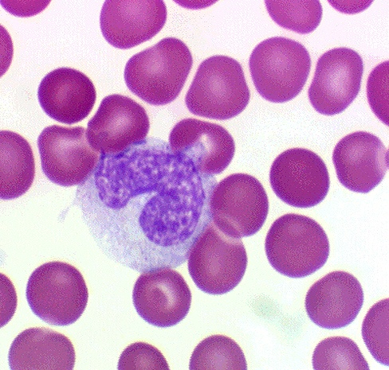
Agranular leukocytes
Differential count: 3 - 8%
Size : 20 microns
Shape : rounded
LM:
Largest in blood film
Nucleus:
Large, eccentric , Kidney- shaped (Indented)
Cytoplasm:
Abundant, Pale basophilic,
Finely granular.
Monocyte

Slide 2
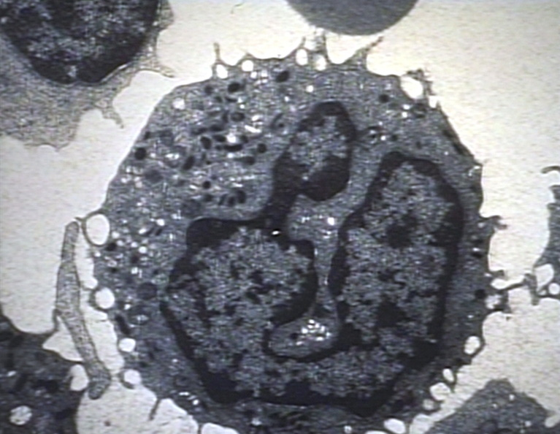
Monocyte
EM:
Irregular = Pseudopodia
Nucleus: Large, eccentric kidney- shaped (Indented)
The cytoplasm contains a moderate amount of organelles.
Non specific (Azurophilic granules) few small dense granules containing lysosomal hydrolytic enzymes.

Slide 3
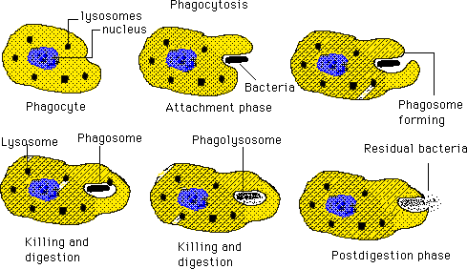
Life span : 1-2 days circulation in the blood, then enter the CT
and trasform into macrophages
Function
Trans- migration & differentiation to tissue MACROPHAGE
Immunologic function:
Phagocytosis and intracellular digestion of bacteria, virus
Ag- presenting cell

Slide 4
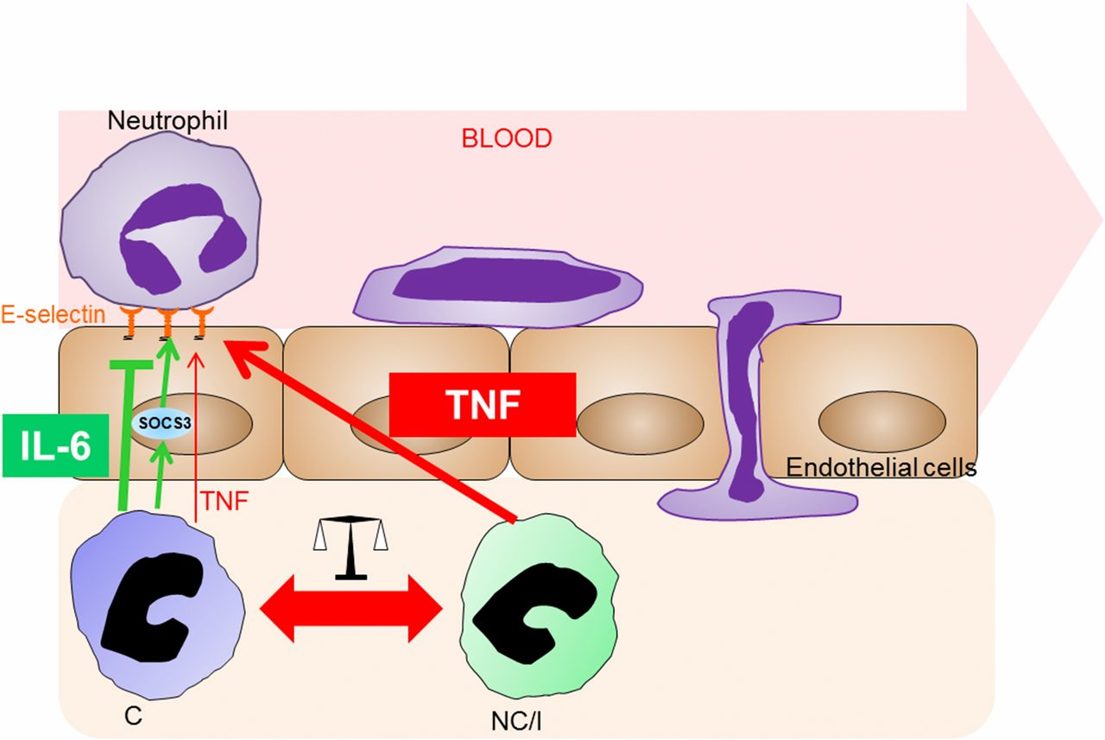
Circulate from region to another & Function in CT= Immunological function
CT

Slide 5
Abnormal Monocyte count
Monocytosis= increase number
Causes:
1- Malaria
2- Chronic infections (glandular fever , syphilis, T.B.)
3-Lymphomas & Leukemia.
in number of Monocyte
Bone marrow depression
drugs
Irradiation
Severe chronic diseases

Slide 6
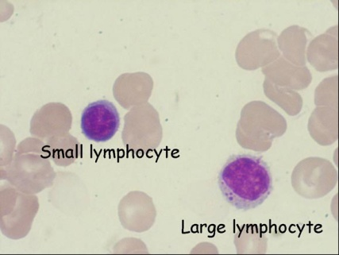
lymphocyte
3 functional types:
T- lymphocytes:
Start development in bone marrow.
Differentiate in thymus.
Cell-mediated IR.
B-lymphocytes:
Develop & differentiate in bone marrow.
Humoral immune response.
Natural killer cells:
Develop in bone marrow.
Lack CDs of B or T.
Are null cells(non B, nonT).
They don't enter the thymus to be competent.
They act nonspecifically to kill virally infected cells &tumor cells
Differential count: 20-30%
Size : 9-12 microns
According to the sizes:
1- large lymphocytes.
2- Medium-sized lymphocytes.
3- Small lymphocytes:
Diameter = RBC.
Most numerous.
Functionally mature.

Slide 7
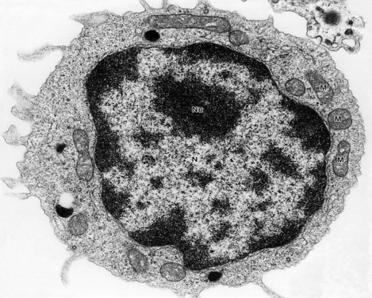
Lymphocytes
EM:
Nucleus: dense clumps.
Cytoplasm thin rim
No specific granules Lysosomes= small & dense Azurophilic granules
Many free ribosomes& few mitochondria + 2centrioles.
▲▲The cell coat = antigenic markers.
LM:
Shape = rounded
Large nucleus, thin cytoplasmic rim
No stained granules in the cytoplasm (except small Azurophilic granules
Small most common 90%
Types: B- and T-lymphocytes (morphologically not distinguishable)
Null-cells (somewhat smaller size) Non B Non T

Slide 8
Antigenic markers of lymphocyte The cell coat: Large no. of cell receptors.
Major histocompatibility complex (MHC) Glycoprotein + specific a.a. sequence.
Tissue typing & antigenic recognition.
2 subclasses: MHC I & MHC II.
2- The cluster of differentiation antigens (CDs):
Cell- surface glycoprotein + specific a.a. sequence.
Expressed on different types of lymphocytes.
Marker proteins upon which Functional types of lymphocytes.

Slide 9
Antigenic markers of lymphocyte Major histocompatibility complex
MHC I:
On all nucleated cells.
Glycoprotein + specific a.a. sequence.
Tissue typing.
Endogenous antigenic recognition:
virus- infected cells.
malignant cells.
MHC II:
Expressed on antigen- presenting cells.
Glycoprotein + specific a.a. sequence.
Tissue typing.
Exogenous antigenic recognition:
Phagocytosed foreign Ags.

Slide 10
Lymphocytes
Function :
After stimulation T-cells and B-cells become : Memory cells and Effector cells
B cells form plasma cells, function in humoral immunity via immunoglobulins
T cells function in cell-mediated immunity
Effector T-cells: T helper cells, T suppressor cells, cytotoxic T cells
Some T cells with “memory” of antigen exposure survive long periods; immunization
Null Cells are composed of: Stem cells and Natural killer cells
NK cells kill some foreign and virally alerted cells
Life span:
months------years

Slide 11
Functions of Lymphocytes
T-lymphocytes
B-lymphocytes
NK cells
Humoral
(Antibody-mediated)
Immune Response
Attack
large particles
e.g.
Viruses,
Cancer cells
Cell-mediated
Immune Response

Slide 12
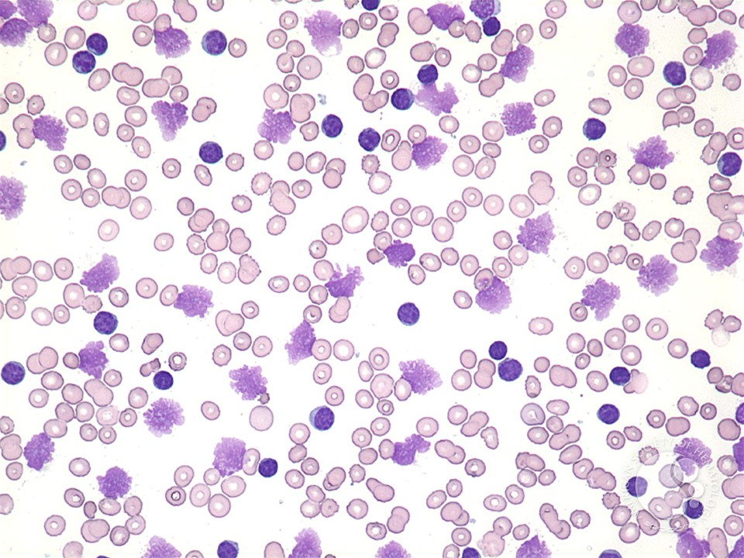
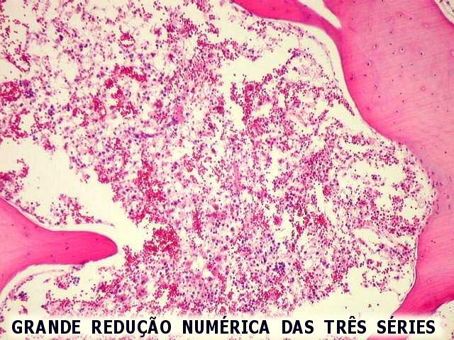
Abnormal lymphocyte count
1-Lymphocytosis:
Causes:
Physiological: in children
Pathological:
1-chronic infections tuberculosis, syphilis,
2-leukemia, Lymphoma.
2-Lymphopenia:
Bone marrow depression.
drugs
Irradiation
Severe chronic diseases

Slide 13
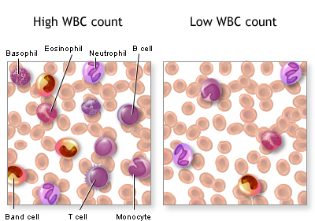
Abnormalities in leukocytic count
Bone marrow
depression
-drugs
Irradiation
Severe chronic
diseases
Typhoid fever
Measles
leukocytosis
Infection
Inflammations
Allergic reaction
Leukaemia
Leukopenia

Slide 14
Acquired Causes of decrease in number
Decreased Production | Increased Destruction | Shift to Marginating Pool
Bone marrow | Peripheral circulation | Move from the circulating pool to attach along the vessel wall
Medication: Chemotherapy Antibiotics, etc | Autoimmune diseases (Rheumatoid arthritis, SLE, etc) | Severe infection Endotoxin release Hemodialysis Cardiopulmonary bypass

Slide 15
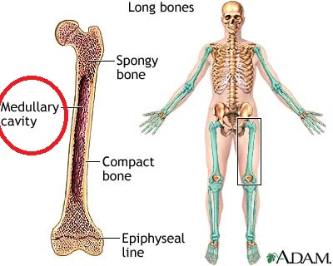
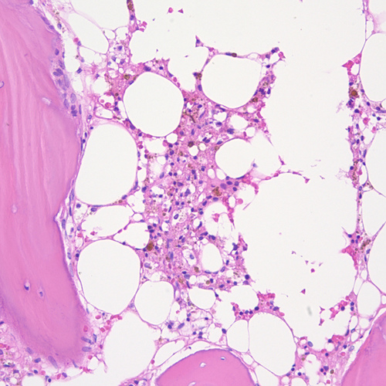
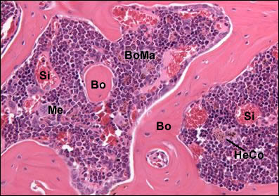
Types of bone marrow
The tissue responsible for Hemopoiesis = formation of balanced amounts of the different blood elements.
daily formed = daily destroyed elements
1-Red bone marrow: active.
2-Yellow bone marrow:
inactive. Yellow color ►large number of fat cells.
can revert to the red type in stress as hemorrhage and anaemia.
Sites:
Central bone marrow cavity in long bones.
Multiple marrow cavities between trabeculae of cancellous bone.

Slide 16
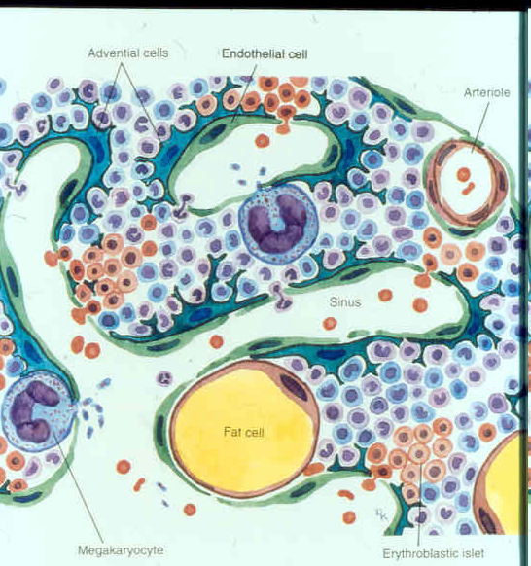
Large, turtuous channels.
fenestrated endothelium.
discontinuous basal lamina.
A- reticular fibers: supporting network
B- stromal cells►►
1- Reticular cells:
Modified fibroblasts
Secrete growth factors.
Change to adipocytes.
2- Macrophages:
Blood monocytes.
Phagocytosis of malformed elements.
Storage of Fe.

Slide 17
Bone Marrow Functions
Production of blood cells (controlled by growth & releasing factors).
Destruction of old RBCs
Storage of iron derived from break down of Hb in macrophages

Slide 18
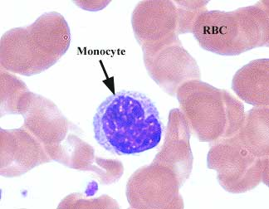
 | Monocyte | Lymphocyte Subsets T, B, natural killer
Number | 3-8% of WBCs | 20-25 % of WBCs Next most common after neutrophils
Size | 12-20 µm diameter | 9-11 µm diameter Small , medium , large
Shape | Spherical | Spherical
Structure | Spherical , Nucleus kidney-shaped No obvious granules | Spherical , Nucleus indented No obvious granules
Life span | Circulate for 3-4 days before enter into tissues and organs | variable life spans Month – years (memory cell )
Function | Precursor of macrophages in tissues Macro = “big”; phage = “eat” Phagocytic function | B Cells involved in humoral immunity T Cells involved in cell-mediated immunity T helper cells, T suppressor cells, cytotoxic T c & memory cell
Abnormality | Monocytosis: is an abnormal increase in the number of blood monocytes. It occurs in diseases like malaria, typhus, viral infections | Lymphocytosis: It is an abnormal increase in the number of lymphocytes as in: -lymphatic leukaemia - chronic infections e.g. tuberculosis, syphilis, whooping cough.

