Slide 1
Assisted reproductive techniques
Presented by :
Raad Lababneh
Hisham Mahmoud
Hala darawi
Shatha Ababneh
Tayma shehab
Ali Alabed
Supervised by : Dr. Mohammad Ramadhneh

Slide 2
Female Infertility: Ovulation Induction Agents

Slide 3
Female infertility is often due to problems with ovulation, where the ovaries fail to release mature eggs, leading to difficulties in conception.
Ovulation induction is a common and effective treatment for women with ovulatory disorders, aiming to stimulate the ovaries to produce and release eggs.
Several medications, known as ovulation induction agents, play a pivotal role in this process, targeting hormonal pathways to trigger ovulation. Here, we’ll explore the primary agents used, their mechanisms, and complementary therapies that support successful ovulation and conception.

Slide 4
Clomiphene Citrate (CC):
Clomiphene citrate is considered a first-line treatment because of its low cost, relative ease of use, and minimal side effects.
Clear indications for clomiphene citrate use include anovulation or oligo-ovulation due to hypothalamic pituitary dysfunction (women with PCOS, unexplained anovulation, hyper prolactinemia ) and luteal phase defect.

Slide 5
Mechanism of action:
Clomiphene citrate is nonsteroidal anti “estrogenic agent” which is recently reclassified as a selective estrogen receptor modulator.
It competes for the estrogen receptor at the hypothalamus, pituitary, and ovarian levels.
Because of the action at the estrogen-receptor level within the hypothalamus, CC alleviates the negative feedback effect exerted by endogenous estrogens.

Slide 6
Dosage:
The standard dose of CC is 50 mg PO for 5 days, starting on the menstrual cycle day 3–5 or after progestin-induced bleeding ,Ovulation usually occurs 5 to 10 days (mean 7 days) after the last day of clomiphene.
Ovulation occurs in 85 % of women.
Side effects: Hot flushes, thick cervical mucus, dry vagina, multiple pregnancy.

Slide 7
Aromatase Inhibitors:
Aromatase inhibitors (letrozole, anastrozole) inhibit the action of the enzyme aromatase, which converts androgens into estrogens by a process called aromatization. As a result, estrogen levels are dramatically reduced, releasing the hypothalamic-pituitary axis from its negative feedback.

Slide 8
Aromatase inhibitors are not approved for ovulation induction due to the possibility of fetal toxicity and fetal malformations. More studies is needed for the safety profile.

Slide 9
Gonadotropins Indication of use:
Gonadotropins are typically used as second-line treatment after selective oestrogen receptor modulation has failed.
However, they may be first-line options for patients with hypothalamic amenorrhoea.(Kallman Syndrome ).

Slide 10
Success rate:
When exogenous gonadotropins are used appropriately, > 95% of women treated with them ovulate, but the pregnancy rate is only 50 to 75%.
Side effects:
1. Multiple pregnancy (24–33%).
2. Ectopic pregnancy (5–8%).
3. Miscarriages (15–21%).
4. Ovarian torsion and rupture.5
. Ovarian hyperstimulation syndrome.

Slide 11
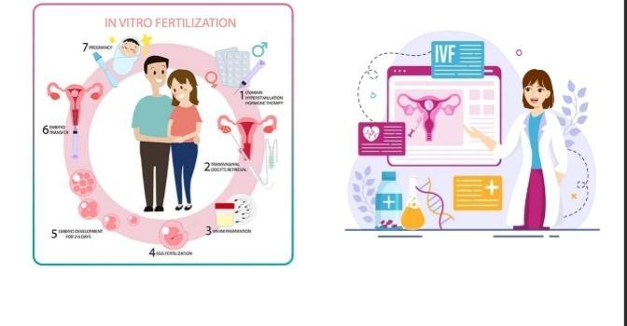
In Vitro Fertilization (IVF)
Hisham Al-hamaideh

Slide 12
What is IVF?
Definition: In vitro fertilization (IVF) is a procedure aimed at overcoming infertility and achieving live birth as a direct result of the intervention.
Type: IVF is one form of assisted reproductive technology (ART).
Current Uses: Although primarily used to treat infertility, IVF is now also used for other medical indications beyond infertility such as : Preimplantation Genetic Testing (PGT
Involves ovarian stimulation, oocyte retrieval, fertilization, and embryo transfer
Timing:
These steps are typically completed within approximately two weeks, referred to as an IVF cycle.

Slide 13
Who Needs IVF?
Unexplained infertility
Male factor infertility (e.g., low sperm count)
Ovulatory disorders (e.g., PCOS)
Tubal blockage or damage
Advanced maternal age
Endometriosis

Slide 14
Alternative Indications for IVF
Preimplantation Genetic Testing (PGT)
Fertility preservation (e.g., before cancer treatment)
LGBTQ+ family building

Slide 15
Components of an IVF Cycle
1. Ovarian Stimulation: Fertility medications are given to stimulate the ovaries to produce multiple follicles.
2. Monitoring: Ultrasounds and blood tests are used to monitor follicle growth and hormone levels.
3. Final Maturation Induction: An injection (usually hCG) is given to mature the oocytes.
4. Oocyte Retrieval: Mature eggs are collected from the ovaries using a needle under ultrasound guidance.

Slide 16
5. Sperm Collection and Preparation: A sperm sample is collected and processed to isolate the best sperm.
6. Fertilization: Eggs and sperm are combined in the lab using conventional insemination or ICSI (intracytoplasmic sperm injection).
7. Embryo Culture: Fertilized eggs are cultured for several days to monitor development.
8. Embryo Transfer: Selected embryos are transferred into the uterus under ultrasound guidance.
9. Luteal Phase Support: Hormonal support (usually progesterone) is given to help the uterine lining support pregnancy.

Slide 17
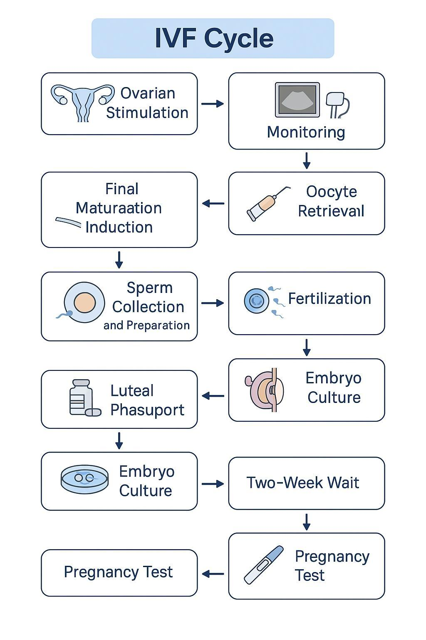
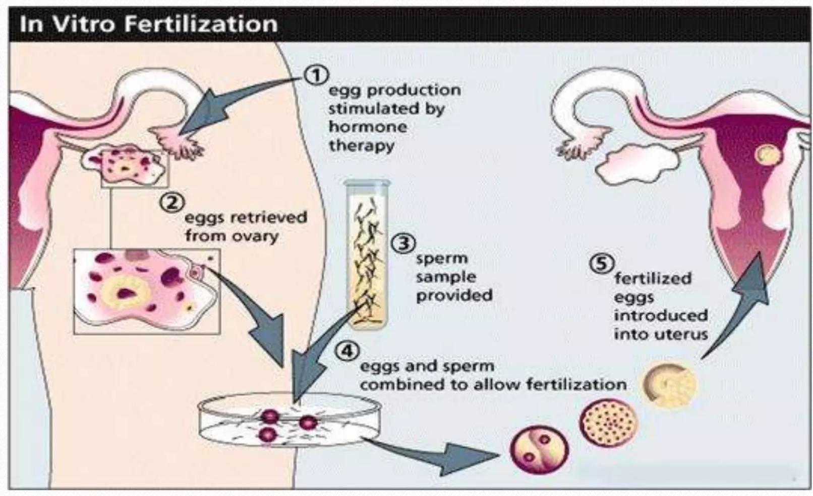

Slide 18
There are two main protocols for ovarian stimulation used in in vitro fertilization (IVF): 1. Gonadotropin-Releasing Hormone (GnRH) Agonist Protocol: This involves the administration of GnRH agonists to initially stimulate and then suppress the pituitary gland. This suppression prevents premature ovulation and allows for better control of the ovarian stimulation process. After suppression, gonadotropins are administered to stimulate the ovaries to produce multiple follicles. 2. Gonadotropin-Releasing Hormone (GnRH) Antagonist Protocol: This protocol uses GnRH antagonists to directly and immediately suppress the pituitary gland, preventing premature ovulation. Gonadotropins are administered simultaneously to stimulate the ovaries. This protocol is often shorter and may reduce the risk of ovarian hyperstimulation syndrome (OHSS).

Slide 19
Success Rates and Risks
Success ~30% per cycle depending on age and cause of infertility
Risks: OHSS, multiple pregnancy, infection, bleeding

Slide 20
Ethical and Emotional Aspects
Emotional stress, financial burden
Ethical concerns: embryo use, genetic testing, donors
Need for counseling and support

Slide 21
References (UpToDate)
UpToDate: IVF Procedure Overview (Mar 2025)
UpToDate: Infertility and IVF Indications (Mar 2025)
UpToDate: IVF Risks and Outcomes (Mar 2025)
UpToDate: Ethics in Assisted Reproduction (Mar 2025)

Slide 22
ICSI
Hala Darawi

Slide 23
🞇 Intracytoplasmic sperm injection (ICSI) refers to a technique in which a single sperm is injected directly into the cytoplasm of a mature oocyte. This procedure is performed as part of an in vitro fertilization (IVF) cycle and provides an effective method for assisting fertilization in men with suboptimal semen parameters or who experienced no or low fertilization rates after conventional insemination.

Slide 24
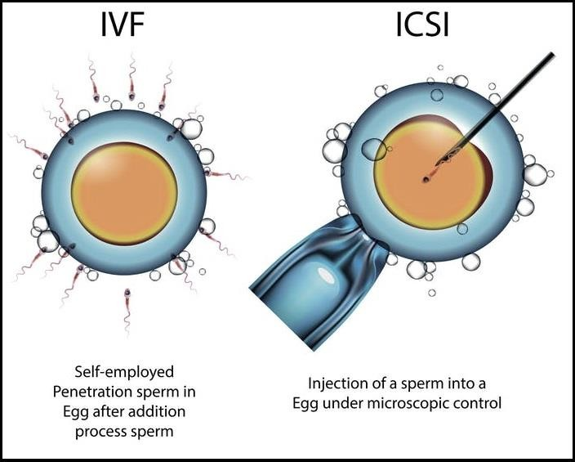
Used for male
factor infertility

Slide 25
🞇 ICSI is a type of IVF. Intracytoplasmic sperm injection differs from conventionl in vitro fertilization in that the embryologist selects a single sperm to be injected directly into an oocyte instead of fertilization taking place in a dish where many sperm are placed near an egg

Slide 26
🞇 The Process of ICSI Treatment:-
🞇
1-Ovarian Stimulation: The female partner undergoes hormonal
medication to stimulate the ovaries to produce multiple eggs.
🞇 2-Egg Retrieval: Eggs are retrieved from the ovaries using a minimally invasive procedure called transvaginal ultrasound aspiration.
🞇 3-Sperm Collection: A semen sample is collected from the male partner, which is then processed in the laboratory to isolate healthy, motile sperm.
🞇 4-ICSI Procedure: A single sperm is carefully selected and injected directly into each mature egg under a microscope.
🞇 5-Embryo Culture: Fertilized eggs (embryos) are cultured in the
laboratory for a few days to monitor their development.
🞇 6-Embryo Transfer: The healthiest embryos are selected and transferred into the woman’s uterus to establish pregnancy.

Slide 27
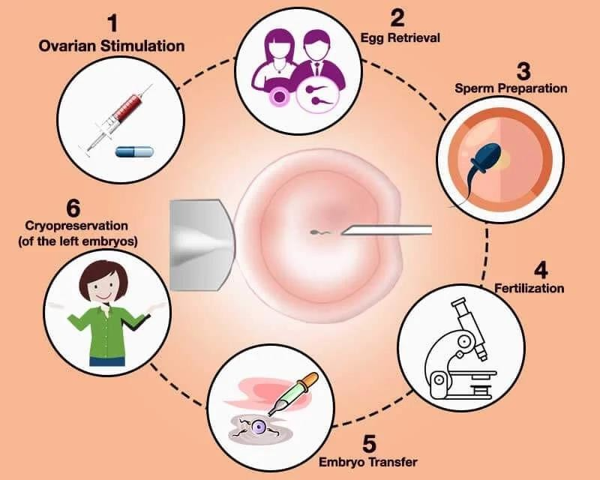

Slide 28
how-sperm-is-collected-for ICSI
🞇 1- Percutaneous Epididymal Sperm Aspiration{A small 30- Ga needle is inserted percutaneously into the epididymis and its contents are aspirated}
🞇 2-Microsurgical Epididymal Sperm Aspiration
{similar manner to percutaneous epididymal sperm aspiration, except that it uses an open incision and surgical microscope.}
🞇 3-Testicular Sperm Extraction{A testicular biopsy (or testicular sperm extraction) is executed through an open scrotal incision. It can be performed with or without the use of a surgical microscope.

Slide 29
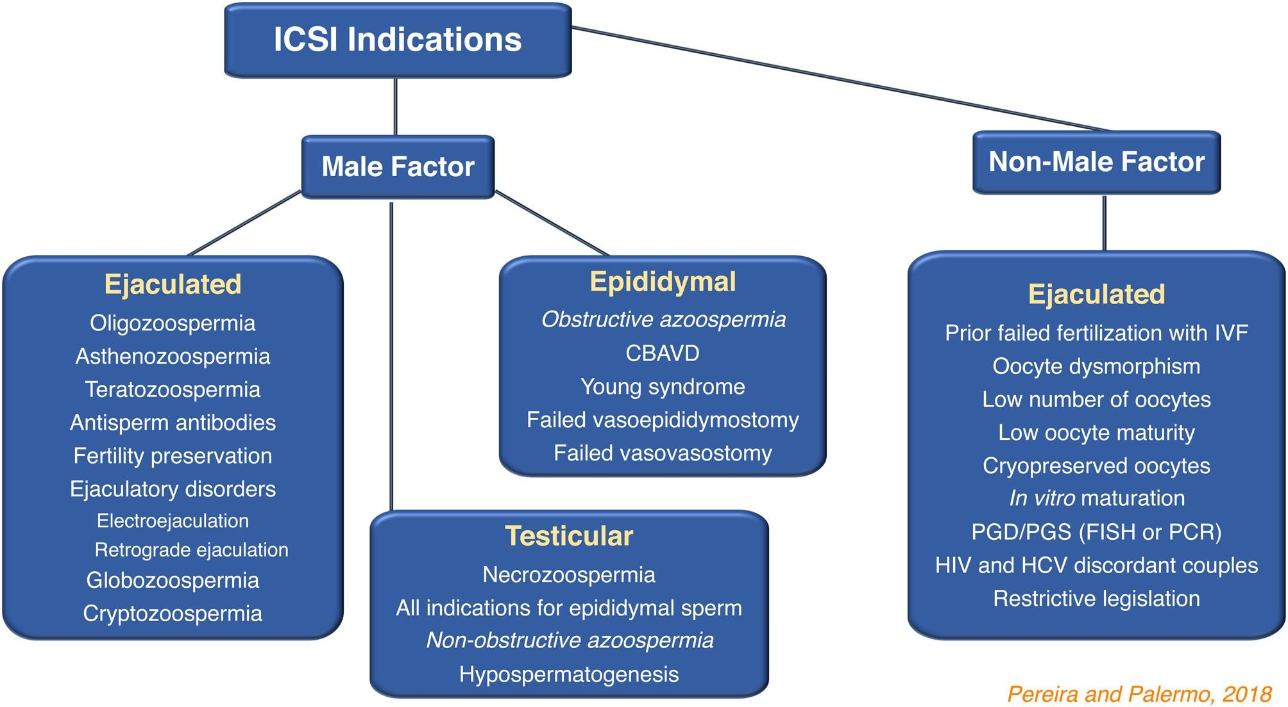

Slide 30
What are the risks of ICSI to the
baby?
🞇 The risk of multiple births and ectopic pregnancy.
🞇
🞇
The risk of congenital abnormalities.
There is an increased risk of genetic problem carried
by the sperm. ICSI may slightly increase a child’s risk of:
🞇 Angelman syndrome.
🞇
🞇
🞇
🞇
🞇
Autism.
Beckwith-Wiedemann syndrome (a growth disorder).
Disorders of sex differentiation.
Hypospadias.
Intellectual disabilities.

Slide 31
🞇 these complications may occur with ICSI:
🞇 Damage to some or all of the eggs during needle penetration.
🞇 An egg doesn’t fertilize after the sperm injection.
🞇 An embryo stops developing in the lab or
after embryo transfer.

Slide 32
Age and ICSI Success Rates
🞇 women in the 30-35 age group have a high ICSI success rate that frequently exceeds 40% per cycle of ICSI treatment.
🞇 Women in the 35-37 age group also have high chances of success when using ICSI. Their success rate is between 35% and 40%
🞇 Conception rates for women using ICSI in the 38 to 40 age group start to decline but are still an encouraging 30% per cycle

Slide 33
Preimplantation genetic test PGT
Preimplantation genetic testing is a technique used to identify chromosomal genetic abnormalities in embryos created through in vitro fertilization before pregnancy.
PGT is widely used today in in-vitro fertilization (IVF) centers over the world for selecting euploid embryos for transfer and to improve clinical outcomes in terms of embryo implantation, clinical pregnancy, and live birth rates

Slide 34
PGT involves:
• Biopsy of a few cells from an embryo at the blastocyst stage (Day 5/6)
• Genetic analysis of these cells
• Selection of embryos free of certain genetic defects

Slide 36
PGT - A
involves checking embryos for abnormalities in the number of chromosomes. Embryos with missing or extra chromosomes (known as aneuploid embryos) have less chance of developing into a baby or, less commonly, may result in a baby being born with a genetic condition. Embryos with the correct chromosome number are known as euploid. PGT-A is therefore offered to some patients as a treatment to help identify euploid embryos and avoid transferring aneuploid embryos.
To perform PGT-A, embryologists remove a cell, or if at a later stage, several cells (a biopsy), from the embryo, which are then tested to assess the number of chromosomes they contain. The biopsy result is used to reflect the embryo as a whole.

Slide 37
Who can benefit from PGT-A?
Women over the age of 35 desire to conceive and have a child.
Women who have previously been pregnant with an abnormal chromosome.
Women with a history of more than 2 miscarriages due to chromosomal abnormalities or unknown causes.
Women or men with infertility who have failed more than 2 IVF cycle attempts.
Women or men with a family history of chromosomal abnormalities.
Couples who choose IVF/ICSI to have a child in order to reduce the risk of having a baby with Down syndrome or another genetic disorder .

Slide 38
What does the PGT-A result mean?
The PGT-A results can be reported in 4 types:
Euploidy
Normal: Embryo chromosomes consist of 23 pairs of chromosomes (for a total of 46 chromosomes) and are suitable for transfer into the uterus for pregnancy.
Aneuploidy
Abnormal: Embryo chromosomes are missing, have extra chromosome numbers than the normal 46 chromosomes, or have an abnormal shape and are not suitable for transferring into the uterus for pregnancy.

Slide 39
Mosaic
Mixed: Normal and abnormal embryo chromosomes are mixed. Some types of Mosaic chromosomes can transfer the embryo into the uterus for pregnancy. The reproductive endocrinologist will determine the ratio of normal and abnormal chromosomes. If the ratio of abnormal chromosomes is less than normal chromosomes and there is a high chance of conceiving a normal, healthy baby, the reproductive endocrinologist will decide whether to proceed with the embryo transfer procedure as a next step, depending on the doctor’s discretion.
No Result
Inconclusive: The embryo chromosome results were inconclusive due to poor chromosome quality or an inadequate number of chromosomes for PGT-A. The reproductive endocrinologist will consider repeating PGT-A using the remaining frozen embryo in order to obtain conclusive results.

Slide 40
What are the advantages of PGT-A?
Increased Implantation Rates: Missing embryonic chromosomes is the most common cause of miscarriage in the first eight weeks of pregnancy.
Reduces Miscarriage Rates: PGT-A detects abnormal chromosomes, prevents the transmission of genetic diseases to the future child, and potentially lowers the risk of miscarriage.

Slide 41
Reduce IVF/ICSI Cycles: PGT-A aids in achieving a successful IVF pregnancy in just one cycle (depending on the maternal health) by selecting only healthy chromosomes before transferring, significantly saving time and cost from repetitive IVF cycles and lowering the risk of conceiving a baby with genetic conditions that require postpartum, long-term treatment.
Improved Pregnancy Outcomes: PGT-A selects normal chromosomes for transfer into the maternal womb. Only healthy chromosomes will result in a healthy pregnancy and contribute to a quality pregnancy, particularly in the first trimester when the pregnancy is most vulnerable.

Slide 42
PGT-M
PGT-M (formerly PGD) is a test that can be applied to embryo biopsies to determine if embryos are affected or unaffected with a specific single gene disease. The test is custom designed for each patient and their specific genetic mutation(s)
It is used to identify single gene defect like cystic fibrosis , sickle cell anemia & Huntington’s disease
PGT-M helps to identify embryos that carries these genes ensuring only unaffected healthy embryos are implanted

Slide 43
Indications for PGT -M
Carrier couples
Known genetic mutations
Recurrent miscarriages
Previous affected pregnancy with a monogenic disorder
Unexplained infertility

Slide 44
PGT-SR
PGT that involves looking at the chromosome structure of your embryos, and finding where segments may have been deleted, duplicated or inverted. It can be used for people with a known chromosome structural rearrangement, to improve the chance of a healthy pregnancy.

Slide 45
Indications for PGT-SR
Chromosomal structural abnormalities include
reciprocal translocation
Robertsonian translocation
inversion, complex translocation
pathogenic microdeletions or microduplications.

Slide 46
Why is PGT-SR Important?
PGT-SR becomes especially important in certain circumstances:
• Balanced Chromosomal Rearrangements in Parents: Parents who are carriers of balanced chromosomal rearrangements (such as balanced translocations) may not show any clinical symptoms themselves but are at increased risk of having embryos with unbalanced chromosomal material. This imbalance can result in early miscarriage or birth defects.
• Repeated Pregnancy Losses: Couples who have experienced recurrent pregnancy loss (miscarriages) may have an underlying chromosomal rearrangement that is preventing healthy pregnancies from being carried to term.
• Infertility: Some couples may face infertility due to structural rearrangements in their chromosomes that impair embryo development.
By identifying these structural abnormalities early in the embryo’s development, PGT-SR allows for the selection of embryos that do not carry these rearrangements, potentially increasing the chances of a healthy pregnancy and reducing the risk of genetic disorders.

Slide 47
References
Kupka, M.S.; Ferraretti, A.P.; de Mouzon, J.; Erb, K.; D’Hooghe, T.; Castilla, J.A.; Calhaz-Jorge, C.; De Geyter, C. Assisted reproductive technology in Europe, 2010: Results generated from European registers by ESHRE. Hum. Reprod. 2014, 29, 2099–2113. [Google Scholar] [CrossRef]
Paternot, G.; Devroe, J.; Debrock, S.; D’Hooghe, T.M.; Spiessens, C. Intra- and inter-observer analysis in the morphological assessment of early-stage embryos. Reprod. Biol. Endocrinol. 2009, 7, 105. [Google Scholar] [CrossRef] [Green Version]
Abeyta, M.; Behr, B. Morphological assessment of embryo viability. Semin. Reprod. Med. 2014, 32, 114–126. [Google Scholar] [CrossRef]
Minasi, M.G.; Colasante, A.; Riccio, T.; Ruberti, A.; Casciani, V.; Scarselli, F.; Spinella, F.; Fiorentino, F.; Varricchio, M.T.; Greco, E. Correlation between aneuploidy, standard morphology evaluation and morphokinetic development in 1730 biopsied blastocysts: A consecutive case series study. Hum. Reprod. 2016, 31, 2245–2254. [Google Scholar] [CrossRef] [Green Version]
Desai, N.; Ploskonk, S.; Goodman, L.R.; Austin, C.; Goldberg, J.; Falcone, T. Analysis of embryo morphokinetics, multinucleation and cleavage anomalies using continuous time-lapse monitoring in blastocyst transfer cycles. Reprod. Biol. Endocrinol. 2014, 20, 12–54. [Google Scholar] [CrossRef]
Katz-Jaffe, M.G.; McReynolds, S. Embryology in the era of proteomics. Fertil. Steril. 2013, 15, 1073–1077. [Google Scholar] [CrossRef]

Slide 48
Ovarian hyperstimulation syndrome

Slide 49
Definition
It’s a ﻿﻿complication of fertility treatment, which uses pharmacological ovarian stimulation to increase the number of oocytes and, therefore, embryos available during assisted reproductive technology (ART).
Incidence:
﻿﻿Mild OHSS occurs in 13.5% of clomiphene cycles.
﻿﻿With gonadotropin injections, the incidence of moderate disease is 3% to 6%.
Severe OHSS occurs in 0.1% to 2% of patients.
In cycles of IVF, mild OHSS has been estimated to affect around one-third of cycles, while the combined incidence of moderate or severe OHSS varies from 3.1% to 8%

Slide 50
Early vs late OHSS
Early onset | Late onset
Presents within 7 days of the hCG injection | Presents 10 or more days after the hCG injection
Usually associated with an excessive ovarian response. | The result of endogenous hCG derived from an early pregnancy tends to be more severe with multiple gestation.

Slide 51
Pathophysiology

Slide 52
Manifestations
Ovarian enlargement
Abdominal distension and discomfort
Severe pain is uncommon. Consider coexistent complication (e.g., ovarian torsion, ectopic pregnancy)
Extravascular effusion
Abdominal pain and distension – ascites
Respiratory symptoms (e.g., discomfort, tachypnea) : Splinting effect of ascites on diaphragm, Pleural effusion
Intravascular dehydration
Oliguria
Thrombosis

Slide 54
Risk factors
Polycystic Ovarian Syndrome (PCOS).
Hypogonadotropic hypogonadism.
Young age.
Low body mass index (BMI).
Increased ovarian volume and high antral follicle count on baseline scan.
Elevated baseline measurements of anti-mullerian hormone (AMH).
High treatment doses of FSH.
Rapidly rising / high estrogen levels (>10,000pmol/L).
A Large number of oocytes was collected (>17).

Slide 55
Prediction
It is concluded that combined E2 plasma level and US folliculometry are accurate . Help in predicting OHSS and in determining the optimum time and safety for giving hcg

Slide 57
Diagnosis

Slide 58
Relevant history from a woman suspected to have OHSS
Time of onset of symptoms relative to trigger
Medication used for trigger (hCG or GnRH agonist)
Number of follicles on final monitoring scan
Number of eggs collected
Were embryos replaced, and how many?
Polycystic ovary syndrome diagnosis?
Symptoms:
Abdominal bloating
Abdominal discomfort/pain, need for analgesia
Nausea and vomiting
Breathlessness, inability to lie flat or talk in complete sentences
Reduced urine output
Leg swelling
Vulval swelling
Associated comorbidities such as thrombosis

Slide 59
Examination
General: Assess for dehydration, oedema (pedal, vulval, and sacral); record heart rate, respiratory rate, blood pressure, and body weight.
Abdominal: Assess for ascites, palpable mass, peritonism; measure girth.
Respiratory: Assess for pleural effusion, pneumonia, pulmonary oedema.

Slide 60
Investigation
Full blood count
Hematocrit (hemoconcentration)
C-reactive protein (severity)
Urea and electrolytes (hyponatremia and hyperkaliemia)
Serum osmolality (hypo-osmolality)
Liver function tests (elevated enzymes and reduced albumin)
Coagulation profile (elevated fibrinogen and reduced antithrombin)
hCG (to determine outcome of treatment cycle) if appropriate
Ultrasound scan: ovarian size, pelvic and abdominal free fluid. Consider ovarian Doppler if torsion is suspected

Slide 61
Management
Mild OHSS Management (Outpatient Care)
Rest and Observation:
Advise limited physical activity (no vigorous exercise).
Daily weight monitoring.
Monitor for worsening symptoms (e.g., shortness of breath, severe bloating).
Hydration:
Encourage oral fluid intake (2-3 liters/day).
Electrolyte-rich fluids (e.g., sports drinks) are better than plain water.
Analgesics:
Paracetamol (acetaminophen) for pain relief
Avoid NSAIDs if there’s concern for kidney function.
Follow-up: Frequent checkups every 1–2 days to monitor weight, abdominal girth, urine output, and blood tests (hematocrit, creatinine, electrolytes).

Slide 62
Management
Moderate OHSS Management
Same as mild, plus:
Close outpatient monitoring or consider hospitalization.
Ultrasound monitoring of ascites and ovarian size.
Blood tests to check: Hematocrit, WBC count, electrolytes, liver and renal function.
Antiemetics: If nausea or vomiting is present (ondansetron, metoclopramide).
Albumin infusion (if hypoalbuminemia is suspected): Human albumin 25% IV to maintain oncotic pressure and reduce third spacing.

Slide 63
Management
Severe OHSS Management (Hospitalization Required)
Hospital Admission Criteria:
Rapid weight gain (>2 kg in 24 hours).
Hemoconcentration (HCT >45%).
Oliguria or elevated creatinine.
Significant ascites or pleural effusion.
Thromboembolic event or respiratory distress.
Intravenous Fluids:
Isotonic saline or lactated Ringer’s solution.
Avoid aggressive fluid replacement to prevent pulmonary edema.
Monitor input/output strictly.

Slide 64
Management
Paracentesis:
Therapeutic removal of ascitic fluid to relieve abdominal pressure and dyspnea.
Ultrasound-guided transvaginal or transabdominal.
Thromboprophylaxis:
Low-molecular-weight heparin (e.g., enoxaparin) in high-risk patients.
Compression stockings and early ambulation when possible.
Monitoring:
Daily labs: CBC, electrolytes, liver/renal function, coagulation profile.
Abdominal girth, weight, respiratory status, urine output (catheterization may be needed).
Electrolyte and Albumin Correction: IV albumin, Correct hyponatremia/hyperkalemia as needed.
Pleural Effusion Management: Thoracentesis if large and symptomatic.

Slide 65
Surgery
Rarely done only in cases of:
Ovarian torsion, rupture
Intraperitoneal hemorrhage

Slide 66
Prevention
Risk Identification Before Stimulation with baseline investigation like transvaginal ultrasound, hormonal profile, serum AMH
Ovarian Stimulation Strategies: Use of mild stimulation protocols or GnRH antagonist protocol
Careful Monitoring During Stimulation
Frequent ultrasound scans
Monitor follicular growth (every 2–3 days)
Serial estradiol (E2) measurements:
Monitor for rapid rise or levels >3000–4000 pg/mL
Cancel or adjust the cycle if needed:
Withhold gonadotropins temporarily (“coasting”) if too many follicles develop or E2 rises too fast
Pharmacologic Prevention: Dopamine agonists (e.g., cabergoline), which reduce VEGF-mediated vascular permeability

Slide 67
Thank you

