Slide 1
Cervical intraepithelial neoplasia
|PRICE: 0.25 |
Dr. Mohammed Khader
Consultant obstetrician and gynecologist
oncologic gynecologist

Slide 2
Cervical cancer screening tests
INTRODUCTION
Cervical cancer screening detects preinvasive neoplasia, thereby making treatment possible before the disease becomes invasive. Screening is performed using cervical cytology (Pap test), or a human papillomavirus (HPV) test, or a combination of the two tests.

Slide 3
Techniques for obtaining specimens
HOW TO OBTAIN A SAMPLE — Cell samples for cervical cytology and HPV testing are obtained during the speculum examination. The same specimen can be used for both tests or separate specimens can be obtained.
Specimens for cytology — There are two methods for preparing a specimen for cervical cytology: the conventional Pap smear and the liquid-based, thin layer preparation (eg, ThinPrep®, SurePath™).
For both methods, cells are obtained from the external surface of the cervix (ectocervix) and the cervical canal (endocervix) to evaluate the transformation zone (squamocolumnar junction), the area at greatest risk for neoplasia

Slide 4
Collection device
Several collection devices are available for cervical cytology sampling. It’s suggested to use a spatula and a separate endocervical brush as this combination provides a specimen with more endocervical cells than when only a spatula is used. It is also slightly better for detecting any grade of cervical intraepithelial neoplasia (CIN) than the single broom device . Cotton tipped swabs should be avoided because they collect fewer endocervical cells and do not detect CIN as well as other devices.

Slide 6
Sample preparation
For conventional Pap smears, the ectocervical spatula is smeared and the endocervical brush is rolled uniformly onto a single slide promptly after obtaining the specimens. The slide is then rapidly fixed to avoid air-drying; the usual fixatives are either ethyl ether plus 95 percent ethyl alcohol or 95 percent ethyl alcohol alone. If spray fixatives are used, the spray should be held at least 10 inches away from the slide to prevent disruption of cells by the propellant.
For liquid-based thin layer cytology, the collecting device is placed into a liquid fixative solution and vigorously swirled or rotated ten times in the solution. When the liquid is processed by the cytology laboratory, loose cells are trapped onto a filter and then plated in a monolayer onto a glass slide.

Slide 9
HPV testing
Specimens for HPV testing can be collected from the endocervix using a Dacron swab or cervical brush, which is then placed in HPV test transport medium . If liquid-based cytology sampling is performed, the same specimen can be used for HPV testing and cytology.
Commercial HPV assays, used with liquid based cytology sampling, only test for HPV types that have been associated with cancer. These HPV types are called oncogenic or high risk HPV

Slide 11
SAMPLE INTERPRETATION
Cytologic analysis — Cytopathologists review cervical cytology slides. The interpretation of cytologic smears is subject to considerable inter-observer variability, particularly in the case of non-diagnostic squamous and glandular atypias (atypical squamous cells of undetermined significance [ASCUS] and atypical glandular cells of undetermined significance).
In some settings, cytotechnologists and/or automated slide interpretation devices perform initial review of the cytology slides to identify a subgroup of slides for subsequent evaluation by a cytopathologist. This subgroup consists of slides with specific abnormal characteristics.
Standardized terminology for reporting cervical cytology results were introduced with the Bethesda System in 1988, which was last revised in 2001

Slide 14
TERMINOLOGY
Historically, mild, moderate, and severe dysplasia were the terms used to describe premalignant squamous cervical cellular changes. This nomenclature, although still in use, has generally been replaced by the term CIN, which is used to describe histologic changes (those detected with biopsy). CIN has three degrees of severity
CIN 1 is considered a low grade lesion. It refers to mildly atypical cellular changes in the lower third of the epithelium (formerly called mild dysplasia). HPV viral cytopathic effect (koilocytotic atypia) is often present.
CIN 2 is considered a high grade lesion. It refers to moderately atypical cellular changes confined to the basal two-thirds of the epithelium (formerly called moderate dysplasia) with preservation of epithelial maturation.

Slide 15
CIN 3 is also considered a high grade lesion. It refers to severely atypical cellular changes encompassing greater than two-thirds of the epithelial thickness, and includes full-thickness lesions (formerly called severe dysplasia or carcinoma in situ).

Slide 18
HPV testing result reporting
In the United States, human papilloma virus (HPV) testing is used as primary screening for cervical cancer (as a co-test with cytology) in women over age 30 and for reflex testing after a cervical cytology result of atypical squamous cells of undetermined significance in women 21 years and older
There are two types of available HPV tests
Tests that detect the presence or absence of any of 12 to 14 high-risk HPV subtypes that are associated with a high risk of cervical cancer. These tests do not report which of the individual subtypes are present. A negative test means that no oncogenic HPV types or only HPV types of low oncogenic risk were detected (however, the laboratory will report a negative test even if no cells are present.

Slide 19
Tests that perform HPV genotyping and report the presence or absence of HPV 16 or 18, which are the subtypes most commonly associated with high-grade cervical intraepithelial neoplasia and cervical cancer types. In addition, HPV 18 infection appears to be associated with an increased risk of cervical adenocarcinoma compared with other oncogenic types.

Slide 20
Type-specific testing for HPV 16 and 18 is not useful for identifying women who should not receive HPV vaccination, since HPV infection can be transient and it is not known if previous HPV infection is protective against
Patients with apparently normal immune systems may “reactivate” latent HPV infections and may develop new episodes of cervical, vulvar, or vaginal dysplasia, without a new exposure. For women with latent infections, the virus may remain dormant in the cytoplasm. In such cases, the HPV virus is still technically present, but the HPV test will be negative.

Slide 21
ROLE OF HUMAN PAPILLOMAVIRUS
The terms transformation zone and squamocolumnar junction are frequently used interchangeably in the literature. However, these are two distinct entities. The squamocolumnar junction is the area in which the squamous epithelium of the ectocervix meets the columnar epithelium of the endocervix. The cervical transformation zone is a dynamic entity of metaplasia throughout a women’s life and is histologically the area where the glandular epithelium has been replaced by squamous epithelium. Thus, the squamocolumnar junction is part of the transformation zone, but the transformation zone comprises a larger area than just the squamocolumnar junction

Slide 22
HPV infection is endemic among sexually experienced individuals. The risk correlates with the lifetime number of sex partners, but is relatively high (4 to 20 percent) even in those with one partner. At least 80 percent of sexually active women will have acquired a genital HPV infection by age 50
Most HPV infections occur in young women and are transient, over 50 percent of new infections are cleared in 6 to 18 months, and 80 to 90 percent will have resolved within two to five years. Transient infections are particularly common in young women in whom the average length of a newly diagnosed HPV infection is 8 to13 months. It is unclear whether HPV positive women who become HPV negative actually clear the virus from their bodies or retain the virus in an inactive or low-level state

Slide 23
Sequelae of acute infection
Latent infection without physical, cytological, or histological manifestations. This is the most common clinical sequelae of HPV infection, occurring in well over 90 percent of infected women.
Active infection in which HPV undergoes vegetative replication, but not integration into the genome. Actively replicating HPV produces characteristic cellular changes, such as nuclear enlargement, multinucleation, hyperchromasia, and perinuclear cytoplasmic clearing (halos). On average, these changes occur two to eight months after the woman is first infected. The cytological findings are also the cytological characteristics of LSIL and ASC-US (atypical squamous cells of undetermined significance), thus LSIL and HPV positive ASC-US can be considered cytological manifestations of active HPV infection.

Slide 24
Resolution of infection is associated with regression of the cytological changes. Resolution appears to be related, at least in part, to formation of HPV antibodies and recruitment of macrophage natural killer cells and activated CD4+ T-lymphocytes. In most women the immune response is a dominant process so the infection remains latent or is suppressed quickly; however, these antibodies can take months to develop, or never develop at all.
Neoplastic transformation in which HPV integrates into the human genome. Possible clinical manifestations of this state include high grade lesions and cancer. This process occurs years after the acute infection

Slide 25
Factors associated with development of high grade lesions and cancer
Subtype
Low-risk subtypes, such as HPV 6 and 11, do not integrate into the host genome and only cause low grade lesions (eg, LSIL and CIN 1) and benign condylomatous genital warts (Overall, HPV 6 and 11 account for 10 percent of low grade lesions and 90 percent of condylomatous genital warts).
High risk HPV subtypes, such as 16 and 18, are strongly associated with high grade lesions (HSIL and CIN 2,3), persistence, and progression to invasive cancer, although they may also be associated with low grade lesions. HPV 16 and 18 account for 25 percent of low grade lesions, 50 to 60 percent of high grade lesions, and 70 percent of cervical cancers. High grade lesions are usually flat, but cancers can be nodular, ulcerative, exophytic, or endophytic.
Persistence: A persistent HPV infection is variably defined as one that is present at least 6 to 12 months
Viral load: The effect of HPV viral load is controversial

Slide 26
COFACTORS IN PATHOGENESIS
Immunosuppression
HIV infection — The incidence of CIN is increased in HIV-infected women In addition, cervical cancer is one of the most common AIDS-related malignancies in women.
Immunosuppressive therapy
Cigarette smoking — Cigarette smoking and HPV infection have synergistic effects on the development of CIN and cervical

Slide 27
Cigarette smoking — Cigarette smoking and HPV infection have synergistic effects on the development of CIN and cervical
Herpes simplex virus and chlamydia — Infection with chlamydia, herpes simplex virus (HSV), or other sexually transmitted diseases may be a surrogate marker of exposure to HPV, rather than a causal factor itself
Oral contraceptives — Long-term use of oral contraceptives has been implicated as a cofactor that increases the risk of cervical carcinoma in women who are HPV positive
Other — For the most part genetic, familial, dietary, and endogenous hormonal factors are not thought to play a role in development of CIN or cervical cancer

Slide 28
Colposcopy
Colposcopy is a diagnostic procedure in which a colposcope (a dissecting microscope with various magnification lenses) is used to provide an illuminated, magnified view of the cervix, vagina, and vulva.
Colposcopic evaluation of the cervix and vagina is based on the finding that malignant and premalignant epithelium have specific macroscopic characteristics relating to contour, color, and vascular pattern that are recognizable by colposcopy.
The improved visualization of epithelial surfaces enhances the colposcopist's ability to distinguish normal from abnormal areas and to obtain directed biopsies from suspicious tissue.
Colposcopy of the vulva, a keratinized epithelium, provides a magnified bright light examination. The primary goal of colposcopy is to identify precancerous and cancerous lesions so that they may be treated early

Slide 30
INDICATIONS
Specific cytological abnormalities:
Persistent atypical cells of undetermined significance (ASC-US) or ASC-US with positive high-risk human papillomavirus (HPV) subtypes
ASC suggestive of high-grade lesion (ASC-H)
Atypical glandular cells (AGC)
Low-grade squamous intraepithelial lesions (LSIL)
High-grade squamous intraepithelial lesion (HSIL)
Suspicious for invasive cancer
Malignant cells present

Slide 31
Additional common indications for colposcopy include :
Evaluation of patients with persistent (two consecutive years) positive testing for high-risk human papillomavirus and normal cytology.
Assessment of women exposed to diethylstilbestrol (DES) exposure in utero.
Evaluation of a palpably or visually abnormal cervix, vagina, or vulva (see individual topic reviews).
In conjunction with laser or other treatment modalities to ensure that known lesions are completely removed or treated, to detect any other lesions in surrounding areas, and for posttreatment surveillance.
Evaluation of a positive screening test for cervical neoplasia such as spectroscopy, cervicography, or speculoscopy

Slide 32
Steps in the colposcopic exam
Examine cervix using low power (inflammation, infection, leukoplakia, punctation, mosaicism, abnormal vessels)
Use green filter and normal saline
Apply 5% acetic acid. Repeat Q 5 min if needed.
Scan entire cervix with white light. Start with low power and move to higher magnification to document abnormal vascular patterns. Use endocervical speculum if needed to view entire transformation zone
The entire TZ, including SCJ, and borders of all lesions must be visualized in order for colposcopy to be satisfactory

Slide 33
5% Acetic Acid Application

Slide 34
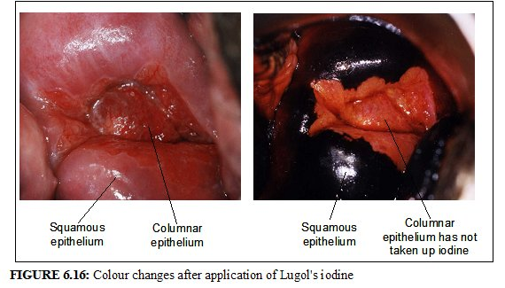
Apply Lugol’s iodine solution to aid in delineating potential biopsy site
Lugol's iodine consists of 5 g of iodine and 10 g of potassium iodide in 100 mL distilled water

Slide 35
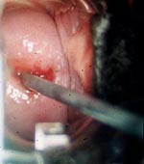
Steps in the colposcopic exam
Perform endocervical curettage, if indicated
ASC-H; HSIL
Adenocarcinoma in situ
Glandular lesion
Unsatisfactory colposcopy
ASC-US/LSIL but no visible lesion
CONTRAINDICATED in pregnancy or active cervicitis

Slide 36
Steps in the colposcopic exam
Mentally map abnormal areas
Mild acetowhite < Intensely acetowhite
No blood vessel pattern < Punctation < Mosaicism
Diffuse vague borders < Sharply demarcated borders
Follows normal contours of the cervix < “humped up”
Leukoplakia – usually a very good (condylomata) or very bad sign
Atypical vessels – usually cancer
Normal iodine reaction (dark) < Iodine-negative epithelium (yellow)

Slide 37
Steps in the colposcopic exam
Perform cervical biopsies, if necessary
Biopsy posterior areas first
A depth of 3 mm is adequate
Biopsy area of the lesion with worst features and closest to SCJ, include the area with atypical vessels

Slide 38
Performing two or more biopsies appears to increase sensitivity .
Options include performing additional biopsies
from another part of the most abnormal appearing lesion,
from more than one abnormal appearing area,
randomly from normal appearing quadrants .
Apply pressure and Monsel’s paste to bleeding sites after biopsy
Remove speculum and inspect vaginal walls, vulva, perineum, and perianal areas
Allow patient to recover
Document findings
Discuss findings with patient and give post-procedure instructions

Slide 39
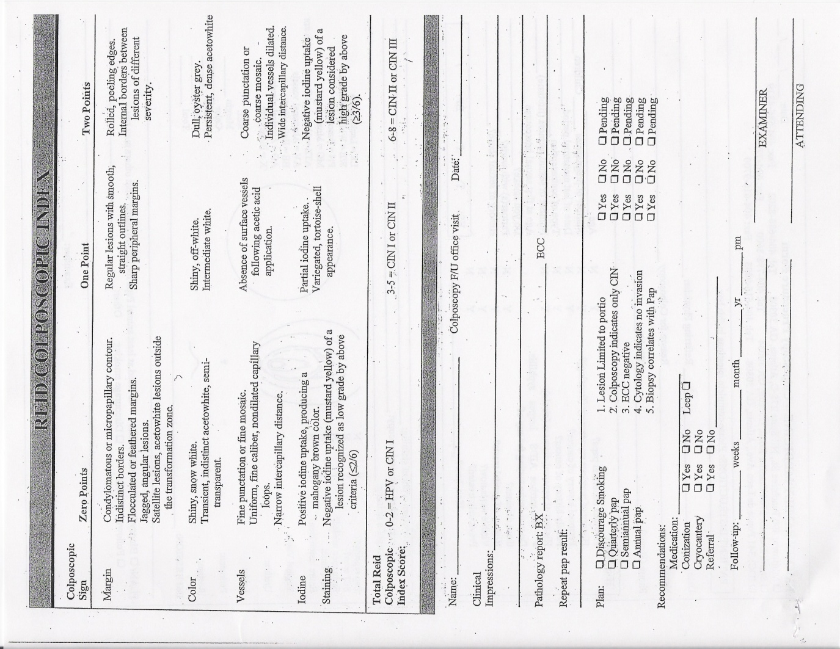
Documentation

Slide 40
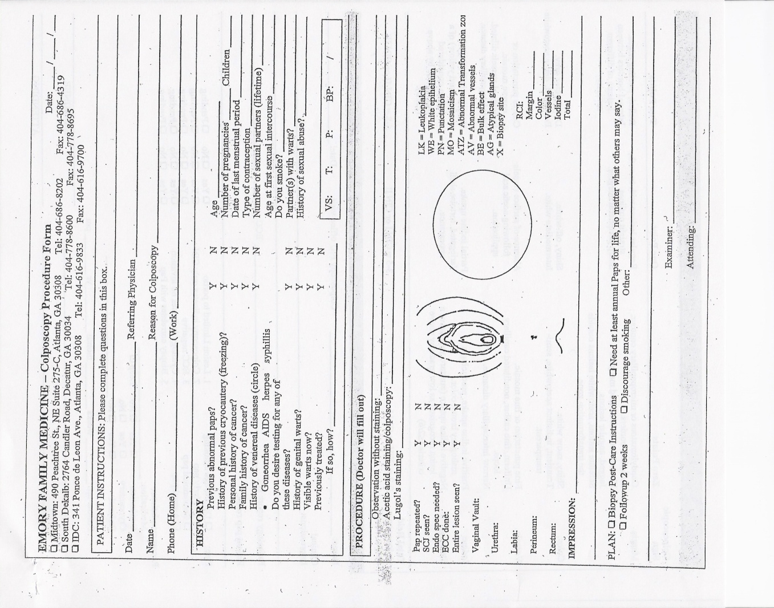

Slide 41
Management
CIN 1 — Given the high rate of spontaneous regression, it’s suggested that expectant management rather than treatment of most patients with CIN 1
CIN 2,3 — Given the low rate of spontaneous regression and high rate of progression, it’s suggested that treatment rather than expectant management of patients with CIN 2,3 (except for adolescents and pregnant women)

Slide 42
Treatment options fall into one of two main categories: procedures that ablate the abnormal tissue; these do not produce a specimen for additional histologic evaluation, and procedures that excise the area of abnormality; these allow further histologic study. Clinical trials comparing the different treatment modalities have not found that any treatment is significantly more successful than another .Regardless of the modality used, the entire transformation zone should be eliminated

Slide 43
Ablative therapy
Women are candidates for ablative therapy if they have no suspected glandular or invasive squamous disease and are compliant with follow-up.
Cryotherapy — Cryotherapy uses a refrigerant gas (carbon dioxide or nitrous oxide ) to cool the ectocervix with a metal cryoprobe. The ectocervix must be cooled to -20ºC to cause crystallization of intracellular water and destroy the lesion. This can be achieved by forming an ice ball in the cervical tissue that is at least 5 mm from the tip of the probe.

Slide 44
CO2 laser — Laser surgery should only be performed by physicians with specialized training. The laser is directed at the cervical lesion under colposcopic guidance. Water in the tissue absorbs the laser energy, which destroys the tissue by vaporization. To be effective, the lesion is typically ablated to a depth of 5 mm on the ectocervix and 8 to 9 mm around the endocervix.

Slide 45
Cold coagulation — Despite the term "cold" coagulation, this method uses heat to ablate the cervical stroma. The term "cold" coagulation is used because lower temperatures are used compared with electrocoagulation diathermy ablation (see below). Similar to cryotherapy, a probe (thermosound) is used to conduct heat to the cervix. Probe temperatures vary from 50ºC to 120ºC. Depth of penetration into the cervical stroma depends on the temperature of the probe and duration of probe application.
Diathermy — The term diathermy means "electrically induced heat". This technique uses a needle that is attached to an electrosurgical generator (cautery device) to destroy cervical tissue.

Slide 46
Excisional therapy
Indications for excisional therapy are:
Suspected microinvasion
Unsatisfactory colposcopy (the transformation zone is not fully visualized)
Lesion extending into the endocervical canal (including CIN 1)
Endocervical curettage showing CIN or a glandular abnormality
Lack of correlation between the cytology and colposcopy/biopsies
Suspected adenocarcinoma in situ
Colposcopist unable to rule out invasive disease
Recurrence after an ablative or previous excisional procedure

Slide 47
Excisional treatment can be performed by cold knife conization, laser conization, or the loop electrosurgical excision procedure (LEEP), also called large loop excision of the transformation zone (LLETZ).
In general, with suspected microinvasion or adenocarcinoma in situ (AIS), cold knife conization is often recommended so that margins can be evaluated without cautery artifact.

Slide 48
Hysterectomy
Hysterectomy should not be performed as an initial treatment of CIN 2,3. The incidence of significant morbidity with hysterectomy is higher than with the less invasive modalities discussed above.
There are, however, some indications for which hysterectomy remains a valid treatment option for CIN
Conization specimen margins that are positive for CIN 2,3, especially in the setting of completed childbearing and expected poor compliance with follow-up
Presence of coexistent gynecologic conditions requiring hysterectomy
Patient request and persistent or recurrent CIN 2,3

