Slide 1
10 – Regulation Of Arterial Blood Pressure
By
Assisst. Prof. Nourelhuda A. Mohammed
Biochem.& Physiology dept.
Mutah school of medicine

Slide 10
I. IMPULSES FROM THE CARDIOVASCULAR RECEPTORS
These afferent act as feed back control of the circulatory hemodynamics.
[A] Baroreceptors (pressor receptors):
These receptors are stimulated by blood pressure variations and are divided:
1-High pressure baroreceptors.
2-Low pressure receptors or volume receptors.

Slide 11
1) Arterial baroreceptors:
• Site:
- Aortic arch and carotid sinus.
- They are sensitive nerve endings which respond to the stretch of arterial wall.
• Nerve connection:
a. Aortic arch: through the aortic nerve from the vagus.
b. Carotid sinus: through the carotid sinus nerve (branch from glossopharyngeal).
The aortic nerve and carotid sinus nerve are called the buffer nerves.
• Stimuli:
They are stimulated by stretching the arterial wall by the blood pressure changes

Slide 12
a. Arterial blood pressure:
- They are stimulated by changes in blood pressure ranges from 60-180 mmHg.
- Below 60 mmHg → no discharge
- at 180 mmHg → maximal discharge.
- above 180 mmHg → no further increase in the rate of discharge.
b. Pulse pressure (systolic pressure-diastolic pressure):
- They respond to the pulse pressure changes, so their rate of discharge increases during systolic rise of the blood pressure and decreases during the diastolic fall of blood pressure.

Slide 13
Functions:
Discharge continuous inhibitory impulses during rest, thus causing the vagal tone.
They have buffering action on the ABP.
- If ABP increases:
They increase the rate of discharge of the inhibitory signals to the pressor area leading to:
(a) arteriolar dilatation → ↓ peripheral resistance → ABP to normal.

Slide 14
(b) Veno-dilatation → decreased VR → decreased COP → decreased ABP.
(c) Decrease HR : leading to decrease COP and ABP.
(d) Decreased cardiac contractility : leading to decreased SV → decreased COP → decreased ABP.
All of the above mentioned actions tend to decrease the BP to its normal level.
- If the BP decreases the reverse actions occur to increase the BP.

Slide 15
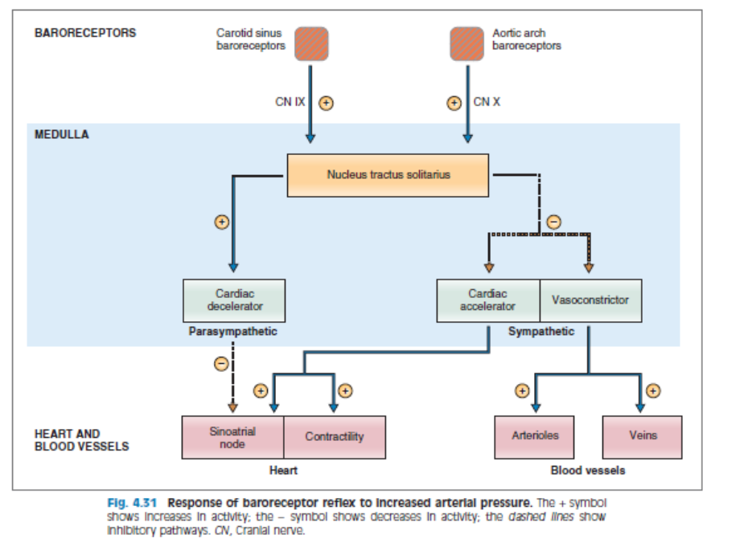

Slide 16
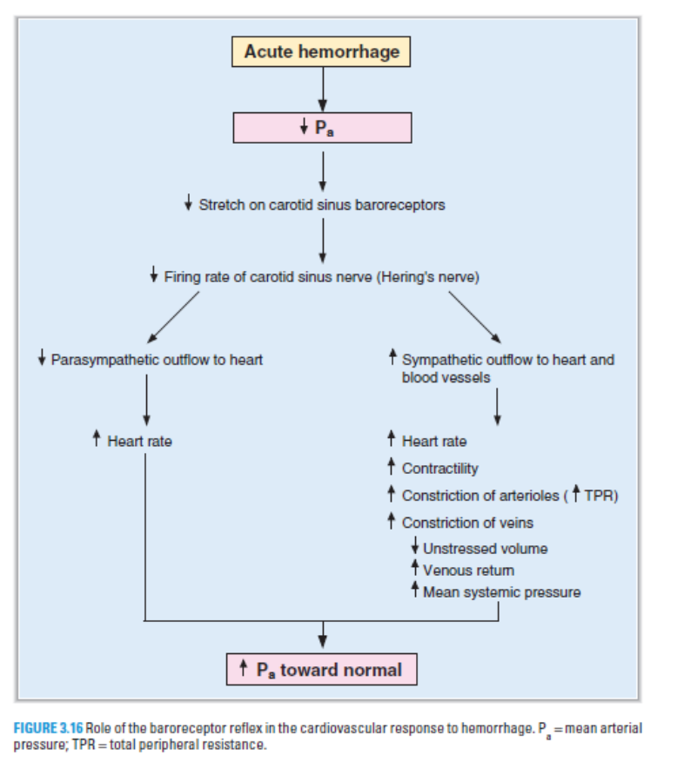

Slide 17
Carotid sinus syndrome:
In some people the carotid sinus reflex is very sensitive so that a slight pressure on the carotid sinus leads to great drop in the ABP and and fainting as a result of cerebral ischemia. It is treated by denervation of the carotid sinus.
Mary's law:
The HR is inversely proportional to the ABP provided that other factors are kept constant.
Nervous mechanism of essential hypertension:
Resetting of the arterial baroreceptors to a new higher level may be the cause of essential hypertension.

Slide 18
2) Atrial receptors:
• Site: In the wall of both atria near the venous openings.
• Nervous connection: Vagus nerve..
• Types:
Type A : discharges during atrial systole.
Type B: discharges late in diastole (by atrial filling)
• Stimulus: stimulated by the increase in the CVP (so also called volume receptors).
• Function: Regulation of the CVP when the VR increases lead to increase in the central venous pressure (CVP) so the atrial receptors increase the discharge leading to the following actions.

Slide 19
a. Inhibition of (VCC) leading to:
- Arteriolar dilatation (↓ PR) → ↓ ABP
- Veno-dilatation → ↓ VR → ↓ central venous pressure → ↓ COP → ↓ ABP.
b. Inhibition of secretion of (ADH) and aldosterone, this leads to increased excretion of Na+ and water in urine decreased blood volume → ↓ central venous pressure → ↓ VR → ↓ COP → ↓ ABP.

Slide 20
BAINBRIDGE REFLEX:
An increase in the right atrial pressure leads to acceleration of the heart (↑ HR )
Mechanism:
- When the RAP increases it sends impulses to cause inhibit of CIC SO, stimulation of the CSC resulted and finally tachycardia occurs.
BAINBRIDGE EFFECT:
- Some authors believe that the tachycardia occurring during the increased right atrial pressure is resulting from local stretch of S.A. node.

Slide 21
[B] Chemoreceptor:
1) Peripheral chemoreceptors:
•Site: Aortic body Carotid body
•Stimuli:
1- Hypoxia (↓ PO2 to 60mmHg) the main stimulus. So, they are called O2 lack receptors.
2- Hypercapnia (↑ CO2 tension) with less effect
3- Acidosis (↑H+ tension)
• Afferent: The buffer nerves.
Function: It sends excitatory impulses to stimulate the pressor area and inhibit the depressor area leading to increased ABP.
- Its main function is stimulate the respiratory centers.

Slide 22
2) Coronary chemoreflex: (Bezold-Jarish reflex)
• Injection of serotonin (VC of coronaries) and chemicals released from myocardial infarction → stimulate the ventricular or coronary chemoreceptors → reflex ↓ABP & ↓HR and respiratory depression.
3) Pulmonary receptors (j-receptors):
• Distension of the pulmonary vessels as in pulmonary embolism or congestion → reflex hypotension, bradycardia and apnea.

Slide 23
2- Intermediate mechanisms
1. Capillary fluid shift mechanism:
- The intermediate mechanisms begin to act within a few minutes, and reaching full function within a few hours.
- Any changes in the arterial pressure lead to similar changes in the capillary hydrostatic pressure which in turn affects the rate of filtration and reabsorption.
(1) ↑ ABP → ↑ capillary hydrostatic pressure → ↑ fluid filtration → ↓ blood volume → ↓ CVP → ↓ venous return →↓ cardiac output → the blood pressure return to normal.
(2) ↓ABP produces shift of fluid from tissue fluid to plasma so tissue fluid acts as a reservoir for the plasma.

Slide 24
2. Stress and reverse-stress relaxation:
A pressure change causes the vessels gradually to adapt to a new size, thereby accommodating the available amount. The phenomenon is called stress relaxation or reverse stress relaxation.
Massive transfusion leading to increase in blood pressure at first but because of relaxation of the circulation during the next ten minutes to an hour return nearly to the normal even if the blood volume is 30% above normal.
-Reverse stress relaxation occurs when there is a blood loss (it's limit is only 15% blood loss).

Slide 25
3- Thirst sensation:
- In cases of fluid or blood loss volume receptors in the right atrium stimulate thirst center in the hypothalamus →↑ water intake → ↑blood volume → restoration of blood volume and ABP.

Slide 26
3- Slowly acting mechanisms
(Role of kidney)
1- Pressure Diuresis:
Increased ABP→ increased filtration force in the kidney→ more urine excretion → decreased blood volume → ABP decreased back to normal.
Decreased ABP as in hemorhage and shock → decreased urine formation → preservation of blood volume and blood pressure.

Slide 27
2- Renin- angiotensin -system:
Decreased blood pressure (dehydration, hemorrhage) →↓renal blood flow→ renal ischemia → juxtaglomerular apparatus secret renin which act on alpha globulin in the plasma called angiotensinogen producing angiotensin I which is converted to angiotensin II by the angiotensin convertase enzyme in the lung.

Slide 28
Angiotesin II has the following effects:
1-Strong arteriolar VC (50 times as noradrenaline) leading to increased peripheral resistance and blood pressure.
2-Stimulation of aldosterone release from the suprarenal gland → salt and water retention→ increase blood volume, COP and blood pressure.

Slide 29
3- Stimulation of ADH (vasopressin) secretion from the pituitary gland → water retention and increase blood pressure .
4- Stimulate NA release from postganglionic sympathetic fibers.
5- Stimulate thirst sensation→↑ water intake→ ↑Blood volume →↑ ABP.
6- Stimulate salt and water retention by the kidney → Increase blood volume and blood pressure.

Slide 30
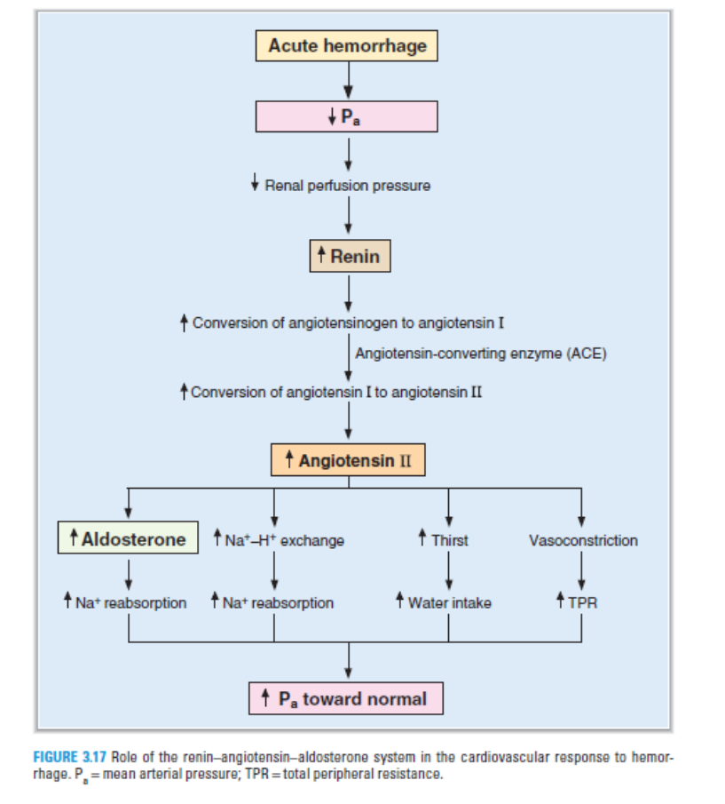

Slide 31
T
H
A
N
K
U
Y
O

