Slide 1
5- Pulmonary Capillary Dynamics By Prof. Sherif W. Mansour Physiology dpt., Mutah school of Medicine .

Slide 2
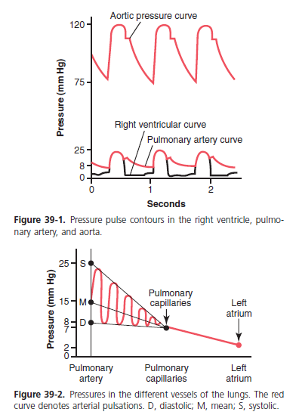

Slide 3
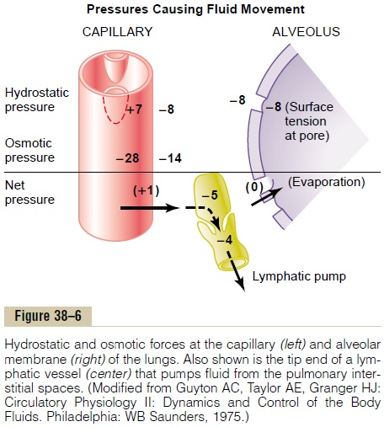

Slide 4
Starling forces affecting pulmonary cap.
1. The pulmonary capillary pressure is low, about 7 mm Hg, in comparison with a considerably higher functional capillary pressure in the peripheral tissues of about 17 mm Hg.
2. The interstitial fluid pressure in the lung is slightly more negative than that in the peripheral subcutaneous tissue. (This has been measured by measuring the absorption pressure of fluid from the alveoli, giving a value of about –8 mm Hg.)
3. The pulmonary capillaries are relatively leaky to protein molecules, so that the colloid osmotic pressure of the pulmonary interstitial fluid is about 14 mm Hg, in comparison with less than half this value in the peripheral tissues.
4. Plasma colloid osmotic pressure = 28 mm Hg.
-The alveolar walls are extremely thin, and the alveolar epithelium is so weak that it can be ruptured by any positive pressure in the interstitial spaces greater than alveolar air pressure (greater than 0 mm Hg), which allows dumping of fluid from the interstitial spaces into the alveoli.

Slide 5
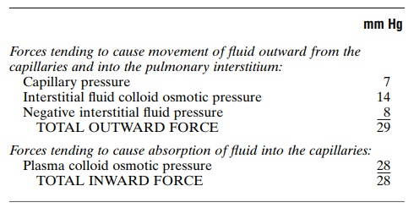
The dynamics of fluid exchange across the lung capillary membranes are qualitatively the same as for peripheral tissues. However, quantitatively, there are important differences, as follows:

Slide 6
Thus, the normal outward forces are slightly greater than the inward forces, providing a mean filtration pressure at the pulmonary capillary membrane; this can be calculated as follows:
This filtration pressure causes a slight continual flow of fluid from the pulmonary capillaries into the interstitial spaces, and except for a small amount that evaporates in the alveoli, this fluid is pumped back to the circulation through the pulmonary lymphatic system.

Slide 7
Negative Pulmonary Interstitial Pressure and the Mechanism for Keeping the Alveoli “Dry.”
One of the most important problems in lung function is to understand why the alveoli do not normally fill with fluid. One’s first inclination is to think that the alveolar epithelium is strong enough and continuous enough to keep fluid from leaking out of the interstitial spaces into the alveoli.
This is not true, because experiments have shown that there are always openings between the alveolar epithelial cells through which even large protein molecules, as well as water and electrolytes, can pass.

Slide 8
It is clear that whenever extra fluid appears in the alveoli, it will simply be sucked mechanically into the lung interstitium through the small openings between the alveolar epithelial cells. Then the excess fluid is either carried away through the pulmonary lymphatics or absorbed into the pulmonary capillaries.
Thus, under normal conditions, the alveoli are kept “dry,” except for a small amount of fluid that seeps from the epithelium onto the lining surfaces of the alveoli to keep them moist.

Slide 9
Pulmonary Edema
The most common causes of pulmonary edema are as follows:
1. Left-sided heart failure or mitral valve disease, with consequent great increases in pulmonary venous pressure and pulmonary capillary pressure.
2. Damage to the pulmonary blood capillary membranes caused by infections such as pneumonia or by breathing noxious substances such as chlorine gas or sulfur dioxide gas.
-Edema safety factors:
A) Low pulmonary capillary pressure (7 mmHg) while the osmotic (oncotic) pressure of plasma proteins = 28 mmHg, so alveoli are always dry.
B) Surfactant decreases surface tension, which attract fluid towards alveoli.
C)The rich lymphatic circulation carries any fluid remains out the capillaries.
D) Drainage away of proteins by continuous lymph flow.
E) –ve ISF.

Slide 10
-Safety Factor in Chronic Conditions:
When the pulmonary capillary pressure remains elevated chronically (for at least 2 weeks), the lungs become even more resistant to pulmonary edema because the lymph vessels expand greatly, increasing their capability of carrying fluid away from the interstitial spaces perhaps as much as 10-fold.
Rapidity of Death in Acute Pulmonary Edema
When the pulmonary capillary pressure rises even slightly above the safety factor level, lethal pulmonary edema can occur within hours, or even within 20 to 30 minutes if the capillary pressure rises 25 to 30 mm Hg above the safety factor level.
Thus, in acute left-sided heart failure, in which the pulmonary capillary pressure occasionally does rise to 50 mm Hg, death frequently ensues in less than 30 minutes from acute pulmonary edema.

Slide 11
Thank You

