Slide 1
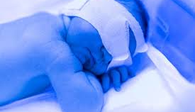
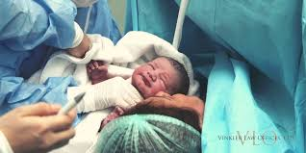
Birth injuries
Jafar radawneh
Rashed bataineh
Mohammed maaitah
Ahmad maaitah
Sara Hloul
Jood sagarat
Presented by:

Slide 2
What are birth injuries?
Birth injuries: Are any physical or emotional distress that occurs to the fetus or the mother during labor (specially the 2nd stage)
Types of the injuries could be physical or psychological:
Psychological : affecting the mother and the family. Giving birth is usually a positive event, but it can be a mixed experience or even a very negative one resulting in psychological traumas with lasting negative impact on the parents’ life like PTSD , Anxiety or even Postnatal depression.
So psychological assessment is recommended after any delivery whether its traumatic or not.
Physical injuries : they can affect the mother or the fetus or even sometimes both usually resulting in birth canal injuries in the mother and hypoxic, neurological, bleeding , soft tissue and brain injuries for the fetus or newborn.

Slide 3
Risk factors:
Risk factors can be sorted according to the elements involved in the delivery or the process itself into fetal or maternal related risk factors or process related risk factors.
Fetal:
Macrosomia
Abnormal presentation & positioning
Maternal:
Obesity
Pelvic abnormalities
Uterine inertia
Short stature
Delivery/Process :
Instrumental delivery:
Forceps.
Vacuum (ventose).
Duration of delivery.
Skills of the obstetrician.

Slide 4
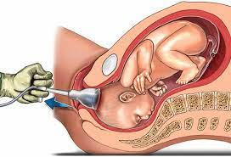
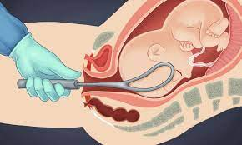
Vacuum (ventose)
Forceps
Way of application doesn’t matter
Failure rate in vaginal delivery 12%
Higher rate of fetal morbidity
Cephalhematomas and exclusively having Subgaleal hematomas and retinal hemorrhage
it must never be used for delivery of fetuses presenting by the face or breech.
Contraindicated in preterm
Injuries occur with wrong application
Failure rate in vaginal delivery 7%
Higher rates of maternal injuries
Vaginal & perineal tissue & anal sphincter dmg
Sequential use of one instrument followed by another has been associated with disproportionately high fetal morbidity rates.

Slide 5
Types of birth injuries:
Newborn injuries:
Extracranial injuries: Caput succedaneum, Subgaleal hematoma & Subperiosteal hematoma.
Intracranial injuries: Epidural, Subdural, Subarachnoid, Intracerebral & Intraventricular
Facial injuries: Nasal septal dislocation & Ocular injuries.
Neurological injuries: Bell’s palsy, Erb’s palsy & Klumpke’s paralysis.
Soft tissue injuries: Bruising, Abrasions , Lacerations, Fat necrosis & Torticollis.
Fractures: Clavicle , Skull , Humerus & Femur.
Abdominal injuries.
Maternal injuries:
Perineal tears.
Vulvar hematoma.
Uterine rupture.

Slide 6
Extracranial injuries:
Neonatal scalp hematoma is a swelling that occurs to a baby’s scalp shortly after delivery. During childbirth, especially during head-first deliveries, pressure exerted on a baby’s head can damage the scalp, leading to scalp hematomas.
three types:
Caput succedaneum.
Subgaleal hematoma.
Subperiosteal cephalhematoma.
Ultrasound cannot identify the layers of the scalp, so we must generally rely on other features to distinguish one type from another.

Slide 7
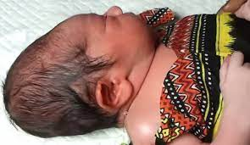
Caput succedaneum:
Scalp edema due to :
Normal application of ventose (Vacuum).
Prolonged or obstructed labor.
Located at the presenting portion of the skull or vacuum placement site.
Only skin involvement and isn't limited by suture lines & skin ecchymosis is usually present.
Resolves on its own within 1-2 days

Slide 8
Subgaleal hematoma:
Bleeding from the emissary vein into the loose connective tissue layer of scalp.
Caused by vacuum or forceps assisted delivery or skull fracture
Wide-spread and isn’t limited by sutures so there is no barrier to limit the bleeding.
LETHAL , because of the massive blood loss and hypovolemic shock, can cause up to 70% blood loss .
Usually develops slowly 12-72 hours after delivery. However, if severe it can be noticed immediately
Resuscitation & intensive care

Slide 9
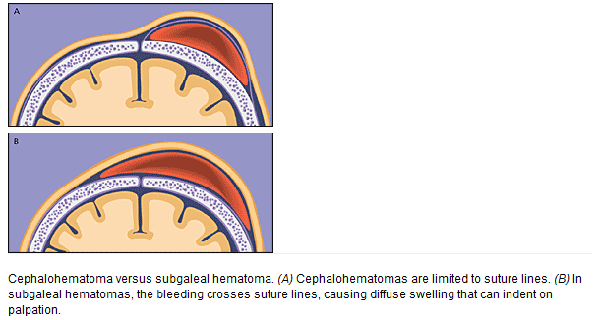
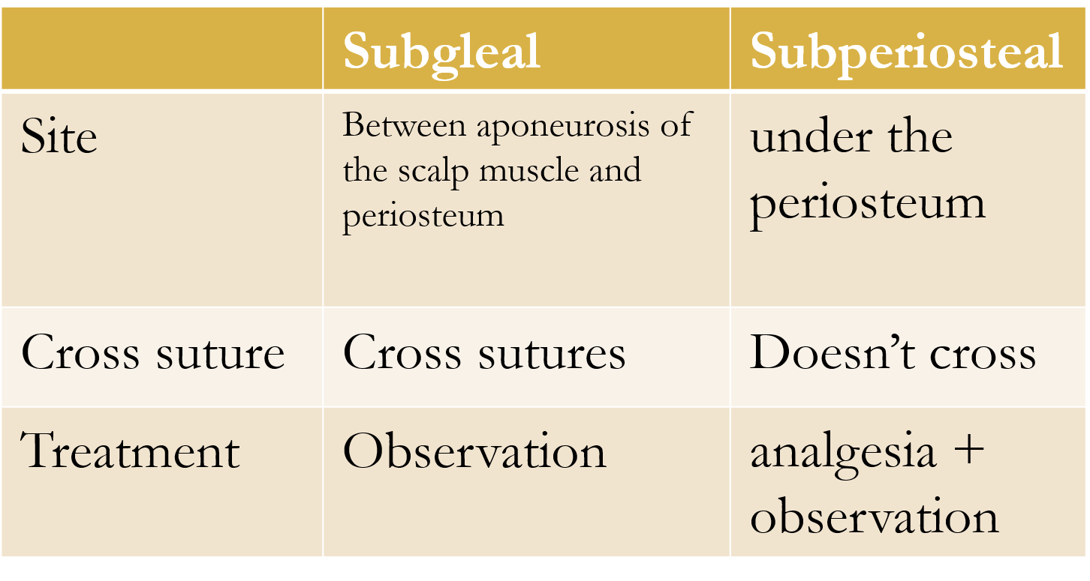
Cephalhematoma:
blood directly beneath periosteum so it doesn’t cross suture lines.
Caused by wrong application of forceps or using vacuum, may be accompanied by depressed or diastatic skull fracture
The mass is firm and has well defined margins and the scalp moves freely above it.
Shouldn’t be aspired in newborns because of risk of infection and abscess formation.
Cephalhematoma vs. Subgaleal hematoma
Resuscitation if needed

Slide 10
Infants intracranial hemorrhage (Brain bleeds)
Infant intracranial hemorrhages (otherwise known as brain bleeds) are birth injuries that range from minor to extremely severe. They can be caused by birth asphyxia (oxygen deprivation during or around the time of birth) or birth trauma (injuries caused by excessive mechanical force to the baby’s head) In many cases, may these complications stem from medical negligence.

Slide 11
1) Subdural hemorrhage or subdural hematoma:
occurs when one or more blood vessels rupture in the subdural space, which is the area between the surface of the dura and the arachnoid membranes. These ruptures are usually caused by traumatic injuries, like birth trauma. (2Subarachnoid hemorrhage: characterized by bleeding in the subarachnoid space, which is the area between the innermost of the two membranes that cover the brain. - the second most common type of neonatal intracranial hemorrhage. -Birth trauma (excessive mechanical force on the baby during birth) or hypoxic-ischemic injury (lack of oxygenated blood flow to the brain).

Slide 12
3) Intraventricular hemorrhage:
(IVH) is a serious type of intracranial hemorrhage that occurs when there is bleeding in the brain’s ventricular system, where cerebrospinal fluid is produced. It is usually seen in premature infants and infants with low birth weight, because the blood vessels in their brains are not fully developed, and are therefore weaker than that of babies born at term. - Oxygen deprivation and birth trauma can also contribute to intraventricular hemorrhage.
Most common

Slide 13
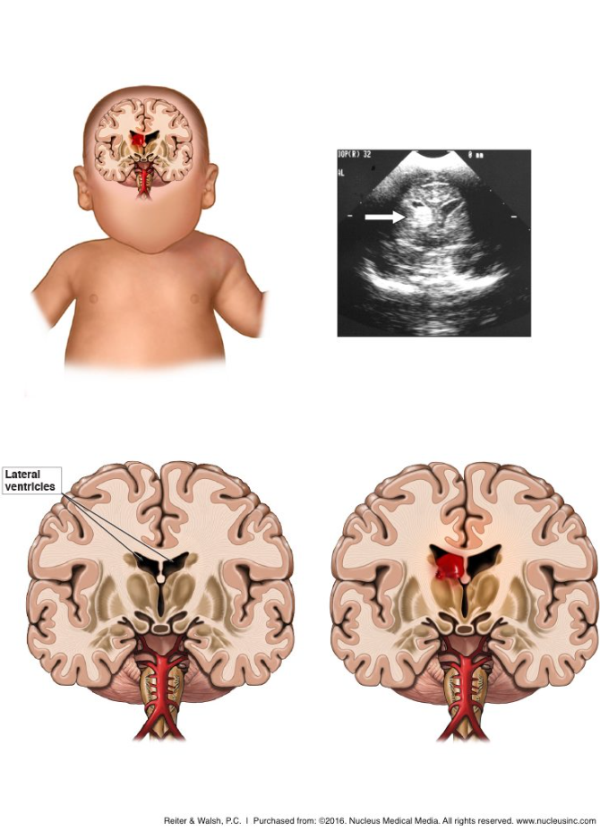
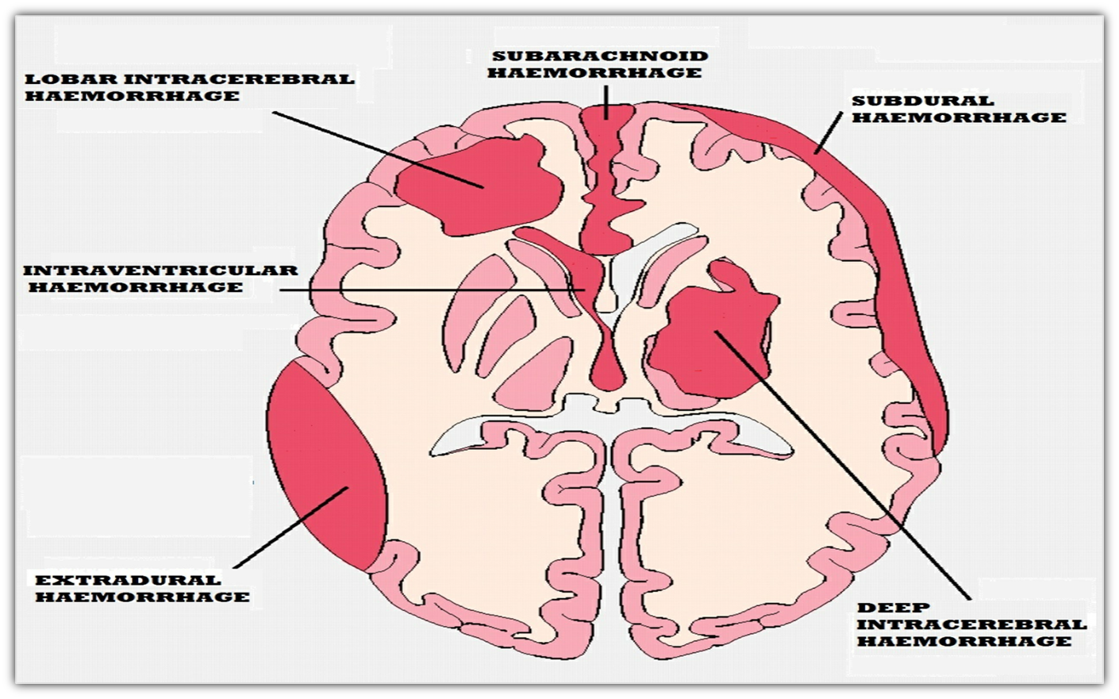

Slide 14
4) Intracerebral hemorrhage:
Also known as cerebral hemorrhage, this type of brain bleed is characterized by bleeding that originates from blood vessels within the brain.
Signs and Symptoms of Intracranial Hemorrhages
Signs of brain bleeds in babies will vary based on the type and severity of the bleed, but include:
Lethargy
Neonatal seizures
Apnea
Feeding difficulties
Irritability
Bulging fontanelle/soft spot
Shallow breathing
Abnormal tone
Altered level of consciousness

Slide 15
Risk Factors and Causes of Intracranial Hemorrhages
Macrosomia
Cephalopelvic disproportion (CPD): A similar condition to macrosomia, except that it specifically refers to a size mismatch between the fetal head and the mother’s pelvis (the head is unusually big and/or the pelvis is unusually small).
Abnormal fetal presentation: A baby that comes out of the birth canal in the breech, face, or brow presentation.
Trauma from prolonged labor Hypoxic-ischemic encephalopathy (HIE): A dangerous neonatal brain injury resulting from decreased oxygen and blood flow to the baby at or near the time of delivery. - The lack of blood flow results in cell death and causes the blood vessel walls to break down, which leads to bleeding.

Slide 16
Treatment of infant brain bleeds is mostly of a supportive nature, although neurosurgical intervention may be necessary to manage certain types. - prognosis varies depending on the severity and location of the bleed. -If risk factors for intracranial hemorrhage are present, medical professionals must closely monitor the baby for signs of fetal distress and discuss the possibility of C-section with the mother

Slide 17
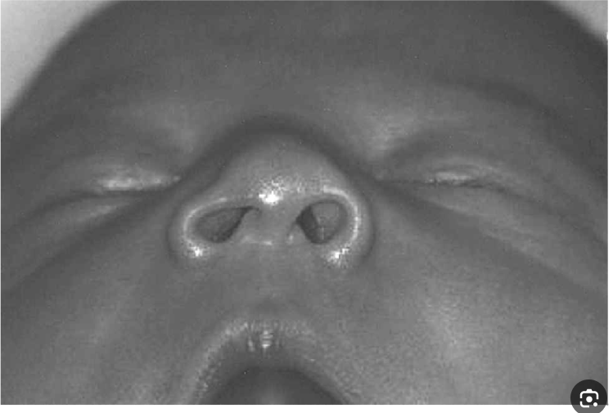
Facial injuries:
1) Nasal septal dislocation in neonates : can occur due to various reasons, including birth trauma during delivery, the use of forceps or vacuum extraction during birth, or inherent structural abnormalities in the baby's nasal septum. - Dislocation of the triangular cartilaginous portion of the septum from the vomerine groove. - Presentation : 1. deviation of the nose to one side 2. airway obstruction 3. an asymmetrical appearance of the nose. 4. noisy breathing (stridor) - Definitive diagnosis by Rhinoscopy

Slide 18
Treatment:
The treatment approach for nasal septal dislocation in neonates depends on the severity of the condition. In mild cases, conservative management may be sufficient, which includes keeping the nasal passages clear of mucus, using saline drops to help with congestion, and observing the baby's growth and development. - For more severe cases or cases causing significant breathing difficulties, surgical intervention may be considered to reposition the nasal septum.

Slide 19
2) Ocular Injuries
Trauma to the eye can occur during childbirth, especially if there are complications or the baby is in an abnormal position. -- Forceps or vacuum extraction used during delivery can also increase the risk of eye injuries. --Traumatic injuries may include hemorrhages, retinal detachment, or damage to the eye structures. -retinal, sub-conjunctival hemorrhage -- in vaginal delivery - ocular, periorbital injury -- forceps delivery - local laceration - palpebral edema

Slide 20
Neurological injuries:
Cranial nerve injuries : -facial nerve injury -recurrent laryngeal nerve injury
spinal cord injury
Cranial nerve root injury: - phrenic nerve palsy c3,4,5 - brachial plexus (esp. in cases of shoulder dystocia) 1.Erb’s palsy c5-6 2. Klumpke’s palsy c8 & T1

Slide 21
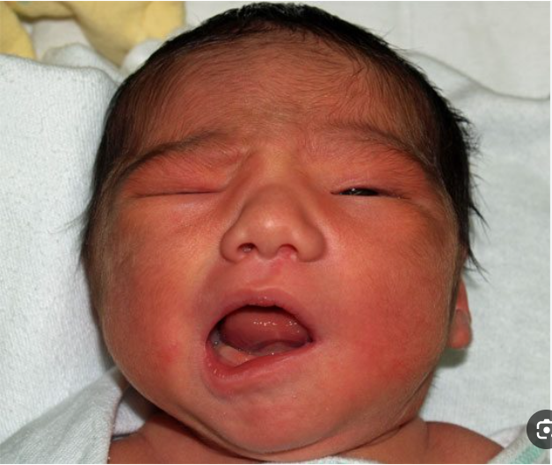
Facial (Bell’s) palsy:
Epidemiology: most common cranial nerve injury during birth
-- Injury occurs during forceps-assisted delivery (most common)
Prolonged birth in which the head is pressed against the maternal sacral promontory
Clinical features :
1- Absence of nasolabial fold.
2- Loss of wrinkling of the forehead.
3- Impaired closure of the eye.
3- Mouth does not move down the same way on both sides while crying.
-- Treatment: eye care with artificial tears and ointment
Prognosis: spontaneous recovery in 90% of cases within several weeks.

Slide 22
Neonatal brachial plexus palsy:
Excessive lateral traction on the neck during delivery → injury to the upper trunk of the brachial plexus → Erb's palsy (C5-C6) (most common iatrogenic brachial plexus injury during delivery)
Excessive traction on the arm during delivery → injury to the lower trunk of the brachial plexus → Klumpke palsy
Prognosis: approx. 25% of affected infants experience persistent functional impairment - Brachial plexus injury is associated with shoulder dystocia, which more commonly leads to Erb palsy than Klumpke palsy.

Slide 23
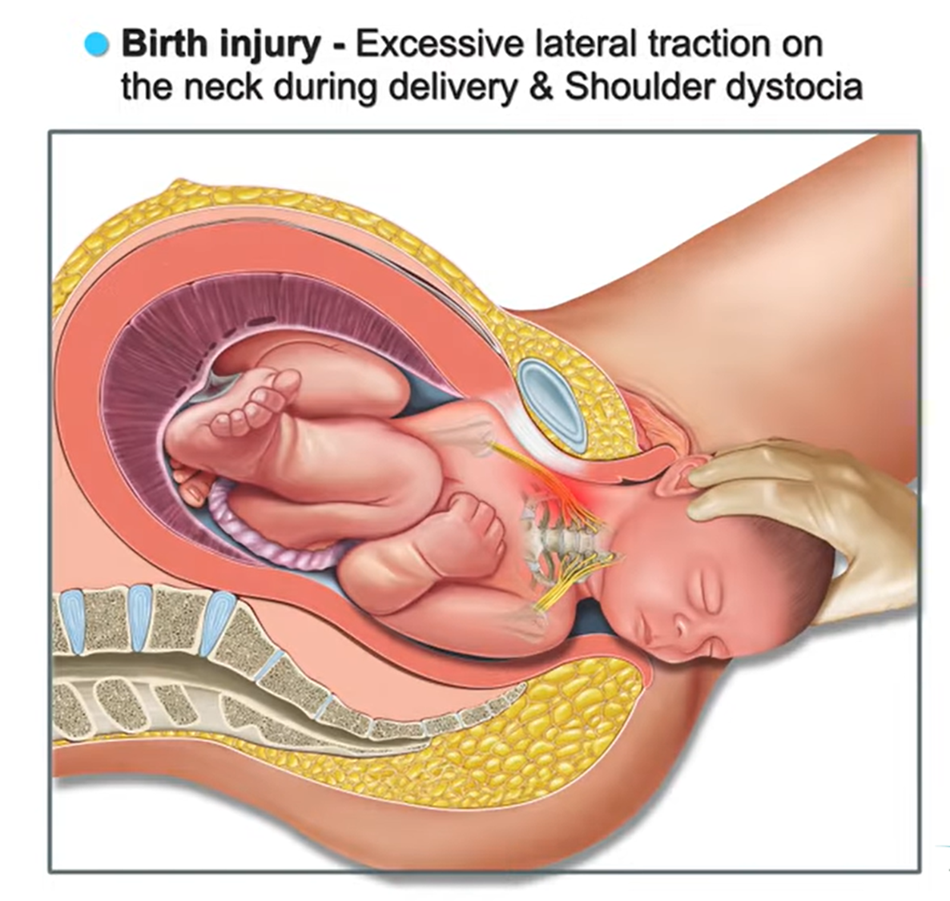
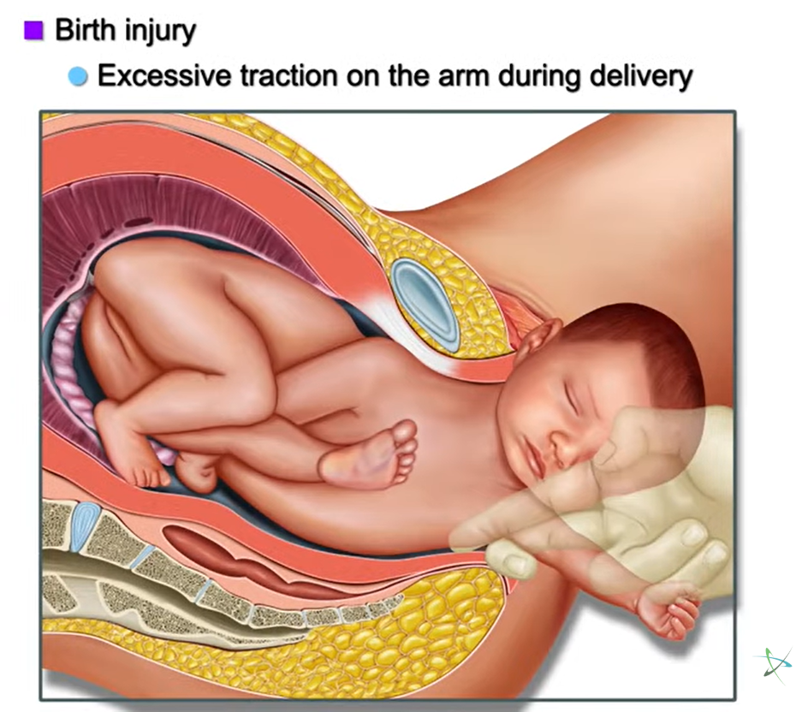

Slide 24
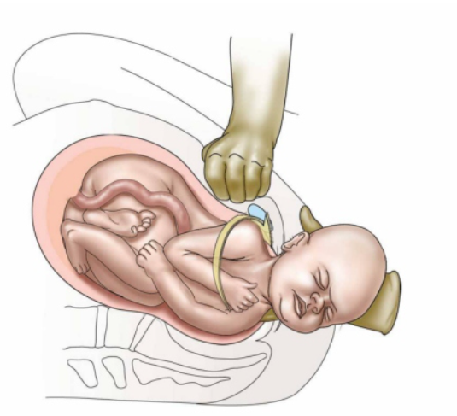
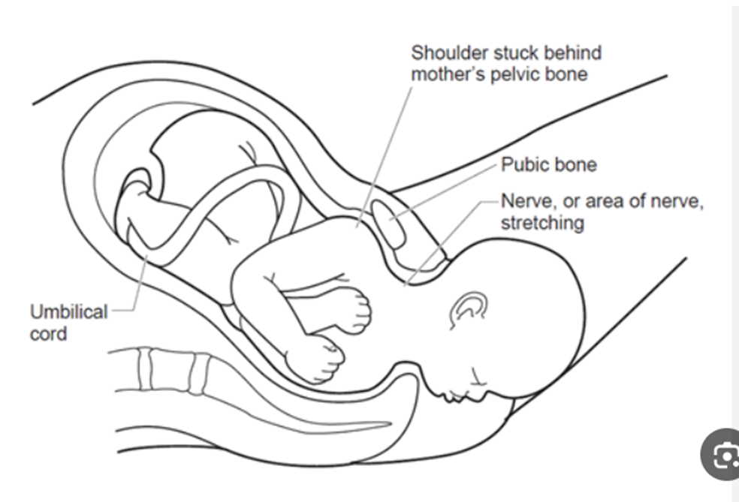
Shoulder dystocia: is a condition that happens when one or both newborn’s shoulders get stuck during vaginal delivery. There are no signs and no way to prevent the condition.

Slide 26
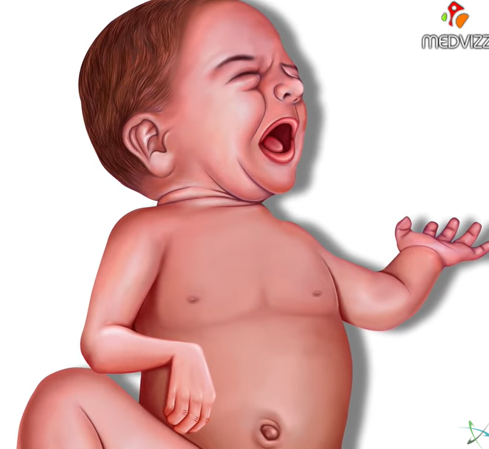
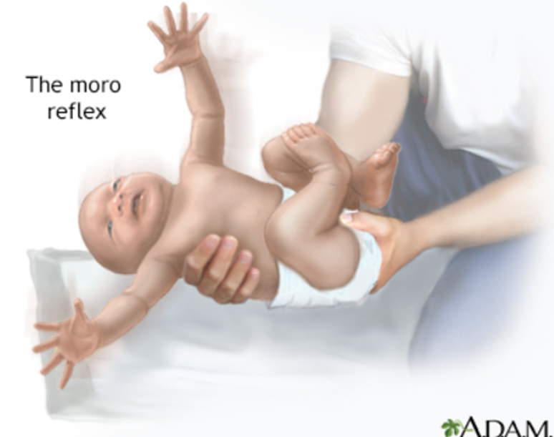
Erb’s palsy (C5-C6):
(most common iatrogenic brachial plexus injury during delivery)
associated with lack of shoulder motion.
- The involved extremity lies adducted, prone, and internally rotated.
- Moro, biceps, and radial reflexes are absent on the affected side. (asymmetrical )
- The grasp reflex is usually present.

Slide 27
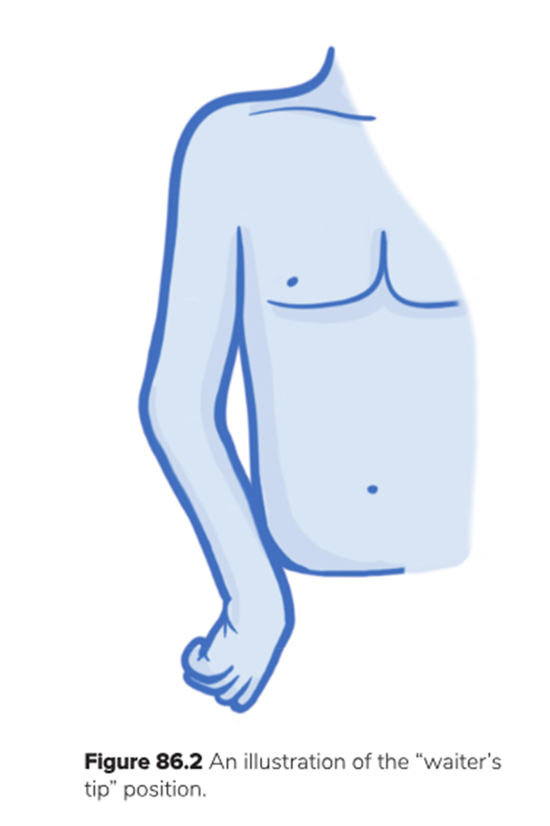
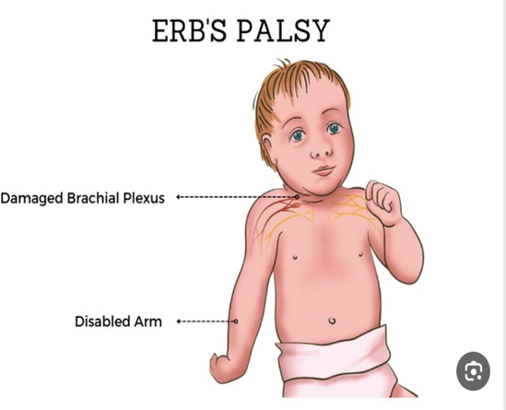

Slide 28
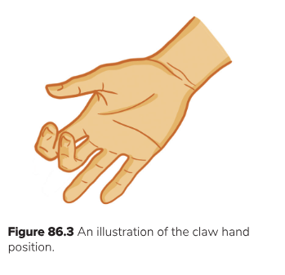
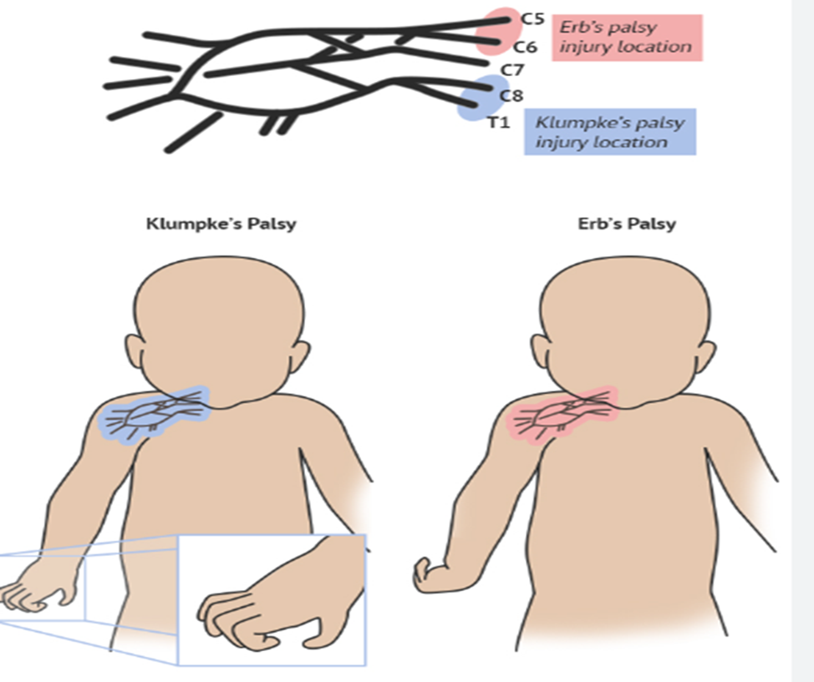
Klumpke’s paralysis (C8,T1):
Abducted arm during childbirth → arm traction , pulling → nerve stretching in inferior brachial plexus area → nerve plexus damage - is rare and results in weakness of the intrinsic muscles of the hand;
- the grasp reflex is absent.

Slide 29
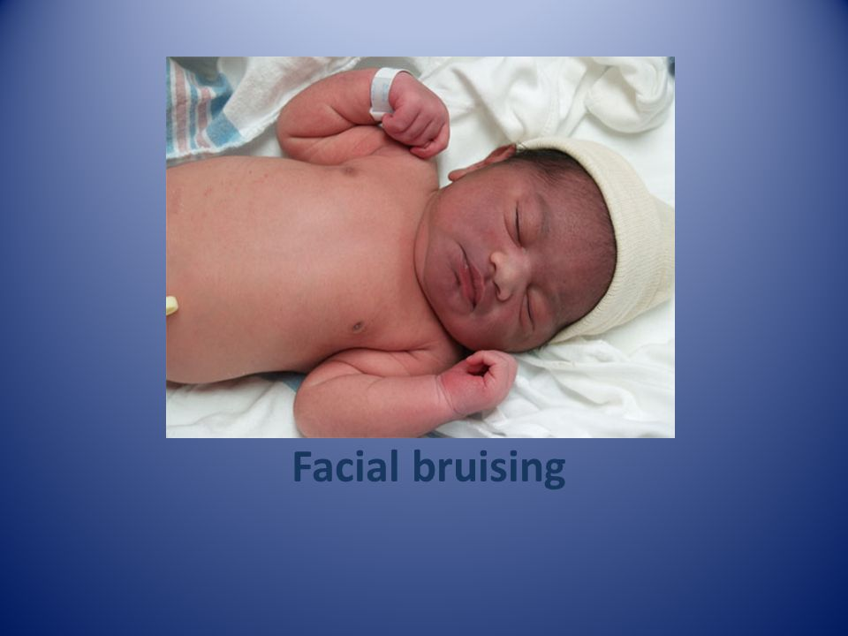
Soft tissue injuries:
Brusing and Petechiae:
A difficult delivery may lead to bruising especially on the head and
face , from pressure against the mother's pelvis or pressure caused by
forceps or ventouse used in delivery
-no need for treatment, spontaneous resolution in 1 week

Slide 30
2) Abrasions and lacerations:
May occur as scalpel cuts during Cesarean delivery or during instrumental delivery (i.e, vacuum, forceps)
Infection remains a risk, but most uneventfully heal
Management:
Careful cleaning, application of antibiotic ointment, and observation
Lacerations occasionally require suturing
3) Subcutaneous fat necrosis use of instruments during delivery and stress on neoborn can injure the fat under the skin
- appear in 1st 2 weeks of life - irregular, hard, non pitting, subcutaneous plaque with overlying dusky, red
purple discoloration - sites: cheeks, arms, back, buttocks, thigh
No treatment is necessary

Slide 31
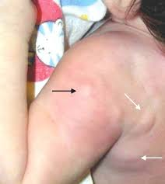
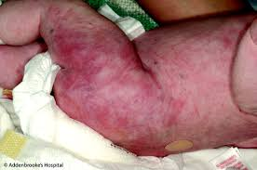
Subcutaneous fat necrosis:

Slide 32
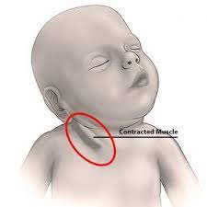
Infant torticollis:
Definition: twisted or rotated neck caused by contraction of the sternocleidomastoid muscle; can be acquired or congenital (congenital muscular torticollis).
Patho-mechanism of acquired torticollis:
Sternocleidomastoid or trapezius muscle injury
Cervical muscle spasm
Cervical nerve irritation
Associated with:
Intrauterine constraint, which causes unilateral shortening of the sternocleidomastoid muscle.
Oligohydramnios
Multiple gestation
Macrosomia
Decreased fetal movement.
Breech presentation.
Assisted vaginal delivery.

Slide 33
Infant torticollis
Clinical features:
Head noticeably tilted to one side with the chin rotated towards the opposite side
Muscular tightness; limited passive range of motion
Treatment:
Early initiation of physiotherapy, passive positioning
Surgery at 12 months of age if conservative management is insufficient: myotomy or bipolar release of the affected SCM

Slide 34
Fractures:
1. Clavicle : most common (occurring in 2% of normal births) - presentation: pseudoparalysis of the affected side, crepitus - management: x-ray studies for chest, shoulders and cervical spines
Etiology Mostly occurs during normal labor and delivery
May be associated with high birth weight (e.g., due to macrosomia)
2. Humerus, Femur: - presentation: swelling, crepitus and pain - management: splinting humeral fractures Caused by rotation or hyperextension of the upper extremity during passage through the birth canal.
3. Skull: - complications: seizure, disruptions of blood vessels, brain contusions, death -management: 1.xray and CT scan for diagnosis 2.if linear fracture without CNS manifestation: observation 3. if depressed fracture : neurological evaluation 4. repeat x-ray 0-12 week for growing fractures
* Common in breech position and shoulder dystocia in macrosomic infants.

Slide 35
Abdominal injuries:
Types:
Rupture or subcapsular hemorrhage into liver, spleen or adrenal glands.
.
*clinical presentation :
Abdominal distention, poor feeding, pallor & shock.
*management: 1.clinical examination and serial hematocrit levels. 2. abdominal ultrasound. 3.paracenthesis in case of intraperitoneal bleeding.

Slide 36
Maternal Birth injuries

Slide 37
We will talk about :
Perineal and vaginal wall tears
Uterine rupture
Vulvar hematoma
Episiotomy

Slide 38
Perineal and vaginal wall tear :
Perineal tear : A perineal tear is a tear or laceration that occurs in the perineum, which is the area of tissue between the vaginal opening and the anus, during childbirth.
A vaginal wall tear : also known as a vaginal laceration, is a tear or injury that occurs in the vaginal tissue during childbirth.
According to RCOG guidelines state that perineal tears can occur in approximately 85-90% of vaginal deliveries .

Slide 39
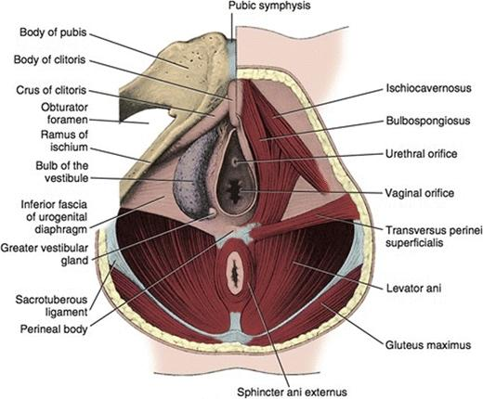
Perineal structures :

Slide 40
Grading of perineal tears:
Perineal tears are classified into four main stages based on their severity:
First-Degree Tear: This is the least severe type of tear, involving only the vaginal lining.
Second-Degree Tear: A second-degree tear extends beyond the vaginal lining and may involve the perineal muscles (but the anal sphincter is not involved )

Slide 41
Grading of perineal tears:
Third-Degree Tear: A third-degree tear extends further into the anal sphincter muscles.
III a: Less than 50% of EAS thickness torn.
III b: More than 50% of EAS thickness torn
III c: Both EAS and IAS torn
Fourth-Degree Tear: The most severe type of tear, a fourth-degree tear extends through the anal sphincter and the rectal lining.

Slide 42
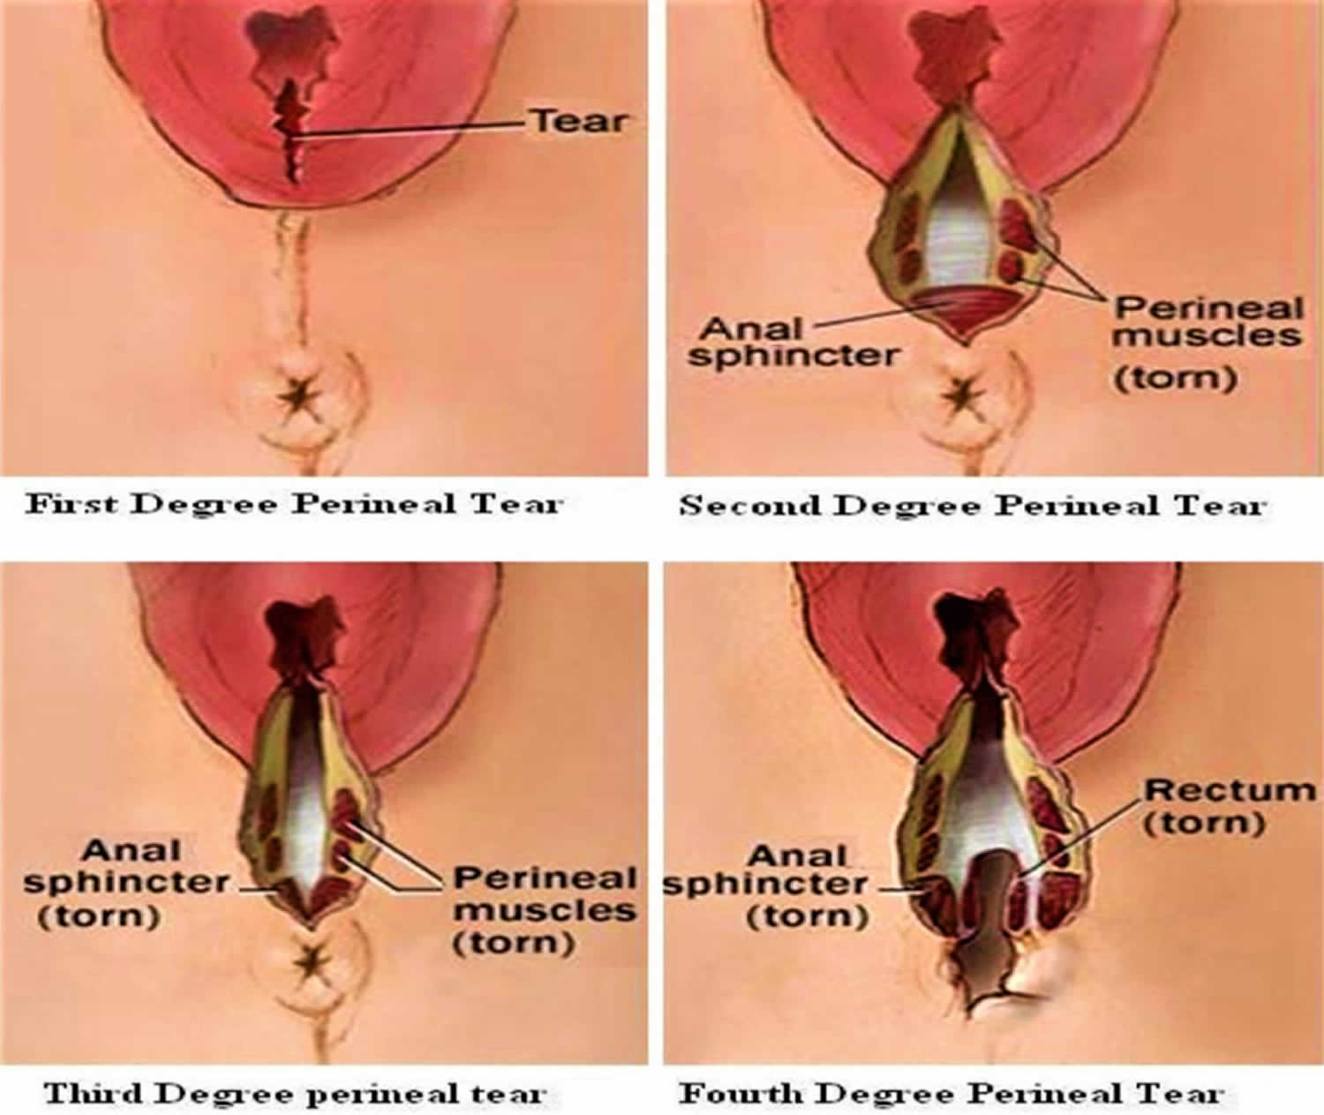

Slide 43
Risk factors :
Maternal risk factors:
Nulliparity (mother has not given birth before)
Vaginal birth after caesarean section
Shortened perineal length (<25 mm)
Fetal risk factors:
Large fetal weight (>4000 g)
Shoulder dystocia
Fetal head is oriented OP (occiput posterior, i.e. face forward)

Slide 44
Intrapartum risk factors:
Instrumental delivery (eg forceps, vacuum)
Prolonged second stage of labour
Epidural use
Oxytocin use
Midline episiotomy
Delivery in lithotomy

Slide 45
First and second-degree management
cleaning the area
Analgesia such as :
Local anaesthesia (lidocaine gel)
Pudendal nerve block
a few stitches with dissolvable sutures to ensure proper healing.

Slide 46
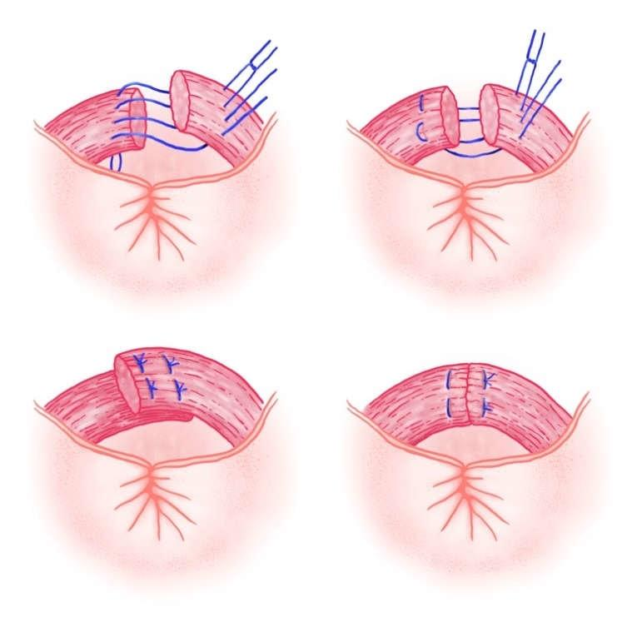
Third and fourth-degree management
⚫Repair is more complex and may require consultation with a specialist, such as a colorectal surgeon.
⚫Repair is done in an operating room, under regional or general anaesthesia.
⚫It is important to ensure that the muscle is correctly approximated with long-acting sutures so that the muscle is given adequate time to heal.
⚫Some surgeons opt for an end-to-end repair,
while others use an overlap technique;
current evidence suggests that the
outcome is similar with both methods

Slide 47
Postoperative Management:
Broad-spectrum antibiotics
to reduce the risk of infections
Analgesia
Paracetamol and nonsteroidal anti-inflammatory drugs (NSAIDs) can be used
However, limit the use of opioids to reduce the risk of constipation.
Laxatives or stool softeners
Wound care

Slide 48
Prevention :
Prenatal Exercises: Engaging in prenatal exercises, particularly those that strengthen the pelvic floor muscles to prevent long-term urinary incontinence and pelvic floor weakness
Perineal Massage: Perineal massage involves gently massaging and stretching the perineum . This practice can help increase the flexibility and elasticity of the perineal tissues, potentially reducing the risk of tears during delivery
Water Birth: they give birth in a warm birthing pool.
Warm Compresses: Applying warm compresses to the perineum during the later stages of labor can help relax the tissues and make them more supple
Perineal Support: Adequate perineal support from healthcare providers during the birth process can help prevent tears. This may involve manually supporting and guiding the perineum as the baby's head crowns to allow for more gradual stretching

Slide 49
Vulvar hematoma:
Hematomas can occur anywhere from the vulva to the upper vagina because of delivery trauma.
Hematomas may also develop at the site of episiotomy or perineal laceration.
Vulvar or vaginal hematomas are characterized by exquisite pain with or without signs of shock.
If the hematoma is at the site of episiotomy, the sutures should be removed and a search made for the actual bleeding site, which is then ligated.
If it is not at the episiotomy site, the hematoma should be opened at its most dependent portion and drained, the bleeding site identified, If possible, and the site closed with interlocking hemostatic Sutures.
Drains and vaginal packs are often used to prevent re-accumulation of blood.

Slide 50
Signs and Symptoms:
Tense and tender swelling to one side of the vagina.
Sever pain unrelieved with painkillers.
Difficulty in passing urine, if the swelling presses on the urethra.
Rectal pressure can occur.
The bleeding can be severe enough to cause the patient to go into Hemorrhagic shock.
Management:
Hematomas that are ≤5 cm in diameter and are not enlarging can usually
be managed expectantly by frequent evaluation of the size of the hematoma and close monitoring of vital signs and urinary output.
Application of ice packs can also be helpful.
Larger and enlarging hematomas must be managed surgically

Slide 51
Uterine rupture:
Uterine rupture: Complete separation of all uterine layers leading to possible fetal or maternal compromise (A uterine rupture is a frank opening between the uterine cavity and the abdominal cavity)
Uterine scar dehiscence: Often an occult scar separation with intact uterine serosa; does not lead to fetal or maternal compromise (A uterine dehiscence is a “window” covered by the visceral peritoneum)
Significantly higher rates of maternal and fetal morbidity, and even maternal mortality, occur in cases of overt rupture
Rupture can occur at the site of a previous cesarean delivery or other surgical procedure involving the uterine wall—from intrauterine manipulation or trauma, or from congenital malformation (small uterine horn), or spontaneously. Abnormal labor, operative delivery, and placenta accreta can lead to rupture
The overall incidence is 0.5%
A prior uterine scar is associated with 40% of cases. With a prior lower-segment transverse incision, the risk for rupture is less than 1%, whereas the risk with a high vertical (classical) scar is 4-7%.
Oxytocin: Possible increase in risk of rupture (up to 1.5% versus 0.8% with spontaneous labor)
Misoprostol: Increased risk of rupture

Slide 52
PREVENTION
Active management of the third stage of
labor, which involves immediate manual removal of the placenta and the administration of a uterotonic agent, has been shown to reduce the incidence of hemorrhage. In addition to preventing many cases of uterine atony.
Finally, all obstetric units and practitioners must have the facilities, personnel, and equipment in place to manage PPH properly. Clinical drills to enhance the management of maternal hemorrhage are also recommended

Slide 53
DIAGNOSIS AND MANAGEMENT
The signs and symptoms of uterine rupture are highly variable.
Typically, rupture is characterized by the sudden onset of intense abdominal pain.
The patient may or may not have vaginal bleeding, and if it occurs, it can range from spotting to severe hemorrhage so if it severe may develop hypovolemia .
Impending rupture may be heralded by hyperventilation, restlessness, agitation, and tachycardia.
No reassuring FHR pattern with decelerations or bradycardia
Loss of station
After the rupture has occurred, the patient may be free of pain momentarily and then complain of diffuse pain thereafter.
The most consistent clinical finding is an abnormal fetal heart rate pattern.
The presenting part may be found to have retracted on pelvic examination, and fetal parts may be more easily palpable abdominally.
Abnormal contouring of the abdomen may be seen.
Fetal distress develops commonly, and fetal death or long-term neurologic sequelae may occur in 10% of cases.
A high index of suspicion is required, and immediate laparotomy is essential. In most cases, total abdominal hysterectomy is the treatment of choice, although debridement of the rupture site and primary closure may be considered in women of low parity who desire more children

Slide 54
Prognosis:
MATERNAL-FETAL RISK Delay in management of uterine rupture places both mother and child at significant risk. The major risk to the mother is hemorrhage and shock. Although the associated maternal mortality rate is now less than 1%, if the mother is left untreated, she will almost certainly die. For the fetus, rapid intervention will minimize morbidity and mortality. The associated fetal mortality rate is still about 30%.

Slide 55
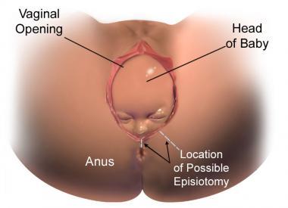
Episiotomy:
Episiotomy: is a surgical incision of the perineum performed to widen the vaginal opening to facilitate the delivery of fetus during the 2nd stage of labor.
Episiotomy is one of the most common operations performed on women .
Incidence:
The WHO recommends an episiotomy rate of 10% for all normal deliverie
The rate of episiotomy was found to be higher in primipara women than multipara women.

Slide 56
Maternal benefits:
Facilitating repair compared to a spontaneous perineal laceration that might occur otherwise.
Decreased postpartum pain.
Avoiding severe degrees of lacerations.
Shortening the time for which the perineum was stretched during birth.
Prevention of trauma to the pelvic floor muscles
Neonatal benefits:
Prevention of asphyxia, cranial trauma and cerebral hemorrhage & shoulder dystocia.
It is also suggested that episiotomy increases the APGAR score of the baby.

Slide 57
Indication (according to WHO):
Complicated vaginal delivery:
breech delivery.
shoulder dystocia.
Forceps.
ventouse(vacuum).
If there is extensive lower genital tract scarring:
female genital mutilation.
poorly healed 3rd or 4th degree tears.
When there is fetal distress.

Slide 58
Other indications:
Threatened perineal injury in primiparous ladies.
Anticipated perineal tear : big size baby (macrosomic), breech delivery, face to pubis delivery or shoulder dystocia .
Rigid perineum.
Instrumental vaginal delivery as forceps and ventouse (vacuum).
Previous perineal surgery : pelvic floor repair or perineal reconstructive surgery.

Slide 59
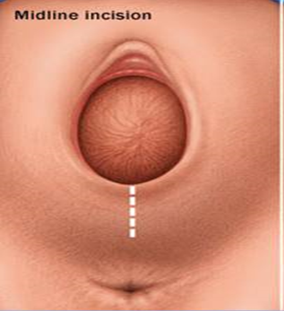
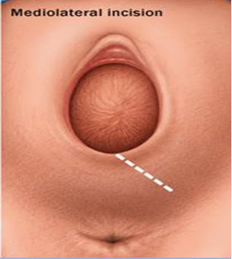
Types of episiotomy:
1) Median/Midline:
The incision commences from the center of the fourchette and extends posteriorly along the midline towards the anus.
2) Mediolateral:
The incision extends from the center of the vaginal opening mediolaterally at 5 or 7 o’clock towards the direction of the ischial tuberosity.

Slide 60
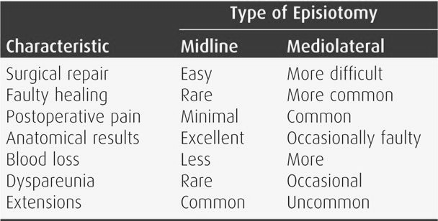

Slide 61
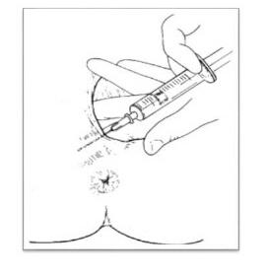
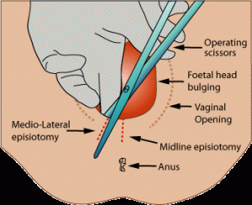
Procedure:
For anesthesia, it is normal to use lidocaine at a concentration of 0.5% in 10ml, or at a higher concentration of 1% in 5ml.
To protect the fetal head, the midwife will insert two fingers into the vagina, which should follow the proposed incision line.
Aspirate to be sure that no vessel has been penetrated.
After sufficient time for the anesthesia to take effect, the incision should be made.
A single cut should be made.
This should be 3-4 cm in length.
Ideally the incision is made during a contraction, when there is a clear view and a reduced likelihood of severe bleeding.

Slide 63
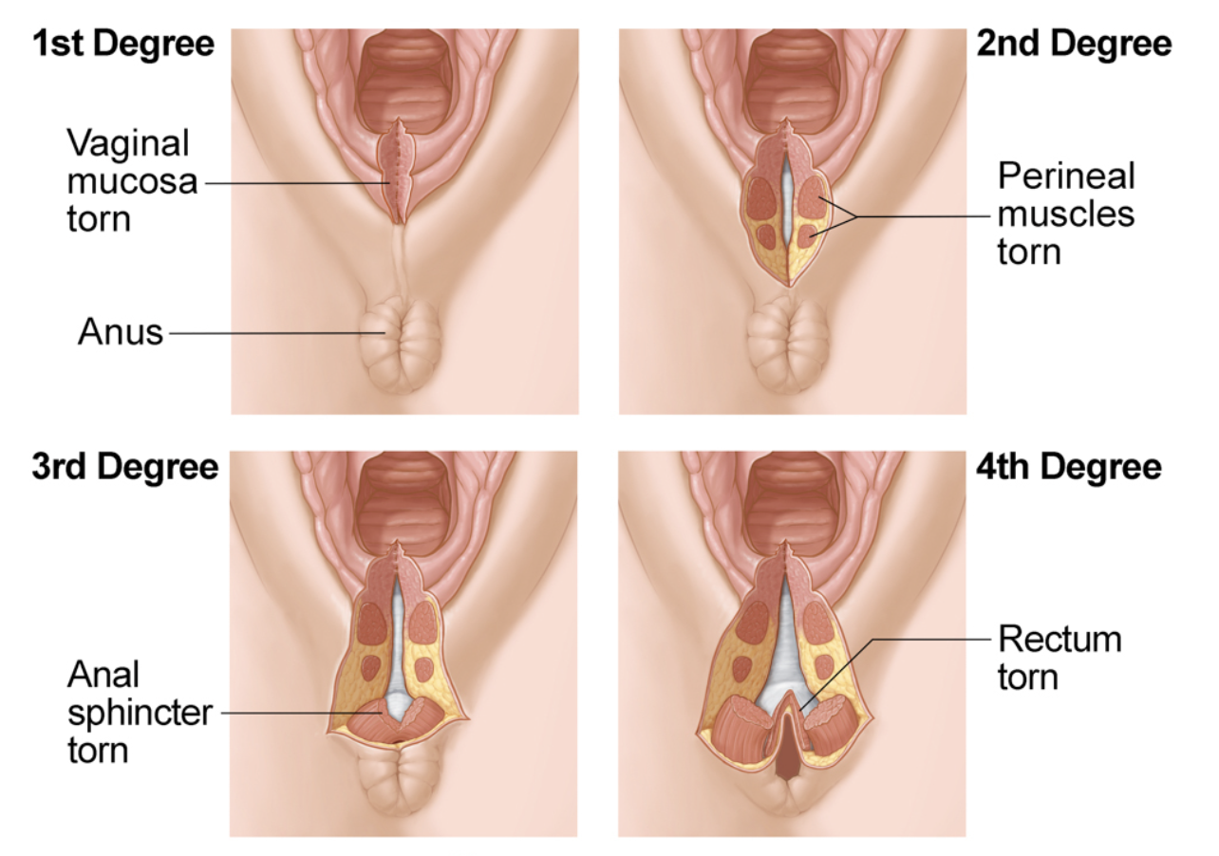
Degree of perineal tears :
First-degree: A small tear that involves just the lining of your vagina.
Second-degree: A tear that extends through the lining of your vagina to the underlying vaginal tissue. Most episiotomies are second-degree.
Third-degree: A tear that involves your vaginal lining, vaginal tissues and extends to your anal sphincter.
Fourth-degree: The tear affects the vaginal lining, vaginal tissues, anal sphincter and rectum. The most severe type of tear with the most complications.

Slide 64
Complication of episiotomy:
Early | Late
Extension to involve the rectum. Vulval hematoma. Infection. Wound dehiscence. Rectovaginal fistula | Dyspareunia . perineal lacerations. Scar endometriosis (rare).

Slide 65
Postpartum care:
NSAID agent as diclofenac is used as an analgesic for the first 72 hours.
Local antiseptic lotion and antibiotic powder or spray is used for 7 days.
Apply ice pack whenever swelling present .
Kegel's exercise (squeeze the perineal muscles as if you are trying to stop the flow of urine 5-10 s then relax several times)
Eat high fiber diet to avoid constipation
Avoid squatting position
Sit in a tub of warm water
Change sanitary pads at least every 4 h to help prevent infection, AND always keep the wound clean and dry after each urination or defecation (perineal hygiene).

Slide 73
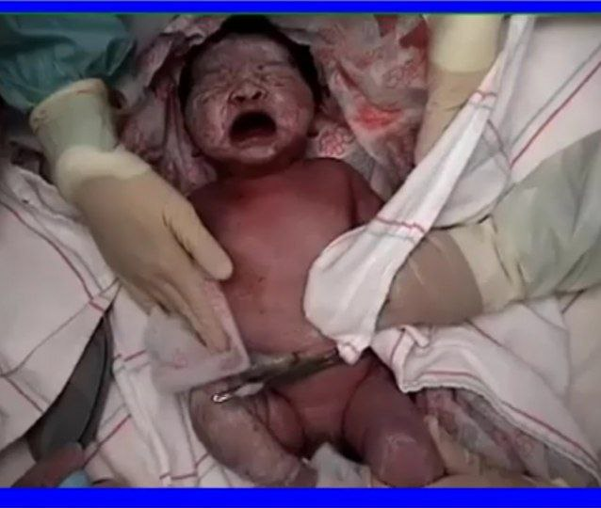

Slide 84
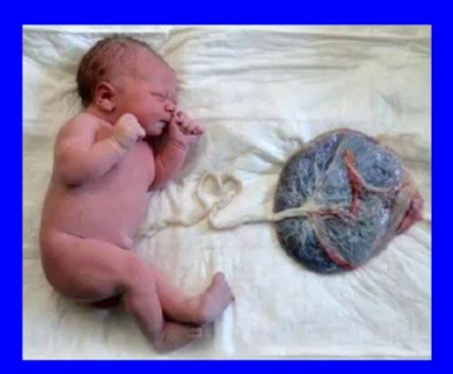

Slide 88
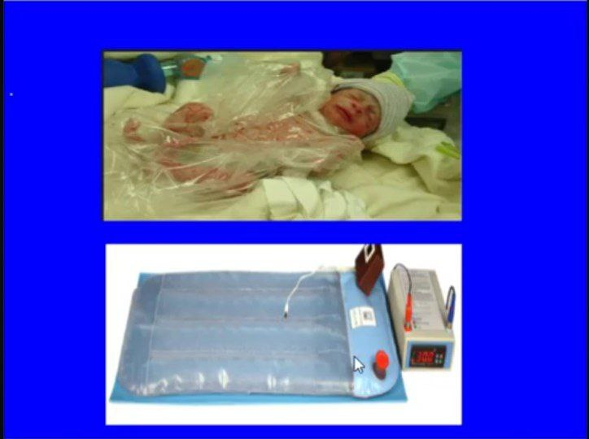

Slide 99
THANK YOU

