Slide 1
(Abnormal Uterine Bleeding)
6th year Seminar
- Supervised By :
Dr. Omar aldabbas
 Presented by :
 References :
Ten Teachers Gyn. 20th Edition
UpToDate

Slide 2
Definition
AUB :Uterine bleeding of abnormal quantity , duration, or time that affects females of all ages ..
What do we mean by “ abnormal “ ?
Any deviation in normal character of menstruation women of reproductive age .
Any postmenopausal bleeding
Once a woman who is not taking hormone therapy enters menopause and the menstrual cycles have ended , any uterine bleeding is considered abnormal !!

Slide 3
Normal cycle
Frequency: 24-38 day ( Average = 28 d )
Menses:
- Duration : <8d ( Average = 5 d )
Volume : 20-80 ml (subjective assessment)
Normal Cycle-to-cycle Variation
Menopause onset : 45 -55 year( average 51y)

Slide 5
Old terms to describe the cycle disorders
Frequency ( length of cycle ) :
Polymenorrhoea : (<21 d) , at regular intervals
Oligomenorrhea : (>35 d) , at regular intervals
Amount :
Menorrhagia : Excessive (>80 ml) Volume or prolonged Duration of menses ( > 7 days ) , at regular intervals
Hypomenorrhea
❑ Metrorrhagia: Uterine bleeding at irregular intervals, particularly between the expected menstrual periods
Now We describe the frequency as ( Normal , frequent , infrequent ) and the flow volume as ( Normal , heavy , light ) and the menses as ( normal , prolonged ) ..
Metrorrhagia Now commonly called Intermenstrual bleeding ..

Slide 7
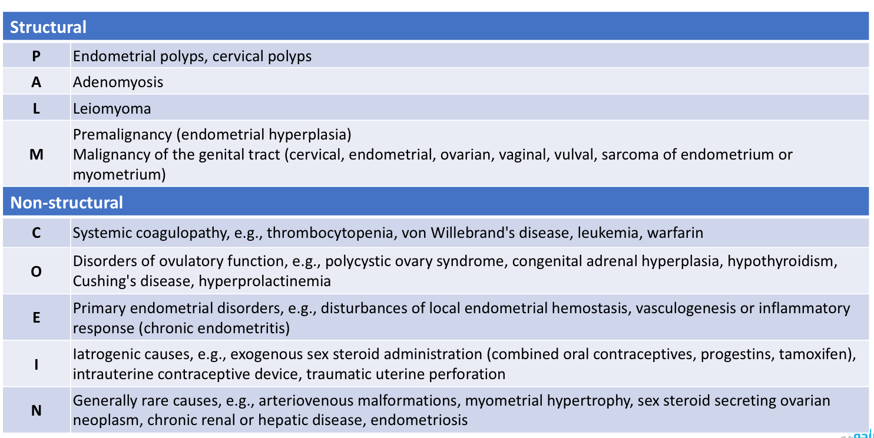
FIGO classification of the causes of AUB

Slide 8
Notes
HMB : often seen with structural lesion & coagulopathy.
Prolonged menses : often, but not always, associated with heavy menstrual bleeding
IMB : often seen with polyps or cervical causes .
PCB: Often associated with cervical abnormalities.

Slide 10
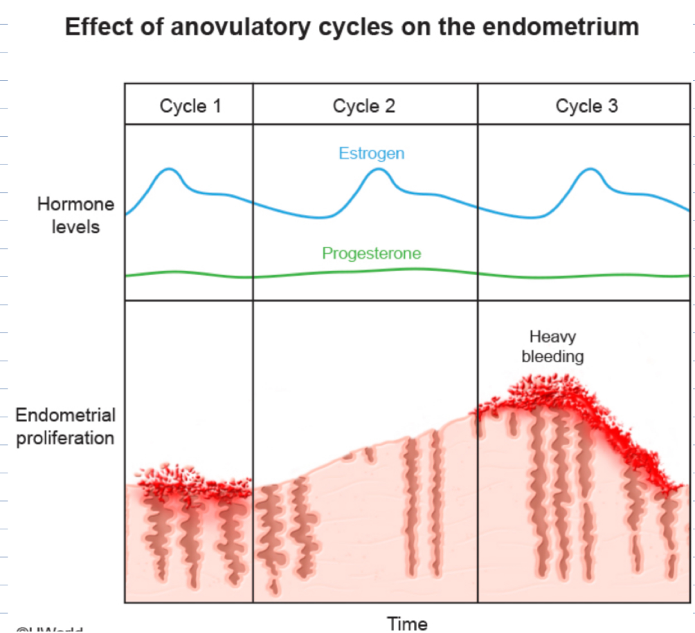
Irregular bleeding— Irregular uterine bleeding is most commonly associated with ovulatory dysfunction (AUB-O) and typically occurs at the extremes of reproductive age (ie, postmenarchal, perimenopausal) ,Bleeding is typically characterized by phases of no bleeding that may last for two or more months and other phases with either spotting or episodes of heavy bleeding. Molimina symptoms (eg, breast tenderness, bloating, fatigue) are typically absent.

Slide 11
PMB: Bleeding more than 1 year after cessation of periods. We consider it Malignancy Until proven otherwise ..(although just 10% of PMB is due to malignancy)

Slide 12
NOTES
AUB can be caused by structural uterine pathology or Nonuterine causes >> PALM – COIEN classification
may cause anemia and impair quality of life.
bleeding of endometrial origin’ or "Anovulatory uterine bleeding" is the preferred term for Heavy noncyclic uterine bleeding unrelated to structural lesions of the uterus, systemic disease, or sexually transmitted infection ..

Slide 13
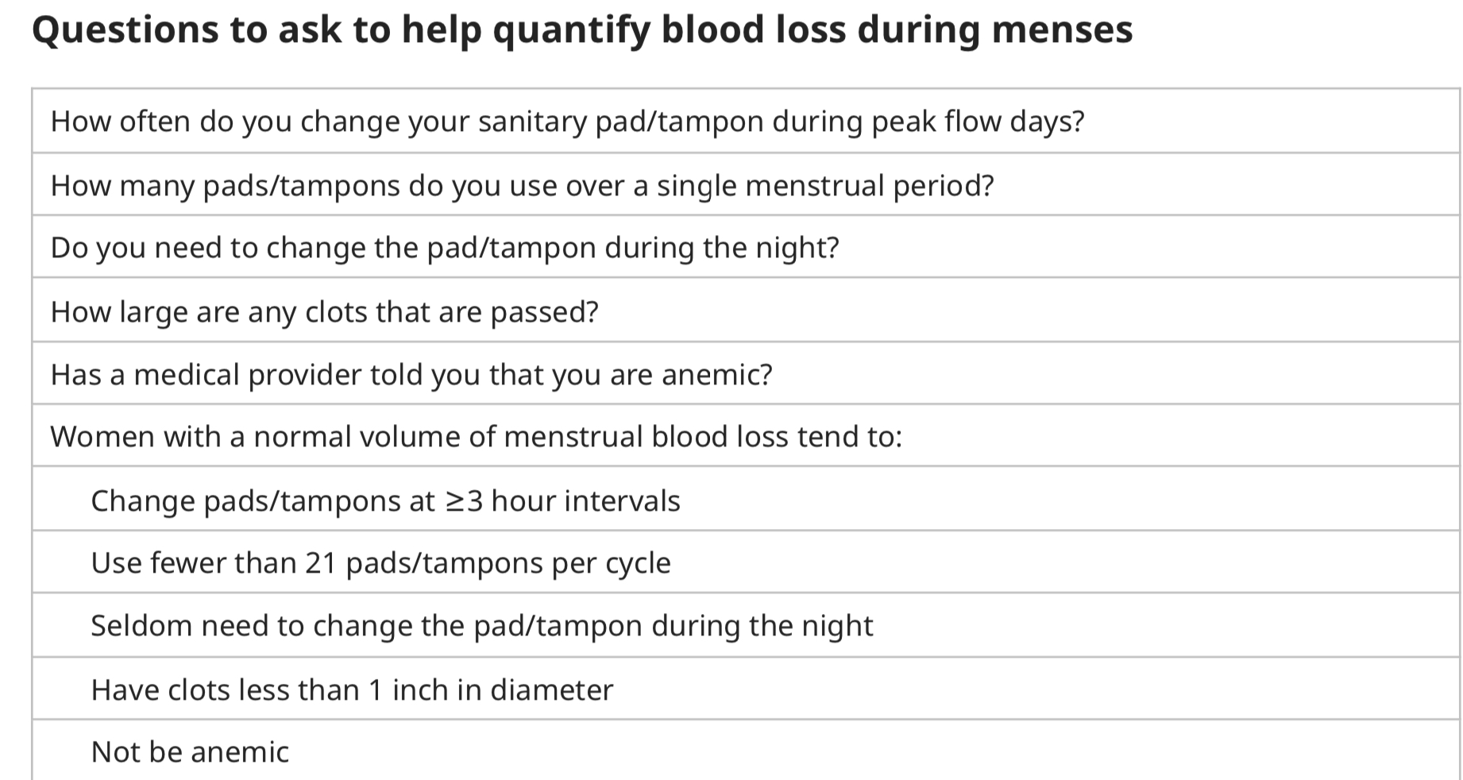
General Approach and investigation
History & Examination :
- Aiming to identify the pattern of bleeding and DDx of the Underlying pathology ..
Age
Menstrual Or Non-menstrual (Intermenstrual Bleeding , Postcoital Bleeding , Postmenopausal Bleeding)
Subjective Assessment of HMB And how much affect her quality of life :
- Bleeding that lasts more than 7 days.
- Needing to change >1 pad every 2 hours
- Needing to wear more than one pad at a time to control menstrual flow.
- Needing to change pads or tampons during the night.
- Menstrual flow with large blood clots .
Any Alteration In The Menstrual Cycle pattern
Pelvic Pain And Pressure Effects And other associated symptoms of anemia and suspected pathology
Previous Medical Or Surgical Treatment For AUB
Up-to-date Smear Test
Family History Of Gynecological Pathology.

Slide 14
History of HMB since menarche , PPH , surgical-related bleeding , bleeding associated with dental work , presence of bruises or epistaxis may indicate underlying coagulopathy !
After examining the patient for signs of anemia , it is important to perform an Abdominal and Pelvic examination in All women complaining of HMB
There Is No Agreed 'Gold Standard' Investigation For AUB !

Slide 15
Investigation :
Pregnancy test -- Pregnancy should be excluded in all reproductive-age patients with AUB
It should also be performed in patients who report no sexual activity and in those who report use of contraception !!
Full blood count (FBC) should be performed in all women .. (but serum ferritin should not be performed).
Pelvic Ultrasound (Structural Pathology) .
Pelvic Infection Screening (Genital Tract Swab).
Hysteroscopy (For Endometrial Pathology)
Cervical Smear
Coagulation screen And Thyroid function If suggestive history

Slide 17
Endometrial biopsy :
( NOTE ) - Sensitivity of EB increases when performed in addition to using the cut-off of 4 mm endometrial thickness on TVUS in postmenopausal bleeding .

Slide 18
Polyps :
uterine polyps, also called endometrial polyps, are small, soft growths on the inside of a woman's uterus. They come from the tissue that lines the uterus, called the endometrium. They can range in size .
Polyps can make heavy periods or bleeding between periods
polyps should be treated if they cause heavy bleeding during menstrual periods, or if they are suspected to be precancerous or cancerous.
They should be removed if they cause problems during pregnancy, such as a miscarriage, or result in infertility in women who want to become pregnant
It is rare for uterine polyps to be cancerous

Slide 19
Cervical polyps commonly occur during the reproductive years, especially after age 40 years. The etiology is unknown. Chronic inflammation of the cervical canal may play a role, as may hormonal factors, since endometrial hyperplasia and polyps coexist more frequently than one would expect by chance alone.
. The size is typically less than 3 cm in diameter; however, polyps large enough to fill the vagina
Polyps should be removed when symptomatic (eg, bleeding, excessive discharge), large (≥3 cm), or appearing atypical. Polypectomy can usually be accomplished by grasping the base of the polyp with forceps and twisting it off.
Malignancy is rarely found in a cervical polyp

Slide 20
Uterine Adenomyosis
Adenomyosis refers to a disorder in which endometrial glands and stroma are present within the uterine musculature.
the ectopic endometrial tissue appears to induce hypertrophy and hyperplasia of the surrounding myometrium, which results in a diffusely enlarged uterus (often termed "globular" enlargement) analogous to the concentric enlargement of the pregnant uterus
Just as endometriosis can be localized or diffuse, adenomyosis can be present diffusely throughout the myometrium, or confined to a discrete area .
On gross inspection, the uterus with diffuse adenomyosis is uniformly enlarged and boggy, in contrast to the irregular and firm appearance of the fibroid uterus.
Adenomyomas can clinically resemble leiomyomas.

Slide 21
EPIDEMIOLOGY AND RISK FACTORS
The incidence of adenomyosis has not been determined accurately since the diagnosis can only be made with certainty by microscopic examination of the uterus, typically following hysterectomy.
generally estimated: 20 percent of women, Presenting age is around 42 years old.
Adenomyosis appears to be more common in multipara than nulliparous women.
Several studies have reported that prior uterine surgery may also be a risk factor for adenomyosis.

Slide 22
CLINICAL MANIFESTATIONS
Heavy menstrual bleeding and painful menstruation are the major symptoms of adenomyosis, occurring in approximately 60 and 25 percent of women, respectively.
Chronic pelvic pain may occur
Approximately one-third of women are asymptomatic.
Physical examination usually reveals diffuse uterine enlargement (often termed "globular" enlargement), generally not exceeding the size of a pregnant uterus at 12 weeks of gestation. However, some women have a normal sized uterus while others develop nodules (termed adenomyomas), which clinically resemble leiomyomas.
There is no evidence that uterine adenomyosis affects the risk of spontaneous abortion or other obstetric outcomes

Slide 23
DIAGNOSIS
A definitive diagnosis of adenomyosis can only be made from histological examination of a hysterectomy specimen.
The preoperative diagnosis is suggested by characteristic clinical manifestations (ie, menorrhagia and dysmenorrhea with a uniformly enlarged uterus) in the absence of endometriosis or leiomyomas.
MRI is clearly the best imaging technique, but is expensive.
Transvaginal ultrasound, although less accurate than MRI, can be useful for assessment of a woman with suspected adenomyosis

Slide 24
Submucosal leiomyoma
Submucosal leiomyomas – These leiomyomas derive from myometrial cells just below the endometrium. These neoplasms often protrude into the uterine cavity
Pt come with Abnormal uterine bleeding (any type of bleeding)
Risk factor :
-nullipara
-early menarche ,
-FHx , (obese)
-alcoholic , infections
-Black race

Slide 25
cont
Hx-PE-imaging - > US
Ultrasound — Transvaginal ultrasound has high sensitivity
Saline infusion sonography (sonohysterography) improves characterization of the extent of protrusion into the endometrial cavity by submucous myomas and allows identification of some intracavitary lesions not seen on routine ultrasonography
HYSTEROSCOPE
HSG

Slide 26
SIS outlines the intrauterine polyp (Figure B), which could not be easily seen with in the routine transvaginal pelvic ultrasound (Figure A).

Slide 27
Malignancy And Hyperplasia
Premalignancy (endometrial hyperplasia) Malignancy of the genital tract (cervical, endometrial)

Slide 28
COEIN
ETAF SHABAN
COEIN in PALM-COEIN is an abbreviation that includes physiologic, non-structural and other unspecified cause for AUB in a non-gravid uterus of reproductive age group

Slide 29
C-Coagulation Von Willebrand Disease
Presents as HMB
Von Willebrand disease, the most common inherited bleeding disorder among American women
a).0.6-1.3% in normal population
b).5-24% of pts with AUB
c).74-92% of pts with this disease complain of AUB
Type I and type II are inherited autosomal dominant: There’s type III as well
-Type I is more common and less severe
-Type III is less common but more severe

Slide 30
C-Coagulation: Von Willebrand Disease cont.
Pts with VWD may also present with bruising and bleeding tendency or history of excessive bleeding during surgery
**Absence of these symptoms does not exclude the disease

Slide 31
C-Coagulation
LIVER DYSFUNCTION: Pts with cannot make enough clotting factors → increase bleeding tendency
LEUKEMIA: could be a cause of AUB. The proliferation of abnormal blood components will compromise the synthesis and functional normal platelets which would lead to thrombocytopenia
**Presents as HMB and the bleeding is usually serious
DRUGS: Warfarin, Aspirin, Estrogen, Tamoxifen…etc
THROMBOCYTOPENIA

Slide 32
O-Ovulation Dysfunction
PATTERN OF AUB IN OVULATORY DYSFUNCTION
Short cycles or HMB
Periods of amenorrhea followed by periods of painless profuse and prolonged bleeding (anovulatory amenorrhea)
Periods of amenorrhea followed by scanty bleeding

Slide 33
O-Ovulation Dysfunction
MOST COMMON NON-STRUCTURAL CAUSE OF AUB
PCOS: HPO Dysfunction
high LH→ theca cell produces more Androsterodione→ excess flows into the blood → adipose tissue converts the excess to eestrone → -ve feedback on pituitary to stop FSH
ENDOMETRIOSIS: 20% of pts with endometriosis have anovulatory cycles for unknown reasons (HMV and AUB)

Slide 34
O-Ovulation Dysfunction
CONGEINITAL ADRENAL HYPERPLASIA (CAD): presents with irregular or absent mestrtual bleeding
Other symptoms
ambigious genitalia, weight loss, dehydration, hypoglycemia, vomiting, precocious puberty infertility, masculine charachteristucs
3 types
21-hydroxylase deficiency
11-beta-hydroxylase deficiency
17-alpha-hydroxylase def

Slide 35
21-Hydroxylase deficiency

Slide 38
O-Ovulation Dysfunction
CUSHING DISEASE: increase level of androgens and cortisol
**cortisol suppresses the GnRH → suppresses the FSH and LH pulsations
HYPERPROLACTINEMIA: it inhibits GnRH → suppresses FSH and LH pulsation
THYROID ABNORMALITY:
Both hypo and hyperthyroid can cause oligomenorrhea or amenorrhea by increase in SHBG (hyper) or increase in prolactin levels (hypo) by high TSH
Hypo can also cause polymenorrhea by decreased progesterone and SHBG production
**most common systemic disease associated with AUB (23%of pts with hypo have AUB)

Slide 39
E-Endometrial
Primarily caused from the endometrium
Regular ovulatory cycles with HMB
E.G.
Vasculogenesis abnormality
Endometritis
Abnormality in the PGE, PGF2alpha receptors
Notes:
PG2alpha cause uterine smooth muscle contraction

Slide 40
I-Iatrogenic
Cu-IUD→ HMB
LNG-IUD→ IMB + IRREGULAR BLEEDING
HRT in post menopausaul women → irregular bleeding
estrogen-progesterone therapy → irregular bleeding
Drugs

Slide 41
N-Not otherwise specified
AV malformation in uterus
CKD: Pts with kidney impairment (esp CKD) have increased bleeding tendency due to impairment in the adhesion of platelets to the vessel wall because of uremic toxins
HEPATIC DISEASE: liver is responsible for metabolism of estrogen, so decrease in its function would cause increase in estrogen levels → endometrial hyperplasia
Sex hormone secreting ovarian neoplasm

Slide 42
MANAGMENT

Slide 43
Medical therapy
Hormonal treatment :
Estrogen-progestin contraceptives
- Combined oral contraceptives (OCs) are first-line management for many patients with AUB. The advantages of estrogen-progestin contraceptives are that they typically make bleeding more regular, lighter, and reduce dysmenorrhea, as well as provide contraception, if needed.
Reductions in menstrual blood loss ranging from 35 to 69 percent
Other routes of administration include the transdermal contraceptive patch and vaginal contraceptive ring. The efficacy of these in treating AUB is similar, and the choice of delivery system depends on patient preference.

Slide 44
OCs may be prescribed in a cyclic (with a monthly withdrawal bleed), extended (for instance, with a withdrawal bleeding every three months), or continuous (no withdrawal bleed) regimen. Although extended or continuous OC use may more effectively suppress menstrual blood loss in many patients, unscheduled (breakthrough) bleeding is more common with this approach than with traditional 28-day OC formulations
- OCs are contraindicated in patients who are at elevated risk for thrombosis.

Slide 45
Levonorgestrel intrauterine device
- A highly effective and easy-to-use treatment option for AUB and is approved by the FDA for treatment of HMB. Most patients using the LNG 52 develop scant bleeding or amenorrhea.
- Mean reductions in mean blood loss (MBL) of around 95% are achieved by 1 year after insertion.
- LNG 52 reduced menstrual blood loss more than other medical treatments and was comparable to endometrial ablation.
- Menstrual suppression may attenuate prior to five years of use, and patients may benefit from more frequent removal and replacement of the device
- In one large observational study, increasing use of the LNG 52 was accompanied by a decrease in use of oral tranexamic acid, oral progestogen, and hysterectomy

Slide 46
Depot medroxyprogesterone acetate
Typically used for patients with AUB who have contraindications to or prefer to avoid estrogen and/or if they prefer this method of contraception. DMPA is not an option for patients who are trying to conceive or interested in conceiving in the next one to two years.
One short-term study in patients with AUB-O or HMB noted that after two months, those using DMPA experienced a 49% reduction in menstrual blood loss.

Slide 47
Norethindrone acetate
- 5 mg tablets one to three tablets daily
- Promotes endometrial suppression
- May cause progestin-related side effects, including dysphoria, bloating, and an increased appetite.
- In some patients in whom AUB has responded well to higher doses of norethindrone acetate (eg, one to three 5 mg tablets daily), we slowly taper the dose down to, if possible, as low as 2.5 mg daily.

Slide 48
GnRH agonist
These are only used in the short term due to the resulting hypo-oestrogenic state that predisposes to osteoporosis.
They may be used preoperatively to shrink fibroids or cause endometrial suppression to enhance visualization at hysteroscopy.

Slide 49
Non-hormonal treatment :
Tranexamic acid
- An option for treatment of patients with HMB who do not desire or contraindicated to use hormonal treatment (eg, patients with a personal history of breast cancer).
- Is an antifibrinolytic agent that competitively blocks the conversion of plasminogen to plasmin, thereby reducing fibrinolysis.
- Reduces menstrual blood loss by 50%
- Advantages of this antifibrinolytic medication are that it may be used while trying to conceive and is taken only during menses, rather than daily.
- Use of tranexamic acid was associated with an elevated risk of thrombosis

Slide 50
Nonsteroidal anti-inflammatory drugs
- NSAIDs used to treat HMB include ibuprofen, naproxen, and mefenamic acid.
- NSAIDs reduce the volume of menstrual blood loss by causing a decline in the rate of prostaglandin synthesis in the endometrium, leading to vasoconstriction and reduced bleeding.
- Start on the first day of bleeding and should be continued for four or five days or until menstruation ceases
- Advantages of NSAIDs include:
Do not increase risk of thrombosis
Low risk of adverse effects
Reduction of dysmenorrhea
Low cost and often available over the counter
Unlike most hormonal therapies, they do not need to be taken daily

Slide 51
Surgical therapy
Myomectomy
Is an option for patients with uterine leiomyomas. If one or two intracavitary myomas are present, a hysteroscopic myomectomy is minimally invasive and may resolve AUB symptoms.
Patients with fibroids at other sites that result in AUB may be initially treated with medical therapy. However, laparoscopic or open myomectomy is required if medical management fails and if the patient desires to preserve fertility.

Slide 52
Endometrial ablation
Endometrial ablation is a minimally invasive option for treatment of heavy or prolonged uterine bleeding when medical therapy fails or in patients who do not want to use chronic medical therapy.

Slide 53
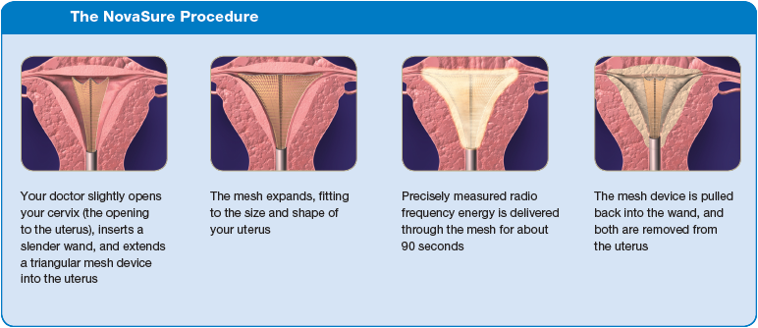
The first-generation techniques including transcervical resection of the endometrium with electrical diathermy or rollerball ablation have largely been replaced by newer second-generation techniques including:
• Impedance controlled endometrial ablation (Novosure™).
• Thermal uterine balloon therapy.
• Microwave ablation (Microsulis™)

Slide 54
MIRENA VS. ENDOMETRIAL ABLATION
Both are effective in reducing menstrual blood loss. The decision to use the LNG 52 or endometrial ablation depends on a patient's preferences regarding treatment factors, such as plans for fertility and contraception, convenience, and risks of anesthesia. The LNG 52 is a reversible contraceptive. Pregnancy is contraindicated after endometrial ablation, but the procedure may not prevent pregnancy; thus, patients will need to continue to use contraception following ablation. The LNG 52 is placed in an office setting and requires no or local anesthesia. Endometrial ablation can also be done in an office but is often performed in an operating room under general anesthesia. If successful, endometrial ablation is performed once, while the LNG 52 needs to be replaced at regular intervals every five years.

Slide 55
Uterine artery embolization
Uterine artery embolization is an option for patients with uterine leiomyomas.
Women wishing to retain their fertility should be counseled carefully before undergoing UAE as the effects on subsequent reproductive function are uncertain. Pregnancies have been reported in the literature, but concerns remain over premature ovarian failure and effects on the endometrium that may lead to abnormal placentation.

Slide 56
Hysterectomy
Hysterectomy represents definitive treatment for uterine bleeding. This procedure has a high rate of patient satisfaction because it is curative, is frequently performed after medical management has failed, is not associated with drug-related side effects, and does not require repeated procedures or prolonged follow-up.

Slide 57
THANK YOU!

