Slide 1
Polycystic kidney disease

Slide 3
What is polycystic kidney disease (PKD)?
Polycystic kidney disease (PKD): is an inherited kidney disease.
It is denoted by cysts formation in the kidney and enlargement of the kidney.
It is the 4th leading cause of kidney failure
It can also cause developing cysts in the liver and other complication
It impairs kidney function and eventually lead to kidney damage and failure
PKD isn’t the same as simple kidney cysts, which are usually harmless. PKD is a serious type of chronic kidney disease. The cysts can enlarge the kidneys and prevent them from filtering waste out of the blood. PKD can lead to kidney failure.

Slide 4
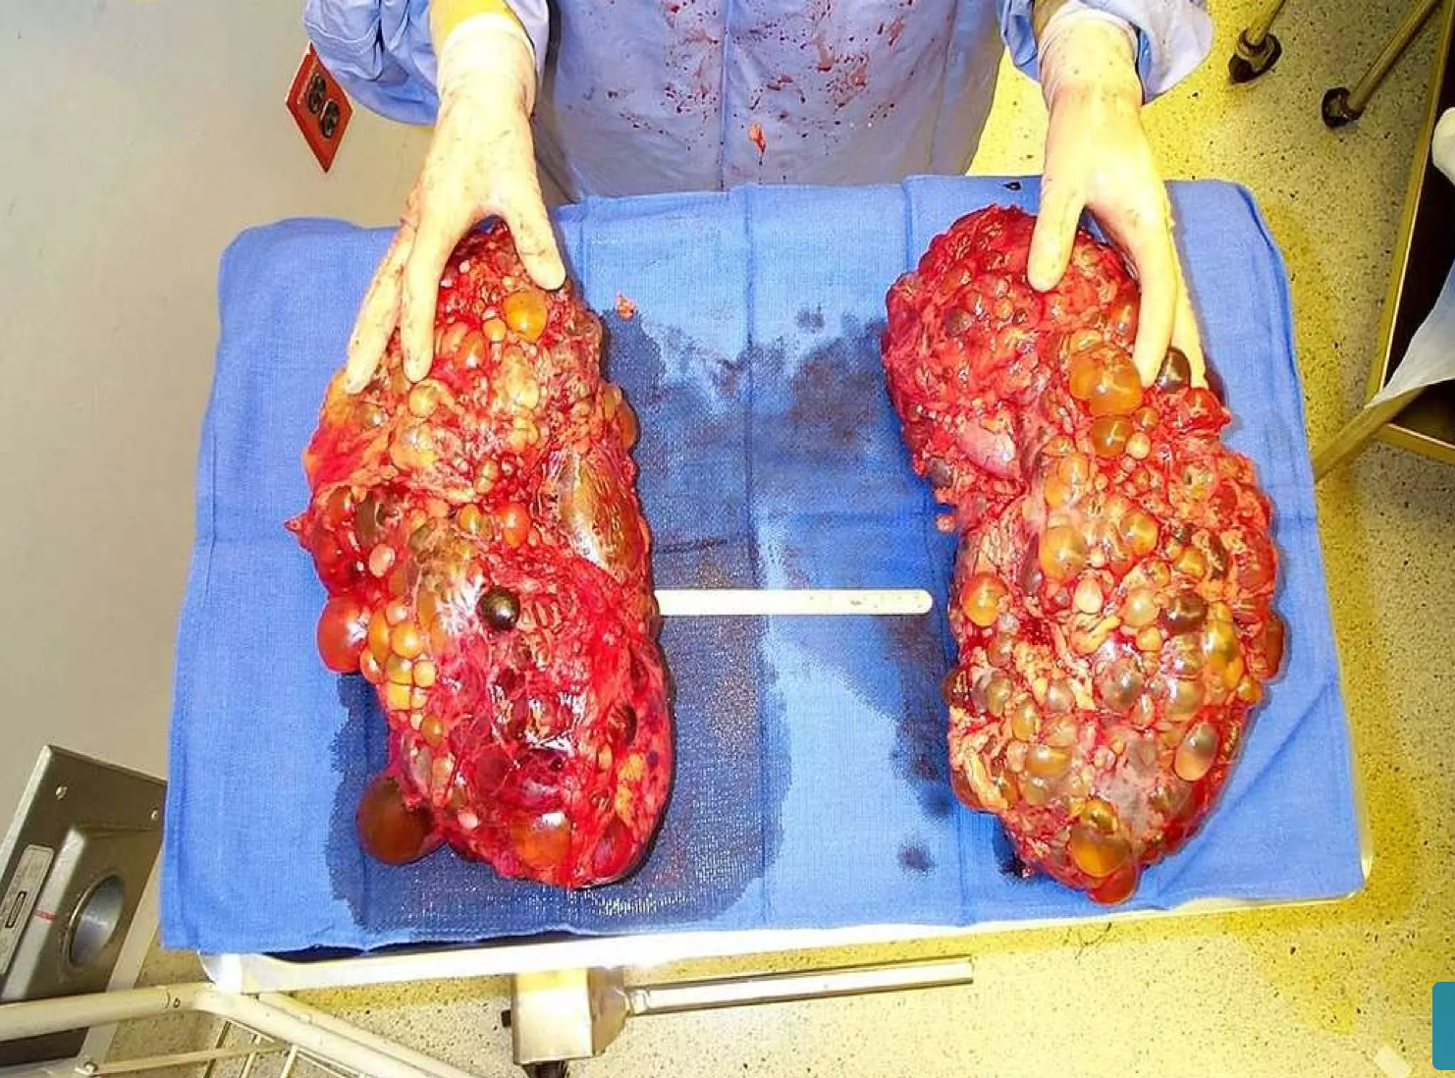

Slide 5
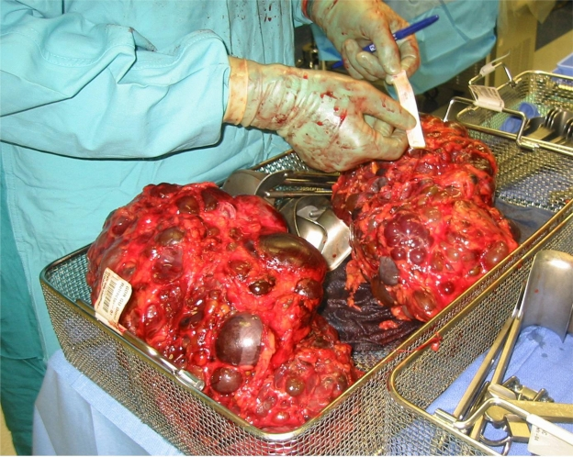
Explanted polycystic kidneys reveal the massive expansion resulting from progressive cystic growth.

Slide 6
What are the symptoms of polycystic kidney disease?
PKD can cause several symptoms, including high blood pressure, blood in urine and pain in the lower back. High blood pressure occurs in about 60-70% of people with PKD, and it’s often one of the first noticeable polycystic kidney disease symptoms. When cysts form on your kidneys, they press on the surrounding blood vessels. Your kidneys start getting less blood, mimicking the circumstances of low blood pressure. In response, your body starts releasing substances that tighten blood vessels, causing blood pressure to rise even higher.

Slide 7
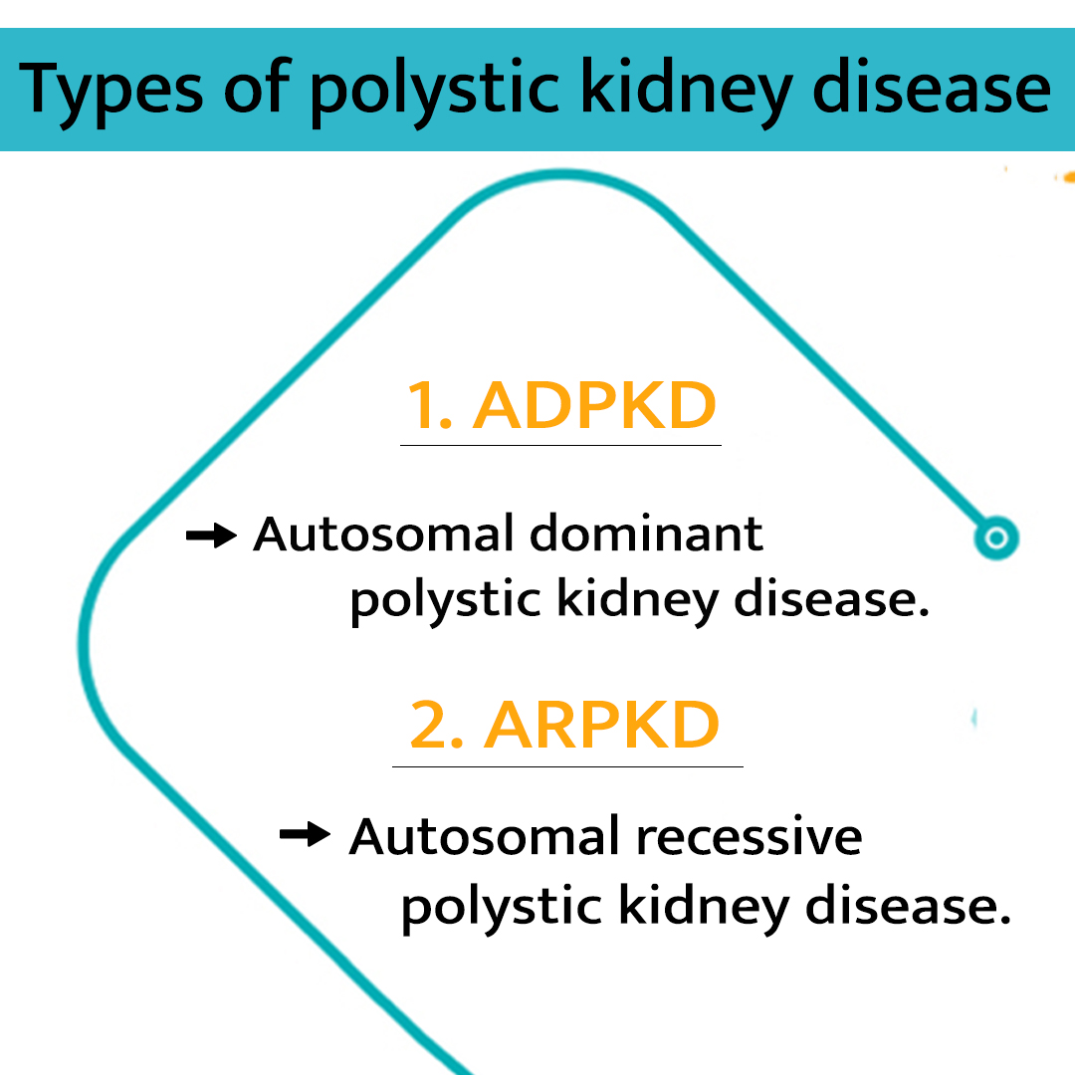
What are the two types of PKD?
The two main types of PKD are: autosomal dominant PKD and autosomal recessive PKD.

Slide 8
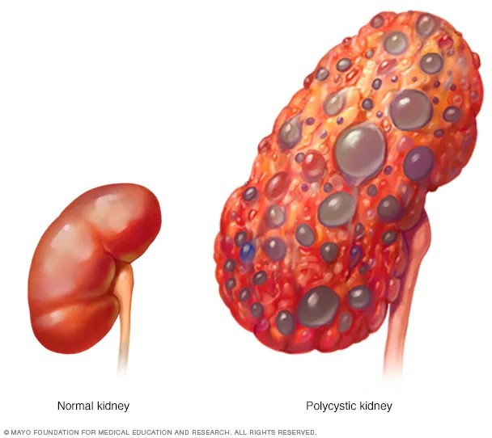
Polycystic kidney disease
Autosomal dominant polycystic kidney disease (ADPKD) is the most common genetic cause of CKD.
The course is variable, but ESRD commonly develops in 50% of the patients (by late 50s or 60s); remainder have a normal lifespan.
Pathophysiology:
Renal failure occurs from cysts replacing renal parenchyma over time, as well as recurrent episodes of pyelonephritis and nephrolithiasis

Slide 9
A wide range of different mutations in PKD1 and PKD2
The PKD1 encodes a large integral membrane protein named polycystin-1
Polycystin-1 is expressed in tubular epithelial cells , particularly those of the distal nephron and usually involved in cell-cell and cell-matrix interactions
Mutations in PKD1 ( located on chromosome 16) account for about 85% of cases
The PKD2 gene ( on chromosome 4) accounts for most of the remaining cases of polycystic disease. Its product, Polycystin-2, is an integral membrane protein that is expressed in all segments of the renal tubules and in many extrarenal tissues .

Slide 10
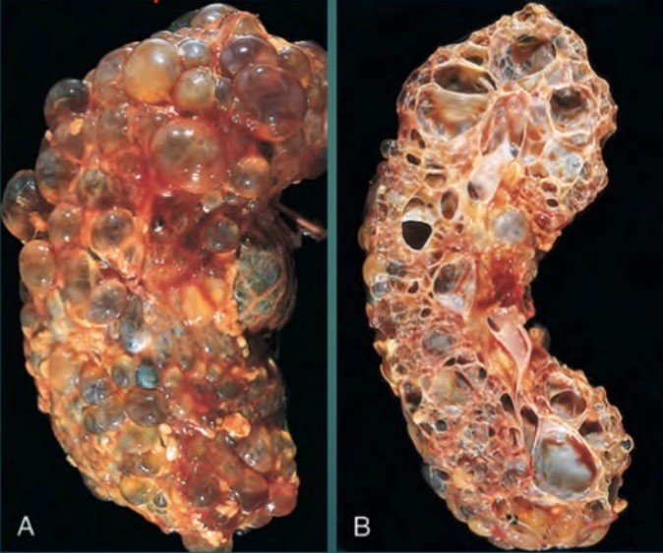
Morphology:
In gross appearance , the kidneys are bilaterally enlarged and may achieve enormous sizes; weight as much as 4 kg.
The external surface appears to be composed solely of a mass of cysts, up to 3 to 4 cm in diameter, with no intervening parenchyma.
Microscopic examination reveals functioning nephrons dispersed between the cysts.
The cysts may be filled with a clear , serous fluid or with turbid , red to brown, sometimes hemorrhagic fluid.

Slide 11
Clinical features:
1. Hematuria:
usually visible and thought to be due to rupture of cysts
into the collecting system
2. Abdominal pain:
sources include pyelonephritis, stones, and
hemorrhaging into cysts
3. HTN (in >50% of the cases )
4. Palpable kidneys on abdominal examination
ADPKD presents with :
Pain
Hematuria
Infection
Hypertension
Kidney stones

Slide 12
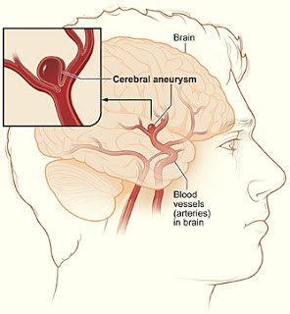
Complications:
Renal problems:
Infection of renal cysts; bleeding into cysts - Most patients with polycystic
kidney disease complain of pain at some point
Renal failure (late in the disease) - once renal failure sets in, almost all
patients develop severe hypertension.
This may be marked by symptoms such as dizziness, vomiting, dyspnea and headache.
Kidney stones - Up to 20% of patients.K
CVS problems:
Heart valve abnormalities (especially mitral valve prolapse)
Intracerebral berry aneurysm (in 5% to 20% of cases)—most do not rupture

Slide 13
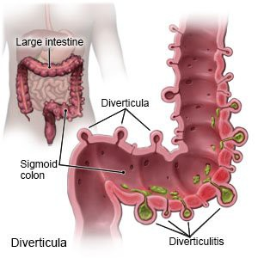
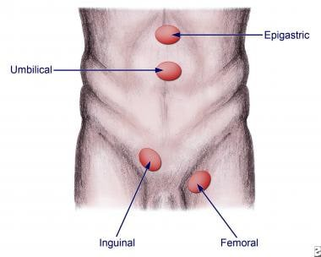
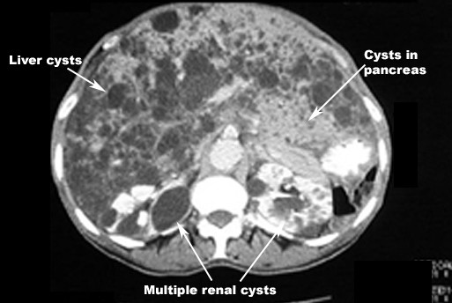
Complications:
GI cysts:
Cysts in other organs (liver, spleen, pancreas, brain)
Diverticula (colon) -may lead to colicky pain in the abdomen, characteristically left- sided, with bloating, at this stage the patient usually has end-stage renal disease. However, in most patients the condition is asymptomatic, though it may be complicated by hemorrhage into or infection of the diverticula.
Hernias (abdominal/inguinal)

Slide 14
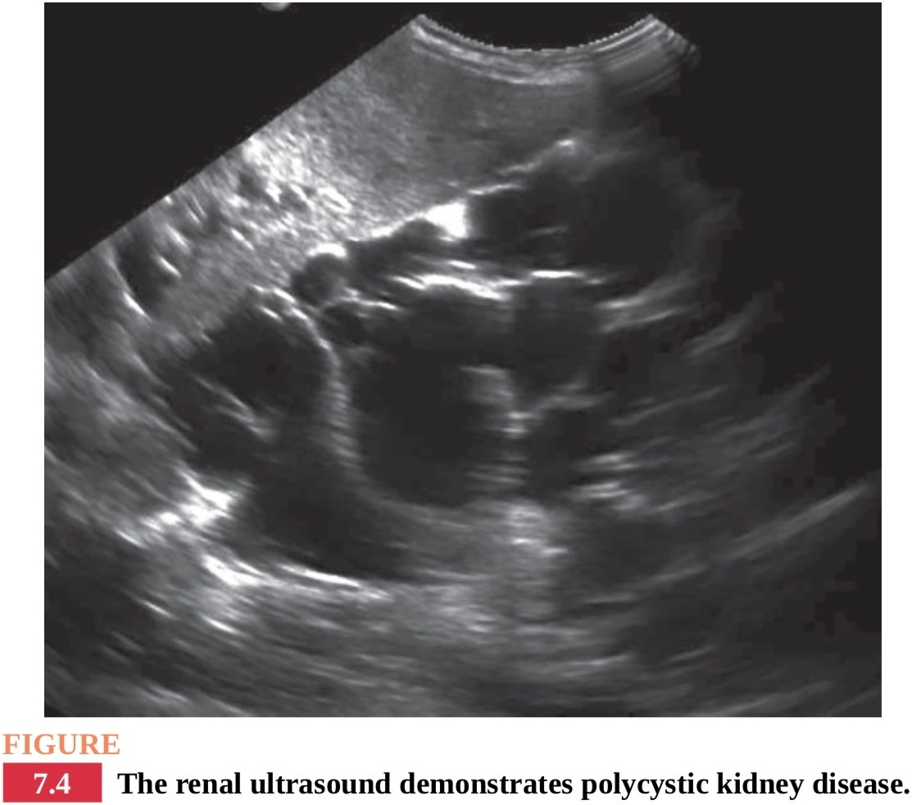
Investigation & treatment:
Investigations :
ultrasound is confirmatory - multiple cysts appear on the kidney
CT scan and MRI are alternatives
Treatment:
No curative therapy is available
Drain cysts if symptomatic
Treat infection with antibiotic
Control HTN and other cardiovascular risk factors

Slide 15
Autosomal Recessive Polycystic Kidney Disease
A. General Characteristic
1.Autosomale polycystic kidney disease (ARPKD) was previously called infantile polycystic kidney disease. It is characterized by cysts predominantly in the renal collecting ducts as well as hepatic fibrosis.
. It is less common compared to the ADPKD,though the true incidence is unknown since many affected newborns die without proper diagnosis.
3. As with ADPKD,there is a wide variability in the level of renal impairment. However, most patients ultimately will experience progressive renal failure

Slide 16
B. Clinical Features
1. Liver involvement is always present,and maybe the dominant clinical feature, especially in older individuals.
a. Hepatic complications include portal HTN and cholangitis.
2. Kidneys are increased in size which may cause severe abdominal distension.
3. HTN
4. Pulmonary insufficiency secondary to pulmonary hypoplasia and enlarged kidneys limiting diaphragmatic movement may be severe. Pulmonary complications are the leading cause of morbidity and mortality in the neonatal period.
5. Newborns with severe ARPKD may present with Potter syndrome,whichisthe constellation of clinical features associated with decreased amniotic fluid (oligohydramnios). Potter syndrome is characterized by hypoplasia of the lungs, limb abnormalities (e.g., club feet), and characteristic abnormal facies

Slide 17
C. Diagnosis
1. Some cases are detected prenatally due to the wide spread use of ultra sound during pregnancy. Less severe cases may not be detected until much later.
2. Oligohydramnios during pregnancy usually indicates severe disease.
3. Ultrasound will show characteristic renal cysts in the absence of renal cystsin
either parent. Ultrasound will also show hepatomegaly and dilated bile ducts.
4. Molecular genetic testing may confirm the disease in cases where the diagnosis is unclear.
D. Treatment
1. No curative therapy is available.
2. Manage respiratory issues in newborns,and treat ESRD with renal replacement therapy.

