Slide 1
بسم الله الرحمن الرحيم
( وَقُلْ رَبِّ زِدْنِي عِلْمًا )
Open fracture
Done by :
Shahed awad alqatawneh

Slide 2
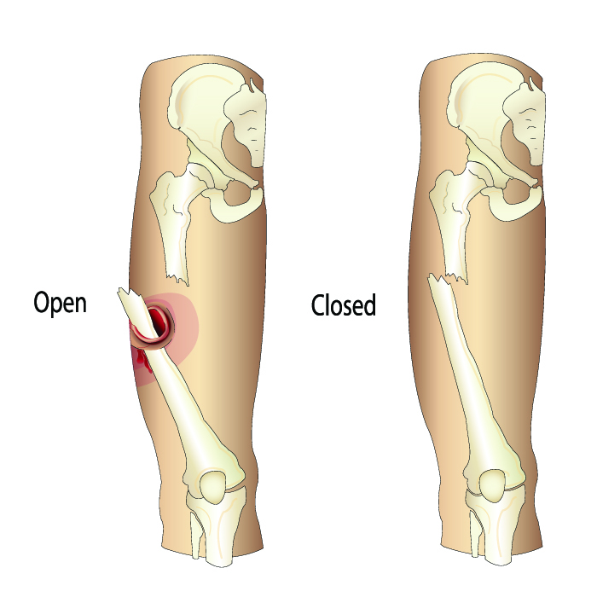
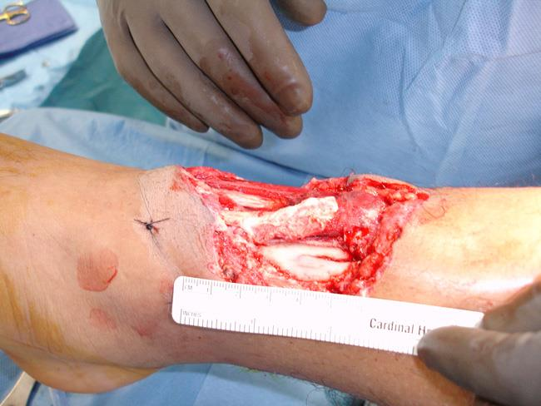
difintion
- A fracture is a break in the structural continuity of
bone.
It may be no more than a crack, a crumpling or
a splintering of the cortex; more often the break is
complete and the bone fragments are displaced.
If the overlying skin remains intact it is a closed (or simple)
fracture; if the skin or one of the body cavities is
breached it is an open (or compound) fracture, liable to
contamination and infection.

Slide 3
causes))HOW FRACTURES HAPPEN?
sudden and excessive force(high-energy event) which may be direct or indirect ,such as a
gunshot or motor vehicle accident
. An open fracture can also result from a lower-energy incident, such as a simple fall at home or an injury playing sports

Slide 4
Gustilo – Anderson classification divides soft-tissue wounding of open fractures into three grades – I, II & III. The III grade was later further subdivided into types IIIA, IIIB & IIIC

Slide 5
Management aim :
1) prevent infection
2)ensure healing
3)restore function
Patients with open fractures may have multiple injuries;
a rapid general assessment is the first step and any lifethreatening conditions are addressed
Physical Examination history & In the emergency room, you will do an initial evaluation and check for other injuries. you will want to know how the injury occurred and will ask about the patients medical history. You will then examine the wound and fracture site, checking for damage to soft tissues, nerves, and circulation. When there is any wound in the same area as a broken bone, it is assumed that there is an open fracture
Tests You will order x-rays to help determine the extent of the fracture. X-rays will show the number of breaks in the bone, as well as the position and degree of separation (displacement) between the bony fragments. If more information is needed, a computerized tomography (CT) scan or another type of imaging study may also be ordered

Slide 6
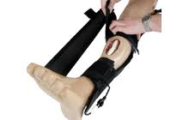
4 As:
1-analgesia
2-Anti-tetanus
3-Adequate Irrigation and debridement
4-Antibiotic prophylaxis: first or second generation cephalosporine + aminoglycoside (high energy) +penicillin (barnyard).
-not all skin injuries mean open fracture
Antibiotics and Tetanus To help prevent infection, you will give antibiotics as soon as Antibiotics and Tetanus To help prevent infection, you will give antibiotics as soon as possible in the emergency room. You will also give a tetanus booster if the patient have not had one within the last five yearsossible in the emergency room.
Injury Stabilization You will cover the wound with sterile dressings. Then will then place the injured limb in a splint to keep the bones from moving until it is taken to surgery

Slide 7
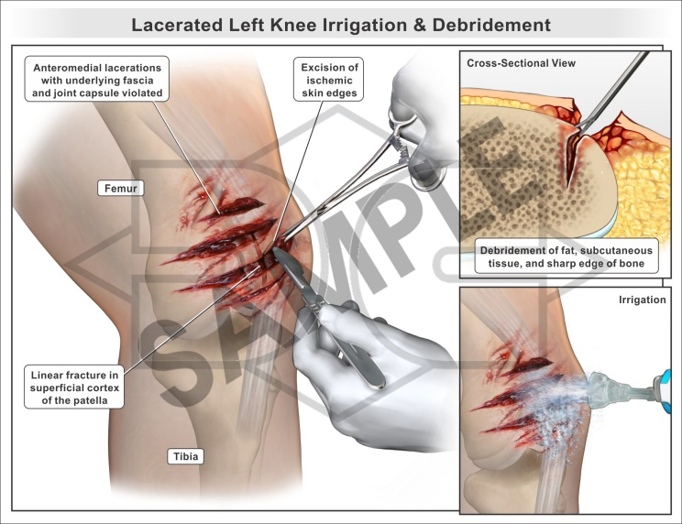
Treatment
Almost all open fractures are treated in the operating room. It is important to go to surgery as soon as possible so that the open wound can be cleaned out to help prevent infection. Depending on the specific injury, you will give either regional or general anesthesia during this procedure
Debridement and Irrigation
These are the first steps in controlling the risk for infection. In debridement, you will remove all foreign and contaminated material—as well as damaged tissue—from the wound.
Once the wound has been cleaned, you will evaluate the fracture and stabilize the bones. Open fractures are treated with either internal or external fixation.

Slide 8
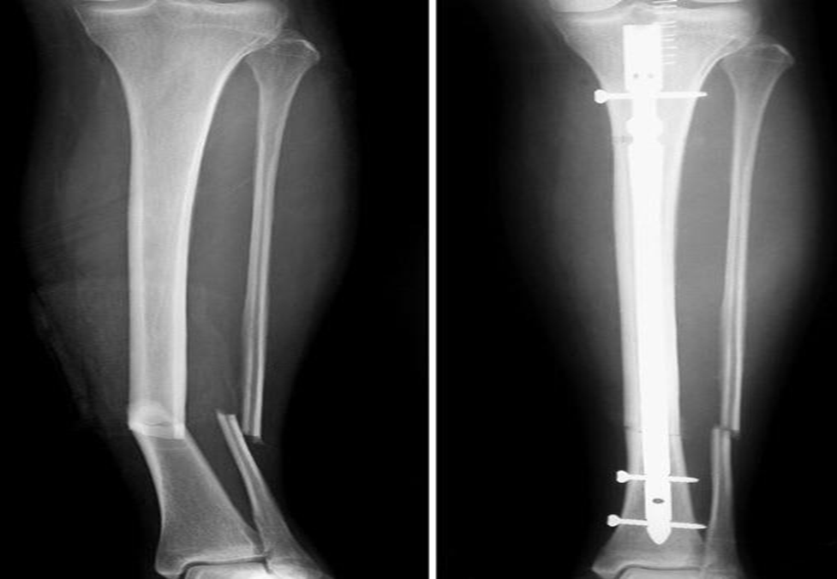
Internal Fixation
In this procedure, you will place metal implants—such as plates, rods, or screws—on the surface of or inside the broken bone. The implants will maintain the position of the bone and hold it together while the fracture heals.
Internal fixation can be used to treat open fractures in which:
The wound is clean,
There is minimal skin or tissue damage, and
The broken pieces of bone can be well aligned
It can be performed as an initial surgery or delayed if the soft tissues need to heal.
(Left) X-ray of compound fractures of tibia and fibula. (Right) A rod has been placed down the center of the tibia to hold the bone fragments in place.

Slide 9
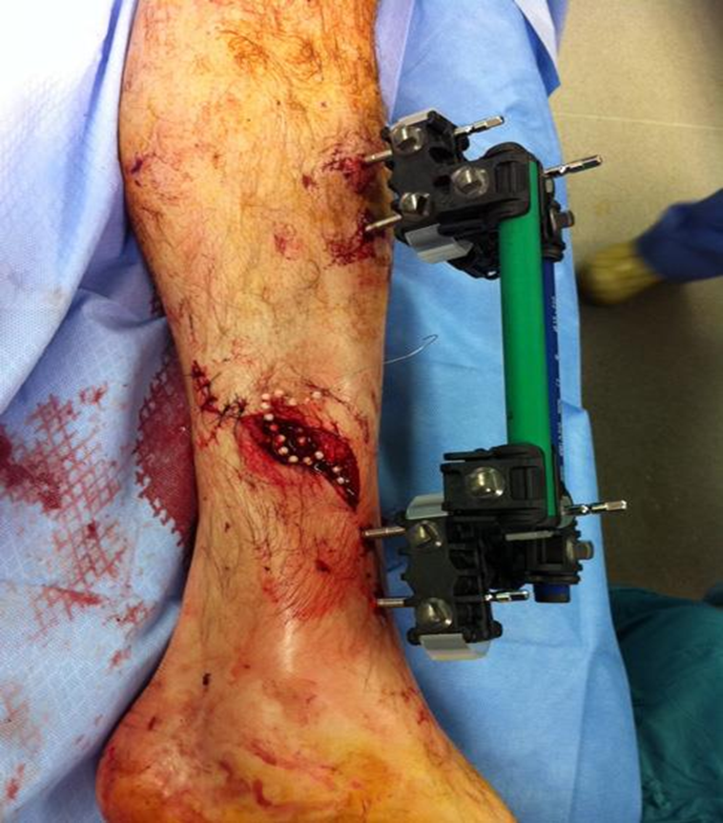
External Fixation
In the case of severe open fracture, you will close the wound with stitches after debridement and external fixation.
If the wound and broken bones are not yet ready for a permanent implant, you may apply external fixation to the injured limb. Most severe open fractures are first stabilized with external fixation.
In some cases, the wound may need further debridement or skin and tissue grafting to cover the injured bone. With an external fixator in place, the patient can often get out of bed and be mobile despite the open wound.
In most cases, an external fixator is kept in place only until it is safe to perform internal fixation. Sometimes, however, an external fixator is used to stabilize the bones until healing is complete. It is then removed during a second procedure when the fracture is healed
This patient's open fracture has been stabilized with external fixation and the wound has been partially closed with antibiotic beads

Slide 10
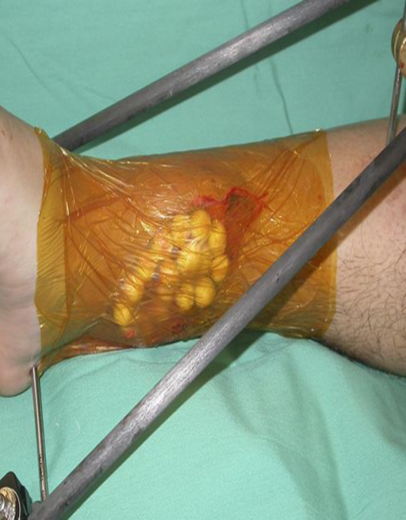
Treatment of More Complex Wounds
Some open fractures have large wounds with extensive skin and soft tissue loss. These wounds are often too large to be closed. In this situation, the doctor will temporarily cover the wound to help decrease the risk of infection and promote healing.
There are many types of dressings that can be used for temporary coverage but, in many cases, a semipermeable dressing is used to seal the wound until it can be permanently closed. Antibiotic beads are often placed into the wound before sealing to provide a high concentration of antibiotics directly to the injury.

Slide 11
After a period of time, a permanent technique will be used to close the wound. Permanent techniques for wound coverage include:
Skin graft. If there is skin loss only, a piece of skin can be taken from another part of the body and used to cover the wound.
Local flap. Muscle tissue from a nearby area in the same limb can be rotated into the wound to cover the defect. A skin graft may then be placed over the flap.
Free flap. Tissue can be transferred from another part of the body, usually the back or abdomen. A free flap procedure is often done with a microvascular surgeon who can establish blood circulation to the flap.

Slide 12
Infection
Infection can occur early on during healing or much later after both the wound and fracture have healed.
A bone infection can become chronic (osteomyelitis) and lead to further surgeries.
Nonunion
Some open fractures may have difficulty healing because of damage to the blood supply around the bone at the time of injury. If the bone does not heal, further surgery, including bone grafting to the fracture site and repeat internal fixation, may be necessary.
Compartment Syndrome
This painful condition develops when the injured arm or leg swells and pressure builds within the muscles. When this happens, immediate surgery to relieve the pressure is required. If left untreated, compartment syndrome can lead to permanent tissue damage and loss of function

