Slide 1
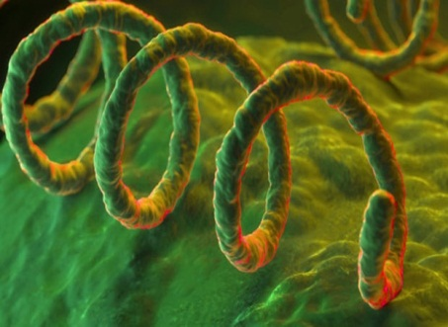
Syphilis
By:
Prof. Dr. Ghada Fahmy Helaly
GUS Module

Slide 2
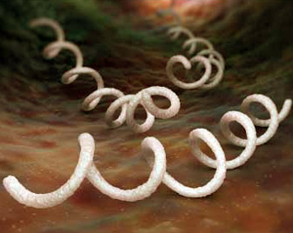
Treponema pallidum:
Syphilis is a disease caused by Treponema pallidum , a spirochaete bacterium(corkscrew-shaped, motile spiral bacteria with an endoflagellum [axial filament]).
T. pallidum is a human organism only.

Slide 3
T. pallidum has not been grown on bacteriologic media or in cell culture.
Syphilis occurs worldwide.
Marked increase in incidence of the disease in homosexual men in recent years.

Slide 4
Transmission :
Sexual contact: from spirochete-containing lesions of skin or mucous membranes.
From pregnant women to their fetuses.
Rarely, blood for transfusions (early syphilis).

Slide 5
Clinical Findings:
Primary syphilis:
10-90 days after contact with an infected individual.
Mainly on external genitalia.
Regional non-tender lymphadenopathy.
Chancres: Solitary (may be multiple “kissing” lesions) , raised, firm, red papules → ulcerate, not tender, heals within 4-8 weeks, with or without therapy.
Chancre of primary syphilis

Slide 6
Secondary syphilis:
One to 3 months later.
Lesions are rich in spirochetes and highly infectious.
Maculopapular rash (including palms and soles)
Moist lesions on the genitals “condylomata lata”
Patchy alopecia.
Constitutional symptoms of secondary syphilis: fever,……
Meningitis, hepatitis, nephropathy,…..

Slide 7
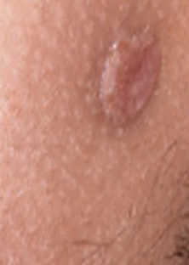
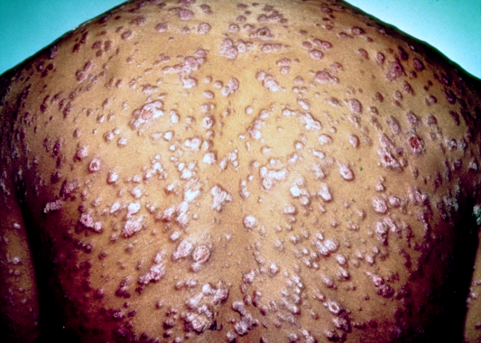
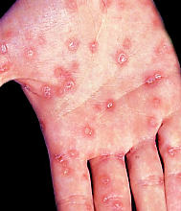
Condylomata lata (secondary syphilis)
Reddish papules and nodules over much of the body due to secondary syphilis
Palmar lesion of secondary syphilis

Slide 8
Latent syphilis:
Few years to as many as 25 years.
No lesions appear, positive serologic tests.
latent period divided into early and late stages.
Early latent: last for a year or 2 after the secondary stage→ the symptoms of secondary syphilis may reappear (infectious).
Late latent: last for many years: No symptoms, not infectious.

Slide 9
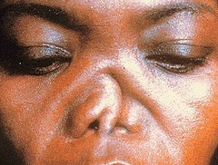
Tertiary syphilis
Within 3-10 years of infection.
Slowly progressive, affect any organ.
Treponemes are rarely seen (not infectious).
Granulomas (gummas), of skin and bones; CNS (e.g., tabes dorsalis); or CVS lesions (e.g., aortitis, aneurysm of the ascending aorta).

Slide 10
Congenital syphilis:
Transmitted across the placenta.
Infected neonates (early): abortion, stillbirth, birth defects, or latent infection (most common) with snuffles (rhinitis) followed by a rash and desquamation.
After age 2 years (late): hearing, language development and vision problems, facial and dental abnormalities.
Immunity:
Antibodies do not stop the progression of the disease.
Patients can contract syphilis again.

Slide 11
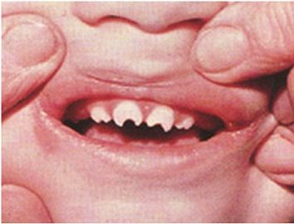
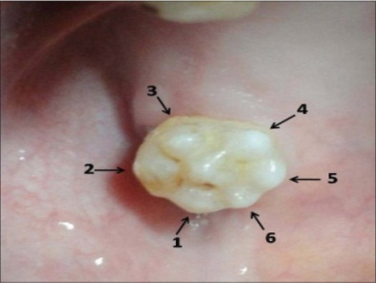
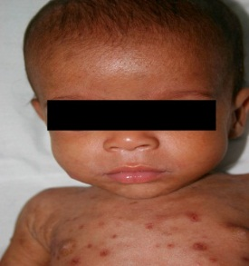
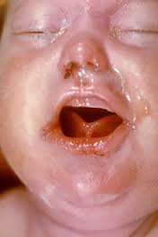
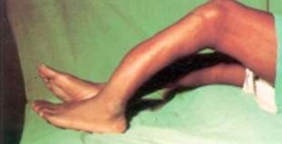
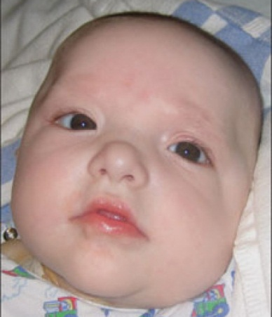
Hutchinson’s teeth
Mulberry molars
Frontal bossing
Desquamation
Rhagades, Snuffles
Saber shins
Saddle nose

Slide 12
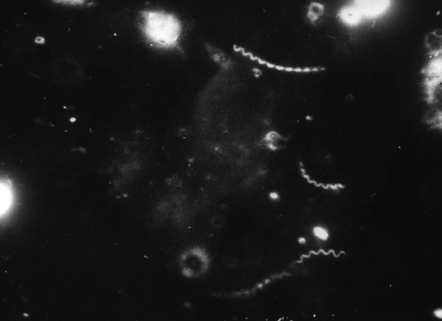
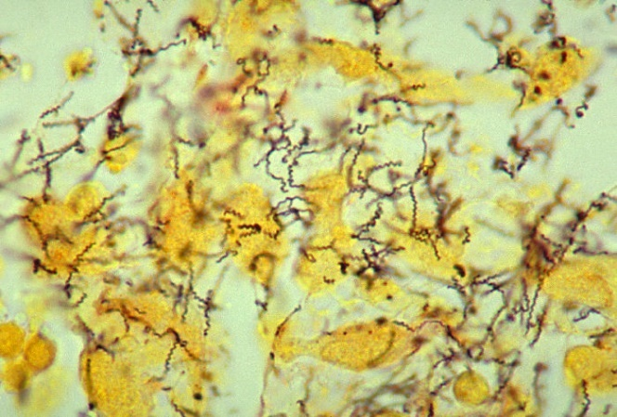
Laboratory Diagnosis:
Microscopy:
Not seen on a Gram-stained smear.
In the lesions of primary or secondary syphilis by Dark field microscopy (wet preparation → motile treponemes) or by direct fluorescent antibody (DFA) test.
In biopsy specimens (gummas) histologic stains such as silver stain or fluorescent antibody can be used.

Slide 13
Nonspecific Serologic Tests:
Inexpensive and easy → screening.
Venereal Disease Research Laboratory [VDRL] and rapid plasma reagin [RPR] tests)
Non-treponemal antigens, Cardiolipin (from beef heart) which react with antibodies “reagin” in serum.
Decline with effective treatment, in contrast to the specific antibodies, which are positive for life.

Slide 14
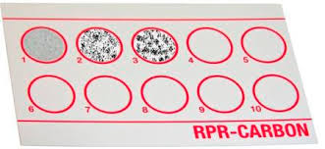
False-positive results.
False-negative: prozone phenomenon.

Slide 15
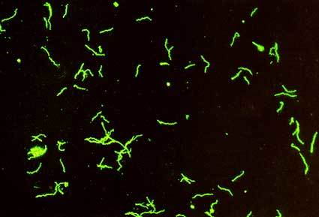
Specific Serologic Tests:
Use treponemal antigens (killed T. pallidum), highly specific, expensive and difficult .
Includes:
FTA-ABS (Fluorescent treponemal antibody absorption)→ neurosyphilis.

Slide 16
TP-PA (T. pallidum particle agglutination assay).
MHA-TP (Micro-hemagglutination assay).
Immunoassays (AIA)- for screening purposes.
Molecular testing ( PCR→ detects the genetic material from the sore, in blood, or in CSF).

Slide 17
Treatment:
Long-lasting penicillin.
Treatment of secondary syphilis may trigger the Jarisch-Herxheimer reaction immediately after antibiotic therapy.
Prevention:
Early diagnosis and adequate treatment.
Use of condoms.
Antibiotic after suspected exposure.
Follow-up of infected individuals and their contacts.
STD → test for syphilis.

Slide 18
Thank you

