Slide 1
Heavy menstrual bleeding in adolescence

Slide 2
Learning objectives
Understand how to clinically evaluate adolescent HMB
Understand when and how to investigate adolescent HMB
The different medical treatment options for HMB ( their efficacy, risks and alternatives )
Understand the management of acute adolescent HMB

Slide 3
*Heavy menstrual bleeding is the most common gynecological reason for referral of adolescent to 2nd care . *HMB has physical and psychosocial consequences with higher rates of fatigue, decreased verbal learning and memory, depression and school absenteeism . * The prevalence of HMB varies in population depending on : definition, geographical location and socioeconomic status . *NICE defines HMB as excessive menstrual loss which impacts an individual’s quality of life ,or where sanitary products are changed 1-2 hourly ,or where menses last longer than 7 days.

Slide 4
Adolescent menstrual cycle
The mean age of menarche in the UK is 12-13 years old and has been decline in age over the past century
This decline due to many factors : HPO axis immaturity ,higher childhood body mass index ,African American ethnicity , oestrogen receptor-a and leptin gen polymorphisms
HMB commonly improves with time , and reassurance may be all that need

Slide 5
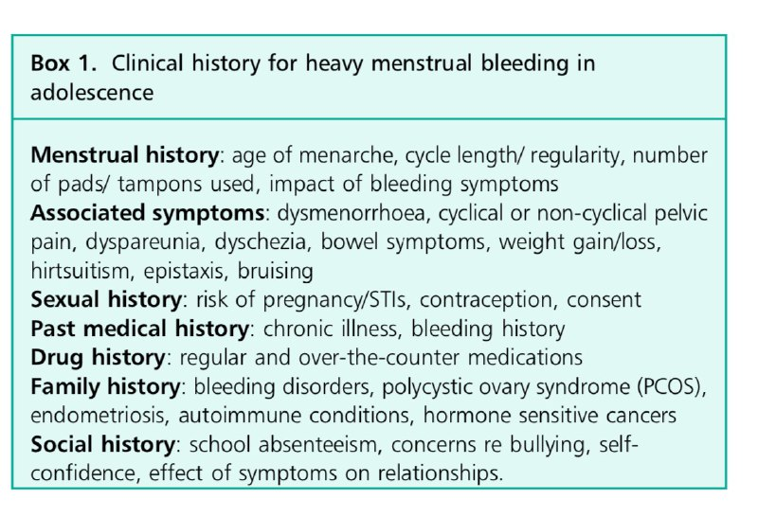
Clinical evaluation for heavy menstrual bleeding
A. History : should ideally taken both with/without a parent to allow clinicians to explore sensitive or confidential subjects
*Sexual Hx should always be taken in the absence of a caregiver

Slide 6
B. Examination : is rarely needed, assess for complication from bleeding or sign of an underlying causes * A chaperone must be present ,the girl having the choice of a parent present too. C. Investigations ( when and how ) : start Tx without additional investigations, although FBC, Ferritin, Coagulation screen are recommended *Further investigations are needed if fail to response or when an underlying pathological causes or complication from acute/prolonged HB these include : 1)Von Willebrand disease…..>factor VIII ,VWF:Ag ,VWF:Rco (VWF can rise in acute stress ,inflammation,illness and high dose oestrogen therapy ) 2)Hormonal profile …..>TSH and Prolactin level for Hypothyroidism ,SHBG and Free androgen index for PCOS 3)STI screening and a urinary pregnancy test if sexually active presented with vaginal bleeding ,abdominal or pelvic pain, abnormal discharge or cervical excitation *Swab should be taken to assess bacterial vaginalis ,N.gonorrhea and trichomonas vaginalis ,etc. 4)Ultrasound : assess pelvic mass and congenital uterine anomalies

Slide 7
Pathological causes of HMB
1)Bleeding disorders : considered after the following of : HMB from the onset of menarche ,Hx of recurrent epistaxis , excessive bruising , FHx of bleeding disorder ,evidence of anaemia ,failure to responed to conventional hormonal therapy .
2) Endocrinopathies :
Hypothyroidism : many causes include ( autoimmune ,thyroidectomy ,hypopituitarism ,iron deficiency or radiation)
PCOS
Von Willebrand disease
Immune thrombocytopenia
Haemophilia
Ashkenazi Jewish descent
3) Connective tissue disorder
Ehlers Danlos Syndrome
SLE esp. Lupus anticoagulant hypoprothrombinemia syndrome

Slide 8
4) Chronic systemic disease and their treatments
Supraphysiological insulin treatment in type 1 Dm or hyperinsulinemia 2nd to ovarian insulin resistance in type 2 Dm (lead to hyperandrogenemia)
Drugs used for epilepsy and bipolar disorder as lamotrigine and carbamazepine
Enzyme inducers as phenytoin and phenobarbital will reduce the efficacy CHC/oral progestogens ,therefore increasing likelihood of breakthrough bleeding and contraception failure (Tx with Mirena and DMPA if medically eligible)
5)Endometriosis rara to cause HMB but if came with HMB and cyclical or chronic pelvic pain , it should be considered

Slide 9
Management of heavy menstrual bleeding
Most adolescent can be managed in outpatients care which minimize schooling disruption
Admission to an acute gynecology or children’s unit should be arranged if : bleeding heavily , hemodynamically compromised or significantly anemic
By consultation we educate girls about their menstrual and sexual health
Management should consider their physical, psychological and social welllbeing

Slide 10
Pharmacological therapy
1)Non hormonal therapy
2)Hormonal therapy
1-Tranexamic acid (500-1000 mg three times a day ) IMP: prevent excessive fibrin dissolution and reduce mean menstrual blood loss in idiopathic HMB Side effects : gastrointestinal disturbance and it’s CI in fibrinolytic conditions, convulsions or thromboembolic disorder
2-NSAID no evidence of any particular NSAID being superior over another *Ibuprofen : readily and cheaply available over the counter *Mefenamic acid is generally avoided owing to dose related increase in seizure risk
3)Iron replacement and dietary modification for anemic adolescent *replaced orally with a dose of 3-6mg/kg daily given in 2-3 divided doses
1-CHC is the 1st line Tx without CI *can be taken continuously in PTs with bleeding disorder who present with anemia or acute heavy bleeding .Also, can be taken cyclically *Taken as oral tablet(20-35 mcg) at 1st and if the Pts develop S/E related to excess estrogen reduce the dose and moving to transdermal atches .If develop S/E related to progestogen switching to a non androgenic progestogen *Vaginal ring consider with nausea or significant mood changes associated with COCP *1st line Tx in SLE patients in the absence of antiphospholipid antibodies
2) Progestogen only preparation( for PTs with CI to CHC or seeking LARC) Desogestrel Norethisterone Medroxyprogesterone acetate LNG-IUS

Slide 11
Progestogen only preparation
Drugs | Dose | Side Effects | Additional information
Desogestrel | 75mg once daily | Breast tenderness/enlargement, low mood, reduce libido, acne, weight gain, headache | One third of PTs get amenorrhea after 9-12 months and after 3 months if we double dose (150mg)
Norethisterone Medroxyprogesterone acetate | 5mg twice a day 5-10 mg twice a day | Increase the risk of VTE ,weight gain headache and menstrual irregularities Breast abnormalities ,mood changes fluid retention, skin reaction ,risk of osteoporosis should be consider >5years uses | Started from the 5th day until 26 day of menstrual cycle Can be used cyclically to promote a monthly withdrawal bleed MPA preferred to norethisterone (VTE)
LNG-IUS ,Mirena ,Levosert | 20 mcg/24h levonorgestrel | Ovarian cysts, device expulsion, ectopic pregnancy ,weight changes Placed under general anesthesia | Most effective in reducing excessive menstrual loss Irregular bleeding up to 6 months and reduce blood loss or amenorrhea by 12 months
Depot injection (Sayana Press) | 104mg Every 12 weeks | GI discomfort, vulvovaginal infection, anxiety, fluid retention | Long term use >5 years associated with osteopenia

Slide 12
Follow up
https://drive.google.com/file/d/1klM4AZKsrmXx1DEdQYFPAyT3q7zTqauM/view?usp=drivesdk
Following their outpatient appointment patients should be provided with a written copy of their treatment plan and point of contact. BritSPAG recommends that adolescents should have a medical review 6 months after starting hormonal therapy. The review should focus on their current symptoms and change over the past 6 months, compliance to therapy, acceptability of treatment and the impact of their symptoms of their quality of life.

Slide 13
The management of acute heavy menstrual bleeding
Stabilizing PTs hemodynamically
Clinical Hx
Clinical Ex
Treatment
Discharge plane
Acute heavy menstrual bleeding is a medical emergency, and initial management should focus on stabilizing the patient hemodynamically.
Recommended that clinicians use a systemic approach in acute hemodynamically compromise

Slide 15
*The child safeguarding lead and police will need to be informed in the instance of sexual assault and appropriate forensic swabs taken. *Girls should remain inpatient until the bleeding has stabilized
Targeted Clinical Hx | Targeted Clinical Ex
Onset, severity of bleeding | Abdomen (to exclude pelvic/abd. Mass)
Associated symptoms (anemia, pelvic/Abd. Pain) | Inspection of pads and towel (ongoing bleeding, estimate total blood loss)
Hx of gynecological conditions | If trauma suspected ( inspection of vulva, vaginal and perineal area under anesthesia )
Bleeding disorder
Medical condition
Drugs Hx(prescribed-non prescribed medication)
Sexual Hx (risk of STI,pregnancy,sexual assault)

Slide 16
Thank you

