Slide 1
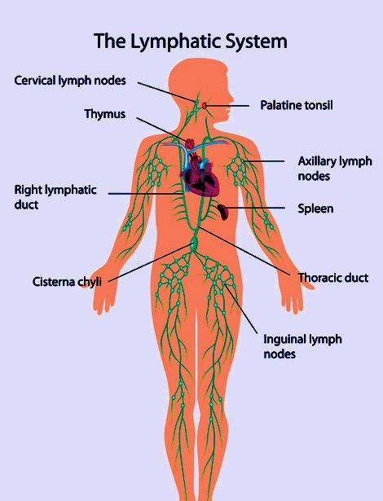
The lymphatic system (Lecture II) Professor Dr. Hala El-mazar

Slide 2
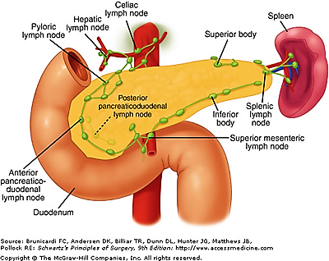
Spleen
Largest single hemo-lymphatic organ
Important blood filter. Site of destruction of aged RBCs & recycling of iron
Immunological function through B & T cells (humoral & cell mediate immunity)
A site of hematopoiesis in the fetus, and stores RBCs & platelets (blood reservoir).

Slide 3
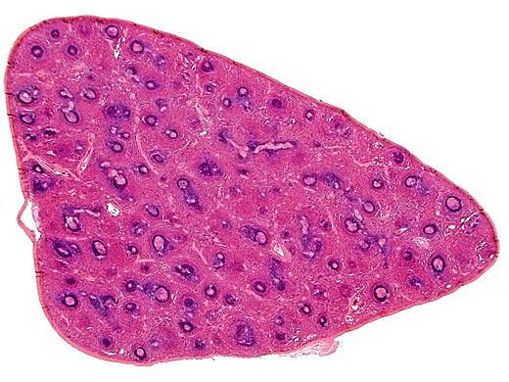
Spleen
A-
Stroma
B-
Parenchyma
Capsule
Trabeculae
Reticular CT
1-
White pulp
2-
Red pulp
Lymphatic
nodules
splenic
cords
Blood
sinusoids

Slide 4
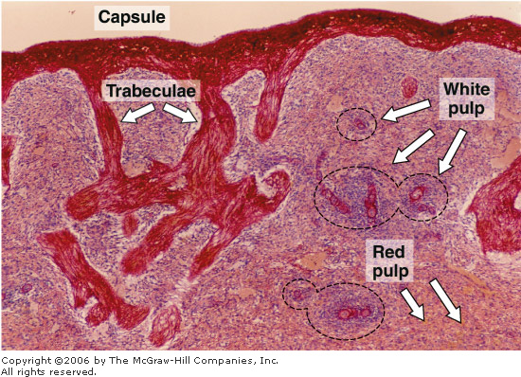
Structure of spleen
A-Stroma
1-Capsule: thick, rich in collagenous,
elastic fibers & smooth ms cells.
2-Trabecula: are short ones, extend from capsule.
divide the spleen into incomplete compartment, rich in elastic fibers & smooth ms. cells
3-Reticular CT: reticular cells and fibers, form background

Slide 5
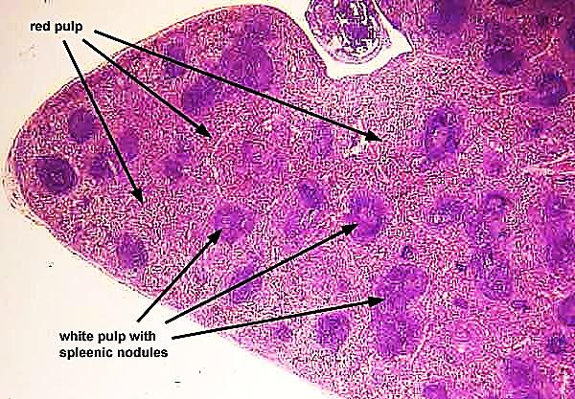
B- parenchyma
White pulp
Lymphoid follicles
Red pulp
Blood sinusoids
Splenic cords
PALS
Peri-arteriolar lymphatic sheath

Slide 6
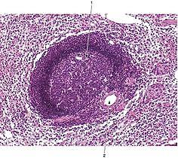
I- white pulp
1- lymphatic nodules (splenic Malpighian corpuscles):
1ry or 2ry lymphatic nodules
distributed throughout the
parenchyma of the spleen
2- Central arterioles ( follicular arterioles):
Run at the periphery of the nodules (eccentric). They are branches of splenic artery
which give numerous
branches before
leaving the white pulp
to enter the red pulp.

Slide 7
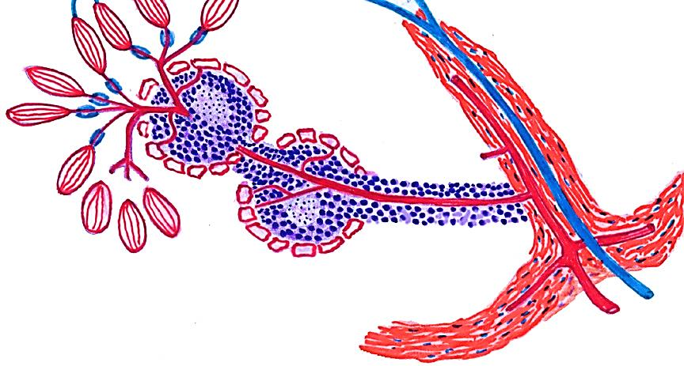
Central arteriole
White pulp
The sketch shows the lay out of the blood supply of the spleen

Slide 8
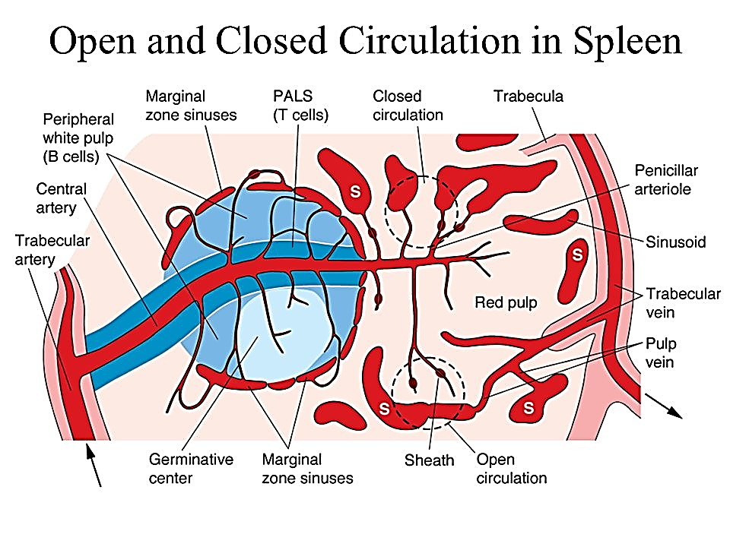
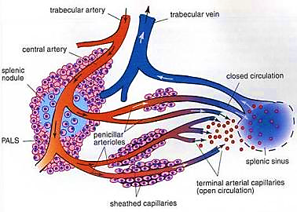
Splenic artery → trabecular arteries → central arterioles → penicillinar arterioles enter the red pulp and they terminate as:
Closed circulation when terminate directly into splenic sinusoids
Open circulation when terminate in splenic cords

Slide 9
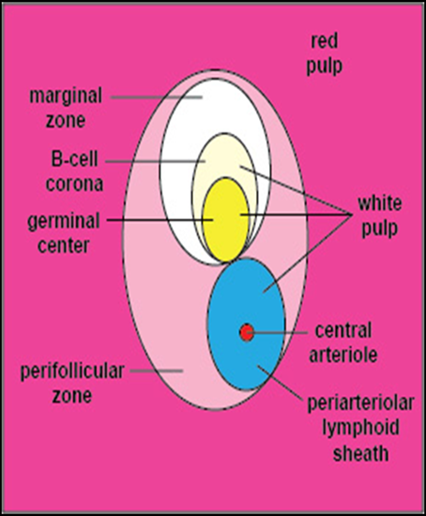
Organization of Cells in white pulp of spleen:
Periarteriolar lymphoid sheaths (PALS): mainly T lymphocytes encircle the central arteriole
(Thymus dependent zone of spleen)
Germinal center : lightly stained,
contain activated B cells, plasma cells & macrophages
(located between PALS and marginal zone)
Marginal zone at the periphery of W. pulp close to red pulp, has many APCs & macrophages.

Slide 10
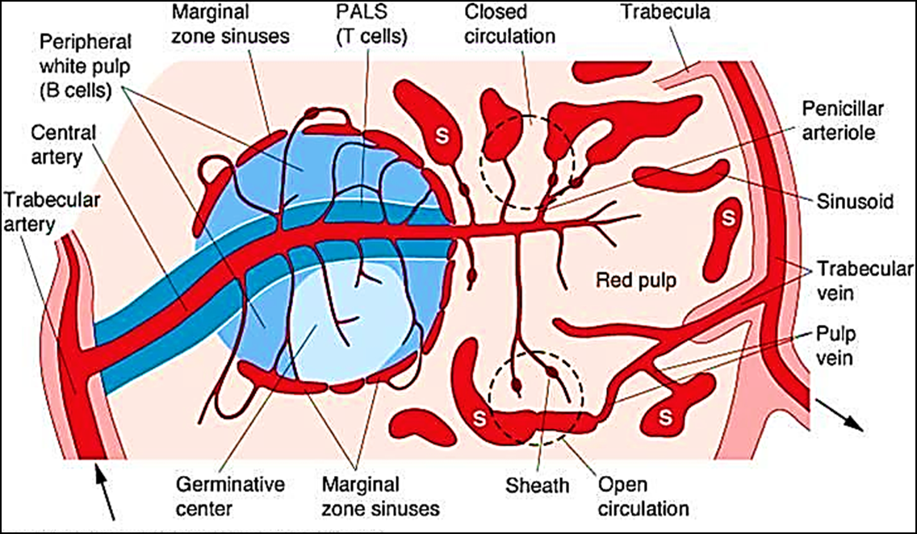
Organization of Cells in white pulp of spleen

Slide 11
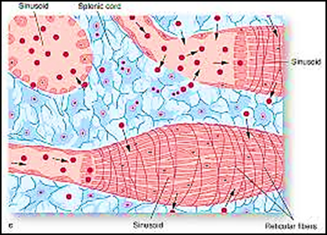
II- Red pulp
1-Splenic cords (Billroth cords):
Network of reticular fibers between blood sinusoids to support blood cells, T & B lymphocytes , plasma cells , macrophages
2-Blood sinusoids (venous sinuses):
wide spaces lined e fenestrated endothelium called stave cells which filter the blood
(Macrophages of spleen called Littoral cells )

Slide 12
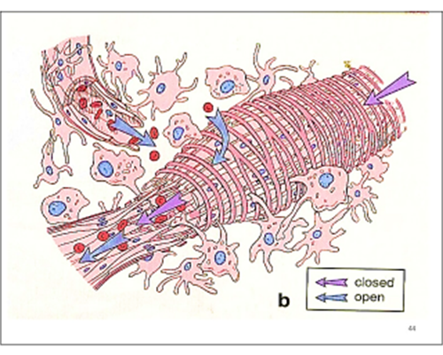
Stave cells , unusual elongated endothelial cells oriented parallel to the sinusoidal blood flow
These cells are sparsely wrapped in reticular fibers
The gaps between the endothelial cells mechanically filter the blood cells.. Old or abnormal RBCs attempting to squeeze through the endothelial gaps become badly damaged and subsequently removed by macrophages

Slide 13
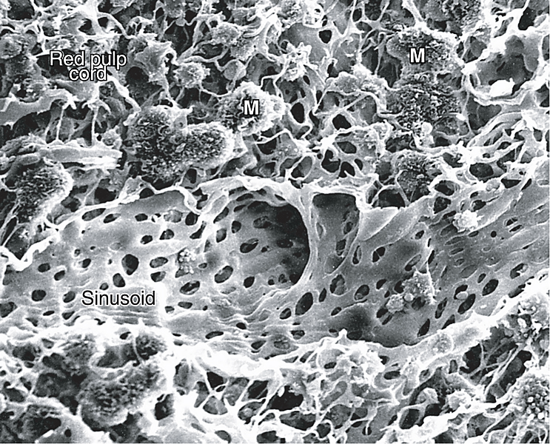
Red Pulp of Spleen (EM)
After about 120 days the erythrocytes undergo membrane changes & swell , signals for their engulfment by macrophages in the cords of the reticular between the venous sinuses
Macrophages
Sinusoids with fenestrated endothelium

Slide 14
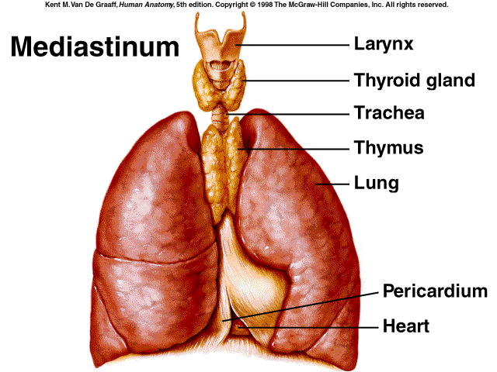
Thymus
is a 1ry lymphatic organ e an endocrine function
Location: behind the sternum in the mediastinum
Single bi-lobed structure
Development:
Infant – ↑ in size
Puberty – maximum size
Adult – ↓ in size
Function
Differentiation and maturation of T cells

Slide 15
Thymus
A-Stroma
1-Capsule
2-Trabeculae
B-Parenchyma
1- Lymphatic
2- Epithelial
1.
Cortex
2.
Medulla

Slide 16
A- Stroma:
The thymus is highly lobulated organ
1- Capsule: loose CT
2- Trabeculae (septa):
Arise from capsule, penetrate its substance forming lobes, carry blood vessels. Each lobe is divided into incomplete lobules
3- Thymus has no reticular fibers . Reticulum is formed by the processes of epithelial reticular cells

Slide 17
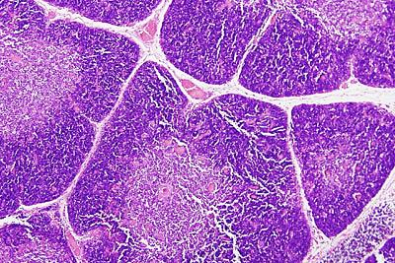
B-parenchyma
Cortex
Outer & dark
Inner & pale
Medulla
Both contain:
1- T. Lymphocytes.
2- Epithelial reticular cells.
3- Few macrophages.
4- Blood capillaries

Slide 18
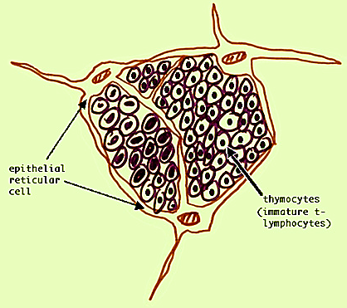
1- Cortex:
Peripheral dark-stained zone,
where T cell maturation occur
Cortex contains thymocytes:
The hematopoietic precursors migrated from bone marrow →
thymus. Thymocytes supported by a network of finely
branched epithelial reticular cells
Thymocytes are completely
surrounded epithelial reticular cells
The cortex is the site of earliest events in thymocyte development, where T cell receptor mature & positive selection take place
Mature T lymphocytes leave the cortex → the medulla.

Slide 19
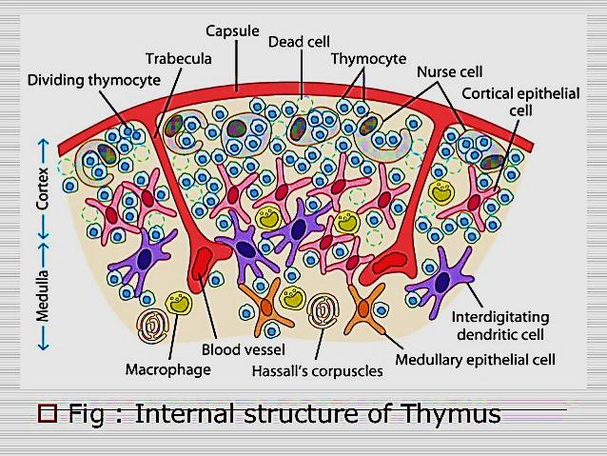

Slide 20
T- lymphocytes:
Responsible for cell mediated immunity & assist B cells in developing humoral response
Includes several subtypes: Naïve, memory, effector ( T helper, T cytotoxic , T suppressor (T reg cells) &T killer cells)
The process of T cell development:
Stem cells from bone marrow travel to the thymus to reside in the outer part of cortex once there they are called thymocytes
These thymocytes have neither CD4 nor CD8 surface markers ( double –ve T cells)

Slide 21
Within outer cortex the thymocytes will proliferate & undergo genetic arrangement & express 2 cell markers:
TCR (T cell receptor)
Cluster differentiation: CD4⁺ & CD8⁺ ( double positive T cells )
Double positive T cells that don’t recognize self –MHC epitope offered to them by cortical ER cells are forced into apoptosis (MHC: large section on vertebrates DNA contain genes that code for cell surface proteins )
Still in cortex: double +ve cells contact ER cells that bear MHC I stop expressing CD4⁺ marker & become single +ve T cells that express only CD8⁺ maker

Slide 22
Double +ve T cells contact ER cells bear MHC-II stop expressing CD8⁺ marker & become single +ve T cells that express only CD4⁺ marker
By doing that the T cells acquired the thymic education which was done under the influence of hormones sec by ERC
Only 1- 3% of Double +ve T cells will survive the selection process and will allow to enter the medulla
The previous process is called positive selection and take place in the thymus cortex
The final step in maturation of T cells occurs in the medulla

Slide 23
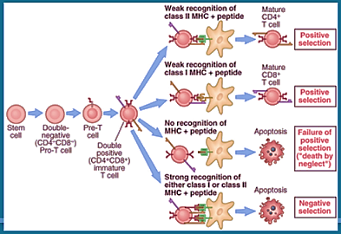

Slide 24
The medullary ER cells will do another test & present self-epitopes on MHC-I & MHC-II to the single +ve T cells & those who bind strongly ( It has to be weak reaction) to the MHC - epitopes complex are forced to apoptosis to prevent autoimmune response. This called negative selection and takes place in the Thymic medulla
T cells re-enter blood stream & travel to 2ry lymphatic organs (LN & spleen) where they settle in thymus dependent zones

Slide 26
Epithelial Reticular cells secrete thymic hormones that stimulate:
T cell differentiation
Expression of surface markers
CD4+ cells called helper T cells, indirectly can kill cells indicated as foreign. While CD8+ cells called cytotoxic T cells are able directly to kill virus infected & tumor cells
MHC I molecule is expressed on all nucleated cells Except RBCs
MHC II molecule is expressed on antigen presenting cells: macrophages , dendritic cells…etc

Slide 27
Epithelial reticular cells (ERCs) :
Branched, acidophilic cells e oval nuclei, their long processes contain tonofilaments
Called thymic nurse cells
Reticular cells connected
together by desmosomes
Do not produce reticular fibers.
Found in both cortex & medulla (Cortical ERCs & medullary ERCs)
Contain secretory granules which contain thymic hormones

Slide 28
Functions of ERCs:
1- nursing cells for T cells during their differentiation
2- Secrete the thymic hormones
3- Share in the blood-thymus barrier
4- Antigen presenting cells for developing T lymphocytes
5- in medulla form Hassall’s corpuscles

Slide 29
Blood- thymus barrier
Barrier exists in the cortex only to separate the developing T- lymphocytes from antigens in blood
The barrier is formed by:
1-continuous capillary endothelium
2- pericytes
3-thick, continuous basal lamina around endothelium
4- perivacular space contains macrophages to deal e any antigen escape
5- complete layer of epithelial reticular cells around capillaries
The barrier allow immature T lymphocytes to multiply & differentiate free from foreign Ags before they migrate to medulla & leave thymus to blood

Slide 30
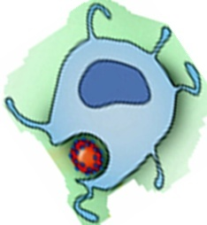
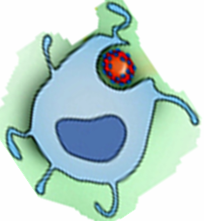
Blood thymic barrier
endothelium
macrophage
epithelial
reticular
cell
RBC
Ag
pericyte
macrophage
basement
membrane

Slide 31
Function of thymus:
Production of mature T-lymphocytes (helper & cytotoxic T cells)
(mature T-lymphocytes → thymus dependent zones )
Secretion of hormones
Thymulin
Thymopoietin
Thymosins
Thymic humoral factor

Slide 32
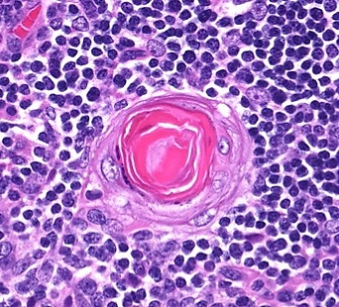
2-Medulla:
Contains fully differentiated T lymphocytes, which leave medulla through venules.
T cells travel to 2ry lymphatic organs (LN & spleen) where they settle in thymus dependent zones
Contains Hassall's corpuscles (diagnostic feature), which vary in size from 25 to 200 µm in diameter & are acidophilic in reaction.
Hassall’s corpuscle

Slide 33
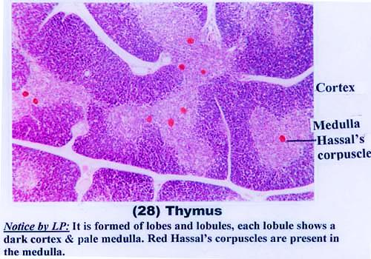
Thymus gland showing Hassall’s corpuscles in medulla

Slide 34
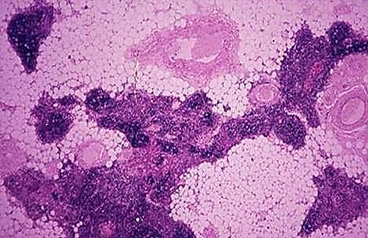
Hassall’s corpuscle consist mass of degenerated reticular cells surrounded e concentric layers of epithelial reticular cells
Thymus gland of adult
Formed by:
* Fibrous & adipose tissue.
* Few lymphocytes, ER cells.
* Hassall's corpuscles

Slide 35
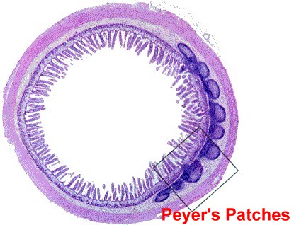
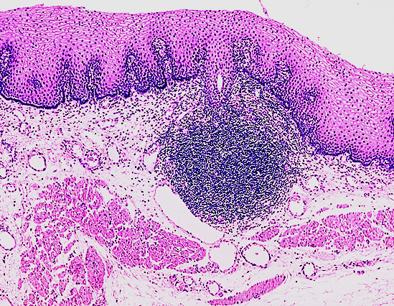
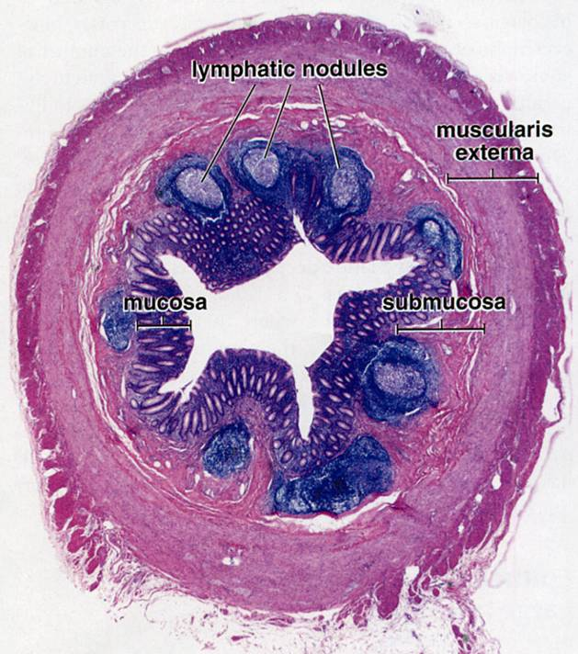
MALT Examples are:
1 .Payer's patches of ileum .
2. MALT of appendix.
MALT in ileum
MALT in wall of esophagus
MALT in appendix

Slide 36
Thank you

