Slide 1
Diagnosis & Classification of Psychological Problems
Summer of 2021
Dr. Yazan Al-Mrayat

Slide 2
Outlines
Different definitions of an “abnormal behavior”
Definition of a “Mental Illness”
The importance of establishing a diagnosis
Early classification of mental illnesses – DSM-IV-TR

Slide 3
WHAT IS ABNORMAL BEHAVIOR?
Some of the reasons that abnormal behavior is so difficult to define are (a) no single descriptive feature is shared by all forms of abnormal behavior, and no one criterion for “abnormality” is sufficient; and (b) no discrete boundary exists between normal and abnormal behavior.
Three proposed definitions of abnormal behavior: (a) statistical infrequency or violation of social norms, (b) the experience of subjective distress, and (c) disability, dysfunction, or impairment.

Slide 4
A. Statistical Infrequency or Violation of Social Norms
When a person’s behavior tends to conform to prevailing social norms or when this particular behavior is frequently observed in other people, the individual is not likely to come to the attention of mental health professionals. However, when a person’s behavior becomes patently deviant, outrageous, or otherwise nonconforming, then he or she is more likely to be categorized as “abnormal.”

Slide 7
Statistical Infrequency or Violation of Social Norms
Both of these cases are examples of individuals commonly seen by clinical psychologists for evaluation or treatment. The feature that immediately characterizes both cases is that Dmitri’s and Juanita’s behaviors violate norms. Dmitri may be considered abnormal because his IQ and school performance depart considerably from the mean.
This aspect of deviance from the norm is very clear in Dmitri’s case because it can be described statistically and with numbers. Once this numerical categorization is accomplished, Dmitri’s assignment to the deviant category is assured. Juanita also came to people’s attention because she is different. Her clothes, appearance, and interests do not conform to the norms typical of girls or women in her culture.

Slide 8
Statistical Infrequency or Violation of Social Norms - Advantages of This Definition
1. Cutoff Points: The statistical infrequency approach is appealing because it establishes cutoff points that are quantitative in nature. If the cutoff point on a scale is 80 and an individual scores 75, the decision to label that individual’s behavior as abnormal is relatively straightforward.
2. Intuitive Appeal: It may seem obvious that those behaviors we ourselves consider abnormal would be evaluated similarly by others.

Slide 9
Statistical Infrequency or Violation of Social Norms - Problems with This Definition
Conformity criteria seem to play a subtle yet important role in our judgments of others. However, although we must systematically seek the determinants of the individual’s nonconformity or deviance, we should resist the reflexive tendency to categorize every non-conformist behavior as evidence of mental health problems. Conformity criteria in fact have a number of problems.
1. Choice of Cutoff Points: Conformity-oriented definitions are limited by the difficulty of establishing agreed-upon cutoff points. However, very few guidelines are available for choosing the cutoff point. For example, in the case of Dmitri, is there something magical about an IQ of 64? Traditional practice sets the cutoff point at 70. Get an IQ score below 70 and you may be diagnosed with mental retardation. But is a score of 69 all that different from a score of 72? Rationally justifying such arbitrary IQ cutoff points is difficult. This problem is equally salient in Juanita’s case. Are five crucifixes on the wall too many? Is attendance at three church services per day acceptable?

Slide 10
Statistical Infrequency or Violation of Social Norms - Problems with This Definition
2. The Number of Deviations: Another difficulty with nonconformity standards is the number of
behaviors that one must evidence to earn the label “deviant.” In Juanita’s case, was it just the
crucifixes, or was it the total behavioral configuration— crucifixes, clothes, no makeup or
jewelry, withdrawal, fasting, and so on? Had Juanita manifest only three categories of unusual
behavior, would we still classify her as deviant?

Slide 11
Statistical Infrequency or Violation of Social Norms - Problems with This Definition
3. Cultural and Developmental Relativity: Juanita’s behavior was not deviant in some absolute sense. Had she been a member of an exceptionally religious family that subscribed to radical religious beliefs and practices, she might never have been classified as maladjusted. What is deviant for one group is not necessarily so for another. Thus, the notion of cultural relativity is important. Likewise, judgments can vary depending on whether family, school officials, or peers are making them. When considering the presence of psychopathology among youth, it is important to consider whether a child’s behavior is inappropriate as compared to same-aged peers, or as compared to all peers.

Slide 12
B. Subjective Distress
Here the basic data are not observable deviations of behavior, but the subjective feelings and sense of well-being of the individual. Whether a person feels happy or sad, tranquil or troubled, and fulfilled or barren are the crucial considerations. If the person is anxiety-ridden, then he or she is maladjusted regardless of whether the anxiety seems to produce overt behaviors that are deviant in some way.

Slide 15
Subjective Distress
Cynthia and Kwame are obviously two very different kinds of people. Cynthia’s behavior is, in
a sense, quite conforming. Her ability to cope would be cause for admiration by many. Yet she is unhappy and conflicted, and she experiences much anxiety. A clinical psychologist might not be surprised if she turned up in the consulting room. Her friends, however, would likely be shocked were they to learn that she had sought psychological help.
In contrast, many of Kwame’s friends, associates, and family members would be gratified if he were to seek help because most of them have, at one time or another, described him as sick. But Kwame is not at odds with himself. He sees nothing wrong with himself, and he would probably react negatively to any suggestion that he should seek therapy. Furthermore, his lack of motivation for therapy would probably make it an unprofitable venture.

Slide 16
Subjective Distress - Advantage of This Definition
It seems reasonable to expect that adults and some children can assess whether they are experiencing emotional or behavioral problems and can share this information when asked to do
so.

Slide 17
Subjective Distress - Problems with This Definition
Not everyone whom we consider to be “disordered” reports subjective distress. For example, clinicians sometimes encounter individuals who may have little contact with reality yet profess inner tranquility. Nonetheless, these individuals are institutionalized. Another problem concerns the amount of subjective distress necessary to be considered abnormal.

Slide 18
C. Disability, Dysfunction, or Impairment
For behavior to be considered abnormal, it must create some degree of social (interpersonal) or occupational (or educational) problems for the individual. Dysfunction in these two spheres is often quite apparent to both the individual and the clinician. For example, a lack of friendships or of relationships because of a lack of interpersonal contact would be considered indicative
of social dysfunction, whereas the loss of one’s job or failing grades because of emotional problems (e.g., depression) would suggest occupational dysfunction.

Slide 21
Disability, Dysfunction, or Impairment
According to the disability/dysfunction/ impairment definition, both of these cases would suggest the presence of abnormal behavior. Richard is completely dependent on his wife (social dysfunction), and this, coupled with his litany of somatic complaints and his inability to cope with stress, has left him unemployed (occupational dysfunction). Phyllis’s drug habit has interfered with her occupational (in this case, school) functioning.

Slide 22
Advantages of This Definition
Little inference is required.
Problems with This Definition
Who should establish the standards for social or occupational dysfunction? The patient, the therapist, parents, teachers, friends, or an employer? In some ways, judgments regarding both social and occupational functioning are relative—not absolute—and involve a value-oriented
standard. It is harder to agree on what specifically constitutes an adequate level of functioning in these spheres.
Achieving a reliable consensus about the nature of an individual’s social relationships and contributions as a worker or student may be difficult.

Slide 23
Long Story Short ….
Several criteria are used to define abnormal behavior. Each criterion has its advantages and disadvantages, and no one criterion can be used as a gold standard. Some subjectivity is involved in applying any of these criteria.
These definitions can readily incorporate certain examples of abnormal behavior, but exceptions that do not fit these definitions are easy to provide.
Abnormal behavior does not necessarily indicate mental illness. Rather, the term mental illness refers to a large class of frequently observed syndromes that are comprised of certain abnormal
behaviors or features. These abnormal behaviors/ features tend to covary or occur together such that they often are present in the same individual. For example, major depression is a widely recognized mental illness whose features (e.g., depressed mood, sleep disturbance, appetite disturbance, and suicidal ideation) tend to co-occur in the same individual.

Slide 24
What is Mental Illness??
“is conceptualized as a clinically significant behavioral or psychological syndrome or pattern that occurs in an individual and that is associated with present distress (e.g., a painful symptom) or disability (i.e., impairment in one or more important areas of functioning) or with a significantly
increased risk of suffering, death, pain, disability, or an important loss of freedom. In addition, this syndrome or pattern must not be merely an expectable and culturally sanctioned response to a particular event, for example, the death of a loved one. Whatever its original cause, it must currently be considered a manifestation of a behavioral, psychological, or biological dysfunction in the individual. Neither deviant behavior (e.g., religious, political, or sexual) nor conflicts that are primarily between the individual and society are mental disorders unless the deviance or
conflict is a symptom of the dysfunction in the individual as described above” (DSM-IV-TR).

Slide 25
What is Mental Illness??
Several aspects of this definition are important to note: (a) The syndrome (cluster of abnormal behaviors) must be associated with distress, disability, or increased risk of problems; (b) a mental disorder is considered to represent a dysfunction within an individual; and (c) not all deviant behaviors or conflicts with society are signs of mental disorder.
The astute reader has probably noticed that the DSM-IV-TR definition of mental disorder incorporates the three definitions of abnormal behavior presented earlier in this chapter. On the one hand, the DSM-IV-TR definition is more comprehensive than any one of the three individual definitions of abnormal behavior presented earlier. On the other hand, the DSM-IV-TR definition is more restrictive because it focuses on syndromes, or clusters of abnormal behaviors, that are associated with distress, disability, or an increased risk for problems.

Slide 26
The Importance of Diagnosis
There are at least four major advantages of diagnosis.
First, a primary function of diagnosis is communication. A wealth of information can be conveyed in a single diagnostic term. For example, a patient with a
diagnosis of paranoid schizophrenia was referred to one of the authors by a colleague in New
York City. Immediately, without knowing anything else about the patient, a symptom pattern
came to mind (delusions, auditory hallucinations, severe social/occupational dysfunction, continuous signs of the illness for at least 6 months). Diagnosis can be thought of as “verbal shorthand” for representing features of a particular mental disorder. Using standardized diagnostic criteria (e.g., those that appear in the DSM-IV & DSM-V) ensures some degree of comparability with regard to mental disorder features among patients diagnosed anywhere else.

Slide 27
The Importance of Diagnosis
Second, the use of diagnoses enables and promotes empirical research in psychopathology. Clinical psychologists define experimental groups in terms of individuals’ diagnostic features, thus allowing comparisons between groups with regard to personality features, psychological test performance, or performance on an experimental task. Further, the way diagnostic constructs are defined and described will stimulate research on the disorders’ individual criteria, on alternative criteria sets, and on the comorbidity (co-occurrence) between disorders.

Slide 28
The Importance of Diagnosis
Third, research into the etiology, or causes, of abnormal behavior would be almost impossible to conduct without a standardized diagnostic system. To investigate the importance of potential etiological factors for a given psychopathological syndrome, we must first assign subjects to groups whose members share diagnostic features.
For example, several years ago, it was hypothesized that the experience of childhood sexual abuse may predispose individuals to develop features of borderline personality disorder (BPD). The first empirical attempts to evaluate the veracity of this hypothesis involved assessing the prevalence of childhood sexual abuse in well-defined groups of subjects with borderline personality disorder as well as in non-borderline psychiatric controls. These initial studies indicated that childhood sexual abuse does occur quite frequently in BPD individuals and that these rates are significantly higher than those found in patients with other (non-BPD) mental disorder diagnoses. Thus, it is worth investigating whether it is an important etiological factor in BPD. Before we could reach these types of conclusions, there had to be a reliable and systematic method of assigning subjects to the BPD category.

Slide 29
The Importance of Diagnosis
Finally, diagnoses are important because, at least in theory, they may suggest which mode of
treatment is most likely to be effective. This is a general goal of a classification system for mental disorders. For example, a diagnosis of schizophrenia suggests to us that the administration of an antipsychotic medication is more likely to be effective than is a course of psychoanalytic psychotherapy.

Slide 30
Early Classification Systems
The earliest reference to a depressive syndrome appeared as far back as 2600 B.C.
The Congress of Mental Science adopted a single classification system in 1889 in Paris.
The World Health Organization and its 1948 International Statistical Classification of Diseases, Injuries, and Causes of Death, included a classification of abnormal behavior.
In 1952, the American Psychiatric Association published its own classification system in the Diagnostic and Statistical Manual, and this manual contained a glossary describing each of the diagnostic categories that were included. This first edition, known as DSM-I, was followed by revisions in 1968 (DSM-II), 1980 (DSM-III), 1987 (DSMIII- R), 1994 (DSM-IV), and 2013 (DSM-V).

Slide 31
DSM-IV-TR
The text revision of the fourth edition of the Diagnostic and Statistical Manual of Mental Disorders (DSM-IV-TR) was published in 2000.
A complete DSM-IV-TR diagnostic evaluation is a multiaxial assessment. Clients or patients are
evaluated along five axes, or domains of information. Each of these axes/domains should aid in
treatment planning and prediction of outcome. Axis I is used to indicate the presence of any of
the clinical disorders or other relevant conditions, with the exception of the personality disorders
and mental retardation. These two classes of diagnoses are coded on Axis II. Axis III is used to
highlight any current medical condition that may be relevant to the conceptualization or treatment of an individual’s Axis I or Axis II clinical disorder. Psychosocial and environmental problems relevant to diagnosis, treatment, and prognosis are indicated on Axis IV. Finally, a quantitative estimate (1 to 100) of an individual’s overall level of functioning is provided on Axis V. Each of the five axes contributes important information about the patient, and together they provide a fairly comprehensive description of the patient’s major problems, stressors, and level of functioning.

Slide 32
DSM-IV-TR
Please refer to Table 5-2 (p. 145) of the Clinical Psychology Textbook by Trull & Prinstein

Slide 33
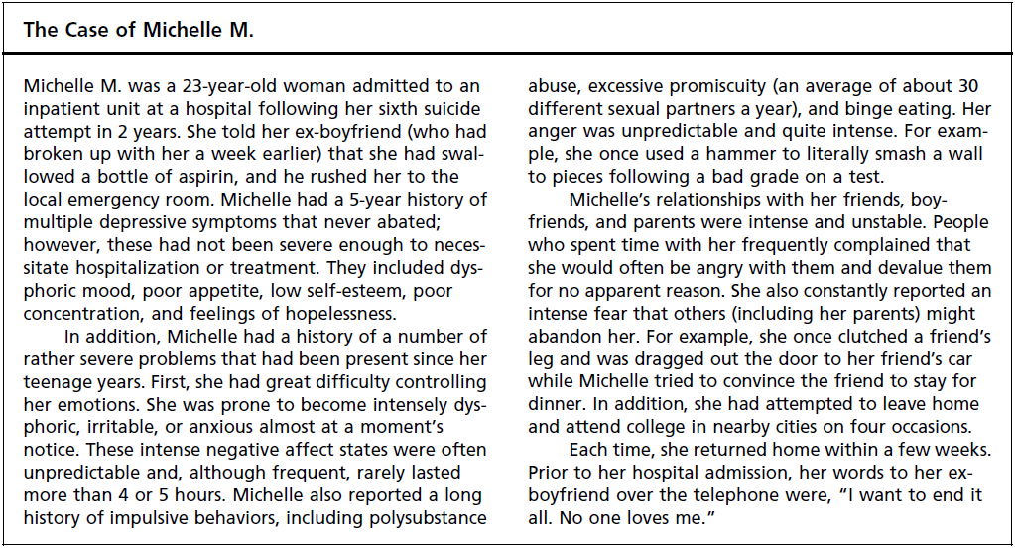

Slide 34
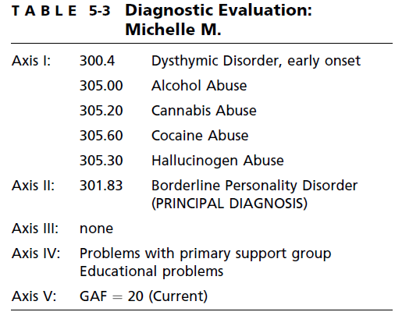

Slide 35
Thank you!

