Slide 1
FLUID THERAPY IN CHILDREN
SUPERVISED BY :DR.ASEEL AL-Dmoor
DONE BY : Leen Allan
Safaa aljaafra
Jana nassar
Jebreen Alaydi
Abdallah Dradkeh

Slide 2
OUTLINE :
Intruduction
Dehydration
Lab Test In Dehydration
Fluid Therapy in Children
Water and Solute deficit calculations

Slide 3
Body Composition :
Total body water (TBW) a percentage of water in the body .
The fetus has a high TBW, which gradually decreases to about 75% of birth weight for a term infant , Pre-mature infants have a higher TBW.
During the first year of life, TBW decreases to about 60% of body weight and basically remains at this level until puberty.
At puberty, the fat content of females increases more than that of males , by the end of puberty TBW in Male remains at 60%, but it decreases to 50% of body weight in Female ;Because fat has low water content, and muscle has high water
Although water makes up a large component of body weight, the exact proportion varies with Age , Body size ,& Body composition
In adult TBW=2/3 or 0.6 *wt
Notes:
كم بتشكل الماء من وزن جسمنا

Slide 4
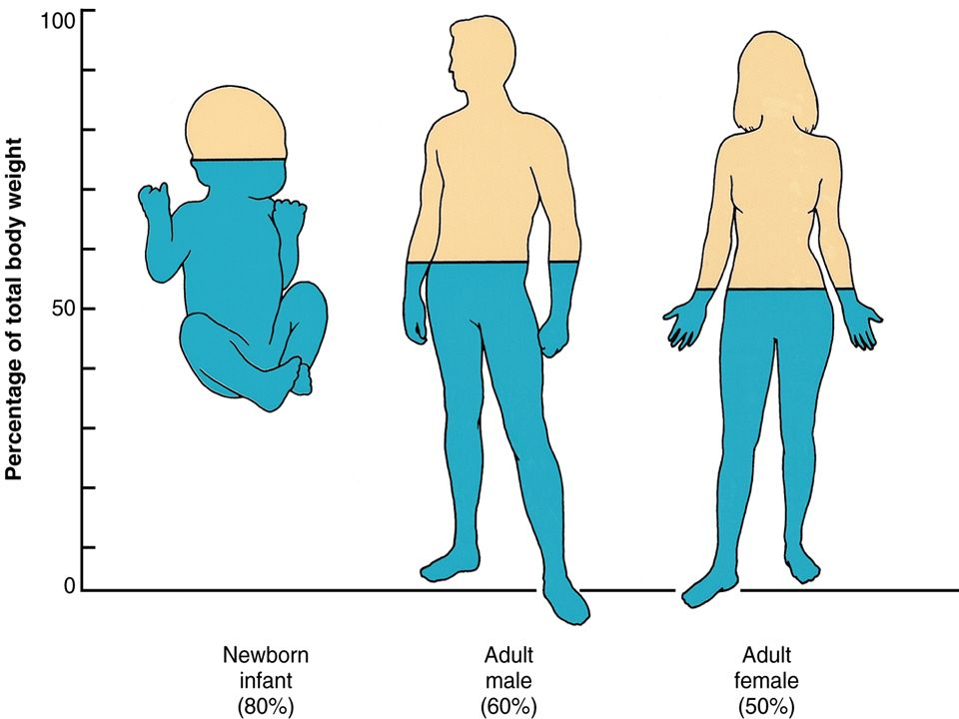

Slide 5
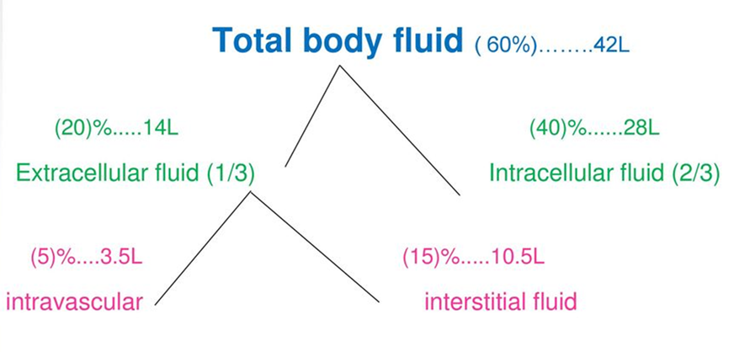
TBW has two main compartments: (ICF) and (ECF), ECF is divided further into plasma water and interstitial fluid .
Plasma water is about 5% of body weight.
Blood volume 8% of body weight
Interstitial fluid, 15% of body weight
ECF : Na+ & Cl- are the dominant cation and anion .
ICF : K+ is the most abundant cation in the ICF and proteins, organic anions, and phosphate are the most
plentiful anions .
Due to the activity of the Na + ,K + -ATPase pump

Slide 6
TBW Depend On Peadiatric
Age Groups & Compartments
In the fetus and new-born, the ECF volume is larger than the ICF volume.
The normal postnatal diuresis causes an immediate decrease in the ECF volume and followed by continued expansion of the ICF volume because of cellular growth(BSA)
By 1 year of age, the ratio of the ICF volume to the ECF volume approaches adult levels
With puberty, the increased muscle mass of males results in a higher ICF volume than in females
Newborn … 80%
Infant…75%
Child 1 year …60%
Male at puberty…60%
Female at puberty…50%
Notes:
Body surface area ,

Slide 7
Maintaining Intake & Output Homeostasis
Urine
skin
Breathing
stool
Water
Food
Cellular process

Slide 8
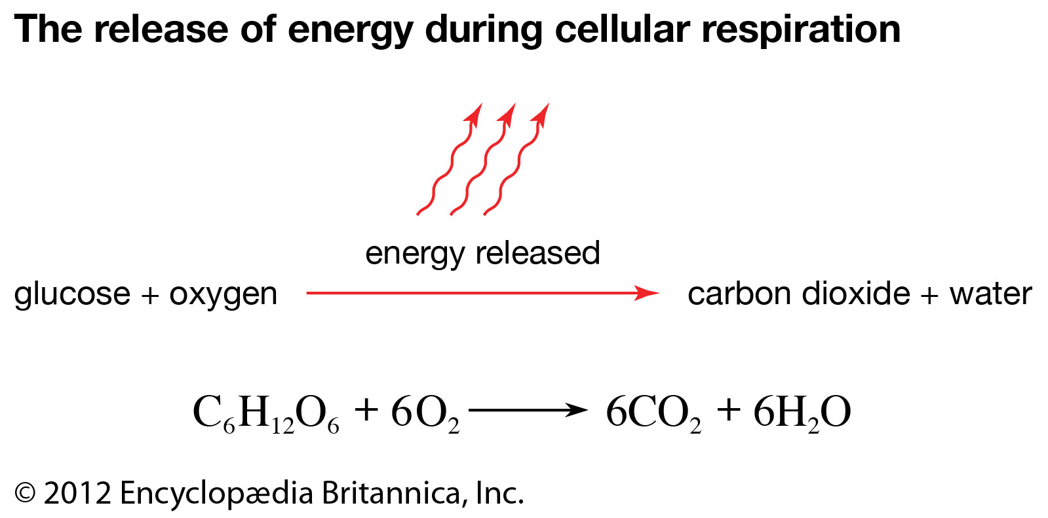

Slide 9
Osmolality :
Osmolality means the amount of particles per 1kg of plasma ( mOsmol/kg)/ Electrolyte-Water Balance.
It should be kept between 285 - 295 mOsmol/kg.
Serum osmolality <240 or > 320 is critically abnormal.
It is regulated by water intake and loss.
The main regulator is ADH hormone.
Osmolality ADH Water reabsorption
Another regulator is the Thirst center
Notes:
N- osmoreceptor : is a sensory receptor primarily found in the hypothalamus that detects changes in osmotic pressure.
renal tubular reabsorption of water, decreases urinary water losses. بغغغغغغغغض النظر عن الفوليوم هاد بتحكم فيو الصوديوم (:

Slide 10
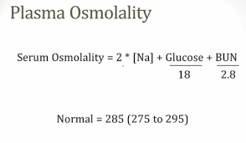
Blood Osmolality :
Mostly contribution of serum Na , and lesser from urea and Glucose .
Calculated as : 2Na+Glucose+Urea in mmol/kg
18 2.8
Notes:
Measured & calculated

Slide 11
Effective Circulating Volume :
Is a relative clinically important term.
It is non measurable.
Biologically more important than the intravascular
volume.
It is the part of the intravascular compartment ECF
in the arterial system that effectively perfusing tissue.
Notes:
كمية الدم يلي بروح للخلايا باي ارتري .
Effected by cardio and renal cause ; CHF, HTN …. etc

Slide 12
Body response to changes
in the Effective Circulating Volume :
Receptors : in cardiopulmonary circulation, carotid sinus, aortic arch and the kidney .
Works to restore normovolumia by alteration in cardiac output, renal water and salt excretion.
Renin –Angiotensin-Aldosterone system/volume control (Na+ ).
Osmoreceptors - ADH system/osmolality control .

Slide 13
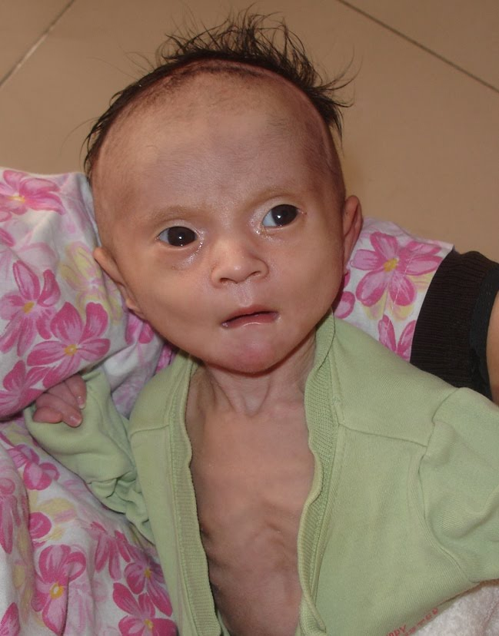
CHILD DEHYDRATION

Slide 14
Clinical assessment and diagnosis of hypovolemia (Dehydration) in children:
Volume depletion reduces the effective circulating
volume (ECV), compromising tissue and organ perfusion.
occurs when fluid is lost from the extracellular space
at a rate that exceeds intake can result from
prolonged inadequate intake without excessive losses.
The most common sites for ECF loss are:
GI : (eg, diarrhea, vomiting /GE/, bleeding)
Skin: (eg, fever, burns)
Urine: (eg, glucosuria, diuretic therapy,
diabetes insipidus)
Notes:
The most common cause of dehydration in children is gastroenteritis.
The first step in assessing a dehydrated child is determining the degree of dehydration ( either by physical examination or by calculations )
hypovolemia can result from prolonged inadequate intake without excessive losses

Slide 15
The most common cause of dehydration in children is Gastroenteritis

Slide 16
Children are at increased risk for hypovolemia for the following reasons:
There is a higher frequency of gastroenteritis (diarrhea and vomiting) in children compared to adults.
Children, especially young children, have a higher surface area to volume ratio with proportionally higher insensible losses that are accentuated in disease states (eg, fever or burns).
Young children are unable to communicate their need for fluids or cannot independently access fluids to replenish volume losses.

Slide 17
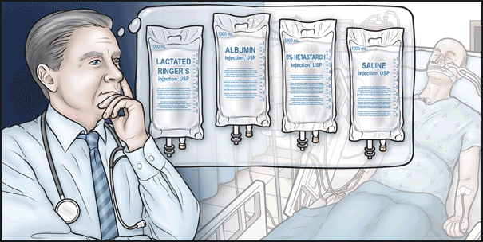
When assessing a child with hypovolemia, We needs to address two issues :
The type of fluid lost (extracellular fluid
or both intracellular and
extracellular fluid
The degree of extracellular
fluid volume depletion.

Slide 18
Degree of dehydration :
Is most objectively measured as a change in weight from baseline.
In most cases a previous recent weight is not available.
Acute loss of body weight reflects the loss of fluid, not lean body mass.
As a result, a number of findings on physical examination coupled with the clinical history are used to help assess the severity of hypovolemia.

Slide 19
According to amount of fluid depleted , we classify dehydration into mild ,moderate and severe
Mild : symptoms
Moderate : sign & Sym
Sever :vital sign , shock
Pulse, Rate ,Bp & volume

Slide 20
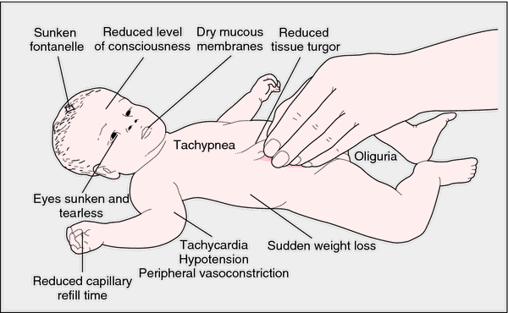
Signs and symptoms of dehydration
Fontanelle depression
baby less 18 Mo

Slide 21
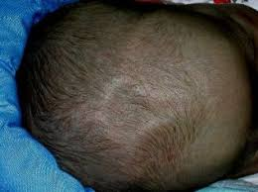
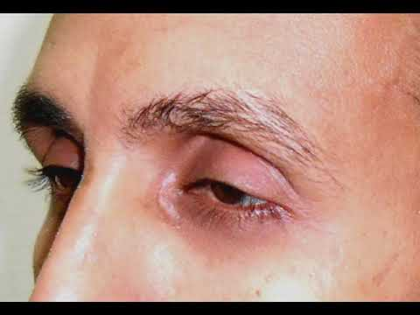
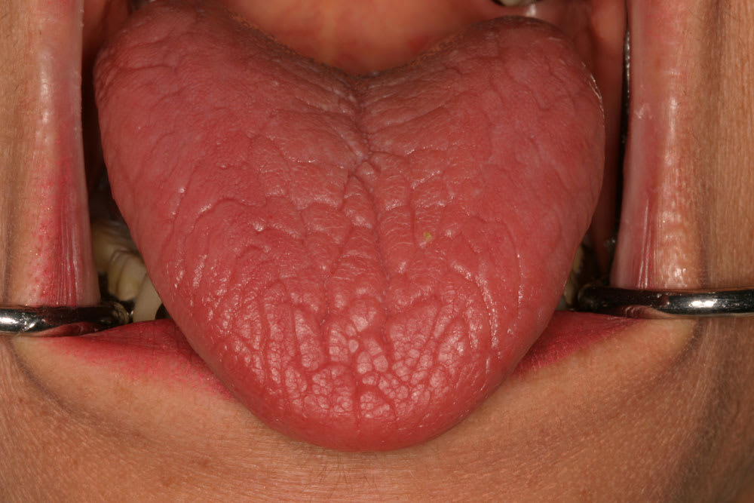

Slide 22
Severe (≥10 percent) Shocked | Moderate (6 to 9 percent) S&S | Mild (3 to 5 percent) Symptoms | Finding
Rapid (>160)and weak OR Absent | Rapid | Normal rate | Pulse
Low | Normal to low | Normal | Systolic pressure
Deep, tachypnea OR decreased to absent | Deep, rate may be Increased | Normal | Respirations
Parched ضمآن | Dry | slightly dry | Buccal mucosa
Markedly sunken | Sunken | Normal | Anterior fontanelle
Markedly sunken | Sunken | Normal | Eyes

Slide 23
Severe | Moderate | Mild | Finding
Markedly increased >5sec | Increased >3sec | normal | Capillary refill
Cool, mottled, acrocyanosis | Cool | Normal | Skin
tenting | decreased | Slightly decreased | Skin Turgor
Anuria ( PRE-AZOTEMIA) | Markedly reduced | Normal or mildly reduced | Urine output
Grunting, lethargy, Coma,loss consciousness | Restlessness, irritability | Increased thirst | Systemic signs

Slide 24
Laboratory testing :
Laboratory testing often reveals normal electrolytes and acid base balance in children with mild dehydration.
As a result, measurement of serum electrolytes is typically limited to children who require intravenous fluid repletion.
Serum sodium
Serum potassium
Serum bicarbonate
Urine sodium

Slide 25
LAB TEST : Serum Sodium(135-145)
The serum sodium concentration is determined by
the ratio between sodium salts and water in the ECF .
Thus, the serum sodium concentration in a child with
hypovolemia varies with the relative loss of solute to water.
Changes in the serum sodium concentration play an
important role in deciding the:
1. Type
2. Speed of fluid repletion therapy, especially in children
with severe hyponatremia or hypernatremia.

Slide 26
Hyponatremia
The development of hyponatremia (serum sodium less than 130 meq/L) reflects net solute loss in excess of water loss , Look ILL.
Isonatremia
A serum sodium between 130 and 150 mEq/L reflects isonatremia.
In this setting, solute is lost in proportion to water loss.
As an example, in patients with secretory diarrhea (eg, Vibrio cholera gastroenteritis)
Hypernatremia
The development of hypernatremia (serum sodium greater than 150 mEq/L) reflects water loss in excess of solute loss.
Fever or tachypnea often accompany pediatric illness associated with hypovolemia, resulting in increased insensible water losses, especially in young children
Notes:
Usually Hypo and Iso

Slide 27
Notes:
Most sever CASE IS ISO & HYPO

Slide 28
LAB TEST : Serum Potassium(3.5-5.3)
Hypokalemia Diarrhea has a high concentration of potassium, ,is usually associated with a metabolic acidosis secondary to stool losses of bicarbonate.
Hyperkalemia can occur in hypovolemic patients with renal impairment (AKI ) EXCEPTION!.
….

Slide 29
LAB TEST :
Serum bicarbonate(22-26MEq/L)
The serum bicarbonate concentration (less than 17 meq/L) may be useful in assessing the degree of hypovolemia.
The serum bicarbonate in
hypovolemia almost always represents
metabolic acidosis Usually in Diarrhea.
(normal anion gap)

Slide 30
In children with Gastroenteritis, the acidosis is because of the loss of bicarbonate in the stool.
Other causes of acidosis (High anion gap ) associated with diarrheal losses include:
Increased acid production from shock (lactic acidosis).
From enhanced fat breakdown (eg, starvation or
fasting ketosis(DKA)) .
Decreased acid excretion by the kidney caused by
a reduction in renal perfusion due to a reduction
of effective circulatory perfusion due to hypovolemia(AKI)
Metabolic acidosis is the most common acid-base disturbance associated with acute kidney injury)

Slide 31
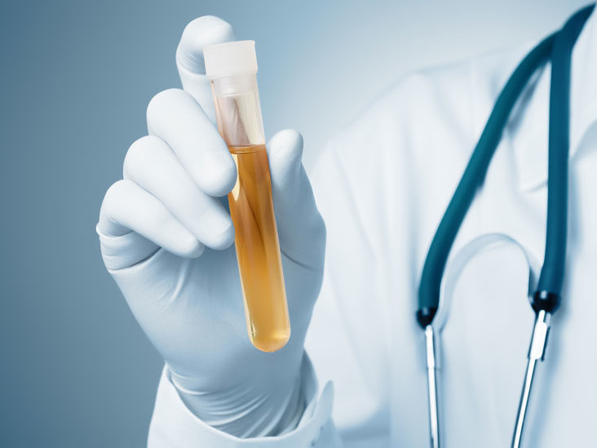
LAB TEST :
Urine sodium
The response of the kidney to volume depletion is to conserve sodium and water to restore the ECV.
Normal urine sodium values are generally 20 mEq/L in a random urine sample
In Hypovolemia, the urine sodium concentration in a random void should be less than 20 meq/L and may actually become non-detectable.

Slide 32
Fluid Therapy in children

Slide 33
Treatment of hypovolemia (dehydration) in children:
Clinically, it is useful to divide fluid therapy into Emergent/resuscitation, repletion therapy and maintenance therapy.
Emergent/resuscitation :
to replenish volume rapidly
in moderate& severe dehydration
Or when patient shocked
Repletion therapy replaces:
Any current existing water and electrolyte deficits.
Replaces any ongoing abnormal losses.
Returns the patient to a normal volume and electrolyte status.
Maintenance therapy (day 2 continue to home management):
Replaces the expected ongoing losses of water and electrolytes from normal physiologic processes.
Maintains normal volume and electrolyte status.

Slide 34
Repletion therapy in hypovolemic children is based on two steps:
The first step involves (Emergent or Acute phase):
Emergent correction of moderate to severe hypovolemia, ensuring a return of adequate intravascular volume and avoiding tissue damage.
This is primarily provided with intravenous fluids.
The second step (Replacment phase > over 24 h):
Finishes repletion of fluids and electrolyte losses in children initially treated with emergent intravenous fluid therapy.
The second step can be completed either intravenously or by ORT.

Slide 35
EMERGENT FLUID PHASE
Rapid volume repletion is required in children with severe hypovolemia.
Emergent intravenous fluid therapy should begin with rapid infusion of 20 mL/kg of isotonic NS 0.9% saline over (30-60 min) (may be faster (esp if patient in shock or sever dehydration ) ?! Can be repeated up to 3 boluses ! ). If patient is given more than 60 ml/kg bolus without improvement, consider septic shock or hemorrhage.
The child should be reassessed during and after the saline bolus, and similar isotonic fluid infusions should be repeated as needed until adequate perfusion is restored.
If intravenous access is not readily obtainable, intraosseous is an effective alternative.
(6 Kg * 20 ml = 120 ml over 20 min)

Slide 36
Type of fluid
Isotonic crystalloid is the only crystalloid solution recommended for emergent volume resuscitation in pediatric patients. Isotonic saline (0.9 percent saline solution or normal saline) is the isotonic solution of choice because it is most effective in restoring the circulatory volume.
The use of hypotonic or hypertonic crystalloid solutions for the purpose of emergent volume resuscitation is never recommended in pediatric patients. high morbidity and mortality.

Slide 37
Types of fluid solutions
Standard Na content in IVF (NS):
NS (0.9% NaCl) = 154 mEq/L
½ NS (0.45% NaCl) = 77 mEq/L
1/3 NS (0.3% NaCl) = 51 mEq/L
¼ NS (0.25% NaCl) = 39 mEq/L
1/5 NS (0.18% NaCl) = 31 mEq/L
Maintenance fluid in children Type of fluid : G5W ½NS

Slide 38
SECOND FLUID PHASE (Replacement phase)
After severe volume depletion has been corrected with intravenous fluid, fluid repletion can continue with either:
Continued intravenous fluid or
Oral rehydration therapy (ORT)
Breast feeding (in infants and toddlers in Diarrhea).
Therapy according to serum sodium
N.B.: According to American academy of pediatrics: only 4% of IV replacement is indicated. The rest can be treated with ORT.

Slide 39
Oral rehydration therapy
Advantages of ORT include:
Lower cost.
Elimination of the need for IV line placement.
Involvement of the parents in a rehydration process they can continue at home and utilize in future illnesses.
When to use ?
After effective arterial blood volume has been restored (if severe).
As initial therapy in patients with mild or moderate hypovolemia.
ORT involves the administration of frequent small amounts of fluid by spoon or syringe.

Slide 40
Oral rehydration therapy
ORT: preferred choice in mild to moderate dehydration. Even if vomiting and diarrhea persist.
It contains For maintenance:
- In mild dehydration 3-5%: 50ml/kg over 4 hours
- In moderate dehydration 5-10%: 100ml/kg over 4 hours
N.B.: According to American academy of pediatrics: only 4% of IV replacement is indicated. The rest can be treated with ORT.

Slide 41
Intravenous rehydration therapy
Indications for continued intravenous therapy include:
1. Inability of the child to take ORT .eg,
Alteration in mental status.
Ileus.
Anatomic anomaly.
2. Inability of the caretaker to provide ORT.
3. Failure of ORT to provide adequate rehydration (eg, persistent vomiting)
4. Severe electrolyte problems in clinical setting where ORT cannot be closely monitored or electrolytes frequently assessed

Slide 42
3 Concepts of rehydration therapy:
Maintenance: Normal fluids and electrolytes.
Deficit: Losses of fluids and electrolytes resulting from an illness.
On-going Losses: Requirement of fluids and electrolytes to replace ongoing losses.

Slide 43
Water maintenance Holliday-Segar Method
Body weight | mL/kg/day | mL/kg/hour
First 10 kg | 100 | 4
Second 10 kg | 50 | 2
Each additional kg | 20 | 1
Example : Fluid rate of 10 years old boy weighting 30 kg:
100 ml/kg/day 1000 ml/day (1st 10kg)
50ml/kg/day 500ml/day (2nd 10kg)
20ml/kg/day 200ml/day (per add. Kg)
Total = 1700ml/day and type of fluid : G5W ½NS
Apply the above always except in :
- anuria, renal failure (use insensible = 300-400ml/m2)
-Polyuria ……. need more

Slide 44
Solute maintenance:
* Na maintenance
2 - 3 mEq/kg /day
* K maintenance
1- 2mEq/kg /day

Slide 45
Factors Increasing Maintenance Fluid Requirements
Factors Decreasing Maintenance Fluid Requirements
Fever
(each 1 degree over 38 increases maintenance fluid by 12%
(10-15%)
Increased temperature of the environment
Burns
polyuria increased output
tachypnea
Lungs: Humidified ventilation

Slide 46
Water deficit
Fluid deficit
- Ideally we need the weight before illness eg:
child wt. pre illness 7.5 kg and now he is 7.0 Kg , his deficit is :
7.5-7.0kg = 0.5 kg = 500ml
But we don’t have the child's weight most of cases so use signs and symptoms to estimate dehydration level:
water deficit is calculated as
E.g. Child weighs 8 kg with 10% dehydration?
wt x 10 x %dehydration= 8x10x10=800ml
Type of fluid : G5W ½NS (maintenance).
= % of dehydration x body weight x 10

Slide 47
Solute deficit
Na deficit
K deficit
Calculated as a fraction of the total fluid rate needed
20 mEq/1000ml of IV fluids/day (with normal K level) Type of fluid : G5W ½NS
***Increase to 30-40 mEq/1000ml if hypokalemia
= Fluid deficit (L) x 0.8 x (serum Na )

Slide 48
Solute deficit
Isonatremia Na : 130-150 mEq/l
Estimated deficit of Na⁺ =
Mild 4-6 meq/ kg
Moderate 6-8 meq/ kg
Severe 8-12 meq/ kg
OR
water deficit (L) x 0.8 x (serum Na)

Slide 49
Isonatremic Dehydration
Fluid replacement over 24hrs :
First half of the fluid volume over 8hr then the other half over 16hr
= Maintenance + deficit of fluids and electrolytes

Slide 50
Example: Stop!!! You should to Remember :
Maintenance
Deficit
* Na maintenance
2 - 3 mEq/kg /day
* K maintenance
1- 2mEq/kg /day
Water deficit= % of dehydration x body weight x 10
Na deficit = Fluid deficit (L) x 0.8 x (serum Na )
Ka 20 mEq/1000ml of IV fluids/day,, if hypoka 40meq/1000ml
% Dehydration

Slide 51
NOW GO TO Example….
In a 20 kg child, with moderate dehydration , Na= 135
calculate the Fluid replacement over 24hrs ?
Water Maintenance = (10)x(100) + (10)x(50) = 1500cc Deficit = Weight x % dehydration x 10
(20)x(6)x10 = 1200cc Total = 1500cc+1200cc = 2.7 L
Solute Na⁺ maintenance = (3)x(20) = 60 mEq Na⁺ deficit = Fluid deficit(L) x 0.8 x (serum Na )
(1.2)x(0.8) x (135 ) = 129.6 =130 mEq
Total = 60+130=190 mEq Given as G5%W 0.45% NS with KCL 20mEq/L

Slide 52
When hypovolemia is associated with significant hyponatremia or hypernatremia attention must be paid to the rate of correction of the serum sodium concentration to avoid excessive shifts of water out of or into the brain that can lead to serious neurologic complications.

Slide 53
Water and Solute deficit
calculations

Slide 54
Types of dehydration
Isonatremic
hyponatremic
hypernatremic
Na : 130-150 mEq/l
Common cause : secretory diarrhea.
Na : <130 mEq/l
- Common cause : Replacing with hypotonic fluid .
Na : > 150 mEq/l
Common cause :
Viral gastroenteritis.

Slide 55
01
Isonatremic Dehydration
01
02
03

Slide 56
Isonatremic Dehydration
Fluid replacement over 24hrs :
Maintenance + deficit of fluids and electrolytes
First half of the fluid volume over 8hr then the other half over 16hr

Slide 57
Example: In a 10 kg infant, with moderate dehydration , Na 137 (10% dehydration)
Water Maintenance = (10)x(100) = 1000cc Deficit = W * % dehydration * 10
(10)x(10)x10 = 1000cc Total = 2 L
Solute Na⁺ maintenance = (3)x(10) = 30 mEq Na⁺ deficit = Fluid deficit(L) x 0.8 x (serum Na )
(1)x(0.8) x (137 ) = 110
Total = 140 mEq
140/2=70 Given as G5%W 0.45% NS with KCL 20mEq/L

Slide 58
02
Hyponatremic Dehydration
01
02
03

Slide 59
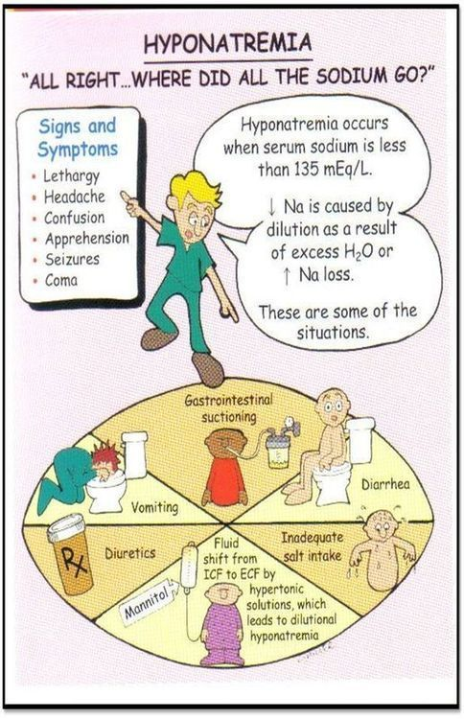
Hyponatremic Dehydration
As the serum sodium falls, an osmotic gradient develops between the intravascular space and the intracellular space, resulting in water movement from the extracellular space into the intracellular space.
- Result in cerebral edema with neurologic signs and symptoms.

Slide 60
As the sodium:
Falls acutely below 125 mEq/L, patients may begin to complain of nausea and malaise.
Fall below 120 mEq/L, headache, lethargy, and seizures
(( An initial goal is to raise the serum sodium by 5 mEq/L over the first several hours ))
And a total of max 10-12 meq/day to avoid Central pontine myelinolysis

Slide 61
In hyponatremic dehydration the Na Deficit :
is calculated similar to Isonatremic Dehydration
plus the Na correction
(Desired Na – Actual Na ) × Wt × 0.6
Desired ideal=135
Na correction :

Slide 62
In a 10 kg infant, with moderate dehydration & Na 127 mEq/L (10% dehydration)
Water
Maintenance =
(10)x(100) = 1000cc
Deficit =
W * % dehydration * 10
(10)x(10)x10 = 1000cc Total = 2 L
Solute
Na correction =
wt (10) x 0.6 x (135-127) = 10x0.6x8= 48 meq
Na⁺ maintenance =
(3)x(10) = 30 mEq
Na⁺ deficit =
Fluid deficit(L) x 0.8 x (serum Na )
= 1 x 0.8 x (127 ) = 102 Total = 180 mEq

Slide 63
Hypertonic Saline
Hypertonic Saline | size (mL) | Composition (g/L) | Ionic Concentration (mEq/L) |  | *Osmolarity (mOsmol/L) (calc) | pH
 |  | Sodium Chloride USP (NaCl) | Sodium | Chloride
3% Sodium Chloride Injection, USP | 500 | 30 | 513 | 513 | 1027 | 5.0 (4.5 to 7.0)
5% Sodium Chloride Injection, USP | 500 | 50 | 856 | 856 | 1711 | 5.0 (4.5 to 7.0)
*Normal physiological osmolarity range is approximately 280 to 310 mOsmol/L. Administration of substantially hypertonic solutions ( ≥ 600 mOsmol/L) may cause vein damage.
Table 1

Slide 64
Hyponatremic Dehydration - severe
tx of Convulsions or Coma if Na <120 :
Rapid Intravenous administration of hypertonic Na⁺ 3% saline infusion
correction is of (5 mEq ) calculation
ie ( wt x 5mEq x 0.6 ) and infuse over 2-3 hr
Management of seizures in hyponatrermia :
1mL/kg of 3%NS
Increases serum Na by 1mEq/L .
4mL/kg of 3% NS
stops the seizure most of the time
P.S : Avoid phenobarpital : pontine demylenation
Notes:
Avoid phenobarpital pontine demylenation

Slide 65
03
Hypernatremic Deyhration
01
02
03

Slide 66
Hypernatremic Deyhration
Child usually somnolent
Hyperirritable when stimulated.
Doughy skin.
Underestimated % of dehydration .

Slide 67
Hypernatremia
Calculate the water deficit :
Water deficit = wt x (0.6 x( serum Na- 145)) /current Na
Or
consider as 10 % dehydration and
If > 150 mEq/l correct over 36-48hr .
If > 170 mEq/l correct over 72-96 hr
Use 0.45% NS as initial type of solution
Give NS 0.9% 20cc/kg bolus if patient in shock

Slide 68
Rapid correction of hypernatremia can cause ;
-Cerebral edema -Seizures

Slide 69
Lots of success
Thank you

