Slide 1
Congenital Spinal Deformities
Anas O. Satari
- 5th year MD student.
-Mutah University / P.O. Box 7 Mu’tah 61710, Al-Karak, Jordan.
-Email: 420171501622@mutah.edu.jo
-Mobile No: 00962798608525

Slide 2
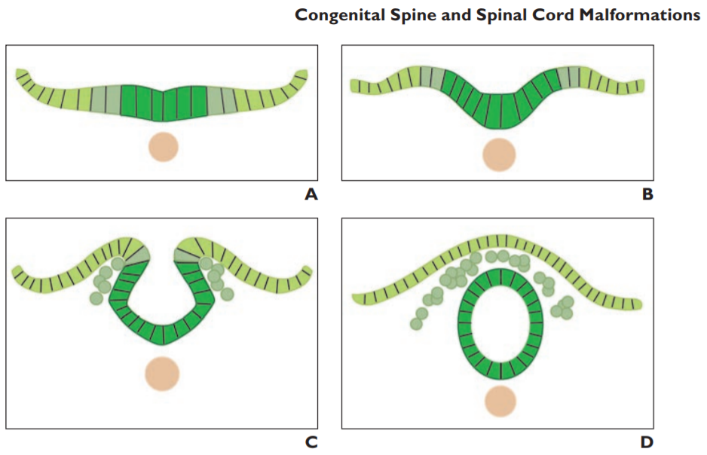
Embryology
Spinal development can be summarized in three basic embryologic stages
1) gastrulation (2nd-3rd week): involves conversion of the embryonic disk from a bilaminar disk to a trilaminar disk.
2) primary neurulation (3rd-4th week): during it, the notochord and overlying ectoderm interact to form the neural plate.
The neural plate bends and folds to form the neural tube, which then closes bidirectionally in a zipperlike manner
3) secondary neurulation (5th – 6th week): The secondary neural tube is initially solid and subsequently undergoes cavitation, eventually forming the tip of the conus medullaris and filum terminale by a process called retrogressive differentiation

Slide 3
Anomalies
Abnormalities in any of the forementioned steps can lead to spine or spinal cord malformations.
All congenital abnormalities of the spine and spinal cord are referred to as spinal dysraphisms.
Spinal Dysraphisms can be categorized from various perspectives.

Slide 4
Classification
Embryologically they are classified according to the three embryologic phases to:
1) Anomalies of gastrulation.
2) Anomalies of primary neurulation.
3) Anomalies of secondary neurulation.
Clinically they are classified to Open and Closed according to neural tissue's exposure to external environment.
Closed type is also classified according to presence of absence of subcutaneous mass.

Slide 5
Nomenclature
Open (not covered by skin) type is called spina bifida aperta.
Closed (covered by skin) type with subcutaneous mass is called spina bifida cystica.
Closed (covered by skin) type without subcutaneous mass includes are called spina bifida occulta.

Slide 6
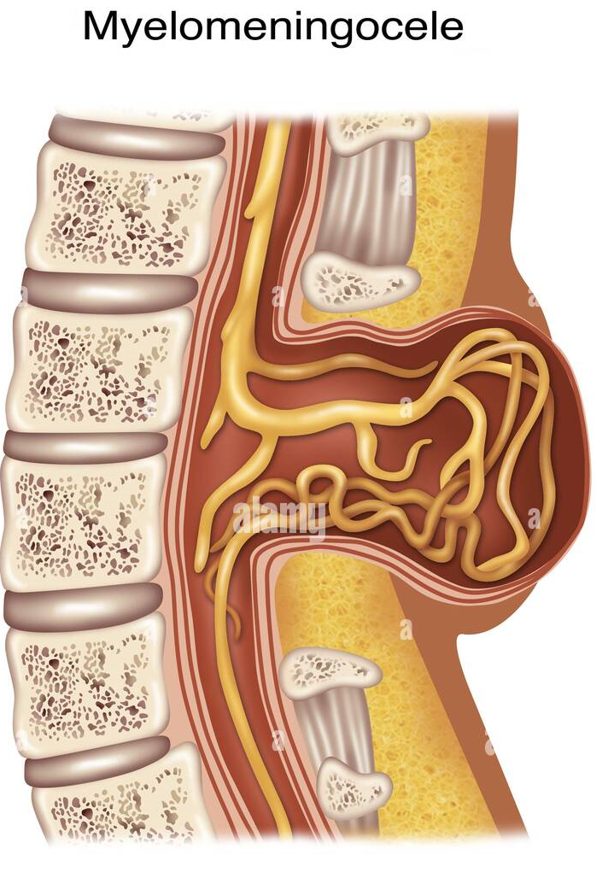
Open Spinal Dysraphisms
Myelomeningocele and myelocele:
They are caused by defective closure of the primary neural tube.
Clinically characterized by exposure of the neural placode -non-neurulated neural tissue found in all open spinal dysraphisms and some closed types- through a midline skin defect on the back.
Myelomeningoceles account for more than 98% of open spinal dysraphisms. Myeloceles are rare.
They are usually diagnosed clinically, so imaging is not always performed.
Hemimyelomeningocele and hemimyelocele are extremely rare but are also types of the open anomalies.

Slide 7
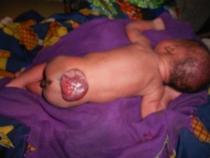
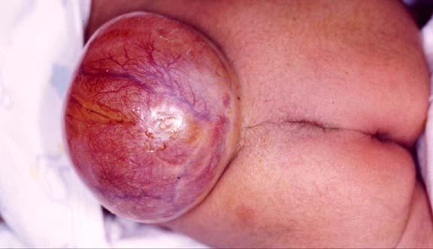
Myelomeningocele
It is a defect consisting of a herniation of meningeal tissue and CNS tissue through a defect in the spine
Clinically:
Sensory and motor changes distal to anatomic level producing varying degrees of weakness
Urinary and fecal incontinence
Highly associated with hydrocephalus
Most patients have Type II Chiari malformation
taken from past seminars

Slide 8
Myelomeningocele
It can be diagnosed in-utero by routine ultrasound. Also, the possible linked conditions can be ruled out by the same method.
High levels of maternal serum and amniotic fluid Alpha Fetoprotein confirm the diagnosis
Most common cause of mortality are complications from Chiari malformation (respiratory arrest and aspiration).
Whereas late mortality is due to shunt malfunction.
taken from past seminars

Slide 9
MRI findings
When imaging is performed, the main differentiating feature between a myelomeningocele and myelocele is the position of the neural placode.
The neural placode protrudes above the skin surface with a myelomeningocele.
The neural placode is flush with the skin surface with a myelocele.

Slide 10
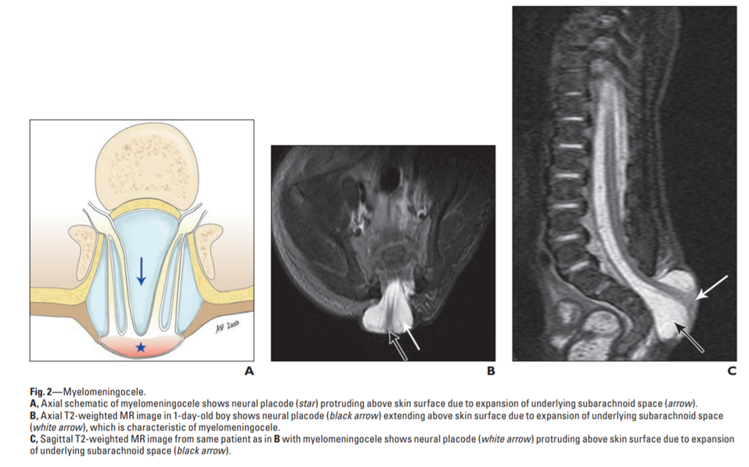
myelomeningocele

Slide 11
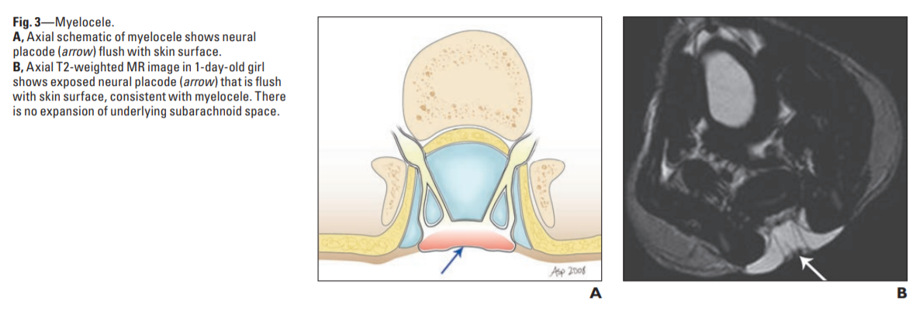
myelocele

Slide 12
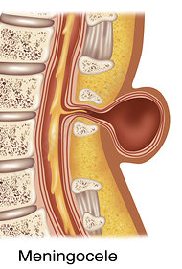
Closed spinal dysraphisms with a subcutaneous mass
They are:
1) Meningocele
2) Lipomas with a dural defect:
a) lipomyelocele
b) lipomyelomeningocele
3) Terminal myelocystocele
4) Non-terminal myelocystocele

Slide 13
Meningocele
It is defined as Herniation of a CSF-filled sac lined by dura and arachnoid mater.
The spinal cord is not located within a meningocele but may be tethered to the neck of the sac.
They are usually posterior and are located in the lumbosacral region.

Slide 14
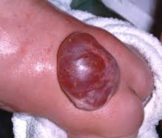
Meningiocele
The disease usually doesn’t cause disabilities, and it is less common than myelomeningiocele.
It is not associated with neither chiari 2 malformation nor with hydrocephalus.
The outcome is excellent.

Slide 15
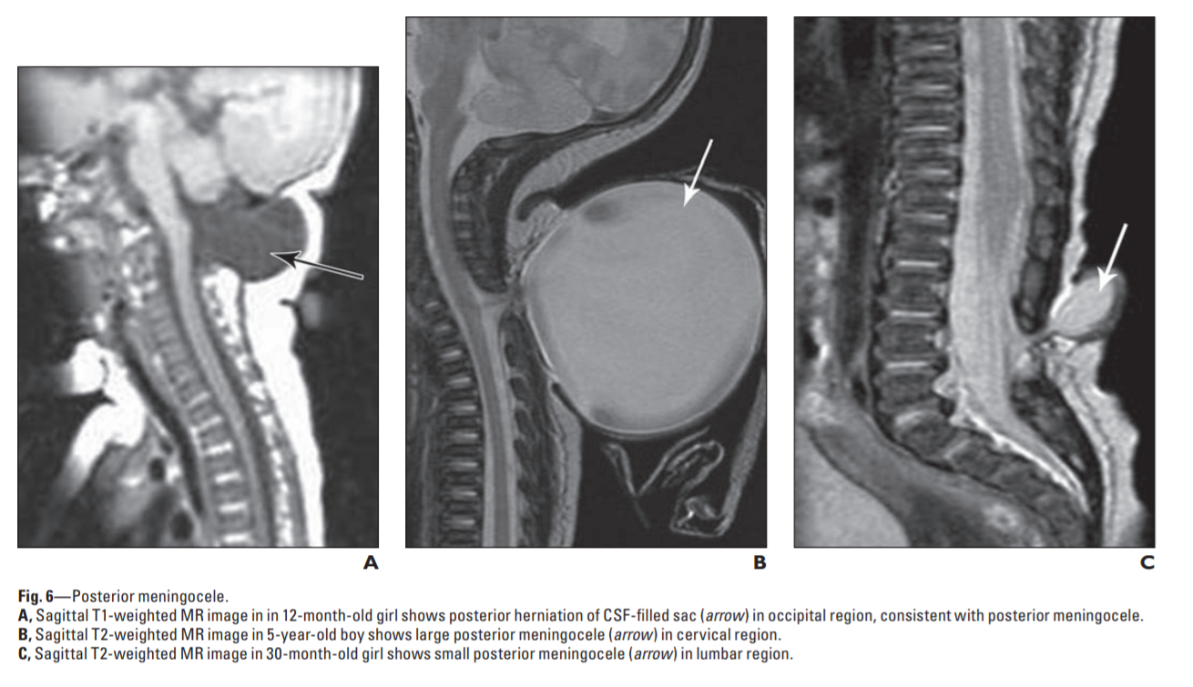
Meningiocele

Slide 16
Lipomas with a dural defect
This entity includes both lipomyelocele and lipomyelomeningocele.
These abnormalities result from a defect in primary neurulation whereby mesenchymal tissue enters the neural tube and forms lipomatous tissue.
They characterized clinically by the presence of a subcutaneous fatty mass above the intergluteal crease.

Slide 17
MRI findings
The main differentiating feature between the two types is the position of the placode–lipoma interface.
With a lipomyelocele, the placode–lipoma interface lies within the spinal canal.
With a lipomyelomeningocele, the placode–lipoma interface lies outside of the spinal canal due to expansion of the subarachnoid space.

Slide 18
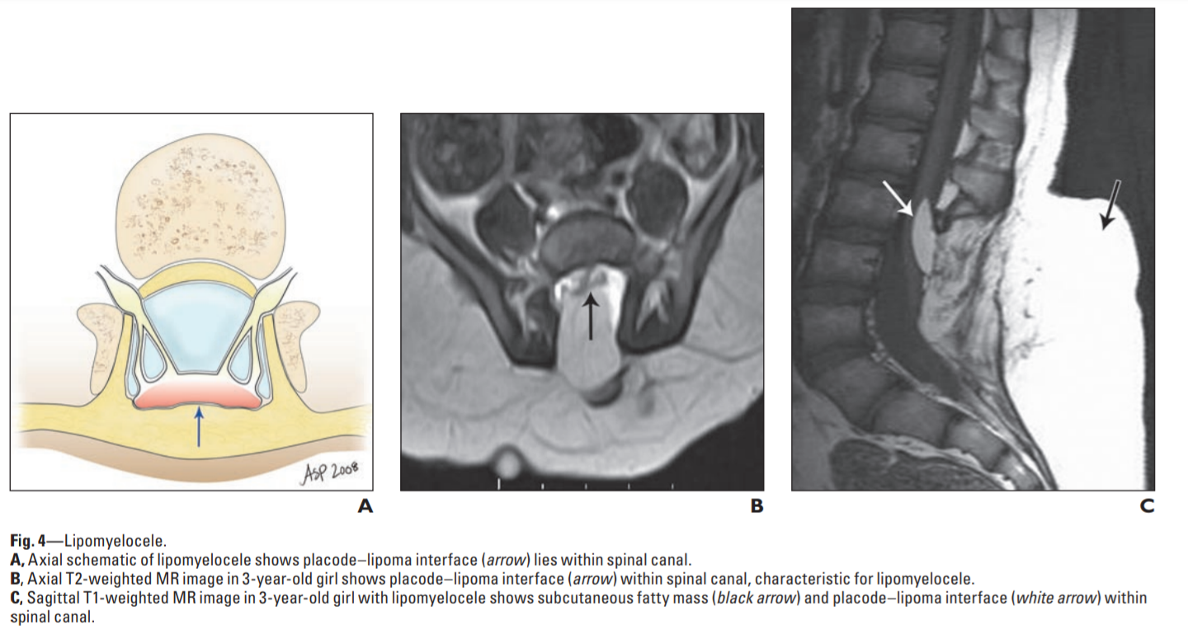
lipomyelocele

Slide 19
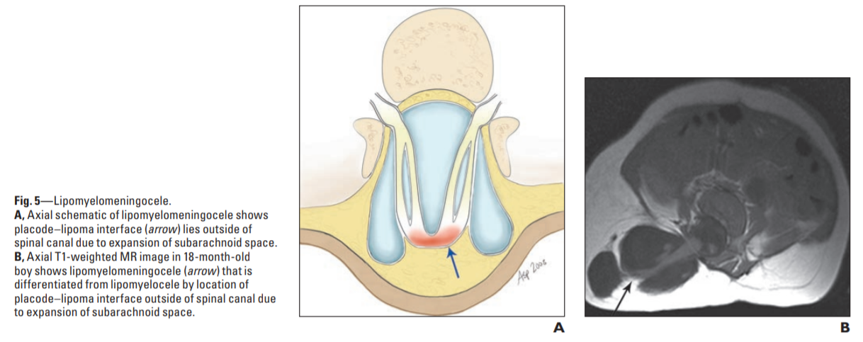
Lipomelomeningiocele

Slide 20
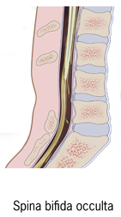
Closed spinal dysraphisms without a subcutaneous mass
They are either Simple or Complex
The simple dyraphic state includes:
intradural lipoma.
filar lipoma.
tight filum terminale.
persistent terminal ventricle.
dermal sinus.
In these conditions, usually the baby comes with tethered cord syndrome without cutaneous (skin) symptoms

Slide 21
Closed spinal dysraphisms without a subcutaneous mass (cont.)
Complex dysrapic state includes both:
disorders of notochordal integration:
dorsal enteric fistula.
neurenteric cyst.
Diastematomyelia.
disorders of notochordal formation:
caudal agenesis.
segmental spinal dysgenesis.
In these conditions there is cutaneous manifestation ( hair , dimple ,nevus , pigmentation).

Slide 22
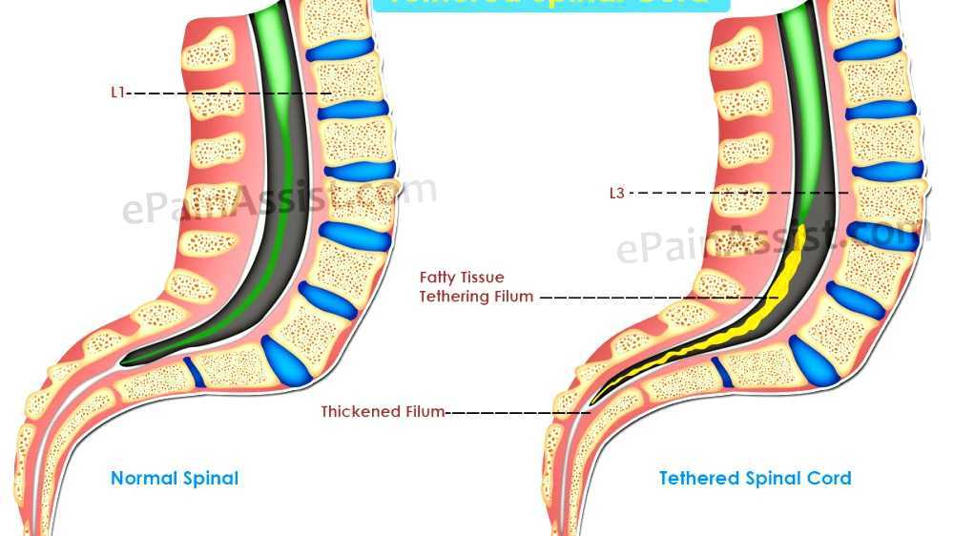
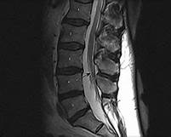
Tethered cord
Spinal cord is abnormally attached to tissues around ( most commonly at the base of spine )
Abnormally low conus medullaris. Usually associated with a short, thickened filum terminale, or
with an intradural lipoma (other lesions, e.g lipoma extending through dura, dermal sinuses tracts, dermoids. or diastematomyela
Most common in myelomeningocele (MM). Diagnosis must be made clinically in MM, as almost all of these patients will have tethering radiographically.
The spinal cord normally hangs loose in the canal free to move up and down with growth and bending and streching , a tethered cord is held taut at the end
taken from past seminars

Slide 23
Clinical features:
In children : symptoms may include lesions , hairy patches , dimples , or fatty tumors on the lower back , Foot and spinal deformeties , weakness in the legs ,Low back pain , Scoliosis , And incontenece
In adults : onset of symptoms typically include severe pain ( in the lower back and radiating in to the legs , groin , and perineum ) , bilateral muscle weakness and numbness , bladder and bowel incontinence
Treatment :
In children :early surgery is recommended to prevent further neurological deterioration
In adults :surgery to free (detether) the spinal cord can reduce the size and further development of cysts in the cord and may restore some function or alleviate other symptoms
taken from past seminars

Slide 24
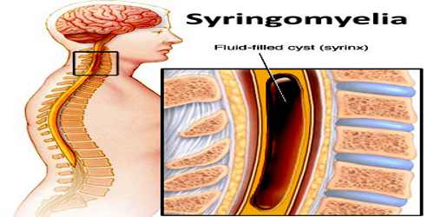
syringomyelia
Is a genetic term referring to a disorder in which a cyst or cavity (fluid-filled )forms within the spinal cord,this cyst called a syrinx ,can expand and elongate over time destroying spinal cord
Patients may present with sensory disturbances weakness of the hands loss of pain and temperature sensation or progressive kyphoscoliosis.
Hindbrain herniation can lead to headache neck pain , ataxia , spasticity and lower cranial nerve palsies .
Associated with Chiari I malformation ,scoliosis
and other congenital malformations;
acquired causes include trauma and tumors.
Most common
location cervical > thoracic >> lumbar
Syrinx = tube, as in “syringe.”
taken from
past seminars

Slide 25
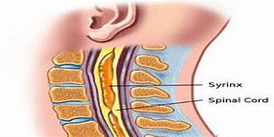
taken from
past seminars

Slide 26
Types of syringomyelia
Syringomyelia due to blockage of CSF circulation (without fourth ventricular communication)
Syringomyelia due to spinal cord injury
Syringomyelia and spinal dysraphism
Syringomyelia due to intramedullary tumors
idiopathic syringomyelia
taken from
past seminars

Slide 27
Treatment
Treat underlying pathology :
If associated with a type I Chiari , then a posterior cranial fossa decompression is indicated to restore cerebral spinal fluid outflow through formen of Magendie
If the cause is an intramedullary spinal cord tumor , excision of tumor should restore the communication with central canal
If post traumatic cause , the obstruction should be revealed by decompression
Not with standing this , fluid diversion to the
peritoneum or plural space syingoperitonial or
syringopleural ) has been used with moderate success
taken from
past seminars

Slide 28
Thank you
PMID of the article: 20173174

