Slide 1
Sleep disorder
Done by :
Rahaf nawiseh
Islam al banawi
Supervised by : dr.amer rawajfeh

Slide 2
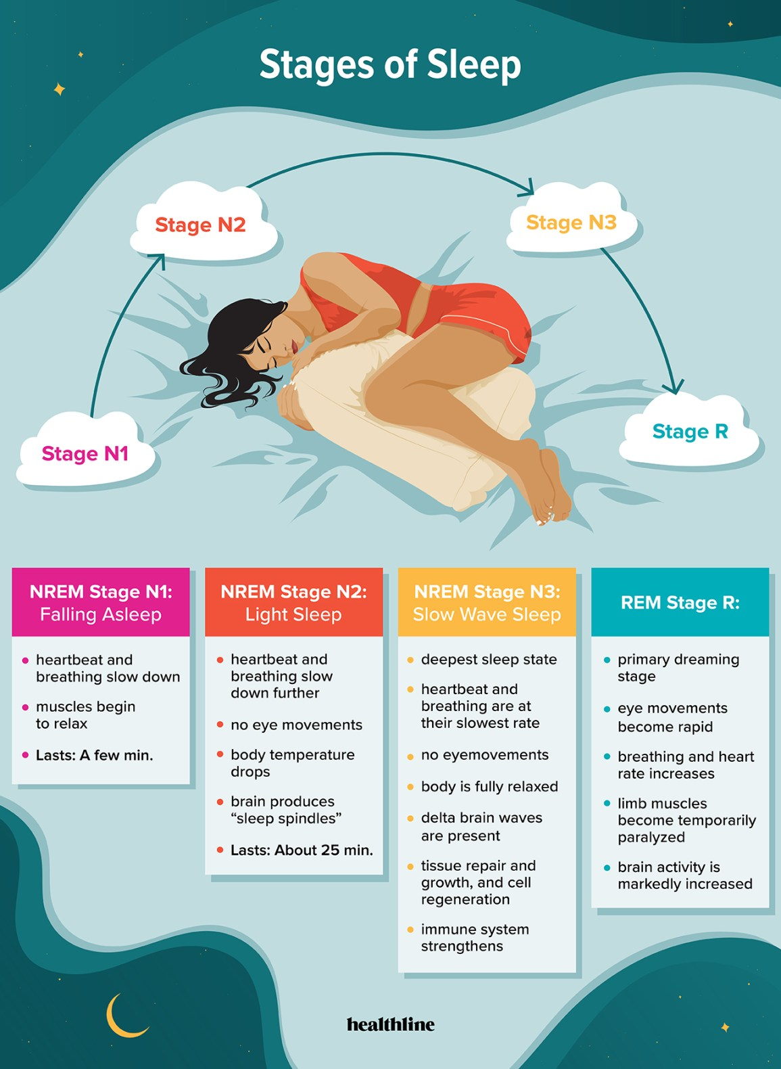

Slide 4
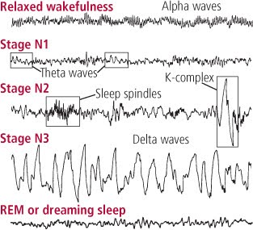
.

Slide 5
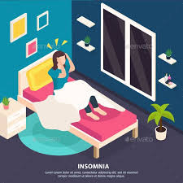
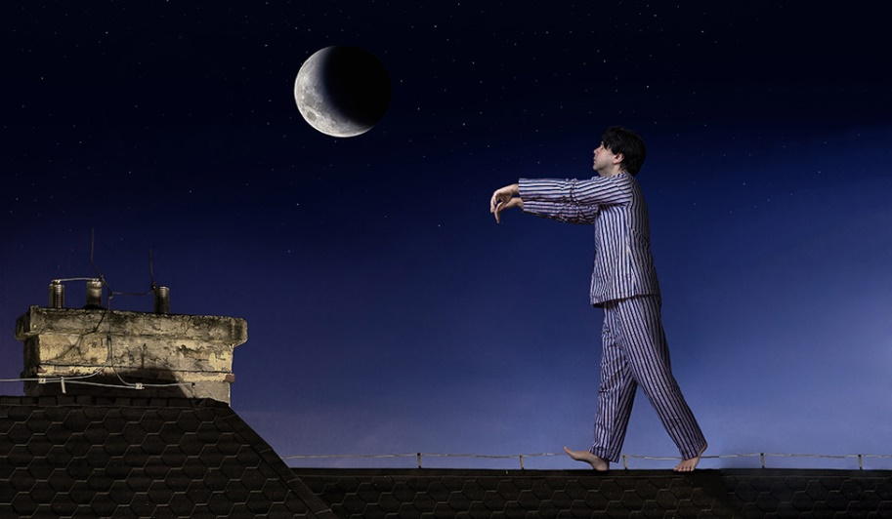
Types of sleep disorders:
1.primary sleep disorder
Dyssomnia: its excessive or
altered or insufficient timing of
sleep.
Parasomnia : abnormal sleep related
habits.
2. Secondary sleep disorder

Slide 6
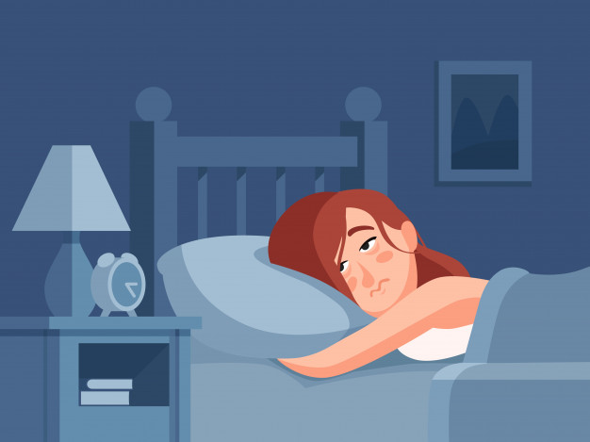
Dyssomnia
Dyssomina : its defined as having hard time in falling a sleep or remaining a sleep , or excessive day time sleep .
There are 2 types of dyssomnia:
Insomnia (difficult to fall or remain asleep)
Hypersomnalnce:
Breathing related disorder.
Narcolepsy.
Circadian rhythm sleep disorder.
Parasomnia

Slide 7
INSOMNIA DISORDER
Its a group of symptoms that interfere with duration and/or quality of sleep despite adequate opportunity for sleep.
Types of insomnia:
Acute insomnia: sleep difficulty which is less than 3 months in duration and associated with stress and change in sleep schedule ,usually it resolves spontaneously .
Chronic insomnia : sleep difficulty which last from 3 month up to a year and associated with reduced quality of life and increase risk for psychological disorders .

Slide 8
Symptoms of insomnia :
Initial insomnia (sleep onset) .
Middle sleep insomnia(sleep maintenance insomnia) .
Late sleep insomnia (early morning awaking) .
Non restorative sleep :
(waking up feeling fatigued ,unrefreshed)
Causes of insomnia :
Subclinical mood and/or anxiety disorders
Preoccupation with a perceived inability to sleep
Bedtime behavior not conducive to adequate sleep (poor sleep hygiene).
idiopathic

Slide 9
DIAGNOSTIC CRITERIA :
Difficulty initiating/maintaining sleep or early-morning awakening with inability to return to sleep.
At least 3 days a week for at least 3 months.
Causing significant distress or impairment in normal function of the patient .
Happen even if there is adequate opportunity to sleep.
Does not occur exclusively during the course of another sleep-wake disorder.
Its not resulting as physiological effects of a substance or medication.
Having a Coexisting mental and medical disorders do not adequately explain the insomnia.

Slide 10
Treatment of insomnia:
Non pharmacotherapy | Pharmacotherapy
* Sleep hygiene measures. | Benzodiazipine: Estozolam Flurazepam - s.e :dizzness , slurred speech and muscle weakness .
* Cognitive-behavioral therapy (CBT). | * Non-benzodiazepines: Melatonin , zolpidem ,eszopiclone zaleplon :zolpidem causes increased risk of falls and may induce cognitive impairment. suvorexant
* Chronotherapy e.g: (bright light therapy) has evidence supporting its use in treating insomnia by entraining the circadian rhythm. | * Anti-depressant : Trazodone ,amitriptyline ,doxepin Mirtazapine -S.E: sedation, dizziness, and psychomotor impairment.

Slide 11
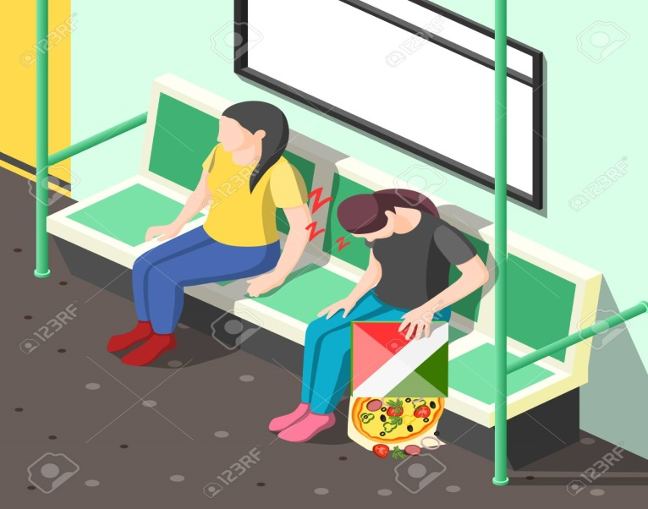
HYPERSOMNOLENCE DISORDER
Defined as increased quantity of sleep and reduced quality of wakefulness (sleep drunkenness) and it causes decreased function and alertness after waking up.
The patient usually complains of nonrestortive sleep, reduced or inability to recall the routine daily preformed activities plus having a hard time to wake up in the morning .
So hypersomnolence is characterized
by :
Increased daytime sleepiness.
Prolonged nocturnal sleep episodes.
Increased irresistible urge to sleep.

Slide 12
Causes:
Obstructive sleep apnea (the most common cause).
Side effect from drugs: BNZ
Bad sleep routine : staying awake online or playing games.
Chronic physical illness.
Insufficient night time rest.
Narcolepsy.
Circadian rhythm disorder.
kleine-levin syndrome (recurrent episodes of excessive sleep with cognitive and behavioral changes. The patient may sleep up to 20h per episode).
Psychiatric disorder(it’s a form of major depressive disorder characterizes by persistent feeling of sadness and hopelessness).

Slide 13
Diagnostic criteria:
Excessive sleepiness other than the normal daily 7 h .
Recurrent episodes of sleep during the same say.
Prolonged non restorative sleep more than 9h .
Difficulty in being fully awake after waking up .
2) It should happen more than 3 times a week for more than 3 months.
3) Causing significant impairment in the patient functioning abilities.
4) Does not occur during the course of another sleep-wake disorder.
5)Not being a side effect of some substance or medication .
6) Coexisting mental and medical disorders do not adequately explain the hypersomnolence.

Slide 14
- Epidimiology :
■ Prevalence: 5–10% of individuals presenting to sleep disorders clinics.
■ Equal frequency in men and women.
- Etiology:
■ Viral infections (e.g., HIV pneumonia, infectious mononucleosis, Guillain–Barré).
■ Head trauma.
■ Genetic—may have autosomal dominant mode of inheritance in some individuals.
- Course :
■ Progressive onset, beginning between ages 15 and 25.
■ Persistent course unless treated.

Slide 15
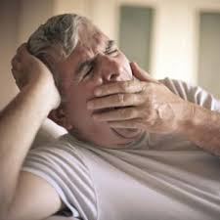
Treatment :
■ Life-long therapy with modafinil or stimulants such as methylphenidate; amphetamine-like antidepressants such as atomoxetine are second-line therapy.
■ Pitolisant (Wakix) and sodium oxybate (Xyrem) have shown benefit as well.
■ Scheduled napping.

Slide 16
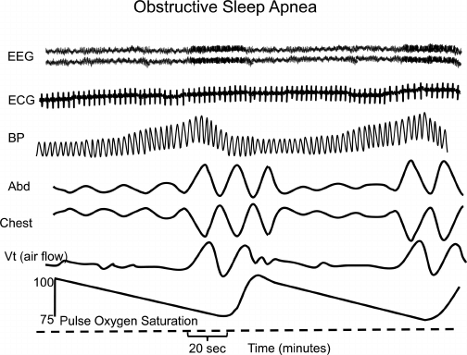
Obstructive sleep apnea hypopnea
chronic breathing disorder characterized by repetitive collapse of the upper airways during sleep or if there is evidence on polysomnography of multiple sleep apnea or
hypopnea per hour of sleep
Features :
- Excessive day time sleepiness.
Apneic episodes
(cessation of breathing) or
hypopneic episodes of decreased airflow (>15 per hour ).
- Sleep fragmentation.
Notes:
Representation of a polysomnogram from a person with OSA. Shown are two sleep apnea events during which oxygen saturation decreases, blood pressure increases, and heart rate decreases. Respiratory efforts continue during the apneas, but there is no airflow. Rib cage and abdominal motion are not in phase. After arousal, airflow is restored, oxygen saturation increases, blood pressure falls, and heart rate increases.

Slide 17
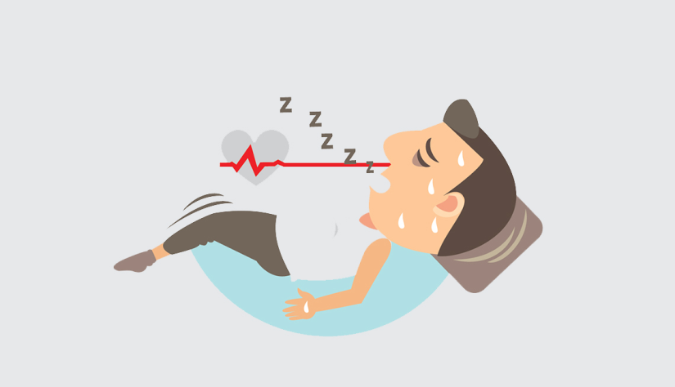
Snoring.
Frequent awaking due to gasping or choking.
Non-refreshing sleep or fatigue.
Morning headache.
Hypertension
Risk factors :
Obesity .
Increased nick circumference.
Narrowing of the airways
Prevalence:
Most common in middle-aged men and women.
Male to female ratio ranges from 2:1 to 4:1.
Children 1-2% , middle aged adults 2-15% , older adults > 20%
Notes:
Snoring(due to narrowed airways).

Slide 18
Treatment:
Positive airway pressure: continuous (CPAP)
Behavioral strategies such as weight loss and exercise.
Surgery.
Central sleep apnea
five or more central apneas per hour of sleep.
It can be idiopathic, or due to heart failure, stroke, or renal failure, or due to opioid use. It is associated with insomnia and daytime sleepiness
30% of chronic opioid users have central sleep apnea.
. Higher frequency in men than women
Treatment .
Treat the underlying condition - CPAP/BIPAP • Supplemental O, • Medications (eg. Acetazolamide ). Theophyllin

Slide 19
Narcolepsy
Its excessive sleepiness in daytime and
in inappropriate places or time.
DSM-5 criteria
• Recurrent episodes of need to sleep, lapsing into sleep, or napping during the day, occurring at least 3 times per week for at least 3 months associated with at least one of the following:
• Cataplexy (brief episodes of sudden bilateral loss of muscle tone, most often associated with intense emotion) .
Hypocretin deficiency in the CSF
Reduced REM sleep latency on polysomnography
- Hallucinations and/or sleep paralysis at the beginning or end of sleep episodes are common (but not necessary for diagnosis in the DSM-5)

Slide 20
Epidemiology/Prevalence
Narcolepsy with cataplexy occurs in 0.02-0.04% worldwide. Slightly more common in males than females.
Pathophysiology
Linked to a loss of hypothalamic neurons that produce hypocretin , May have autoimmune component
Treatment –
- Scheduled daytime naps
- Avoidance of shift work
• For excessive daytime sleepiness: Amphetamines \- Non-amphetamines such as methylphenidate, modafinil, and sodium oxybate
For cataplexy: Sodium oxybate (drug of choice)
SSRIs (e.g. fluoxetine) have also been used to help reduce cataplexy. These drugs are indicated for usage in treatment as they have a tendency to help in suppressing REM.
Notes:
HLA-DR2 is the gene which is mainly responsible for this condition.
Decreased hypocertin1 and hypocertin2 in patient with narcolepsy.(hypocretin is a hypothalamic neuropeptide neurotransmitter which regulate the sleep-wake cycle

Slide 21
Circadian rhythm sleep wake disorders
-recurrent patterns of sleep disrup-tion due to an alteration of the circadian system or misalignment between the endegenous cireadian rhythm and sleep wake sehedule required by an individual's environment or schedule. sleep-wake, and shift
Symptoms
-Excessive daytime sleepiness , Insomnia , - Headaches , Difficulty concentrating reaction , times and frequent performance errors , irritability, Waking up at inappropriate times

Slide 22
Types
Advanced sleep-wake phase disorder
the patient may find it very difficult to stay awake in the early evening and wake up too early in the morning. This can interfere with work, school, or social responsibilities.
Usually occur in older age .
Delayed sleep-wake phase disorder
The patient may fall asleep later than he would like and find it difficult to wake up on time in the morning which can lead to daytime tiredness or anxiety , usually occur with caffeine and nicotine use , irregular sleep schedule and in puberty .

Slide 23
Shift work disorder
Sleep deprivation secondary to untraditional hours of work
Jet lag disorder
Sleep disturbances (insomnia, hypersomnia) associated with travel across multiple time zones , usually resolve 2-3 days after travel

Slide 24
TREATMENTS
treatment plan will depend on the type and severity of the circadian rhythm disorder.
The most common treatments are healthy lifestyle changes and to avoid risk factors
Timed bright light phototherapy during early morning
Administration of melatonin in the evening
Modafinil may be helpful for patients with severe SWD
Hypnotic : short acting benzodiazepine

Slide 25
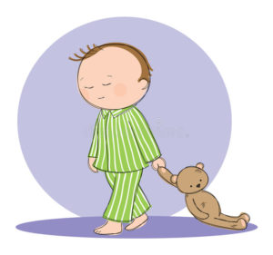
Parasomnia
Abnormal behaviors, experiences, or physiological events that occur during sleep or sleep-wake transitions.
Symptoms may include abnormal movements, emotions, dreams, and autonomic activity.
Isolated episodes common in childhood and adolescence..

Slide 26
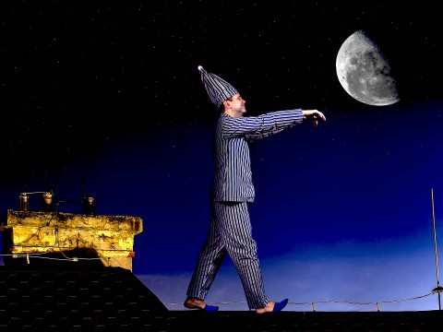
Types of parasomnia
Some parasomnias occur in the first half of the night,
during non-rapid eye movement sleep. Others happen later in the night, during REM sleep.
1- Sleepwalking, or somnambulism, It may include sitting up in bed, walking around, eating, and in some cases "escaping" outdoors. Eyes are usually open with a blank stare and "glassy look.“
1-7% of adults have sleepwalking episodes
. 10-30% of children have at least one episode

Slide 27
Risk Factors : Sleep deprivation , Irregular sleep sehedules , Obstractive sleep apnea , Fever , medication , family history .
2- sleep talking
Sleep talking can involve a wide range of talking, from mumbling to full conversations.
Unlike sleepwalking, sleep talking can happen during any part of the night. The talking is usually easier to understand in the lighter stages of sleep.
3-Nightmares
Recurrent frightening dreams that occur during the second
half of the sleep episode
Nightmares are seen in at least 50-70% of posttraumatic stress disorder (PTSD) cases

Slide 28
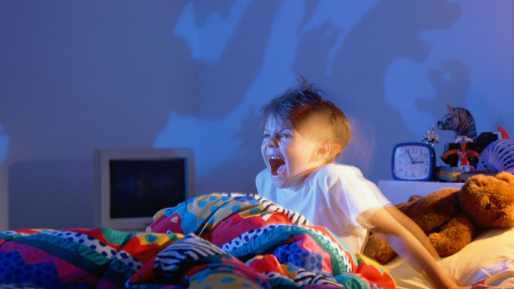
4-Night terrors
Recurrent episodes of sudden terror arousals, usually beginning with screaming or crying, that occur during slow-wave sleep. Signs of autonomic arousal, including tachycardia, tachypnea, diaphoresis, and mydriasis.. After episode, patients usually return to sleep without awakening. Dreams aren't remembered and there is amnesia for the episode.
5-Sleep-related groaning
(usually happen when you exhale slowly and deeply and can be mistaken with snoring).

Slide 29
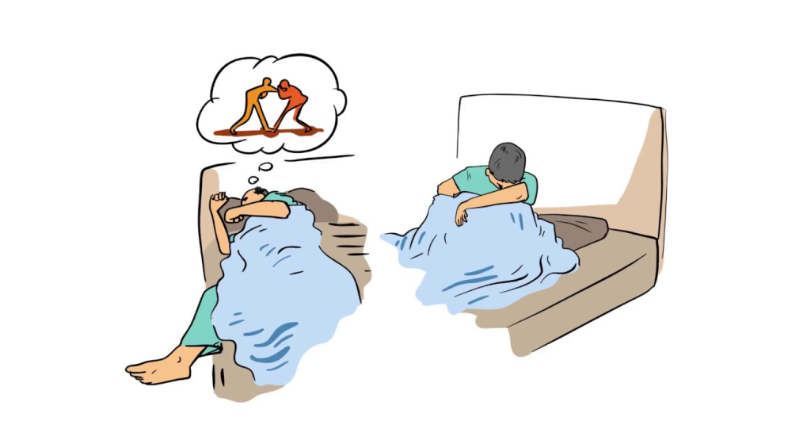
6-REM sleep related behaviors
Repeated arousals during sleep associated with vocalization or complex motor behavior (dream enacting behaviors) occurring during REM, more often in the second half of the sleep episode I Characterized by lack of musele atonia during REM sleep
Dream-enacting behaviors include: -
Sleep talking , screaming –Limb jerking - Walking and/or running - Punching and/or other violent behaviors –

Slide 30
7-restless legs syndrome
urge to move legs accompanied by unpleasant sensation in the legs, characterized by relief with movement, aggravation with inactivity, and only occurring or worsening in the evening.
Risk Factors
Increases with age, Strong familial component Iron deficiency , Antidepressants, antipsychotics, dopamine-blocking antiemeties, and anti- histamines can contribute to or worsen symptoms - Multiple medical comorbidities, including cardiovascular disease

Slide 31
Causes of parasomnia:
Stress .
Anxiety.
Depression.
Substance use.
Side effect of some medication.
Irregular sleep (night shifts).
Other sleep disorders(insomnia).
Sleep deprivation
Parasomnia treatment
It maybe by using medication, behavioral therapy or lifestyle change.

Slide 32
Thank you

