Slide 1
Obesity in Pregnancy
Omar Armosh
Sara Jaafreh
Hamza Sarairah
Lujain Rawashdeh

Slide 2
Defining Obesity
“Overweight” and “obesity” are both terms that categorize weight levels that are greater than what is considered to be healthy for a given height. The most common metric used to categorize weight class is the body mass index (BMI).

Slide 3
Defining Obesity

Slide 4
Defining Obesity
Class III obesity, also termed “morbid obesity,” has been associated with significant health consequences, including hypertension, diabetes, heart disease, and premature death.
For women, a BMI greater than or equal to 50 kg/m2 , sometimes termed “superobesity,” is associated with the most severe morbidity.

Slide 5
Epidemiology
Obesity prevalence has increased significantly in recent years.
Higher obesity rates are seen among women of reproductive age.
Non-Hispanic Black women have the highest prevalence of obesity, followed by Hispanic women.

Slide 6
Prenatal Care in Obesity
Early assessment and counseling are critical.
Obese pregnant women require specialized monitoring and interventions.
Management strategies aim to reduce maternal and fetal risks.

Slide 7
Counseling
Discuss risks of obesity in pregnancy with patients.
Set weight gain goals based on BMI category.
Provide nutritional and lifestyle guidance.

Slide 8
Maternal Risks
Increased risk of hypertension, gestational diabetes, preeclampsia, DVT, PE, and intensive care unit (ICU) admission.
Obstetric complication like preterm birth at less than 32 weeks, large-for-gestational-age and transient tachypnea of the newborn.
Higher rates of cesarean delivery.
Greater risk of postpartum complications.
Increased risk of metabolic syndrome.

Slide 9
Fetal and Neonatal Risks
Higher risk of miscarriage and stillbirth.
Increased rates of birth defects include neural tube defects, cardiovascular anomalies, cleft lip and palate, anorectal atresia, hydrocephaly, and limb reduction anomalies.
Greater chance of low Apgar scores, macrosomia and neonatal intensive care unit (NICU) admission.

Slide 10
Gestational Weight Gain (GWG)
Recommended GWG for obese women: 11-20 lbs.(5-9)KG
Excessive GWG linked to postpartum weight retention.
Inadequate GWG may lead to fetal growth restriction.

Slide 11
Long-Term Risks to Offspring
Increased risk of obesity in adolescence and adulthood.
Higher likelihood of developing type 2 diabetes.
Potential neurodevelopmental effects.

Slide 12
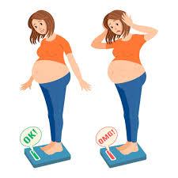
Management of the Obese Gravida & Fetal Surveillance
By:sara jaafreh

Slide 13
Preconception Counseling
01
Identification of Common Comorbidities
02
Ultrasound
03
Genetic Screening
04

Slide 14
Preconception Counseling:
Women should be advised about obesity-related risks. Weight loss before conception and control of comorbidities are recommended

Slide 15
Identification of Common Comorbidities
Screening for hypertension, diabetes, and sleep apnea should be performed. An ECG may be needed for high-risk patients.

Slide 16
Common Obesity-Related Comorbidities
Chronic Hypertension Defined as hypertension diagnosed before pregnancy or before 20 weeks of gestation. May progress to hypertensive disorders such as preeclampsia.
2.Diabetes Can be pre-existing or undiagnosed. Early screening is recommended using fasting blood glucose, 2-hour glucose tolerance test (75g load), or HbA1c levels (though less sensitive).

Slide 17
3. Obstructive Sleep Apnea (OSA) Associated with increased risk of preeclampsia and gestational diabetes. Symptoms such as excessive daytime sleepiness or loud snoring should prompt referral to a sleep specialist.
4. Dyslipidemia Obesity increases the risk of high cholesterol and triglyceride levels, contributing to cardiovascular disease.
5. Neuromuscular Disorders Includes chronic headaches and idiopathic intracranial hypertension (pseudotumor cerebri), which may impact pregnancy.
6. Osteoarthritis Obesity can exacerbate joint pain and mobility issues during pregnancy.

Slide 18
Initial Assessment and Screening
Body Mass Index (BMI) measurement and documentation.
Comprehensive blood tests, including kidney and liver function and lipid profile. Cardiac evaluation: Electrocardiogram (ECG) for women with class III obesity or additional risk factors
. Echocardiography if ECG abnormalities are detected.
OSA screening for women with excessive daytime sleepiness or loud snoring.

Slide 19
Medical Referrals
Cardiologist: For women with hypertension or suspected heart disease.
Endocrinologist: For advanced management of diabetes or metabolic disorders. Anesthesiologist: For early assessment of potential complications before labor or cesarean delivery.
Nutritionist: To assist with weight management and dietary optimization.

Slide 20
Recommended Interventions .
1.Lifestyle modifications, including a healthy diet and regular physical activity. 2. Monitoring gestational weight gain (GWG) according to Institute of Medicine (IOM) guidelines. Daily exercise (e.g., 30 minutes of walking) to reduce complications.
3. Low-dose aspirin therapy for high-risk cases of preeclampsia.
4. Early delivery planning to ensure a safe labor and birth process

Slide 21
Ultrasound
Ultrasound plays a crucial role in dating the pregnancy, assessing fetal growth, and detecting abnormalities. However, obesity poses technical challenges that can reduce the accuracy of ultrasound imaging.

Slide 22
Key Challenges in Obese Women
Reduced Image Quality – Increased maternal body fat limits the penetration of ultrasound waves, making it harder to visualize fetal structures.
Lower Detection Rate of Congenital Anomalies – Studies show that fetal structural abnormalities are detected 20% less frequently in obese women compared to those with normal weight.
Difficulty in Fetal Growth Assessment – Fundal height measurements are less reliable in obese women, requiring third-trimester ultrasounds for proper fetal growth monitoring.

Slide 23
Recommended Adjustments for Better Imaging
Early first-trimester ultrasound (12–16 weeks) using transvaginal approach for better visualization.
Delayed second-trimester anatomy scan (20–22 weeks) to improve structural assessment.
Lowering the transducer frequency to enhance image penetration.
Follow-up ultrasounds every 2–4 weeks when the initial scan is inconclusive

Slide 24
Genetic Screening
Obesity affects the accuracy and reliability of genetic screening

Slide 25
Key Challenges
Maternal Serum Screening Limitations: The quadruple screen test is adjusted for maternal weight, but its accuracy decreases for women weighing over 270 lbs (122 kg).
2. Non-Invasive Prenatal Testing (NIPT) Challenges: Cell-free DNA (cfDNA) testing is less reliable in obese women due to a lower fetal fraction in maternal blood. Higher failure rates (10-20% "no-call" results), meaning obese women are more likely to need repeat testing or alternative methods.

Slide 26
Fetal Surveillance
Stillbirth Risk: The risk increases in late pregnancy. Weekly fetal surveillance is recommended from 37 weeks for BMI 30 or higher and from 34 weeks for BMI 40 or higher.
2. Surveillance Methods: Non-stress tests (NST) are commonly used. External fetal monitoring may be challenging, and internal monitoring may be required.

Slide 27
Intrapartum Management

Slide 28
Timing of Delivery: - Obesity increases the risk of stillbirth, but no guidelines recommend delivery before full term solely due to
Obesity
Current recommendations rely on standard obstetric indications (e.g., medical complications) for delivery timing, as randomized clinical trial evidence is lacking.
- Induction of labor (IOL) at 39 weeks or later may improve outcomes for obese women, even without traditional medical indications, and should not be withheld

Slide 29
Delivery Site:
All delivery centers should assess resources to accommodate obese women, given rising obesity rates.
- Women with class III obesity (severe obesity) should deliver in centers equipped to manage potential complications.
- Delivery site suitability should be evaluated early in pregnancy to allow care transfer if needed.
- Experts advocate for obesity-specific protocols to standardize care

Slide 30
Fetal Monitoring:
Electronic fetal monitoring (EFM) is technically challenging in
obese women due to:
- Poor acoustic signal quality.
Difficulty identifying anatomic landmarks for device placement-.
- Obese women are more likely to require internal monitors)
- Fetal scalp electrodes should be considered if external EFM is suboptimal.

Slide 31
Facility Considerations:
Essential equipment for obese women includes:
Large hospital gowns, long gloves/speculums, oversized blood- pressure cuffs.
- Wheelchairs and operating tables supporting ≥300 lbs.
- Reinforced floor-mounted toilets and appropriately sized seating.
Higher BMI correlates with:
- Longer hospital stays during delivery.
- Increased resource utilization.
- Non-delivery units must also ensure suitability for obese patients

Slide 32
Labor Management in Obese Women
Induction of Labor (IOL):
- Obese women (BMI ≥40 kg/m²) are more likely to require IOL due to higher risks of comorbidities and obstetric complications.
- Higher doses and longer durations of oxytocin are often needed for successful labor induction compared to women with normal BMI.
- Increased likelihood of cesarean delivery (4x higher) due to labor arrest.
Class III obesity is an independent risk factor for unsuccessful IOL
- Risk-Reducing Induction of Labor at 39 Weeks:
Considered as a strategy to reduce adverse outcomes in obese women.

Slide 33
Labor Progression in Obese Women
Time to Cervical Dilation:
- Nulliparous women:
- Highest BMI category took 1.2 hours longer to reach 10 cm dilation compared to the lowest BMI category.
- Multiparous women:
- BMI ≥40 kg/m² took 3.4 hours to reach the active phase vs. 2.4 hours for BMI <25 kg/m².
- Clinical Implications:
- Labor management strategies should account for prolonged labor duration in this population.

Slide 34
Modes of Delivery in Obese Women
Vaginal Delivery:
Increased likelihood of operative vaginal delivery
(e.g., forceps/vacuum).
- Higher rates of birth trauma and shoulder dystocia, potentially linked to macrosomia.

Slide 35
Vaginal Birth After Cesarean (VBAC):
- Obese women undergoing TOLAC (trial of labor after cesarean) have 50% reduced odds of successful VBAC compared to normal-weight women
Risks of failed TOLAC:
- Higher rates of venous thromboembolism (VTE) and surgical site infections
Key considerations for providers:
- Challenges in fetal monitoring.
- Need for emergent delivery preparedness.
- Prolonged incision-to-delivery time.
- Adequate anesthesia planning.

Slide 36
Cesarean Delivery:
- Higher cesarean rates in obese women, especially with increasing BMI:
- Nulliparous women with labor arrest disorders: - Class I obesity: 39.3% - Class II obesity: 47.1% - Class III obesity: 56.8%
- Superobesity (BMI ≥50 kg/m²) linked to cesarean rates ≥50%
Elective cesarean debate: - Proposed to reduce morbidity from cesarean after labor, but insufficient evidence to support routine use for improved outcomes.

Slide 37
Cesarean Delivery Technical Aspects in Obese Women
Challenges in Obese Patients
- Cesarean deliveries are more technically difficult, especially with multiple prior cesareans (higher BMI correlates with complexity).
Requires specialized equipment (e.g., larger instruments, weight-capable operating tables)
- Positioning: - Standard dorsal lithotomy with leftward tilt may not prevent uterine hypoperfusion.
- Minimize time in supine position to reduce risks.

Slide 38
Preparation for Surgery
Preoperative Measures: Antacid administration (nonparticulate) to reduce aspiration risk
- Antibiotic prophylaxis: - Reduces surgical site infections by up to 75%
- Debate over dosing: 2g vs. 3g cefazolin shows no significant
difference in outcomes).
- VTE prophylaxis: - Obesity is a minor risk factor; combine with other factors for thromboprophylaxis.
- Mechanical prophylaxis (sequential compression devices) recommended until ambulation

Slide 39
Surgical Technique - Incision Planning:
Pfannenstiel vs. vertical midline:
- *Pfannenstiel*: Lower pain, easier access to lower uterine segment.
- *Vertical midline*: Faster entry, better exposure but higher risk of wound complications (e.g., dehiscence,

Slide 40
Hysterotomy Considerations - Uterine Incision:
Low transverse hysterotomy may lead to difficulty closing after involution.
- Ensure incision width accommodates estimated fetal weight (macrosomia risk).
- Delivery Challenges:
- Unengaged fetal head and limited fundal pressure efficacy.
- Have vacuum/forceps available for instrumental assistance.

Slide 41
Anesthesia Management in Obese Women During Childbirth
Anesthesia-Related Risks
Failed epidural placement: 17% in obese women vs. 3% in normal-weight women
- Difficult airway management: Higher risk of failed endotracheal intubation and aspiration.
- Respiratory suppression: Increased sensitivity to opioids and anesthesia.
- Hypotension: More common after epidural placement; associated with late decelerations).
- Other challenges:
- Longer procedure times.
- Difficult intravenous access.

Slide 42
Anesthesia Options
1. Epidural Analgesia: - Preferred for labor pain management but technically challenging in obesity.
2. Spinal Anesthesia: - Faster onset but limited by inability to re-dose.
- Risky for prolonged procedures (e.g., adhesive disease or complex cesarean).
3. Combined Spinal-Epidural (CSE): - Combines rapid spinal onset with epidural flexibility for prolonged analgesia.
- Ideal for severe obesity or anticipated lengthy procedures

Slide 43
General Anesthesia - Higher morbidity/mortality: - Increased aspiration risk and difficult airway management.
- 50% of anesthesia-related maternal deaths in obese women linked to airway loss.
Declining use: Recent data show reduced reliance on general anesthesia.
- Preference for neuraxial anesthesia: Safer than general anesthesia for cesarean delivery

Slide 44
Postpartum care

Slide 45
After discharge from the hospital, approximately 2% to 3% of obese women will have a postpartum readmission. Cesarean delivery and maternal comorbidities were strongest predictors of postpartum readmission including :
1.Hypertension.
2.Psychiatric disorder.
3.Substance use.
4.Seizure disorder.

Slide 46
BREAST FEEDING
Breastfeeding is well recognized to be beneficial for both maternal and infant health. Women who have prepregnancy obesity are more likely to have delayed onset of lactogenesis, are less likely to initiate breastfeeding, and are less likely to sustain exclusive breastfeeding in the postpartum period. A strong emphasis on lactation support may be able to help overcome those difficulties. The reported longterm benefits of breastfeeding include a decreased risk of future metabolic syndrome, diabetes, and cardiovascular disease.

Slide 47
CONTRACEPTION
For women with morbid obesity and no comorbidity, the Centers for Disease Control and Prevention (CDC) has recommended that the benefits of using combined estrogen-progestin methods likely outweigh the risks, particularly when compared with risks associated with pregnancy.
women at increased risk of VTE, the use of oral and parenteral formulations containing ethinyl estradiol should be avoided when other options are available.

Slide 48
Progestin-only formulations of oral contraceptives can undergo extensive metabolism in adipose tissue, affecting contraceptive efficacy.
Medroxyprogesteroneo has be as effective in the prevention of pregnancy in obese women as in normal-weight women.
Long-acting reversible contraceptive implants appear to be highly effective in overweight and obese women.

Slide 49
An effective option for women who are obese and want to prevent pregnancy may be intrauterine contraception, which provides local contraceptive action and is not rendered less effective by obesity. Obesity is a risk factor for endometrial cancer, and both levonorgestrel and copper intrauterine devices have been associated with a reduced risk of endometrial cancer.

Slide 50
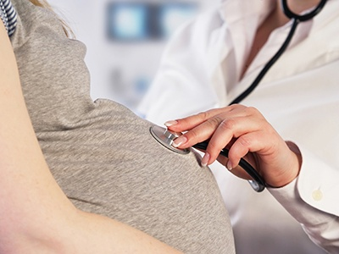
INTERPREGNANCY care

Slide 51
The interpregnancy period is an ideal time to optimize maternal health before the next pregnancy.
Weight loss improves outcome in the subsequent pregnancy and across the life span combining diet and physical activity are efficacious in reducing postpartum weight.

Slide 52
Obesity Management

Slide 53
There is increased recognition that obesity treatment strategies exclusively focused on lifestyle-based approaches are ineffective for many individuals.
Currently, the US Food and Drug Administration has approved drugs for long-term use for obesity.

Slide 54
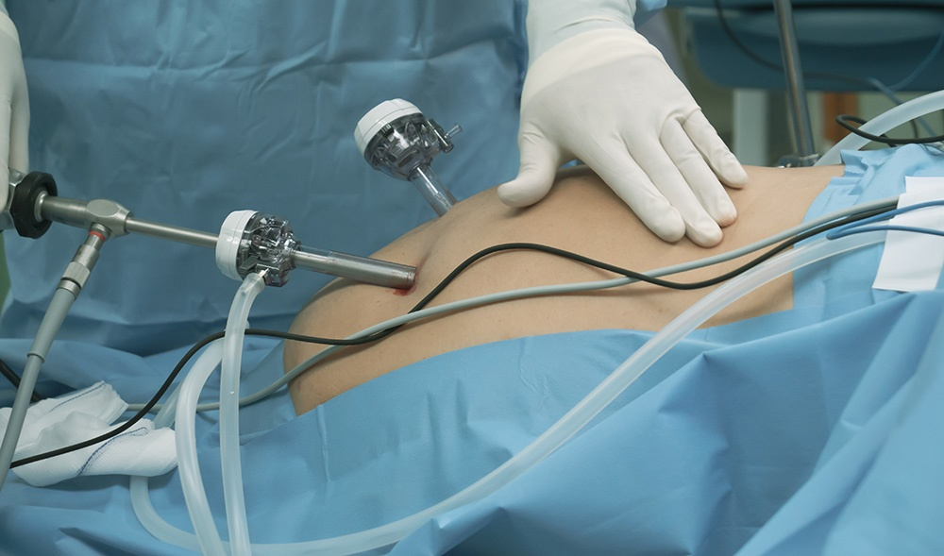
Bariatric Surgery

Slide 55
While behavior modifications have been advocated and medications used in efforts to lose weight, bariatric surgery remains one of the most effective options.
Weight reduction after bariatric surgery between pregnancies is associated with better outcomes in subsequent pregnancies.

Slide 56
In compared with obese women who had not undergone bariatric surgery the have lower risk of:
Gestational diabetes
Hypertensive disorders
Macrosomia
Pre-eclampsia
Congenital defects
In compared with obese women who had not undergone bariatric surgery the have increase risk of
Small for gestational age neonates
Admission to NICU
Preterm birth
Maternal anaemia and nutritional def

Slide 57
The American College of Obstetricians and Gynecologists recommends a wait of 12 to 24 months to ensure that pregnancy does not occur during the rapid catabolic weight-loss period, which theoretically may lead to fetal malnutrition and impaired growth.
The three most commonly performed bariatric surgery procedures include Roux-en-Y gastric bypass, sleeve gastrectomy, and laparoscopic adjustable gastric band.

