Slide 1
Transverse myelitis
Done by : rawan alzeidanen

Slide 2
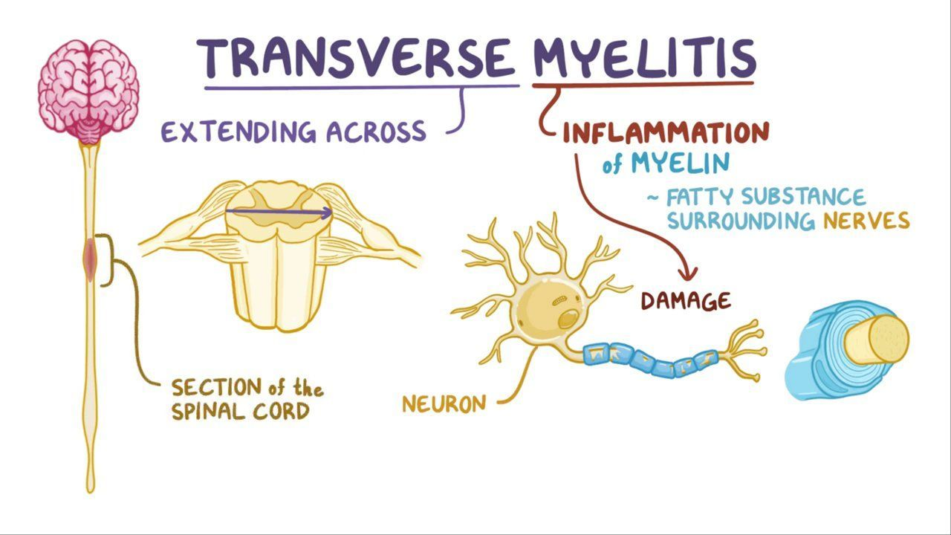
Definition
Transverse myelitis : is a segmental spinal cord injury caused by acute inflammation

Slide 3
Epidimonology
• affecting all ages with bimodal
peaks between the ages of 10 and 19 years and 30 and 39 years.
• Boys and girls are affected equally

Slide 4
Etiology
A. Postinfectious
Respiratory or gastrointestinal infections within 3 to 8 weeks
B. Direct invasion of spinal cord
C. autoimmune diseases
Systemic Lupus Erythematosus (SLE) / Multiple Sclerosis/ neuromylitis optica
D. Sarcoidosis
E.Post-vaccination

Slide 5
clinical presentation
• Prior history of fever (nonspecific viral illness)
• the onset usually develop over a few hours to a few days and may sometimes progress gradually over several weeks
• Pain. may begin sudden lower back. may go down to legs or arms or around chest or abdomen.
• Abnormal sensations. Some people report sensations of numbness, tingling, coldness or burning.
• Weakness in your arms or legs
• Bladder and bowel problems .Urinary retention is an early finding; incontinence occurs later in the course.

Slide 6
Physical Examination
• spasticity/hyper reflexia
•sensory examination
• visual acuity and color vision
• funduscopic examination

Slide 7
Diagnosis
Clinically and by investigation
* MRI can show inflammation of the spinal cord.
*Lumbar puncture CSF may have abnormally high numbers of white blood cells or immune system proteins. Spinal fluid can also be tested for viral and other infections
* Blood tests may include a test that checks for antibodies associated with neuromyelitis optica .

Slide 8
Complication
Pain.
Stiffness, tightness or painful spasms in your muscles (muscle spasticity).
Partial or total paralysis of arms, legs or both.
Sexual dysfunction.
Depression or anxiety

Slide 9
Treatment
Intravenous steroids.
Plasma exchange therapy.
Antiviral medication.
Pain medication.
Nerve pain may be treated with antidepressant drugs), and anticonvulsant drugs,
Medications to treat other complications. .
Medications to prevent recurrent attacks. People who have antibodies associated with neuromyelitis optica need ongoing medications, such as corticosteroids and/or immunosuppressants, to reduce their chances of more transverse myelitis attacks or developing optic neuritis.

