Slide 1
Cell cycle
Ass. Prof Dr. Heba Hassan Abd El-Gawad

Slide 2
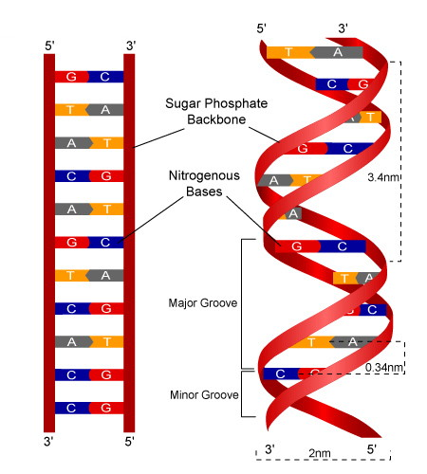
Chemical (Molecular) structure of chromatin
Chromatin is composed mainly of DNA (2nm) combined with basic proteins known as histones. There are five types of histones which are H₁, H₂A, H₂B, H₃ and H_{4 .}They are packaged together in special manner named order of condensation.

Slide 3
Packaging of DNA into chromatin & chromosome
(Order of condensation)
1-Nucleosome is the basic structural unit of chromatin. DNA filament is wrapped twice around a core of eight histones (octamer). The octamer is formed of two molecules of the 4 histones ; H₂A, H₂B, H₃ and H_{4.} The segment of DNA between two successive nucleosomes is known as linker DNA which is attached to histones H₁.
2-Nucleosomes and linker DNA constitute what is known as Beads-on-a string form of chromatin, which is 10-11 nm in diameter .

Slide 6
3-Solenoid or 30 nm fibers: It is the next higher order of organization of chromatin. In this structure, nucleosomes become coiled around an axis, with six nucleosomes per turn .
4- Looped domain of chromatin (300nm) is formed due to further coiling of the 30 nm fiber forming series of loops.
5- Heterochromatin (700nm) and metaphase chromosomes (1400) are formed during mitosis due to further coiling and condensation of the looped domains.

Slide 7
DNA Double Helix 2 nm
Beads-on- a-string form of chromatin 11nm (nucleosome)
30nm chromatin fiber of packed nucleosomes (Solenoid)
Looped domain (300nm )
Prophase chromosome 700nm
Metaphase chromosome 1400nm

Slide 8
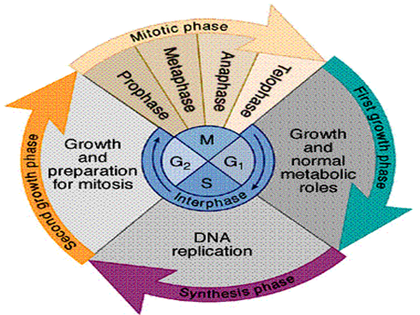
CELL CYCLE
Two major events: 7 phases
1- Mitosis: is the short period of time (1- 2 1 /2 hour) during which the cell divides its nucleus and cytoplasm giving rise to two daughter cells.
2- Interphase, a longer+ period of time (20 hours) between two successive divisions, during which the cell increases its size and content and replicates its genetic material.

Slide 9
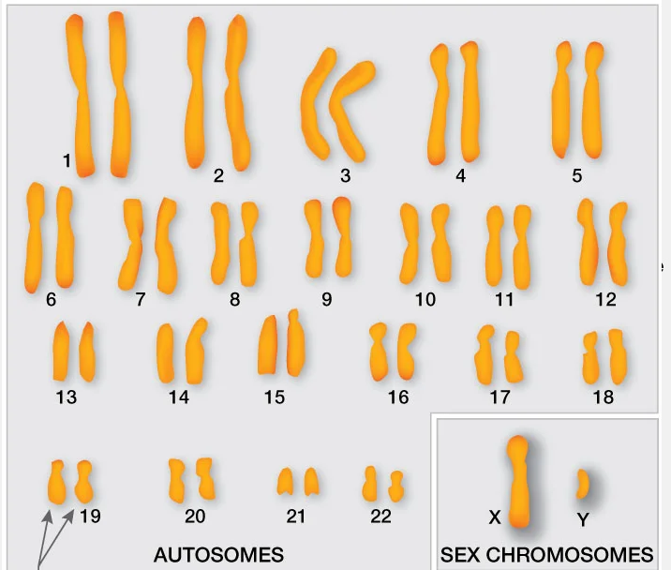
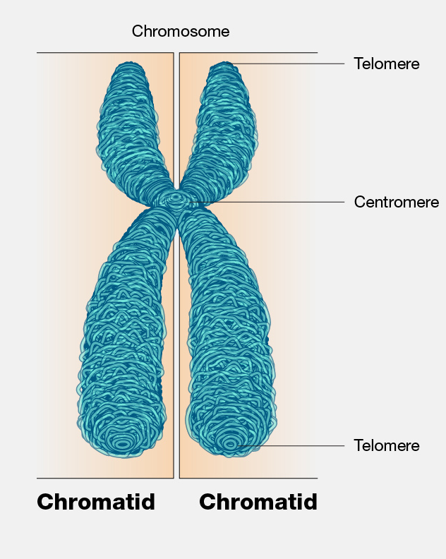
Haploid number:
23 s-chromosomes = 23 chromatids (ovum & sperm)
Diploid number:
46 s-chromosomes = 46 chromatids
46 d-chromosomes = 92 chromatids
Amount of DNA=n
1n: in germ cells (ovum & sperm)
2n: in somatic cells (46s)
4n: in S-phase (46 d)

Slide 10
INTERPHASE
is subdivided into three phases:
G1 (gap1): cell prepare for DNA duplication.
S (synthetic): DNA duplicatation.
G2 (gap2): cell prepare for mitosis.
G1 phase (pre-duplication)
It is the period between the end of mitosis and the beginning of S- phase. It takes 8 hours.
During this phase:
The cell increases in size.
Starts to synthesize RNA and protein to build themselves
The cell contains 46 s-chromosomes (diploid number) = 2n (amount of DNA).

Slide 11
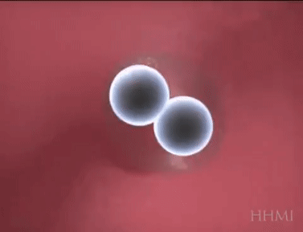
G1 phase (pre-duplication)
The duration of G1 phase may vary from one cell to another according to the main function of the cell :
Highly proliferated cells:
have short G₁ phase e.g. stem cells of bone marrow and germinal epithelium

Slide 12
G1 phase (pre-duplication)
Highly differentiated cells:
after the last mitosis may leave the cell cycle at G₁ phase either:
Temporarily (e.g. hepatocyte): The cells perform their specific functions and some of them may enter the cycle again to repair and regenerate damaged cells (Prolonged G₁ phase).
2. Permanently (e.g. nerve cells and cardiac muscle); there is no repair if the cells are damaged, these cells are said to be in resting stage, the G0 phase.

Slide 13
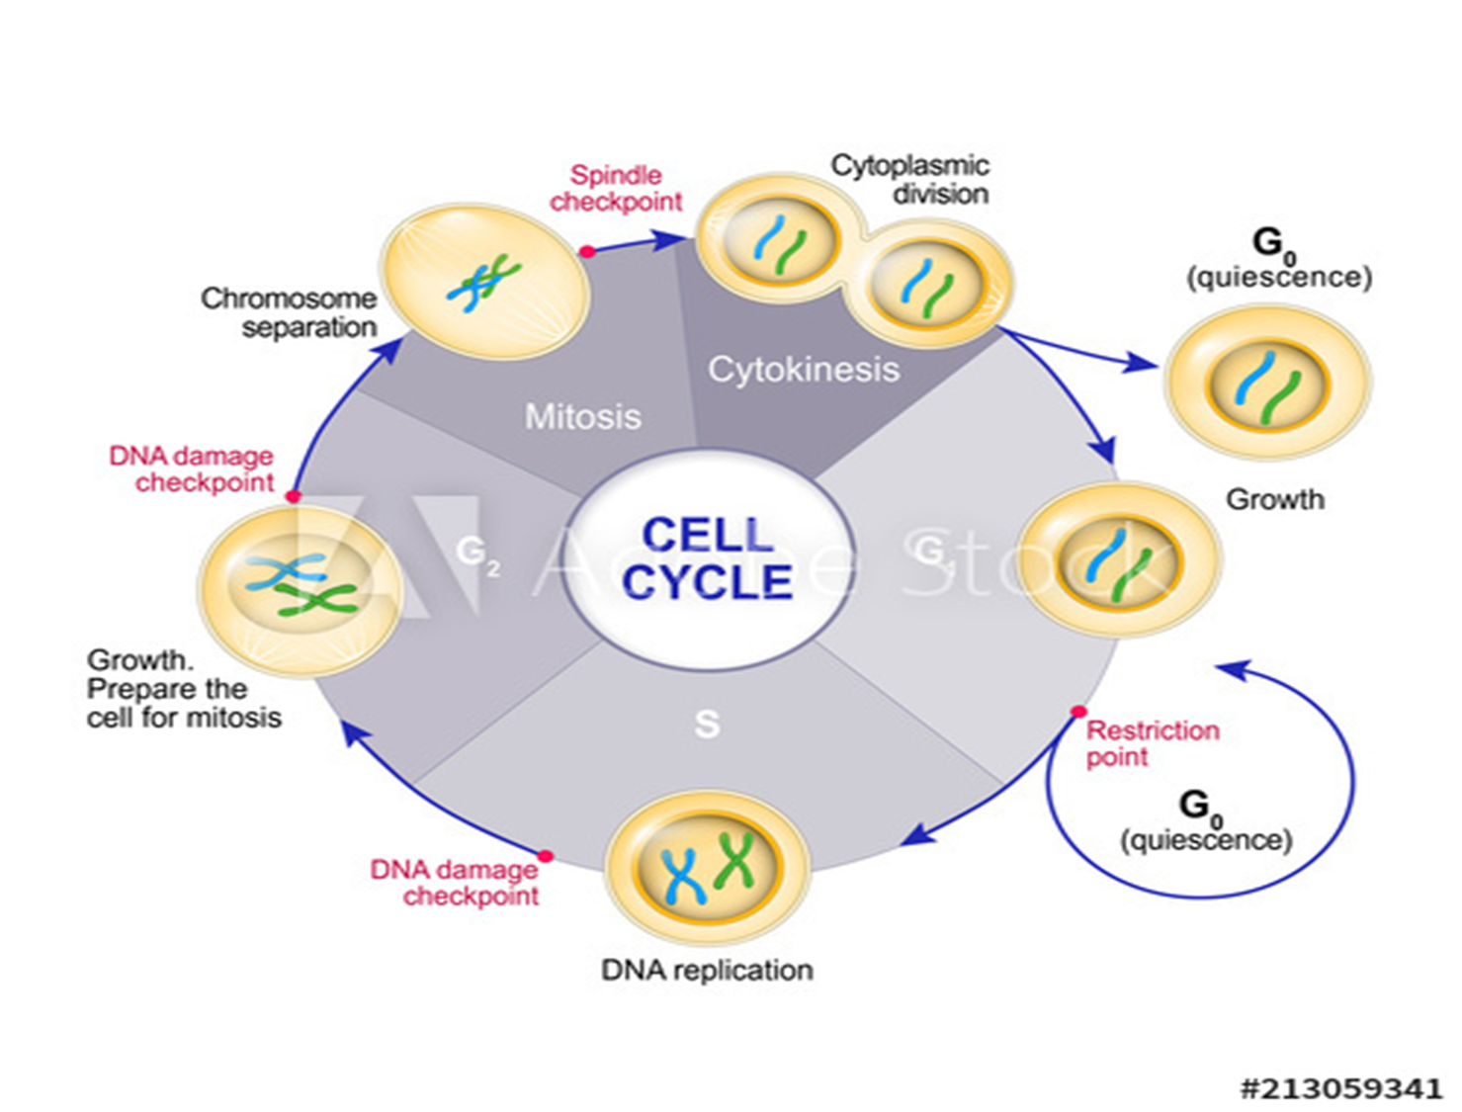

Slide 14
S-Phase (DNA synthesis)
Definition: The period that follows G1 phase
Duration: It takes 8 hours.
-During this phase:
a. DNA is duplicated (DNA replication). Thus, each somatic cell having 46 s-chromosme and 2n DNA after duplication will contain 46 d-chromosomes and double the amount of DNA (4n).
b. Duplication of the 2 centrioles into 2 pairs

Slide 16
G2 Phase (post-DNA duplication)
Definition: It is the period between S-phase and the beginning of the next mitosis.
Duration: It takes 4 hours.
During this phase: the cell prepares itself for mitosis by:
a. Synthesis of RNA and proteins essential to cell.
b. Storage of energy for mitosis.
c. Synthesis of tubulin that is essential for formation of microtubules required for the mitotic spindle.

Slide 17
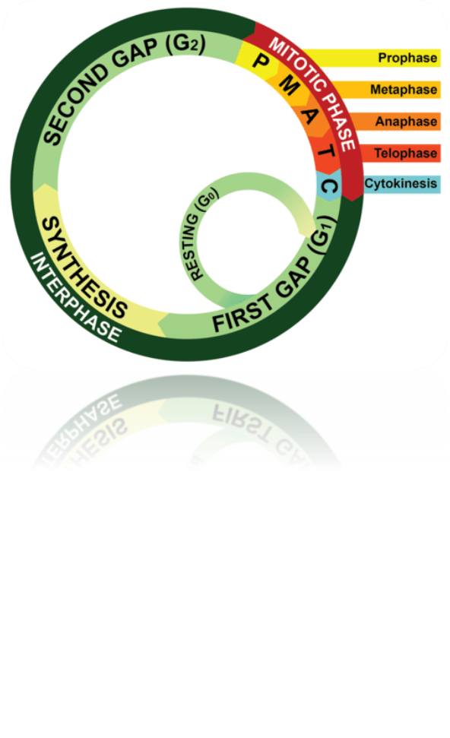
G2 Phase (post-DNA duplication)

Slide 18
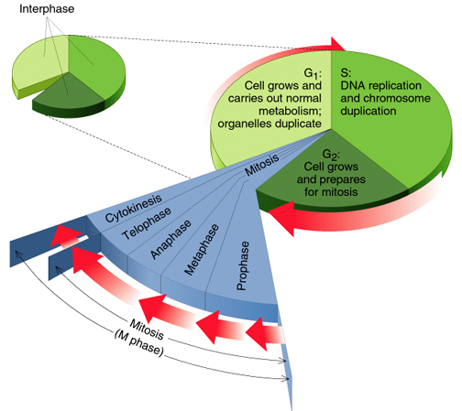

Slide 19
MITOSIS
Definition: It is the process by which the cytoplasm & nucleus of somatic cell are divided equally into two identical daughter cells, each cell having the same number of chromosomes (46 = 23 pairs) s chromosome as the parent cell.
Duration: 1- 2¹/₂ hours.
Phases
Karyokinesis
Division of the nuclear material
Cytokinesis
Division of the cytoplasm

Slide 20
Karyokinesis

Slide 21
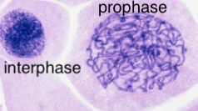
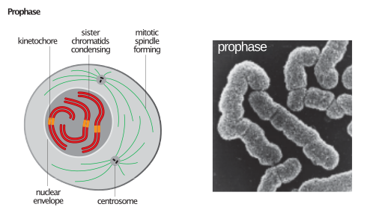
Prophase
It is characterized by:-
1.Disappearance of the nucleolus.
2.The chromosomes are condensed and become visible with L/M.
3.The nuclear envelope remains intact until late in this phase, and then starts to disappear.

Slide 22
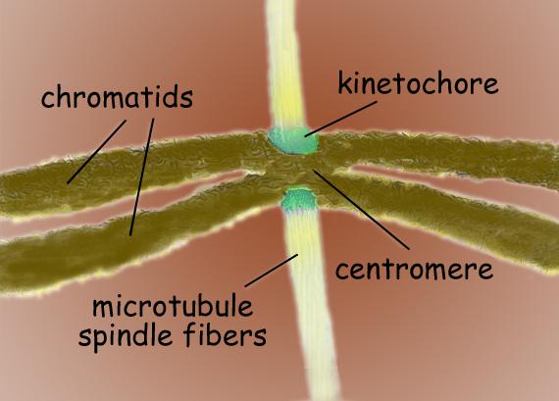
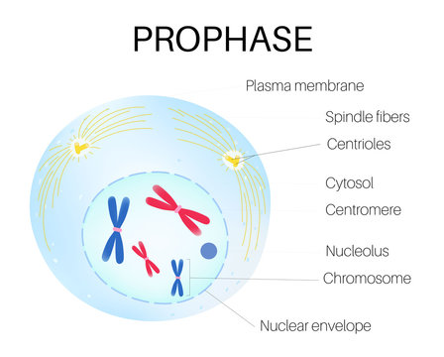
Prophase
It is characterized by:-
4. Each chromosome consists of two sister chromatids joined together by centromere.
5. At the centromere region of each chromatid the kinetochore develops which is a microtubule-organizing center (MTOC).
6. Each pair of centrioles moves towards one pole of the cell to form mitotic spindle.

Slide 23
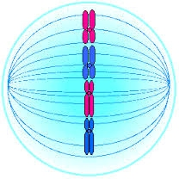
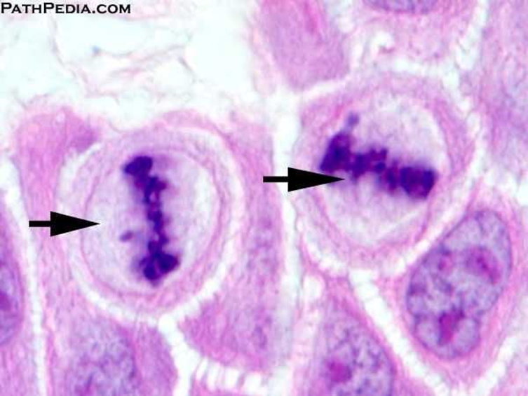
Metaphase
It is characterized by:-
Complete disappearance of nuclear envelope.
Migration of chromosomes to equatorial plane of the cell.

Slide 24
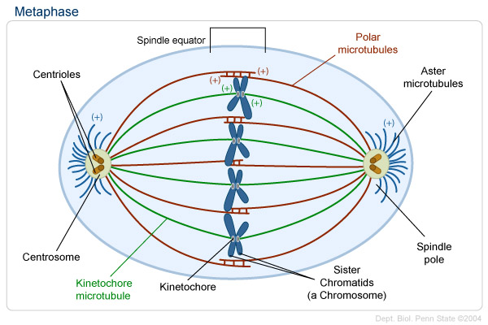

Slide 25
Metaphase
Mitotic spindle at this stage consist of :
Chromosomal microtubules that become attached to kinetochores. They assist in migration of each set of chromatids to one pole of the cell.
Polar microtubules are not attached to kinetochores and extend between the two pairs of centrioles. They are responsible for maintaining the spacing between the two poles during mitotic events.
Astral microtubules are originating from the centrosome and organized into radial arrays around it and are not connected to a kinetochores

Slide 26
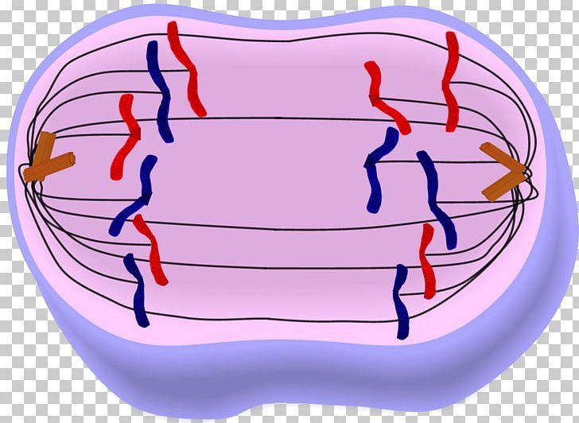
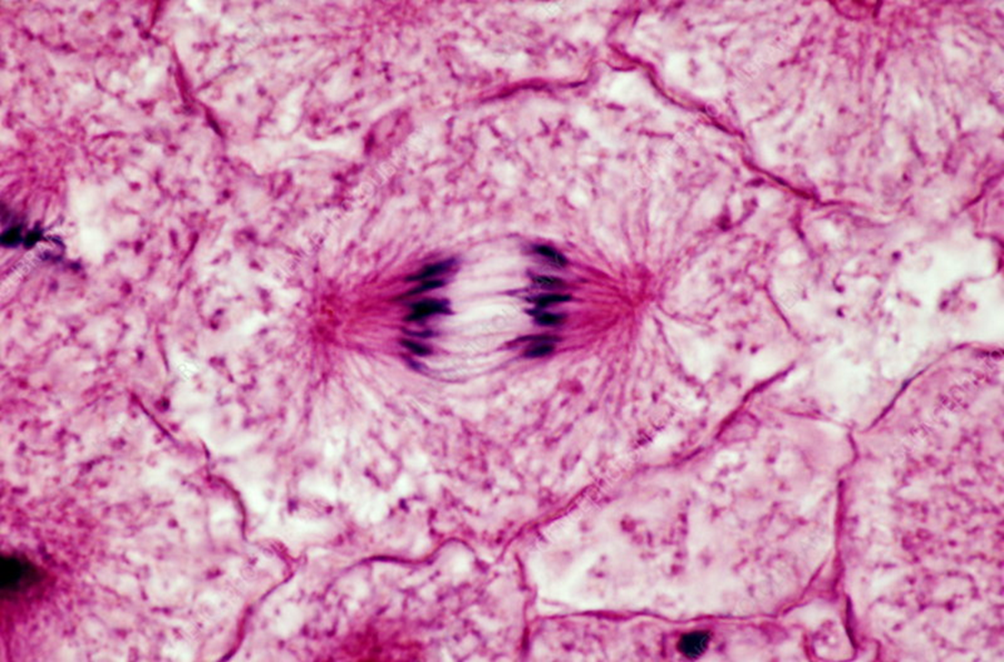
Anaphase
It begins when sister chromatids separate from each other. Now the cell contains 92 chromatids (s-chromosomes). They begin to migrate, so that 46 chromatids move to one pole of the cell and the other 46 chromatids move to the other pole.
In late anaphase a cleavage furrow begins to form at cell membrane.

Slide 27
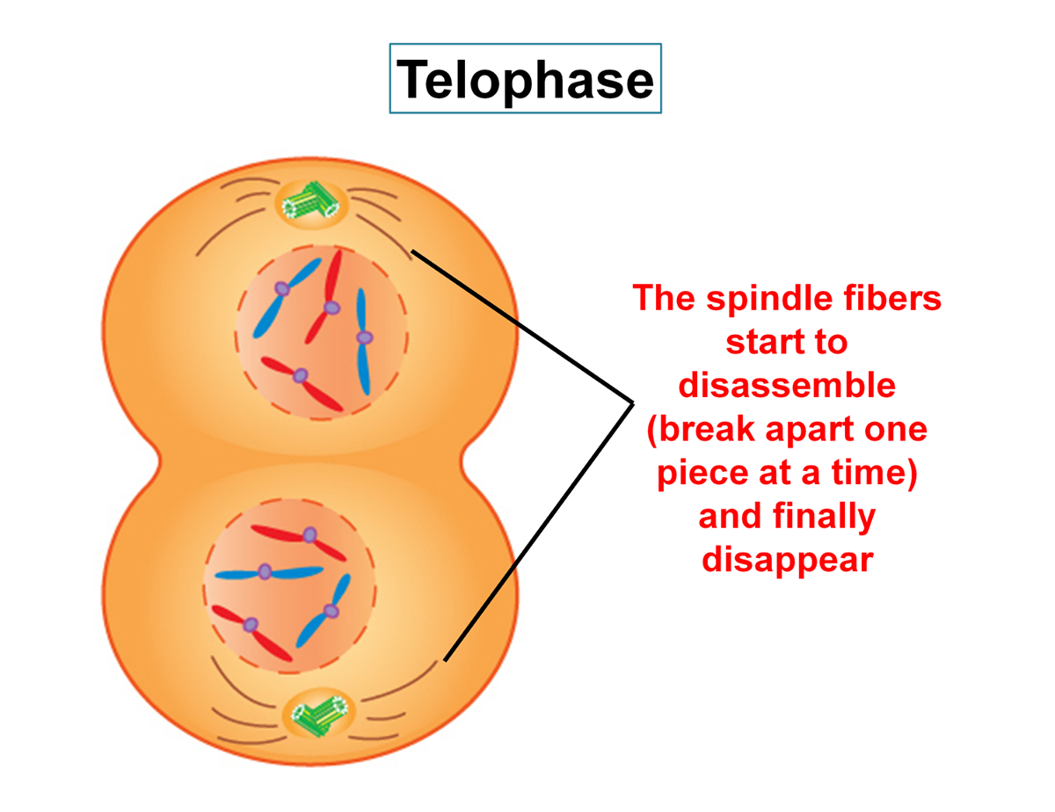
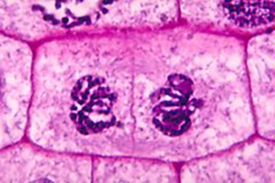
telophase
Each set of chromosomes has reached its respective pole.
Reappearance of nuclei in the daughter cells.
The chromosomes uncoil and become organized into heterochromatin and euchromatin of the interphase cell.
Nuclear envelope is reconstituted.

Slide 28
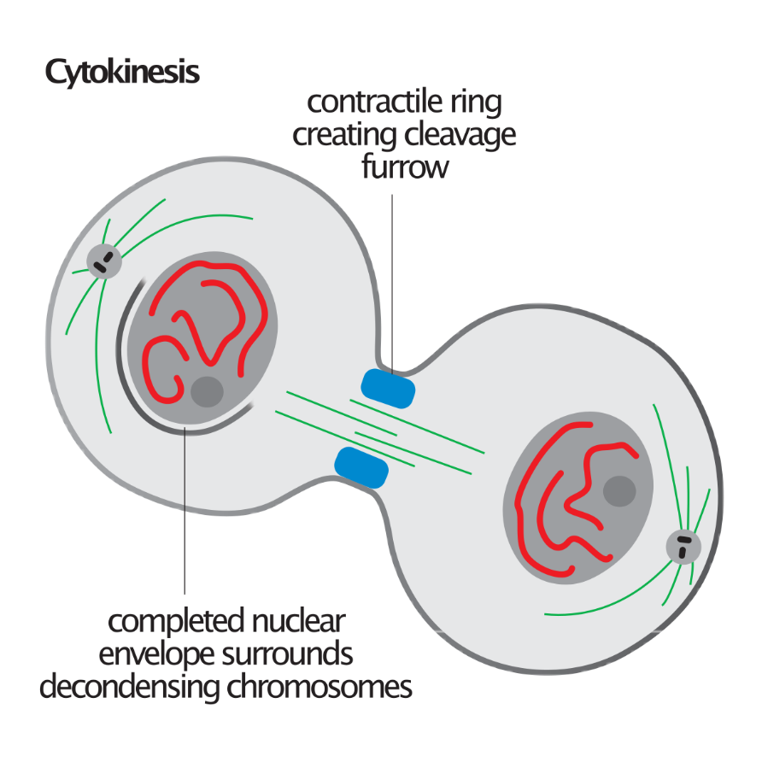
Cytokinesis
The cleavage furrow continues to deepen until the mid body.
Mid body is a small bridge of cytoplasm connecting the two daughter cells together. It is formed of polar microtubules and surrounded by contractile ring.
Contractile ring is composed of actin and myosin filaments.
Constriction of the ring is followed by separation of the two daughter cells. Each cell contains 46 s-chromosomes.

Slide 29
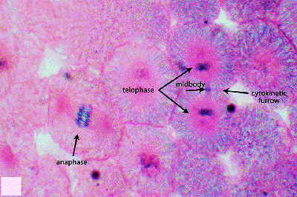

Slide 33
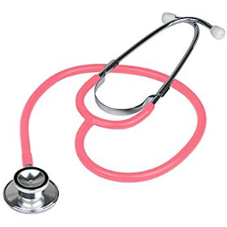
Mitotic figures
A genome is the complete set of genetic information in an organism. It provides all of the information the organism requires to function.
Gene: Segment of chromosomal DNA which controls the production of a particular polypeptide chain.
Cells in mitosis
Appear in rapidly growing tissues (eg. Intestinal epithelium)
-Increased number of mitotic figures & abnormal mitosis in tumors is important to distinguish malignant from benign tumors
-Mitotic figures are important also in prognosis of tumors.
Clinical application

